Slide 1
3. Gut Microbes: How They Help us Out
Stephanie Seneff
Wise Traditions Workshop
Nov. 8, 2013
people.csail.mit.edu/seneff/WAPF_Slides_2013/3_gut_bacteria.pdf

Slide 2
Outline
Gut bacteria under siege
Infection: A novel perspective
Influenza
Natural resistance and antibiotics
Summary

Slide 3
Gut Bacteria Under Siege

Slide 4
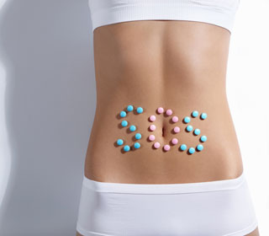
Notes:
http://www.rodale.com/glyphosate-research

Slide 5
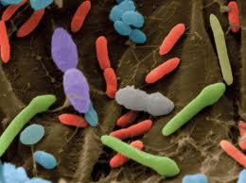
Gut Bacteria and Health*
We are an ecosystem: a community of interacting cells
Trillions of bacteria live in our body
They outnumber our own cells 10:1
Killing them off may make us sick or fat
5-8 million microbial genes in our bodies (3 million in digestive system from more than 1000 species)
They play very essential roles in our bodies
Digest foods, absorb nutrients, provide enzymes, make vitamins and antiinflammatories
Regulate appetite and brain function
Vaginal birth matters
Everyone has unique set of gut bacteria
* NPR’s On Point: Your Inner Ecosystem, http://onpoint.wbur.org/2012/06/20/bacteria-2

Slide 6
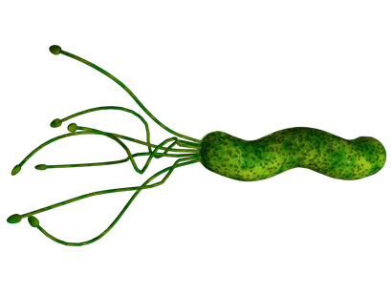
“Our microbes are under threat — and the enemy is us”*
“Microbiome”
99% of them are benign or offer protection
Synthesize vitamins B12 and folate
Birth through birth canal (v.s. C section)
Infant picks up mother's microbiome
Colostrum provides food for gut bacteria
Industrialized countries are too clean
Drastically altered microbiome
H. pylori 90% → < 10% in last hundred years in U.S.
Esophageal cancer and childhood asthma have risen in step
* Liz Szabo, USA Today,
http://www.usatoday.com/news/health/story/2012-07-13/body-bugs-microbes/56255904/1
Notes:
./microbes_usatoday.text

Slide 7
H. pylori: There are Benefits!*
The Western world has now significantly reduced the presence of H. pylori in the gut
This has reduced the incidence of stomach ulcers and stomach cancer
But it has also increased the incidence of esophageal reflux disease and esophageal cancer
H. pylori serve a useful role in reducing acid production by stomach: excess acid aggravates the esophagus
We host a colony of bacteria and they work together with us for a jointly beneficial solution
*Caroline Hadley, EMBO reports 7(5), 471-473, 2006
Notes:
gut_bacteria.pdf

Slide 8
“Our biggest exposure to the environment is actually the lining of our intestines – not our lungs, not our skin. We are in fact very much dependent on the microbiota, the bacteria living in the gut, to maintain our health.”
Dr. David Perlmutter, neurologist
Interview with Dr. Mercola*
*http://articles.mercola.com/sites/articles/archive/2013/09/29/dr-perlmutter-gluten.aspx

Slide 9
Glyphosate and the Shikimate Pathway*
Glyphosate disrupts the shikimate pathway, leading to dysbiosis of aromatic amino acids
Monsanto claims glyphosate is safe because human cells don’t have the shikimate pathway
However, gut bacteria are very important to human health, and they do have the pathway
Dysbiosis in the gut is increasingly being recognized as a factor in modern diseases
*A. Samsel and S. Seneff, Entropy 2013, 15, 1416-1463.

Slide 10
Glyphosate and the Shikimate Pathway*
Glyphosate disrupts the shikimate pathway, leading to dysbiosis of aromatic amino acids
Monsanto claims glyphosate is safe because human cells don’t have the shikimate pathway
However, gut bacteria are very important to human health, and they do have the pathway
Dysbiosis in the gut is increasingly being recognized as a factor in modern diseases
I will have much more to say about this in the section on glyphosate
*A. Samsel and S. Seneff, Entropy 2013, 15, 1416-1463.

Slide 11
Celiac Disease: an Epidemic*
Celiac disease (gluten intolerance) is found throughout the US at a rate of up to 1 in every 133 persons, several orders of magnitude higher than previously estimated
Our food choices and environmental toxins influence which genes get expressed
Celiac disease can be framed as a healthy response to an unhealthy food
Diarrhea expels the toxins quickly
*Sayer Ji, The Dark Side of Wheat.
Notes:
laurie_lentz/dark_side_of_wheat.pdf

Slide 12
“Time and time again, we hear from patients that they never felt depressed or anxious until they started experiencing problems with their gut. Our study shows that the gut–brain connection is a two-way street.”
-- Dr. Kristin Tillisch*
*http://newsroom.ucla.edu/portal/ucla/changing-gut-bacteria-through-245617.aspx
Notes:
http://newsroom.ucla.edu/portal/ucla/changing-gut-bacteria-through-245617.aspx

Slide 13
Connections Between the Gut and the Brain*
* J.F. Cryan and T.G. Dinan, Nature Reviews Neuroscience 2012, 701-712.
Notes:
CRF = corticotropin releasing factor
./gut_brain_connection_review.pdf
Figure 1 | Pathways involved in bidirectional communication between the gut
microbiota and the brain. Multiple potential direct and indirect pathways exist Nature Reviews | Neuroscience
through which the gut microbiota can modulate the gut–brain axis. They include endocrine (cortisol), immune (cytokines) and neural (vagus and enteric nervous system) pathways. The brain recruits these same mechanisms to influence the composition of the gut microbiota, for example, under conditions of stress. The hypothalamus–pituitary– adrenal axis regulates cortisol secretion, and cortisol can affect immune cells (including cytokine secretion) both locally in the gut and systemically. Cortisol can also alter gut permeability and barrier function, and change gut microbiota composition. Conversely, the gut microbiota and probiotic agents can alter the levels of circulating cytokines, and this can have a marked effect on brain function. Both the vagus nerve and modulation of systemic tryptophan levels are strongly implicated in relaying the influence of the gut microbiota to the brain. In addition, short-chain fatty acids (SCFAs) are neuroactive bacterial metabolites of dietary fibres that can also modulate brain and behaviour. Other potential mechanisms by which microbiota affect the brain are described in BOX 1. ACTH, adrenocorticotropic hormone; CRF, corticotropin-releasing factor. Figure is modified from REF. 23.

Slide 14
Recapitulation
Healthy gut bacteria are essential to health
Glyphosate (Roundup) disrupts gut bacteria
Celiac disease is a modern epidemic, likely due to glyphosate (more later)
H. pylori has both pros and cons
The gut-brain axis links gut bacterial distress to neurological diseases

Slide 15
Infection: A Novel Perspective

Slide 16
Infection
Impaired cholesterol sulfate synthesis can lead to susceptibility to infection, which introduces widespread pathology
Infection serves a useful role in resupplying critical nutrients such as cobalamin, folate, and heparan sulfate

Slide 17
Leaky Gut Syndrome*
* From http://www.precisionnutrition.com/all-about-gluten
Notes:
./gluten_web_page.text

Slide 18
Wild Speculation
Leaky gut and leaky skin and leaky blood brain barrier lead to infiltration of microbes from gut or skin into brain
Bacteria are “lured” into the body & into the brain and then killed and harvested to renew important nutrients
Possible nutrients include:
Vitamin B12 (cobalamin), vitamin B9 (folate), thiamine, vitamin K and heparan sulfate

Slide 19
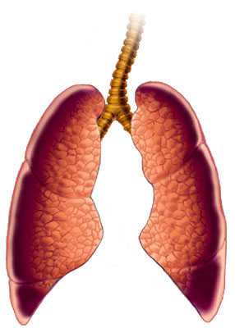
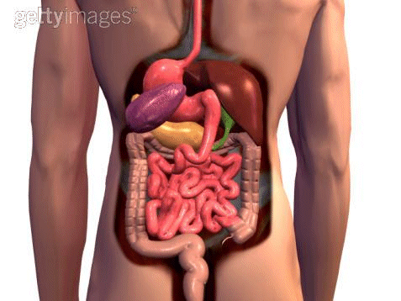
What Causes Increased Infection?
Impaired Cholesterol Sulfate Synthesis!
Microbes
Microbes
Microbes

Slide 20
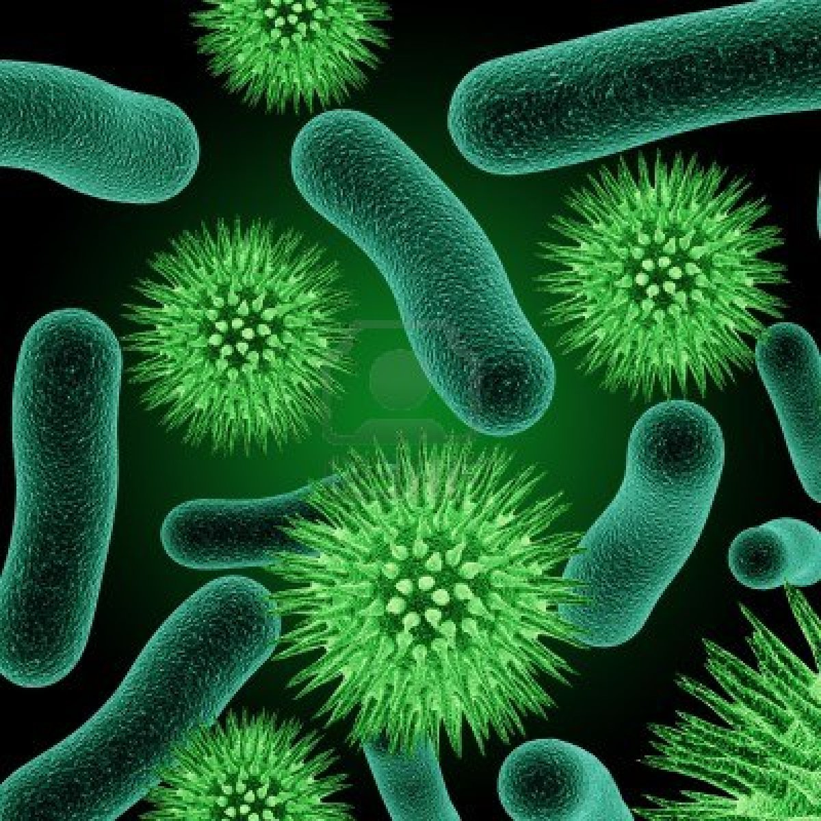
Adrenalin Stimulates Bacterial Growth*
Various species grown in culture (both gram negative and gram positive)
Adrenalin added to medium stimulated growth
Some species produce unknown growth-enhancing stimulus in presence of adrenalin
This can stimulate growth of other species as well
*K.S. Kinney et al., Life Sciences 67 (2000) 3075–3085
Notes:
./bacterial_growth_stimulated_by_norepinephrine.pdf

Slide 21
Sulfate Depletion in Colitis *
GAGs in intestinal mucosa greatly depleted in sulfate in association with both colitis and Crohn’s disease
Colitis: mostly GAGs in luminal surface
Crohn’s: mostly GAGs near blood vessels
Serum albumin leaves vasculature and penetrates intestinal lining:
Insufficient negative charge results in easy access
Serum albumin depletion has severe consequences to blood stability
* Murch et al., The Lancet 341:711-714, Mar 20, 1993
Notes:
vitaminK/sulfated_glycosaminoglycans_intestinal_inflammation.pdf

Slide 22
Sulfate Depletion in Colitis *
GAGs in intestinal mucosa greatly depleted in sulfate in association with both colitis and Crohn’s disease
Colitis: mostly GAGs in luminal surface
Crohn’s: mostly GAGs near blood vessels
Serum albumin leaves vasculature and penetrates intestinal lining:
Insufficient negative charge results in easy access
Serum albumin depletion has severe consequences to blood stability
People with colitis or Crohn’s have greatly increased risk to colon cancer
* Murch et al., The Lancet 341:711-714, Mar 20, 1993
Notes:
vitaminK/sulfated_glycosaminoglycans_intestinal_inflammation.pdf

Slide 23
Leaky Gut
Reduced sulfate in the GAGs in the intestines
Cells are defective in transporting nutrients
Leads to severe vitamin deficiencies (e.g., B12)
Tight junctions between cells become loose
Microbes can penetrate the gut wall and enter the blood stream
They can be harvested by macrophages!

Slide 24
Microvilli in Gall Bladder Epithelium*
Healthy – negative charge makes them stand tall
Unhealthy – addition of cationic polymer destroys them
* Figures 1 and 2 in Quinton and Philpott, J. Cell Biol. 56, 1978, 787-796.
Notes:
vitaminK/epithelium_anionic_1978.pdf
1.0 microgram/ml of poly-L-lysine
FIGURE 1Control gall bladder epithelium not exposed to cationic polymers. Note the structural indi- viduality of the microvilli (my) and lateral invaginations (li). The cytoplasmic ground substance, mitochondrial size and ground substance, and nuclear size and ground substance are comparatively con- sistent from one cell to another. Scale bar, 1/zm; 5,800 diameters.
mURE o Gall bladder epithelium exposed to 1.0 /zg/ml of poly-L-lysine. Note: (a) the collapse of the microvillar structure, (b) the membrane folds extending from the apical border into the terminal web, and (c) the contrasting densities of the cytoplasmic ground substances of adjacent ceils. Scale bar, 1 gm; 6,600 diameters.

Slide 25
Bacteria can Swim Across Gut Barrier!

Slide 26
Microbial Invasion through BBB*
* Figure 5, p. 380, J.A. Orellana et al., Antioxidants and Redox Signaling 11(2), 2009
Notes:
vitamink/neurodegeneration_inflammation_gap_junctions_2009.pdf
FIG. 5.Connexin based channels in brain cells during bacterial meningitis. During bacterial infection blood levels of cytokine (e.g., TNF-􏰃 and IL-􏰉) are elevated. Both, TNF-􏰃 and IL-1􏰉 enhance hemichannel activity (1) of brain endothelial cells. Furthermore, these cytokines induce BBB discontinuity favoring bacterial extravasation (2). Once in the interstitium, bacteria and their extracellular wall components such as LPS and PGN are recognized by microglia (3) which are activated and release cytokines that further activate them (reciprocal arrows). ATP released via hemichannels from microglia (4) pro- motes microglial migration from less affected regions. Activated microglia can also release glutamate through hemichan- nels and oxygen- and nitrogen-derived free radicals that are neurotoxic (5). The enhanced hemichannel activity of activated astrocytes induces neuronal damage through the release of neurotoxic and/or inflammatory compounds such as glutamate and PGE2 (6). These compounds may also increase the activity of neuronal pannexin hemichannels (7), causing electro- chemical imbalance and Ca2􏰁 overload in neurons. In contrast to increased opening of hemichannels, astroglial gap junc- tion communication is reduced (8) (depicted in the figure as reduction in channel number, but could also be the conse- quence of a reduction in permeability or open probability), impairing glutamate and K􏰁 spatial buffering, which enhances neuronal susceptibility to insults. Bacterial meningitis can also induce demyelination (9), possibly via microglial cytokine release. Severe inflammation induces recruitment of leucocytes (10) to the infected loci. Gap junction communication be- tween leucocytes and endothelial cells (11) may contribute to stronger heterocellular adhesion and allow transfer of signals that regulate leucocyte diapedesis across the endothelium (12). Activated microglia may perform antigen cross-presenta- tion interaction with infiltrating leucocytes in which gap junctions between them may play an important role (13). Direct microglial interaction with LPS or PGN induces gap junction communication between microglia which can coordinate mi- croglial function (14). (For interpretation of the references to color in this figure legend, the reader is referred to the web version of this article at www.liebertonline.com/ars).

Slide 27
The Good Side of Infection and Inflammation in the Brain
Inflammation activates microglia to phagocytose (eat) dying cells and Amyloid beta
Bacterial exposure promotes phagocytosis
Both dying cells and bacteria can be recycled into new raw materials!
These nutrients may be essential to brain health

Slide 28
A Possible Cause-and-Effect Relationship
First comes impaired barriers, impaired nutrient transport and impaired blood colloidal suspension
Certain nutrients are desperately needed to fix the problems: e.g., cobalamin, vitamin K, heparan sulfate
Bacteria are invited in to provide those nutrients!
The disease may be uncomfortable, but the alternative may be worse!

Slide 29
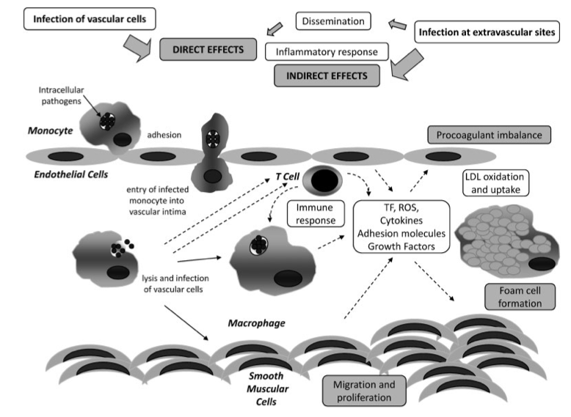
Infection and Atherosclerosis*
* A. Tufano et al., Semin Thromb Hemost 2012(38), 515–523.
Notes:
vitaminK/infection_atheroma_2012_Luca.pdf
./infection_and_atheroma.png
Figure 1Postulated mechanisms by which infectious agents may contribute to the development of atherosclerosis. Infections of vascular cells (direct or via dissemination from extravascular sites, through monocyte/macrophage migration in the case of intracellular pathogens) exert direct effects, whereas the inflammatory response secondary to the infection is responsible for indirect effects. Direct infections of macrophages and smooth muscular cells (SMC) and effects of pathogens on endothelial cells and T cells induce tissue factor expression and generation of reactive oxygen species and of a series of cytokines, growth factors and adhesion molecules. An inflammatory state of the vascular wall is progressively amplified, resulting in SMC migration and proliferation, low-density lipoprotein oxidation and uptake by macrophages transforming into foam cells, and procoagulant imbalance of endothelial function, all crucial atherogenic mechanisms. LDL, low-density lipoprotein; ROS, reactive oxygen species; TF, tissue factor.

Slide 30
What Happens if you Treat with Antibiotics?*
* A. Tufano et al., Seminars in Thrombosis & HemostasisVol. 38(5), 2012, 515-523.
Notes:
vitaminK/antibiotics_increase_cardiovascular_disease.pdf
Kaplan-Meier estimate (with 95% confidence intervals) of cardiovascular mortality according to intervention. Figures below the diagram are biannual number at risk in the clarithromycin and placebo groupsFig 3

Slide 31
What Happens if you Treat with Antibiotics?*
Significantly more people die of cardiovascular disease following antibiotic treatment (p=0.01)
* A. Tufano et al., Seminars in Thrombosis & HemostasisVol. 38(5), 2012, 515-523.
Notes:
vitaminK/antibiotics_increase_cardiovascular_disease.pdf
Kaplan-Meier estimate (with 95% confidence intervals) of cardiovascular mortality according to intervention. Figures below the diagram are biannual number at risk in the clarithromycin and placebo groupsFig 3

Slide 32
Chlamydia pneumoniae
Cause pneumonia when they infect the lungs
Show up frequently in cardiovascular plaque
Show up frequently in Alzheimer’s plaque
What are they doing there???

Slide 33
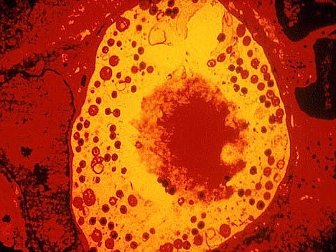
Chlamydia Produce Heparan Sulfate!*
Chlamydia are viable only inside host cells
They set up housekeeping in vacuoles within the cell (e.g., a macrophage in the plaque)
They produce a glucosamine-containing sulphated polysaccharide that is nearly indistinguishable from heparan sulfate
They have a unique set of enzymes for this
* S.J. Rasmussen-Lathrop et al, Cell Microbiol. 2000 Apr, 2(2), 137-44.
Notes:
vitaminK/chlamydia_produce_heparan_sulfate.text

Slide 34
Special Issue Devoted to Alzheimer's and Infection:* Key Points
Pathogens can produce progressive chronic diseases like Alzheimer’s, asthma, and heart disease
Alzheimer himself proposed involvement of infective agents in Alzheimer's 100 years ago
Pathogens stimulate inflammation
Pathogens evade host defenses and establish chronic latent infections
Persistent superoxide, nitric oxide and peroxynitrite (ROS) cause DNA damage and apoptosis and alter gene expression
Environmental toxins and poor nutrition weaken immune system and provide opportunity to bacteria and viruses
* Special Issue of the Journal of Alzheimer’s Disease, 2008

Slide 35
Amyloid Plaque Structure*
Microglia and amyloid plaque accumulate side-by-side in a central region surrounded by astrocytes
Microglia harbor dormant bacteria
Should the bacteria leave, they will encounter the plaque, which will kill them
The astrocytes guard the gates and shield the neurons from the damaging plaque
Chlamydia in plaque region produce heparan sulfate!
* Microphotograph from Schwab et al., Journal of Alzheimer’s Disease 13 359–369, 2008.
Notes:
Picture from alzhiemers_inflammation_2008.pdf

Slide 36
Sepsis and the Vasculature*
Impaired ability to modulate blood flow
Immune cells stick to wall of venule and block flow
Small blood clots form in capillaries and block flow
* S. Trzeciak et al., Acad Emerg Med. 2008 May ; 15(5): 399–413
Notes:
vitaminK/
2008_Trzeciak_resuscitating_microcirculation_septic_shock_Bob.pdf
Figure 1.Sepsis is a disorder of the microcirculation. Much of the pathophysiology of sepsis can be explained within the microcirculatory unit – the terminal arteriole, capillary bed, and the post- capillary venule. The arteriole is where the characteristic vasodilation and vasopressor hyporesponsiveness of sepsis occurs. The capillary bed is where the effects of endothelial cell activation/dysfunction are most pronounced and microvascular thromboses are formed. The post-capillary venule is where leukocyte trafficking is most disordered – leukocytes adhere to the vessel wall, aggregate, and further impair flow through the microcirculation.
Figure 1.
Sepsis is a disorder of the microcirculation. Much of the pathophysiology of sepsis can be
explained within the microcirculatory unit – the terminal arteriole, capillary bed, and the postcapillary
venule. The arteriole is where the characteristic vasodilation and vasopressor
hyporesponsiveness of sepsis occurs. The capillary bed is where the effects of endothelial cell
activation/dysfunction are most pronounced and microvascular thromboses are formed. The
post-capillary venule is where leukocyte trafficking is most disordered – leukocytes adhere to
the vessel wall, aggregate, and further impair flow through the microcirculation.

Slide 37
Effect of de-novo statin treatment on patients with sepsis plus pneumonia*
Figure 2. Proportions of Nonsurvivors in the Simvastatin and Placebo Groups
* Laurent Papazian et al., JAMA, Oct. 9, 2013 [Epub ahead of print]
Notes:
For_vic/statins_kill_people_with_pneumonia.pdf

Slide 38
Hypothesis
Blood flow needs to nearly shut down during sepsis; organs need to shut down; the entire body focuses on harvesting heparan sulfate from the invasive microbes to recover blood stability.

Slide 39
Recapitulation
Infection is a consequence of impaired supply of sulfate to the barriers
Leaky gut syndrome allows bacteria to personally deliver nutrients to the body
Adrenalin encourages bacterial growth (to help supply nutrients under stress?)
Atherosclerosis is associated with infective agents, but antibiotics make things worse
Chlamydia pneumoniae can produce heparan sulfate using a unique set of enzymes
Do they help us out in pneumonia, heart disease and Alzheimer's?

Slide 40
Influenza

Slide 41
Influenza (Viral Disease)
1/3 of infected individuals are asymptomatic
These are people with plenty of sulfate?
Flu vaccine is aggressively promoted in US and elsewhere for protection
Often required in healthcare workers
Big mistake in pregnant women (mercury)
Claims of effectiveness are probably exaggerated
Treatment includes Tamiflu and dextran sulfate
Flu can sometimes lead to pneumonia (viral or bacterial) [in vulnerable individuals]

Slide 42
Flu Vaccine Increases Risk to Other Respiratory Infections*
Double-blind randomized trial conducted in Hong Kong
115 children aged 6–15 years
Received 2008–2009 seasonal trivalent influenza inactivated vaccine (TIV) or placebo
Monitored over following 9 months
TIV recipients did not have a significant reduction in risk to flu
TIV recipients had a 4.4-fold increased risk to non-influenza infections
*BJ Cowling et al., CID 2012:54, 1778-1783.
Notes:
./influenza_vaccine_increases_risk_to_respiratory_infection.pdf

Slide 43
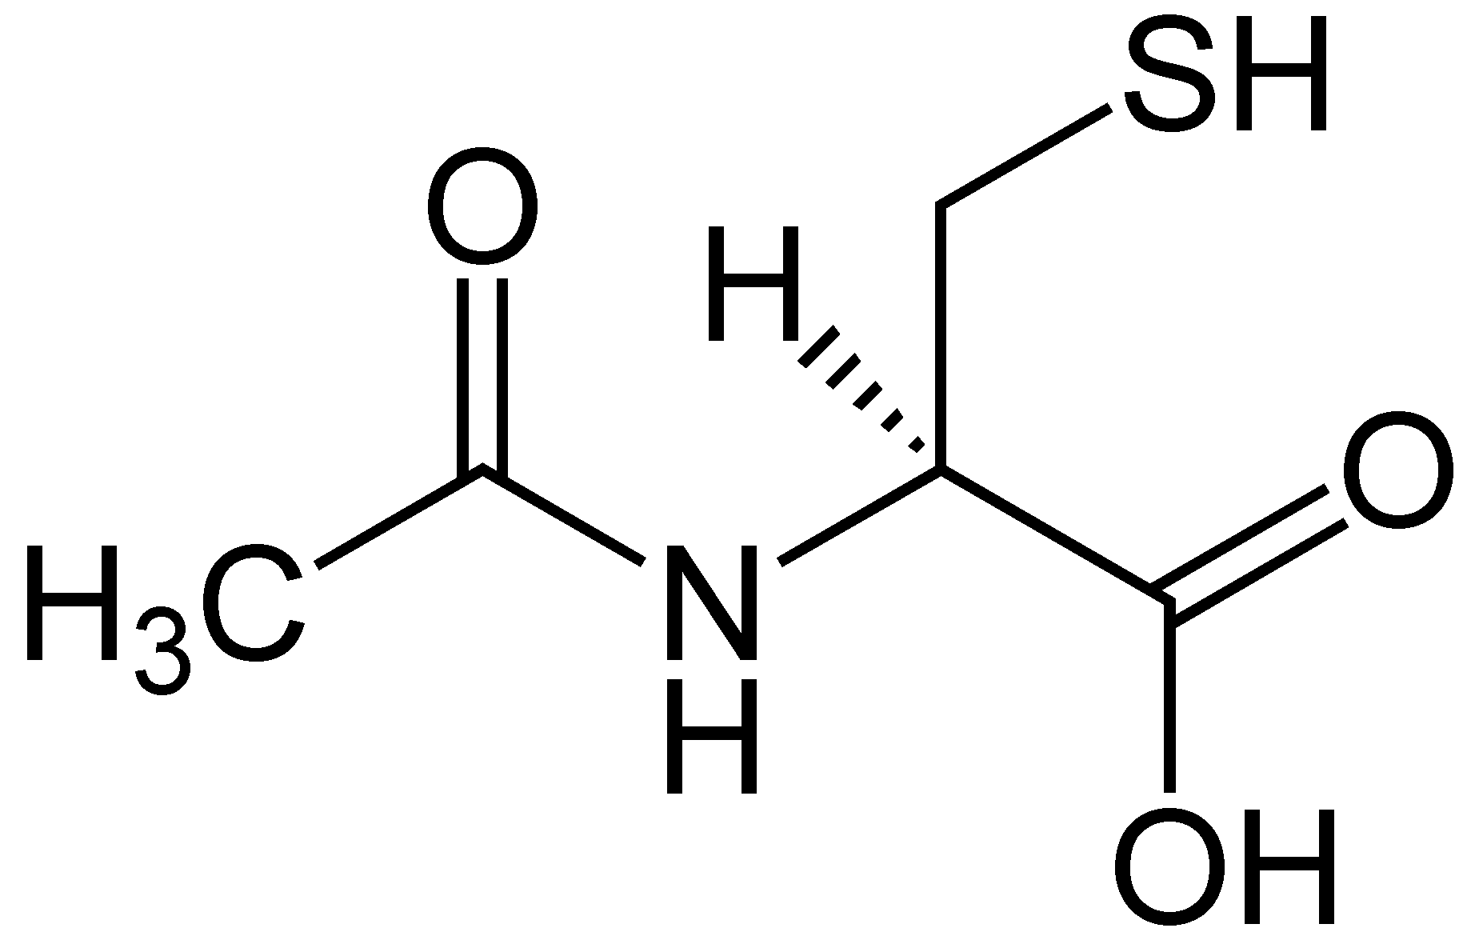
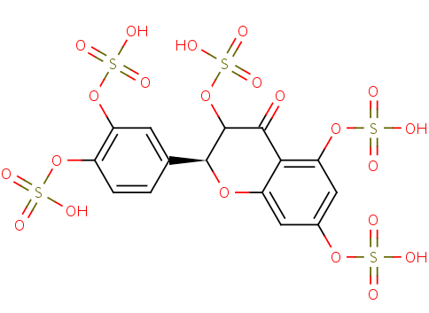
Supplement and Dietary Protection from Influenza*
N-acetyl cysteine
Green tea (catechines)
*S. De Flora et al., Eur Respir J 10 (7): 1535–1541.
Notes:
Where?

Slide 44
Muscle Aches and Pains with Flu*
“Patients with an influenza-like illness should be observed for signs and symptoms of rhabdomyolysis and myoglobinuria during the course of their illness”
Is the virus leaching sulfate from the muscles?
*RA Minow et al., Ann Intern Med. 1974;80(3):359-361.
Notes:
./rhabdomyolisis_flu.text

Slide 45
Does Influenza Virus Transport Sulfate?
Influenza virus
Infects muscle cells and causes muscle wasting*
Incorporates sulfated mucopolysaccharides synthesized by the host cell into its own plasma membrane**
Inhibits mucopolysaccharide incorporation into the host cell's membrane.**
Is viral infection an opportunity to steal sulfate from muscle cells and deliver it to the blood?
* HA Kessler et al., JAMA 1980 243(5), 461-462.
**Nakamura and Compans, Virology 79(2), 1977, 381-392.
Notes:
Treasures/incorporation_of_sulfate_into_influenza_glycoproteins.pdf

Slide 46
Is This True More Generally?*
More sulfur showed up in multiple tissues following infection
Infected animals
Mucopolysaccharides labelled with radioactive sulfur to measure growth
*Bernhard Muschlien, Inflammations and Their Therapy by Means of Isopathy
Notes:
./text_with_example_of_bacteria_cause_sulfate_renewal_German.text
Treasures/bactera_renew_sulfate_German.pdf
Fig. 3: Increase of the MPS-synthesis in the connective tissue of liver, spleen, heart, kidney, cartilage, skin, aorta and bones (rats), controlled by measuring the 35S-sulfate deposit in the SMPS after the infection with Pasteurella multocida. (Universal nonspecific mesenchyme reaction after infection.)
MPS = mucopolysaccharides.

Slide 47
Choline sulfate!!*
Produced by plants, lichens, algae, fungi, and several bacterial species
Experiment demonstrated that it had superior capabilities to inhibit amyloid formation in pancreatic beta cells
Amyloid in beta cells is akin to amyloid beta in Alzheimer‘s disease and plays a major role in type-II diabetes
*M. Hagihara et al., FEBS Open Bio 2 (2012) 20–25.
Notes:
Alzheimers/choline_sulfate_inhibits_amyloid_formation.pdf*M. Hagihara et al., FEBS Open Bio 2 (2012) 20–25.

Slide 48
Tamiflu and dextran sulfate are drugs to suppress flu virus replication that are imitations of products produced by gut bacteria

Slide 49
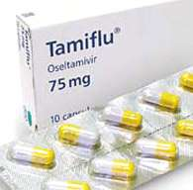
“Flu is a threat and Tamiflu is the answer?”*
Side effects include:
Convulsions, delirium and delusions
Allergic reactions including anaphylaxis
Hepatitis and elevated liver enzymes
Nausea, diarrhea
Nightmares
Headache
Skin rash
*http://articles.mercola.com/sites/articles/archive/2012/02/07/
recommended-tamiflu-has-flawed-results.aspx

Slide 50
Neuraminic Acid and Tamiflu
Neuraminic Acid: Basic unit in sialic acids in human GAGs
Broken down by neuraminidase produced by flu virus
Tamiflu inactivates neuraminidase
This prevents viral entry into cell
Shikimate is a precursor to active ingredient in Tamiflu
Shikimate is produced by gut bacteria

Slide 51
Inhibition of Neuraminidase by Dextran Sulfate*
Negatively charged, sulfated polysaccharide
Synthesized from sucrose by lactic-acid bacteria
Suppresses replication of influenza A virus strain
Induces viral aggregation at cell surface
Inhibits neuraminidase activity (likely due to its negative charge)
Used as drug to treat flu
*H Yamada et al., Antiviral Res. 2012 Dec;96(3):344-52.

Slide 52
Inhibition of Neuraminidase by Dextran Sulfate*
Negatively charged, sulfated polysaccharide
Synthesized from sucrose by lactic-acid bacteria
Suppresses replication of influenza A virus strain
Induces viral aggregation at cell surface
Inhibits neuraminidase activity (likely due to its negative charge)
Used as drug to treat flu
A bacterium that interferes with flu virus can transport the dextran sulfate to distant places.
Dextran sulfate as a drug is a “trick”.
*H Yamada et al., Antiviral Res. 2012 Dec;96(3):344-52.

Slide 53
Dextran Sulfate
Notes:
Chemical structure of dextran sulfate sodium (DSS), a sulfated polysaccharide, and its biological activities. DSS (1–5% in drinking water or diet) induces colitis in rodents. Treatment with DSS (1% in diet) after DMH exposure produces colonic adenocarcinoma [44]. The tumorigenicityof DSS is non-genotoxic effects [20]. Cycle treatment with 3% DSS (MW 54,000, 7 days) and distilled water (14 days) produces colonic tumors [45]. DSS increases the number of ACF induced by AOM [19].

Slide 54
WIKI on Dextran
The antithrombotic effect of dextran is mediated through its binding of red blood cells, platelets, and the endothelial cells in the vascular wall, increasing their electronegativity and thus reducing red blood cell aggregation and platelet adhesiveness.

Slide 55
Side Effects from Dextran Sulfate Treatment
Anaphylaxis (itchy rash, throat swelling, and low blood pressure)
Excess fluid in blood
Pulmonary edema
Cerebral edema
Platelet dysfunction
The molecule by itself can’t multiply whereas bacteria that produce it can!!

Slide 56
Phase II Trial: Hepatitis C Drug*
Trial halted early due to 9 hospitalizations and 1 death
Drug works by thwarting viral replication machinery
Drug is toxic to heart and kidney
Side effects of hepatitis C treatments, more generally, include anemia, cardiac arrhythmias, severe depression, and flu-like symptoms
Cholesterol sulfate is a natural inhibitor of Hepatitis C**
*http://www.the-scientist.com/?articles.view/articleNo/32552/title/Clinical-Trial-Misfortune/
**A Furuta et al., J Enzyme Inhib Med Chem. 2013 Feb 25. [Epub ahead of print]

Slide 57
Recapitulation
Better to prevent flu than to treat it
Better to prevent flu through nutrition than through vaccines
Flu is associated with aching muscles: is the virus forcing muscles to give up their sulfate?
Treating flu can lead to severe “side effects”
Are these the consequence of the virus being aborted early before it can follow through on its promise to deliver sulfate to the blood stream?
I suspect many other viruses (e.g., hepatitis C) provide much-needed sulfate to the body

Slide 58
Natural Resistance and Antibiotics

Slide 59
Multiple Antibiotic Resistance
Antibiotic resistance is a serious and growing threat in modern times
Organisms become resistant to "first-line" antibiotics, necessitating second-line agents that are more potent and more toxic to humans
Sequentially, microbes become resistant to second- and even third-line defenses.
Result is MRSA: Multiple resistant Staph aureus.

Slide 60
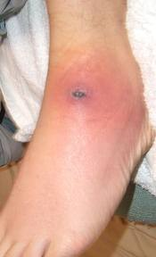
LDL Protects from MRSA*
Methicillin-resistant Staphylococcus aureus (MRSA) has become a major problem in hospitals worldwide
ApoB in LDL limits invasion by binding to and neutralizing a key enzyme responsible for promoting invasion through the skin
Skin penetration and bacterial density were significantly greater in ApoB-deficient mice.
* Peterson et al., Cell Host Microbe 4(6): 555–566, 2008
Notes:
For_vic/apoB_protects_from_staph_MRSA.pdf

Slide 61
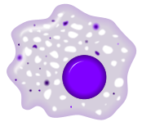
The Cholesterol Connection: VLDL Fights Infections*
TNF-α
LBP
LPS (toxic)
LPS (toxic)
VLDL
LBP
LPS: Lipopolysaccharide
LBP: Lipopolysaccharide binding protein
VLDL
* Barcia and Harris,”Triglyceride Rich Lipoproteins as Agents of Innate Immunity CID, 2005
Notes:
Cancer/triglycerides_immunity.pdf

Slide 62
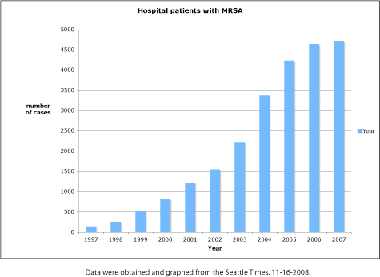
The MRSA Epidemic*
*M. Berens and K. Armstrong
How our hospitals unleashed a MRSA epidemic
Seattle Times 11-16, 2008
Notes:
http://scienceblogs.com/digitalbio/2008/11/the_seattle_times_takes_on_hos.php
In 2008 – 33 fold in past ten years in Washington State

Slide 63
MRSA in Children On The Rise*
The infections overwhelmingly resulted in hospitalization (91%); 6% were fatal.
Most of the affected kids (68%) had another underlying medical condition, most commonly prematurity (19%) or a skin condition such as eczema or abscesses (18%).
Black children also had a disproportionate share, accounting for 59% of the cases, with an incidence of 6.7 versus 1.6 per 100,000 among other children.
*Crystal Phend , Medpage Today Sept. 23, 2013
Notes:
./MRSA_kids_rising.pdf
Iwamoto M, et al "Trends in invasive methicillin-resistant staphylococcus aureus infections" Pediatrics 2013; 132: e817–e824.
The researchers analyzed data from the CDC's Active Bacterial Core Surveillance (ABCs), an active, population-based surveillance system for laboratory-confirmed MRSA in nine metropolitan areas across the country.

Slide 64
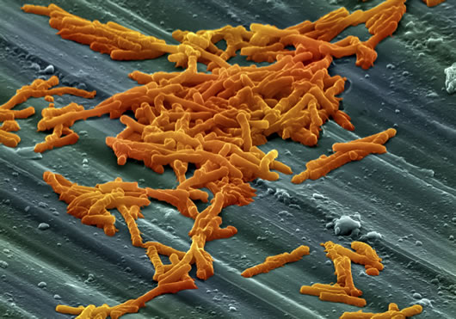
Clostridium Difficile and Klebsiella Pneumoniae Are Coming*
Two super bugs resistant to nearly all antibiotics
Breakouts in hospitals are dire threats
Susceptibility
Weakened immune system
Disrupted gut bacteria
Clostridium difficile (C. diff)
Spores are nearly indestructible
New kid on the block: Klebsiella pneumonia super strain
Resistant to every single antibiotic in the medical arsenal.
Enclosed by a polysaccharide capsule that protects from antibiotics
Initially flu-like symptoms
high fever, chills, cough
copious amounts of viscous and bloody mucous in the lungs.
Half the cases lead to permanent scarring of lungs
*www.jonbarron.org/topic/clostridium-difficile-and-klebsiella-pneumoniae-are-coming
Notes:
./c_difficile.text
THIS IS A GREAT ARTICLE!!

Slide 65
Fluoroquinones: Toxic Antibiotics!*
Among the most commonly prescribed antibiotics in the US
Inhibit bacterial DNA synthesis
Fluoride increases penetration into BBB
Symptoms include:
Nervous system symptoms (tingling, numbness, anxiety, memory loss, psychosis ..)
Musculoskeletal symptoms (tendonitis, weakness, joint swelling ...)
Sensory symptoms (tinnitis, altered vision, ...)
Cardiovascular symptoms (tachycardia, chest pain, palpitations ...)
Skin reactions (rashes, hair loss, sweating ...)
Gastrointestinal symptoms (nausea, vomiting, diarrhea...)
*articles.mercola.com/sites/articles/archive/2013/09/25/fluoroquinolone-antibiotics.aspx
Notes:
./Mercola_fluoroquinone_antibiotics_toxic.pdf

Slide 66
Recapitulation
Multiple antibiotic resistance is a growing problem
Could it be due to insufficient cholesterol and insufficient sulfate?
Fighting disease with antibiotics Is a losing proposition
Drug resistant microbes lead to ever more toxic antibiotics
Side effects of the antibiotics can kill you

Slide 67
Summary
Our gut bacteria are under siege!
Leaky gut syndrome allows bacteria to personally deliver nutrients to the body
Adrenalin encourages bacterial growth (to help supply nutrients under stress?)
Atherosclerosis is associated with infective agents, but antibiotics make things worse
Chlamydia pneumoniae can produce heparan sulfate using a unique set of enzymes
Do they help us out in pneumonia, heart disease and Alzheimer's?
Influenza infection has a silver lining
MRSA is on the rise, and antibiotics to treat it have dangerous side effects

