Slide 1
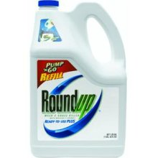
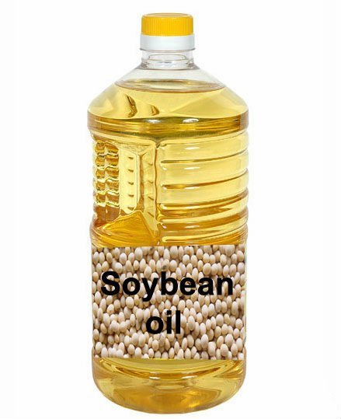
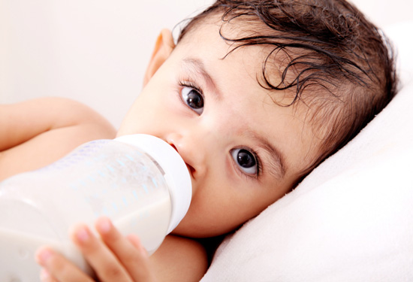
Is Roundup the Toxic Chemical That’s Making Us All Sick?
Stephanie Seneff
MIT CSAIL
June 5, 2014

Slide 2
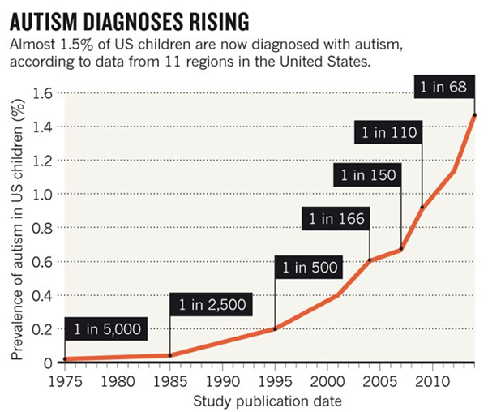
A Frightening Trend*
?
?
*K. Weintraub, Nature 479, Nov. 3 2011, 22-24.
Notes:
./NatureAutismRising.pdf

Slide 3
“If it is an environmental cause contributing to an increase, we certainly want to find it.”*
*K. Weintraub, Nature 479, Nov. 3 2011, 22-24.

Slide 4
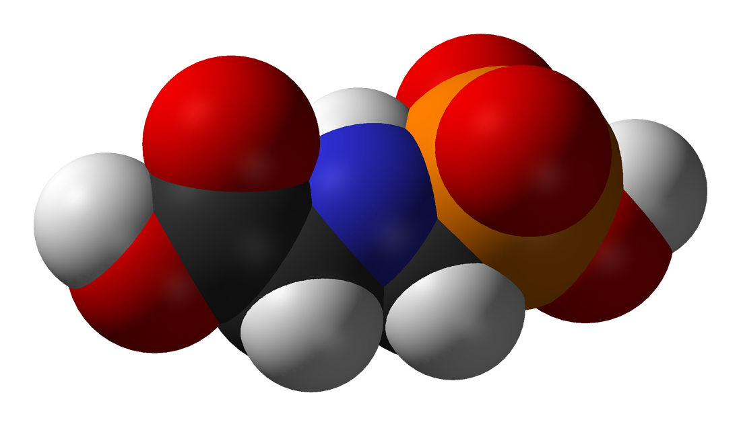
GLYPHOSATE

Slide 5
Glyphosate and Autism

Slide 6
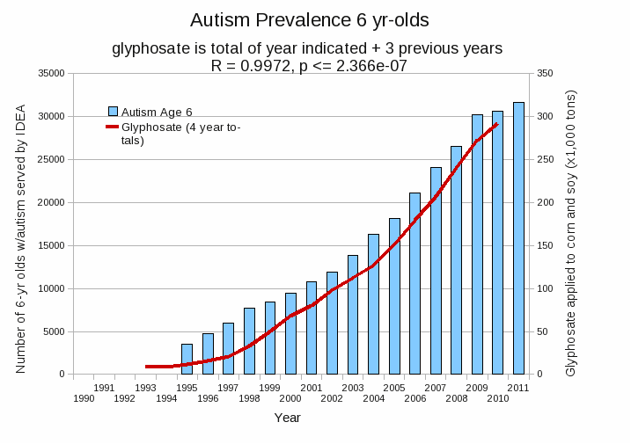
Autism Prevalence: 6 year olds
R = 0.9972
*Plot provided by Nancy Swanson, with permission
Data sources: autism: US Department of Education; Glyphosate: US Department of Agriculture
Notes:
Nancy/latest_plots/6-yr-old autism.gif
autism: USDE
oil consumption: USDA
glyphosate: USDA
GE crops: USDA
Mortality data: CDC

Slide 7
Autism Prevalence: 6 year olds
U.S. Market is 25% of World Market of Roundup
R = 0.9972
*Plot provided by Nancy Swanson, with permission
Data sources: autism: US Department of Education; Glyphosate: US Department of Agriculture
Notes:
Nancy/latest_plots/6-yr-old autism.gif
autism: USDE
oil consumption: USDA
glyphosate: USDA
GE crops: USDA
Mortality data: CDC

Slide 8
Is Glyphosate Toxic?
Monsanto has argued that glyphosate is harmless to humans because our cells don’t have the shikimate pathway, which it inhibits
However, our gut bacteria DO have this pathway
We depend upon them to supply us with essential amino acids (among many other things)
Other ingredients in Roundup greatly increase glyphosate’s toxic effects
Insidious effects of glyphosate accumulate over time
Most studies are too short to detect damage

Slide 9
Main Toxic Effects of Glyphosate*
Kills beneficial gut bacteria and allows pathogens to overgrow
Interferes with function of cytochrome P450 (CYP) enzymes
Chelates important minerals (iron, cobalt, manganese, etc.)
Interferes with synthesis of aromatic amino acids and methionine
Leads to shortages in critical neurotransmitters and folate
Disrupts sulfate synthesis and sulfate transport
*Samsel and Seneff, Entropy 2013, 15, 1416-1463

Slide 10
The Enhancing Effect of Adjuvants*
“Adjuvants in pesticides are generally declared as inerts, and for this reason they are not tested in long-term regulatory experiments. It is thus very surprising that they amplify up to 1000 times the toxicity of their APs [Active Principles] in 100% of the cases where they are indicated to be present by the manufacturer.”
*R. Mesnage et al.BioMed Research International 2014; Article ID:179691.
Notes:
Glypohsate/seralini_2014_pesticide_toxicity_adjuvants.pdf

Slide 11
Roundup Safety Claims Disputed*
“It is commonly believed that Roundup is among the safest pesticides. … Despite its reputation, Roundup was by far the most toxic among the herbicides and insecticides tested. This inconsistency between scientific fact and industrial claim may be attributed to huge economic interests, which have been found to falsify health risk assessments and delay health policy decisions.”
*R. Mesnage et al., Biomed Research International, Volume 2014 (2014),
Article ID 179691
Notes:
Glyphosate/ Mesnage_Seralini_2014_glyphosate_toxicity_proven.pdf
This is the first time that all these formulated pesticides have been tested on human cells well below agricultural dilutions.
adjuvants were also more cytotoxic through the disruption of membrane and mitochondrial respiration,
1000-fold enhancement w/ adjuvants

Slide 12
Okay, It’s toxic!
But are we exposed?
Very little data!

Slide 13
Glyphosate Test Report: Findings in American Mother's Breast milk, urine and water*
Moms Across America initiative!
Breast milk levels ranging from 76 ug/l to 166 ug/l are 760 to 1600 times higher than the European Drinking Water Directive allows
Urine testing shows glyphosate levels over 10 times higher than in Europe
Monsanto is wrong regarding bioaccumulation
*Posted on Apr 6 2014 - 4:19am by Sustainable Pulse

Slide 14
“Another claim of Monsanto's has been that residue levels of up to 5.6 mg/kg in GM-soy represent "...extreme levels, and far higher than those typically found" (Monsanto 1999).
Study of glyphosate and AMPA (breakdown product) residues in soy crops*
5.6
*Figure 1, T. Bohn et al. Food Chemistry 153, 15 June 2014, 207-215.
www.greenmedinfo.com/blog/how-extreme-levels-roundup-food-became-industry-normal
Notes:
http://www.greenmedinfo.com/blog/how-extreme-levels-roundup-food-became-industry-normal

Slide 15
Soy Formula Linked to Seizures in Autism*
"There was a 2.6-fold higher rate of febrile seizures, a 2.1-fold higher rate of epilepsy comorbidity and a 4-fold higher rate of simple partial seizures in the autistic children fed soy-based formula"
*CJ Westmark, PLOSOne March 12, 2014, DOI: 10.1371/journal.pone.0080488.
Notes:
./SoyFormulaSeizuresAutism.pdf

Slide 16
Some Biomarkers for Autism
Disrupted gut bacteria; inflammatory bowel
Low serum sulfate
Methionine deficiency
Serotonin and melatonin deficiency
Defective aromatase
Zinc and iron deficiency
Urinary p-cresol
Mitochondrial disorder
Seizures; Glutamate toxicity in the brain
Notes:
Samantha/zinc_deficiency_autism.text

Slide 17
Some Biomarkers for Autism
Disrupted gut bacteria; inflammatory bowel
Low serum sulfate
Methionine deficiency
Serotonin and melatonin deficiency
Defective aromatase
Zinc and iron deficiency
Urinary p-cresol
Mitochondrial disorder
Seizures; Glutamate toxicity in the brain
These can all be explained as potential effects of glyphosate on biological systems
Notes:
Samantha/zinc_deficiency_autism.text

Slide 18
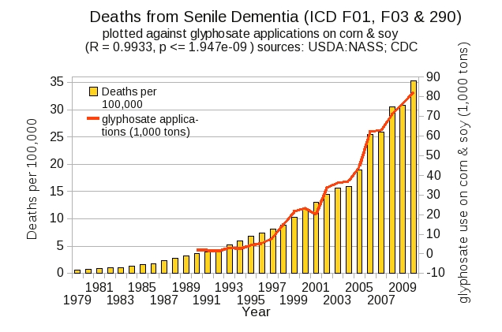
Dementia and Autism Have Much in Common
Plot kindly provided by Nancy Swanson

Slide 19
Digestive System Disorders

Slide 20
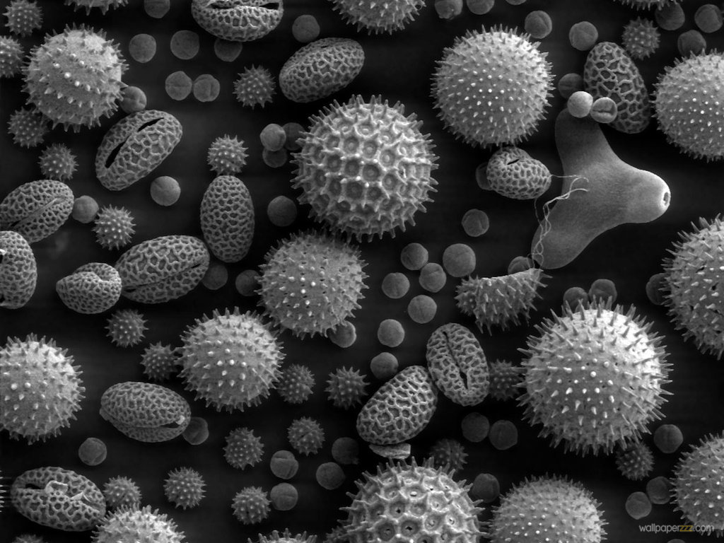
Gut Microbes and Obesity
Our microbes outnumber our own cells 10 to 1
There are between 200 and 300 different species in a typical person.
Glyphosate causes a loss of beneficial bacteria and an overgrowth of pathogens in the gut
Pathogens release toxic phenols (e.g., p-cresol)
This can lead to inflammatory bowel disease
And a direct path to obesity!
Gut microbes from an obese person induced obesity in mice*
*N. Fei and L. Zhao, The ISME Journal, Online Publication Dec. 2012
Notes:
*See: http://www.usaprepares.com/health/scientists-link-obesity-to-gut-bacteria

Slide 21
Obesity Switch*
Reduced sulfate
Loss of beneficial bacteria
Overgrowth of Pathogens
Leaky Gut
Glyphosate!!
*Figure 3, Le Chatelier et al., Nature 500, Aug 29, 2013, 541-548.
Notes:
Wendy/Chatelier_microbiome_metabolic_markers_2013.pdf
Also treasures/
Figure 3 | Functional and phylogenetic shifts in the LGC microbiome. Top, observed increase (red) or decrease (green) of functions and phylogenetic groups. Bottom, potential drivers (yellow) of inflammation related to decreased richness. Left, antibiotic-mediated perturbation of the richness; Right, proteobacterial lipopolysaccharide-mediated perturbation of the richness. AB, antibiotic; IR, insulin resistance.

Slide 22
Obesity in US over Time*
Glyphosate was introduced into the food chain in 1975
*Figure 1 in R.J. Johnson et al., Am J Clin Nutr 2007;86:899–906.
Notes:
Sugar intake per capita in the United Kingdom from 1700 to 1978 (30, 31; E) and in the United States from 1975 to 2000 (32; 􏰏) is compared with obesity rates in the United States in non-Hispanic white men aged60–69y(17;F).Valuesfor1880-1910arebasedonstudiesconducted in male Civil War veterans aged 50–59 y (18).

Slide 23
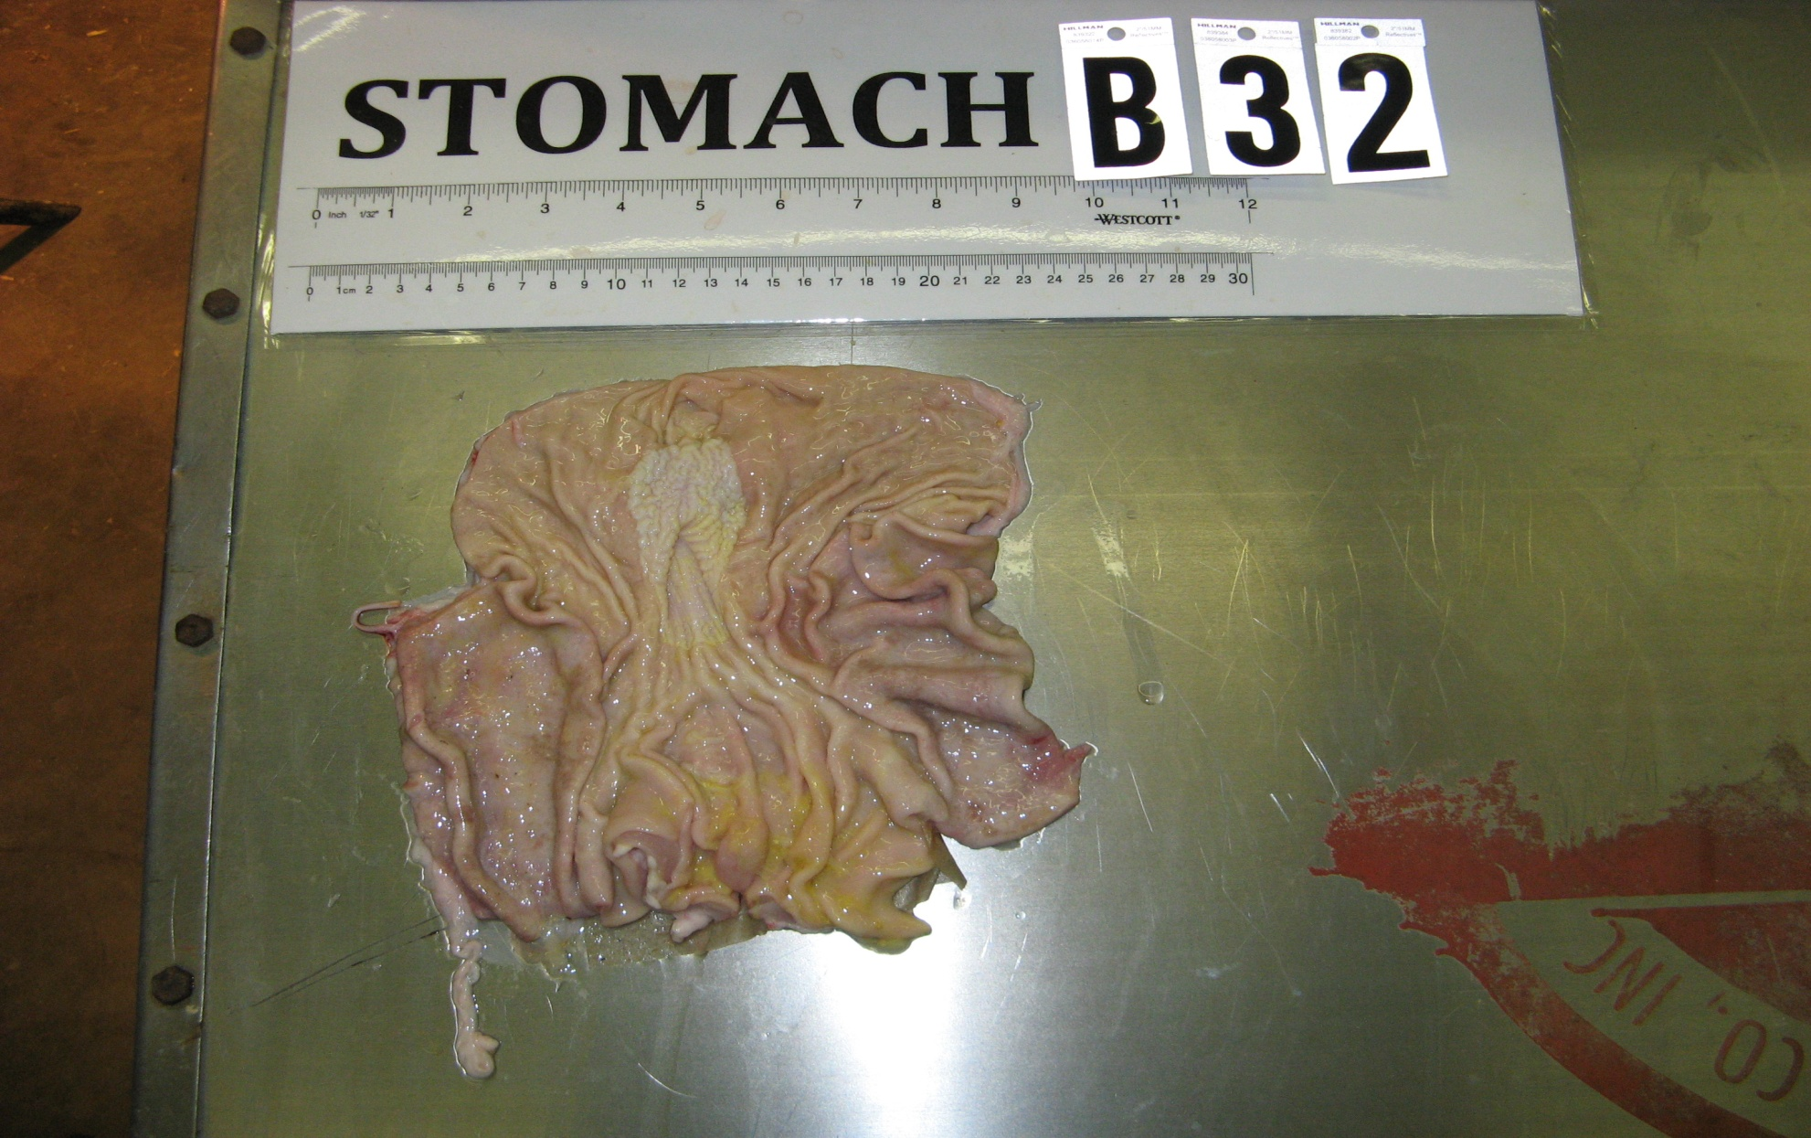
Pigs Fed GMOs Develop Inflamed Gut*
Blind autopsies conducted
Female pigs' uterus 25% larger in GMO-fed pigs
Female pigs 2.2x more likely to get severe stomach inflammation on GMO diet
Males were 4x more likely
Non-GMO Feed
GMO Feed
Photos kindly provided by Howard Vlieger
GMO Feed
*J.A. Carman et al., Journal of Organic Systems, 8(1), 2013.
Notes:
Swine/pigs_fed_GMOs_inflamed_gut.pdf
Also pigs_GMOs_summary.pdf
./Pigs_Study_NaturalNews.pdf

Slide 24
Human Digestive System Disorders
Alarming increase in the US in many diseases related to the gut
Crohn’s disease, inflammatory bowel disease, colitis, acid reflux disease, gluten and casein intolerance, celiac disease, leaky gut
The gut-brain axis links neurological disorders with gut disorders
I believe that glyphosate is a major cause
Notes:
Celiac disease has quadrupled in the US in last 50 years

Slide 26
Celiac Disease has Quadrupled in the US in the Last 50 Years
Notes:
Today’s serum is more than four times as likely to carry those
Antibodies (to gluten)

Slide 27
Wheat! Not corn and soy!
Graph provided by Nancy Swanson, with permission

Slide 28
Why is glyphosate usage on wheat going up?

Slide 29
“Herbicide Resistant Ryegrass Troubling for Wheat Growers”*
“If you see ryegrass at harvest following an Axial XL application, it may be resistant. And you can scatter seed all over the field with the combine.”
“A reduced-tillage approach, using a burndown herbicide ahead of planting in a stale seedbed, also holds promise for improved control.”
“ ‘We may be able to knock out 80% to 90% of the resistant ryegrass with glyphosate.’ ”
-- Jim Swart, integrated pest management specialist
*Ron Smith, Western Farm Press, Mar. 23, 2013
Notes:
Glyphosate/pesticides_for_wheat_slides.pdf
glyphosate/Axial_XL.text

Slide 30
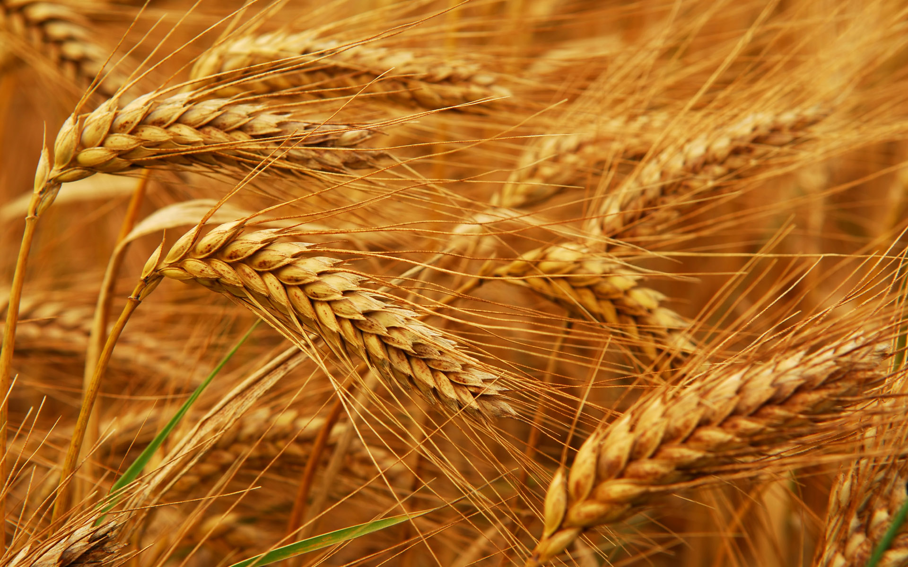
Human Dietary Experiment on Wheat & Inflammatory Bowel Syndrome*
Significant improvement in symptoms with dietary organic wheat from ancient source
Abdominal pain (P< 0.0001)
Bloating (P=0.004)
Stool consistency (P<0.001)
Tiredness (P< 0.0001)
Reduced pro-inflammatory cytokines: IL-6, IL-17, interferon-gamma, VEGF
*F. Sofi et al., Br J Nutr. 2014 Feb 13:1-8. [Epub ahead of print]
Notes:
Csail/2014/Anthony/ancient_wheat_not_allergenic.text

Slide 31
Paper on Glyphosate and Celiac Disease

Slide 32
Celiac Disease, Glyphosate and Non-Hodgkin’s Lymphoma
Bifidobacteria are depleted in celiac disease*
They convert gluten to less toxic form
Glyphosate preferentially kills bifidobacteria**
Celiac disease is associated with increased risk to non-Hodgkin’s lymphoma***
Glyphosate itself is also linked directly to non-Hodgkin’s lymphoma****
*M. Velasquez-Manoff, NY Times Sunday Review, Feb. 23, 2013
**A.A. Shehata et al., Curr Microbiol. 2013 Apr;66(4):350-8.
.*** C. Catassi et all, JAMA. 2002 Mar 20;287(11):1413-9.
****M. Eriksson et al., Int J Cancer. 2008 Oct 1;123(7):1657-63.
Notes:
**./ bifidobacteria_celiac_disease.text
Cancer/Celiac_disease_increases_hodgkins_lymphoma.text
3-4 fold increased risk to non-Hodgkins lymphoma
./Celiac_and_bacteria.text

Slide 33
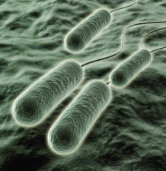
Pseudomonas and Glyphosate*
Pseudomonas aeruginosa, a gram negative bacterium, is a major problem today in hospitals due to its resistance to multiple antibiotics
P. aeruginosa is one of only three bacterial species that can break down glyphosate.
It produces formaldehyde as a by-product
Formaldehyde is a well established neurotoxin
*S. de Betnzmann and P. Plésiat Environ Microbiol. 2011 Jul;13(7):1655-65.

Slide 34
“Dramatic Increase in Hospitalization of US Children With Inflammatory Bowel Disease”*
Study conducted at Case Western Reserve University School of Medicine
> 11 Million hospitalization records examined
Patients < 20 years old
49% increase from 2000 to 2009 in Crohn’s disease discharges
71% increase in ulcerative colitis discharges
* Science Daily, June 25, 2013
Notes:
./inflammatory_bowel_disease_children.text

Slide 35
*Plot prepared by Nancy Swanson from available data online

Slide 36
Kidney Failure in Agricultural Workers*
Workers in sugarcane fields in Central America and in India are dying at a young age in record numbers from kidney failure
Arsenic exposure from drinking water?
Excess use of tylenol?
Glyphosate disrupts the enzyme that breaks down tylenol, leading to tylenol toxicity
*ticotimes.net, San Jose, Costa Rica, August 8, 2013.
Notes:
http://www.ticotimes.net/More-news/News-Briefs/What-is-killing-the-young-men-of-Canas-_Wednesday-August-07-2013
./diabetes_farmers_costa_rica.pdf

Slide 37
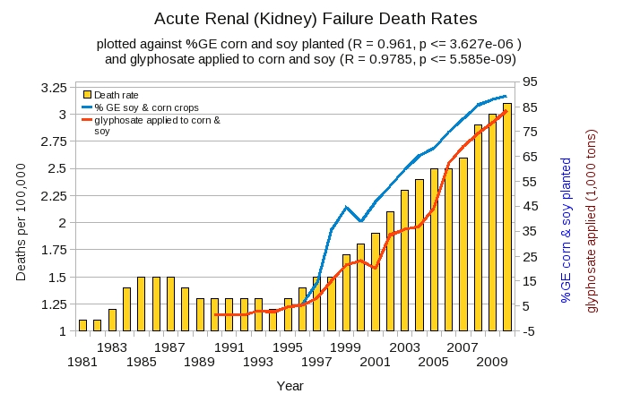
Acute Kidney Disease Death Rate Plotted Against Glyphosate and GMOs*
*Plot prepared by Nancy Swanson from available data online

Slide 38
Sri Lanka is the first Country to Ban Glyphosate
arsenic
Notes:
Project/Glyphosate/glyphosate_sri_lanka_kidney_failure_epidemiology.pdf

Slide 39
Another Country Responds to Kidney Failure in Agricultural Workers!
Notes:
Sri Lanka is the only other nation that has banned glyphosate.

Slide 40
Recapitulation
We depend on our gut bacteria in many ways
Bacteria from an obese person induce obesity in mice
Glyphosate is an antibiotic that preferentially kills the good bacteria
Pigs fed GMO corn and soy develop inflammatory gut
Humans are experiencing an epidemic in gut disorders like inflammatory bowel disease and gluten intolerance
Due to herbicide-resistant rye grass, farmers use glyphosate as a desiccant at harvest time
Kidney failure among agricultural workers can be explained by glyphosate

Slide 41
Summary
We should be very worried about glyphosate contamination in the food supply
Glyphosate usage on corn and soy crops correlates with the epidemic we’re seeing in autism, Alzheimer’s disease, celiac disease, and other intestinal disorders
This correlation can be explained by the known effects of glyphosate in biological systems
Glyphosate should be banned from agriculture

