Slide 1
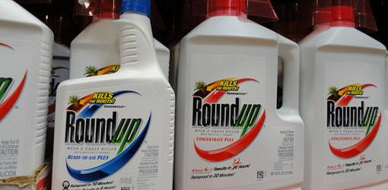
Is Roundup the Toxic Chemical that’s Destroying Our Health?
Stephanie Seneff, CSAIL, MIT
Sunday, March 16, 2014
Physicians’ Round Table, Tampa FL

Slide 2
Download These Slides
http://people.csail.mit.edu/seneff/glyphosate/SeneffTampaGlyphosate2014.pptx (.pdf)

Slide 3
“The price of anything is the
amount of life you exchange for it.”
Henry David Thoreau

Slide 4
Outline
Autism Epidemic
Digestive Disorders and Kidney Failure
Endocrine Disruption, Cancer and Obesity
Are We Exposed?
Summary

Slide 5
The Autism Epidemic in the U.S. (US CDC Data)
One in 50 kids diagnosed on Autism Spectrum in Mar. 2013
One in 150 kids diagnosed on Autism Spectrum in 2007
One in 100 kids diagnosed on Autism Spectrum in 2009

Slide 6
One in Two in 2025?
The rate was 1 in 10,000 in 1970

Slide 7
Some Conditions Associated with Autism
Disrupted gut bacteria
Depleted serotonin supply
Deficiency in sulfur metabolites
Is there a toxic substance that is currently on the rise in our environment that could account for these comorbidities?

Slide 8
GLYPHOSATE

Slide 9
Glyphosate and Autism*
R = 0.9898; p <= 2.6e-06
Pearson Correlation Coefficient = 0.99
*Nancy Swanson, http://www.examiner.com/article/
data-show-correlations-between-increase-neurological-diseases-and-gmos
Notes:
Nancy Swanson – I have a fanclub account for her.
Individuals with disabilities in education act IDEA

Slide 10
Glyphosate and Autism*
U.S. Market is 25% of World Market of Roundup
R = 0.9898; p <= 2.6e-06
Pearson Correlation Coefficient = 0.99
*Nancy Swanson, http://www.examiner.com/article/
data-show-correlations-between-increase-neurological-diseases-and-gmos
Notes:
Nancy Swanson – I have a fanclub account for her.
Individuals with disabilities in education act IDEA

Slide 11
Glyphosate vs. Other Pesticides*
Glyphosate
*http://sustainablepulse.com/wp-content/uploads/GMO-health.pdf

Slide 12
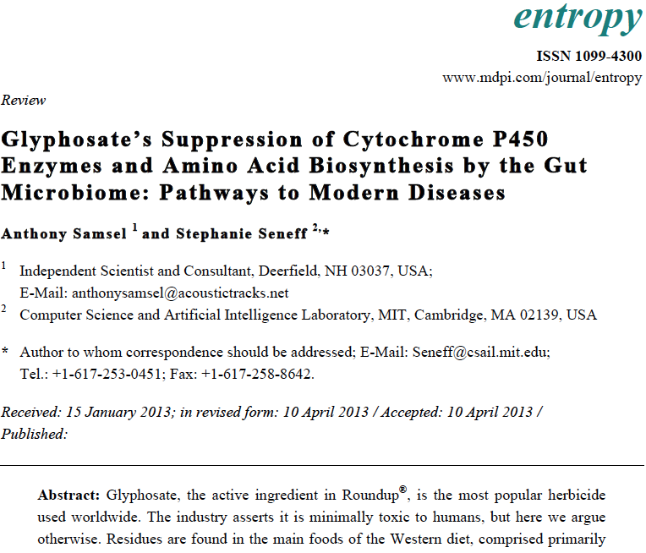
Recent Publication

Slide 13
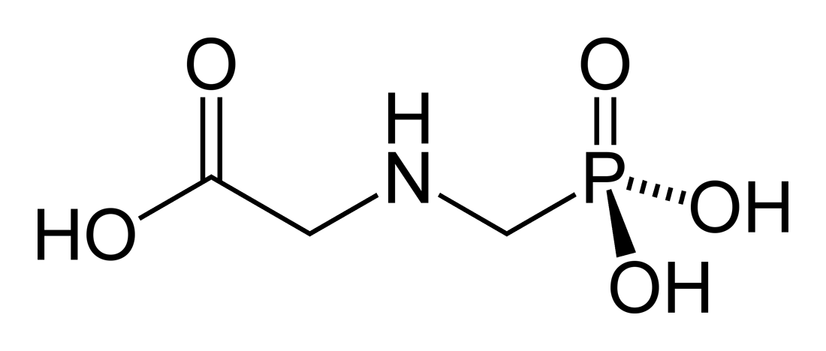
Brief History
Glyphosate is now the #1 herbicide in use in the U.S. and is increasingly used around the world
Developed and patented by Monsanto in the 1970’s
Came out from under patent in 2000
Inhibits an enzyme in the shikimate pathway involved in synthesis of tyrosine, tryptophan and phenylalanine (the three aromatic amino acids)
Huge expansion of GMO corn, soy, cotton, sugar beet and canola crops has led to sharp increases in glyphosate usage in the last decade
New practice of desiccation with Roundup on wheat, sugar cane and other crops contributes as well
Notes:
WIKI

Slide 14
Is Glyphosate Nontoxic?
Monsanto has argued that glyphosate is harmless to humans because we don’t have the shikimate pathway
However, our gut bacteria DO have this pathway
We depend upon them to supply us with essential amino acids (among many other things)
Other ingredients in Roundup greatly increase glyphosate’s toxic effects
Insidious effects of glyphosate accumulate over time
Most studies are too short to detect damage

Slide 15
Glyphosate: Some Biological Effects*
Depletes aromatic amino acids and methionine
Disrupts gut bacteria
Studies with chickens, cows and pigs show overgrowth of pathogens in gut
Disrupts cytochrome P450 (CYP) enzymes which are involved in many biological functions
Depletes important minerals
Calcium, manganese, zinc, cobalt, iron, ….
Likely impairs sulfate synthesis and sulfate transport
* A. Samsel and S. Seneff, Entropy 2013, 15, 1416-1463
Notes:
hydroxylation of vitamin D₃ (cholecalciferol) into 25-hydroxycholecalciferol.

Slide 16
Glyphosate: Some Biological Effects*
Depletes aromatic amino acids and methionine
Disrupts gut bacteria
Studies with chickens, cows and pigs show overgrowth of pathogens in gut
Disrupts cytochrome P450 (CYP) enzymes which are involved in many biological functions
Depletes important minerals
Calcium, manganese, zinc, cobalt, iron, ….
Likely impairs sulfate synthesis and sulfate transport
* A. Samsel and S. Seneff, Entropy 2013, 15, 1416-1463
Notes:
hydroxylation of vitamin D₃ (cholecalciferol) into 25-hydroxycholecalciferol.

Slide 17
Glyphosate: Some Biological Effects (cont’d)
Depletes aromatic amino acids and methionine
Tryptophan → serotonin → melatonin
Serotonin deficiency is linked to obesity, autism, Alzheimer’s disease, depression, and violent behavior
Melatonin controls sleep/wake cycle
Tyrosine → dopamine, adrenaline, melanin, thyroid hormone
Dopamine deficiency leads to Parkinson’s disease
Melanin in skin protects from UV exposure
Methionine is an essential sulfur-containing amino acid
Disrupts cytochrome P450 (CYP) enzymes which are involved in:
Activation of vitamin D, catabolism of retinoic acid
Bile acid production
Detoxifying environmental toxins
Stabilizing blood (hemorrhaging vs blood clots)
Notes:
hydroxylation of vitamin D₃ (cholecalciferol) into 25-hydroxycholecalciferol.

Slide 18
Some Biomarkers for Autism
Disrupted gut bacteria; inflammatory bowel
Low serum sulfate
Methionine deficiency
Serotonin and melatonin deficiency
Defective aromatase (CYP enzyme)
Zinc and iron deficiency
Vitamin D deficiency
Impaired immune function
Chronic low-grade inflammation in the brain
Notes:
Samantha/zinc_deficiency_autism.text

Slide 19
Some Biomarkers for Autism
Disrupted gut bacteria; inflammatory bowel
Low serum sulfate
Methionine deficiency
Serotonin and melatonin deficiency
Defective aromatase (CYP enzyme)
Zinc and iron deficiency
Vitamin D deficiency
Impaired immune function
Chronic low-grade inflammation in the brain
These can all be explained as potential effects of glyphosate on biological systems
Notes:
Samantha/zinc_deficiency_autism.text

Slide 20
Aromatase
“Aromatase protein is significantly reduced in the frontal cortex of autistic subjects relative to sex- and age-matched controls”*
Aromatase is a CYP enzyme that converts testosterone to estrogen
Its association with autism explains the fact that boys are four to five times as susceptible as girls to autism.
*T. Sarachana et al., PLoSONE, Feb. 2011, 6(2):e17116
Notes:
Samantha/aromatase_autism_PlosONE.pdf

Slide 21
Probiotics Treat Mouse Autism*
P-Cresol is produced by Clostridium difficile, a pathogen that is resistant to glyphosate
P-cresol
*Graphical Abstract from E.Y. Hsiao et al., Cell, Dec. 5, 2013
Notes:
./mouse_autism_probiotics.text
http://www.scientificamerican.com/article.cfm?id=bacterium-reverses-autism-like-behavior-in-mice&utm_source=feedburner&utm_medium=feed&utm_campaign=Feed%3A+ScientificAmerican-News+%28Content%3A+News%29

Slide 22
Glyphosate suppresses tryptophan synthesis by plants and gut bacteria
Glyphosate suppresses aromatase which converts testosterone to estrogen
Glyphosate suppresses vitamin D activation in the liver
Autism is associated with low activated vitamin D and low brain serotonin
Vitamin D activates serotonin receptors in the brain
Estrogen rescues females by boosting serotonin levels in brain
Recommendation is supplements in both vitamin D and tryptophan
Notes:
Samantha/vitamin_D_regulates_serotonin_synthesis_2014.pdf

Slide 23
Dementia and Glyphosate*
*Nancy Swanson, http://www.examiner.com/article/
data-show-correlations-between-increase-neurological-diseases-and-gmos

Slide 24
Recapitulation
Autism rates have been increasing at an alarming rate in recent years, in step with increases in glyphosate application to GMO crops
Autism is associated with disrupted gut bacteria, serotonin and vitamin D deficiency, methionine deficiency, excess p-cresol, etc.
Most of the biomarkers associated with autism can be explained by known biological effects of glyphosate
These effects can also explain many other modern diseases and conditions, including dementia

Slide 25
Outline
Autism Epidemic
Digestive Disorders and Kidney Failure
Endocrine Disruption, Cancer and Obesity
Are We Exposed?
Summary

Slide 26
Dr. Roy Dittman*
“If the microbial world is the substrate for life, why are we waging war on it?”
“The same chemicals we use to sterilize our environment sterilize us.”
*Talk at AutismOne Conference, May 25, 2013 Chicago, Illinois

Slide 27
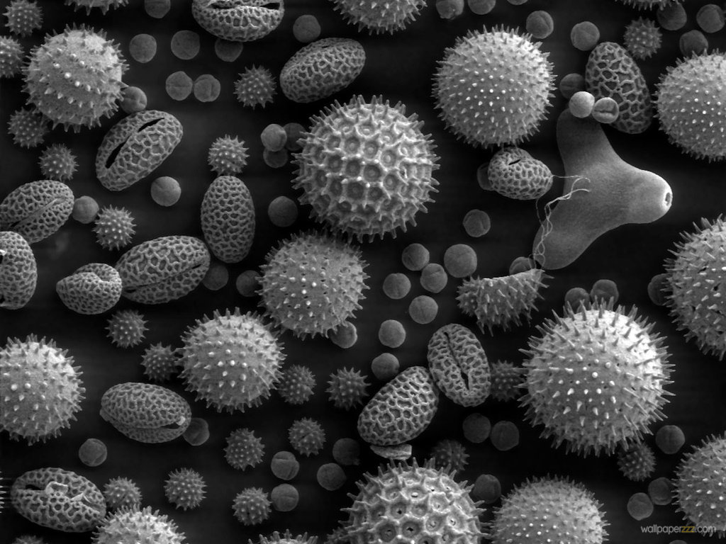
Gut Microbes and Obesity
Our microbes outnumber our own cells 10 to 1
There are between 200 and 300 different species in a typical person.
Glyphosate causes a loss of beneficial bacteria and an overgrowth of pathogens in the gut
Pathogens release toxic phenols (e.g., p-cresol)
This can lead to inflammatory bowel disease
And a direct path to obesity!
Gut microbes from an obese person induced obesity in mice*
*N. Fei and L. Zhao, The ISME Journal, Online Publication Dec. 2012
Notes:
*See: http://www.usaprepares.com/health/scientists-link-obesity-to-gut-bacteria

Slide 28
Pigs Fed GMOs Develop Inflamed Gut*
Pigs have a similar digestive system to humans
Digestive problems observed anecdotally in GMO-fed pigs
inflammation in stomach and intestine, stomach ulcers, thinning of intestinal walls, increase in haemorrhagic bowel disease
Follow-on Experiment:
168 just-weaned pigs fed "typical diet,” soy and corn, until slaughtered
Half fed GMO versions, half organic.
*J.A. Carman et al., Journal of Organic Systems, 8(1), 2013.
Notes:
Swine/pigs_fed_GMOs_inflamed_gut.pdf
Also pigs_GMOs_summary.pdf
./Pigs_Study_NaturalNews.pdf
http://www.beyondpesticides.org/dailynewsblog/?p=10823

Slide 29
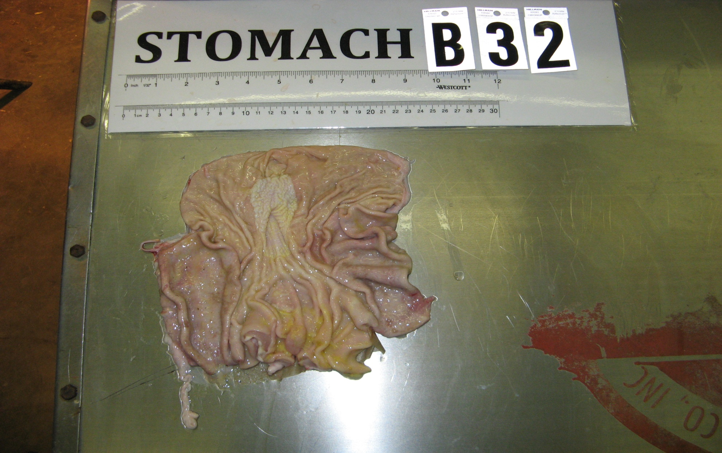
Pigs Fed GMOs Develop Inflamed Gut*
Blind autopsies conducted
Female pigs' uterus 25% larger in GMO-fed pigs
Female pigs 2.2x more likely to get severe stomach inflammation on GMO diet
Males were 4x more likely
Non-GMO Feed
GMO Feed
Photos kindly provided by Howard Vlieger
GMO Feed
*J.A. Carman et al., Journal of Organic Systems, 8(1), 2013.
Notes:
Swine/pigs_fed_GMOs_inflamed_gut.pdf
Also pigs_GMOs_summary.pdf
./Pigs_Study_NaturalNews.pdf

Slide 30
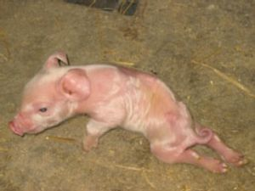
“Deformities, sickness and livestock deaths: the real cost of GM animal feed?”*
"When using GM feed I saw symptoms of bloat, stomach ulcers, high rates of diarrhoea, pigs born with the deformities ... but when I switched [to non GM feed] these problems went away, some within a matter of days.”
Quote from Ib Pedersen, producer of 13,000 pigs a year supplying Europe's largest pork company, Danish Crown
*Andrew Wasley, Nov. 28, 2013, The Ecologist., theecologist.org/News/news_analysis/2176082/
deformities_sickness_and_livestock_deaths_the_real_cost_of_gm_animal_feed.html
Notes:
2014/sickpigs.pdf
2014/naturalNews_on_GMO_feed_to_pigs_in_Europe.pdf

Slide 31
America’s Two-Headed Pig*
Treating Nutritional Deficiencies and Disease in a Genetically Modified, Antibiotic Resistant and Pesticide Dependent World
*book by Leah Dunham, www.americastwoheadedpig.com, 2013
Notes:
./

Slide 32
Human Digestive System Disorders
We are seeing an alarming increase in the US in many diseases related to the gut
Crohn’s disease, inflammatory bowel disease, colitis, acid reflux disease, gluten and casein intolerance, celiac disease, leaky gut
The gut-brain axis links neurological disorders with gut disorders
I believe that glyphosate is a major cause
Notes:
Celiac disease has quadrupled in the US in last 50 years

Slide 34
Celiac Disease has Quadrupled in the US in the Last 50 Years
Notes:
Today’s serum is more than four times as likely to carry those
Antibodies (to gluten)

Slide 35
wheat
Graph provided by Nancy Swanson, with permission

Slide 36
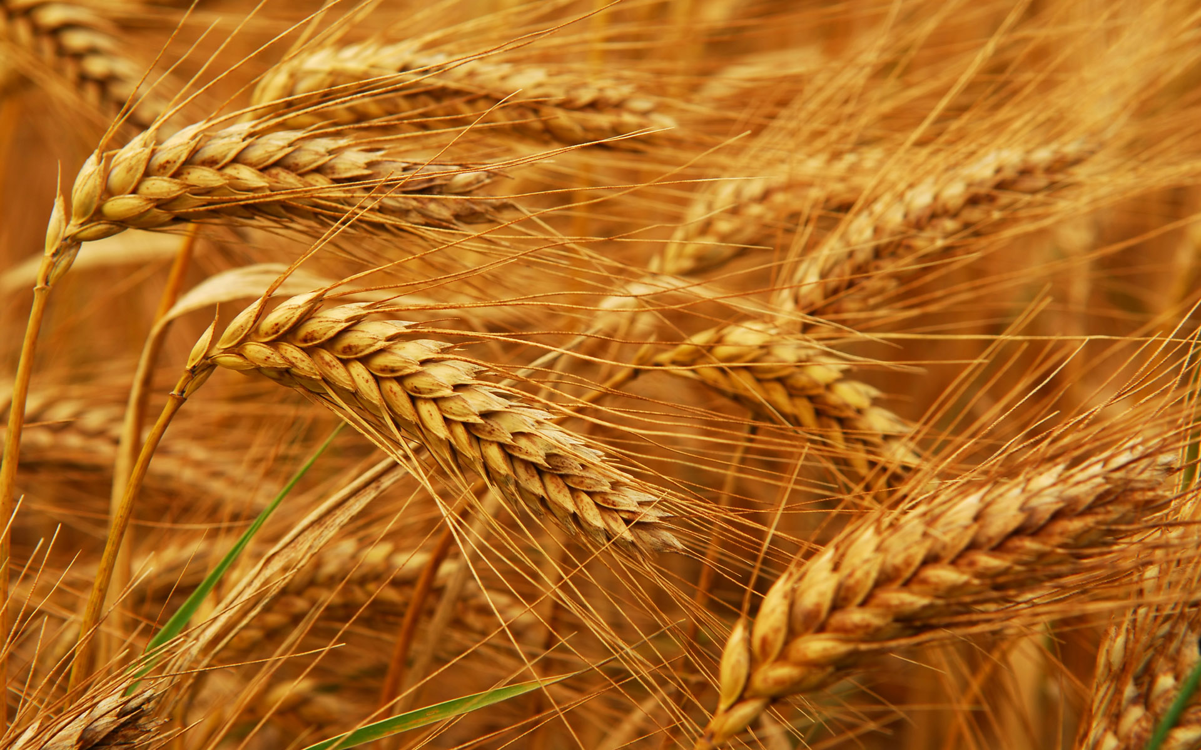
Human Dietary Experiment on Wheat & Inflammatory Bowel Syndrome*
Significant improvement in symptoms with dietary organic wheat from ancient source
Abdominal pain (P< 0.0001)
Bloating (P=0.004)
Stool consistency (P<0.001)
Tiredness (P< 0.0001)
Reduced pro-inflammatory cytokines: IL-6, IL-17, interferon-gamma, VEGF
*F. Sofi et al., Br J Nutr. 2014 Feb 13:1-8. [Epub ahead of print]
Notes:
Csail/2014/Anthony/ancient_wheat_not_allergenic.text

Slide 37
Paper on Glyphosate and Celiac Disease

Slide 38
Celiac Disease, Glyphosate and Non-Hodgkin’s Lymphoma
Bifidobacteria are depleted in celiac disease*
They convert gluten to less toxic form
Glyphosate preferentially kills bifidobacteria**
Celiac disease is associated with increased risk to non-Hodgkin’s lymphoma***
Glyphosate itself is also linked directly to non-Hodgkin’s lymphoma****
*M. Velasquez-Manoff, NY Times Sunday Review, Feb. 23, 2013
**A.A. Shehata et al., Curr Microbiol. 2013 Apr;66(4):350-8.
.*** C. Catassi et all, JAMA. 2002 Mar 20;287(11):1413-9.
****M. Eriksson et al., Int J Cancer. 2008 Oct 1;123(7):1657-63.
Notes:
**./ bifidobacteria_celiac_disease.text
Cancer/Celiac_disease_increases_hodgkins_lymphoma.text
3-4 fold increased risk to non-Hodgkins lymphoma
./Celiac_and_bacteria.text

Slide 39
“Herbicide Resistant Ryegrass Troubling for Wheat Growers”*
“If you see ryegrass at harvest following an Axial XL application, it may be resistant. And you can scatter seed all over the field with the combine.”
“A reduced-tillage approach, using a burndown herbicide ahead of planting in a stale seedbed, also holds promise for improved control.”
“ ‘We may be able to knock out 80% to 90% of the resistant ryegrass with glyphosate.’ ”
-- Jim Swart, integrated pest management specialist
*Ron Smith, Western Farm Press, Mar. 23, 2013
Notes:
Glyphosate/pesticides_for_wheat_slides.pdf
glyphosate/Axial_XL.text

Slide 40
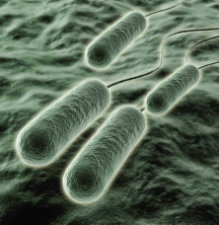
Pseudomonas and Glyphosate*
Pseudomonas aeruginosa, a gram negative bacterium, is a major problem today in hospitals due to its resistance to multiple antibiotics
P. aeruginosa is one of only three bacterial species that can break down glyphosate.
It produces formaldehyde as a by-product
Formaldehyde is a well established neurotoxin
*S. de Betnzmann and P. Plésiat Environ Microbiol. 2011 Jul;13(7):1655-65.

Slide 41
“Dramatic Increase in Hospitalization of US Children With Inflammatory Bowel Disease”*
Study conducted at Case Western Reserve University School of Medicine
> 11 Million hospitalization records examined
Patients < 20 years old
49% increase from 2000 to 2009 in Crohn’s disease discharges
71% increase in ulcerative colitis discharges
* Science Daily, June 25, 2013
Notes:
./inflammatory_bowel_disease_children.text

Slide 42
Kidney Failure in Agricultural Workers*
Workers in sugarcane fields in Central America and in India are dying at a young age in record numbers from kidney failure
Arsenic exposure from drinking water?
Excess use of tylenol?
Glyphosate disrupts the enzyme that breaks down tylenol, leading to tylenol toxicity
*ticotimes.net, San Jose, Costa Rica, August 8, 2013.
Notes:
http://www.ticotimes.net/More-news/News-Briefs/What-is-killing-the-young-men-of-Canas-_Wednesday-August-07-2013
./diabetes_farmers_costa_rica.pdf

Slide 43
“What is killing the young men of Cañas?”*
Crop Dusting Plane
*ticotimes.net, San Jose, Costa Rica, August 8, 2013.
Notes:
http://www.ticotimes.net/More-news/News-Briefs/What-is-killing-the-young-men-of-Canas-_Wednesday-August-07-2013
./diabetes_farmers_costa_rica.pdf

Slide 44
“What is killing the young men of Cañas?”
Abstract: “The effect of the aerial application of 0.86 kg a.i./ha of glyphosate in 75 l of water on the ripening of 3 sugar cane varieties was studied in Costa Rica. …”*
*J.F. Subiros, The effect of applying glyphosate as ripener in three
sugar cane varieties, Turrialba 1990, 40(4), 527-534.
Notes:
http://www.ticotimes.net/More-news/News-Briefs/What-is-killing-the-young-men-of-Canas-_Wednesday-August-07-2013
./diabetes_farmers_costa_rica.pdf
http://www.cabdirect.org/abstracts/19916778875.html;jsessionid=93B05D1723894A0DF7BC4E82BD31A06F

Slide 45
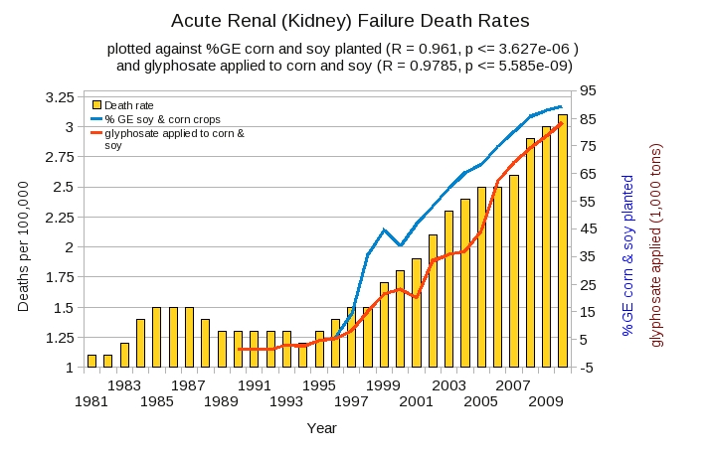
Acute Kidney Disease Death Rate Plotted Against Glyphosate and GMOs*
*Plot prepared by Nancy Swanson from available data online

Slide 46
Sri Lanka is the first Country to Ban Glyphosate
This problem did not exist in Sri Lanka prior to the 1990s.
Notes:
Project/Glyphosate/glyphosate_sri_lanka_kidney_failure_epidemiology.pdf

Slide 47
Another Country Responds to Kidney Failure in Agricultural Workers!
Notes:
Sri Lanka is the only other nation that has banned glyphosate.

Slide 48
Recapitulation
We depend on our gut bacteria in many ways
Bacteria from an obese person induce obesity in mice
Glyphosate is an antibiotic that preferentially kills the good bacteria
Pigs fed GMO corn and soy develop inflammatory gut
Humans are experiencing an epidemic in gut disorders like inflammatory bowel disease and gluten intolerance
Due to herbicide-resistant rye grass, farmers use glyphosate as a desiccant at harvest time
Kidney failure among agricultural workers can be explained by glyphosate

Slide 49
Outline
Autism Epidemic
Digestive Disorders and Kidney Failure
Endocrine Disruption, Cancer and Obesity
Are We Exposed?
Summary

Slide 50
“More and more studies have revealed carcinogenic and endocrine disrupting effects of Roundup at lower doses than those authorized for residues found in Genetically Modified Organisms.”
-- Dr. Nancy Swanson
Notes:
Spacedoc/glyphosate/Nancy_GMO_health.pdf
reports of neural defects and craniofacial malformations from regions where glyphosate-based herbicides (GBH) are used
http://sustainablepulse.com/wp-content/uploads/Argentina-GM-human-pics.jpg
http://sustainablepulse.com/2013/04/27/dr-swanson-gmos-and-roundup-increase-chronic-diseases-infertility-and-birth-defects/#.UXvHfIJAuYm

Slide 51
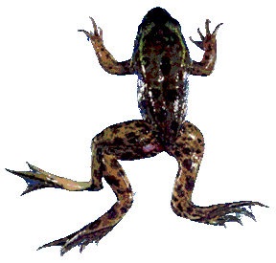
Glyphosate is an endocrine disruptor that promotes breast cancer*
Low and environmentally relevant concentrations of glyphosate possess estrogenic activity
Glyphosate caused human hormone-dependent breast cancer cells to proliferate at concentrations of parts per trillion
Additive effect from genistein, a phytoestrogen in soybeans
* S. Thongprakaisang et al., Food Chem Toxicol. 2013 Jun 8. S0278-6915(13)00363-3.
Notes:
./glyphosate_and_breast_cancer.text
Swine/glyphosate_breast_cancer.pdf
Please make a note that this study shows Glyphosate effects down to parts per trillion (10 to the minus12th).
In this study, we found that glyphosate at a log interval concentration ranging from 10-12 to 10-6 M increased the cell proliferation of a hormorne dependent breast cancer T47D ce

Slide 52
Glyphosate and Anencephaly*
Yakima, Benton and Franklin counties in Washington State have an unusually high number of pregnancies affected by the birth defect, anencephaly
75 pesticides were analyzed in studying contamination due to surrounding agriculture
47 (63%) of these were detected
Glyphosate was applied in large amounts, but was not studied
5% solution of glyphosate was also used heavily around irrigation ditches to control weeds
Main herbicide recommended due to its “low toxicity”
Glyphosate has been linked to anencephaly due to its effect on retinoic acid
*Barbara H. Peterson. Farm Wars, http://farmwars.info/?p=11137
Notes:
23 cases in three years 4x normal
Celiac/brain_damaged_babies_washington_state_glyphosate.text
In the U.S., there are approximately one or two expected cases of anencephaly for every 10,000 annual births. However, in the three named Washington counties, with a total population of approximately 515,000, the health department found that there was an abnormally high number of cases reported from January 2010 to January 2013 with approximately eight cases of anencephaly for every 10,000 births.

Slide 53
Glyphosate Upregulates Retinoic Acid*
Small Brain
CYP Enzyme Repression
*A. Carrasco, Teratogenesis by glyphosate based herbicides and other pesticides. Relationship with the retinoic acid pathway. In Breckling, B. & Verhoeven, R. (2013) GM-Crop Cultivation – Ecological Effects on a Landscape Scale. Theorie in der Ökologie 17. Frankfurt, Peter Lang.

Slide 54
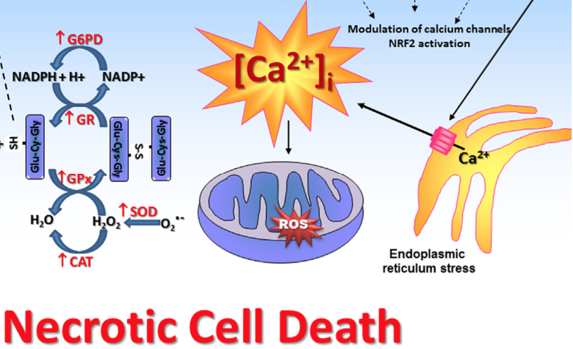
Glyphosate’s Effects on Sertoli Cells in Rat Testis*
Concentrations 10-fold more diluted than that recommended for herbicide action
Several pathologies noted:
Depletes glutathione (essential antioxidant)
Enhanced lipid and protein oxidation
Activates calcium channels; promotes calcium release from ER (stress response); induces cell death
Increases mitochondrial membrane permeability to calcium and protons
*V.L. Oliveira Cavalli et al., Free Radical Biology and Medicine 65, Dec. 2013, 335-346.

Slide 55
Fertility Rates are Dropping Worldwide*
Fertility rates are falling rapidly in countries around the world, often to below 2.0.
Cultural changes play a role
But glyphosate is likely contributing as well
Sperm depend on cholesterol sulfate for decapitation and fertilization
Cholesterol sulfate synthesis depends on cytochrome P450 (CYP) enzymes
Glyphosate disrupts CYP enzyme function
*A. Samsel and S. Seneff, Entropy 2013, 15, 1416-1463.

Slide 56
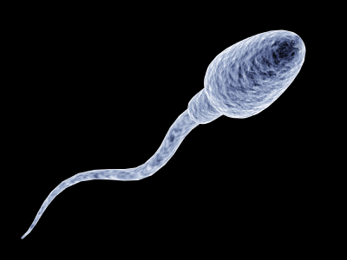
"Male fertility under threat as average sperm counts drop”*
Study of 26,600 men in France found sperm concentration had decreased by 32% since the 1990s.
Numbers steadily dropped by 2% per year from 1989 to 2005.
Proportion of normally formed sperm also declined by about 1/3.
* M. Rolland et al., Hum Reprod. 2013 Feb;28(2):462-70.
Notes:
./falling_sperm_counts.text
Falling_sperm_counts.article.text

Slide 57
Is Glyphosate Making Us Obese?

Slide 58
Obesity in US over Time*
Glyphosate was introduced into the food chain in 1975
*Figure 1 in R.J. Johnson et al., Am J Clin Nutr 2007;86:899–906.
Notes:
Sugar intake per capita in the United Kingdom from 1700 to 1978 (30, 31; E) and in the United States from 1975 to 2000 (32; 􏰏) is compared with obesity rates in the United States in non-Hispanic white men aged60–69y(17;F).Valuesfor1880-1910arebasedonstudiesconducted in male Civil War veterans aged 50–59 y (18).

Slide 59
Nancy Swanson, http://www.examiner.com/article/
data-show-correlations-between-increase-neurological-diseases-and-gmos

Slide 60
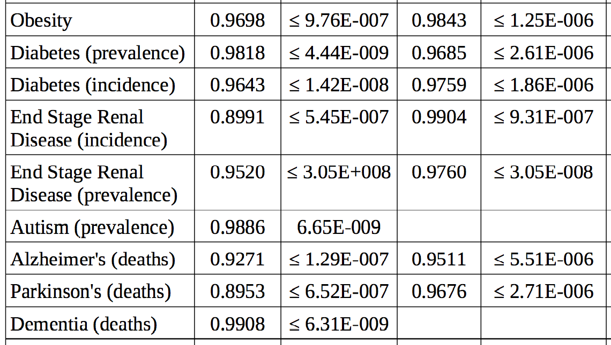
Nancy Swanson’s Data: Pearson Correlation Coefficients between Diseases and Roundup*
Glyphosate Application
Correlation P-value
0.000000976
*Nancy Swanson, personal communication

Slide 61
Recapitulation
Glyphosate is a known endocrine disruptor
Contributes to infertility and birth defects
Glyphosate causes breast tumor cells to proliferate at concentrations of parts per trillion
Glyphosate upregulates retinoic acid which causes microcephaly and anencephaly
This could explain recent high incidence of anencephaly in Yakima, WA
Many diseases and conditions on the rise today are strongly associated with glyphosate application on corn and soy

Slide 62
Outline
Autism Epidemic
Digestive Disorders and Kidney Failure
Endocrine Disruption, Cancer and Obesity
Are We Exposed?
Summary

Slide 63
Is Glyphosate in Our Food?
Wheat desiccated with Roundup
High fructose GMO corn syrup
GMO soy protein filler
GMO Canola Oil
Cows fed GMO corn and soy
Potatoes desiccated with herbicides

Slide 64
Testing for Glyphosate Residues in US Foods*
195 page document
Only one food item was tested for glyphosate: soy
271/300 samples tested contained glyphosate residues (90.3%)
287/300 contained AMPA (a breakdown product of glyphosate) (95.7%)
*USDA Pesticide Data Program: Annual Summary, 2011
Notes:
aminomethylphosphonic acid

Slide 65
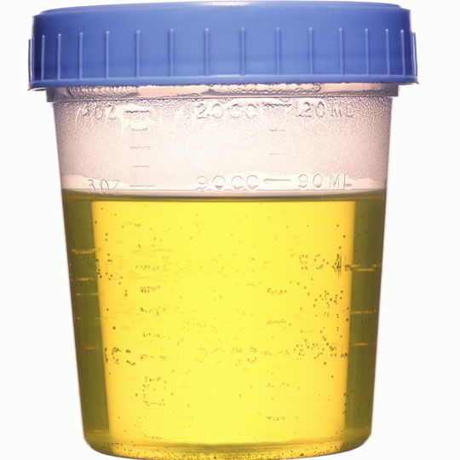
“Determination of Glyphosate residues in human urine samples from 18 European countries”*
182 urine samples from 18 European countries analyzed for glyphosate
city-dwellers who had never handled roundup or any herbicides.
44% of the samples contained quantifiable amounts of glyphosate
7% of the participants exceed 0.8 micrograms/Liter, the reference cutoff for "safety”
Diet seems to be the main source of exposure
These numbers would be much worse if they were measured in the U.S.
*https://www.foeeurope.org/sites/default/files/glyphosate_studyresults_june12.pdf
Notes:
Europe Urine
./WeedKillerHumanUrine.pdf
Swine/glyphosate_in_urine_Europe.pdf

Slide 66
“Determination of Glyphosate residues in human urine samples from 18 European countries”*
"Our testing highlights a serious lack of action by public authorities across Europe and indicates that this weed killer is being widely overused. Governments need to step-up their monitoring and bring in urgent measures to reduce its use. This includes rejecting any genetically modified crops that would increase the use of glyphosate."
182 urine samples from 18 European countries analyzed for glyphosate
city-dwellers who had never handled roundup or any herbicides.
44% of the samples contained quantifiable amounts of glyphosate
7% of the participants exceed 0.8 micrograms/Liter, the reference cutoff for "safety”
Diet seems to be the main source of exposure
These numbers would be much worse if they were measured in the U.S.
*https://www.foeeurope.org/sites/default/files/glyphosate_studyresults_june12.pdf
Notes:
Europe Urine
./WeedKillerHumanUrine.pdf
Swine/glyphosate_in_urine_Europe.pdf

Slide 67
Glyphosate in Air and Rain*
Study conducted by the US Geological Survey in Mississippi
18-fold increase in glyphosate application since 1995
Glyphosate was the predominant new herbicide detected in both air (86%) and rain (77%) in 2007 (not measured in 1995)
*M.S Majewski et al., Environ Toxicol Chem. 2014 Feb 19. Epub ahead of print.
Notes:
Glyphosate/glyphosate_and_other_pesticides_residues_rain_air_US_South.pdf

Slide 68
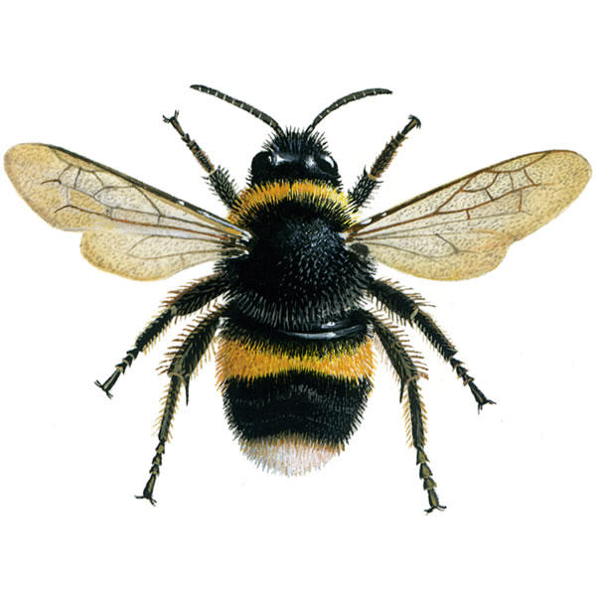
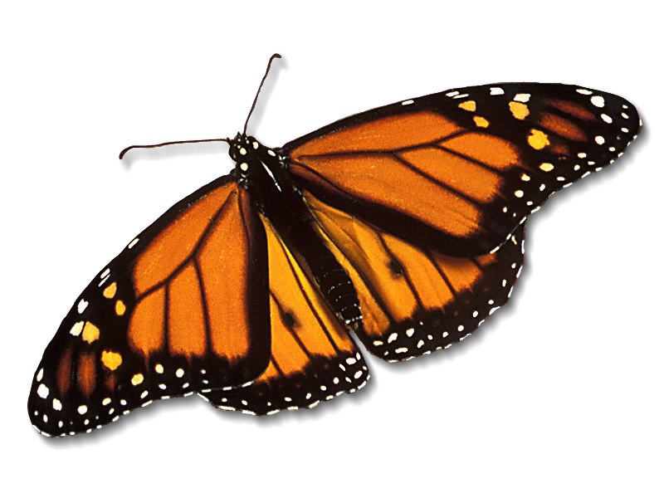
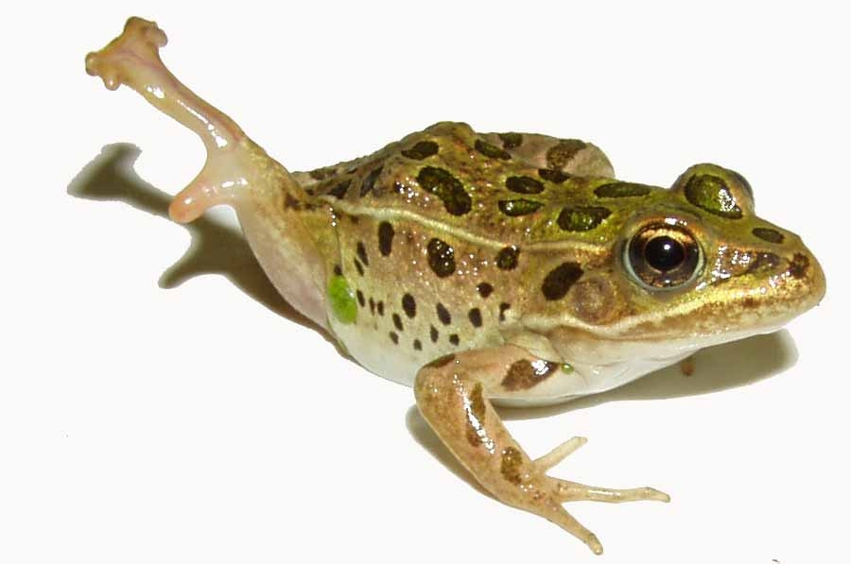
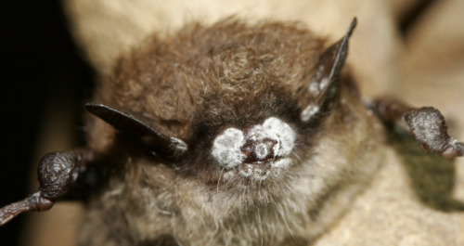
Species in Stress
Fungus Infection
Fungus Infection
Fungus Infection
Fungus Infection
*R. Mason et al., Journal of Environmental Immunology and Toxicology 1:1, 3-12; 2013
Notes:
Frogs -- drop 3.7% every year, meaning they could disappear in half of the habitats they now occupy nationwide in 26 years
Monarch butterflies – milkweed being killed by glyphosate
http://salsa3.salsalabs.com/o/1881/p/dia/action3/common/public/?action_KEY=12506

Slide 69
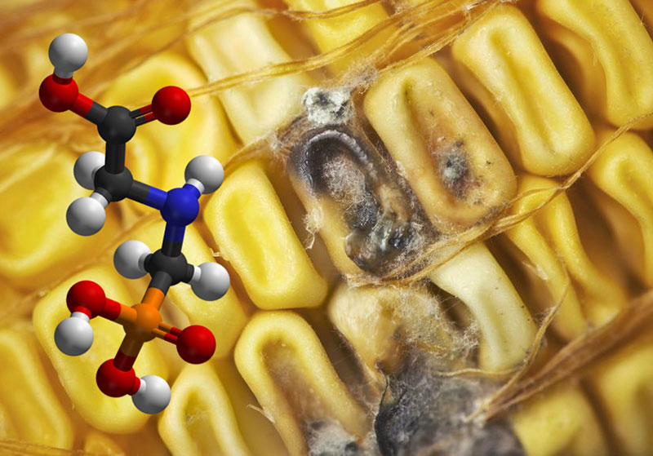
Roundup herbicide enhances the growth of aflatoxin-producing fungi*
*Barberis et al., Journal of Environmental Science and Health, Part B: Pesticides, Food Contaminants, and Agricultural Wastes. 2013, 48(12), 1070-1079.
Notes:
Aflatoxins (AFs) are extensively known to be potent mutagenic,
carcinogenic, teratogenic, hepatotoxic, immunosuppressive, and they
also inhibit several metabolic systems.[13,14]

Slide 70
“Aflatoxins are mutagenic, carcinogenic, teratogenic, hepatotoxic, immunosuppressive, and they also inhibit several metabolic systems”*
*Barberis et al., Journal of Environmental Science and Health, Part B: Pesticides, Food Contaminants, and Agricultural Wastes. 2013, 48(12), 1070-1079.
Notes:
glyphosate/glyphosate_promotes_fungus_growth_2014.pdf
Aflatoxins (AFs) are extensively known to be potent mutagenic,
carcinogenic, teratogenic, hepatotoxic, immunosuppressive, and they
also inhibit several metabolic systems.[13,14]

Slide 71
Monarch Butterfly Decline*
*Sources: U.S. Dept of Agriculture and EPA
http://www.ers.usda.gov/data-products/agricultural-baseline-database/#.UxX3_l5kJkU
http://www.epa.gov/opp00001/pestsales
Notes:
Dr. Mercola!
http://articles.mercola.com/sites/articles/archive/2014/03/04/monarch-butterfly.aspx

Slide 72
Monarch Butterfly Decline*
Glyphosate applied to kill milkweed which monarchs eat
*Sources: U.S. Dept of Agriculture and EPA
http://www.ers.usda.gov/data-products/agricultural-baseline-database/#.UxX3_l5kJkU
http://www.epa.gov/opp00001/pestsales
Notes:
Dr. Mercola!
http://articles.mercola.com/sites/articles/archive/2014/03/04/monarch-butterfly.aspx

Slide 73
Prof. Don Huber on Glyphosate*
“When future historians write about our time, they're not going to write about the tons of chemicals that we did or didn't apply. When it comes to glyphosate, they're going to write about our willingness to sacrifice our children and jeopardize our existence, while threatening and jeopardizing the very basis of our existence; the sustainability of our agriculture.”
*Retired professor from Purdue University; Expert in plant pathology
articles.mercola.com/sites/articles/archive/2012/01/15/dr-don-huber-interview-part-2.aspx
Notes:
Dr. Mercola interview:http://articles.mercola.com/sites/articles/archive/2012/01/15/dr-don-huber-interview-part-2.aspx

Slide 74
Go Organic!

Slide 75
Summary
We should be very worried about glyphosate in the food and water supplies
Glyphosate’s disruption of gut bacteria, depletion of essential amino acids and minerals, and interference with cytochrome P450 enzymes have widespread consequences
Glyphosate can explain health problems worldwide, including autism, diabetes, infertility, kidney failure, gluten intolerance, cancer, etc.
Glyphosate needs to be removed from the market and we need to find the path to sustainable pesticide-free agriculture
Notes:
Mention paper has a lot more

