Slide 1
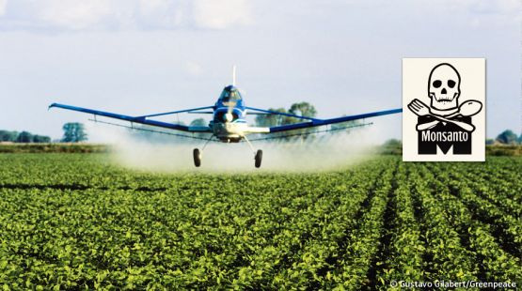
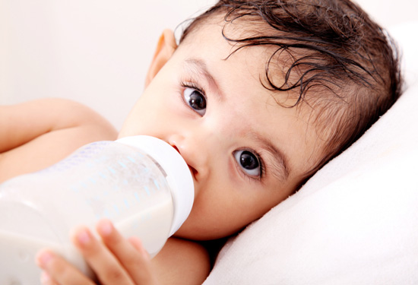
Why Soy is Unhealthy: It’s NOT What You Think!
Stephanie Seneff
MIT CSAIL
UNITE FOR SIGHT
Mar 29, 2015

Slide 2
Outline
Some Problems with Soy
Glyphosate, Aluminum and Arsenic in Soy
Health Consequences
Cultivating Genetically Modified Soy is Dangerous
Summary

Slide 3
Some Problems with Soy

Slide 4
Some Problems with Soy*
About 25% of American babies are fed soy infant formula
Phytic acid in soy blocks the absorption of critical minerals like calcium, magnesium, iron and zinc
Babies fed soy-based formula had 13,000 to 22,000 times more isoflavones (estrogenic substances) in their blood than babies fed milk-based formula
Estrogenic effect leads to early onset of menarche (42% increased rate of menarche before 12.5 years old)
This is linked to infertility and breast cancer in later years
*http://www.thehealthyhomeeconomist.com/
why-soy-formula-even-organic-is-so-dangerous-for-babies

Slide 5
Soy is High in Oxalates
“A buildup of oxalates in the body interferes with many metabolic processes and contributes to problems such as autism, ADD, COPD, asthma, cystic fibrosis, vulvodynia, autoimmune diseases such as fibromyalgia and hypothyroidism, low energy, chronic pain, and delayed healing of injuries.”*
*http://joanneunleashed.com/1789/all-about-oxalates-with-susan-costen-owens/
Notes:
Susan Owen
http://joanneunleashed.com/1789/all-about-oxalates-with-susan-costen-owens/

Slide 6
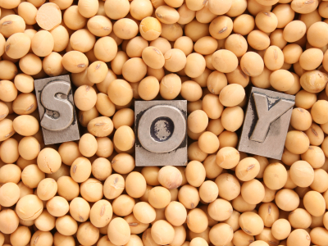
GM

Slide 7
Growth of GM Corn, Soy and Cotton in US, 1996-2012*
Soy
*N. Swanson et al., Journal of Organic Systems, 9(2), 2014, 6-37.

Slide 8
Growth of GM Corn, Soy and Cotton in US, 1996-2012*
Soy
GM Soy is engineered to be “Roundup-Ready”:
Bacterial gene inserted which gives the plants resistance to glyphosate, the active ingredient in the pervasive herbicide Roundup
*N. Swanson et al., Journal of Organic Systems, 9(2), 2014, 6-37.

Slide 9
Glyphosate, Aluminum
and Arsenic in Soy

Slide 10
“Another claim of Monsanto's has been that residue levels of up to 5.6 mg/kg in GM-soy represent "...extreme levels, and far higher than those typically found" (Monsanto 1999).
Study of glyphosate and AMPA (breakdown product) residues in soy crops*
5.6
*Figure 1, T. Bohn et al. Food Chemistry 153, 15 June 2014, 207-215.
*Bøhn et al., Food Chemistry 153(15), 2014, 207-215
Notes:
http://www.greenmedinfo.com/blog/how-extreme-levels-roundup-food-became-industry-normal

Slide 11
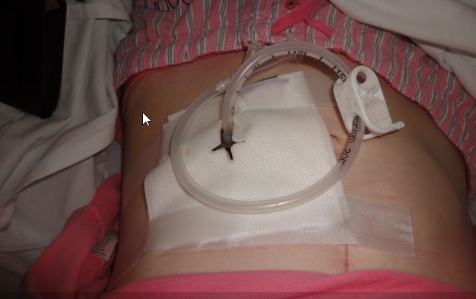
Moms Across America Experiment*
Glyphosate was detected in feeding tube liquid given to babies and children with cancer in hospitals
30% of Pediasure samples from the same batch tested positive at levels > 75ppb
*http://www.momsacrossamerica.com/glyphosate_found_in_feeding_tube_liquid

Slide 12
Aluminum in Soy
Aluminum content of soy infant formulas ranges from 600 to 1300 ng/mL, compared to 4-65 ng/mL in human milk*
Derived from mineral salts used in soy production
Can cause reduced skeletal mineralization in vulnerable preterm infants**
Might glyphosate enhance bioavailability of aluminum in brain leading to neurotoxicity?***
*J Bhatia and F Greer, Pediatrics 2008, 121, 1062-8.
**Bhatia_2008_soy_formula_infant_feeding_review.pdf
***S. Seneff et al., Agricultural Sciences, 2015, 6, 42-70
Notes:
Bhatia, J., and Greer, F. (2008). Use of soy protein-based formulas in infant feeding. Pediatrics 121, 1062-8.
Csail/2015/Yale/NTP_brief_on_soy_infant_formula.pdf
Csail/2015/Yale/Bhatia_2008_soy_formula_infant_feeding_review.pdf

Slide 13
Glyphosate and Aluminum: Partners in Crime*
Glyphosate induces pathogens like C. difficile in gut, leading to leaky gut syndrome
C. diff produces p-cresol which promotes aluminum uptake by cells
p-Cresol is a known biomarker for autism
p-Cresol is an important factor in kidney failure which leads to aluminum retention in tissues → dementia
Glyphosate promotes calcium uptake by voltage-activated channels
Aluminum gains entry as calcium mimetic
*S. Seneff et al., Agricultural Sciences, 2015, 6, 42-70

Slide 14
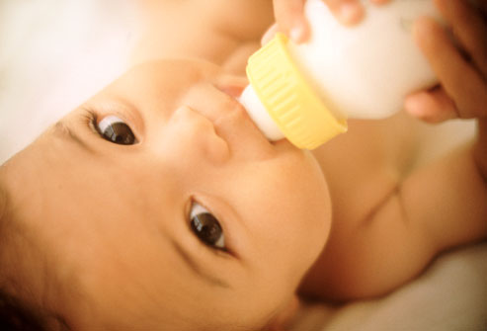
Arsenic in Soy*
Study comparing breast-fed with formula-fed infants
Formula-fed infants had 5.5-fold higher arsenic intake and 7.5-fold higher arsenic in urine
Formula powder as well as water were contributory
*CC Carignan et al., Environmental Health Perspectives, February 23, 2015
[Epub ahead of print]

Slide 15
Health Consequences

Slide 16
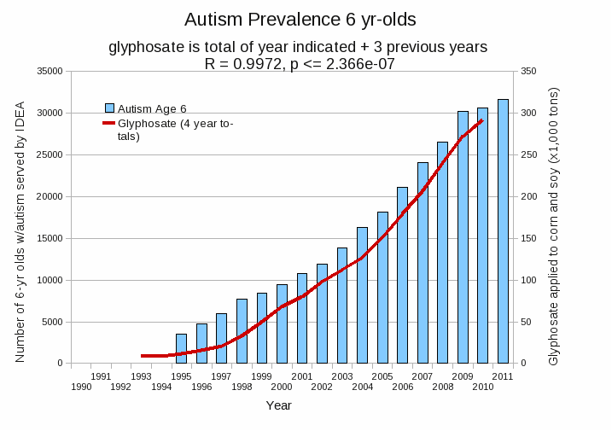
Glyphosate use on corn and soy crops
over previous four years
*Plot provided by Dr. Nancy Swanson
Data sources: autism: US Department of Education; Glyphosate: US Department of Agriculture
Notes:
Nancy/latest_plots/6-yr-old autism.gif
autism: USDE
oil consumption: USDA
glyphosate: USDA
GE crops: USDA
Mortality data: CDC

Slide 17
Percentage of children with Autism in the US*
50%
2032
*Data provided by CDC for 12-year-old children in the US

Slide 18
Percentage of children with Autism in the US*
50%
Half the children born in 2032 will be diagnosed with autism
2032
*Data provided by CDC for 12-year-old children in the US

Slide 19
Glyphosate in GM Soy: Likely Consequences
Glyphosate disrupts gut microbes, leading to inflammatory gut and leaky gut
Glyphosate chelates metals – like phytates
Glyphosate is an endocrine disruptor, like the isoflavone, genistein
Both genistein and glyphosate increase growth rate of breast cancer cells
Glyphosate at parts per trillion concentration*
Glyphosate formulations likely contain oxalate
* S. Thongprakaisang et al., Food Chem Toxicol. 2013 Jun 8. S0278-6915(13)00363-3.

Slide 20
Monsanto Patents: 2002-2010: Pesticide Compositions Containing Oxalic Acid
“[origin: WO02069718A2] Pesticidal concentrate and spray compositions are described which exhibit enhanced efficacy … More particularly, the present invention relates to a method of enhancing the herbicidal effectiveness of glyphosate concentrate and tank mix formulations containing one or more surfactants through the addition of oxalic acid.”
Monsanto Technology,
St. Louis, MO
Notes:
https://data.epo.org/gpi/EP1389912A2-PESTICIDE-COMPOSITIONS-CONTAINING-OXALIC-ACID (quote)
“[origin: WO02069718A2] Pesticidal concentrate and spray compositions are described which exhibit enhanced efficacy due to the addition thereto of a compound which increases cell membrane permeability, suppresses oxidative burst, or increases expression of hydroxyproline-rich glycoproteins. More particularly, the present invention relates to a method of enhancing the herbicidal effectiveness of glyphosate concentrate and tank mix formulations containing one or more surfactants through the addition of oxalic acid.”

Slide 21
Monsanto Patents: 2002-2010: Pesticide Compositions Containing Oxalic Acid
“[origin: WO02069718A2] Pesticidal concentrate and spray compositions are described which exhibit enhanced efficacy … More particularly, the present invention relates to a method of enhancing the herbicidal effectiveness of glyphosate concentrate and tank mix formulations containing one or more surfactants through the addition of oxalic acid.”
Oxalic acid and oxalate are the same thing!
Monsanto Technology,
St. Louis, MO
Notes:
https://data.epo.org/gpi/EP1389912A2-PESTICIDE-COMPOSITIONS-CONTAINING-OXALIC-ACID (quote)
“[origin: WO02069718A2] Pesticidal concentrate and spray compositions are described which exhibit enhanced efficacy due to the addition thereto of a compound which increases cell membrane permeability, suppresses oxidative burst, or increases expression of hydroxyproline-rich glycoproteins. More particularly, the present invention relates to a method of enhancing the herbicidal effectiveness of glyphosate concentrate and tank mix formulations containing one or more surfactants through the addition of oxalic acid.”

Slide 22
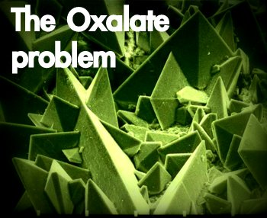
Autism Linked to Oxalate Crystals*
Crystals of oxalate form kidney stones and cause great discomfort
Study has shown at least 3-fold higher serum and urinary levels of oxalate in autistic kids**
*William Shaw, The Role of Oxalates in Autism and Chronic Disorders WAPF, March 26, 2010
**J Konstantynowicz et al., European Journal of Paediatric Neurology 16(5), 2012, 485-491.
Notes:
samantha/oxalates_in_autism.text~
samantha/william_shaw_on_oxalates_autism.text
http://www.westonaprice.org/health-topics/the-role-of-oxalates-in-autism-and-chronic-disorders/

Slide 23
Soy Formula Linked to Seizures in Autism*
"There was a 2.6-fold higher rate of febrile seizures, a 2.1-fold higher rate of epilepsy comorbidity and a 4-fold higher rate of simple partial seizures in the autistic children fed soy-based formula"
*CJ Westmark, PLOSOne March 12, 2014, DOI: 10.1371/journal.pone.0080488.
Notes:
./SoyFormulaSeizuresAutism.pdf

Slide 24
Health effects of GM Soy Imports in China*
China has now switched from growing its own soy to importing GM soy from the West
Autism rates have increased 100 times during the past 20 years
Parkinson's disease in China has increased over 20 fold during the past 20 years
Infertility rates have risen sharply:
2012: 15.6%
2002: 8%
1972: 3%
*Mi Zhen-yu, Former Vice President, Academy of Military Science
English translation by Chen I-wan
blog.sina.com.cn/s/blog_4bb17e9d0102edhg.html
Notes:
http://sustainablepulse.com/2014/05/11/must-face-harm-caused-imported-gm-soybeans-1-3-billion-chinese-people/#.U78PQqhRG1A
Csail/2014/project/Chenny/ChineseArticle_on_GMO_soy_Chenny_2014.pdf
http://blog.sina.com.cn/s/blog_502041670102em9z.html

Slide 25
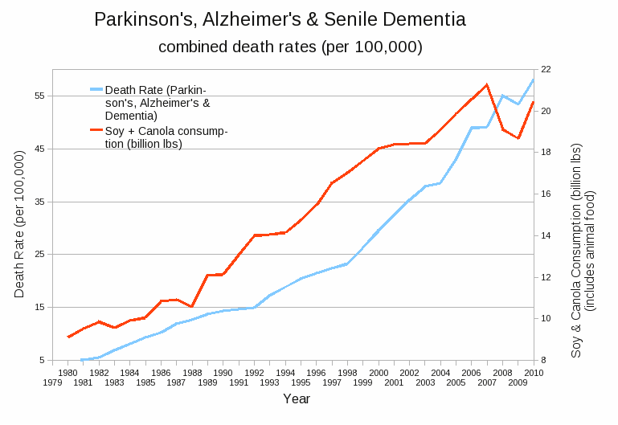
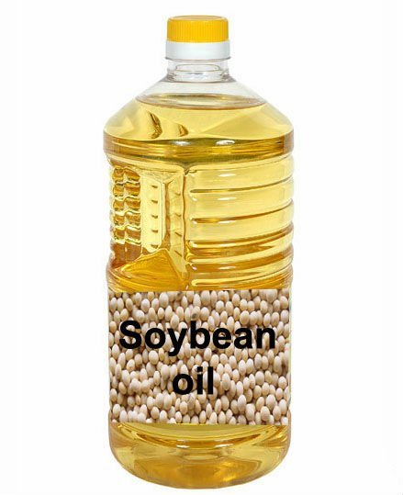
USDA Data on Soy and Canola Oil Consumption: Human + Animal*
R = 0.9769, p <= 5.494e-13
*Plots provided by Dr. Nancy Swanson, with permission
Notes:
I’m still confused!!
Nancy/latest_plots/combined_neurological_oil.gif
Stephanie,
Here are some Pearson correlation coefficients for you:
Total oil consumption & ASD, ADD, PSD etc.: R = 0.8931, p <= 1.442e-06
Glyphosate & combined neurological: R = 0.9873, p <= 3.001e-09
Salad and cooking oil & combined neurological: R = 0.9769, p <= 5.494e-13
On Thursday 29 May 2014 23:42:54 陈一文顾问 wrote:
> Sorry, did not c.c. Nancy.

Slide 26
VAERS Database Analysis Compared to Human Oil Consumption*
Children under 6 with autism, pervasive developmental delay or anxiety
– counts of events in VAERS database
: R = 0.8931, p <= 1.442e-06
VAERS = Vaccine Adverse Event Reporting System
* Plots provided by Nancy Swanson with permission
Notes:
tephanie,
Here are some Pearson correlation coefficients for you:
Total oil consumption & ASD, ADD, PSD etc.: R = 0.8931, p <= 1.442e-06
Glyphosate & combined neurological: R = 0.9873, p <= 3.001e-09
Salad and cooking oil & combined neurological: R = 0.9769, p <= 5.494e-13
On Thursday 29 May 2014 23:42:54 陈一文顾问 wrote:
> Sorry, did not c.c. Nancy.

Slide 27
VAERS Database Analysis Compared to Human Oil Consumption*
Children under 6 with autism, pervasive developmental delay or anxiety
– counts of events in VAERS database
GMO Soy
Introduced
VAERS = Vaccine Adverse Event Reporting System
* Plots provided by Nancy Swanson with permission
Notes:
tephanie,
Here are some Pearson correlation coefficients for you:
Total oil consumption & ASD, ADD, PSD etc.: R = 0.8931, p <= 1.442e-06
Glyphosate & combined neurological: R = 0.9873, p <= 3.001e-09
Salad and cooking oil & combined neurological: R = 0.9769, p <= 5.494e-13
On Thursday 29 May 2014 23:42:54 陈一文顾问 wrote:
> Sorry, did not c.c. Nancy.

Slide 28
Cultivating
Genetically Modified Soy
is Dangerous

Slide 29
Cultivating GM Soy Is Dangerous to Your Health!*
Increasing rates are observed in cancer, birth defects, miscarriages, mental disabilities, endocrine and immune disorders suffered by rural populations in Argentina near GM Soy crops
Glyphosate is the most commonly used toxic agrochemical in Argentina, comprising 64 % of total sales, and 200 million litres of glyphosate were applied during the last crop season
*http://www.i-sis.org.uk/Devastating_Impacts_of_Glyphosate_Argentina.php

Slide 30
Hectares of Land Dedicated to GM Soybean Cultivation, Chaco Argentina*
1988
1998
2008
*http://www.i-sis.org.uk/Devastating_Impacts_of_Glyphosate_Argentina.php
Notes:
Figure 1 The rise in birth defects correlates with the rise in cultivation of GM glyphosate-tolerant soybeans in Chaco, Argentina. Birth defects per 10 000 live births from 1997-2008 have risen drastically (top), as has the hectares of land dedicated to GM soybean cultivation (bottom)

Slide 31
Rate of Birth Defects in Children Born in Chaco, Argentina*
*http://www.i-sis.org.uk/Devastating_Impacts_of_Glyphosate_Argentina.php
Notes:
Figure 1 The rise in birth defects correlates with the rise in cultivation of GM glyphosate-tolerant soybeans in Chaco, Argentina. Birth defects per 10 000 live births from 1997-2008 have risen drastically (top), as has the hectares of land dedicated to GM soybean cultivation (bottom)

Slide 32
Rate of Birth Defects in Children Born in Chaco, Argentina*
Down’s syndrome, spina bifida, neural tube defects, congenital heart disease, etc.
*http://www.i-sis.org.uk/Devastating_Impacts_of_Glyphosate_Argentina.php
Notes:
Figure 1 The rise in birth defects correlates with the rise in cultivation of GM glyphosate-tolerant soybeans in Chaco, Argentina. Birth defects per 10 000 live births from 1997-2008 have risen drastically (top), as has the hectares of land dedicated to GM soybean cultivation (bottom)

Slide 33
Summary
Soy is an unhealthy food, especially GM Roundup-Ready soy used in food processing
Soy contains mineral-chelating phytates, estrogenic genistein, and oxalate
GM soy contains high concentrations of glyphosate, with many health consequences
Soy is also high in aluminum and arsenic
Over 90% of the soy cultivated today is genetically modified to resist glyphosate
Many negative health consequences
Autism, dementia, Parkinson’s disease, breast cancer, infertility, etc.
People exposed to soy crops suffer from negative health effects, including high rate of congenital defects

