Slide 1































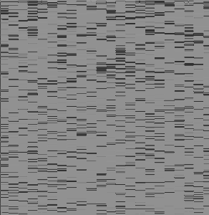
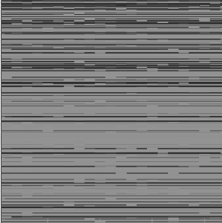
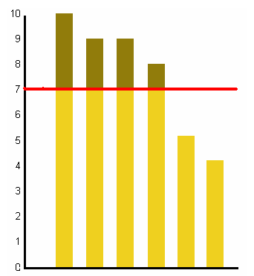
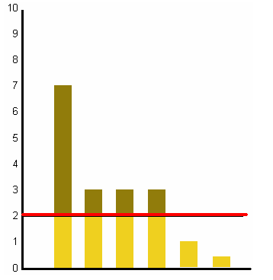
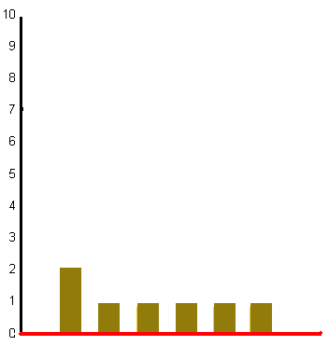
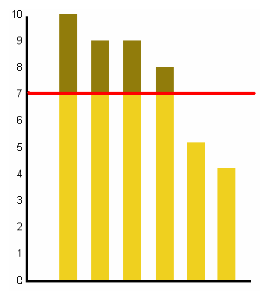





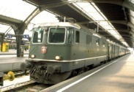

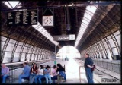





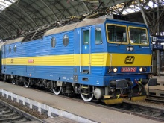
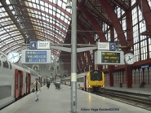




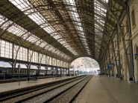
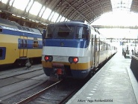
Problem:
Efficient training of jointly sparse models in high dimensional spaces.
Approach:
The l_{1,∞} norm has been proposed for jointly sparse regularization.
Contributions:
We derive an efficient projected gradient method for l_{1,∞} regularization. Our projection works on O(n log n) time, same cost as l₁ projection.
We test our algorithm in a multi-task image annotation problem and show that our algorithm can discover jointly sparse solutions and leads to better performance than l₂ and l₁ regularization.
An Efficient Projection for L_{1-∞} Regularization
Ariadna Quattoni, Xavier Carreras, Michael Collins, Trevor Darrell
MIT Computer Science and Artificial Intelligence Laboratory
Dataset: Image Annotation
president
actress
team
A convex function
We use a Projected SubGradient method.
Advantages: simple, scalable, guaranteed
convergence rates.
40 top content words
Image representation: Vocabulary Tree (Nister 2006)
These methods have been proposed for:
l₂ regularization [Shalev-Shwartz et al. 2007]
l₁ regularization [Duchi et al. 2008]
11000 dimensions
Convex constraints
Differences
are statistically
significant
Joint Regularization Penalty
Euclidean Projection into the l_{1-∞} ball
Characterization of the solution:
How do we penalize solutions that use too many features?
Coefficients for
feature 2
Coefficients for
task 2
Parameter III
Parameter VI
The l∞ norm on each row promotes non-sparsity on each row.
Share features
An l₁ norm on the maximum absolute values of the coefficients across tasks promotes sparsity.
Use few features
Dataset: Indoor Scene Recognition
Feature I
Feature II
Feature III
Feature IV
bakery
bar
Train station
Application: Multitask Learning
Mapping to a simpler problem
67 indoor scenes.
Collection of Tasks
Image representation: Similarities to a set of unlabeled images.
2000 dimensions.
Joint Sparse
Approximation
The total cost of the algorithm is dominated by a
sort of the entries of A
The total cost is in the order of:

