Slide 1
Lecture 19 Constraint based verification meets synthesis
Armando Solar-Lezama

Slide 2
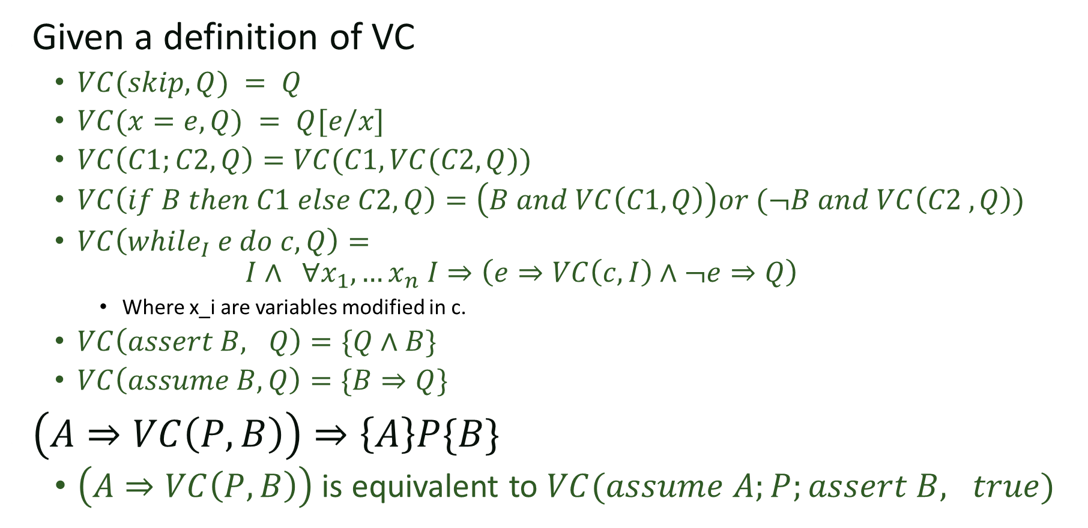
Recap
Given a definition of VC
$VC(skip, Q) = Q$
$VC(x=e,Q) = Q[e/x]$
$VC\left(C1;C2, Q\right)=VC(C1,VC(C2, Q))$
$VC\left(if B then C1 else C2, Q\right)=\left(B and VC\left(C1, Q\right)\right)or (¬B and VC\left(C2 ,Q\right))$
$VC\left(while_{I} e do c, Q\right)=$
$$I∧ ∀x_{1}, …x_{n} I⇒\left(e⇒VC\left(c,I\right)∧¬e⇒Q\right)$$
Where x_i are variables modified in c.
$VC\left(assert B, Q\right)=\{Q∧B\}$
$VC\left(assume B, Q\right)=\{B⇒Q\}$
$\left(A⇒VC\left(P, B\right)\right)⇒\left\{A\right\}P\{B\}$
$\left(A⇒VC\left(P, B\right)\right)$ is equivalent to $VC(assume A;P;assert B, true)$

Slide 3
Synthesizing invariants
Given a program with pre/post conditions, the only obstacle to making verification automatic is finding the invariants
(and checking the resulting formula if it happens to be in a complicated logic)

Slide 4
Example
{y=y_0, k=k_0, t=y_0-k_0}
while(t>0){
y = y-1;
t = t-1;
}
Assert y <= k_0;
Notes:
Work out the verification condition in text.

Slide 5


VC as a sketch harness
$$∀y,y_{0},k,k_{0},t, y^{′}, t^{′}, y^{′′}, \left(y=y_{0}∧k=k_{0}∧t=y_{0}−k_{0}\right)⇒$$
$$inv\left(y, y_{0},k,k_{0},t\right)$$
$$inv\left(y^{′}, y_{0},k,k_{0},t^{′}\right)∧\left(t^{′}>0\right)⇒inv\left(y^{′}−1, y_{0},k,k_{0},t^{′}−1\right)$$
$inv\left(y^{′′}, y_{0},k, k_{0}, t^{′′}\right)∧¬\left(t^{′′}>0\right)⇒y^{′′}≤k_{0}$,
harness void main(int y, int y_0, int k, int k_0, int t,
int yp, int tp, int ypp, int tpp ){
if(y==y_0 && k==k_0 && t==y_0-k_0){
assert inv(y, y_0, k, k_0, t);
if(inv(yp, y_0, k, k_0, tp) && tp>0){
assert inv(yp-1, y_0, k, k_0, tp-1);
}
if(inv(ypp, y_0, k, k_0, tpp) && tpp<=0){
assert ypp <= k_0;
}
} }
Notes:
/*
This sketch is designed to find an invariant for the following problem:
{y=y_0, k=k_0, t=y_0-k_0}
while(t>0){
y = y-1;
t = t-1;
}
Assert y <= k_0;
*/
include "generators.skh";
pragma options "--bnd-inline-amnt 3";
bit inv(int y, int y_0, int k, int k_0, int t){
return exprBool({y, y_0, k, k_0, t}, {PLUS});
}
harness void main(int y, int y_0, int k, int k_0, int t,
int yp, int tp, int ypp, int tpp
){
if(y==y_0 && k==k_0 && t==y_0-k_0){
assert inv(y, y_0, k, k_0, t);
if(inv(yp, y_0, k, k_0, tp) && tp>0){
assert inv(yp-1, y_0, k, k_0, tp-1);
}
if(inv(ypp, y_0, k, k_0, tpp) && tpp<=0){
assert ypp <= k_0;
}
}
}

Slide 6
VC as a sketch invariant
include "generators.skh";
pragma options "--bnd-inline-amnt 3";
bit inv(int y, int y_0, int k, int k_0, int t){
return exprBool({y, y_0, k, k_0, t}, {PLUS});
}

Slide 7
Summary
If we find a solution that works for all inputs, we know the program verifies
Sketch has no loops so bounded execution is not a problem
Sketch is only considering small inputs
To get full guarantees we need to check that the resulting invariant works for *all* inputs
We can check that with an SMT solver
Notes:
Next week we’ll have a lecture on how SMT solvers work.

Slide 8
From program verification to program synthesis
Srivastava, Gulwani, Foster

Slide 9
Key ideas
Structured program statements to reduce symmetries

Slide 10
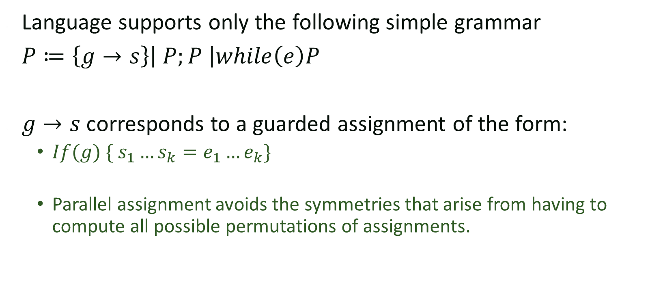
Stylized program fragments
Language supports only the following simple grammar
$P≔\left\{g→s\right\}\left| P;P \right|while\left(e\right)P$
$g→s$ corresponds to a guarded assignment of the form:
$If(g) \{ s_{1}…s_{k}=e_{1}…e_{k}\}$
Parallel assignment avoids the symmetries that arise from having to compute all possible permutations of assignments.

Slide 11
Proof-Theoretic Synthesis
Input: Program Scaffold
Flowgraph template (a nested loop structure)
Function spec (pre-/post-conditions)
Other constraints (temp variables, size limit, etc. )
Output:
Synthesized code fragments
Associated loop invariants and ranking functions
Synthesis Condition:
Generalization of verification conditions
A valid program exists iff. the SC has a satisfying solution

Slide 12
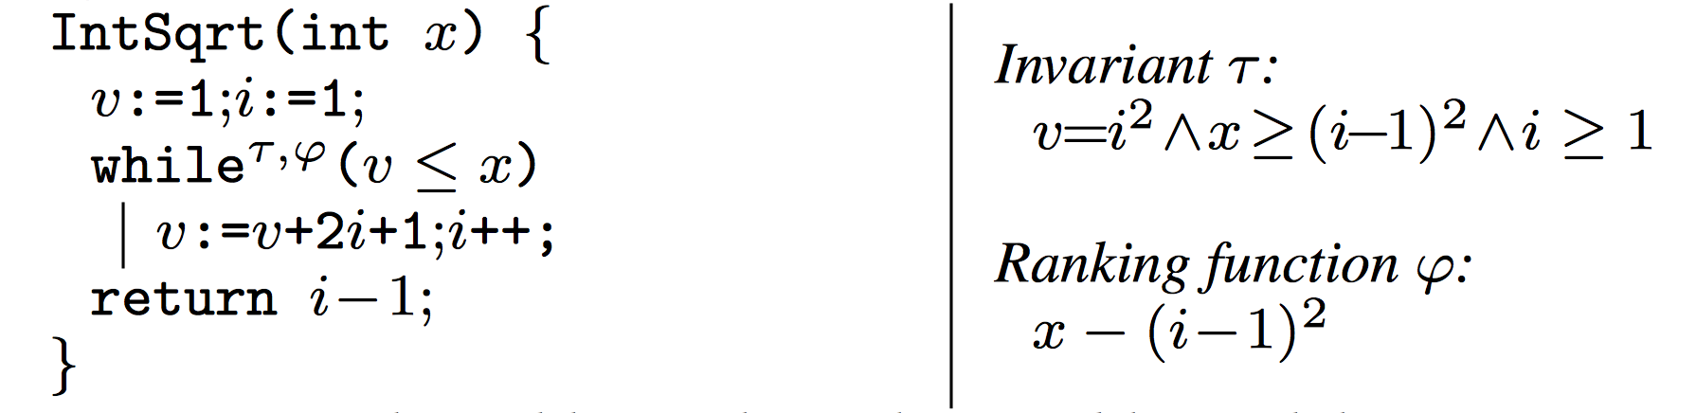
Example: Square Root

Slide 13

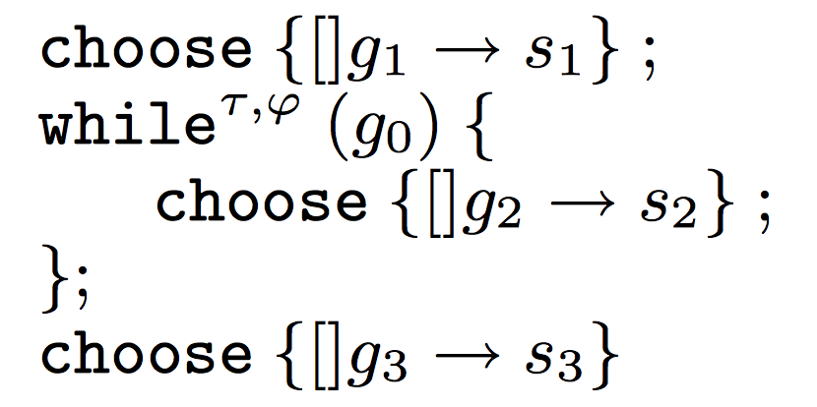

Program Scaffold
Pre:
Post:
(Assume only one branch in each fragment)

Slide 14
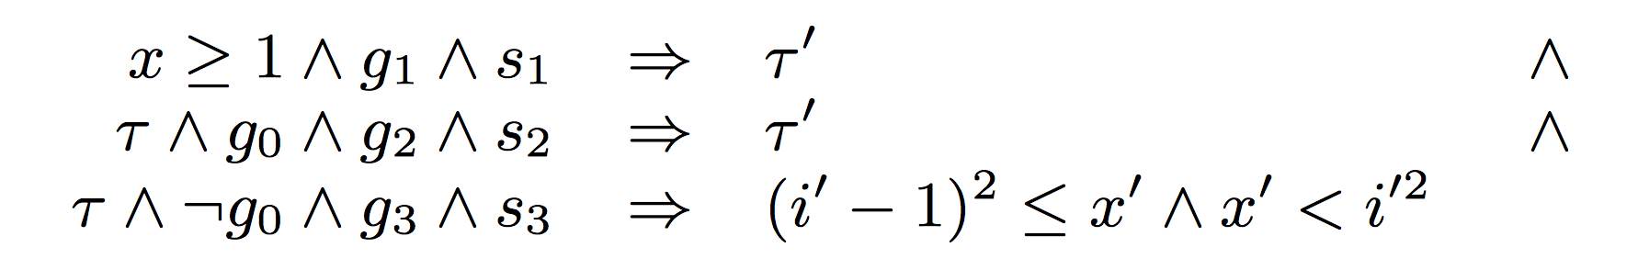
Verification Condition

Slide 15
Well-formedness Condition

Slide 16
Ranking Function

Slide 17
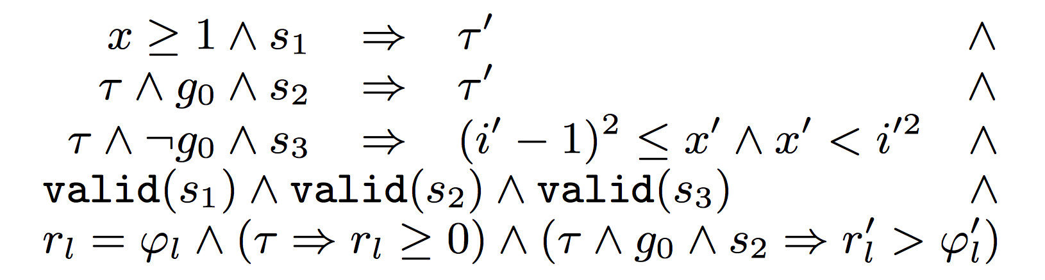
Synthesis Conditions
Theorem (soundness and completeness)
The synthesis conditions are satisfiable iff. there exists a program that is valid w.r.t. the scaffold.

