Slide 1
Lecture 9
Solving Constraints
Armando Solar-Lezama

Slide 2


Constraints to SAT
SAT Solver only understands CNF
  Sum (OR) of variables and their negation
  Equivalent to $\bigwedge_{i∈X}{l_{i}}⇒l_{j}$
h₀
h₁
h₂
$$∧$$
xor
Assert

Slide 3


Constraints to SAT
SAT Solver only understands CNF
  Sum (OR) of variables and their negation
  Equivalent to $\bigwedge_{i∈X}{l_{i}}⇒l_{j}$
h₀
h₁
h₂
$$∧$$
$$t_{1}$$
xor
$$t_{2}$$
Assert

Slide 4
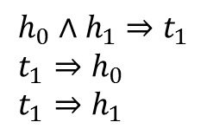
Constraints to SAT
SAT Solver only understands CNF
  Sum (OR) of variables and their negation
  Equivalent to $\bigwedge_{i∈X}{l_{i}}⇒l_{j}$
h₀
h₁
h₂
$$h_{0}∧h_{1}⇒t_{1} \\ t_{1}⇒h_{0} \\ t_{1}⇒h_{1}$$
$$∧$$
$$t_{1}$$
xor
$$t_{2}$$
Assert

Slide 5
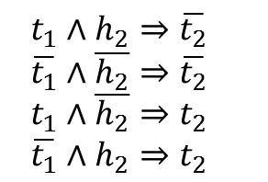
Constraints to SAT
SAT Solver only understands CNF
  Sum (OR) of variables and their negation
  Equivalent to $\bigwedge_{i∈X}{l_{i}}⇒l_{j}$
h₀
h₁
h₂
$$h_{0}∧h_{1}⇒t_{1} \\ t_{1}⇒h_{0} \\ t_{1}⇒h_{1}$$
$$∧$$
$$t_{1}$$
xor
$$t_{2}$$
$$t_{1}∧h_{2}⇒\overline{t_{2}} \\ \overline{t_{1}}∧\overline{h_{2}}⇒\overline{t_{2}} \\ t_{1}∧\overline{h_{2}}⇒t_{2} \\ \overline{t_{1}}∧h_{2}⇒t_{2}$$
Assert

Slide 6
What about integers
Standard approach is bit-blasting

Slide 7




Eager bit-blasting to CNF
SMT solver High-level constraint
SAT solver CNF clauses
msb
lsb
x
y
>
o1
ite
o2
….
Simple approach: Individually Generate CNF Clauses for each operator

Slide 8
Embelishments
Go through an intermediate representation
  And Inverter Graphs (AIG) are a popular IR
    Allow additional algebraic simplification/structural hashing
    Bit-blasting is not confined to individual operator boundaries

Slide 9
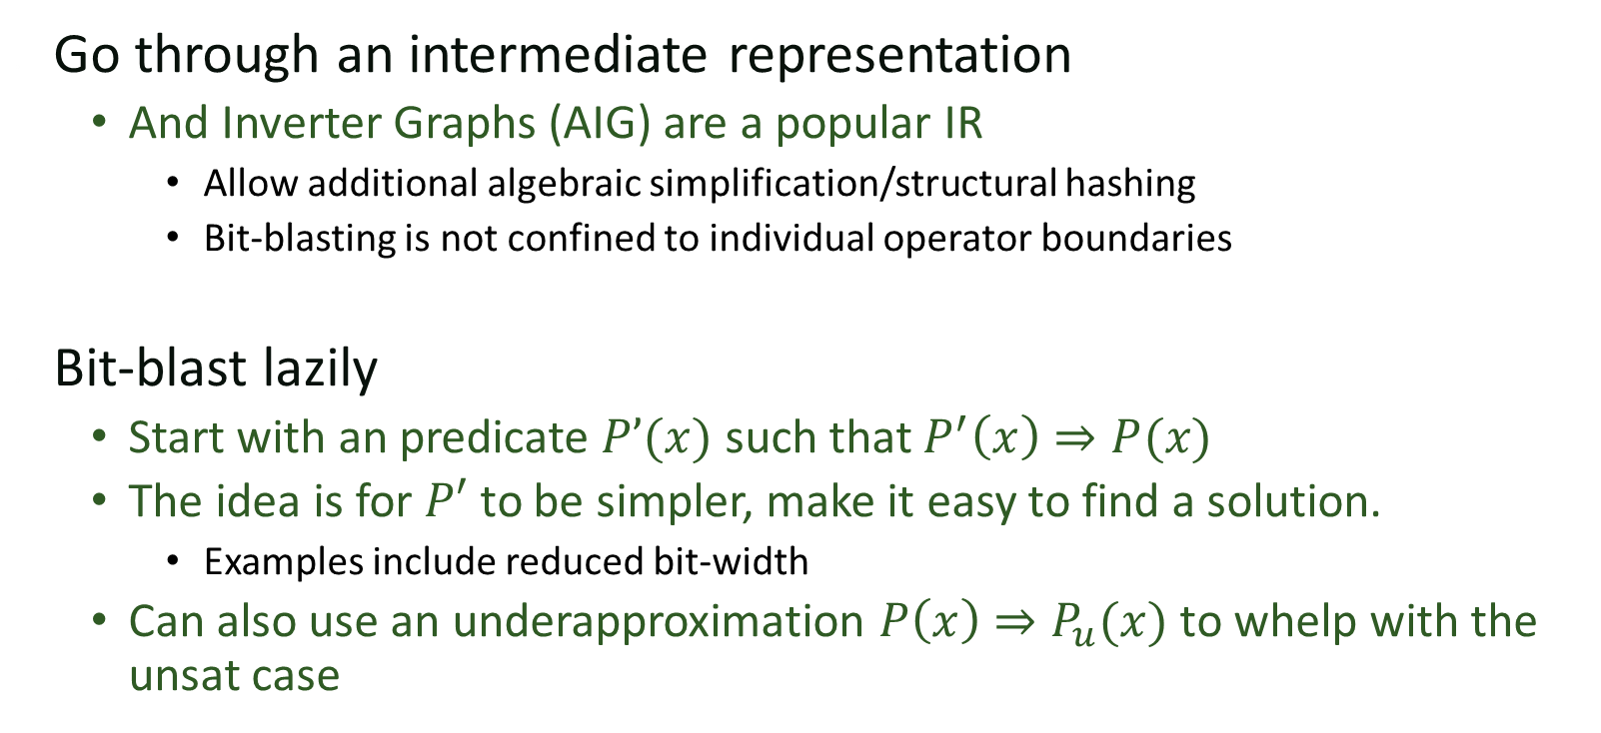
Embelishments
Go through an intermediate representation
  And Inverter Graphs (AIG) are a popular IR
    Allow additional algebraic simplification/structural hashing
    Bit-blasting is not confined to individual operator boundaries
Bit-blast lazily
  Start with an predicate $P’(x)$ such that $P^{′}\left(x\right)⇒P(x)$
  The idea is for $P′$ to be simpler, make it easy to find a solution.
    Examples include reduced bit-width
  Can also use an underapproximation $P\left(x\right)⇒P_{u}(x)$ to whelp with the
  unsat case

Slide 10
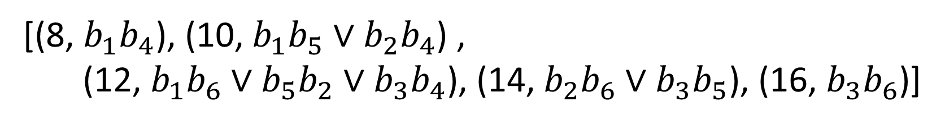
One Hot encoding
Basically Unary encoding
  One bit per possible value
[(5, $b_{1}$), (7, $b_{2}$), (9, $b_{3}$)] + [(3, $b_{4}$), (5, $b_{5}$), (7, $b_{6}$)]
[(8, $b_{1}b_{4}$), (10, $b_{1}b_{5}∨b_{2}b_{4}$) ,
(12, $b_{1}b_{6}∨b_{5}b_{2}∨b_{3}b_{4}$), (14, $b_{2}b_{6}∨b_{3}b_{5}$), (16, $b_{3}b_{6}$)]

Slide 11
One Hot encoding
Can be very efficient, but can also blow up

Slide 12
SAT Solver
SAT solving in a nutshell
Constraint database
x₁
x₇
x₅
x₆
x₄
x₉
x₉

Slide 13
SAT Solver
SAT solving in a nutshell
Constraint is a CNF Clause
x₁ v x₂ v x₃ v x₄ v x₅ v x₆
Constraint database
x₁
x₇
x₅
x₆
x₄
x₉
x₉

Slide 14
SAT Solver
SAT solving in a nutshell
Constraint is a CNF Clause
x₁
x₁ v x₂ v x₃ v x₄ v x₅ v x₆
Constraint database
x₁
x₇
x₅
x₆
x₄
x₉
x₉

Slide 15
SAT Solver
SAT solving in a nutshell
Constraint is a CNF Clause
x₁
x₁ v x₂ v x₃ v x₄ v x₅ v x₆
Constraint database
-x₁ v x₇
x₁
x₇
x₇
x₅
x₆
x₄
x₉
x₉

Slide 16
SAT Solver
SAT solving in a nutshell
Constraint is a CNF Clause
x₁
x₁ v x₂ v x₃ v x₄ v x₅ v x₆
Constraint database
x₅
-x₁ v x₇
x₁
x₇
x₇
x₅
x₆
x₄
x₉
x₉

Slide 17
SAT Solver
SAT solving in a nutshell
Constraint is a CNF Clause
x₁
x₁ v x₂ v x₃ v x₄ v x₅ v x₆
Constraint database
x₅
-x₁ v x₇
x₁
x₇
x₇
-x₇ v x₆ v -x₅
x₅
x₆
x₆
x₄
x₉
x₉

Slide 18
SAT Solver
SAT solving in a nutshell
Constraint is a CNF Clause
x₁
x₁ v x₂ v x₃ v x₄ v x₅ v x₆
Constraint database
x₅
-x₁ v x₇
x₁
x₇
-x₉
x₇
-x₇ v x₆ v -x₅
x₅
x₆
x₆
-x₉
x₉
x₉

Slide 19
SAT Solver
SAT solving in a nutshell
Constraint is a CNF Clause
x₁
x₁ v x₂ v x₃ v x₄ v x₅ v x₆
Constraint database
x₅
-x₁ v x₇
x₁
x₇
-x₉
x₇
-x₇ v x₆ v -x₅
-x₅ v -x₃ v x₉
x₅
x₆
x₆
-x₃
-x₉
-x₃
x₉

Slide 20
SAT Solver
SAT solving in a nutshell
Constraint is a CNF Clause
x₁
x₁ v x₂ v x₃ v x₄ v x₅ v x₆
Constraint database
x₅
-x₁ v x₇
x₁
x₇
-x₉
x₇
-x₇ v x₆ v -x₅
-x₅ v -x₃ v x₉
x₅
x₆
x₆
-x₃
-x₉
-x₆ v x₃ v x₄
-x₃
x₄
x₄

Slide 21
SAT Solver
SAT solving in a nutshell
Constraint is a CNF Clause
x₁
x₁ v x₂ v x₃ v x₄ v x₅ v x₆
Constraint database
x₅
-x₁ v x₇
-x₅ v x₉ v -x₄
x₁
x₇
-x₉
x₇
-x₇ v x₆ v -x₅
-x₅ v -x₃ v x₉
x₅
x₆
x₆
-x₃
-x₉
-x₆ v x₃ v x₄
-x₃
x₄
x₄

Slide 22
SAT Solver
SAT solving in a nutshell
Constraint is a CNF Clause
x₁
x₁ v x₂ v x₃ v x₄ v x₅ v x₆
Constraint database
x₅
-x₁ v x₇
-x₅ v x₉ v -x₄
x₁
x₇
-x₉
x₇
-x₇ v x₆ v -x₅
-x₅ v -x₃ v x₉
-x₄
x₅
x₆
x₆
-x₃
-x₉
-x₆ v x₃ v x₄
-x₃
x₄
x₄

Slide 23
SAT Solver
SAT solving in a nutshell
Constraint is a CNF Clause
x₁
x₁ v x₂ v x₃ v x₄ v x₅ v x₆
Constraint database
x₅
-x₁ v x₇
-x₅ v x₉ v -x₄
x₁
x₇
-x₉
x₇
-x₇ v x₆ v -x₅
-x₅ v -x₃ v x₉
-x₄
x₅
x₆
x₆
-x₃
-x₉
-x₆ v x₃ v x₄
-x₃
x₄
x₄

Slide 24
SAT Solver
SAT solving in a nutshell
Constraint is a CNF Clause
x₁
Conflict Graph
x₁ v x₂ v x₃ v x₄ v x₅ v x₆
Constraint database
x₅
-x₁ v x₇
-x₅ v x₉ v -x₄
-x₉
x₁
x₇
x₇
-x₇ v x₆ v -x₅
-x₅ v -x₃ v x₉
-x₄
x₅
x₆
x₆
-x₃
-x₉
-x₁ v -x₅ v x₉
-x₆ v x₃ v x₄
-x₃
x₄
x₄

Slide 25
SAT Solver
SAT solving in a nutshell
Constraint is a CNF Clause
x₁
x₁ v x₂ v x₃ v x₄ v x₅ v x₆
Constraint database
x₅
-x₁ v x₇
-x₅ v x₉ v -x₄
x₁
x₇
-x₉
x₇
-x₇ v x₆ v -x₅
-x₅ v -x₃ v x₉
-x₄
x₅
x₆
x₆
-x₃
-x₉
-x₁ v -x₅ v x₉
-x₆ v x₃ v x₄
-x₃
x₄
x₄

Slide 26
SAT Solver
SAT solving in a nutshell
Constraint is a CNF Clause
x₁
x₁ v x₂ v x₃ v x₄ v x₅ v x₆
Constraint database
x₅
-x₁ v x₇
-x₅ v x₉ v -x₄
x₁
x₇
x₇
-x₇ v x₆ v -x₅
-x₅ v -x₃ v x₉
x₅
x₉
x₆
-x₁ v -x₅ v x₉
-x₆ v x₃ v x₄
-x₃
x₄

Slide 27
SAT Solver
SAT solving in a nutshell
Constraint is a CNF Clause
x₁
x₁ v x₂ v x₃ v x₄ v x₅ v x₆
Constraint database
x₅
-x₁ v x₇
-x₅ v x₉ v -x₄
x₁
x₇
x₉
x₇
-x₇ v x₆ v -x₅
-x₅ v -x₃ v x₉
x₅
x₉
x₆
x₆
-x₁ v -x₅ v x₉
-x₆ v x₃ v x₄
-x₃
x₄

Slide 28
Key questions
How do we find all the relevant clauses after a variable is set
How do we know which variable to try next

Slide 29
Two-literal watching
x₁ v x₂ v -x₃ v x₄ v x₅ v x₆
Propagation only happens when the second to last literal is set
  visiting the clause when this is not the case is a waste of time
Watch two unset literals.
  when others are set, ignore

Slide 30
VSIDS
Variable State Independent Decaying Sum
  Additive bumping and multiplicative decay
  Bump when a variable participates in a conflict
  Imprecise but very very fast

Slide 31
What about Arithmetic?
1) Bit-blast
2) Unary encoding
3) SMT

