Slide 1
Lecture 21 Synthesizing under a distribution
Armando Solar-Lezama

Slide 2
Programming by Example
[$\left(in_{0} | out_{0}\right),\left(in_{1} | out_{1}\right), …(in_{k}|out_{k})$]
$f$
$$in_{i}$$
$$out_{i}$$
Problem is hopelessly underspecified
Many semantically distinct programs can satisfy the examples
$P\left(f \right|{\left[\left(in_{i} | out_{i}\right)\right]}_{i})≈P_{f}\left(f\right)∗P_{io}\left({\left[\left(in_{i}∕out_{i}\right)\right]}_{i} \right| f )$

Slide 3
Key elements
Any program that does not match the I/O examples has P=0
All programs that match the I/O examples have the same $P_{io}\left({\left[\left(in_{i}∕out_{i}\right)\right]}_{i} \right| f )$

Slide 4
Length minimization
Shortest programs are better than longer programs
$P\left(f\right)=\left\{\begin{matrix}\frac{1}{Z}∗e^{−len(f)} & if f belongs to the space of programs \\ 0 & otherwise\end{matrix}\right.$

Slide 5
Bottom Up Explicit Search
When discarding observationally equivalent programs, keep shortest one.
Naturally finds shortest programs first
Key property:
All subprograms of the shortest program will themselves be the shortest programs

Slide 6
Top Down Explicit Search
Achieving minimality is trickier and more expensive
Algorithm keeps a wavefront of partially completed programs
Need to expand that wavefront in best-first manner

Slide 7
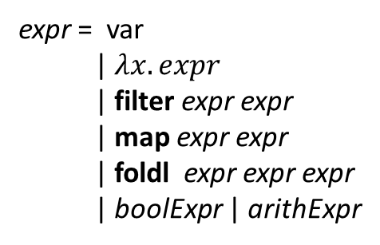
Top Down Explicit Search
expr = var
| $λx. expr$
| filter expr expr
| map expr expr
| foldl expr expr expr
| boolExpr | arithExpr
dropmins in = expr
in
$λ x.$expr
filter expr expr
map expr expr
fold expr expr expr
boolExpr
arithExpr
in
$λ x.$expr
filter expr expr
map expr expr
fold expr expr expr
boolExpr
arithExpr
Wavefront of partially expanded programs that have not been rejected. At each step there is a choice of which program to try to expand.

Slide 8
Symbolic Search
$$∃φ. ∀in. Q\left(φ, in\right)$$
$$∃φ. \left(∀in. Q\left(φ, in\right)∧∀φ^{′} P\left(φ^{′}\right)≤P\left(φ\right)\right)$$
$$∃φ. \left(∀in. Q\left(φ, in\right)∧∀φ^{′} \left(∀in. Q\left(φ^{′}, in\right)\right)⇒P\left(φ^{′}\right)≤P\left(φ\right)\right)$$

Slide 9
Symbolic Search
$$∃φ. ∀in. Q\left(φ, in\right)$$
$$∀φ^{′} \left(∀in. Q\left(φ′, in\right)\right)⇒P\left(φ^{′}\right)≤P\left(φ\right)$$
$$∃φ. ∀in∈E. Q\left(φ, in\right)$$
$$∀φ^{′}∈G \left(∀in. Q\left(φ′, in\right)\right)⇒P\left(φ^{′}\right)≤P\left(φ\right)$$
More permissive, allows all correct $φ$, but also some incorrect ones.
$$∀φ^{′}∈G P\left(φ^{′}\right)≤P\left(φ\right)$$
Works if we can ensure $G$ only contains
$φ′$ that satisfy $∀in. Q\left(φ′, in\right)$

Slide 10
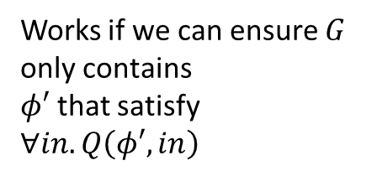
Symbolic Search
$$∀φ^{′} \left(∀in. Q\left(φ′, in\right)\right)⇒P\left(φ^{′}\right)≤P\left(φ\right)$$
$$∃φ. ∀in. Q\left(φ, in\right)$$
$$∀φ^{′}∈G \left(∀in. Q\left(φ′, in\right)\right)⇒P\left(φ^{′}\right)≤P\left(φ\right)$$
$$∃φ. ∀in∈E. Q\left(φ, in\right)$$
Works if we can ensure $G$ only contains
$φ′$ that satisfy $∀in. Q\left(φ′, in\right)$
More permissive, allows all correct $φ$, but also some incorrect ones.
$$∀φ^{′}∈G P\left(φ^{′}\right)≤P\left(φ\right)$$
$$\left(\max_{φ^{′}∈G}{P\left(φ^{′}\right)}\right)≤P\left(φ\right)$$

Slide 11
Extended CEGIS
Synthesize
Check
$Q(φ, in_{0})$
$$φ$$
$$in$$
$$\{in_{i}\}$$

Slide 12
Extended CEGIS
Synthesize
Check
$Q(φ, in_{0})$
$$φ$$
$¬Q(φ, in_{1})$
$$in$$
$$\{in_{i}\}$$

Slide 13
Extended CEGIS
Synthesize
Check
$Q(φ, in_{0})$
$$φ$$
$Q(φ, in_{1})$
$$in$$
$$\{in_{i}\}$$

Slide 14
Extended CEGIS
Synthesize
Check
$Q(φ, in_{0})$
$$φ$$
$Q(φ, in_{1})$
$¬Q(φ, in_{2})$
$$in$$
$$\{in_{i}\}$$

Slide 15
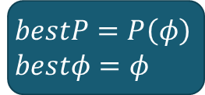
Extended CEGIS
Synthesize
Check
$Q(φ, in_{0})$
$$φ$$
$Q(φ, in_{1})$
$¬Q(φ, in_{2})$
$$bestP< P(φ)$$
UNSAT
$$in$$
$$\{in_{i}\}$$
$$bestP=P\left(φ\right) \\ bestφ=φ$$

Slide 16
Extended CEGIS
Synthesize
Check
$Q(φ, in_{0})$
$$φ$$
$Q(φ, in_{1})$
$¬Q(φ, in_{2})$
$$bestP< P(φ)$$
UNSAT
UNSAT
$$in$$
$$\{in_{i}\}$$
$$bestP=P\left(φ\right) \\ bestφ=φ$$
$$bestφ$$

Slide 17
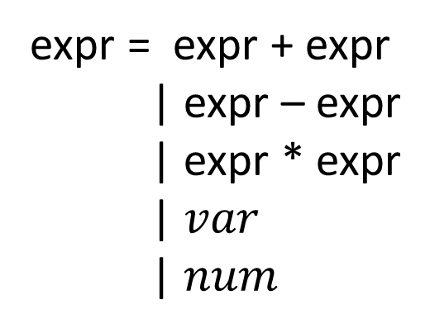
Probabilistic Grammars
expr = expr + expr
| expr – expr
| expr * expr
| $var$
| $num$

Slide 18
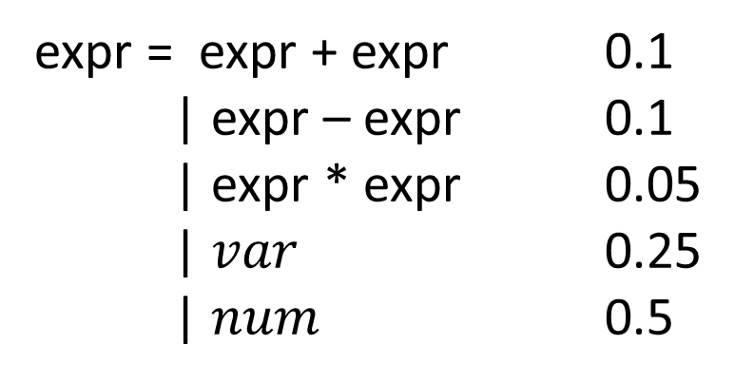
Probabilistic Grammars
P(expr)
expr = expr + expr 0.1
| expr – expr 0.1
| expr * expr 0.05
| $var$ 0.25
| $num$ 0.5

Slide 19
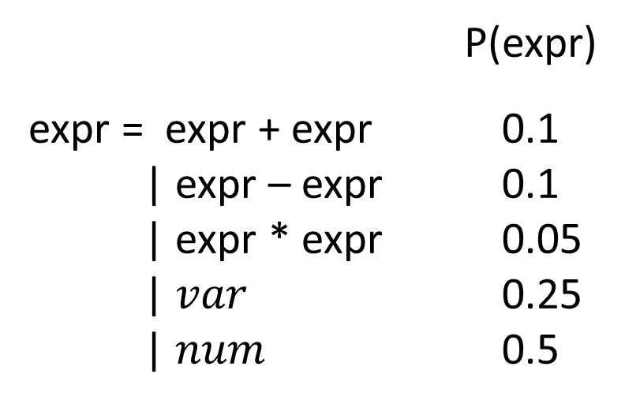
Probabilistic Grammars
0.1
0.1
+
+
0.05
0.1
0.1
0.1
*
+
+
+
x
2
x
3
x
x
x
3
0.25
0.5
0.25
0.5
0.25
0.25
0.25
0.5
P(exp) = $7.81×{10}^{−6}$
P(exp) = $7.81×{10}^{−6}$

Slide 20
Search with P G
Probability is compositional
Same strategies as length-based metric work
$$P(n_{0})$$
+
$$P\left(expr\right)=P\left(n_{0}\right)∗P\left(t_{1}\right)∗P(t_{2})$$
$$P(t_{2})$$
*
+
$$P(t_{1})$$
x
2
x
3

Slide 21
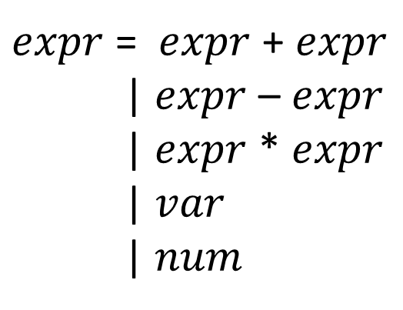
Context sensitive Probabilities
$expr$ = $expr$ + $expr$
| $expr$ – $expr$
| $expr$ * $expr$
| $var$
| $num$

Slide 22
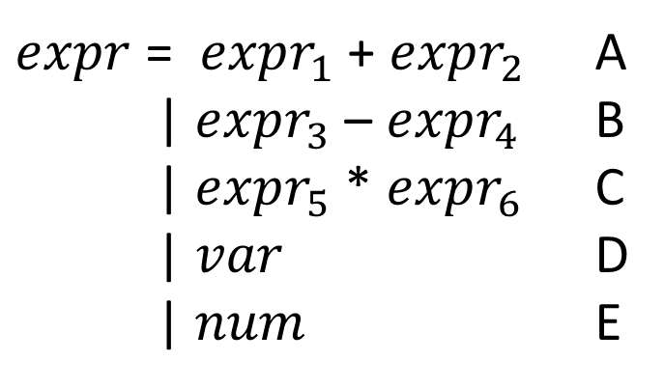
Context sensitive Probabilities
$expr$ = $expr_{1}$ + $expr_{2}$ A
| $expr_{3}$ – $expr_{4}$ B
| $expr_{5}$ * $expr_{6}$ C
| $var$ D
| $num$ E
 | A | B | C | D | E
Root | 0.2 | 0.2 | 0.2 | 0.2 | 0.2
1 | 0.2 | 0.2 | 0.2 | 0.2 | 0.2
2 | 0 | 0 | 1/3 | 1/3 | 1/3
3 | 0.2 | 0.2 | 0.2 | 0.2 | 0.2
4 | 0 | 0 | 1/3 | 1/3 | 1/3
5 | 0.2 | 0.2 | 0.2 | 0.2 | 0.2
6 | 0.25 | 0.25 | 0 | 0.25 | 0.25

Slide 23
Search
Top-down and Constraint-based search are similar
Bottom up search is significantly more challenging

Slide 24
Bottom-up search
x=5 => out=7
*
+
x
2
x
x
We know they are equivalent
Which one do we keep?

Slide 25
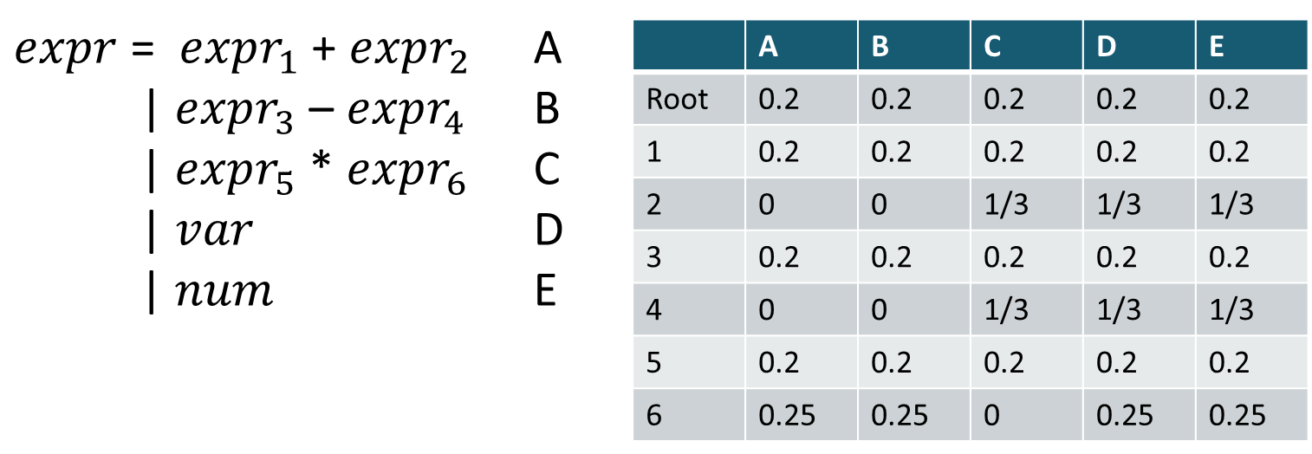
Bottom-up search
x=5 => out=7
*
+
x
2
x
x
0.2
0.25
0.2
0.33
Root | 0.01
1 | 0.01
2 | 0.017
3 | 0.01
4 | 0.017
5 | 0.01
6 | 0
Root | 0.013
1 | 0.013
2 | 0
3 | 0.013
4 | 0
5 | 0.013
6 | 0.0165
Is this exponentially slower?

Slide 26
Bottom-up search
x=5 => out=7
*
+
x
2
x
x
0.2
0.25
0.2
0.33
Root | 0.01
1 | 0.01
2 | 0.017
3 | 0.01
4 | 0.017
5 | 0.01
6 | 0
Root | 0.013
1 | 0.013
2 | 0
3 | 0.013
4 | 0
5 | 0.013
6 | 0.0165
Is this exponentially slower?
No!
Given K contexts, we need at most
k representatives for each equivalence class

Slide 27
Bottom-up search
x=5 => out=7
*
*
Keeping x*2 and x+x does not force us to keep all programs generated from both
0.2
*
2
0.2
+
2
0.25
0.25
x
2
x
x
0.2
0.25
0.2
0.33
Root | 0.0005
1 | 0.0005
2 | 0.0008
3 | 0.0005
4 | 0.0008
5 | 0.0005
6 | 0
Root | 0.0006
1 | 0.0006
2 | 0.001
3 | 0.0006
4 | 0.001
5 | 0.0006
6 | 0
Is this exponentially slower?
No!
Given K contexts, we need at most
k representatives for each equivalence class

Slide 28
Sampling
What if we do not want the best?
Instead we want to sample from the distribution

Slide 29
Sampling with Constraints
Correct programs
Space of all programs
Rejection sampling
Sample according to $P(f)$
Reject anything where $P\left(evidence | f\right)=0$
Very inefficient

Slide 30
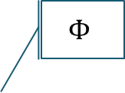
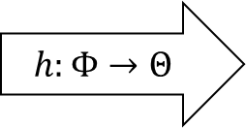
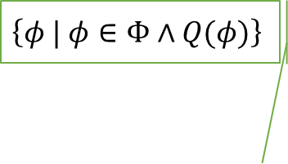
Sampling with Constraints
$$\left\{φ | φ∈Φ∧Q(φ)\right\}$$
$$\left\{θ | ∃φ. θ=h\left(φ\right)∧Q(φ)\right\}$$
$$Φ$$
$$Θ$$
$$h:Φ→Θ$$
If $h$ is measure preserving, sampling uniformly from $Φ$ is equivalent to sampling uniformly from $θ$ and then solving for $φ$ s.t. $θ=h(φ)$

Slide 31
Sampling with Constraints
Approach:
Partition $Θ$
Sample uniformly from the partitions to pick $\overline{θ_{i}}⊂Θ$
Solve for $φ$ s.t. $Q\left(φ\right)∧h\left(φ\right)∈$ $\overline{θ_{i}}$

Slide 32
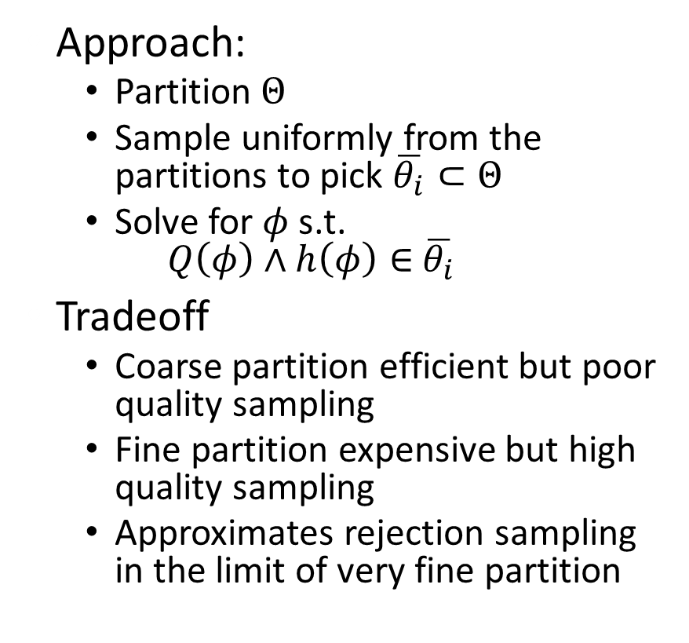
Sampling with Constraints
Approach:
Partition $Θ$
Sample uniformly from the partitions to pick $\overline{θ_{i}}⊂Θ$
Solve for $φ$ s.t. $Q\left(φ\right)∧h\left(φ\right)∈$ $\overline{θ_{i}}$
Tradeoff
Coarse partition efficient but poor quality sampling
Fine partition expensive but high quality sampling
Approximates rejection sampling in the limit of very fine partition

