Slide 1
Lecture 22 Learning Complex Distributions
Armando Solar-Lezama

Slide 2
n-gram models
The big brown bear scares the children with its roar
$$P\left(scares \right|bear, brown)$$
Probability of a word depends on the previous n words
Represented with a table: $P\left(w_{i} \right|w_{i−1}, w_{i−2}, …, w_{i−n})$
Bigger n makes more accurate, but also more difficult to learn, requires much bigger table
Downsides
some words require more context than others
some words carry very little information

Slide 3
Recurrent models
Key idea: let the system figure out how to construct its own context
Now need to learn two interrelated functions
$P\left(word_{i} \right|context_{i−1})$
$context_{i}=f(word_{i}, context_{i−1})$
P
P
P
P
P
P
P
P
P
P
$$C_{0}$$
$$f$$
$$f$$
$$f$$
$$f$$
$$f$$
$$f$$
$$f$$
$$f$$
$$f$$
$$f$$
The big brown bear scares the children with its roar

Slide 4
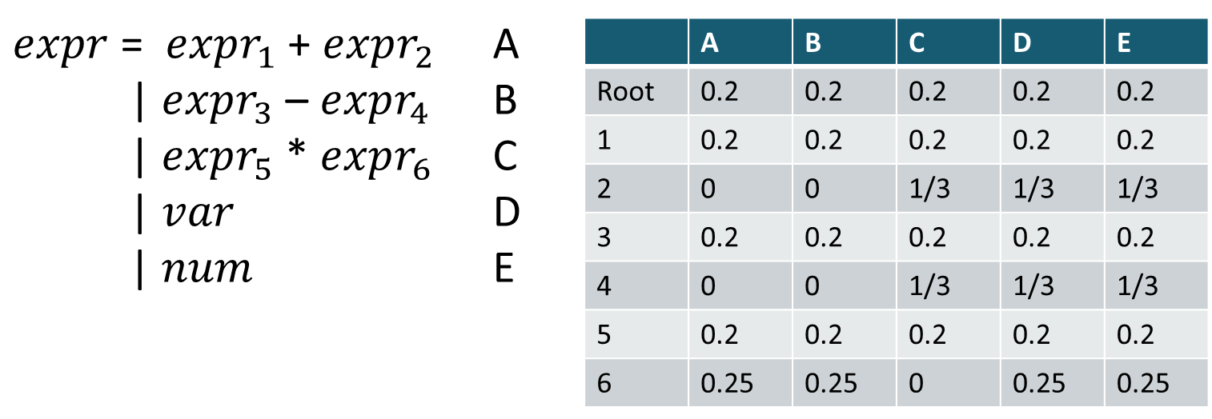
Context sensitive P G
Generalizes n-gram for n = 1
Can be extended to bigger contexts
+
*
+
x
2
x
3
$$P\left(production | site_{i}, site_{i−1}\right)$$
Can also be generalized to a recurrent model

Slide 5
Context sensitive P G
P
$$C_{0}$$
$$f$$
P
+
$$f$$
P
*
+
x
2
x
3
Can also be generalized to a recurrent model

Slide 6
Learning models
$$P_{tree}\left( t \right| p_{nodes})$$
Probability of a tree/string given the probabilities of individual tokens/chars
Usually a simple function that traverses the tree/string and multiplies probabilities (adds their logs)

Slide 7
Learning models
Given a set of sample trees $T={\left\{t_{i}\right\}}_{i<N}$
and a parametric distribution $p_{nodes}^{θ}$
the goal is to find parameters that maximize the
probability of the samples.
$$\underset{θ}{argmax}{Π_{i} P_{tree}\left(t |p_{nodes}^{θ}\right)=\underset{θ}{argmax}{Σ_{i}\log{P_{tree}\left(t |p_{nodes}^{θ}\right)}=}}$$

Slide 8
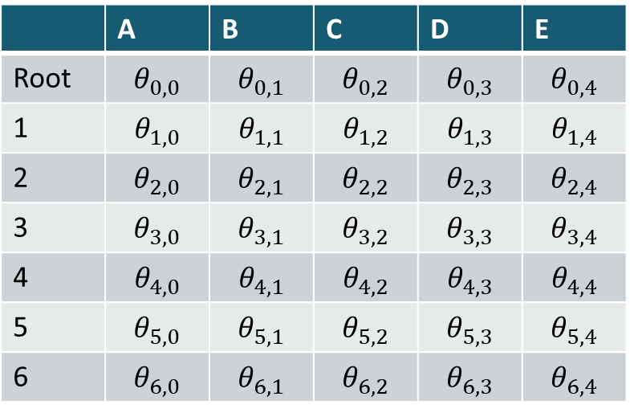
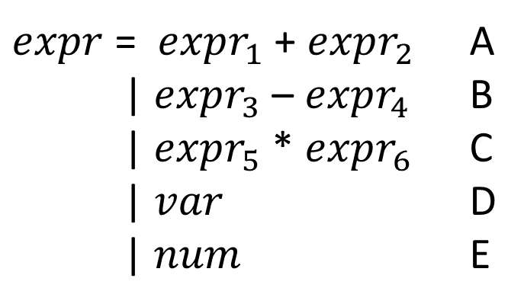
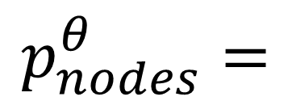
Learning models
$$p_{nodes}^{θ}=$$
$expr$ = $expr_{1}$ + $expr_{2}$ A
| $expr_{3}$ – $expr_{4}$ B
| $expr_{5}$ * $expr_{6}$ C
| $var$ D
| $num$ E
 | A | B | C | D | E
Root | $$θ_{0,0}$$ | $$θ_{0,1}$$ | $$θ_{0,2}$$ | $$θ_{0,3}$$ | $$θ_{0,4}$$
1 | $$θ_{1,0}$$ | $$θ_{1,1}$$ | $$θ_{1,2}$$ | $$θ_{1,3}$$ | $$θ_{1,4}$$
2 | $$θ_{2,0}$$ | $$θ_{2,1}$$ | $$θ_{2,2}$$ | $$θ_{2,3}$$ | $$θ_{2,4}$$
3 | $$θ_{3,0}$$ | $$θ_{3,1}$$ | $$θ_{3,2}$$ | $$θ_{3,3}$$ | $$θ_{3,4}$$
4 | $$θ_{4,0}$$ | $$θ_{4,1}$$ | $$θ_{4,2}$$ | $$θ_{4,3}$$ | $$θ_{4,4}$$
5 | $$θ_{5,0}$$ | $$θ_{5,1}$$ | $$θ_{5,2}$$ | $$θ_{5,3}$$ | $$θ_{5,4}$$
6 | $$θ_{6,0}$$ | $$θ_{6,1}$$ | $$θ_{6,2}$$ | $$θ_{6,3}$$ | $$θ_{6,4}$$

Slide 9
Neural Networks
Most popular way of representing recurrent models
Standard neural network model:
very general, but not great for recurrent models
$$in$$
$$t_{1}$$
$$t_{n}$$
$$out$$
$$M_{0}$$
$$M_{n}$$
$$×$$
$$rect$$
$$…$$
$$×$$
$$rect$$
Constant 1
Matrices of parameters to be discovered

Slide 10
Simple recurrent neural network
P
$$p_{i}$$
$$C_{i−1}$$
$$f$$
$$C_{i}$$
$$in_{i}$$
$$C_{i−1}$$
$$M_{0}$$
$$C_{i}$$
$$×$$
$$tanh$$
$$in_{i}$$
$$p_{i}$$
Constant 1

Slide 11
LSTM
$$p_{i}$$
P
$$C_{i−1}$$
$$f$$
$$C_{i}$$
$$in_{i}$$
$$×$$
$$+$$
$$C_{i−1}$$
$$C_{i}$$
$$p_{i−1}$$
$$M_{0}$$
$$p_{i}$$
$$×$$
$$σ$$
$$tanh$$
$$×$$
$$M_{1}$$
$$σ$$
$$×$$
$$in_{i}$$
$$×$$
$$×$$
$$M_{2}$$
$$tanh$$
$$×$$
$$M_{3}$$
$$σ$$

Slide 12
LSTM
$$p_{i}$$
P
$$C_{i−1}$$
$$f$$
$$C_{i}$$
$$in_{i}$$
$$×$$
$$+$$
$$C_{i−1}$$
Forget Gate Layer
$$C_{i}$$
$$p_{i−1}$$
$$M_{0}$$
$$p_{i}$$
$$×$$
$$σ$$
$$tanh$$
$$×$$
$$M_{1}$$
$$σ$$
$$×$$
$$in_{i}$$
$$×$$
$$×$$
$$M_{2}$$
$$tanh$$
$$×$$
$$M_{3}$$
$$σ$$

Slide 13
LSTM
$$p_{i}$$
P
$$C_{i−1}$$
$$f$$
$$C_{i}$$
$$in_{i}$$
$$×$$
$$+$$
$$C_{i−1}$$
$$C_{i}$$
$$p_{i−1}$$
$$M_{0}$$
$$p_{i}$$
$$×$$
$$σ$$
Input Gate Layer
$$tanh$$
$$×$$
$$M_{1}$$
$$σ$$
$$×$$
$$in_{i}$$
$$×$$
$$×$$
$$M_{2}$$
$$tanh$$
$$×$$
$$M_{3}$$
$$σ$$

Slide 14
Beyond LSTM
Many variants to the basic model
Active area of research

Slide 15
Context sensitive P G
+
*
+
x
2
x
3
Wide latitude on what context to consider

Slide 16
Context sensitive P G
+
*
+
x
2
x
3
Wide latitude on what context to consider

Slide 17
Context sensitive P G
+
*
+
x
2
x
3
Wide latitude on what context to consider

Slide 18
Beam Search
bear 0.1
lion 0.02
fox 0.01
cat 0.001
P
P
P
$$C_{0}$$
$$f$$
$$f$$
$$f$$
The big brown
At each step pick the K most likely successors

Slide 19
Beam Search
runs 0.1
scares 0.02
eats 0.01
sleeps 0.007
P
P
P
P
$$f$$
$$C_{0}$$
$$f$$
$$f$$
$$f$$
bear
The big brown
P
hunts 0.1
hides 0.02
eats 0.01
sleeps 0.001
$$f$$
lion

Slide 20
Beam search for programs
Similar to top-down search
Same strategies for pruning the search space apply

Slide 21
Bayesian View of PBE
$$P\left(f | evidence\right)=\frac{P\left(evidence | f\right)P(f)}{P(evidence)}$$
Can we learn $P\left(f | evidence\right)$ directly?

Slide 22
Encoder-decoder model
Encoder: Generates latent representation of the evidence
Why do children hate the big brown bear?
$$C_{0}$$
$$f$$
$$f$$
$$f$$
$$f$$
$$f$$
$$f$$
$$f$$
$$f$$
$$C_{e}$$
P
P
P
P
P
P
P
P
P
P
$$C_{e}$$
$$f$$
$$f$$
$$f$$
$$f$$
$$f$$
$$f$$
$$f$$
$$f$$
$$f$$
$$f$$
Decoder: Produces a distribution based on the evidence
The big brown bear scares the children with its roar

Slide 23
Synthesis from ambiguous evidence
Statistical model learned from corpus of code
An idealized program
Ambiguous, syntactic “evidence” about what the program does
Synthesizer
Type-safe, compilable candidate implementations (Prog)
Search guided by statistical model
Neural Sketch Learning for Conditional Program Generation. Murali, Qi, Chaudhuri, and Jermaine. ICLR 2018 (oral presentation).
Notes:
These two ideas come together in a recent piece of work.

Slide 24
The Bayou system: Example
Input
Output
void read(String file) {
String s;
BufferedReader br;
FileReader fr;
try {
fr = new FileReader(file);
br = new BufferedReader(fr);
while ((s = br.readLine())!=null){ }
br.close();
} catch (FileNotFoundException _e) {}
catch (IOException _e) {}
}
void read(String file) {
/// call:readline
/// type:BufferedReader
}

