Slide 1
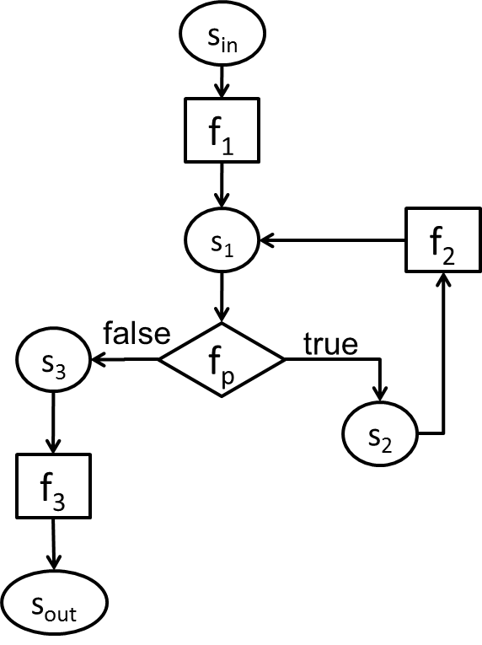
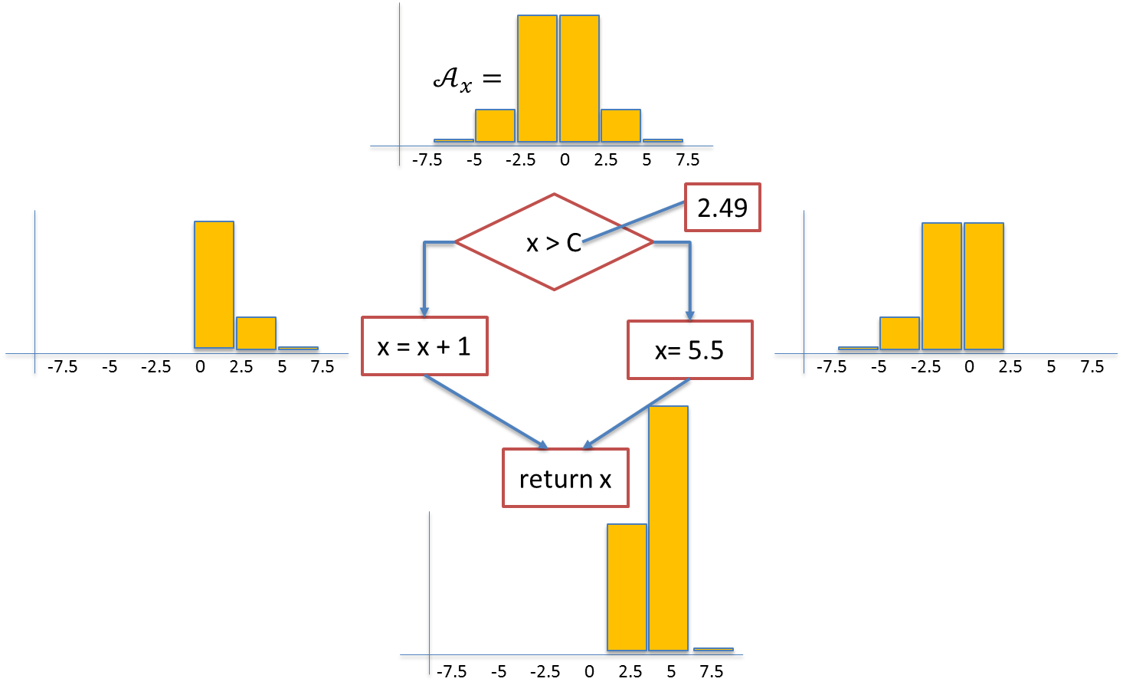
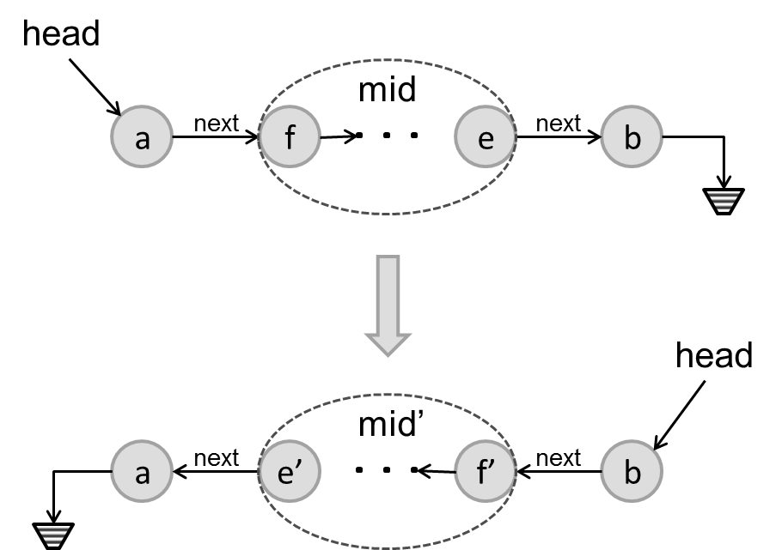

Introduction to Program Synthesis 6.S084/6.887
$$∃c∀in Q(c,in)$$
$$φ\left(p\right)$$
$$Sk[c](in)$$

Slide 2
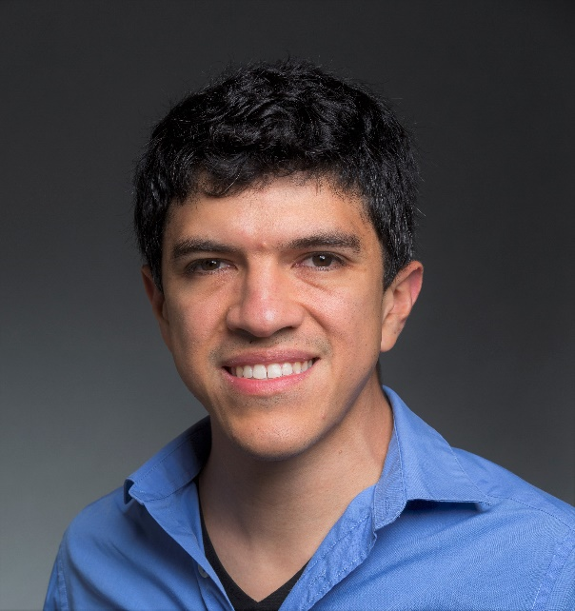
Logistics: Who
Armando Solar-Lezama
Jimmy Koppel

Slide 3
Logistics: When & Where
Lecture: M-W 1-2:30 (32-144)
But you already knew that ☺
Office Hours/Optional Recitation
Answer questions, talk about tools relevant to the pset, review lecture material
Optional but useful
Has worked well in the past
We’ll poll you on the best time (start next week)
Course Website
http://people.csail.mit.edu/asolar/SynthesisCourse/
Piazza: coming soon

Slide 4
Grading
Assignment 1: 20%
Assignment 2: 20%
Assignment 3: 20%
Final Project: 40%

Slide 5
Logistics PSets
Most programming will be in JavaScript and Sketch
First one will be posted this week
Submission details
Due at 5pm on the posted due date
Late penalty will be 10 points per day up to a maximum of 4 days

Slide 6
Logistics: Project
Teams of 1 or 2 people (2.5%)
Expectations commensurate with size of team
One-page project proposal (12.5%)
Tell us what you plan to do and give some evidence that you’ve started to work on it
Project presentation (10%)
Project report (15%)
Projects will be judged in terms of
quality of execution
originality
scope

