Slide 1
Lecture 22
Learning
Complex Distributions
Armando Solar-Lezama

Slide 2

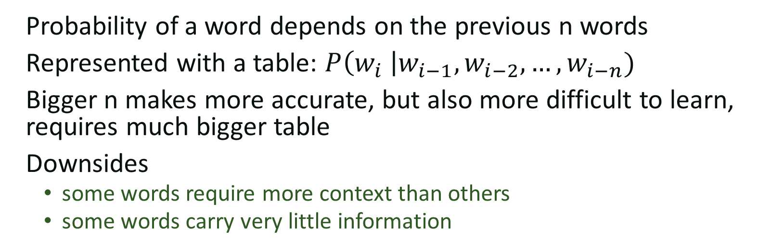
n-gram models
The big brown bear scares the children with its roar
$$P\left(scares \right|bear, brown)$$
Probability of a word depends on the previous n words
Represented with a table: $P\left(w_{i} \right|w_{i−1}, w_{i−2}, …, w_{i−n})$
Bigger n makes more accurate, but also more difficult to learn, requires much bigger table
Downsides
  some words require more context than others
  some words carry very little information

Slide 3












Recurrent models
Key idea: let the system figure out how to construct its own context
Now need to learn two interrelated functions
  $P\left(word_{i} \right|context_{i−1})$
  $context_{i}=f(word_{i}, context_{i−1})$
P
P
P
P
P
P
P
P
P
P
$$C_{0}$$
$$f$$
$$f$$
$$f$$
$$f$$
$$f$$
$$f$$
$$f$$
$$f$$
$$f$$
$$f$$
The big brown bear scares the children with its roar

Slide 4
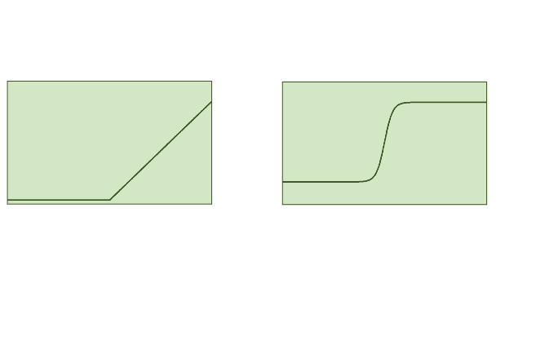











Neural Networks
Most popular way of representing recurrent models
Standard neural network model:
or
$$in$$
$$t_{1}$$
$$t_{n}$$
$$out$$
$$M_{0}$$
$$M_{n}$$
$$×$$
$$rect$$
$$…$$
$$×$$
$$rect$$
Constant 1
Matrices of parameters to be discovered

Slide 5












Simple recurrent neural network
P
$$p_{i}$$
$$C_{i−1}$$
$$f$$
$$C_{i}$$
$$in_{i}$$
$$C_{i−1}$$
$$M_{0}$$
$$C_{i}$$
$$×$$
$$tanh$$
$$in_{i}$$
$$p_{i}$$
Constant 1

Slide 6



























LSTM
$$p_{i}$$
P
$$C_{i−1}$$
$$f$$
$$C_{i}$$
$$in_{i}$$
$$×$$
$$+$$
$$C_{i−1}$$
$$C_{i}$$
$$p_{i−1}$$
$$M_{0}$$
$$p_{i}$$
$$×$$
$$σ$$
$$tanh$$
$$×$$
$$M_{1}$$
$$σ$$
$$×$$
$$in_{i}$$
$$×$$
$$×$$
$$M_{2}$$
$$tanh$$
$$×$$
$$M_{3}$$
$$σ$$

Slide 7
LSTM
$$p_{i}$$
P
$$C_{i−1}$$
$$f$$
$$C_{i}$$
$$in_{i}$$
$$×$$
$$+$$
$$C_{i−1}$$
Forget Gate Layer
$$C_{i}$$
$$p_{i−1}$$
$$M_{0}$$
$$p_{i}$$
$$×$$
$$σ$$
$$tanh$$
$$×$$
$$M_{1}$$
$$σ$$
$$×$$
$$in_{i}$$
$$×$$
$$×$$
$$M_{2}$$
$$tanh$$
$$×$$
$$M_{3}$$
$$σ$$

Slide 8
LSTM
$$p_{i}$$
P
$$C_{i−1}$$
$$f$$
$$C_{i}$$
$$in_{i}$$
$$×$$
$$+$$
$$C_{i−1}$$
$$C_{i}$$
$$p_{i−1}$$
$$M_{0}$$
$$p_{i}$$
$$×$$
$$σ$$
Input Gate Layer
$$tanh$$
$$×$$
$$M_{1}$$
$$σ$$
$$×$$
$$in_{i}$$
$$×$$
$$×$$
$$M_{2}$$
$$tanh$$
$$×$$
$$M_{3}$$
$$σ$$

Slide 9
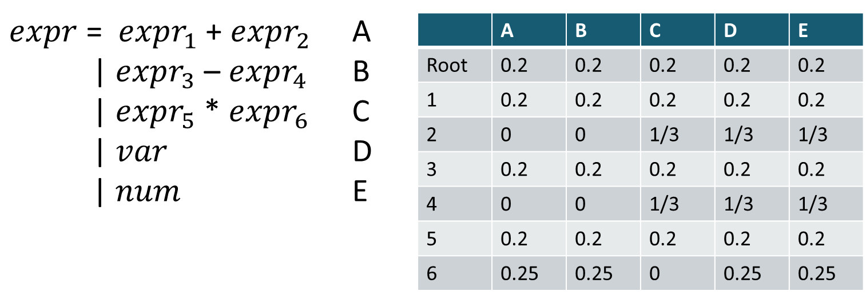

Context sensitive P G
Generalizes n-gram for n = 1
Can be extended to bigger contexts
+
*
+
x
2
x
3
$$P\left(production | site_{i}, site_{i−1}\right)$$
Can also be generalized to a recurrent model

Slide 10



Context sensitive P G
P
$$C_{0}$$
$$f$$
P
+
$$f$$
P
*
+
x
2
x
3
Can also be generalized to a recurrent model

Slide 11





















Encoder-decoder model
Encoder:
Generates latent representation of the evidence
Why do children hate the big brown bear?
$$C_{0}$$
$$f$$
$$f$$
$$f$$
$$f$$
$$f$$
$$f$$
$$f$$
$$f$$
$$C_{e}$$
P
P
P
P
P
P
P
P
P
P
$$C_{e}$$
$$f$$
$$f$$
$$f$$
$$f$$
$$f$$
$$f$$
$$f$$
$$f$$
$$f$$
$$f$$
Decoder:
Produces a distribution based on the evidence
The big brown bear scares the children with its roar

Slide 12
Attention
Key idea: Summarizing into a single vector is a big bottleneck. Every output should have direct access to the whole input

Slide 13













Attention
$$C_{0}$$
$$f$$
$$f$$
$$f$$
$$f$$
$$f$$
$$f$$
$$f$$
$$f$$
$$C_{e}$$
$$h_{0}$$
$$h_{0}$$
A
…
A
+
P
P
P
P
P
P
P
P
P
P
$$C_{e}$$
$$f$$
$$f$$
$$f$$
$$f$$
$$f$$
$$f$$
$$f$$
$$f$$
$$f$$
$$f$$

Slide 14
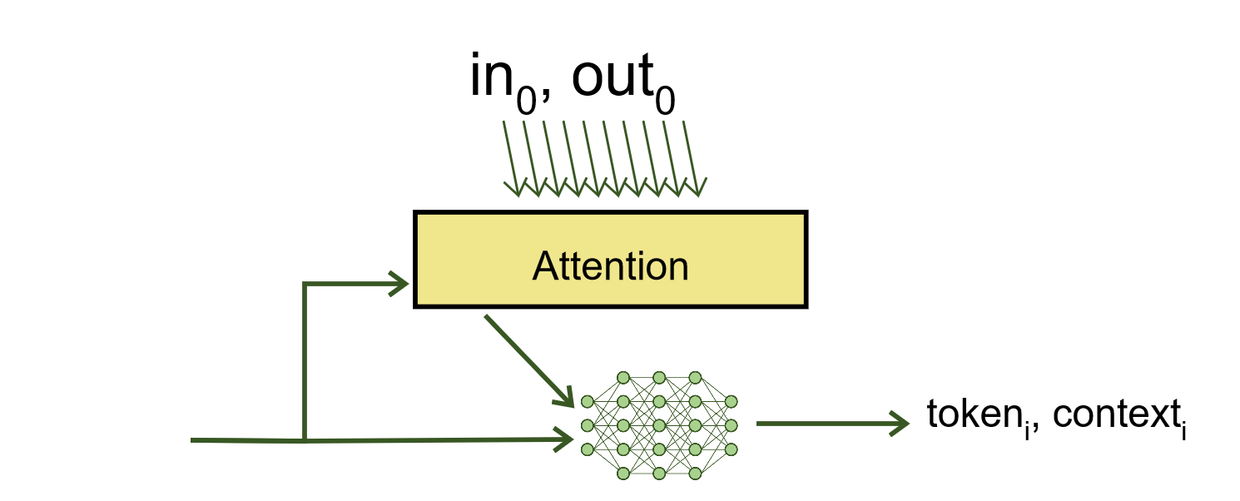
RobustFill
Single example case
  Attend over the input/output to produce each token

Slide 15


RobustFill
Multiple example case
  Compute each example independently
  pool over the result to decide which token to output
…
max_pool
token_{i}

Slide 16




Beam Search
bear 0.1
lion 0.05
fox 0.01
cat 0.001
P
P
P
$$C_{0}$$
$$f$$
$$f$$
$$f$$
The big brown
At each step pick the K most likely successors

Slide 17


Beam Search
runs 0.05
scares 0.03
eats 0.01
sleeps 0.007
P
P
P
P
$$f$$
$$C_{0}$$
$$f$$
$$f$$
$$f$$
bear (0.1)
The big brown
P
hunts 0.1
hides 0.07
eats 0.01
sleeps 0.001
$$f$$
lion (0.05)

Slide 18
Beam Search
runs 0.05
scares 0.03
eats 0.01
sleeps 0.007
P
P
P
P
$$f$$
$$C_{0}$$
$$f$$
$$f$$
$$f$$
bear (0.1)
The big brown
P
hunts 0.1
hides 0.07
eats 0.01
sleeps 0.001
$$f$$
lion (0.05)

Slide 19
Beam Search
fast 0.07
after 0.03
towards 0.01
into 0.007
P
P
$$f$$
P
P
P
$$f$$
runs (0.005)
$$C_{0}$$
$$f$$
$$f$$
$$f$$
bear (0.1)
P
gazelles 0.05
its 0.03
prey 0.01
into 0.007
The big brown
P
$$f$$
$$f$$
lion (0.02)
hunts (0.005)

Slide 20
Beam Search
fast 0.07
after 0.06
towards 0.01
into 0.007
P
P
$$f$$
P
P
P
$$f$$
runs (0.005)
$$C_{0}$$
$$f$$
$$f$$
$$f$$
bear (0.1)
P
gazelles 0.05
its 0.03
prey 0.01
into 0.007
The big brown
P
$$f$$
$$f$$
lion (0.02)
hunts (0.005)

Slide 21
Beam search for programs
Similar to top-down search
  Same strategies for pruning the search space apply

Slide 22
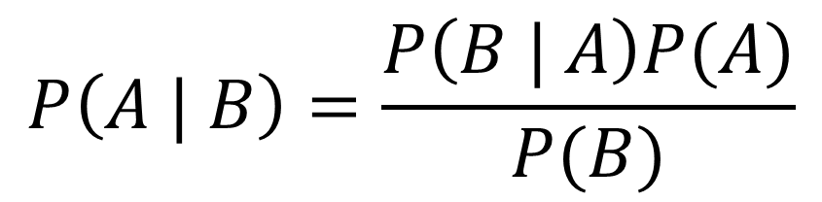
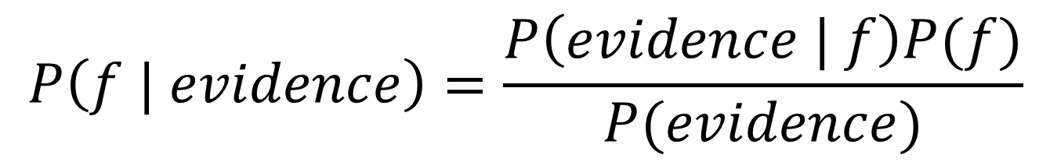

Bayesian View of PBE
$$P\left(f | evidence\right)=\frac{P\left(evidence | f\right)P(f)}{P(evidence)}$$
Can we learn $P\left(f | evidence\right)$ directly?

Slide 23

Synthesis from ambiguous evidence
Statistical model learned from corpus of code
An idealized program
Ambiguous, syntactic “evidence” about what the
program does
Synthesizer
Type-safe, compilable candidate
implementations (Prog)
Search guided by
statistical model
Neural Sketch Learning for Conditional Program Generation. Murali, Qi, Chaudhuri, and Jermaine. ICLR 2018 (oral presentation).
Notes:
These two ideas come together in a recent piece of work.

Slide 24
The Bayou system: Example
Input
Output
void read(String file) {
String s;
BufferedReader br;
FileReader fr;
try {
fr = new FileReader(file);
br = new BufferedReader(fr);
while ((s = br.readLine())!=null){
}
br.close();
}
catch (FileNotFoundException _e) {}
catch (IOException _e) {}
}
void read(String file) {
/// call:readline
/// type:BufferedReader
}

Slide 25
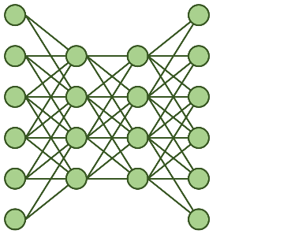
Learning to Sketch
Soft Constraints
encoder
Hard Constraints
Spec Vector
Code

Slide 26



Learning to Sketch
“Drop some elements”
encoder
[1,3,5,8,9]$→$[1,5,8]
Spec Vector
Search
filter input $λx.$HOLE
filter input $λx.$x%3==0

Slide 27
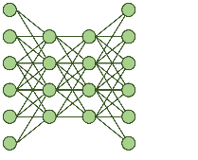
Beam Search + Synthesis
filter in
filter map
filter
filter fold
fold
fold in
fold filter

Slide 28




Training
Penalize heavily for incorrect token
Key idea
Penalty for hole depends on cost
of completing it
“Drop some elements”
filter input $λx.$x%3==0
[1,3,5,8,9]$→$[1,5,8]
fold input $λx.$x%3==0
x
filter input $λx.$HOLE
HOLE

Slide 29
Results

Slide 30
Results

Slide 31
Algolisp Results

Slide 32
Generating programs
Specification
Recurrent state
Recurrent state
Next command

Slide 33

Generating programs
Specification
Program so far
Next command
Program state

Slide 34
Spec
Spec
Next Instruction:
Subtract($3, $1) .5
Subtract($3, $2) .4
Rectangle(….) .1
Next Instruction:
Subtract($1, $2) .5
Rectangle(….) .4
Circle(…) .1
canvas 1
canvas 1
canvas 2
canvas 2
canvas 3

Slide 35
Spec
Spec
Next Instruction:
Subtract($3, $1) .5
Subtract($3, $2) .4
Rectangle(….) .1
Next Instruction:
Subtract($1, $2) .5
Rectangle(….) .4
Circle(…) .1
canvas 1
canvas 1
canvas 2
canvas 1
canvas 2
canvas 1
canvas 3
canvas 2
canvas 1
canvas 1
canvas 1
canvas 3

Slide 36
REPL

Slide 37




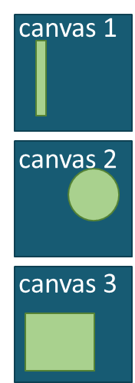
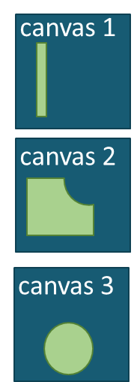


Value function over program states

Slide 38
CSG domain

