Slide 1
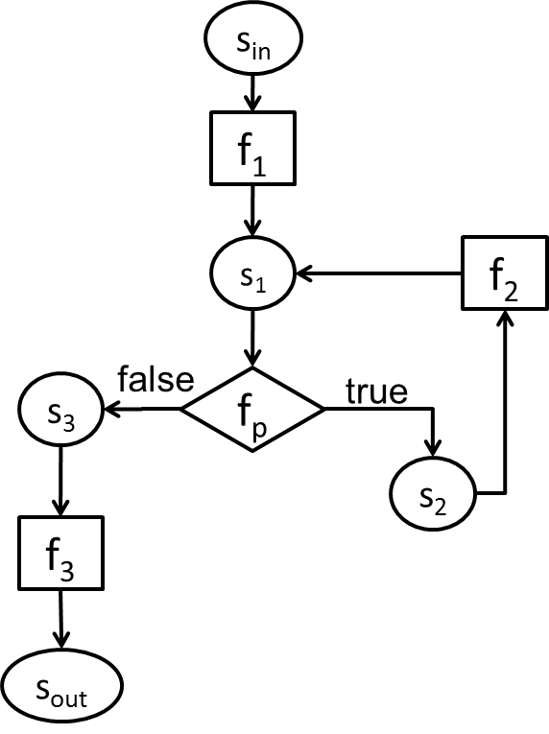
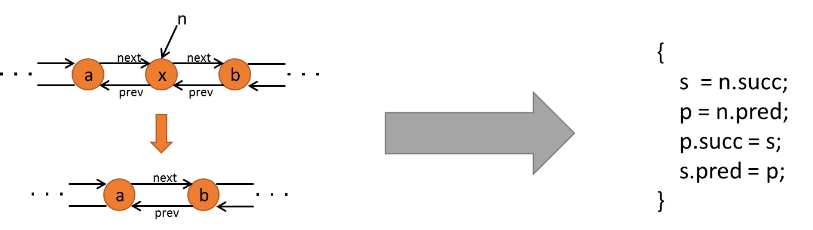
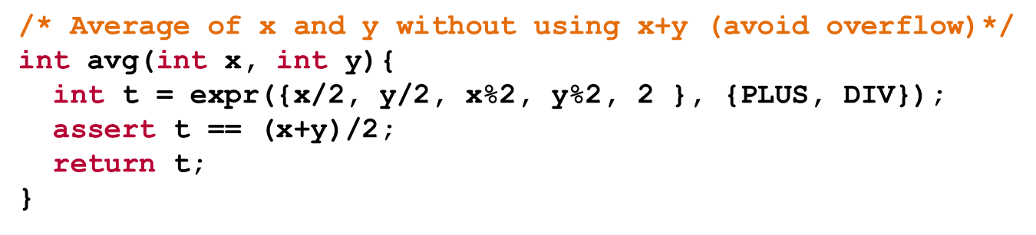
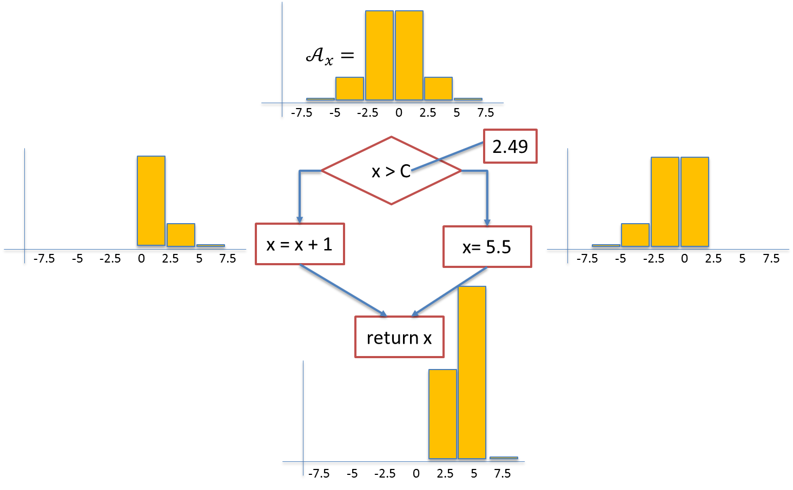
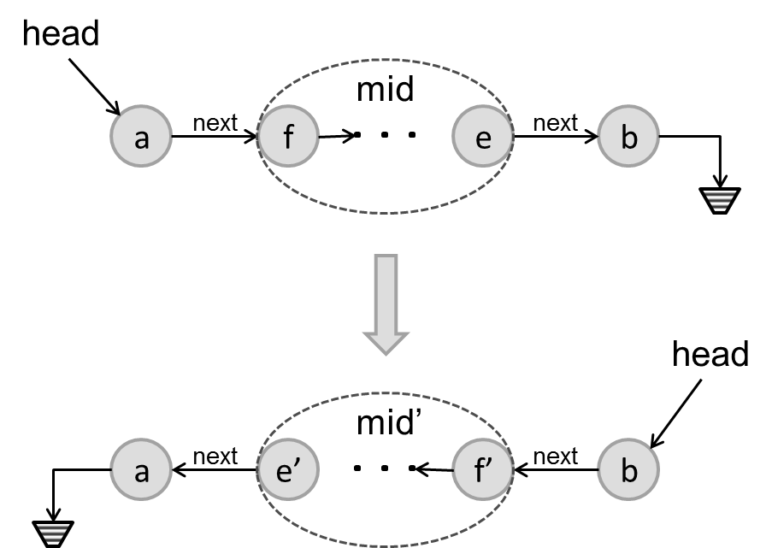
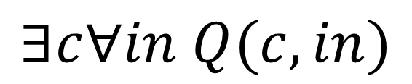
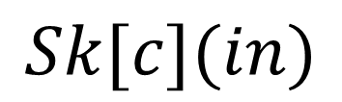

Introduction to
Program Synthesis
6.S981 Fall 2023
$$∃c∀in Q(c,in)$$
$$φ\left(p\right)$$
$$Sk[c](in)$$

Slide 2
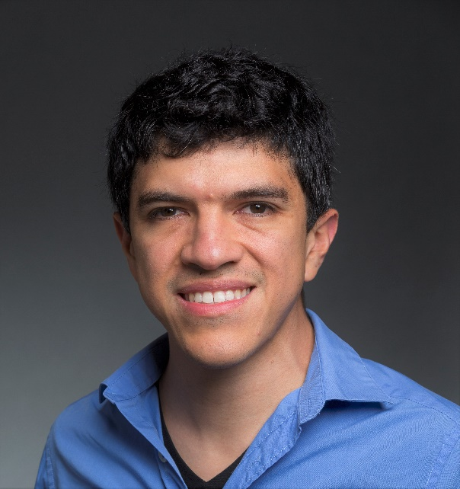
Logistics: Who
Instructor: Armando Solar-Lezama
TA: Kavi Gupta

Slide 3
Logistics: When & Where
Lecture: Tuesday and Thursday 1-2:30 room 26-328
  But you already knew that ☺
Office Hours/Optional Recitation
  Answer questions, talk about tools relevant to the pset, review lecture material
  Optional but useful
    Has worked well in the past
  TBA
Course Website
  http://people.csail.mit.edu/asolar/SynthesisCourse/

Slide 4
Grading
Assignment 1: 20%
Assignment 2: 20%
Assignment 3: 20%
Final Project: 40%

Slide 5
Logistics PSets
Most programming will be in Julia and Sketch
First one will be posted next week
Submission details
  Due at 5pm on the posted due date
  Late penalty will be 10 points per day up to a maximum of 4 days

Slide 6
Logistics: Project
Teams of 1 or 2 people (2.5%)
  Expectations commensurate with size of team
One-page project proposal (12.5%)
  Tell us what you plan to do and give some evidence that you’ve started to work on it.
  For team projects, each team member should submit their own proposal describing their individual understanding of the project and their expected contribution.
Project presentation (10%)
Project report (15%)
Projects will be judged in terms of
  quality of execution
  originality
  scope

