Slide 1
Lecture 11
Proving program correctness
Armando Solar-Lezama

Slide 2
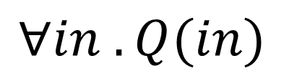
Constraint-based verification
Code
if(x > y){
t = x – y;
while(t > 0){
x = x – 1;
y = y + 1;
t = t – 1;
}
assert y=x_{in}
assert x=y_{in}
}
$$∀in . Q(in)$$
OK
Verification
Condition
Generation
Solver

Slide 3
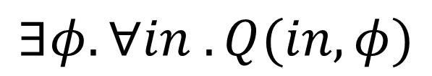
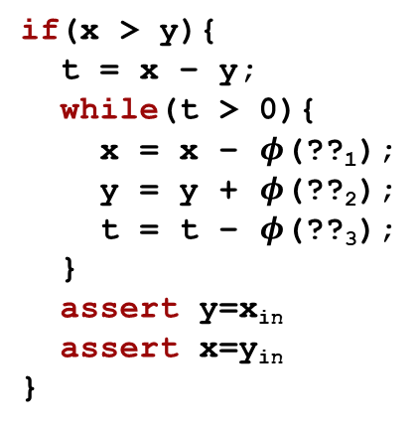

… and Synthesis
Code
if(x > y){
t = x – y;
while(t > 0){
x = x – $φ$(??₁);
y = y + $φ$(??₂);
t = t – $φ$(??₃);
}
assert y=x_{in}
assert x=y_{in}
}
?
$$∃φ. ∀in . Q(in, φ)$$
$$φ$$
Verification
Condition
Generation
Historically, solvers that can deal with quantifier alternations have not been very scalable

Slide 4
Example
Consider the following program
I claim that for any values of x and y
  the loop will terminate
  when it does, if x > y, the values of x and y will be swapped
How could I prove this?
...
if(x > y){
t = x – y;
while(t > 0){
x = x – 1;
y = y + 1;
t = t – 1;
}
}

Slide 5
Axiomatic Semantics
A system for proving properties about programs
Key idea:
  we can define the semantics of a construct by describing its effect on assertions about the program state
Two components
  A language for stating assertions
    can be First Order Logic (FOL) or a specialized logic such as separation logic.
    many specialized languages developed over the years
      Z, Larch, JML, Spec#
  Deductive rules for establishing the truth of such assertions

Slide 6
The basics
{A} stmt {B}
Precondition
Postcondition
Hoare triple
  If the precondition holds before stmt and stmt terminates postcondition will hold afterwards
This is a partial correctness assertion
  we sometimes use the notation
  to denote a total correctness assertion
    that means you also have to prove termination
[A] stmt [B]

Slide 7


What do assertions mean?
We first need to introduce a language
For today we will be using Winskel’s IMP
e:= n | x | e₁ + e₂
c:= x := e | c₁ ; c₂ | if e then c₁ else c₂ | while e do c
Big Step Semantics have two kinds of judgments
  expressions result in values commands change the state

Slide 8
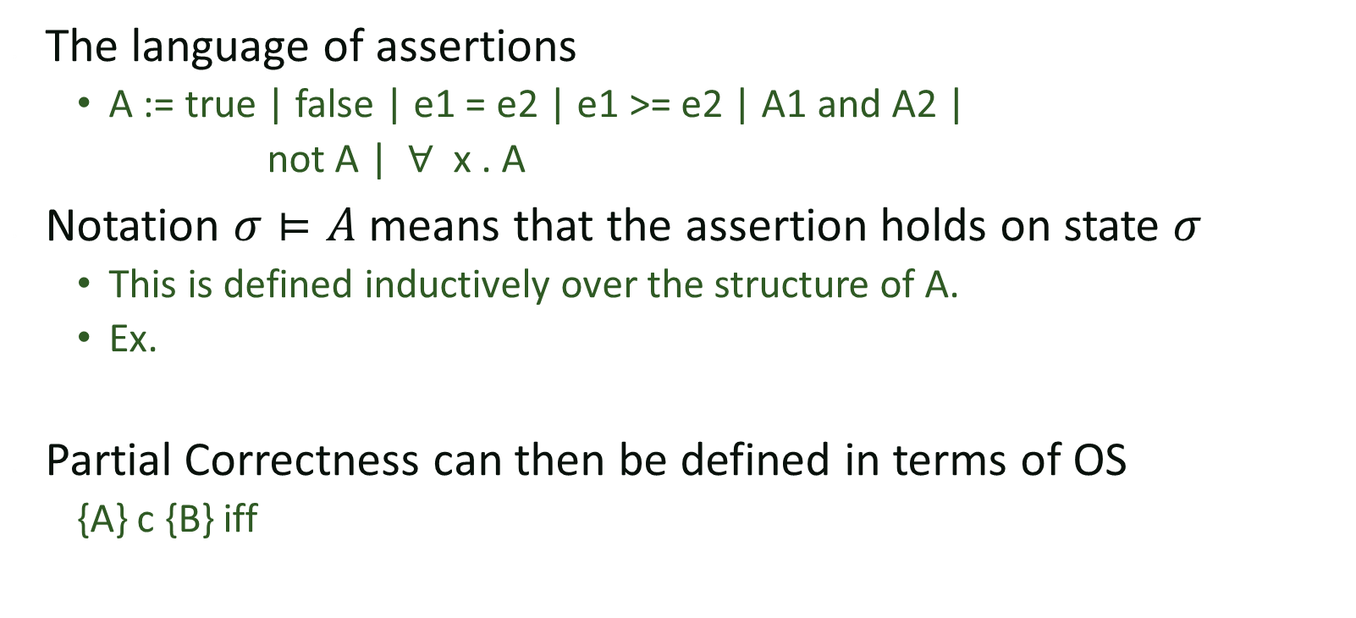
What do assertions mean?
The language of assertions
  A := true | false | e1 = e2 | e1 >= e2 | A1 and A2 |
  not A | $∀$ x . A
Notation $σ⊨A$ means that the assertion holds on state $σ$
  This is defined inductively over the structure of A.
  Ex.
Partial Correctness can then be defined in terms of OS
  {A} c {B} iff

Slide 9


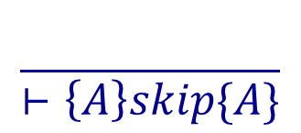



Derivation Rules
Derivation rules for each language construct
Can be combined together with the rule of consequence

Slide 10


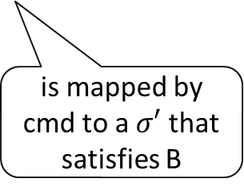
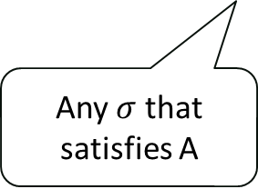

Visualizing the rules
A
cmd
B
$$σ′$$
$$σ$$
Any $σ$ that satisfies A
is mapped by cmd to a $σ′$ that satisfies B
$$\left\{A\right\} cmd \{B\}$$

Slide 11





Visualizing the rules
A
$$c_{1}$$
$$c_{2}$$
B
C
$$σ′$$
$$σ′′$$
$$σ$$

Slide 12


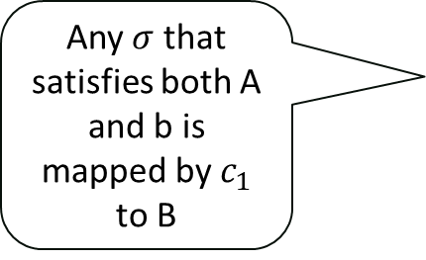







Visualizing the rules
$$c_{1}$$
A
B
b
$¬$b
Any $σ$ that satisfies both A and b is mapped by $c_{1}$ to B
$$σ_{1}$$
$$σ_{1}′$$
$$σ′$$
$$σ_{2}′$$
$$σ_{2}$$
$$c_{2}$$
$$σ$$

Slide 13


Visualizing the rules
A
b
$¬$b
If $c$ maps any point in A and b to another point in A, by the time iteration stops, we are guaranteed to be in $A∧¬b$
$$σ′$$
$$σ$$

Slide 14
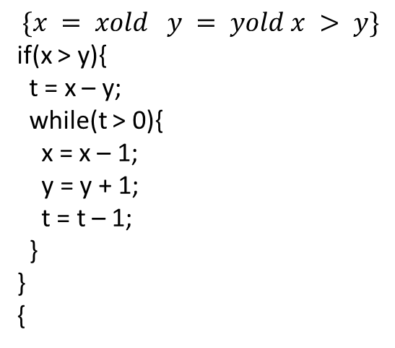
Running Example
$$\{x = xold y = yold x > y\}$$
if(x > y){
t = x – y;
while(t > 0){
x = x – 1;
y = y + 1;
t = t – 1;
}
}
{

Slide 15

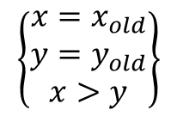
Example
$$\left\{\begin{matrix}x=x_{old} \\ y=y_{old} \\ x>y\end{matrix}\right\}$$
if(x > y)
t = x – y;
while(t > 0)
x = x – 1;
y = y + 1;
t = t – 1;
$$\left\{\begin{matrix}y=x_{old} \\ x=y_{old}\end{matrix}\right\}$$

Slide 16
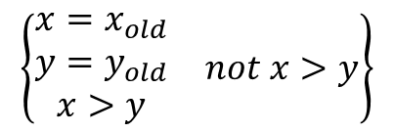


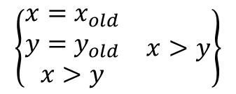
Example
t = x – y;
while(t > 0)
x = x – 1;
y = y + 1;
t = t – 1;
$$\left\{\begin{matrix}\begin{matrix}x=x_{old} \\ y=y_{old} \\ x>y\end{matrix} & x>y\end{matrix}\right\}$$
$$\left\{\begin{matrix}y=x_{old} \\ x=y_{old}\end{matrix}\right\}$$
$$\left\{\begin{matrix}\begin{matrix}x=x_{old} \\ y=y_{old} \\ x>y\end{matrix} & not x>y\end{matrix}\right\}$$
skip
$$\left\{\begin{matrix}y=x_{old} \\ x=y_{old}\end{matrix}\right\}$$
$$\left\{\begin{matrix}x=x_{old} \\ y=y_{old} \\ x>y\end{matrix}\right\}$$
if(x > y)
t = x – y;
while(t > 0)
x = x – 1;
y = y + 1;
t = t – 1;
$$\left\{\begin{matrix}y=x_{old} \\ x=y_{old}\end{matrix}\right\}$$

Slide 17



Example
$$\left\{False\right\}⇒\left\{\begin{matrix}y=x_{old} \\ x=y_{old}\end{matrix}\right\}$$
$$\left\{\begin{matrix}y=x_{old} \\ x=y_{old}\end{matrix}\right\}$$
skip
$$\left\{\begin{matrix}y=x_{old} \\ x=y_{old}\end{matrix}\right\}$$
t = x – y;
while(t > 0)
x = x – 1;
y = y + 1;
t = t – 1;
$$\left\{\begin{matrix}\begin{matrix}x=x_{old} \\ y=y_{old} \\ x>y\end{matrix} & x>y\end{matrix}\right\}$$
$$\left\{\begin{matrix}y=x_{old} \\ x=y_{old}\end{matrix}\right\}$$
$$\left\{\begin{matrix}\begin{matrix}x=x_{old} \\ y=y_{old} \\ x>y\end{matrix} & not x>y\end{matrix}\right\}$$
False
skip
$$\left\{\begin{matrix}y=x_{old} \\ x=y_{old}\end{matrix}\right\}$$
$$\left\{\begin{matrix}x=x_{old} \\ y=y_{old} \\ x>y\end{matrix}\right\}$$
if(x > y)
t = x – y;
while(t > 0)
x = x – 1;
y = y + 1;
t = t – 1;
$$\left\{\begin{matrix}y=x_{old} \\ x=y_{old}\end{matrix}\right\}$$

Slide 18

Example
$$\frac{}{⊢\left\{A\right\}skip\{A\}}$$
$$\left\{False\right\}⇒\left\{\begin{matrix}y=x_{old} \\ x=y_{old}\end{matrix}\right\}$$
$$\left\{\begin{matrix}y=x_{old} \\ x=y_{old}\end{matrix}\right\}$$
skip
$$\left\{\begin{matrix}y=x_{old} \\ x=y_{old}\end{matrix}\right\}$$
t = x – y;
while(t > 0)
x = x – 1;
y = y + 1;
t = t – 1;
$$\left\{\begin{matrix}\begin{matrix}x=x_{old} \\ y=y_{old} \\ x>y\end{matrix} & x>y\end{matrix}\right\}$$
$$\left\{\begin{matrix}y=x_{old} \\ x=y_{old}\end{matrix}\right\}$$
$$\left\{\begin{matrix}\begin{matrix}x=x_{old} \\ y=y_{old} \\ x>y\end{matrix} & not x>y\end{matrix}\right\}$$
False
skip
$$\left\{\begin{matrix}y=x_{old} \\ x=y_{old}\end{matrix}\right\}$$
$$\left\{\begin{matrix}x=x_{old} \\ y=y_{old} \\ x>y\end{matrix}\right\}$$
if(x > y)
t = x – y;
while(t > 0)
x = x – 1;
y = y + 1;
t = t – 1;
$$\left\{\begin{matrix}y=x_{old} \\ x=y_{old}\end{matrix}\right\}$$

Slide 19



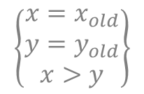



Example
$$\left\{False\right\}⇒\left\{\begin{matrix}y=x_{old} \\ x=y_{old}\end{matrix}\right\}$$
$$\left\{\begin{matrix}y=x_{old} \\ x=y_{old}\end{matrix}\right\}$$
skip
$$\left\{\begin{matrix}y=x_{old} \\ x=y_{old}\end{matrix}\right\}$$
t = x – y;
while(t > 0)
x = x – 1;
y = y + 1;
t = t – 1;
$$\left\{\begin{matrix}\begin{matrix}x=x_{old} \\ y=y_{old} \\ x>y\end{matrix} & x>y\end{matrix}\right\}$$
$$\left\{\begin{matrix}y=x_{old} \\ x=y_{old}\end{matrix}\right\}$$
$$\left\{False\right\}$$
skip
$$\left\{\begin{matrix}y=x_{old} \\ x=y_{old}\end{matrix}\right\}$$
$$\left\{\begin{matrix}x=x_{old} \\ y=y_{old} \\ x>y\end{matrix}\right\}$$
if(x > y)
t = x – y;
while(t > 0)
x = x – 1;
y = y + 1;
t = t – 1;
$$\left\{\begin{matrix}y=x_{old} \\ x=y_{old}\end{matrix}\right\}$$

Slide 20
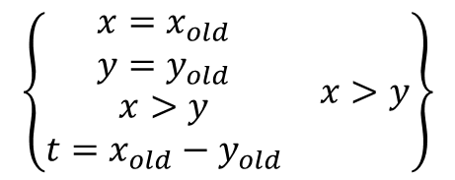


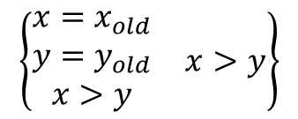
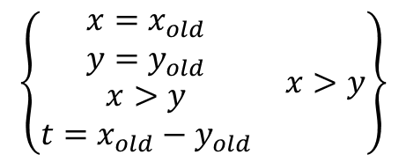
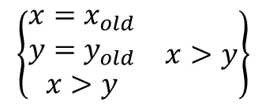
Example
while(t > 0)
x = x – 1;
y = y + 1;
t = t – 1;
$$\left\{\begin{matrix}\begin{matrix}x=x_{old} \\ y=y_{old} \\ x>y\end{matrix} & x>y\end{matrix}\right\}$$
$$\left\{\begin{matrix}\begin{matrix}x=x_{old} \\ y=y_{old} \\ \begin{aligned}x>y \\ t=x_{old}−y_{old}\end{aligned}\end{matrix} & x>y\end{matrix}\right\}$$
$$\left\{\begin{matrix}\begin{matrix}x=x_{old} \\ y=y_{old} \\ \begin{aligned}x>y \\ t=x_{old}−y_{old}\end{aligned}\end{matrix} & x>y\end{matrix}\right\}$$
$$\left\{\begin{matrix}y=x_{old} \\ x=y_{old}\end{matrix}\right\}$$
t = x – y;
t = x – y;
while(t > 0)
x = x – 1;
y = y + 1;
t = t – 1;
$$\left\{\begin{matrix}\begin{matrix}x=x_{old} \\ y=y_{old} \\ x>y\end{matrix} & x>y\end{matrix}\right\}$$
$$\left\{\begin{matrix}y=x_{old} \\ x=y_{old}\end{matrix}\right\}$$

Slide 21

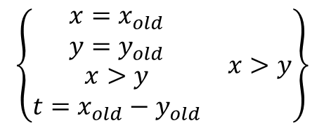

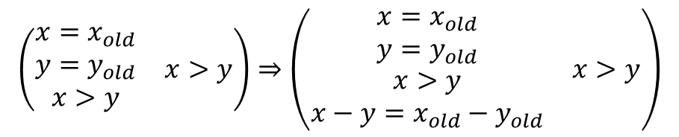
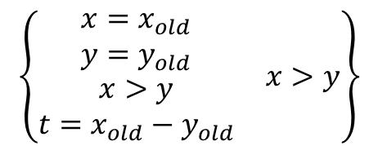
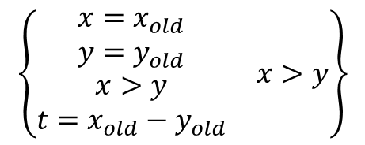
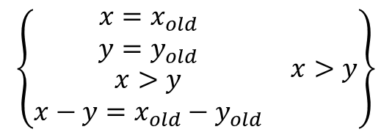
Example
$$\left(\begin{matrix}\begin{matrix}x=x_{old} \\ y=y_{old} \\ x>y\end{matrix} & x>y\end{matrix}\right)⇒\left(\begin{matrix}\begin{matrix}x=x_{old} \\ y=y_{old} \\ \begin{aligned}x>y \\ x−y=x_{old}−y_{old}\end{aligned}\end{matrix} & x>y\end{matrix}\right)$$
$$\left\{\begin{matrix}\begin{matrix}x=x_{old} \\ y=y_{old} \\ \begin{aligned}x>y \\ x−y=x_{old}−y_{old}\end{aligned}\end{matrix} & x>y\end{matrix}\right\}$$
$$\left\{\begin{matrix}\begin{matrix}x=x_{old} \\ y=y_{old} \\ \begin{aligned}x>y \\ t=x_{old}−y_{old}\end{aligned}\end{matrix} & x>y\end{matrix}\right\}$$
t = x – y;
while(t > 0)
x = x – 1;
y = y + 1;
t = t – 1;
$$\left\{\begin{matrix}\begin{matrix}x=x_{old} \\ y=y_{old} \\ x>y\end{matrix} & x>y\end{matrix}\right\}$$
$$\left\{\begin{matrix}\begin{matrix}x=x_{old} \\ y=y_{old} \\ \begin{aligned}x>y \\ t=x_{old}−y_{old}\end{aligned}\end{matrix} & x>y\end{matrix}\right\}$$
$$\left\{\begin{matrix}\begin{matrix}x=x_{old} \\ y=y_{old} \\ \begin{aligned}x>y \\ t=x_{old}−y_{old}\end{aligned}\end{matrix} & x>y\end{matrix}\right\}$$
$$\left\{\begin{matrix}y=x_{old} \\ x=y_{old}\end{matrix}\right\}$$
t = x – y;
t = x – y;
while(t > 0)
x = x – 1;
y = y + 1;
t = t – 1;
$$\left\{\begin{matrix}\begin{matrix}x=x_{old} \\ y=y_{old} \\ x>y\end{matrix} & x>y\end{matrix}\right\}$$
$$\left\{\begin{matrix}y=x_{old} \\ x=y_{old}\end{matrix}\right\}$$

Slide 22

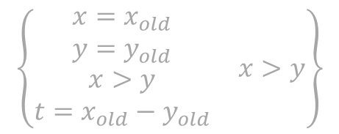
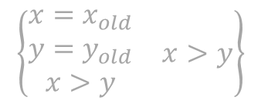
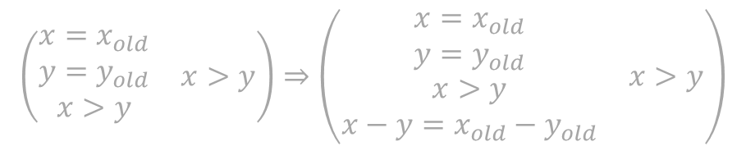
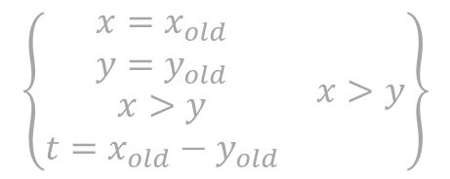
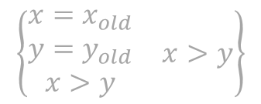
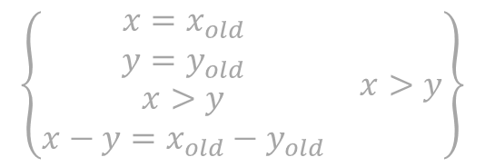
Example
$$\left(\begin{matrix}\begin{matrix}x=x_{old} \\ y=y_{old} \\ x>y\end{matrix} & x>y\end{matrix}\right)⇒\left(\begin{matrix}\begin{matrix}x=x_{old} \\ y=y_{old} \\ \begin{aligned}x>y \\ x−y=x_{old}−y_{old}\end{aligned}\end{matrix} & x>y\end{matrix}\right)$$
$$\left\{\begin{matrix}\begin{matrix}x=x_{old} \\ y=y_{old} \\ \begin{aligned}x>y \\ x−y=x_{old}−y_{old}\end{aligned}\end{matrix} & x>y\end{matrix}\right\}$$
$$\left\{\begin{matrix}\begin{matrix}x=x_{old} \\ y=y_{old} \\ \begin{aligned}x>y \\ t=x_{old}−y_{old}\end{aligned}\end{matrix} & x>y\end{matrix}\right\}$$
t = x – y;
while(t > 0)
x = x – 1;
y = y + 1;
t = t – 1;
$$\left\{\begin{matrix}\begin{matrix}x=x_{old} \\ y=y_{old} \\ x>y\end{matrix} & x>y\end{matrix}\right\}$$
$$\left\{\begin{matrix}\begin{matrix}x=x_{old} \\ y=y_{old} \\ \begin{aligned}x>y \\ t=x_{old}−y_{old}\end{aligned}\end{matrix} & x>y\end{matrix}\right\}$$
$$\left\{\begin{matrix}\begin{matrix}x=x_{old} \\ y=y_{old} \\ \begin{aligned}x>y \\ t=x_{old}−y_{old}\end{aligned}\end{matrix} & x>y\end{matrix}\right\}$$
$$\left\{\begin{matrix}y=x_{old} \\ x=y_{old}\end{matrix}\right\}$$
t = x – y;
t = x – y;
while(t > 0)
x = x – 1;
y = y + 1;
t = t – 1;
$$\left\{\begin{matrix}\begin{matrix}x=x_{old} \\ y=y_{old} \\ x>y\end{matrix} & x>y\end{matrix}\right\}$$
$$\left\{\begin{matrix}y=x_{old} \\ x=y_{old}\end{matrix}\right\}$$

Slide 23
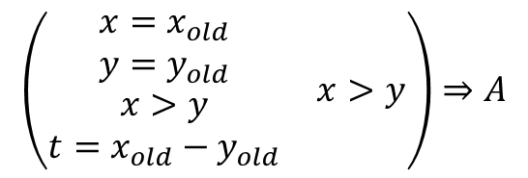


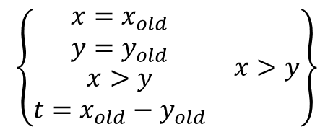




Example
x = x – 1;
y = y + 1;
t = t – 1;
$$\left\{A∧t>0\right\}$$
$$\left\{A\right\}$$
while(t > 0)
x = x – 1;
y = y + 1;
t = t – 1;
$$\left(\begin{matrix}\begin{matrix}x=x_{old} \\ y=y_{old} \\ \begin{aligned}x>y \\ t=x_{old}−y_{old}\end{aligned}\end{matrix} & x>y\end{matrix}\right)⇒A$$
$$\left\{A\right\}$$
$$\left\{\begin{matrix}A∧ & not t>0\end{matrix}\right\}$$
$$A∧not t>0⇒\left(\begin{matrix}y=x_{old} \\ x=y_{old}\end{matrix}\right)$$
while(t > 0)
x = x – 1;
y = y + 1;
t = t – 1;
$$\left\{\begin{matrix}\begin{matrix}x=x_{old} \\ y=y_{old} \\ \begin{aligned}x>y \\ t=x_{old}−y_{old}\end{aligned}\end{matrix} & x>y\end{matrix}\right\}$$
$$\left\{\begin{matrix}y=x_{old} \\ x=y_{old}\end{matrix}\right\}$$

Slide 24

Loop Invariant
{Pre} while(p) c {Post}
Need to find invariant A such that
  $Pre⇒A$
  $A∧¬ p⇒Post$
  $\left\{A∧p\right\}c \{A\}$

Slide 25
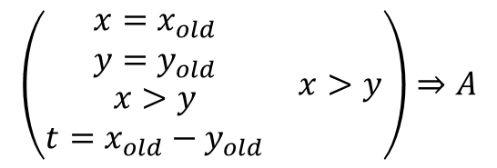



Example
x = x – 1;
y = y + 1;
t = t – 1;
$$\left\{A∧t>0\right\}$$
$$\left\{A\right\}$$
$$\left(\begin{matrix}\begin{matrix}x=x_{old} \\ y=y_{old} \\ \begin{aligned}x>y \\ t=x_{old}−y_{old}\end{aligned}\end{matrix} & x>y\end{matrix}\right)⇒A$$
$$A∧not t>0⇒\left(\begin{matrix}y=x_{old} \\ x=y_{old}\end{matrix}\right)$$
Notes:
x=y0+t and y=x0-t and t>=0

Slide 26
Soundness and Completeness
What does it mean for our deduction rules to be sound?
  You will never be able to prove anything that is not true
  truth is defined in terms of our original definition of {A} c {B}
  we can prove this, but it’s tricky
What does it mean for them to be complete?
  If a statement is true, we should be able to prove it via deduction
So are they complete?
  yes and no
    They are complete relative to the logic
    but there are no complete and consistent logics for elementary arithmetic (Gödel)

Slide 27
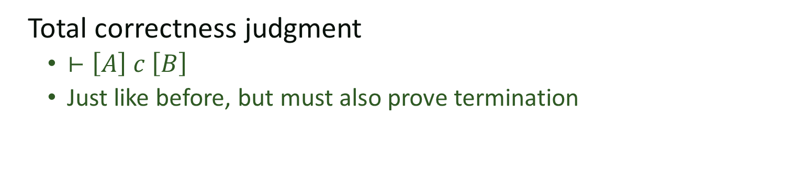
From partial to total correctness
Total correctness judgment
  $⊢\left[A\right] c \left[B\right]$
  Just like before, but must also prove termination
What about loops

Slide 28
Rank function
Function F of the state that
  a) Maps state to an integer
  b) Decreases with every iteration of the loop
  c) Is guaranteed to stay greater than zero
  Also called variant function
z is just a fresh variable not used elsewhere in the expressions

Slide 29
Example
Can we prove this?
[ x=x0 and y=y0 and x > y ]
if(x > y){
t = x – y;
while(t > 0){
x = x – 1;
y = y + 1;
t = t – 1;
}
}
[y=x0 and x=y0 ]

Slide 30



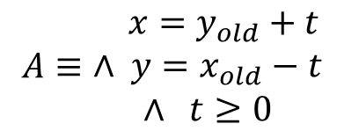



Example
$$A≡\begin{matrix} x=y_{old}+t \\ ∧ y=x_{old}−t \\ ∧ t≥0\end{matrix}$$
$$F≡t$$
x = x – 1;
y = y + 1;
t = t – 1;
$$\left[A∧t>0∧t=z\right]$$
$$\left[A∧(t<z)\right]$$
$$A∧t>0⇒t≥0$$
while(t > 0)
x = x – 1;
y = y + 1;
t = t – 1;
$$\left[A\right]$$
$$\left[\begin{matrix}A∧ & not t>0\end{matrix}\right]$$
Notes:
x=y_{old}+t \\
\wedge& y=x_{old}-t \\
\wedge & t>=0

Slide 31
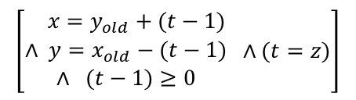

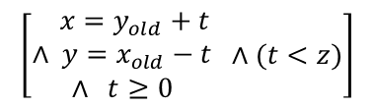

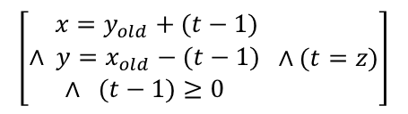

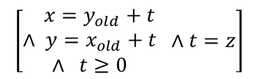
Example
$$\left[\begin{matrix} x=y_{old}+t \\ ∧ y=x_{old}+t \\ ∧ t≥0\end{matrix} ∧t=z\right]$$
x = x – 1;
y = y + 1;
$$\left[\begin{matrix} x=y_{old}+(t−1) \\ ∧ y=x_{old}−(t−1) \\ ∧ (t−1)≥0\end{matrix} ∧(t=z)\right]$$
$$\left[\begin{matrix} x=y_{old}+(t−1) \\ ∧ y=x_{old}−(t−1) \\ ∧ (t−1)≥0\end{matrix} ∧(t=z)\right]$$
t = t – 1;
$$\left[\begin{matrix} x=y_{old}+t \\ ∧ y=x_{old}−t \\ ∧ t≥0\end{matrix} ∧(t<z)\right]$$
x = x – 1;
y = y + 1;
t = t – 1;
$$\left[A∧t>0∧t=z\right]$$
$$\left[A∧(t<z)\right]$$
$$A∧t>0⇒t≥0$$
while(t > 0)
x = x – 1;
y = y + 1;
t = t – 1;
$$\left[A\right]$$
$$\left[\begin{matrix}A∧ & not t>0\end{matrix}\right]$$
Notes:
x=y_{old}+t \\
\wedge& y=x_{old}-t \\
\wedge & t>=0

Slide 32
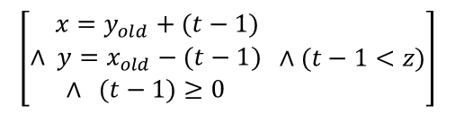
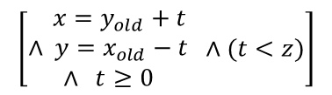

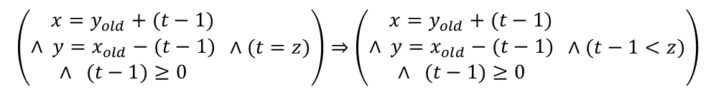
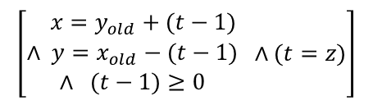
Example
$$\left(\begin{matrix} x=y_{old}+(t−1) \\ ∧ y=x_{old}−(t−1) \\ ∧ (t−1)≥0\end{matrix} ∧(t=z)\right)⇒\left(\begin{matrix} x=y_{old}+(t−1) \\ ∧ y=x_{old}−(t−1) \\ ∧ (t−1)≥0\end{matrix} ∧(t−1<z)\right)$$
$$\left[\begin{matrix} x=y_{old}+(t−1) \\ ∧ y=x_{old}−(t−1) \\ ∧ (t−1)≥0\end{matrix} ∧(t−1<z)\right]$$
t = t – 1;
$$\left[\begin{matrix} x=y_{old}+t \\ ∧ y=x_{old}−t \\ ∧ t≥0\end{matrix} ∧(t<z)\right]$$
$$…$$
$$\left[\begin{matrix} x=y_{old}+(t−1) \\ ∧ y=x_{old}−(t−1) \\ ∧ (t−1)≥0\end{matrix} ∧(t=z)\right]$$
t = t – 1;
$$\left[\begin{matrix} x=y_{old}+t \\ ∧ y=x_{old}−t \\ ∧ t≥0\end{matrix} ∧(t<z)\right]$$
x = x – 1;
y = y + 1;
t = t – 1;
$$\left[A∧t>0∧t=z\right]$$
$$\left[A∧(t<z)\right]$$
$$A∧t>0⇒t≥0$$
while(t > 0)
x = x – 1;
y = y + 1;
t = t – 1;
$$\left[A\right]$$
$$\left[\begin{matrix}A∧ & not t>0\end{matrix}\right]$$
Notes:
x=y_{old}+t \\
\wedge& y=x_{old}-t \\
\wedge & t>=0

Slide 33


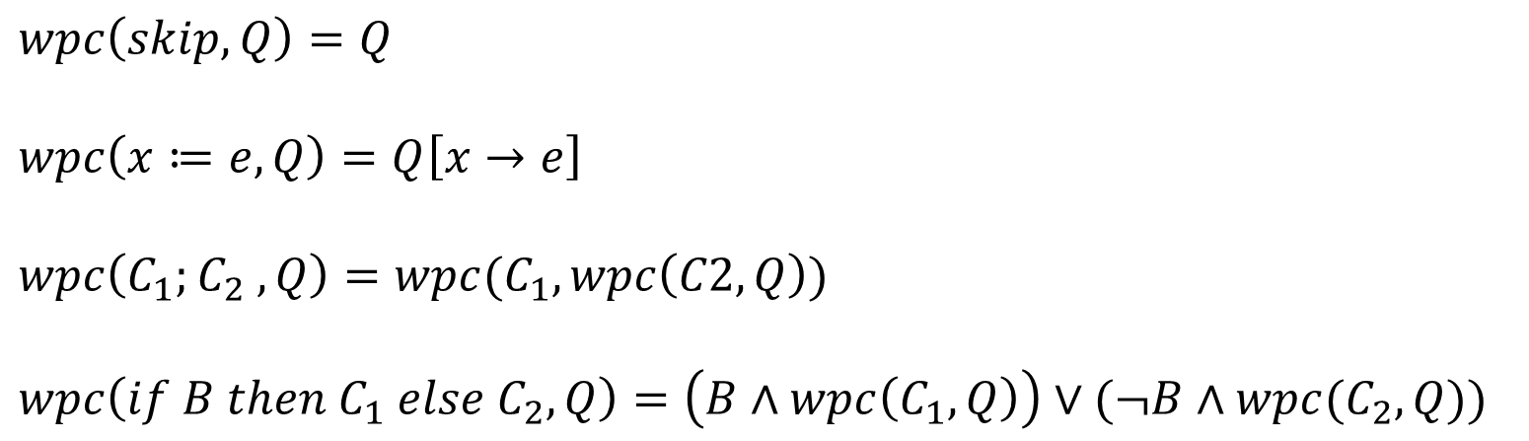
Weakest Preconditions
$$P=wpc(c, A)$$
Command
Predicate
Weakest predicate P such that $\left\{P\right\} c \{A\}$
  P weaker than Q iff $Q⇒P$
P
Q
$$wpc\left(skip, Q\right)=Q$$
$$wpc\left(x≔e, Q\right)=Q\left[x→e\right]$$
$$wpc\left(C_{1};C_{2} , Q\right)=wpc(C_{1}, wpc\left(C2, Q\right))$$
$$wpc\left(if B then C_{1} else C_{2}, Q\right)=\left(B∧wpc\left(C_{1}, Q\right)\right)∨(¬B∧wpc(C_{2}, Q))$$

Slide 34

Weakest Precondition
While-loop is tricky
  Let W $=wpc\left(while e do c, B\right)$
  then,
  W = $e⇒wpc\left(c, W\right) ∧ ¬e⇒B$

Slide 35
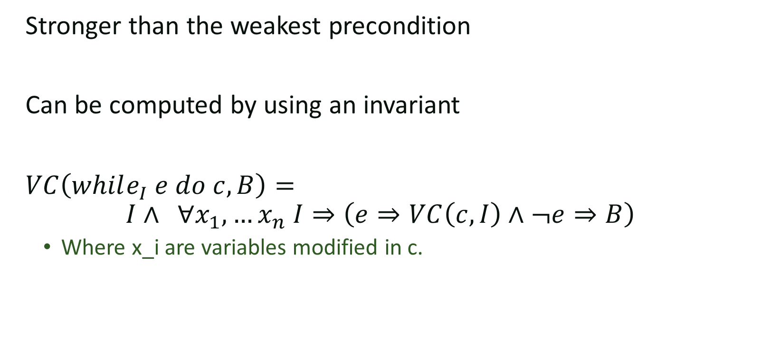
Verification Condition
Stronger than the weakest precondition
Can be computed by using an invariant
$VC\left(while_{I} e do c, B\right)=$
$$I∧ ∀x_{1}, …x_{n} I⇒\left(e⇒VC\left(c,I\right)∧¬e⇒B\right)$$
  Where x_i are variables modified in c.

