Slide 1
Lecture 12
Synthesis + Verification
Armando Solar-Lezama

Slide 2
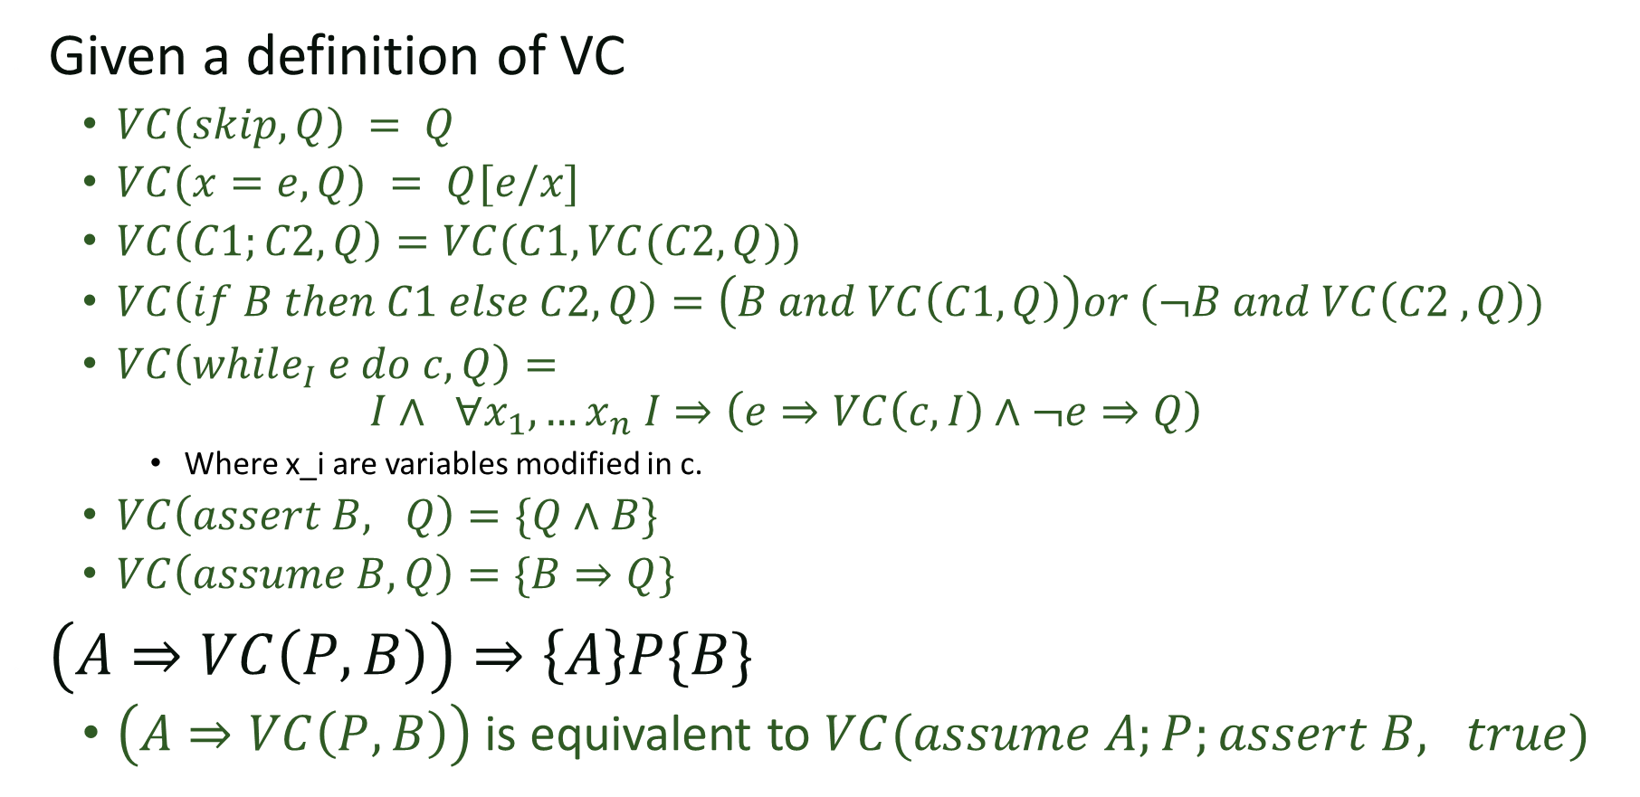
Recap
Given a definition of VC
  $VC(skip, Q) = Q$
  $VC(x=e,Q) = Q[e/x]$
  $VC\left(C1;C2, Q\right)=VC(C1,VC(C2, Q))$
  $VC\left(if B then C1 else C2, Q\right)=\left(B and VC\left(C1, Q\right)\right)or (¬B and VC\left(C2 ,Q\right))$
  $VC\left(while_{I} e do c, Q\right)=$
  $$I∧ ∀x_{1}, …x_{n} I⇒\left(e⇒VC\left(c,I\right)∧¬e⇒Q\right)$$
    Where x_i are variables modified in c.
  $VC\left(assert B, Q\right)=\{Q∧B\}$
  $VC\left(assume B, Q\right)=\{B⇒Q\}$
$\left(A⇒VC\left(P, B\right)\right)⇒\left\{A\right\}P\{B\}$
  $\left(A⇒VC\left(P, B\right)\right)$ is equivalent to $VC(assume A;P;assert B, true)$

Slide 3
Synthesizing invariants
Given a program with pre/post conditions, the only obstacle to making verification automatic is finding the invariants
  (and checking the resulting formula if it happens
  to be in a complicated logic)

Slide 4
Example
{y=y_0, k=k_0, t=y_0-k_0}
while(t>0){
y = y-1;
t = t-1;
}
Assert y <= k_0;
Notes:
Work out the verification condition in text.

Slide 5


VC as a sketch harness
$$∀y,y_{0},k,k_{0},t, y^{′}, t^{′}, y^{′′}, \left(y=y_{0}∧k=k_{0}∧t=y_{0}−k_{0}\right)⇒$$
$$inv\left(y, y_{0},k,k_{0},t\right)$$
$$inv\left(y^{′}, y_{0},k,k_{0},t^{′}\right)∧\left(t^{′}>0\right)⇒inv\left(y^{′}−1, y_{0},k,k_{0},t^{′}−1\right)$$
$inv\left(y^{′′}, y_{0},k, k_{0}, t^{′′}\right)∧¬\left(t^{′′}>0\right)⇒y^{′′}≤k_{0}$,
harness void main(int y, int y_0, int k, int k_0, int t,
int yp, int tp, int ypp, int tpp ){
if(y==y_0 && k==k_0 && t==y_0-k_0){
assert inv(y, y_0, k, k_0, t);
  if(inv(yp, y_0, k, k_0, tp) && tp>0){
  assert inv(yp-1, y_0, k, k_0, tp-1);
  }
  if(inv(ypp, y_0, k, k_0, tpp) && tpp<=0){
  assert ypp <= k_0;
  }
} }
Notes:
/*
This sketch is designed to find an invariant for the following problem:
{y=y_0, k=k_0, t=y_0-k_0}
while(t>0){
y = y-1;
t = t-1;
}
Assert y <= k_0;
*/
include "generators.skh";
pragma options "--bnd-inline-amnt 3";
bit inv(int y, int y_0, int k, int k_0, int t){
return exprBool({y, y_0, k, k_0, t}, {PLUS});
}
harness void main(int y, int y_0, int k, int k_0, int t,
int yp, int tp, int ypp, int tpp
){
if(y==y_0 && k==k_0 && t==y_0-k_0){
assert inv(y, y_0, k, k_0, t);
if(inv(yp, y_0, k, k_0, tp) && tp>0){
assert inv(yp-1, y_0, k, k_0, tp-1);
}
if(inv(ypp, y_0, k, k_0, tpp) && tpp<=0){
assert ypp <= k_0;
}
}
}

Slide 6
VC as a sketch invariant
include "generators.skh";
pragma options "--bnd-inline-amnt 3";
bit inv(int y, int y_0, int k, int k_0, int t){
return exprBool({y, y_0, k, k_0, t}, {PLUS});
}

Slide 7
Summary
If we find a solution that works for all inputs, we know the program verifies
Sketch has no loops so bounded execution is not a problem
Sketch is only considering small inputs
  To get full guarantees we need to check that the resulting invariant works for *all* inputs
  We can check that with an SMT solver
Notes:
Next week we’ll have a lecture on how SMT solvers work.

Slide 8
Verified synthesis
What if we want to synthesize the function body too?
Candidate solution:
  Inline all generators
  Pretend that ?? Is just another expression
  Generate VC from that program.
  Solve for all unknowns
  Plug them back into the original program
This almost works

Slide 9
Verified synthesis
{P}
While(true){ }
{Q}
This is valid for any P and Q!

Slide 10

From partial to total correctness
Total correctness judgment
  $⊢\left[A\right] c \left[B\right]$
  Just like before, but must also prove termination
What about loops

Slide 11
Ranking function
Function F of the state that
  a) Maps state to an integer (in general, a well-ordered set)
  b) Decreases with every iteration of the loop
  c) Is guaranteed to stay greater than zero
  Also called variant function
If a ranking function exists, program is guaranteed to terminate
We can synthesize that too!

Slide 12
From program verification to program synthesis
Srivastava, Gulwani, Foster

Slide 13
Key ideas
Structured program statements to reduce symmetries

Slide 14
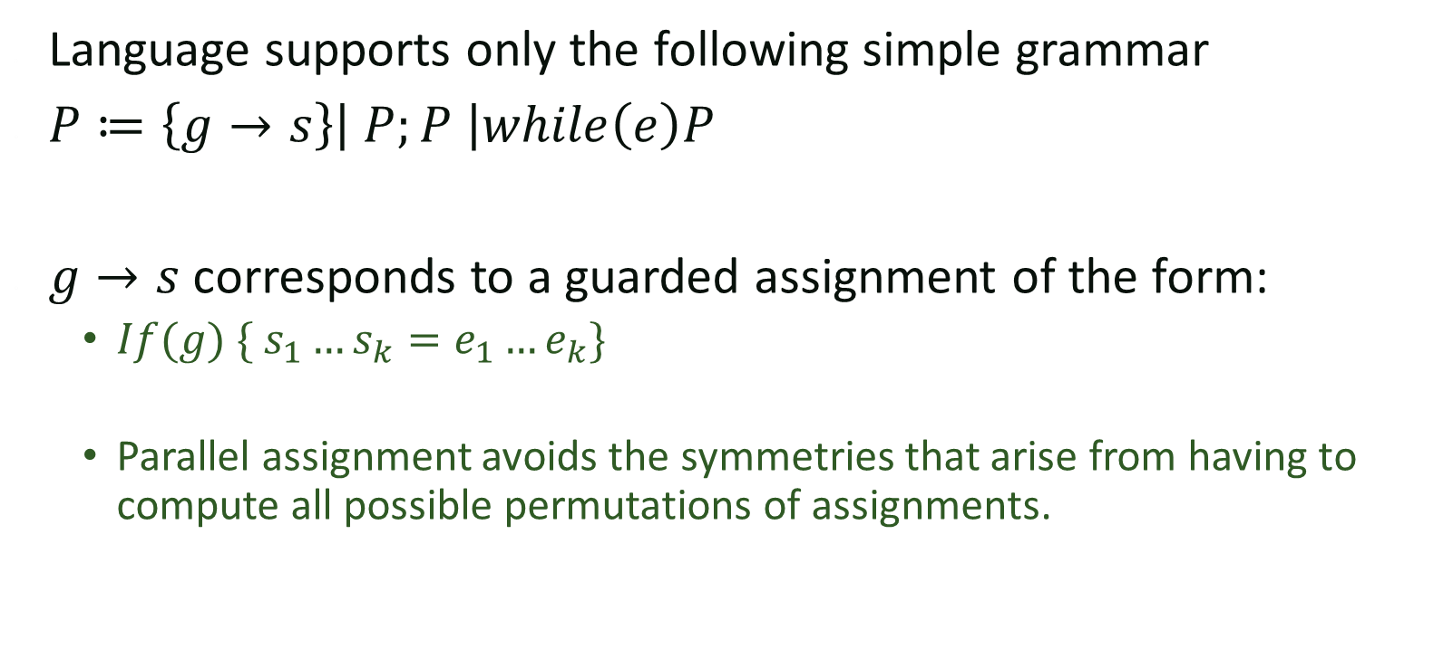
Stylized program fragments
Language supports only the following simple grammar
$P≔\left\{g→s\right\}\left| P;P \right|while\left(e\right)P$
$g→s$ corresponds to a guarded assignment of the form:
  $If(g) \{ s_{1}…s_{k}=e_{1}…e_{k}\}$
  Parallel assignment avoids the symmetries that arise from having to compute all possible permutations of assignments.

Slide 15
Proof-Theoretic Synthesis
Input: Program Scaffold
  Flowgraph template (a nested loop structure)
  Function spec (pre-/post-conditions)
  Other constraints (temp variables, size limit, etc. )
Output:
  Synthesized code fragments
  Associated loop invariants and ranking functions
Synthesis Condition:
  Generalization of verification conditions
  A valid program exists iff. the SC has a satisfying solution

Slide 16
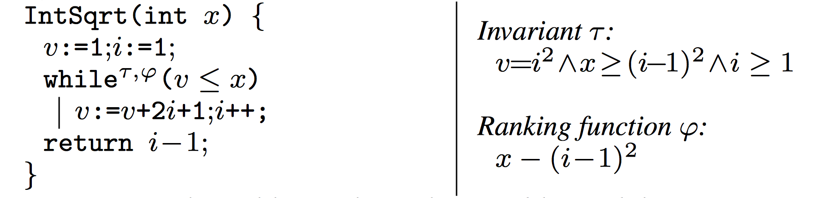
Example: Square Root

Slide 17

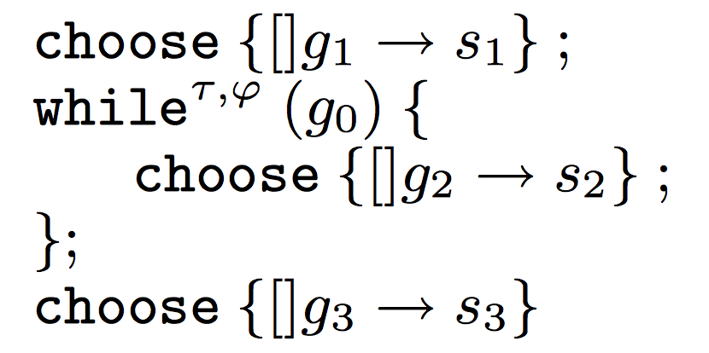

Program Scaffold
Pre:
Post:
(Assume only one branch in each fragment)

Slide 18
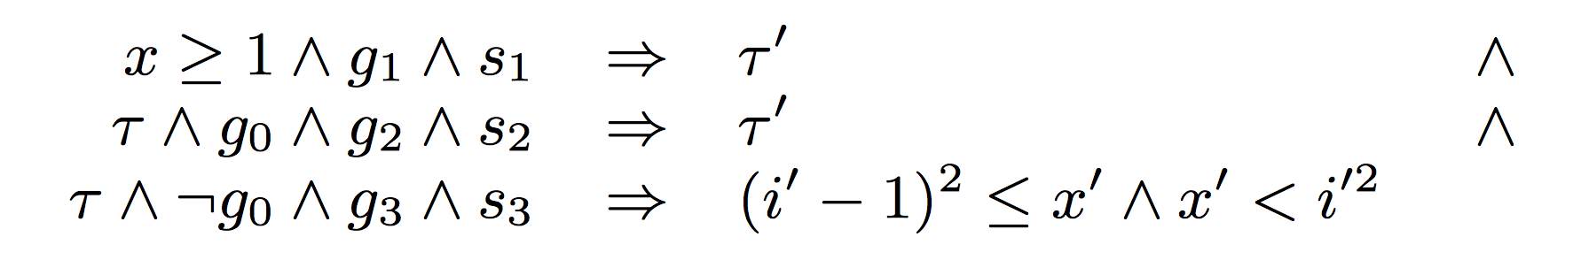
Verification Condition

Slide 19
Well-formedness Condition

Slide 20
Ranking Function

Slide 21
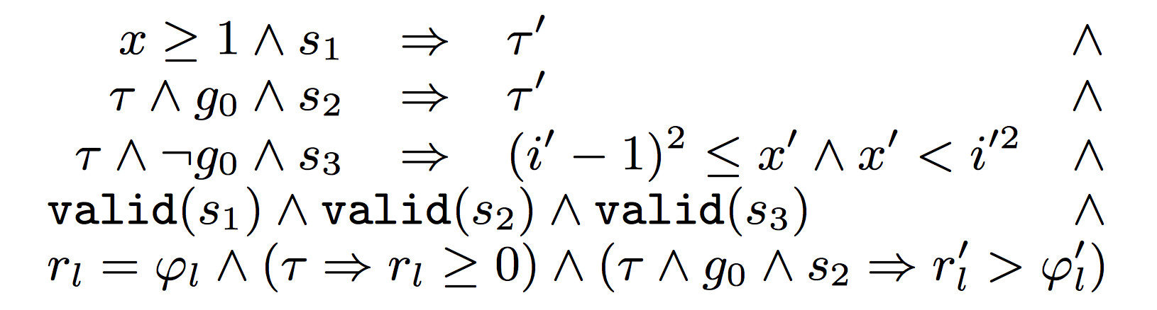
Synthesis Conditions
Theorem (soundness and completeness)
  The synthesis conditions are satisfiable iff. there exists a program that is valid w.r.t. the scaffold.

