Slide 1
Lecture 17
Deductive and Transformational Synthesis
Armando Solar-Lezama
with some slides from Adam Chlipala

Slide 2
A Transformation System for Developing Recursive Programs
R.M. Burstall and John Darlington 1977

Slide 3
“We make no claim for any sort of completeness of the system; it embodies only one family of program transformations, and we have no formal delineation of this family. … However, we hope that the examples will give the reader pleasure…”

Slide 4
Key premise
(1) Start with a clean high-level representation of the problem
(2) Apply semantics preserving transformations
(3) Arrive at a less clean but more efficient representation

Slide 5
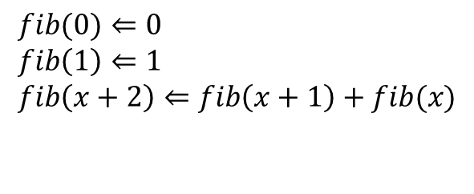
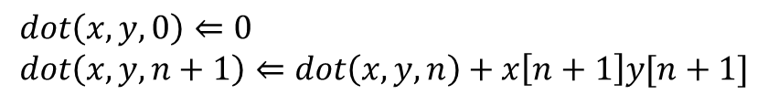
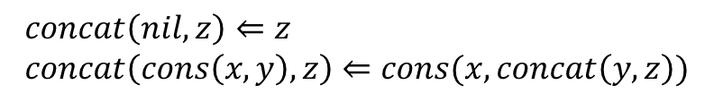
Clean high-level spec
$$dot\left(x,y,0\right)⇐0 \\ dot\left(x,y,n+1\right)⇐dot\left(x,y,n\right)+x\left[n+1\right]y[n+1]$$
$$fib(0)⇐0 \\ fib\left(1\right)⇐1 \\ fib\left(x+2\right)⇐fib\left(x+1\right)+fib(x)$$
$$concat\left(nil,z\right)⇐z \\ concat\left(cons\left(x,y\right),z\right)⇐cons(x,concat\left(y,z\right))$$

Slide 6
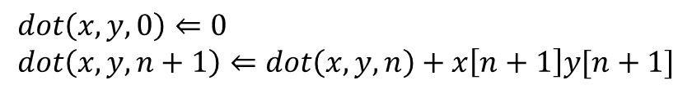
Example
$$dot\left(x,y,0\right)⇐0 \\ dot\left(x,y,n+1\right)⇐dot\left(x,y,n\right)+x\left[n+1\right]y[n+1]$$
$$f\left(a,b,c,d,n\right)⇐dot\left(a,b,n\right)+dot(c,d,n)$$

Slide 7
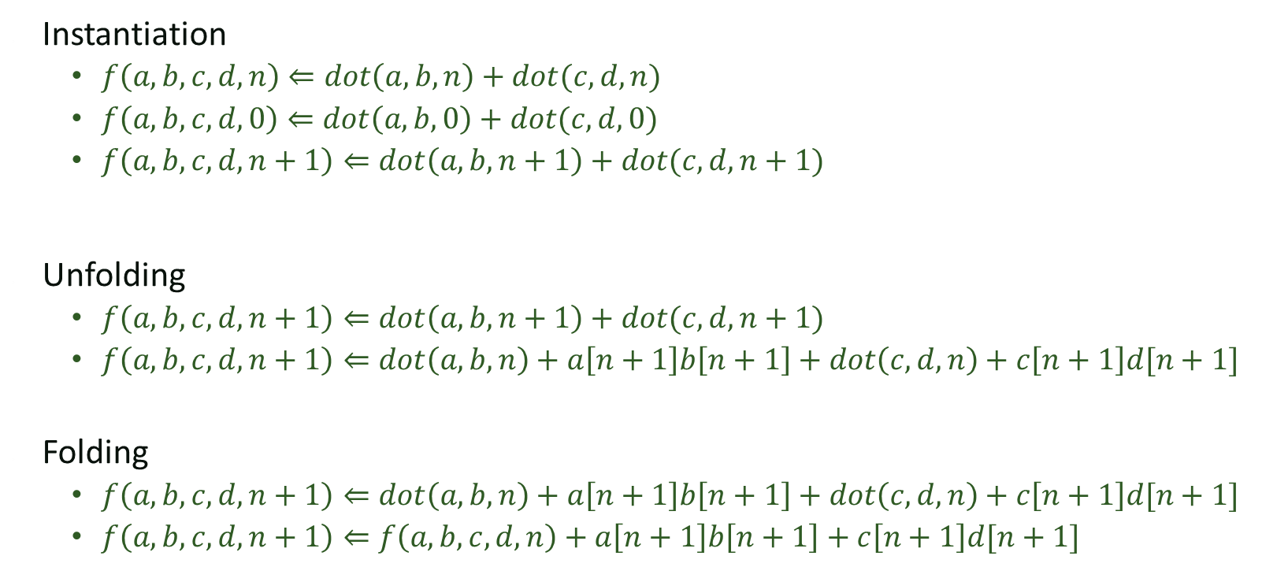
Key transformation rules
Instantiation
  $f\left(a,b,c,d,n\right)⇐dot\left(a,b,n\right)+dot(c,d,n)$
  $f\left(a,b,c,d,0\right)⇐dot\left(a,b,0\right)+dot(c,d,0)$
  $f\left(a,b,c,d,n+1\right)⇐dot\left(a,b,n+1\right)+dot(c,d,n+1)$
Unfolding
  $f\left(a,b,c,d,n+1\right)⇐dot\left(a,b,n+1\right)+dot(c,d,n+1)$
  $f\left(a,b,c,d,n+1\right)⇐dot\left(a,b,n\right)+a\left[n+1\right]b\left[n+1\right]+dot\left(c,d,n\right)+c\left[n+1\right]d[n+1]$
Folding
  $f\left(a,b,c,d,n+1\right)⇐dot\left(a,b,n\right)+a\left[n+1\right]b\left[n+1\right]+dot\left(c,d,n\right)+c\left[n+1\right]d[n+1]$
  $f\left(a,b,c,d,n+1\right)⇐f\left(a,b,c,d,n\right)+a\left[n+1\right]b\left[n+1\right]+c\left[n+1\right]d[n+1]$

Slide 8

Key transformation rules
Algebraic laws
  $f\left(a,b,c,d,n+1\right)⇐dot\left(a,b,n\right)+a\left[n+1\right]b\left[n+1\right]+dot\left(c,d,n\right)+c\left[n+1\right]d[n+1]$
  $f\left(a,b,c,d,n+1\right)⇐dot\left(a,b,n\right)+dot\left(c,d,n\right)+a\left[n+1\right]b\left[n+1\right]+c\left[n+1\right]d[n+1]$
Abstraction
  $E\left[F_{1}→u_{1},…F_{n}→u_{n}\right] where \left\langle u_{1}…u_{n}\right\rangle =\left\langle F_{1},…,F_{n}\right\rangle$

Slide 9
Fibonacci

Slide 10
Dreams => Programs
Waldinger & Manna 1979

Slide 11
Deductive synthesis
Similar ideas to Burstall and Darlington with a solid theoretical footing
A lot more ambitious
“…Such a system accepts specifications that express the purpose of the program to be constructed, without giving any hint of the algorithm to be employed. With no further human intervention, the system attempts to transform these specifications into a program that achieves the expressed purpose”

Slide 12
Specifications

Slide 13
Basic transformation rules

Slide 14
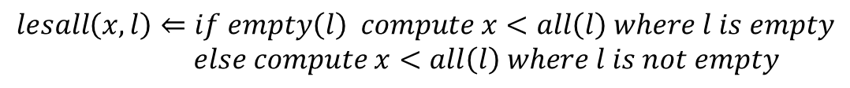
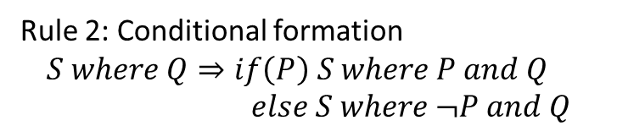
Derivation
Rule 1:
✖
Rule 2: Conditional formation
$$S where Q⇒if\left(P\right) S where P and Q \\ else S where ¬P and Q$$
$$lesall\left(x,l\right)⇐if empty\left(l\right) compute x<all\left(l\right) where l is empty \\ else compute x<all\left(l\right) where l is not empty$$

Slide 15
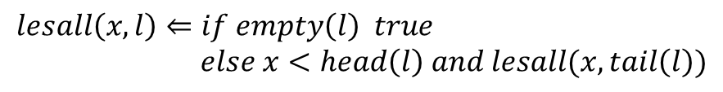
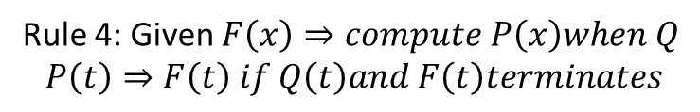
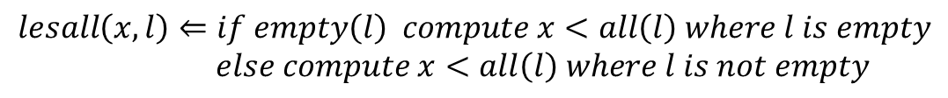
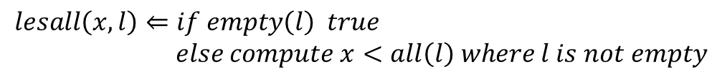
Derivation
Rule 1:
$$lesall\left(x,l\right)⇐if empty\left(l\right) compute x<all\left(l\right) where l is empty \\ else compute x<all\left(l\right) where l is not empty$$
Rule 3:
$$lesall\left(x,l\right)⇐if empty\left(l\right) true \\ else compute x<all\left(l\right) where l is not empty$$
$$lesall\left(x,l\right)⇐if empty\left(l\right) true \\ else x<head\left(l\right) and lesall(x, tail\left(l\right))$$
Rule 4: Given $F\left(x\right)⇒compute P\left(x\right)when Q$
$$P\left(t\right)⇒F\left(t\right) if Q\left(t\right)and F\left(t\right)terminates$$

Slide 16
Challenges
Proving that conditions are satisfied could be non-trivial
Transformation rules can be very domain-specific and you need a lot of them
Knowing what to apply when can be challenging
  Very large space of possible derivations

Slide 17
Modern incarnations
Fiat: Deductive Synthesis of Abstract Data Types in a Proof Assistant
  Benjamin Delaware, Clément Pit--Claudel, Jason Gross, Adam Chlipala
Rely on modern proof assistant to help automate routine parts of the derivation
Lift the level of abstraction of transformation rules so they are easier to apply

Slide 18

Fiat: A Program Derivation Framework in Coq
Program synthesis by stepwise refinement
1. Write mathematical specifications without worrying about performance.
2. Apply optimization scripts to refine specifications into efficient programs.
3. Coq's usual proof checker validates that scripts have preserved semantics.
Big delta from past related work:
“high automation without giving up high assurance”

Slide 19
Step 1: Specification
query "NumOrders" (author : string) : nat :=
Count (For (o in “Orders”) (b in “Books”)
Where (author = b!”Author”)
Where (b!”ISBN” = o!”ISBN”)
Return ())
Notes:
Example of an SQL-style query
Similar to monadic query comprehension notation.
Parsed & type-checked within normal Coq code (extensible parser, etc.)

Slide 20
Step 2: Optimization Script
Choose data structures:
Definition BookStorage : IndexFor Book.
mkIndex [ BookSchema/sAUTHOR; BookSchema/sISBN ].
Defined.
Definition OrderStorage : IndexFor Order.
mkIndex [ OrderSchema/sISBN ].
Defined.
Define abstraction relation connecting them to specification:
Definition Bookstore_AbsR := …
Call library tactic to implement specs in terms of this relation:
plan Bookstore_AbsR.

Slide 21
Step 3: Reasonable Code!
meth “NumOrders” (p : rep, s : string) : nat :=
ret (p, fold_left
(fun (count : nat) (x : Tuple) =>
count + bcount (snd p) (Some x!”ISBN”, []))
(bfind (fst p) (Some s, (None, []))) 0)
Calls to methods of library data structures (nested AVL trees)

Slide 22
Modern Transformation systems
Spiral
  Led by Markus Puschel, Franz Franchetti and Jose Moura
Key ideas:
  Focus on a specific domain
  Build in heuristics and transformations that capture domain insights
  Throw a lot of computing power!

Slide 23
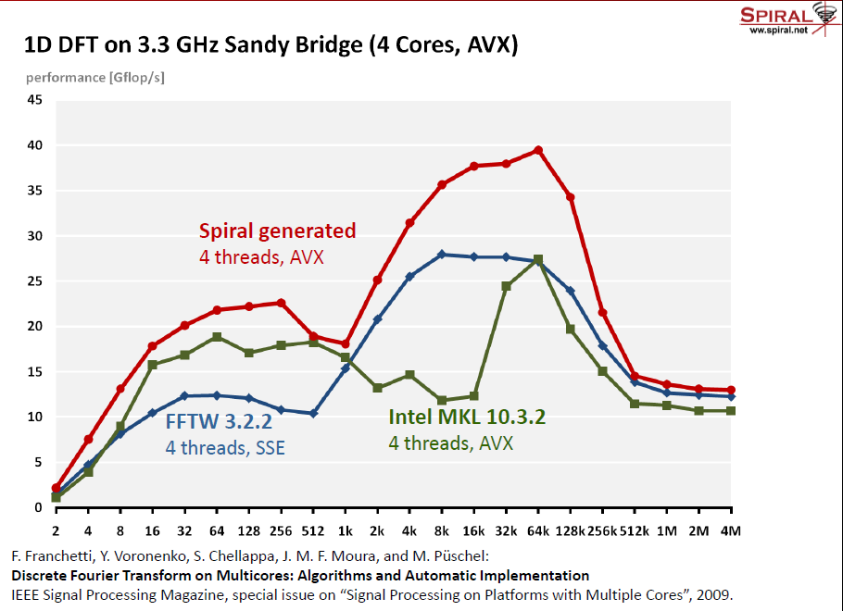
Spiral performance

