Slide 1
Lecture 19
Synthesis with Abstract Interpretation
Armando Solar-Lezama

Slide 2
History
POPL 77 paper by Patrick Cousot and Radhia Cousot
  Brings together ideas from the compiler optimization community with ideas in verification
  Provides a clean and general recipe for building analyses and reasoning about their correctness

Slide 3

Key idea 1: Abstract domain
Concrete states
Concrete semantics
New concrete states
x=5
x=6
x=-2
x=7
x=8
x=0
x=4
x := x + 2
x=6
x=-7
x=-5
x=-5
x=-3
x=7
x=9
x=9
$\left\{E\left[x↦x+2\right]\right\}x≔x+2 \{E\}$
x=11

Slide 4
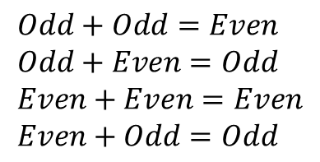
Key idea 1: Abstract domain
Abstract states
Abstract semantics
New abstract states
x=5
x=6
x=-2
x=7
x=8
x=0
Odd
Odd
x=4
x := x + 2
x=6
x=-7
x=-5
x=-5
x=-3
x=7
x=9
x=9
Even
$$Odd+Odd=Even \\ Odd+Even=Odd \\ Even+Even=Even \\ Even+Odd=Odd$$
x=11
Even

Slide 5










Abstract values form a lattice
Often called $⊤$
$$Anything$$
$$Even ⊑Anything$$
$$Odd ⊑Anything$$
$$Even$$
$$Odd$$
$$Nothing ⊑Even$$
$$Nothing ⊑Odd$$
$$Nothing$$
Often called $⊥$

Slide 6
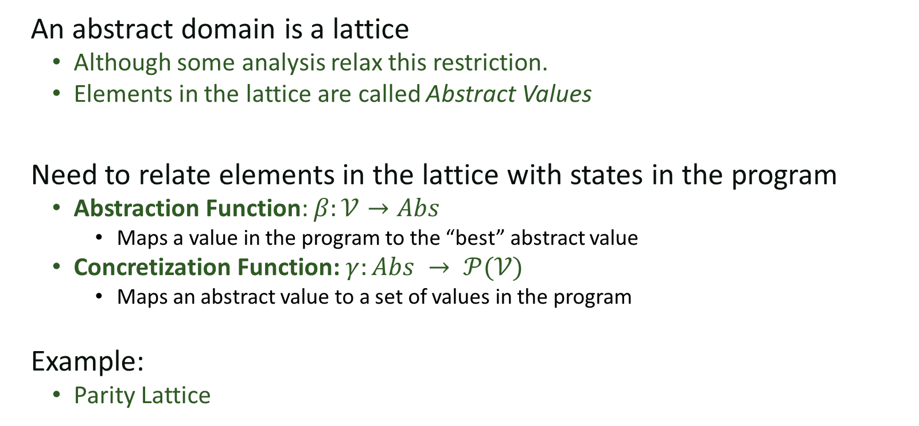
Abstract Domain
An abstract domain is a lattice
  Although some analysis relax this restriction.
  Elements in the lattice are called Abstract Values
Need to relate elements in the lattice with states in the program
  Abstraction Function: $β:𝒱→Abs$
    Maps a value in the program to the “best” abstract value
  Concretization Function: $γ:Abs → 𝒫(𝒱)$
    Maps an abstract value to a set of values in the program
Example:
  Parity Lattice

Slide 7



Concretization
$$Anything$$
x=5
x=6
x=-2
$$Odd$$
$$Even$$
x=4
x=-7
x=-5
$$Nothing$$
x=7
x=9
$$∅$$

Slide 8
Abstraction
`
$$Anything$$
x=5
x=6
x=-2
$$Odd$$
$$Even$$
x=4
x=-7
x=-5
$$Nothing$$
x=7
x=9
$$∅$$

Slide 9
Key idea 2: Abstract Interpretation
Compute an abstract value for every program point
  Abstraction of the set of states possible at that point
Iterate until computation converges

Slide 10

Example
L0
$$x=⊤ y=⊤$$
x = _input();
x = x * 2;
y = 0;
L0
x = _input();
x = x * 2;
y = 0;
while(x < 16){
x = x – y;
y = 2 + x;
}
L1
L1
X<16
L2
L2
x = x – y;
y = 2 + x;
L3
L3
L4
L4
end

Slide 11




Example
L0
$$x=⊤ y=⊤$$
x = _input();
x = x * 2;
y = 0;
L0
x = _input();
x = x * 2;
y = 0;
while(x < 16){
x = x – y;
y = 2 + x;
}
$$x=even y=even$$
L1
L1
X<16
$$x=even y=even$$
L2
L2
x = x – y;
y = 2 + x;
L3
L3
L4
L4
$$x=even y=even$$
end
$$x=even y=even$$

Slide 12
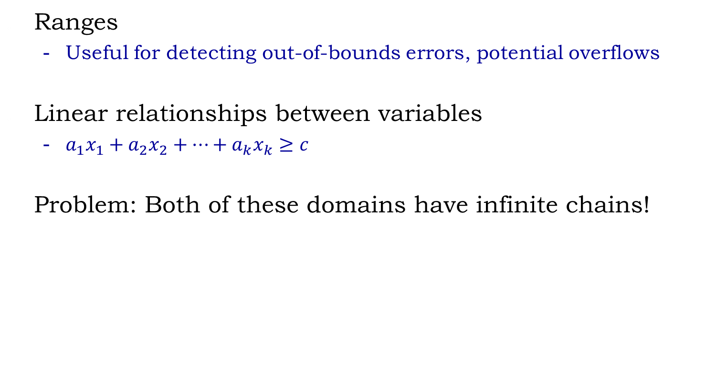
Some useful domains
Ranges
  Useful for detecting out-of-bounds errors, potential overflows
Linear relationships between variables
  $a_{1}x_{1}+a_{2}x_{2}+…+a_{k}x_{k}≥c$
Problem: Both of these domains have infinite chains!

Slide 13
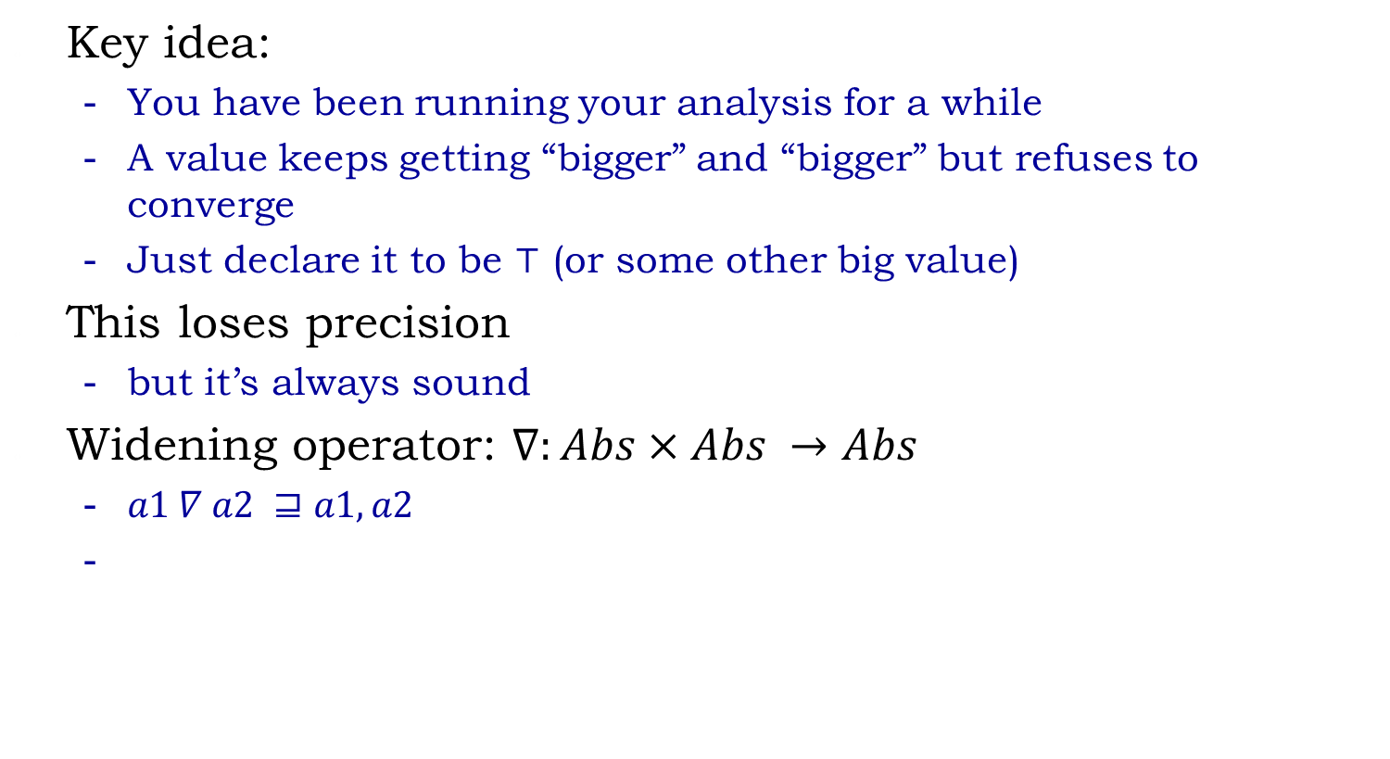
Widening
Key idea:
  You have been running your analysis for a while
  A value keeps getting “bigger” and “bigger” but refuses to converge
  Just declare it to be $⊤$ (or some other big value)
This loses precision
  but it’s always sound
Widening operator: $∇:Abs×Abs →Abs$
  $a1 ∇ a2 ⊒a1, a2$

Slide 14
Abstract Interpretation for Synthesis

Slide 15



Example
L0
$$x=⊤ y=⊤$$
x = _input();
x = x * ??₁;
y = 0;
L0
x = _input();
x = x * ??₁;
y = 0;
while(x < 16){
x = x – y;
y = ??₂ + x;
assert even(y)
}
L1
$$x=x_{l1} y=y_{l1}$$
L1
X<16
$$x=x_{l2} y=y_{l2}$$
L2
L2
x = x – y;
y = ??₂ + x;
L3
L3
L4
$$x=x_{l3} y=y_{l3}$$
L4
end

Slide 16
Storyboard Programming
head
mid
a
next
f
e
next
b
head
mid’
a
next
e’
f’
next
b

Slide 17
Scenarios for LL-reversal
head
next
mid
next
a
f
e
b
head
next
mid’
next
a
e’
f’
b
head
head
head
a
next
b
a
head
head
head
a
next
b
a

Slide 18
Inductive insights with fold/unfold
Unfold:
x’ = f
x’= e
x’
mid
f
e
x’ = f
e = e’
mid
x’
next
f’
e’

Slide 19
Inductive insights with fold/unfold
Unfold:
x’ = f
x’= e
x’
mid
f
e
x’ = f
e = e’
mid
x’
next
f’
e’
Fold:
x’ = f
x’= e
x’
mid
f
e
x’ = f
e = e’
mid
x’
next
f’
e’

Slide 20
Fold/Unfold
These rules are part of the specification
  without them the scenarios are too imprecise
They can also serve to communicate insights
y
val > y.val
f=y
b=b’
f’
val ==y.val
f=b=y
stuff
stree’
f
y
b’
stree
b
stuff
stuff’
val < y.val
f=y
b=b’
y
Underspecified summary node
f’
stuff’
stree’
b’

Slide 21
Fold/Unfold
These rules are part of the specification
  without them the scenarios are too imprecise
They can also serve to communicate insights
v
lleft
next
next
next
a
x
b
prev
prev
prev
lright
lleft
next
next
a
b
prev
prev
lright

Slide 22




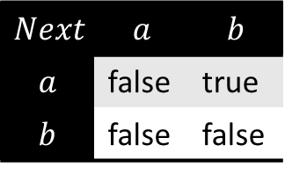
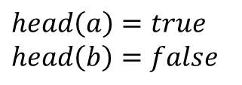
Concrete Domain
Memory locations: $ℒ^{\#}$
Variables: $v_{0}, v_{1}, …v_{k}$
Variable predicates: $v_{i}:ℒ^{\#}→Bool$ $v_{i}(l)$ indicates that variable $v_{i}$ points to loc $l$
Fields: $sel_{0}, sel_{1}, …sel_{k}$
Field predicates : $sel_{0}:ℒ^{\#}×ℒ^{\#}→Bool$
$sel_{i}\left(l_{1}, l_{2}\right)$ indicates that there is a field $sel_{i}$ from object $l_{1}$ to object $l_{2}$
$ℒ^{\#}$ = $\{a, b\}$
$$head\left(a\right)=true$$
$$head\left(b\right)=false$$
head
a
next
b
$$Next$$ | $$a$$ | $$b$$
$$a$$ | false | true
$$b$$ | false | false

Slide 23

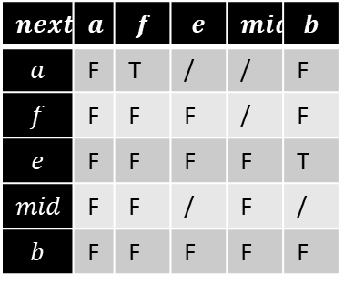
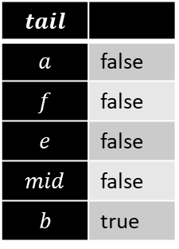

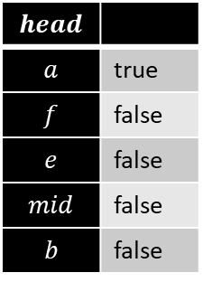
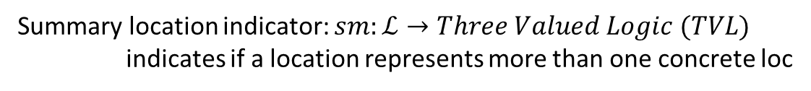
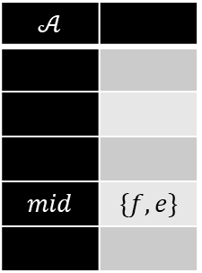
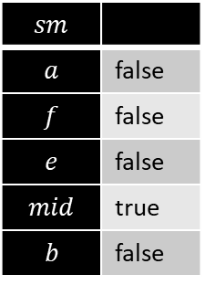

Slide 24
Inductive insights with fold/unfold
Unfold:
x’ = f
x’= e
x’
mid
f
e
x’ = f
e = e’
mid
x’
next
f’
e’
Fold:
x’ = f
x’= e
x’
mid
f
e
x’ = f
e = e’
mid
x’
next
f’
e’

Slide 25

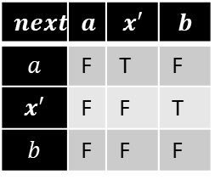
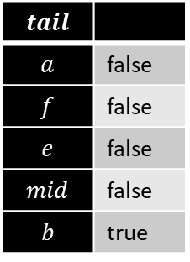
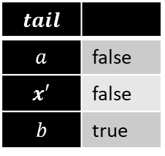
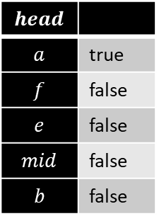
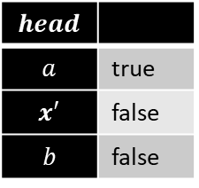
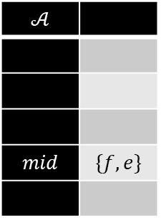
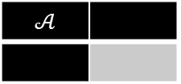
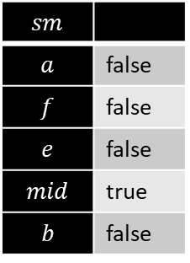
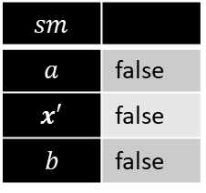
Unfold
mid
x’ = f
x’= e
f
e
x’
$$sm$$
$$a$$ | false
$$f$$ | false
$$e$$ | false
$$mid$$ | true
$$b$$ | false
$$𝒜$$
$$mid$$ | $$\{f, e\}$$
$$head$$
$$a$$ | true
$$f$$ | false
$$e$$ | false
$$mid$$ | false
$$b$$ | false
$$tail$$
$$a$$ | false
$$f$$ | false
$$e$$ | false
$$mid$$ | false
$$b$$ | true
$$next$$ | $$a$$ | $$f$$ | $$e$$ | $$mid$$ | $$b$$
$$a$$ | F | T | / | / | F
$$f$$ | F | F | F | / | F
$$e$$ | F | F | F | F | T
$$mid$$ | F | F | / | F | /
$$b$$ | F | F | F | F | F
head
tail
next
mid
next
a
f
e
b
Unfold(head.next)
$$sm$$
$$a$$ | false
$$x′$$ | false
$$b$$ | false
$$𝒜$$
$$head$$
$$a$$ | true
$$x′$$ | false
$$b$$ | false
$$tail$$
$$a$$ | false
$$x′$$ | false
$$b$$ | true
$$next$$ | $$a$$ | $$x′$$ | $$b$$
$$a$$ | F | T | F
$$x′$$ | F | F | T
$$b$$ | F | F | F
tail
head
a
next
x’
next
b

Slide 26

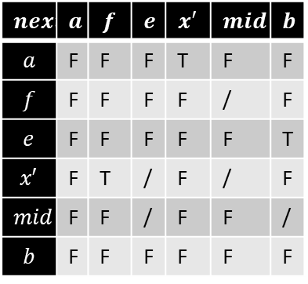
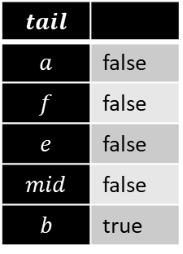
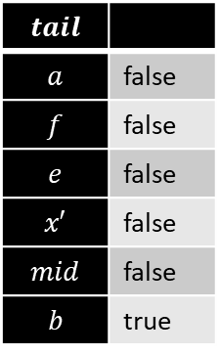
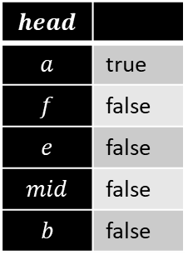
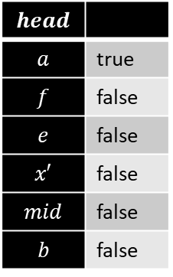

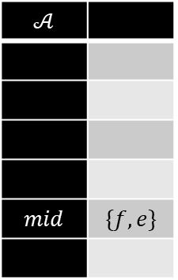
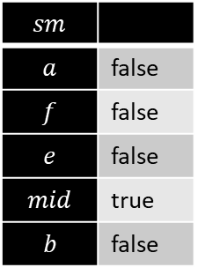
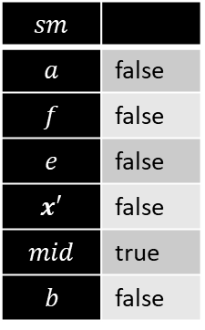
Unfold
mid
x’ = f
e = e’
mid
f
e
x’
next
f’
e’
$$sm$$
$$a$$ | false
$$f$$ | false
$$e$$ | false
$$mid$$ | true
$$b$$ | false
$$𝒜$$
$$mid$$ | $$\{f, e\}$$
$$head$$
$$a$$ | true
$$f$$ | false
$$e$$ | false
$$mid$$ | false
$$b$$ | false
$$tail$$
$$a$$ | false
$$f$$ | false
$$e$$ | false
$$mid$$ | false
$$b$$ | true
$$next$$ | $$a$$ | $$f$$ | $$e$$ | $$mid$$ | $$b$$
$$a$$ | F | T | / | / | F
$$f$$ | F | F | F | / | F
$$e$$ | F | F | F | F | T
$$mid$$ | F | F | / | F | /
$$b$$ | F | F | F | F | F
head
tail
next
mid
next
a
f
e
b
Unfold(head.next)
$$sm$$
$$a$$ | false
$$f$$ | false
$$e$$ | false
$$x′$$ | false
$$mid$$ | true
$$b$$ | false
$$𝒜$$
$$mid$$ | $$\{f, e\}$$
$$head$$
$$a$$ | true
$$f$$ | false
$$e$$ | false
$$x′$$ | false
$$mid$$ | false
$$b$$ | false
$$tail$$
$$a$$ | false
$$f$$ | false
$$e$$ | false
$$x′$$ | false
$$mid$$ | false
$$b$$ | true
$$next$$ | $$a$$ | $$f$$ | $$e$$ | $$x′$$ | $$mid$$ | $$b$$
$$a$$ | F | F | F | T | F | F
$$f$$ | F | F | F | F | / | F
$$e$$ | F | F | F | F | F | T
$$x′$$ | F | T | / | F | / | F
$$mid$$ | F | F | / | F | F | /
$$b$$ | F | F | F | F | F | F
head
tail
next
next
mid
next
a
x’
f
e
b

Slide 27
Example
head
mid
next
f
e
b
x = head;
while (x.next != null) {
x = x.next;
}
head
x
mid
next
f
e
b

Slide 28
Example
head
mid
next
f
e
b
head
x
mid
next
f
e
b
x = head;
while (x.next != null) {
unfold(x);
p = x;
x = x.next;
fold(p);
}
head
head
x
mid
mid
x
x’
next
f
e
next
b
p
x’
next
f
e
next
b
head
head
x
x
x’
next
b
p
x’
next
b
head
x
p
mid
mid
f
e
f
e
next
b
head
x
head
x
mid
p
mid
f
e
next
b
f
e
next
b

Slide 29
Example
head
mid
next
f
e
b
head
x
mid
next
f
e
b
head
x = head;
while (x.next != null) {
unfold(x);
p = x;
x = x.next;
fold(p);
}
mid
x
x’
next
f
e
next
b
head
x
next
mid
next
head
p
x’
f
e
b
x
x’
next
b
head
x
p
x’
next
b
head
x
p
mid
mid
f
e
x’
f
e
next
b
head
x
p
mid
mid
f
e
f
e
next
b
head
x
head
x
mid
p
mid
f
e
next
b
f
e
next
b

Slide 30
Example
head
head
x
mid
next
mid
f
e
b
f
e
next
b
head
x
head
next
mid
next
x = head;
while (x.next != null) {
unfold(x);
p = x;
x = x.next;
fold(p);
}
mid
p
x’
f
e
b
x
x’
next
f
e
next
b
head
x
head
p
x’
next
b
x
x’
next
b
head
p
x
mid
mid
head
x
f
e
x’
f
e
next
b
p
mid
mid
f
e
x’
f
e
next
b
head
x
p
mid
mid
f
e
f
e
next
b
head
x
head
x
mid
next
mid
f
e
b
p
next
f
e
b

Slide 31
Loop skeleton
void llReverse(Node head)
{
?? /*1*/
while (?? /*p*/)
{
?? /*2*/
}
?? /*3*/
}
Notes:
In addition to the storyboard, the framework also requires the user to provide a loop skeleton of the implementation the programmer is looking for. In this example, the skeleton says that the implementation should have a single while loop. There should be a set of statements before the loop, a set of statements inside the loop body and a set of statements following the loop. The goal of the synthesizer is now to fill up these blanks appropriately to obtain the desired implementation.

Slide 32
Loop skeleton
void llReverse(Node head)
{
cstmt* /*1*/
while (cond /*p*/)
{
cstmt* /*2*/
}
cstmt* /*3*/
}
Notes:
In addition to the storyboard, the framework also requires the user to provide a loop skeleton of the implementation the programmer is looking for. In this example, the skeleton says that the implementation should have a single while loop. There should be a set of statements before the loop, a set of statements inside the loop body and a set of statements following the loop. The goal of the synthesizer is now to fill up these blanks appropriately to obtain the desired implementation.

Slide 33
Conditional Statements
var(.ptr?) op var(.ptr?) | null
cstmt : if(COND) then STMT
var(.ptr?) = var(.ptr?)
  unfold/fold var

Slide 34



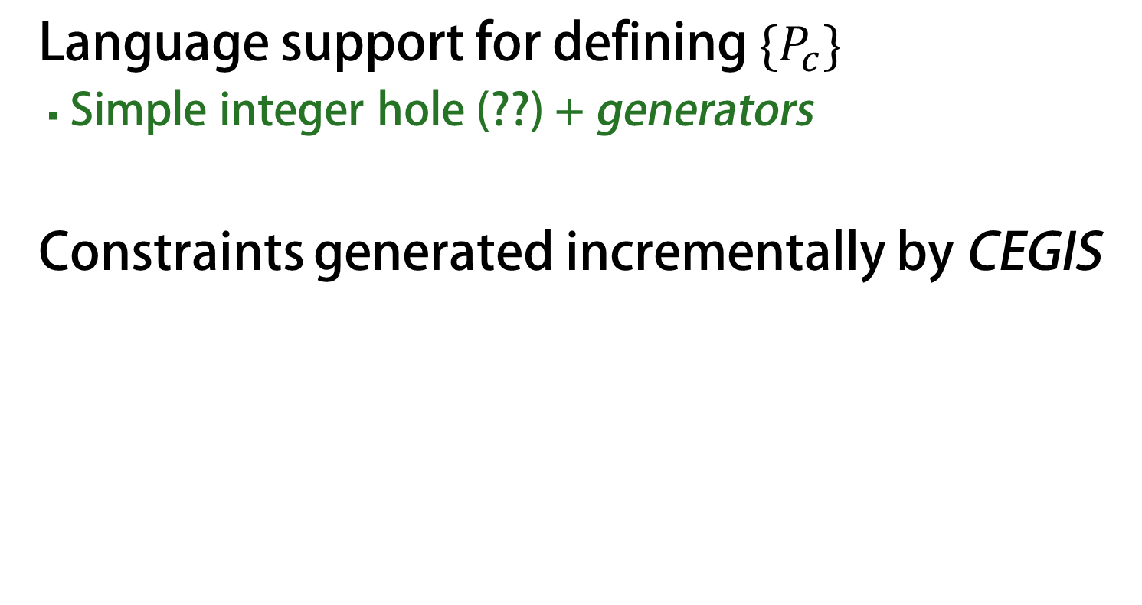
Data flow equations
s_{in}
$$s_{1}=f_{1}\left(s_{in}\right)∪f_{2}\left(s_{2}\right)$$
f₁
$$s_{2}=f_{p}\left(s_{1}\right)$$
s₁
f₂
$$s_{3}= \overline{f_{p}}\left(s_{1}\right)$$
false
f_{p}
true
s₃
$$s_{out}=f_{3}\left(s_{3}\right)$$
s₂
f₃
s_{out}

Slide 35




Synthesis vs. Verification
$$s_{1}=f_{1}\left(s_{in}\right)∪f_{2}\left(s_{2}\right)$$
Verification
known : f, s_{in}
unknown : s_{out}
Synthesis
known : s_{in,} s_{out}
unknown : f
$$s_{2}=f_{p}\left(s_{1}\right)$$
$$s_{3}= \overline{f_{p}}\left(s_{1}\right)$$
$$s_{out}=f_{3}\left(s_{3}\right)$$

Slide 36



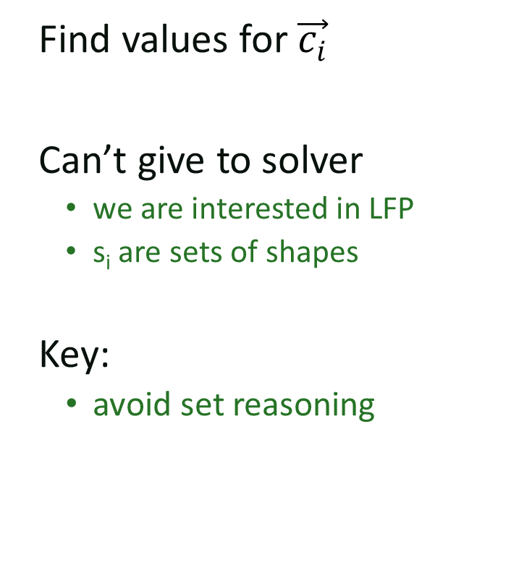

Synthesis Challenges
Find values for $\vec{c_{i}}$
Can’t give to solver
  we are interested in LFP
  s_{i} are sets of shapes
Key:
  avoid set reasoning
$$s_{1}=F\left(s_{in}, \vec{c_{1}}\right)∪F\left(s_{2},\vec{c_{2}}\right)$$
$$s_{2}=F_{p}\left(s_{1},\vec{c_{p}}\right)$$
$$s_{3}= \overline{F_{p}}\left(s_{1},\vec{c_{p}}\right)$$
$$s_{out}=F\left(s_{3},\vec{c_{3}}\right)$$
Notes:
Each function comes from a bounded family of statements and we use a choice vector to pick the appropriate set of statement from the family.
Sets of shapes (reasoning about) is harder for the solver.

Slide 37
1 : Loop unrolling
P
f₁
m iterations
f_{p}
f₂
Abstract Interpreter
false
true
f₃
m : fixpoint bound of P
Notes:
Let us suppose there exists a solution that the abstract interpreter can verify using n iterations. We call it the fixpoint bound. Now we can safely unroll each of the loops in our loop skeleton k times where k is a constant greater than k.
The abstract interpreter is going to converge after k interpretation.
K is a constant which > the fixpoint point bound that the abstract interpreter

Slide 38

1 : Loop unrolling
f₁
f₁
f_{p}
f₁
f₁
true
f_{p}
f₃
true
k iters
f_{p}
f₂
f_{p}
.
.
.
f₃
false
false
true
f_{p}
f₃
f_{p}
f₃
$$k≥m$$
false
false
f₃
f₃
path₀
path₁
path_{k}
Notes:
Let us suppose there exists a solution that the abstract interpreter can verify using n iterations. We call it the fixpoint bound. Now we can safely unroll each of the loops in our loop skeleton k times where k is a constant greater than k.
The abstract interpreter is going to converge after k interpretation.
K is a constant which > the fixpoint point bound that the abstract interpreter

Slide 39
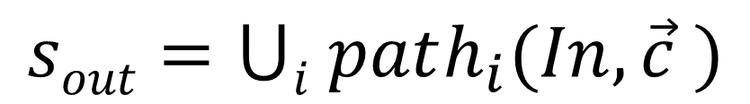
f₁
f₁
f_{p}
f₁
f_{p}
true
f₃
true
f₃
$$sout=⋃i path_{i}(In,\vec{c} )$$
f_{p}
.
.
.
false
f_{p}
f₃
false
f_{p}
f₃
false
f₃
path₀
path₁
path_{k}

Slide 40
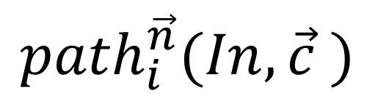
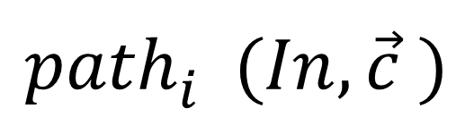
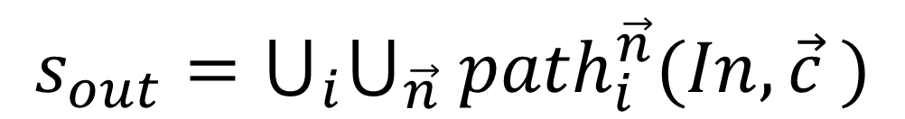
2: Non-deterministic Functions
head
next
mid
next
a
f
e
b
$${path}_{i}^{}(In,\vec{c} )$$
f
unfold head
$${path}_{i}^{\vec{n}}(In,\vec{c} )$$
n
head
head
next
next
mid
next
a
x’
b
a
next
x’
next
f
e
b
Parameterize the non-deterministic choice n
$${s_{out}=⋃}_{i}⋃_{\vec{n}} {path}_{i}^{\vec{n}}(In,\vec{c} )$$
Notes:
Show the unfold statement -> a shape coming in and two shapes coming out

Slide 41
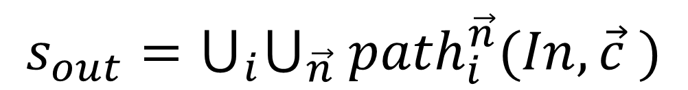
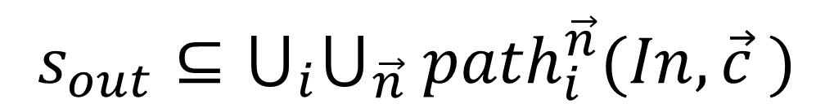
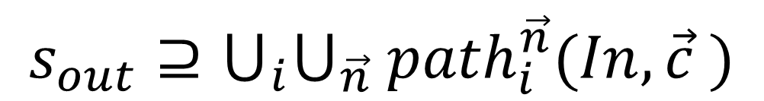
Solving the constraint
$${s_{out}=⋃}_{i}⋃_{\vec{n}} {path}_{i}^{\vec{n}}(In,\vec{c} )$$
Rewrite as subset constraints:
$${s_{out}⊇⋃}_{i}⋃_{\vec{n}} {path}_{i}^{\vec{n}}(In,\vec{c} )$$
$${s_{out}⊆⋃}_{i}⋃_{\vec{n}} {path}_{i}^{\vec{n}}(In,\vec{c} )$$

Slide 42
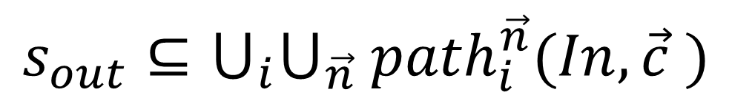
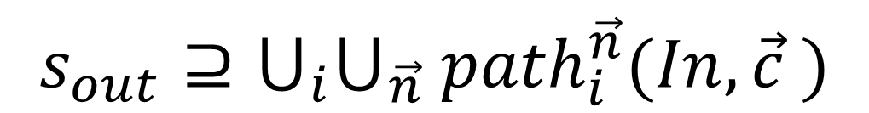
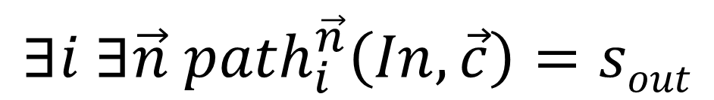
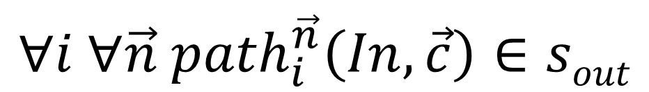
Quantifier alternation constraint
$${s_{out}⊇⋃}_{i}⋃_{\vec{n}} {path}_{i}^{\vec{n}}(In,\vec{c} )$$
$$∀i ∀\vec{n}{ path}_{i}^{\vec{n}}\left(In,\vec{c}\right)∈sout$$
$${s_{out}⊆⋃}_{i}⋃_{\vec{n}} {path}_{i}^{\vec{n}}(In,\vec{c} )$$
$$∃i ∃\vec{n} {path}_{i}^{\vec{n}}\left(In,\vec{c}\right)=sout$$

Slide 43

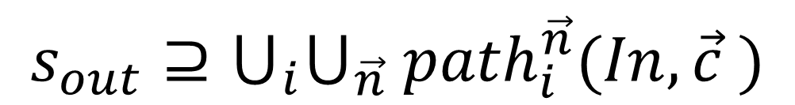
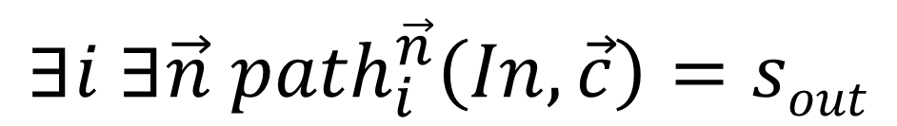
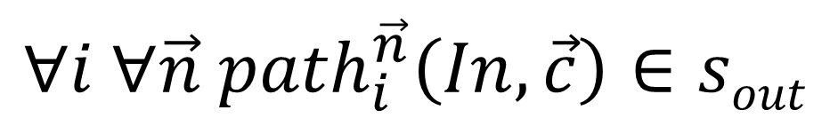
Quantifier alternation constraint
$${s_{out}⊇⋃}_{i}⋃_{\vec{n}} {path}_{i}^{\vec{n}}(In,\vec{c} )$$
$$∀i ∀\vec{n} {path}_{i}^{\vec{n}}\left(In,\vec{c}\right)∈sout$$
$${s_{out}⊆⋃}_{i}⋃_{\vec{n}} {path}_{i}^{\vec{n}}(In,\vec{c} )$$
$$∃i ∃\vec{n} {path}_{i}^{\vec{n}}\left(In,\vec{c}\right)=sout$$
$∃∀ constraints :$ Sketch solver
Notes:
S_{out} is a singleton and we want it to be a subset
-
Are these equivalent?
Expression in terms of sets → how can we represent in terms of quantifier.

