Slide 1
Lecture 2
Inductive Synthesis and Programming by Example
Armando Solar-Lezama

Slide 2
Programming by Example
Outline
  Motivation
  History
  Key issues
  Defining the space of programs
  Explicit search

Slide 3


Programming by Example: Motivation
Two major criticisms of synthesis:
  It’s too hard to make it work
  Even if it works, it ends up being too hard to use
Algorithm
Designers
  (logics, automata, etc.)
Software Developers
Most Useful Target
End-Users
Students and Teachers
  (Examples!)
Notes:
Recall last time we talked about two major criticisms of synthesis:
It’s too hard to make it work.
Even if it works, it ends up being too hard to use.
The dream of PBE was to address the second criticism by allowing users to simply give examples of the behaviors they want and have the system generalize from these examples.

Slide 4

Programming by Example
Search Algorithm
Examples
Program

Slide 5
PBE vs. PBD
Programming by Example (PBE)
  Generally input/output
  E.g., factorial(6) = 720
Programming by Demonstration (PBD)
  In addition to input/output, show a trace of the computation
  E.g., factorial(6) = 6 * (5 * (4 * (3 * (2 * 1)))) = 720
Notes:
PBE is nice if you can do it.
PBD is generally more realistic.
If I tell you f(6)=720 it’s unlikely that you will have any idea of what I expect you to compute,
But if I tell you
f(6) = 6 * ( 5*(4*(3*(2 *1) ) )) = 720
Then it’s easy to see that you want to compute factorial.
The distinction seems to be straightforward, but the boundary is blurry. For some domains (like string manipulation), it’s relatively easy to derive a trace from an output.
String manipulations fall in this category.

Slide 6
PBD/PBE vs. Inductive learning
1, 2, 4, 8, ??
1, 2, 4, 7, ??
PBE/PBD are examples of inductive learning
Most machine learning falls into this category as well

Slide 7
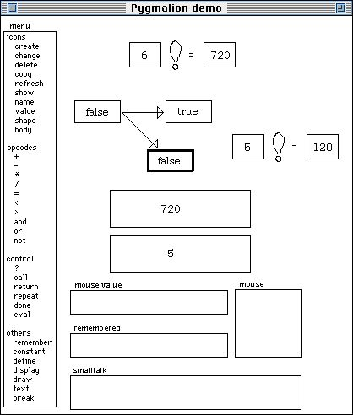
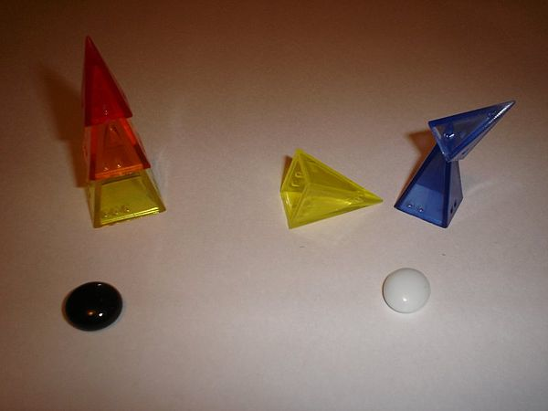
A little bit of history: who was the first?
Learning Structural Descriptions from Examples
  By our very own Patrick Winston [1970]
  Explored the question of generalizing from a set of observations
Pygmalion [Smith 75]
  Real programming by demonstration
  http://acypher.com/wwid/Chapters/01Pygmalion.html
Notes:
The field dates back to the 1970s; our very own Patrick Winston published the seminal work “Learning Structural Descriptions from Examples”
This work was among the first to look into the problem of generalizing from a set of observations, although it was not really about trying to automate programming.
A good candidate for “first PBD system” is Pygmalion [smith 75].
In the early days, most of this work was AI. There is a saying that AI is whatever we don’t know how to do. Well, in the early days, everything was AI.
The idea of generalizing from a set of examples became the foundation of machine learning, which turned into a very successful field, but as we saw last time,
Programming by example is not quite machine learning, and so while machine learning conquered the world, PBE was stuck in demo-land for several decades.

Slide 8

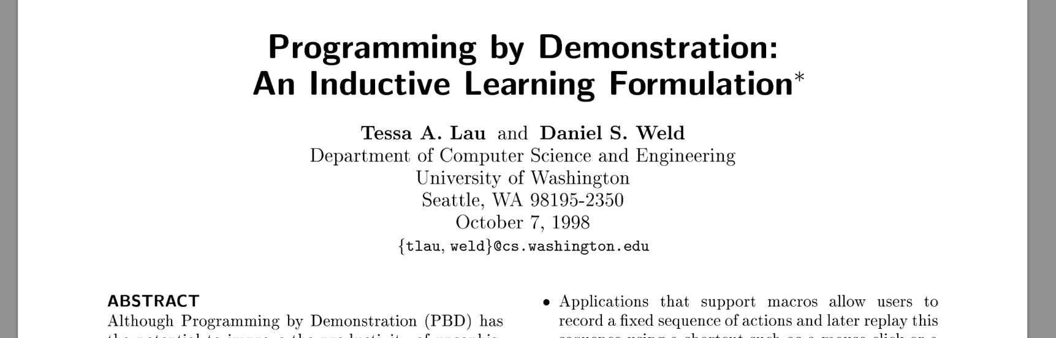
A little bit of history: inductive learning
Ad-hoc approaches → General inductive learning techniques
  Version-space generalization
  Inductive logic programming
Tessa Lau
Notes:
In the mid 1990s, there was a major effort to bring back insights from machine learning to PBE. A very influential work in this vein was the work that Tessa Lau started as a graduate student at UW while working with Daniel Weld and which she continued as a researcher at IBM.
The goal was to move away from ad-hoc and brittle approaches and to develop general techniques that could be adapted to a variety of PBE problems.
The work focused on two major techniques: Version space generalization and Inductive logic programming, both of which we’ll talk more about later.
This line of work caused a lot of excitement for a while, although it petered out after a while.

Slide 9
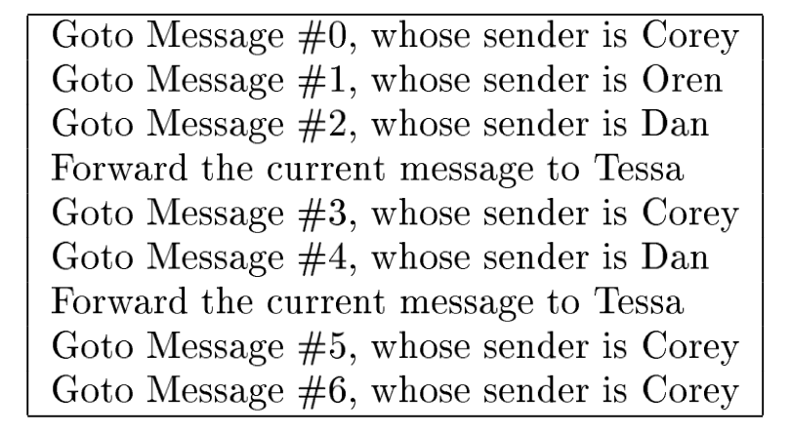
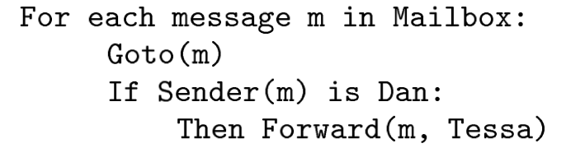
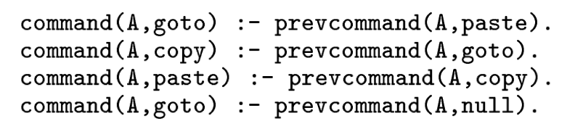
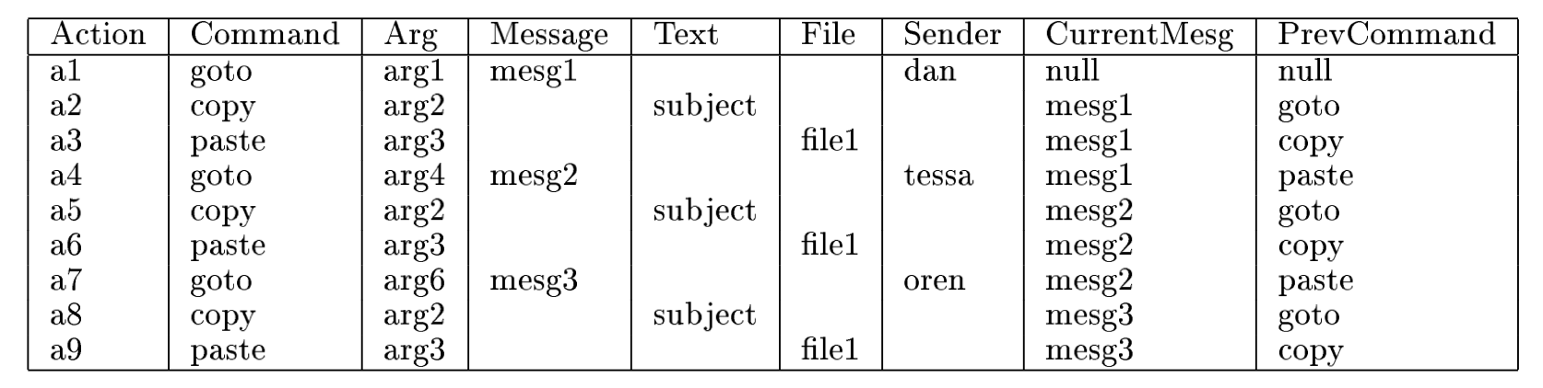
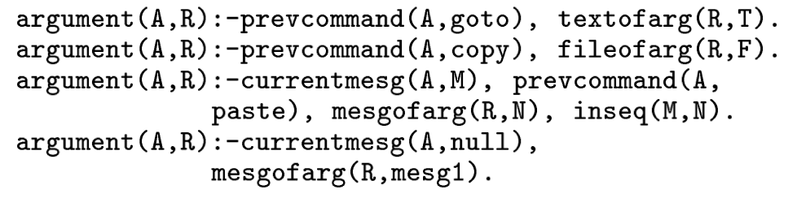
Example

Slide 10
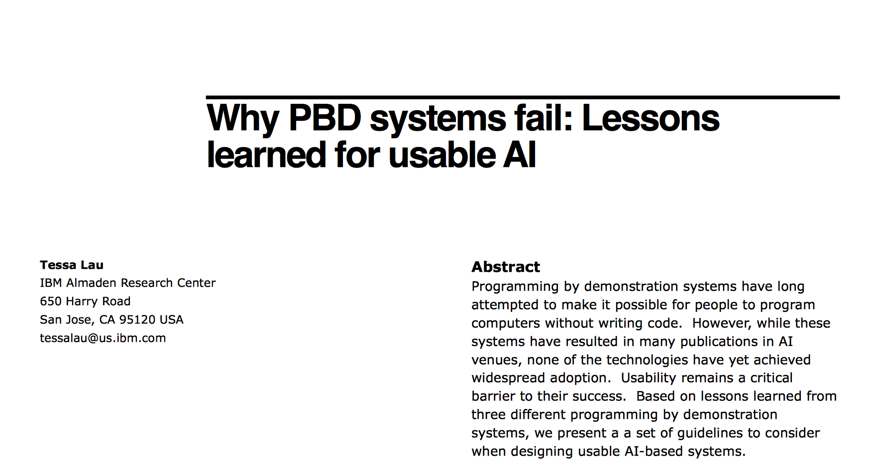
A little bit of history
Detect failure and fail gracefully
Make it easy to correct the system
Encourage trust by presenting a model users can understand
Enable partial automation
Notes:
Interestingly, only a couple of years before FlashFill started being developed, she published a paper titled: “Why PBD systems fail: Lessons learned for usable AI”
Which all of you should read, because it points to many of the pitfalls that such systems can run into.
So why is this problem hard, and why is it that the recent successes in this domain came from the program analysis and languages community as opposed to machine learning or AI?

Slide 11
Key issues in inductive learning
Program you actually want
Programs matching the observations
Space of programs
(1) How do you find a program that matches the observations?
(2) How do you know it is the program you are looking for?
Notes:
The key issue in inductive learning is this: (explain picture)
In traditional machine learning, the focus has historically been on Question 2.
The trick has been to pick spaces of programs that are either too rich (e.g. neural networks) so that there are a ton of ways to match any set of observations and the challenge is how to avoid over-training.
Or you pick a space that is too restricted (e.g. SVMs) such that it is more or less impossible to match all the observations, but you assume some observations are wrong anyway, so you can trade off how many samples you match against other criteria that make it more likely that your solution will work well enough in general.

Slide 12
Key issues in inductive learning
Program you actually want
Programs matching the observations
Traditional ML emphasizes (2)
  Fix the space so that (1) is easy
So did a lot of PBD work
Space of programs
(1) How do you find a program that matches the observations?
(2) How do you know it is the program you are looking for?
Notes:
In traditional machine learning, the focus has historically been on Question 2.
The trick has been to pick spaces of programs that are either too rich (e.g. neural networks) so that there are a ton of ways to match any set of observations and the challenge is how to avoid over-training.
Or you pick a space that is too restricted (e.g. SVMs) such that it is more or less impossible to match all the observations, but you assume some observations are wrong anyway, so you can trade off how many samples you match against other criteria that make it more likely that your solution will generalize.

Slide 13
The synthesis approach
Program you actually want
Programs matching the observations
Modern emphasis
Space of programs
(1) How do you find a program that matches the observations?
(2) How do you know it is the program you are looking for?
Notes:
The modern emphasis in PBE, however, has been to focus more on the space of programs itself.
The focus on restricting the space of programs is not new; many early systems did this to an extreme case by just having a short list of programs that the system would scan through looking for one that matched the examples. The work of tessa lau was also in this direction.
What recent advances in synthesis brought to the table were powerful mechanisms to search *arbitrary* program spaces. What this allowed you to do was to fix the space in such a way that instead of looking like this…

Slide 14
The synthesis approach
Program you actually want
Space of programs
Modern emphasis
  If you can do really well with (1) you can win
  (2) is still important
Programs matching the observations
(1) How do you find a program that matches the observations?
(2) How do you know it is the program you are looking for?
Notes:
What recent advances in synthesis brought to the table were powerful mechanisms to search *arbitrary* program spaces. What this allowed you to do was to fix the space in such a way that instead of looking like this…
Things look like this.
The problem is always going to be underspecified, so it is still very important to be able to rank programs to have a higher likelihood of finding what you are looking for, but the idea is that if you can search large but highly constrained spaces efficiently, you are more likely to get what you are looking for. But by having the ability to reason about arbitrary (and very large) spaces of programs you can get the benefits of the list-of-programs approach without its inherent brittleness.
So for the next few lectures we are going to focus on how to define and search very large spaces of programs.

Slide 15
Interaction model
Program you actually want
Space of programs
Suggested program
A third issue:
  Historically an HCI topic
  Related to two major questions
    How to define the search space
    How to search
Notes:
In addition to the issues we have described so far, there is a third issue that is very important for PBE which is the interaction model.
A lot of good work around PBE has historically been done around the HCI community.
At one level this is orthogonal to the question of how you search a space of programs and how you get things that are more likely to generalize.
However, as we will see later in this unit, the choice of representation of the space and of search mechanism can have a big impact on the kind of search strategies that are possible.

Slide 16
What is a program
A description of how to perform a computation
Described in a programming language
  Syntax
  Semantics

Slide 17
Expressiveness
General purpose languages tend to be Turing Complete
For synthesis, this may be overkill
  A key step for synthesis is designing a language with the right level of expressiveness

Slide 18
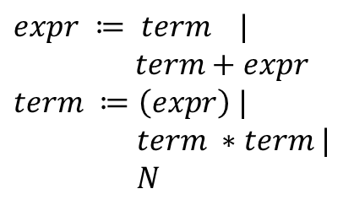
Ex. Arithmetic Language
Grammar
5 + 3 * 2
$$expr ≔ term |$$
$term+expr$
$$term ≔\left(expr\right) |$$
$term ∗term |$
$N$

Slide 19
Representing Programs
Text is not a great choice
We generally use Abstract Syntax Trees (AST)
  Data-structure that captures the structure of the language
  Abstracts away low-level syntactic details

Slide 20
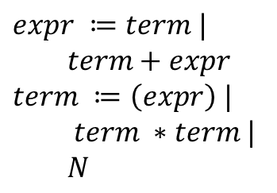
Ex. Arithmetic Language
Grammar
AST
Semantics
$$expr ≔term |$$
$term+expr$
$$term ≔\left(expr\right) |$$
$term ∗term |$
$N$
data Expr = Num Int
| Plus Expr Expr
| Times Expr Expr
eval Num n = n
eval Plus a b = (eval a) + (eval b)
eval Times a b = (eval a) * (eval b)
AST as a Grammar
expr = N
| Plus(expr, expr)
| Times(expr, expr)

Slide 21
A word on Functional Notation
Used in many places in the course
Key ideas:
  No mutation
  Functions are actual mathematical functions
  Functions are first-class values that can be used like any other value
    functions can return functions, take functions as parameters, functions can be stored in variables or data-structures

Slide 22
Search Techniques
Explicit Enumeration
  explicitly construct different programs until one finds a program that satisfies the observations
Can be top-down or bottom up

Slide 23




Top down vs. Bottom Up Enumeration
reduce (map $in$ $λ$ x. x + 5) 0 $λ x.$ $λy. x+y$
reduce
Bottom Up
map
0
$$λx.$$
Top Down
$$in$$
$$λx.$$
$$λy.$$
+
+
x
5
x
y

Slide 24
Search Techniques
Symbolic search
  synthesizer maintains a symbolic representation of the space of all programs that are considered valid
  Different symbolic representations lead to different search algorithms.
  Flashfill and Sketch both use symbolic representations
More of this in a few lectures

Slide 25
Defining the space of programs
Structural hypothesis
  What is the space
    How do you describe it (user’s perspective)
    How do you represent it (system’s perspective)
  Does it have any properties that can help the search
Notes:
In synthesis, this is known as the structural hypothesis.

Slide 26
Example
lstExpr := sort(lstExpr)
lstExpr[intExpr,intExpr]
lstExpr + lstExpr
recursive(lstExpr)
[0]
in
intExpr := firstZero(lstExpr)
len(lstExpr)
0
intExpr + 1
1,4,2,0,7,9,2,5,0,3,2,4,7 → 1,2,4,0,2,5,7,9,0,2,3,4,7,0
Process(in) := sort(in[0, firstZero(in)]) + [0] + recursive(in[firstZero(in)+1, len(in)]);
Notes:
Consider the following example. We are going to define a language of list manipulations.
lstExpr[a,b] is the list starting at position a and ending at position b-1 (so lst[0, len(lst)] ) produces the list.
recursive(lst) calls the program recursively on lst. If lst is empty, recursive(lst) just returns empty without doing a recursive call.
firstZero(lst) returns the position of the first zero in the list, or len(lst) if the list does not have any zeros.
On the one hand, the language is very rich; it includes recursion, concatenation, sorting, search; you can write a ton of interesting programs with this language.
And yet, consider the following input output example:
1,4,2,0,7,9,2,5,0,3,2,4,7 → 1,2,4,0,2,5,7,9,0,2,3,4,7,0
There are only a handful of programs that match this example. (see slide).

Slide 27
What is the space?
lstExpr := sort(lstExpr)
lstExpr[intExpr,intExpr]
lstExpr + lstExpr
recursive(lstExpr)
[0]
in
intExpr := firstZero(lstExpr)
len(lstExpr)
0
intExpr + 1
The set of all programs in lstExpr

Slide 28
What is the space?
Grammars as definitions of program spaces
  Pro
    Clean declarative description
    Easy to sample
    Easy to explore exhaustively
  Con
    Insufficiently expressive

Slide 29
Program spaces with grammars
lstExpr := sort(lstExpr)
lstExpr[intExpr,intExpr]
lstExpr + lstExpr
recursive(lstExpr)
[0]
in
intExpr := firstZero(lstExpr)
len(lstExpr)
0
intExpr + 1
What if we know the following:
  Sort is never called more than once in a sub-list.
  Recursive calls should be made on lists whose length is less than len(in)
  We’ll never have to add one multiple times in a row
Notes:
Some of these can be expressed directly as a grammar. Some can only be approximated with a CFG.

Slide 30
Generators/Generative models
Programs that produce programs
  Can be either random or non-deterministic
Pros:
  Extremely general
    easy to enforce arbitrary constraints
Cons:
  Extremely general
    Hard to analyze and reason about
    Hard to automatically discover structure of the space

Slide 31
Symmetries
Multiple ways of representing the same problem
  Grammar on the right has fewer symmetries
  Grammar on the left can produce all possible ways to parenthesize
  Can completely eliminate symmetries from the right by enforcing a variable ordering
    Can’t be done with a grammar, but it can with a generative model
Expr := var*const
| Expr + Expr
Expr := var*const
| var*const + Expr
w*c1+(x*c2+(y*c3+z*c4))
Expr(vmin) := let v = var() in v*const (assert v>vmin)
| let v=var() in v*const + Expr(v) (assert v > vmin)

Slide 32
Symmetries
Do symmetries matter?
  It depends
Some methods are very sensitive to symmetries
  E.g. symbolic search
Others are largely oblivious to them
  e.g. some forms of bottom-up search

