Slide 1
Lecture 24
Neurosymbolic Synthesis
Armando Solar-Lezama with slides from Swarat Chaudhuri

Slide 2
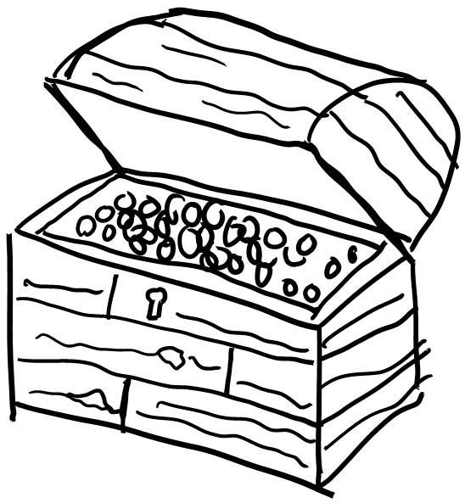
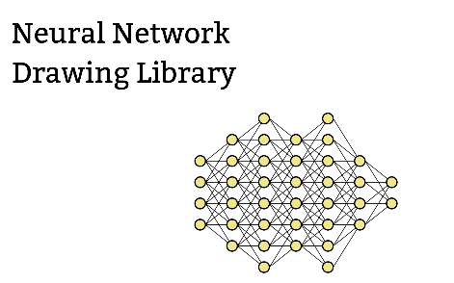

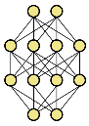



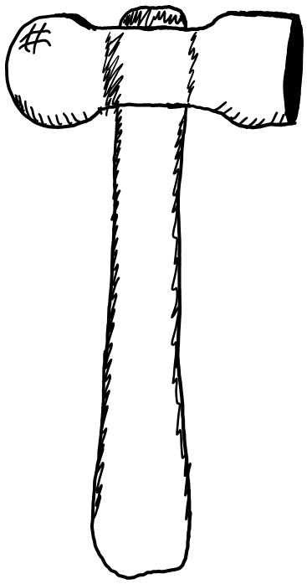






















Neurosymbolic program synthesis
Neural Guided Search
Symbolic Guided DL
Distillation
Relaxation
Goal
$$□$$
Goal
Goal
$$λ$$
$$in$$
$$out$$
$$⇓$$
$$⇓$$
$$in$$
$$out$$
$$in$$
$$out$$
$$⇓$$
$$λ$$
map $□$ $□$
$$⇓$$
$$in$$
$$out$$
$$in$$
$$λ$$
$$out$$
$$λ$$
$$in$$
$$out$$
Component Discovery
Goals
Components
map $in$ $λ □$
$$λ$$

Slide 3





Distillation
Goal
Use the neural network as a starting point for program synthesis
Replace neural components with symbolic ones
  To improve interpretability and analyzability
  To better generalize out of distribution
  To ensure more predictable behavior
$$⇓$$
$$in$$
$$out$$
$$⇓$$
$$in$$
$$λ$$
$$out$$

Slide 4
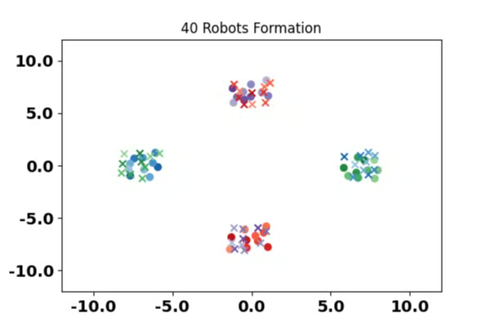
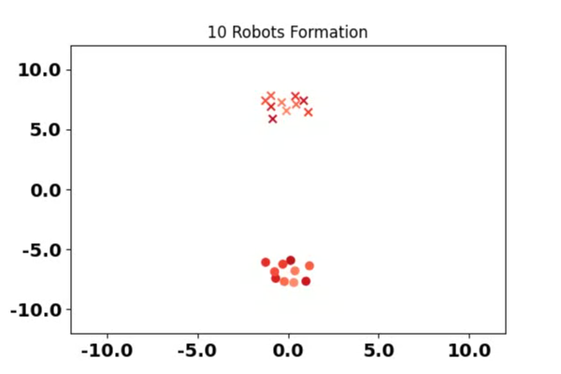
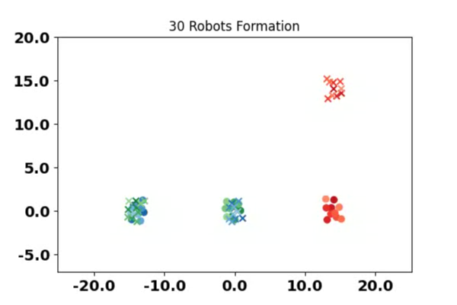
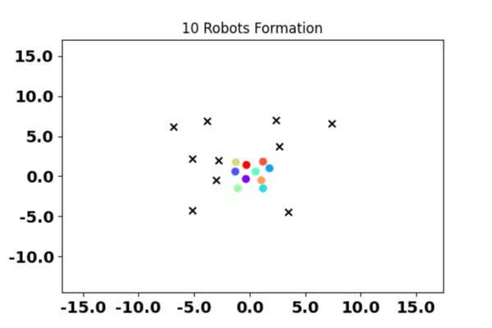
Multi-Agent Systems
Random Cross
Random Grid
Unlabeled goals
Jeevana Priya Inala, Yichen Yang, James Paulos, Yewen Pu, Osbert Bastani, Vijay Kumar, Martin Rinard, Armando Solar-Lezama

Slide 5
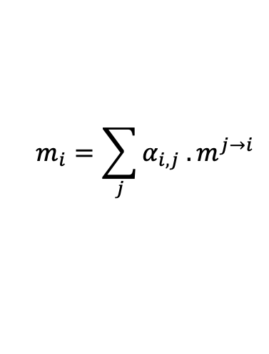





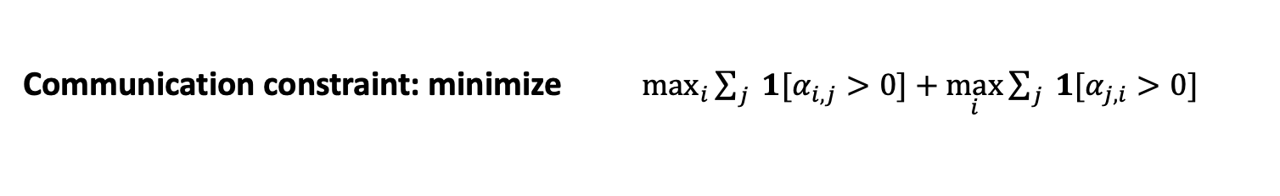
Decentralized policy
state, obs
$$s_{j,}o_{j,i}$$
Message policy
Agent j
message
$$m^{j→i}$$
state, obs
attention
action
$$s_{i, } o_{i,j}$$
$$α_{i,j}$$
$$a_{i}$$
Communication policy
combined message
Action policy
Agent i
$$m_{i}=\sum_{j}{α_{i,j} . m^{j→i}}$$
Communication constraint: minimize $\max_{i}{\sum_{j}{ 1[α_{i,j}}>0]+\max_{i}{\sum_{j}{ 1[α_{j,i}}>0] }}$
Maximum incoming degree
Maximum outgoing degree
Notes:
Make better

Slide 6
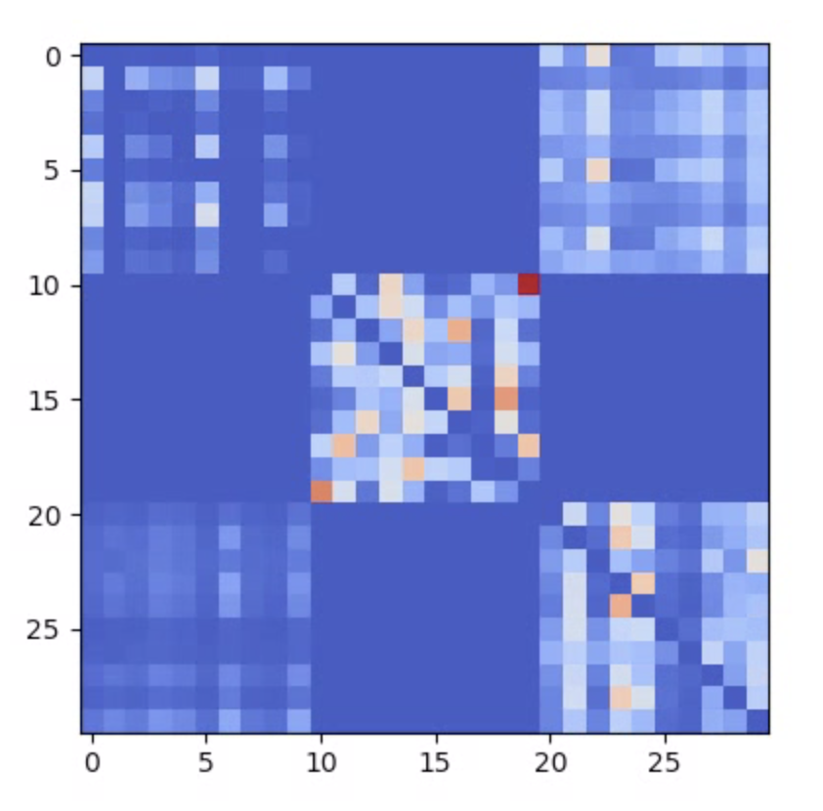

Alternate Approaches
Transformers
Transformer
Das et. al., ICML 2019

Slide 7
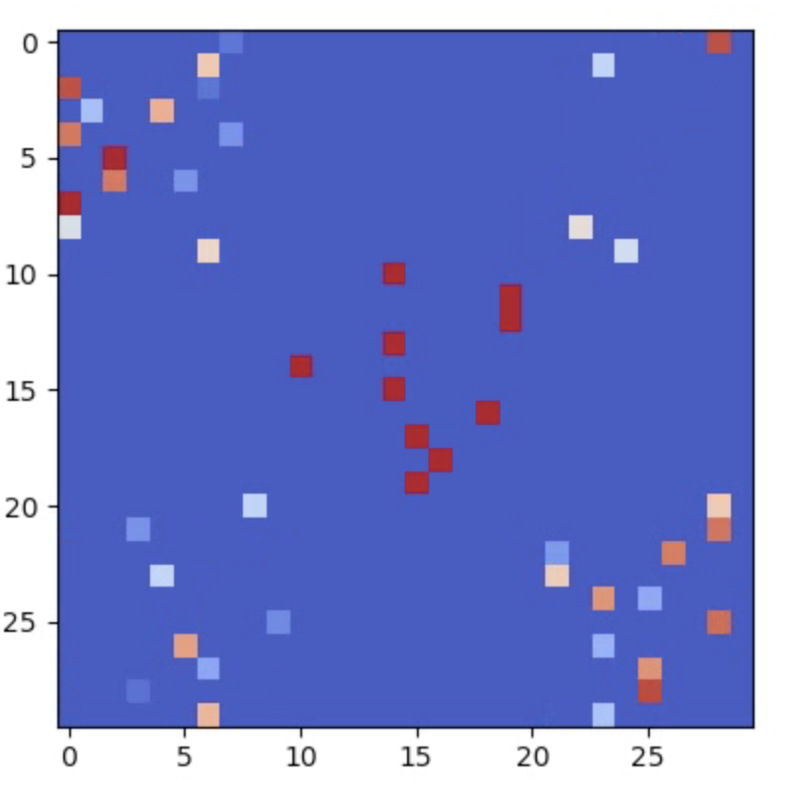
Alternate Approaches
Transformers
Transformer
Our approach: program from a custom DSL
Program

Slide 8
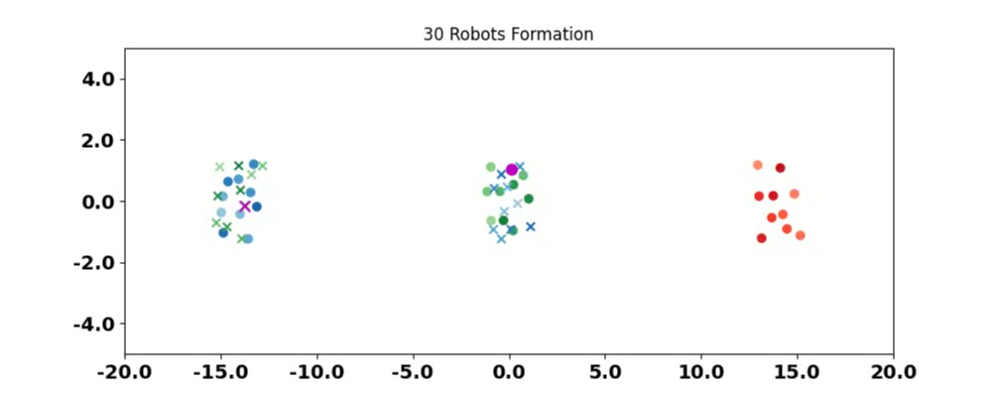
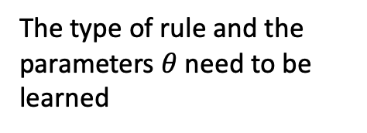

Programmatic communication rules
Deciding agent
Deciding agent’s goal
A → B: A is sending message to B
Rule1 :: random ( filter ( agents in ) )
The type of rule and the parameters $θ$ need to be learned
$$θ$$

Slide 9
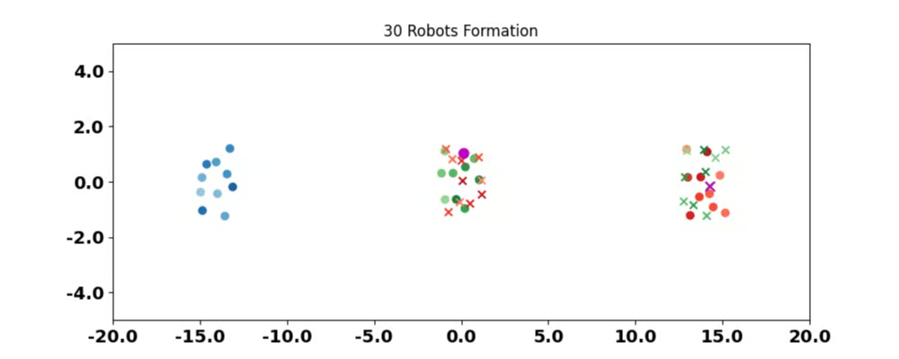
Programmatic communication rules
Deciding agent
Deciding agent’s goal
A → B: A is sending message to B
Rule1 :: random ( filter ( agents in ) )
The type of rule and the parameters $θ$ need to be learned
$$θ$$

Slide 10
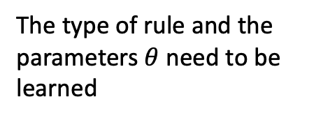

Programmatic communication rules
Deciding agent
Deciding agent’s goal
A → B: A is sending message to B
The type of rule and the parameters $θ$ need to be learned
Rule2 :: argmax ( map ( $f_{θ},$ filter ( agents in ) )
$$θ$$

Slide 11
Results: Good performance

Slide 12
Results: Reduces communication degree

Slide 13
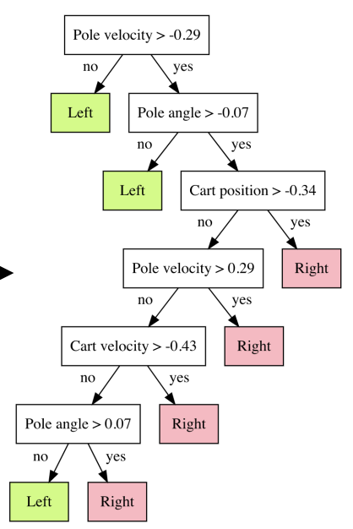
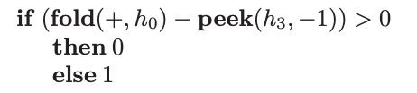
Other similar work
Verma et. al. ICML 2018,
NeurIPS 2019
Distil symbolic controllers from a learned neural policy
Bastani et. al. NeurIPS 2018
Distil a decision tree from a neural policy and verify against a specification

Slide 14
Combinations

Slide 15
Combinations
Symbolic Guided DL
Distillation
Goal
Goal
+
$$⇓$$
$$⇓$$
$$in$$
$$out$$
$$in$$
$$out$$
$$⇓$$
$$⇓$$
$$in$$
$$λ$$
$$out$$
$$λ$$
$$in$$
$$out$$

Slide 16
Inductive Generalization
Train examples
Test
goal
start

Slide 17
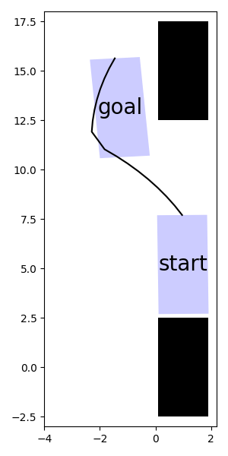
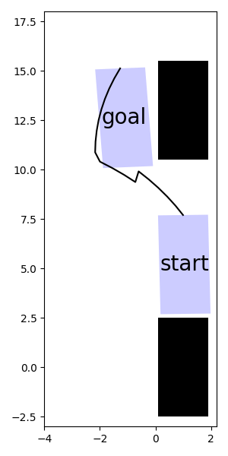
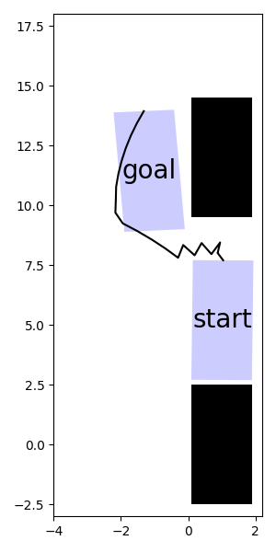
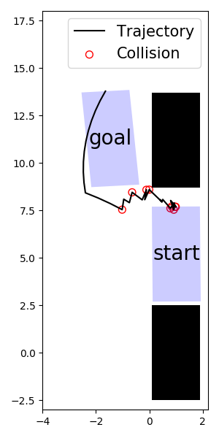
Inductive Generalization – NN fails
Train examples
Test

Slide 18
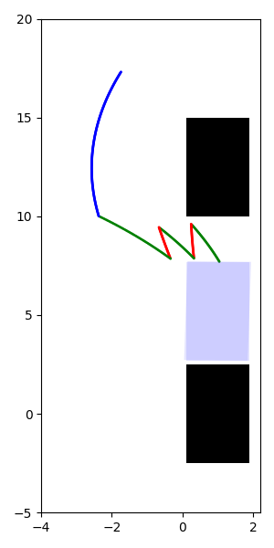

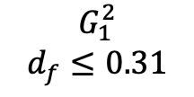











Programmatic Policies based on State Machines
$$G_{s}^{1}$$
$$True$$
$$G_{1}^{3}$$
$$x≤−1.13$$
$$G_{3}^{e}$$
$$θ≤1.58$$
$$m_{1}$$
$$m_{3}$$
$$m_{s}$$
$$m_{e}$$
$$H_{m_{1}}= \left[2.4, .35\right]$$
$$H_{m_{3}}= \left[1.6, −.35\right]$$
$$G_{2}^{1}$$
$$d_{b}≤0.33$$
$$G_{1}^{2}$$
$$d_{f}≤0.31$$
$$m_{2}$$
$$H_{m_{2}}= \left[−2.0, −.09\right]$$

Slide 19

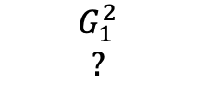









How to learn programs?
$$G_{1}^{3}$$
$$?$$
$$G_{3}^{e}$$
$$?$$
$$G_{s}^{1}$$
$$?$$
$$m_{3}$$
$$m_{1}$$
$$m_{e}$$
$$m_{s}$$
$$H_{m_{1}}= \left[?, ? \right]$$
$$H_{m_{3}}= \left[?, ? \right]$$
$$G_{3}^{1}$$
$$?$$
$$G_{2}^{1}$$
$$?$$
$$G_{1}^{2}$$
?
$$G_{2}^{3}$$
$$?$$
$$G_{3}^{2}$$
$$?$$
$$m_{2}$$
$$H_{m_{2}}= \left[?, ? \right]$$
Direct numerical optimization does not work

Slide 20


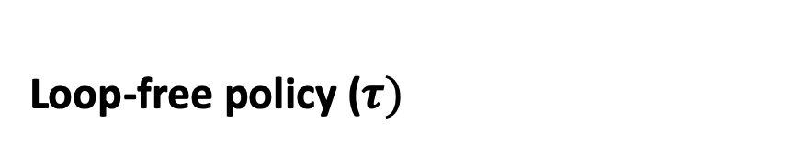











Over-parameterization
Loop-free policy ($τ)$
State-machine policy ($π)$
$$G_{0}^{1}$$
$$F_{θ_{0}}$$
$$F_{θ_{1}}$$
$$F_{θ_{k}}$$
$$F_{θ_{m_{0}}}$$
$$F_{θ_{m_{1}}}$$
….
$$G_{0}^{2}$$
$$G_{2}^{0}$$
$$t_{0}$$
$$t_{1}$$
$$t_{k}$$
$$F_{θ_{m_{2}}}$$
Straight-chain of simple policies
Transitions based on time
Different policies for different initial states
Fully continuous, easy to learn
Not generalizable
Simple policies connected as a graph
Transitions based on a function on state
Same policy for all initial states
Discrete + continuous, hard to learn
Generalizable

Slide 21



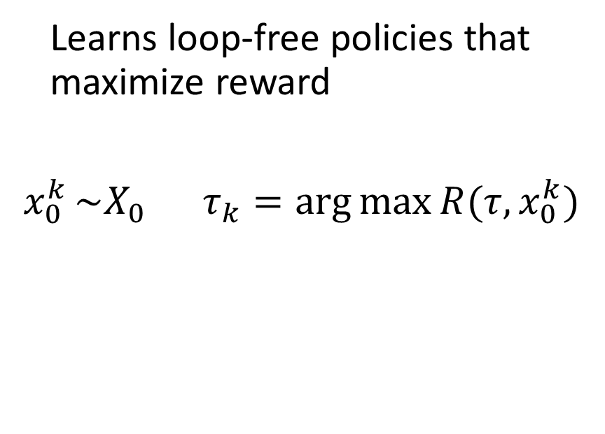








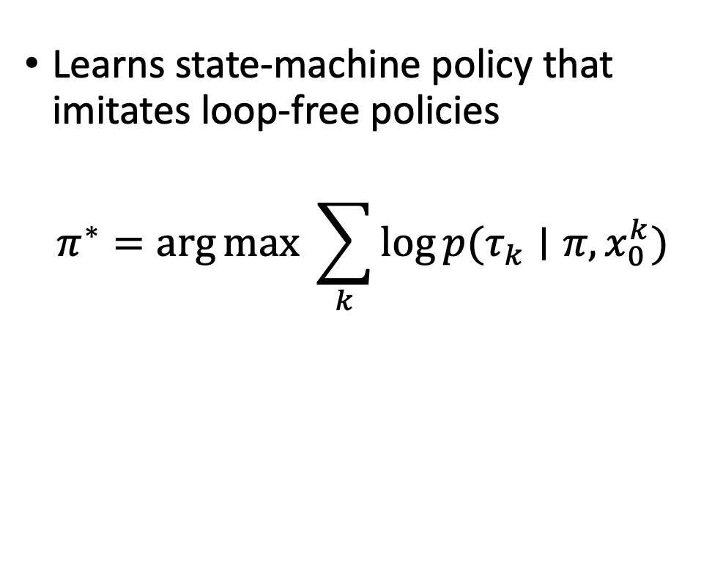


Teacher-Student algorithm
Teacher
Student
Learns state-machine policy that imitates loop-free policies
$$π^{∗}=\arg{\max{ \sum_{k}{\log{p(τ_{k}∣π,x_{0}^{k})}}}}$$
Learns loop-free policies that maximize reward
$x_{0}^{k }\sim X_{0}$ $τ_{k}=\arg{\max{R(τ, x_{0}^{k})}}$
$$τ$$
$$π$$
trajectory
$$G_{0}^{1}$$
$$F_{θ_{0}}$$
$$F_{θ_{1}}$$
….
$$F_{θ_{k}}$$
$$F_{θ_{m_{0}}}$$
$$F_{θ_{m_{1}}}$$
$$t_{0}$$
$$t_{1}$$
$$t_{k}$$
$$G_{0}^{2}$$
$$G_{2}^{0}$$
$$F_{θ_{m_{2}}}$$

Slide 22
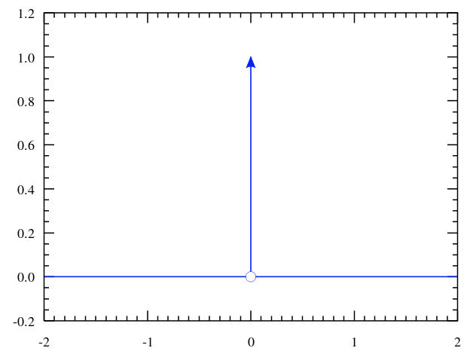
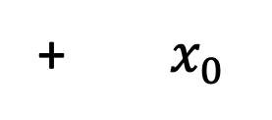













Over-parameterization
State machine policy to loop-free policy
$$G_{0}^{1}$$
$$F_{θ_{m_{0}}}$$
$$F_{θ_{m_{1}}}$$
+ $x_{0}$
$$F_{θ_{0}}$$
$$F_{θ_{1}}$$
….
$$F_{θ_{k}}$$
$$G_{0}^{2}$$
$$G_{2}^{0}$$
$$t_{0}$$
$$t_{1}$$
$$t_{k}$$
$$F_{θ_{m_{2}}}$$
$\text{Issue}\text{:} p\left(τ\right|π, x_{0})$ is degenerate

Slide 23


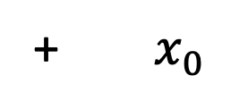

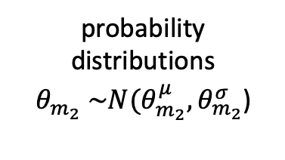




Over-parameterization
State machine policy to loop-free policy
$$G_{0}^{1}$$
$$G_{0}^{1}$$
$$F_{θ_{m_{0}}}$$
$$F_{θ_{m_{0}}}$$
$$F_{θ_{m_{1}}}$$
$$F_{θ_{m_{1}}}$$
+ $x_{0}$
$$F_{θ_{0}}$$
$$F_{θ_{1}}$$
….
$$F_{θ_{k}}$$
$$G_{2}^{0}$$
$$G_{0}^{2}$$
$$G_{2}^{0}$$
$$G_{0}^{2}$$
$$t_{0}$$
$$t_{1}$$
$$t_{k}$$
$$F_{θ_{m_{2}}}$$
$$F_{θ_{m_{2}}}$$
$\text{Issue}\text{:} p\left(τ\right|π, x_{0})$ is degenerate
$$\text{Solution}\text{: }\text{Make} \text{state} \text{machine} \text{policy} \text{probabilistic}$$
$$G_{0}^{1}$$
$$F_{θ_{m_{0}}}$$
$$F_{θ_{m_{1}}}$$
$$p$$
$$G_{2}^{0}$$
+ $x_{0}$
$$G_{0}^{2}$$
probability distributions
$θ_{m_{2}} \sim N(θ_{m_{2}}^{μ}, θ_{m_{2}}^{σ}$)
$$τ$$
$$F_{θ_{m_{2}}}$$
Distribution of loop-free policies

Slide 24














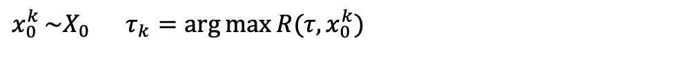


















Algorithm
Teacher: Maximizes reward on an over-parameterized representation of policies (loop-free policies)
$x_{0}^{k }\sim X_{0}$ $τ_{k}=\arg{\max{R(τ, x_{0}^{k})}}$
$$τ$$
$$θ_{0}^{2}, t_{0}^{2}$$
$$θ_{1}^{2}, t_{1}^{2}$$
$$θ_{0}^{1}, t_{0}^{1}$$
$$θ_{1}^{1}, t_{1}^{1}$$
$$x_{0}^{2}$$
f
$$x_{1}^{2}$$
f
….
$$x_{0}^{1}$$
f
$$x_{1}^{1}$$
f
….
$$x_{0}^{1}$$
R = 0
$$x_{0}^{2}$$
R = 0
$$τ_{1}$$
$$τ_{2}$$
Student: Imitate loop-free policies
$$π^{∗}=\arg{\max{ \sum_{k}{\log{p(τ_{k}∣π,x_{0}^{k})}}}}$$
$$π$$
$π:$ Prob program policy
$τ:$ Loop-free policy
R: Reward function
$$G_{s}^{1}$$
$$?$$
$$G_{1}^{3}$$
$$?$$
$$G_{3}^{e}$$
$$?$$
$$m_{s}$$
$$m_{1}$$
$$m_{3}$$
$$m_{e}$$
$$H_{m_{1}}= \left[?, ? \right]$$
$$H_{m_{3}}= \left[?, ? \right]$$
$$G_{3}^{1}$$
$$?$$
$$G_{2}^{1}$$
$$?$$
$$G_{1}^{2}$$
?
$$G_{3}^{2}$$
$$?$$
$$G_{2}^{3}$$
$$?$$
Unknown probability distributions
$$m_{2}$$
$$H_{m_{2}}= \left[?, ? \right]$$
Notes:
Slide for how direct opt does not work
F representation to explain the different boxes
Tau that has high reward are the tau that get high prob from sm

Slide 25























Student - Imitation Learning
Loop-free policies from the teacher
$$x_{0}^{1}$$
$$F_{θ_{0}^{1}}$$
$$F_{θ_{1}^{1}}$$
….
$$F_{θ_{k}^{1}}$$
$$x_{0}^{2}$$
$$F_{θ_{0}^{2}}$$
$$F_{θ_{1}^{2}}$$
….
$$F_{θ_{k}^{2}}$$
$$t_{0}^{1}$$
$$t_{1}^{1}$$
$$t_{k}^{1}$$
$$t_{0}^{2}$$
$$t_{1}^{2}$$
$$t_{k}^{2}$$
$$x_{0}^{1}$$
$$x_{0}^{2}$$
$$τ_{1}$$
$$τ_{2}$$
Step 1: Learn actions for the different modes
$$m_{1}$$
$$m_{3}$$
$$m_{2}$$
$$x_{0}^{1}$$
$$x_{0}^{2}$$

Slide 26













Student – Imitation Learning
Step 2: Learn switching conditions
$$s_{a}$$
$$s_{b}$$
$$m_{1}$$
$$m_{3}$$
$$g_{1}^{2}$$
$$t_{a}$$
$$t_{b}$$
$$m_{2}$$
g$(x_{t})$
0
$$t_{a}$$
$$t$$
$$g_{1}^{2}(x_{t})$$
$${transition time t}_{0}$$

Slide 27

Student – Imitation Learning
Step 2: Learn switching conditions
$$s_{a}$$
$$s_{b}$$
$$m_{1}$$
$$m_{3}$$
$$g_{1}^{2}$$
$$t_{a}$$
$$t_{b}$$
$$m_{2}$$
$$g_{1}^{3}(x_{t})$$
g$(x_{t})$
0
$$t_{a}$$
$$t$$
$$g_{1}^{2}(x_{t})$$
$${transition time t}_{0}$$

Slide 28

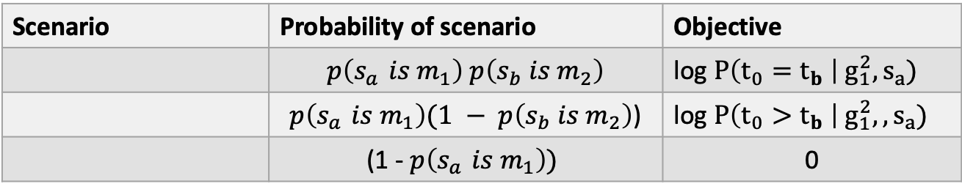
Student – Imitation Learning
Step 2: Learn switching conditions
$$s_{a}$$
$$s_{b}$$
$$m_{1}$$
$$m_{3}$$
$$g_{1}^{2}$$
$$t_{a}$$
$$t_{b}$$
$$m_{2}$$
g$(x_{t})$
Scenario | Probability of scenario | Objective
 | $$p\left(s_{a }is m_{1}\right) p\left(s_{b} is m_{2}\right)$$ | log $P\left(t_{0}=t_{b} \right| g_{1}^{2}, s_{a})$
 | $p\left(s_{a }is m_{1}\right)(1 − p\left(s_{b} is m_{2}\right)$) | log $P\left(t_{0}>t_{b} \right| g_{1}^{2},, s_{a})$
 | (1 - $p\left(s_{a }is m_{1}\right))$ | 0
$$t_{b}$$
0
$$t_{a}$$
$$t$$
$$g_{1}^{2}(x_{t})$$
$${transition time t}_{0}$$

Slide 29







Student – Imitation Learning
Step 2: Learn switching conditions
$$s_{a}$$
$$s_{b}$$
$$m_{1}$$
$$m_{3}$$
$$g_{1}^{2}$$
$$t_{a}$$
$$t_{b}$$
$$m_{2}$$
$$g_{1}^{3}(x_{t})$$
g$(x_{t})$
Scenario | Probability of scenario | Objective
 | $$p\left(s_{a }is m_{1}\right) p\left(s_{b} is m_{2}\right)$$ | log $P\left(t_{0}=t_{b} \right| g_{1}^{2}, s_{a})$
 | $p\left(s_{a }is m_{1}\right)(1 − p\left(s_{b} is m_{2}\right)$) | log $P\left(t_{0}>t_{b} \right| g_{1}^{2},, s_{a})$
 | (1 - $p\left(s_{a }is m_{1}\right))$ | 0
$$t_{b}$$
0
$$t_{a}$$
$$t$$
$$g_{1}^{2}(x_{t})$$
$${transition time t}_{0}$$

Slide 30


Student – Imitation Learning
Step 2: Learn switching conditions
$$s_{a}$$
$$s_{b}$$
$$m_{1}$$
$$m_{3}$$
$$g_{1}^{2}$$
$$t_{a}$$
$$t_{b}$$
$$m_{2}$$
$$g_{1}^{3}(x_{t})$$
g$(x_{t})$
Scenario | Probability of scenario | Objective
 | $$p\left(s_{a }is m_{1}\right) p\left(s_{b} is m_{2}\right)$$ | log $P\left(t_{0}=t_{b} \right| g_{1}^{2}, s_{a})$
 | $p\left(s_{a }is m_{1}\right)(1 − p\left(s_{b} is m_{2}\right)$) | log $P\left(t_{0}>t_{b} \right| g_{1}^{2},, s_{a})$
 | (1 - $p\left(s_{a }is m_{1}\right))$ | 0
$$t_{b}$$
0
$$t_{a}$$
$$t$$
$$g_{1}^{2}(x_{t})$$
$${transition time t}_{0}$$
Full objective $\arg{max \sum_{s_{a}, s_{b}}{}{\begin{aligned} \\ \\ \begin{aligned}p\left(s_{a }is m_{1}\right) p\left(s_{b} is m_{2}\right)\log{P\left(t_{0}=t_{b}\right|g_{1}^{2}, s_{a})} + \\ \\ p\left(s_{a }is m_{1}\right) \left(1 − p\left(s_{b} is m_{2}\right)\right)\log{P\left(t_{0}>t_{b}\right|g_{1}^{2}, s_{a})}\end{aligned}\end{aligned}}}$
$$g_{1}^{2}$$

Slide 31

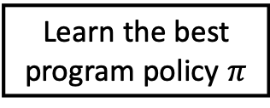

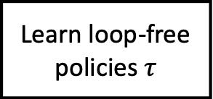




Teacher-student algorithm
Teacher
Student
Learn loop-free policies $τ$
Learn the best program policy $π$
Loop-free policies from the teacher
$$x_{0}^{1}$$
R = 0
$$x_{0}^{2}$$
R = 0
$$τ_{1}$$
$$τ_{2}$$
Best rollouts from the learned state machine
$$x_{0}^{1}$$
R = -10
$$x_{0}^{2}$$
R = -5

Slide 32


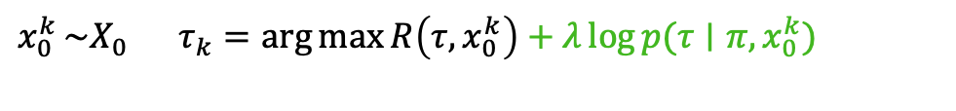

Adaptive Teaching
Adaptive Teacher
Student
Learn loop-free policies $τ$
Learn the best program policy $π$
Loop-free policies from the teacher
$$x_{0}^{1}$$
R = 0
$$x_{0}^{2}$$
R = 0
$$τ_{1}$$
$$τ_{2}$$
Best rollouts from the learned state machine
$$x_{0}^{1}$$
R = -10
$$x_{0}^{2}$$
R = -5
Adaptive Teacher: Maximizes reward on loop-free policies as well as imitates student
$x_{0}^{k }\sim X_{0}$ $τ_{k}=\arg{\max{R\left(τ, x_{0}^{k}\right)+λ\log{p(τ∣π, x_{0}^{k})}}}$
$$τ$$
Loop-free policies from the teacher (iteration 2)
$$x_{0}^{1}$$
R = 0
$$x_{0}^{2}$$
R = 0

Slide 33
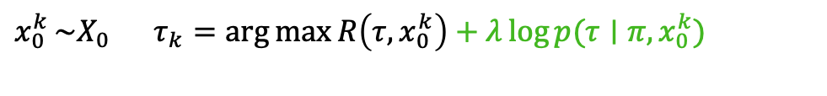
Adaptive Teaching
Teacher: Maximizes reward on loop-free policies as well as imitates student
$x_{0}^{k }\sim X_{0}$ $τ_{k}=\arg{\max{R\left(τ, x_{0}^{k}\right)+λ\log{p(τ∣π, x_{0}^{k})}}}$
Best rollouts from the learned state machine
$$x_{0}^{1}$$
R = -10
$$x_{0}^{2}$$
R = -5
Loop-free policies from the teacher
$$x_{0}^{1}$$
R = 0
$$x_{0}^{2}$$
R = 0

Slide 34
Results: Language is Expressive
On the training set, both our approach and reinforcement learning approaches perform equally.

Slide 35
Results: Inductive Generalization
On the test set, our approach shows better generalization.

Slide 36
Results: Smoother actions
Trajectory of a quadcopter navigating an obstacle course

Slide 37
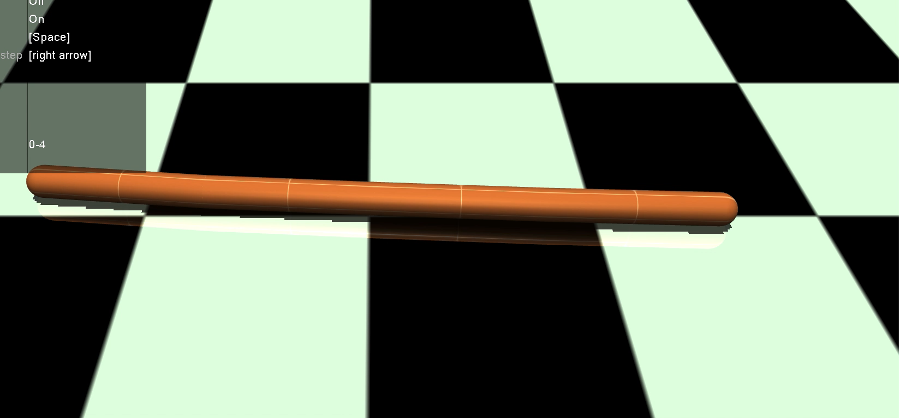


Results: Complex policies
Train: segmets len = 1
Test: segments len = 0.75

Slide 38
















Results: Interpretability
0.5
$$G_{s}^{1}$$
$$True$$
$$G_{1}^{3}$$
$$x≤−1.13$$
$$G_{3}^{e}$$
$$θ≤1.58$$
$$m_{1}$$
$$m_{3}$$
$$m_{s}$$
$$H_{m_{1}}= \left[2.4, .35\right]$$
$$H_{m_{3}}= \left[1.6, −.35\right]$$
$$m_{e}$$
$$G_{2}^{1}$$
$$d_{b}≤0.33$$
0.1
$$G_{1}^{2}$$
$$d_{f}≤0.31$$
0.1
$$m_{2}$$
$$H_{m_{2}}= \left[−2.0, −.09\right]$$

