Slide 1
Lecture 3
Bottom Up
Explicit Search
Armando Solar-Lezama

Slide 2
Idea
Generate programs one by one
  Generate & Test approach
Key issues
  In what order do you generate?
    Influences performance *and* result quality
  How do you prune?
    Essential for scalability
  How do you keep track of the remaining space?
    Especially challenging in the context of pruning

Slide 3
Explicit search from grammars
lstExpr := sort(lstExpr)
lstExpr[intExpr,intExpr]
lstExpr + lstExpr
recursive(lstExpr)
[0]
in
intExpr := firstZero(lstExpr)
len(lstExpr)
0
intExpr + 1
Grammar describes how to generate program fragments from smaller program fragments
plist := set of all terminals
while(true){
plist := grow(plist);
forall( p in plist)
if(isCorrect(p)){ return p; }
}
grow(plist){
// return a list of all trees generated by
// taking a non-terminal and adding
// nodes in plist as children
}

Slide 4
Explicit search from grammars
lstExpr := sort(lstExpr)
lstExpr[intExpr,intExpr]
lstExpr + lstExpr
recursive(lstExpr)
[0]
in
intExpr := firstZero(lstExpr)
len(lstExpr)
0
intExpr + 1
Grammar describes how to generate program fragments from smaller program fragments
Set grows very fast!
Large equivalence classes of equivalent programs
Level 0
in [0] 0
in | [0] | 0 | sort(in) | sort([0]) | in[0,0]
[0][0,0] | in + in | in + [0] | [0] + [0] | [0] + in | rec(in)
rec([0]) | firstZero(in) | firstZero([0]) | len(in) | len([0]) | 0+1
Level 1
Inputs:
[0,7,3,2,5,6,3] and [0,2,13,5,9,1,0]

Slide 5
Identifying equivalent programs
Program equivalence is hard
  It is also unnecessary!
Observational Equivalence
  Are they equivalent wrt the inputs
    easy to check efficiently
    sufficient for the purpose of PBE
  Keep only the simplest one
plist := set of all terminals
while(true){
plist := grow(plist);
plist := elimEquvalents(plist);
forall( p in plist)
if(isCorrect(p)){ return p; }
}

Slide 6
Explicit search from grammars
Features:
  Search small programs before large programs
  Simple
  Works even with black-box language building blocks
    no need to have source for sort or firstZero
    just need to be able to execute them
    no need to know of any properties about them
    e.g. automatically ignores sort(sort(in)) without
    having to know that sort is idempotent
  Complexity depends on the size of the set of distinct programs
    Copes well with symmetries

Slide 7
Explicit search from grammars
Limitations:
  Only scales to very small programs
  Unsuitable for programs with unknown constants
    A single unknown 32-bit constant makes the problem intractable
  Hard to deal with context dependent semantics
Example system:
  Recursive Program Synthesis [Albarghouthi et al., CAV 2013]

Slide 8
Synthesis Through Unification
Idea: Solve many simpler problems, combine their solutions

Slide 9
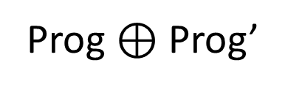

STUN at a glance
STUN(in)
Find Better
Program
Pass
Best Effort
Synthesize
in
Pass
Prog
Fail
Recursive
STUN
Fail
Prog’
$$⊕$$
Prog $⊕$ Prog’

Slide 10


STUN at a glance
(1,2) -> 1
(2,3) -> 2
(4,3) -> 3
(8,1) -> 8
Find Better
Program
Pass
Best Effort
Synthesize
In
Pass
Prog
Fail
Recursive
STUN
Fail
Prog’
$$⊕$$
Prog $⊕$ Prog’

Slide 11
Simple case: (a,b) * c => out
Examples
Grammar
(5,10) * 3 => 15
(8, 11)* -1 => -11
(3,6)*4 => 12
(-3, 8) *4 => -12
expr = expr + expr
| expr * expr
| a | b | c
| - expr
if(bexp) expr else expr
bexp = expr > expr | expr > 0
Level 1:
a => [5,8,3,-3] | b=>[10,11,6,8] | c=>[3,-1,4,4]

Slide 12
Simple case: (a,b) * c => out
Examples
Grammar
(5,10) * 3 => 15
(8, 11)* -1 => -11
(3,6)*4 => 12
(-3, 8) *4 => -12
expr = expr + expr
| expr * expr
| a | b | c
| - expr
if(bexp) expr else expr
bexp = expr > expr| expr > 0
Level 1:
a => [5,8,3,-3] | b=>[10,11,6,8] | c=>[3,-1,4,4]
a+a=>[10,16,6,-6] | a+b=>[15,19,9,5] | a+c=>[8,7,7,1] | b+a=>[15,19,9,5] | b+b=>[20,22,12,16] | b+c=>[13,10,10,12] | c+a=>[8,7,7,1]
c+b=>[13,10,10,12] | c+c=>[6,-2,8,8] | a*a=>[25,64,9,9] | a*b=>[50,88,18,-48] | a*c=>[15,-8,12,-12] | b*a=>[50,88,18,-48] | b*b=>[100,121,36,64]
b*c=>[30,-11,24,32] | c*a=>[15,-8,12,-12] | c*b=>[30,-11,24,32] | c*c=>[9,1,16,16] | -a=>[-5,-8,-3,3] | -b=>[-10,-11,-6,-8] | -c=>[-3,1,-4,-4]

Slide 13
Simple case: (a,b) * c => out
Examples
Grammar
(5,10) * 3 => 15
(8, 11)* -1 => -11
(3,6)*4 => 12
(-3, 8) *4 => -12
expr = expr + expr
| expr * expr
| a | b | c
| - expr
|if(bexp) expr else expr
bexp = expr > expr | expr > 0
Eliminate Observationally equivalent ones
Level 1:
a => [5,8,3,-3] | b=>[10,11,6,8] | c=>[3,-1,4,4]
a+a=>[10,16,6,-6] | a+b=>[15,19,9,5] | a+c=>[8,7,7,1] | b+a=>[15,19,9,5] | b+b=>[20,22,12,16] | b+c=>[13,10,10,12] | c+a=>[8,7,7,1]
c+b=>[13,10,10,12] | c+c=>[6,-2,8,8] | a*a=>[25,64,9,9] | a*b=>[50,88,18,-48] | a*c=>[15,-8,12,-12] | b*a=>[50,88,18,-48] | b*b=>[100,121,36,64]
b*c=>[30,-11,24,32] | c*a=>[15,-8,12,-12] | c*b=>[30,-11,24,32] | c*c=>[9,1,16,16] | -a=>[-5,-8,-3,3] | -b=>[-10,-11,-6,-8] | -c=>[-3,1,-4,-4]

Slide 14
Simple case: (a,b) * c => out
Examples
Grammar
(5,10) * 3 => 15
(8, 11)* -1 => -11
(3,6)*4 => 12
(-3, 8) *4 => -12
expr = expr + expr
| expr * expr
| a | b | c
| - expr
| if(bexp) expr else expr
bexp = expr > expr | expr > 0
Identify an expression that works for a subset of
the inputs
Level 1:
a => [5,8,3,-3] | b=>[10,11,6,8] | c=>[3,-1,4,4]
a+a=>[10,16,6,-6] | a+b=>[15,19,9,5] | a+c=>[8,7,7,1] | b+a=>[15,19,9,5] | b+b=>[20,22,12,16] | b+c=>[13,10,10,12] | c+a=>[8,7,7,1]
c+b=>[13,10,10,12] | c+c=>[6,-2,8,8] | a*a=>[25,64,9,9] | a*b=>[50,88,18,-48] | a*c=>[15,-8,12,-12] | b*a=>[50,88,18,-48] | b*b=>[100,121,36,64]
b*c=>[30,-11,24,32] | c*a=>[15,-8,12,-12] | c*b=>[30,-11,24,32] | c*c=>[9,1,16,16] | -a=>[-5,-8,-3,3] | -b=>[-10,-11,-6,-8] | -c=>[-3,1,-4,-4]

Slide 15
Simple case: (a,b) * c => out
Examples
Grammar
(5,10) * 3 => 15
(8, 11)* -1 => -11
(3,6)*4 => 12
(-3, 8) *4 => -12
expr = expr + expr
| expr * expr
| a | b | c
| - expr
| if(bexp) expr else expr
bexp = expr > expr| expr > 0
Identify an expression that works for the rest
of the inputs
Level 1:
a => [5,8,3,-3] | b=>[10,11,6,8] | c=>[3,-1,4,4]
a+a=>[10,16,6,-6] | a+b=>[15,19,9,5] | a+c=>[8,7,7,1] | b+a=>[15,19,9,5] | b+b=>[20,22,12,16] | b+c=>[13,10,10,12] | c+a=>[8,7,7,1]
c+b=>[13,10,10,12] | c+c=>[6,-2,8,8] | a*a=>[25,64,9,9] | a*b=>[50,88,18,-48] | a*c=>[15,-8,12,-12] | b*a=>[50,88,18,-48] | b*b=> [100,121,36,64]
b*c=>[30,-11,24,32] | c*a=>[15,-8,12,-12] | c*b=>[30,-11,24,32] | c*c=>[9,1,16,16] | -a=>[-5,-8,-3,3] | -b=>[-10,-11,-6,-8] | -c=>[-3,1,-4,-4]

Slide 16


Simple case: (a,b) * c => out
Examples
Grammar
(5,10) * 3 => 15
(3,6)*4 => 12
(-3, 8) *4 => -12
expr = expr + expr
| expr * expr
| a | b | c
| - expr
| if(bexp) expr else expr
bexp = expr > expr| expr > 0
a*c
$$P_{1}$$
(8, 11)* -1 => -11
b*c
$$P_{2}$$
a>a=[f,f,f,f] | a>b=[f,f,f,f] | a>c=[t,f,f,t]
b>a=[t,t,t,t] | b>b=[f,f,f,f] | b>c=[t,t,t,t]
c>a=[f,t,t,f] | c>b=[f,f,f,f] | c>c=[f,f,f,f]
a>0=[t,t,f,t] | b>0=[t,t,t,t] | c>0=[t,t,t,f]

Slide 17

Simple case: (a,b) * c => out
Examples
Grammar
(5,10) * 3 => 15
(3,6)*4 => 12
(-3, 8) *4 => -12
expr = expr + expr
| expr * expr
| a | b | c
| - expr
| if(bexp) expr else expr
bexp = expr > expr| expr > 0
a*c
$$P_{1}$$
(8, 11)* -1 => -11
b*c
$$P_{2}$$
a>a=[f,f,f,f] | a>b=[f,f,f,f] | a>c=[t,f,f,t]
b>a=[t,t,t,t] | b>b=[f,f,f,f] | b>c=[t,t,t,t]
c>a=[f,t,t,f] | c>b=[f,f,f,f] | c>c=[f,f,f,f]
a>0=[t,t,f,t] | b>0=[t,t,t,t] | c>0=[t,t,t,f]
$$P_{1}⊕P_{2}=if\left(c>0\right) a∗c else b∗c$$

Slide 18
Why was this better?

Slide 19
What if there is no top level branch?
The same approach generalizes for other domains without branches
Grammar
var = a | b | c
expr = expr + expr
| expr * expr
| var
| - expr
| if(bexp) var else var
bexp = expr > expr| expr > 0

Slide 20
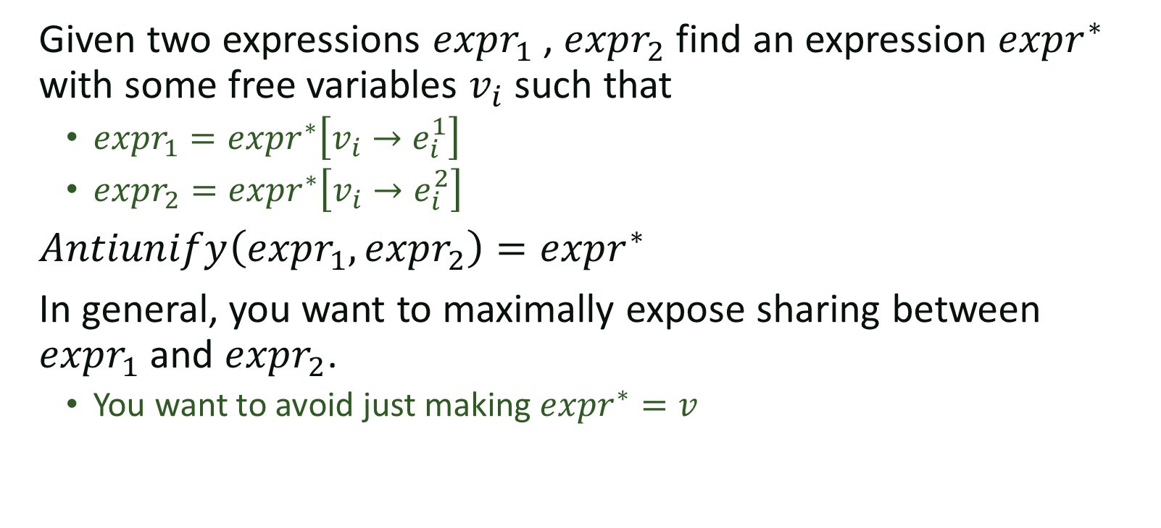
Antiunification
Given two expressions $expr_{1}$ , $expr_{2}$ find an expression $expr^{∗}$ with some free variables $v_{i}$ such that
  $expr_{1}=expr^{∗}\left[v_{i}→e_{i}^{1}\right]$
  $expr_{2}=expr^{∗}\left[v_{i}→e_{i}^{2}\right]$
$Antiunify\left(expr_{1},expr_{2}\right)=expr^{∗}$
In general, you want to maximally expose sharing between $expr_{1}$ and $expr_{2}$.
  You want to avoid just making $expr^{∗}=v$

Slide 21
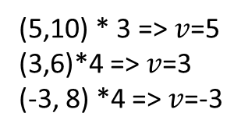


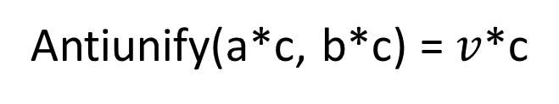
What if there is no top level branch?
Examples
Grammar
(5,10) * 3 => 15
(3,6)*4 => 12
(-3, 8) *4 => -12
var = a | b | c
expr = expr + expr
| expr * expr
| var
| - expr
| if(bexp) var else var
bexp = expr > expr| expr > 0
a*c
$$P_{1}$$
(8, 11)* -1 => -11
b*c
$$P_{2}$$
Antiunify(a*c, b*c) = $v$*c
Find an expression $v$ such that
(5,10) * 3 => $v$=5
(3,6)*4 => $v$=3
(-3, 8) *4 => $v$=-3
(8, 11)* -1 => $v$=11

Slide 22

What if there is no top level branch?
Examples
Grammar
(5,10) * 3 => 15
(3,6)*4 => 12
(-3, 8) *4 => -12
var = a | b | c
expr = expr + expr
| expr * expr
| var
| - expr
| if(bexp) var else var
bexp = expr > expr| expr > 0
a*c
$$P_{1}$$
(8, 11)* -1 => -11
b*c
$$P_{2}$$
Antiunify(a*c, b*c) = $v$*c
Find an expression $v$ such that
(5,10) * 3 => $v$=5
(3,6)*4 => $v$=3
(-3, 8) *4 => $v$=-3
$v$=if(c>0) a else b
(8, 11)* -1 => $v$=11

Slide 23
STUN Summary
STUN provides a general framework for breaking down a global search into a series of local searches.

Slide 24
Hierarchical Search
When can we separate a problem into simpler subproblems?
  What if separating based on input examples is infeasible?

Slide 25
Example: SQL
Input
Output
Employee
---------
Name, Dept
---------
Todd, Sales
Joe, Engineering
Alice, Engineering
Sally, Operations
Depts
-------------
Dept, Building
-------------
Sales, A1
Engineering, A2
Operations, A1
Output
---
XX
---
Todd
Sally
Language
Rel := T | Rel , Rel
| Select Fields from Rel where Pred
Pred := exp = exp | exp > exp | Pred & Pred
Fields := table.name as name | table.name as name, Fields

Slide 26
Hierarchical Search
Key idea:
  First search for the structure of the query
  Then search for the details of the predicates
Observation:
  If a query has the wrong structure we can see it has the wrong structure
  before instantiating the details

Slide 27
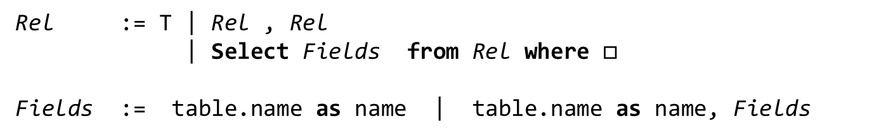
Language with holes
Rel := T | Rel , Rel
| Select Fields from Rel where $□$
Fields := table.name as name | table.name as name, Fields
Input
Query
Superset of output
Employee
---------
Name, Dept
---------
Todd, Sales
Joe, Engineering
Alice, Engineering
Sally, Operations
Depts
-------------
Dept, Building
-------------
Sales, A1
Engineering, A2
Operations, A1

Slide 28
Language with holes
Rel := T | Rel , Rel
| Select Fields from Rel where $□$
Fields := table.name as name | table.name as name, Fields
Input
Query
Superset of output
Employee
---------
Name, Dept
---------
Todd, Sales
Joe, Engineering
Alice, Engineering
Sally, Operations
Depts
-------------
Dept, Building
-------------
Sales, A1
Engineering, A2
Operations, A1
Employee
Todd, Sales
Joe, Engineering
Alice, Engineering
Sally, Operations

Slide 29
Language with holes
Rel := T | Rel , Rel
| Select Fields from Rel where $□$
Fields := table.name as name | table.name as name, Fields
Input
Query
Superset of output
Employee
---------
Name, Dept
---------
Todd, Sales
Joe, Engineering
Alice, Engineering
Sally, Operations
Depts
-------------
Dept, Building
-------------
Sales, A1
Engineering, A2
Operations, A1
Depts
Sales, A1
Engineering, A2
Operations, A1

Slide 30
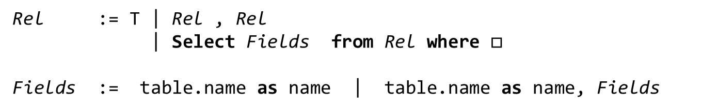
Language with holes
Rel := T | Rel , Rel
| Select Fields from Rel where $□$
Fields := table.name as name | table.name as name, Fields
Input
Query
Superset of output
Employee
---------
Name, Dept
---------
Todd, Sales
Joe, Engineering
Alice, Engineering
Sally, Operations
Depts
-------------
Dept, Building
-------------
Sales, A1
Engineering, A2
Operations, A1
Employee, Depts
Todd, Sales, Sales, A1
Todd, Sales, Engineering, A2
Todd, Sales, Operations, A1
Joe, Engineering, Sales, A1
Joe, Engineering, Engineering, A2
Joe, Engineering, Operations, A1
Alice, Engineering, Sales, A1
Alice, Engineering, Engineering, A2
Alice, Engineering, Engineering, A3
Sally, Operations, Sales, A1
Sally, Operations, Engineering, A2
Sally, Operations, Operations, A1

Slide 31

Language with holes
Rel := T | Rel , Rel
| Select Fields from Rel where $□$
Fields := table.name as name | table.name as name, Fields
Input
Query
Superset of output
Employee
---------
Name, Dept
---------
Todd, Sales
Joe, Engineering
Alice, Engineering
Sally, Operations
Depts
-------------
Dept, Building
-------------
Sales, A1
Engineering, A2
Operations, A1
Select Name from Employee
where $□$
Todd, Sales
Joe, Engineering
Alice, Engineering
Sally, Operations

Slide 32
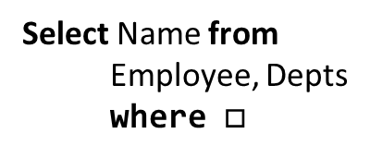
Language with holes
Rel := T | Rel , Rel
| Select Fields from Rel where $□$
Fields := table.name as name | table.name as name, Fields
Input
Query
Superset of output
Employee
---------
Name, Dept
---------
Todd, Sales
Joe, Engineering
Alice, Engineering
Sally, Operations
Depts
-------------
Dept, Building
-------------
Sales, A1
Engineering, A2
Operations, A1
Select Name from
Employee, Depts
where $□$
Todd, Sales, Sales, A1
Todd, Sales, Engineering, A2
Todd, Sales, Operations, A1
Joe, Engineering, Sales, A1
Joe, Engineering, Engineering, A2
Joe, Engineering, Operations, A1
Alice, Engineering, Sales, A1
Alice, Engineering, Engineering, A2
Alice, Engineering, Engineering, A3
Sally, Operations, Sales, A1
Sally, Operations, Engineering, A2
Sally, Operations, Operations, A1

Slide 33
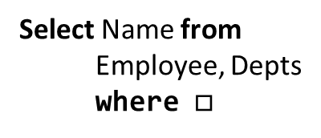

Viable Queries
Select Name from Employee
where $□$
Select Name from
Employee, Depts
where $□$
Todd, Sales
Joe, Engineering
Alice, Engineering
Sally, Operations
Todd, Sales, Sales, A1
Todd, Sales, Engineering, A2
Todd, Sales, Operations, A1
Joe, Engineering, Sales, A1
Joe, Engineering, Engineering, A2
Joe, Engineering, Operations, A1
Alice, Engineering, Sales, A1
Alice, Engineering, Engineering, A2
Alice, Engineering, Engineering, A3
Sally, Operations, Sales, A1
Sally, Operations, Engineering, A2
Sally, Operations, Operations, A1
Can we find the right predicate?
This is an inductive synthesis problem too!

Slide 34
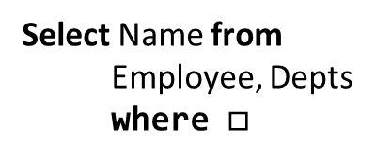
Viable Queries
Select Name from
Employee, Depts
where $□$
Todd, Sales, Sales, A1
Todd, Sales, Engineering, A2
Todd, Sales, Operations, A1
Joe, Engineering, Sales, A1
Joe, Engineering, Engineering, A2
Joe, Engineering, Operations, A1
Alice, Engineering, Sales, A1
Alice, Engineering, Engineering, A2
Alice, Engineering, Engineering, A3
Sally, Operations, Sales, A1
Sally, Operations, Engineering, A2
Sally, Operations, Operations, A1
Employee.Dept = Depts.Dept
& Dept=A1
Todd, Sales, Sales, A1
Sally, Operations, Operations, A1

Slide 35
Summary
We explored a few different ways to speed up search
  Prune based on observational equivalence
    Simple, effective and very general, but fails if you have context dependent semantics
  Break down the search into separate parts of the program
    Can be done based on the inputs or hierarchically
    Language and domain specific

