Slide 1
Lecture 5
Stochastic Search
Armando Solar-Lezama

Slide 2
MCMC and Metropolis Search
Based on “The Markov Chain Monte Carlo Revolution”
Persi Diaconis

Slide 3


Markov Chains
Let $χ$ be a finite set
A Markov chain is defined by a matrix $K\left(x,y\right):χ×χ→ℝ$
  $K\left(x,y\right)≥0$
  $\sum_{y}{K\left(x,y\right)=1}$
  Probability of transitioning from x to y
$$K\left(x,y\right)$$
x
y

Slide 4
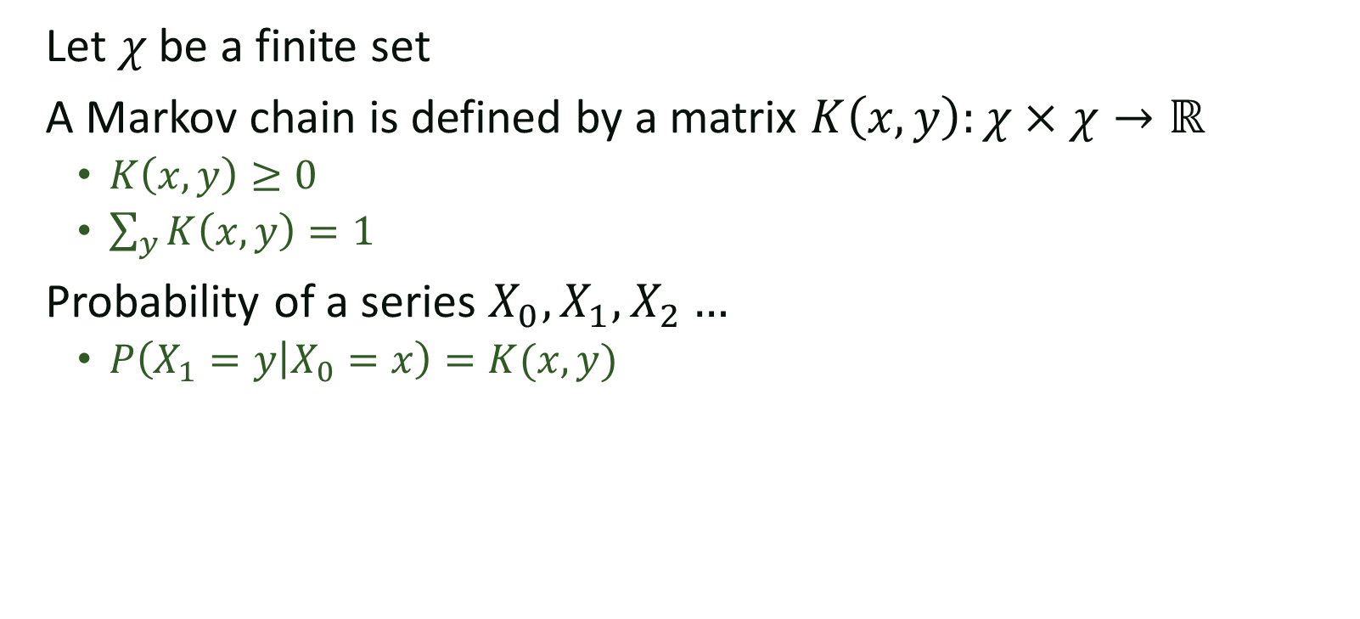
Markov Chains
Let $χ$ be a finite set
A Markov chain is defined by a matrix $K\left(x,y\right):χ×χ→ℝ$
  $K\left(x,y\right)≥0$
  $\sum_{y}{K\left(x,y\right)=1}$
Probability of a series $X_{0}, X_{1}, X_{2}…$
  $P\left(X_{1}=y | X_{0}=x\right)=K(x,y)$
$$K\left(x,y\right)$$
x
y

Slide 5
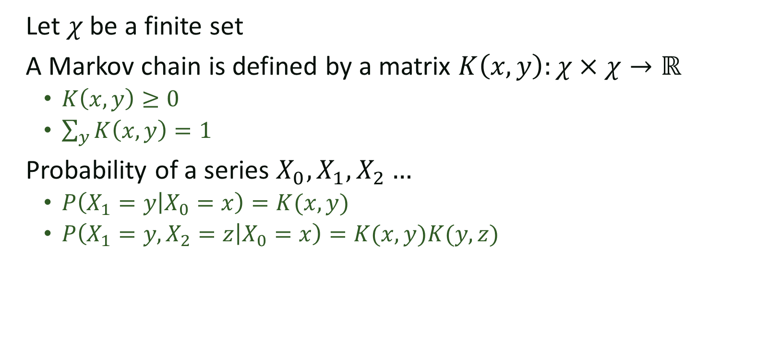

Markov Chains
Let $χ$ be a finite set
A Markov chain is defined by a matrix $K\left(x,y\right):χ×χ→ℝ$
  $K\left(x,y\right)≥0$
  $\sum_{y}{K\left(x,y\right)=1}$
Probability of a series $X_{0}, X_{1}, X_{2}…$
  $P\left(X_{1}=y | X_{0}=x\right)=K(x,y)$
  $P\left(X_{1}=y, X_{2}=z | X_{0}=x\right)=K(x,y)K(y,z)$
$$K\left(x,y\right)$$
x
y
$$K\left(y,z\right)$$
z

Slide 6
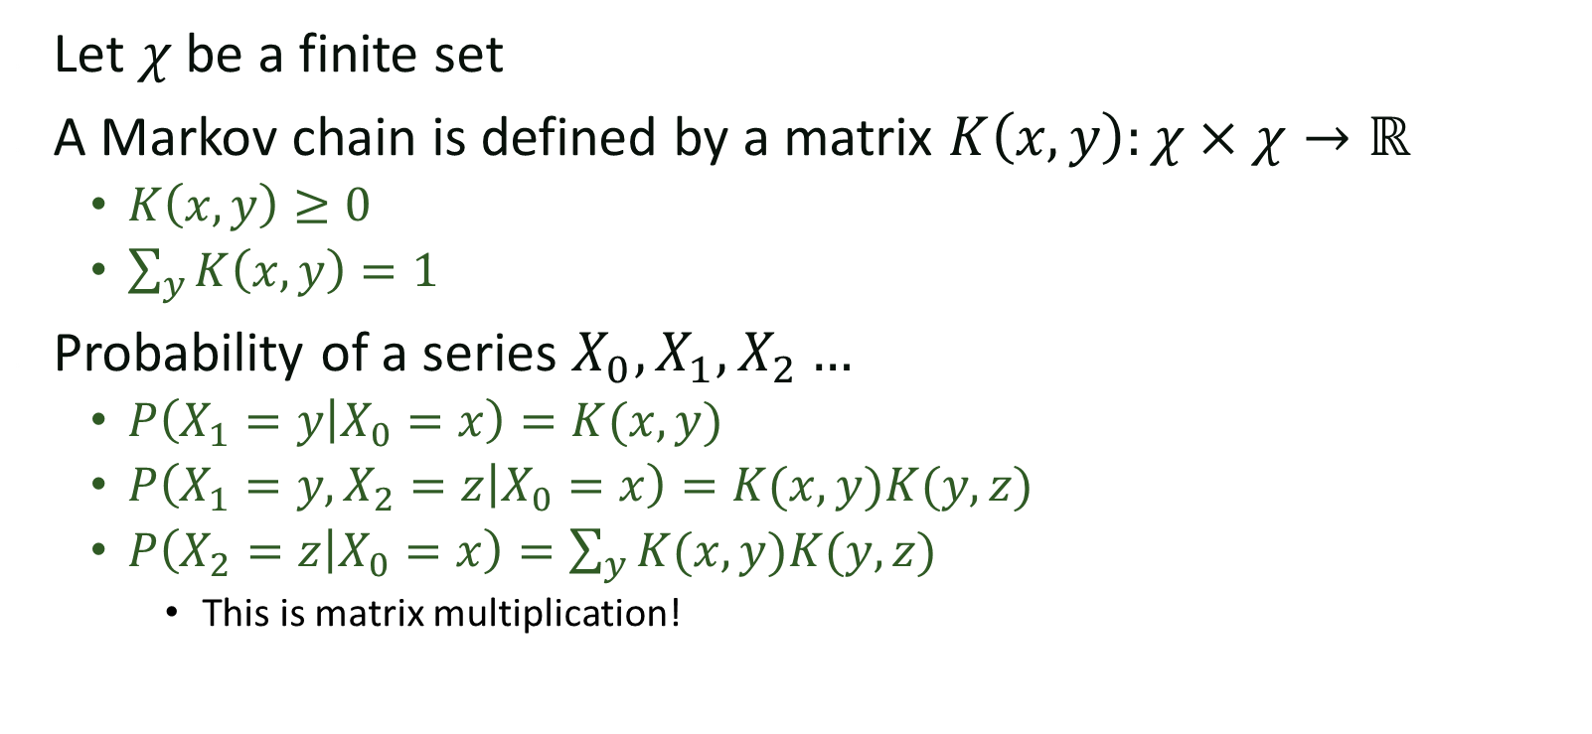
Markov Chains
Let $χ$ be a finite set
A Markov chain is defined by a matrix $K\left(x,y\right):χ×χ→ℝ$
  $K\left(x,y\right)≥0$
  $\sum_{y}{K\left(x,y\right)=1}$
Probability of a series $X_{0}, X_{1}, X_{2}…$
  $P\left(X_{1}=y | X_{0}=x\right)=K(x,y)$
  $P\left(X_{1}=y, X_{2}=z | X_{0}=x\right)=K(x,y)K(y,z)$
  $P\left(X_{2}=z | X_{0}=x\right)=\sum_{y}{K(x,y)K(y,z)}$
    This is matrix multiplication!

Slide 7

Stationary distribution
What is the probability $π(x)$ of being in a node x at some arbitrary step?
  $π\left(x\right)>0 and \sum_{x}{π(x)}=1$
  $π\left(y\right)=\sum_{x}{π\left(x\right)K(x,y)}$
    i.e. $π=πK$

Slide 8
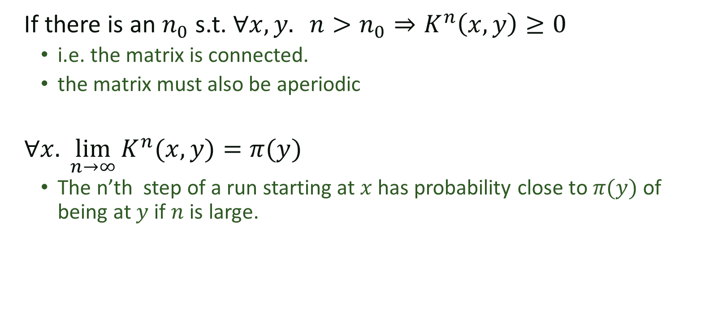
Fundamental theorem of (finite) Markov chains
If there is an $n_{0}$ s.t. $∀x,y. {n>n_{0}⇒K}^{n}\left(x,y\right)≥0$
  i.e. the matrix is connected.
  the matrix must also be aperiodic
$∀x. \lim_{n→∞}{K^{n}(x,y)}=π(y)$
  The n’th step of a run starting at $x$ has probability close to $π(y)$ of being at $y$ if $n$ is large.

Slide 9
Stationary Distribution
4
K(0, x) = 1/12
K(x, 0) = 1 for x !=0
3
5
2
6
0
1
This edge makes it aperiodic
without this edge, if it starts
at the center, the probability of being
at the center on an odd step 2*n would be
zero for any n.
7
11
8
10
9

Slide 10
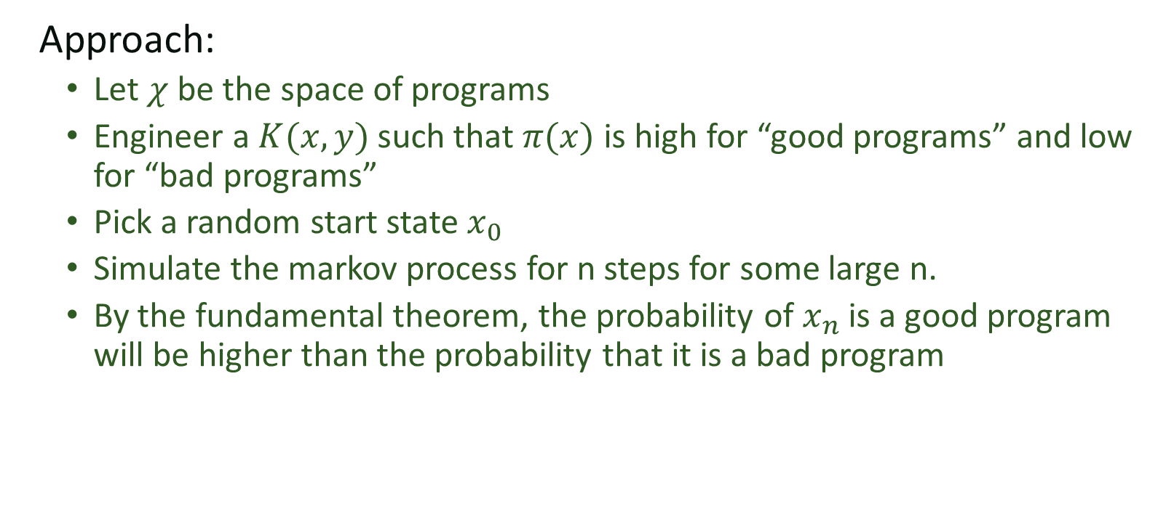
MCMC Based synthesis
Approach:
  Let $χ$ be the space of programs
  Engineer a $K(x,y)$ such that $π(x)$ is high for “good programs” and low for “bad programs”
  Pick a random start state $x_{0}$
  Simulate the markov process for n steps for some large n.
  By the fundamental theorem, the probability of $x_{n}$ is a good program will be higher than the probability that it is a bad program

Slide 11

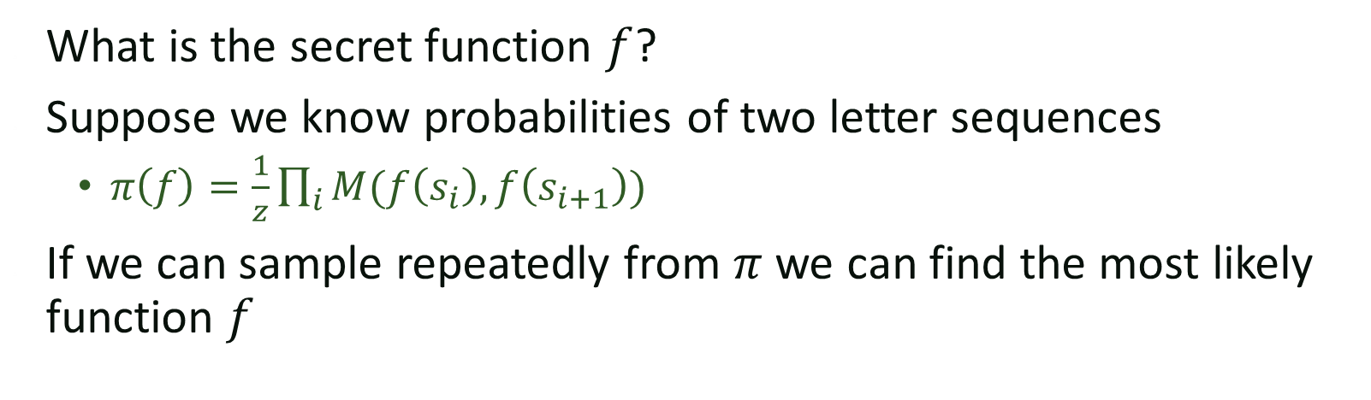
Motivating example
the quick brown fox jumps over the lazy dog
$$f$$
yjr wiovl ntpem gpc kizqd pbrt yjr asxu fph
What is the secret function $f$?
Suppose we know probabilities of two letter sequences
  $π\left(f\right)=\frac{1}{z}\prod_{i}{M(f\left(s_{i}\right),f\left(s_{i+1}\right))}$
If we can sample repeatedly from $π$ we can find the most likely function $f$

Slide 12
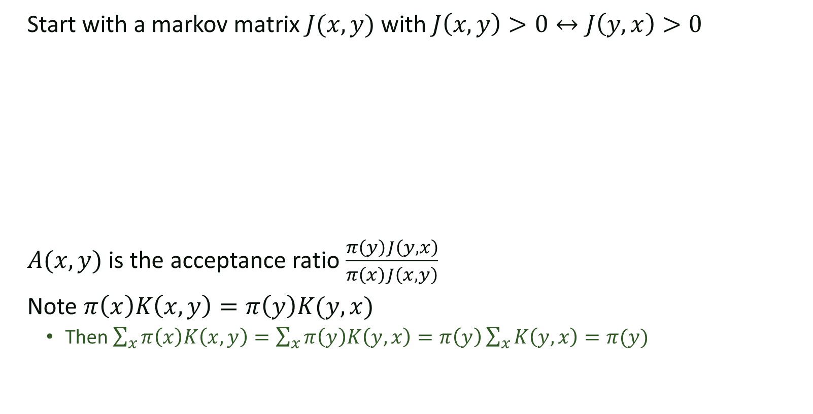
Metropolis algorithm
Start with a markov matrix $J(x,y)$ with $J\left(x,y\right)>0↔J\left(y,x\right)>0$
$A(x,y)$ is the acceptance ratio $\frac{π\left(y\right)J\left(y,x\right)}{π\left(x\right)J\left(x,y\right)}$
Note $π\left(x\right)K\left(x,y\right)=π\left(y\right)K(y,x)$
  Then $\sum_{x}{π\left(x\right)K\left(x,y\right)}=\sum_{x}{π\left(y\right)K\left(y,x\right)=π\left(y\right)\sum_{x}{K\left(y,x\right)}=π(y)}$

Slide 13
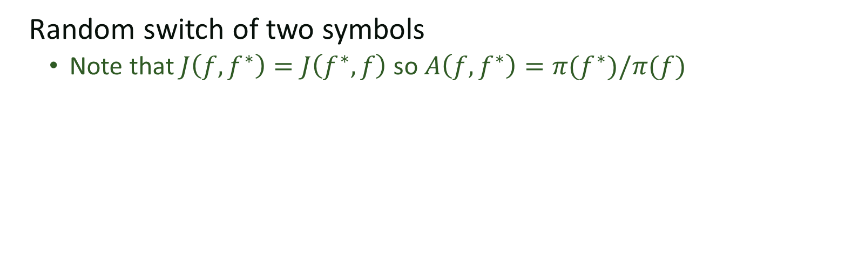
Back to example
Random switch of two symbols
  Note that $J\left(f,f^{∗}\right)=J\left(f^{∗},f\right)$ so $A\left(f,f^{∗}\right)=π(f^{∗})/π(f)$

Slide 14
Many recent synthesis applications
Influential work by Schkufza, Sharma Aiken.
  Focus on program optimization
Wide variety of applications in other areas
  Probabilistic programming
  Cognitive Science
  etc.

Slide 15

Key issues
Need good estimates of $π$
Where does it work?

Slide 16
Stochastic Superoptimization
Goal: Synthesize equivalent assembly program that is
significantly more efficient.
Example from Schkufza, Sharma and Aiken from ASPLOS 13.

Slide 17
The program space
Sequences of assembly instructions of bounded length

Slide 18





The proposal Distribution
movq rsi, r9
movl ecx, ecx
sharq 32, rsi
xorl 0xffffffff, r9d
movq edx, edx
…
Transitions that change one opcode
Transitions that replace one instruction with a NOOP
Transitions that change
one operand
movq rsi, r9
movl ecx, edx
sharq 32, rsi
andl 0xffffffff, r9d
movq edx, edx
…
$$p_{c}$$
$$p_{o}$$
movq rsi, r9
movl ecx, ecx
sharq 32, rsi
NOOP
movq edx, edx
…
movq rsi, r9
movl ecx, ecx
sharq 32, rsi
andl 0xffffffff, r9d
movq edx, edx
…
$$p_{u}$$
movq rsi, r9
movl ecx, edx
andl 0xffffffff, r9d
sharq 32, rsi
movq edx, edx
…
$$p_{s}$$
$$p_{i}$$
Transitions that swap
two instructions
movq rsi, r9
movl ecx, ecx
sharq 32, rsi
mulq rsi
movq edx, edx
…
Transitions that replace one instruction with another

Slide 19
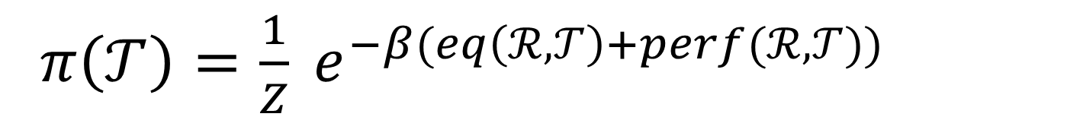
The stationary distribution
$π\left(𝒯\right)=\frac{1}{Z} e^{−β(eq\left(ℛ, 𝒯\right)+perf(ℛ, 𝒯))}$

Slide 20
Improvements
search is conducted in two stages
  In the first stage, the performance component is completely ignored, allowing the search to discover correct programs that are very different from the initial one.
  A set of these correct programs discovered in the first phase are used as starting points for a second phase search that includes the performance term.

Slide 21
Almost disjoint clusters
Starting in one cluster, the probability of transitioning to the other is extremely low

Slide 22
Almost disjoint clusters
Introducing more paths, or increasing the probability for the existing ones helps us converge faster
to a distribution that is representative of both clusters

