Slide 1
Lecture 3
More Explicit Search and Version Spaces
Armando Solar-Lezama and Xiaokang Qiu

Slide 2
Last time
Explicit search
  With pruning for observational equivalence

Slide 3
Alternative interpretation of the algorithm
The algorithm from last time can be understood in terms of partial orders

Slide 4
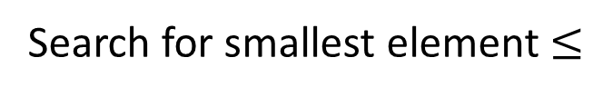
Binary search
<
<
<
<
<
<
<
<
<
<
<
<
Search for smallest element $≤$

Slide 5
Binary search
<
<
<
<
<
<
<
<
<
<
<
<
Search for smallest element $≤$

Slide 6
Binary search
<
<
<
<
<
<
<
<
<
<
<
<
Search for smallest element $≤$

Slide 7
Binary search
<
<
<
<
<
<
<
<
<
<
<
<
Search for smallest element $≤$

Slide 8
Binary search
<
<
<
<
<
<
<
<
<
<
<
<
Search for smallest element $≤$

Slide 9
Binary search
<
<
<
<
<
<
<
<
<
<
<
<
Search for smallest element $≤$

Slide 10
Binary search
<
<
<
<
<
<
<
<
<
<
<
<
Search for smallest element $≤$

Slide 11
Binary search
<
<
<
<
<
<
<
<
<
<
<
<
Search for smallest element $≤$

Slide 12
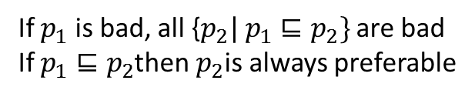

Partial order for search
$$p_{1}⊑p2$$
If $p_{1}$ is bad, all {$p_{2}| p_{1}⊑p_{2}\}$ are bad
If $p_{1}⊑p_{2}$then $p_{2}$is always preferable

Slide 13
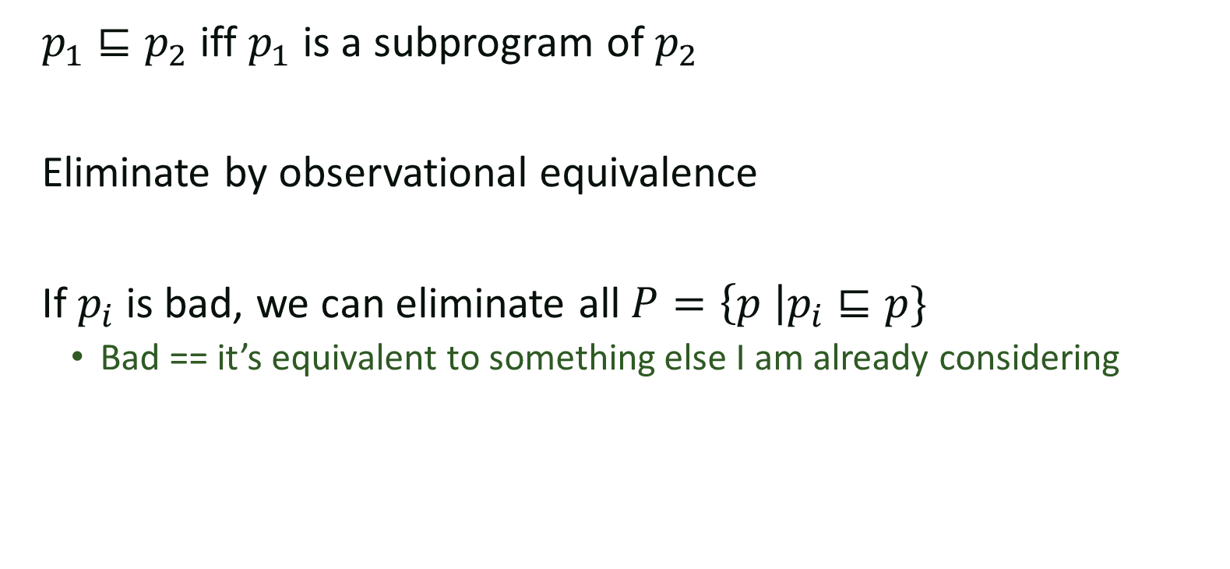
Partial order for grammar
$p_{1}⊑p_{2}$ iff $p_{1}$ is a subprogram of $p_{2}$
Eliminate by observational equivalence
If $p_{i}$ is bad, we can eliminate all $P=\left\{p \right|p_{i}⊑p\}$
  Bad == it’s equivalent to something else I am already considering

Slide 14

Partial order for grammar
$p_{1}⊑p_{2}$ iff $p_{1}$ is a subprogram of $p_{2}$
lstExpr := sort(lstExpr)
lstExpr[intExpr,intExpr]
lstExpr + lstExpr
recursive(lstExpr)
[0]
in
intExpr := firstZero(lstExpr)
len(lstExpr)
0
intExpr + 1
1 non-terminal connecting terminals
Terminals

Slide 15
Partial order for grammar
$p_{1}⊑p_{2}$ iff $p_{1}$ is a subprogram of $p_{2}$
lstExpr := sort(lstExpr)
lstExpr[intExpr,intExpr]
lstExpr + lstExpr
recursive(lstExpr)
[0]
in
intExpr := firstZero(lstExpr)
len(lstExpr)
0
intExpr + 1
1 non-terminal connecting terminals
Terminals

Slide 16
Partial order for grammar
$p_{1}⊑p_{2}$ iff $p_{1}$ is a subprogram of $p_{2}$
lstExpr := sort(lstExpr)
lstExpr[intExpr,intExpr]
lstExpr + lstExpr
recursive(lstExpr)
[0]
in
intExpr := firstZero(lstExpr)
len(lstExpr)
0
intExpr + 1
1 non-terminal connecting terminals
Terminals

Slide 17
Partial order for grammar
$p_{1}⊑p_{2}$ iff $p_{1}$ is a subprogram of $p_{2}$
lstExpr := sort(lstExpr)
lstExpr[intExpr,intExpr]
lstExpr + lstExpr
recursive(lstExpr)
[0]
in
intExpr := firstZero(lstExpr)
len(lstExpr)
0
intExpr + 1
1 non-terminal connecting terminals
Terminals

Slide 18
Partial order for grammar
$p_{1}⊑p_{2}$ iff $p_{1}$ is a subprogram of $p_{2}$
lstExpr := sort(lstExpr)
lstExpr[intExpr,intExpr]
lstExpr + lstExpr
recursive(lstExpr)
[0]
in
intExpr := firstZero(lstExpr)
len(lstExpr)
0
intExpr + 1
1 non-terminal connecting terminals
Terminals

Slide 19
Version spaces
Programming by demonstration using version space algebra
Lau, Wolfman, Domingos, Weld, 2001

Slide 20
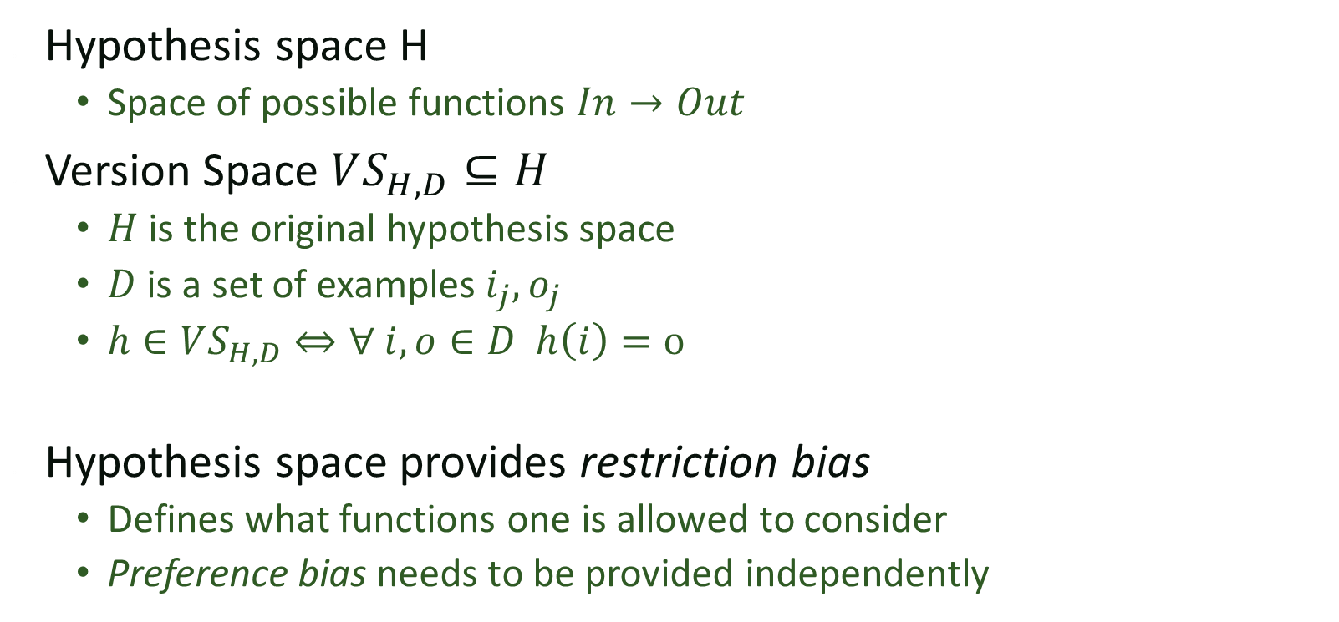
Version Space Formulation
Hypothesis space H
  Space of possible functions $In→Out$
Version Space $VS_{H,D}⊆H$
  $H$ is the original hypothesis space
  $D$ is a set of examples $i_{j},o_{j}$
  $h∈VS_{H,D}⇔∀ i,o∈D h\left(i\right)=o$
Hypothesis space provides restriction bias
  Defines what functions one is allowed to consider
  Preference bias needs to be provided independently

Slide 21

Partial Ordering of hypothesis
Partial order $h_{1}⊑h_{2}$
  $h_{2}$ is “better” than $h_{1}$
Ex: For boolean hypothesis
  “better” == more general
  $h_{1}⊑h_{2}⇔(h_{1}⇒h_{2})$
For booleans, VS forms a lattice

Slide 22
Partial Orders
Set P
Partial order ≤ such that ∀x,y,z∈P
  x ≤ x (reflexive)
  x ≤ y and y ≤ x implies x = y (asymmetric)
  x ≤ y and y ≤ z implies x ≤ z (transitive)
Can use partial order to define
  Upper and lower bounds
  Least upper bound
  Greatest lower bound

Slide 23
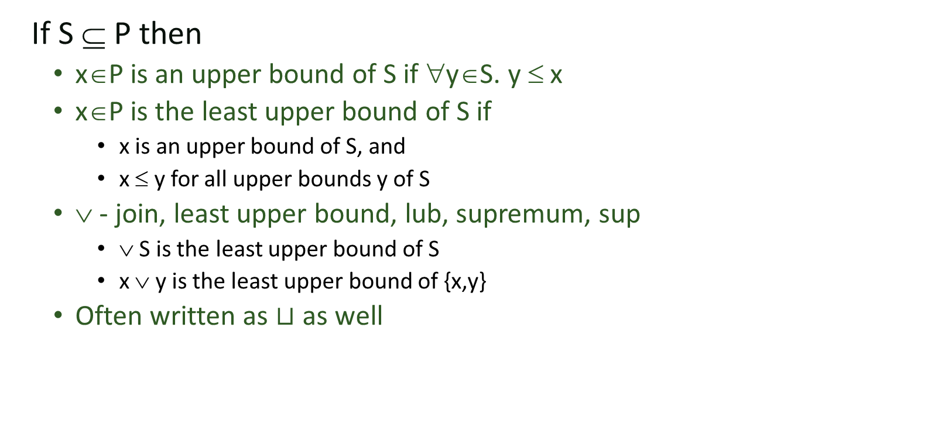
Upper Bounds
If S ⊆ P then
  x∈P is an upper bound of S if ∀y∈S. y ≤ x
  x∈P is the least upper bound of S if
    x is an upper bound of S, and
    x ≤ y for all upper bounds y of S
  ∨ - join, least upper bound, lub, supremum, sup
    ∨ S is the least upper bound of S
    x ∨ y is the least upper bound of {x,y}
  Often written as $⊔$ as well

Slide 24
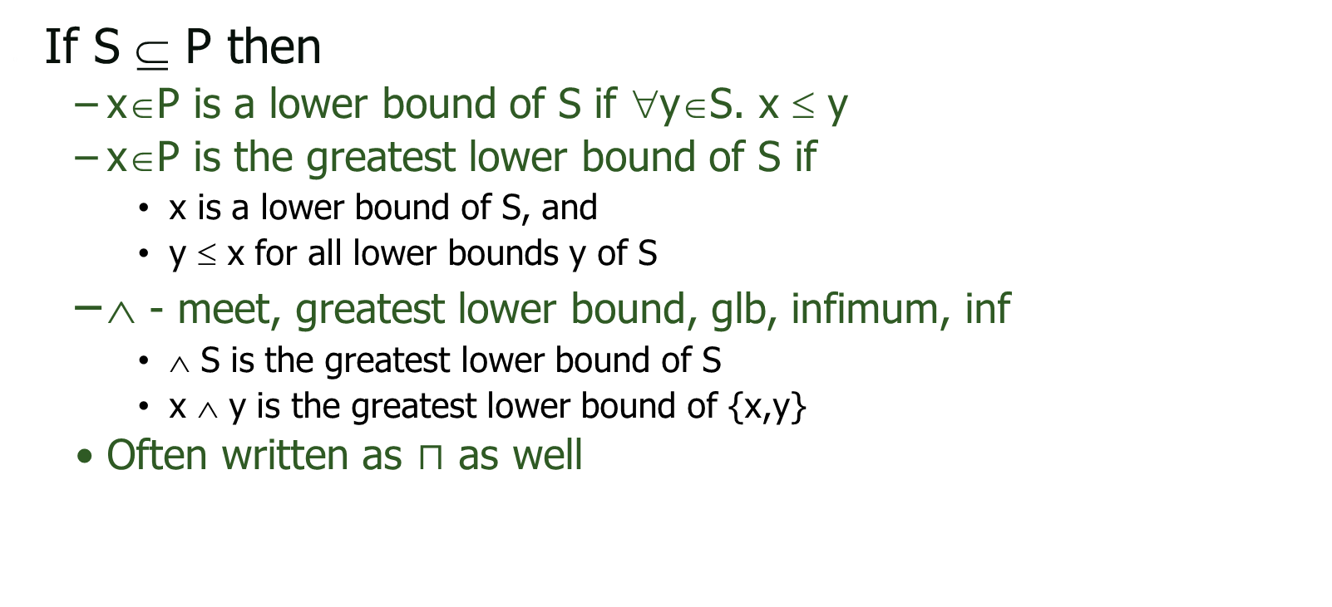
Lower Bounds
If S ⊆ P then
  x∈P is a lower bound of S if ∀y∈S. x ≤ y
  x∈P is the greatest lower bound of S if
    x is a lower bound of S, and
    y ≤ x for all lower bounds y of S
  ∧ - meet, greatest lower bound, glb, infimum, inf
    ∧ S is the greatest lower bound of S
    x ∧ y is the greatest lower bound of {x,y}
  Often written as $⊓$ as well

Slide 25
Lattices
If x ∧ y and x ∨ y exist for all x,y∈P
then P is a lattice
If ∧S and ∨S exist for all S ⊆ P
then P is a complete lattice
All finite lattices are complete
Example of a lattice that is not complete
  Integers I
  For any x, y∈I, x ∨ y = max(x,y), x ∧ y = min(x,y)
  But ∨ I and ∧ I do not exist
  I ∪ {+∞,−∞ } is a complete lattice

Slide 26
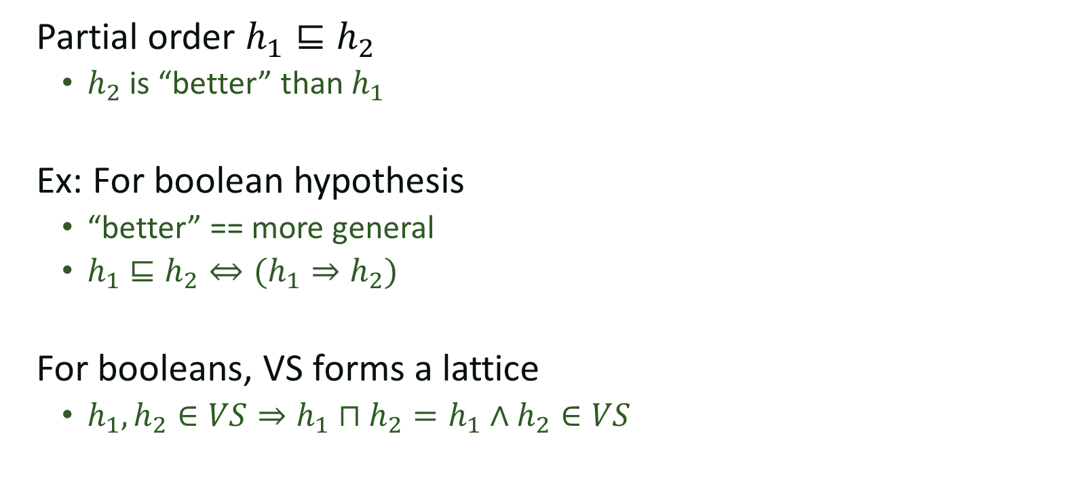
Partial Ordering of hypothesis
Partial order $h_{1}⊑h_{2}$
  $h_{2}$ is “better” than $h_{1}$
Ex: For boolean hypothesis
  “better” == more general
  $h_{1}⊑h_{2}⇔(h_{1}⇒h_{2})$
For booleans, VS forms a lattice
  $h_{1},h_{2}∈VS⇒h_{1}⊓h_{2}=h_{1}∧h_{2}∈VS$
Most specific hypothesis that
satisfies the observations

Slide 27
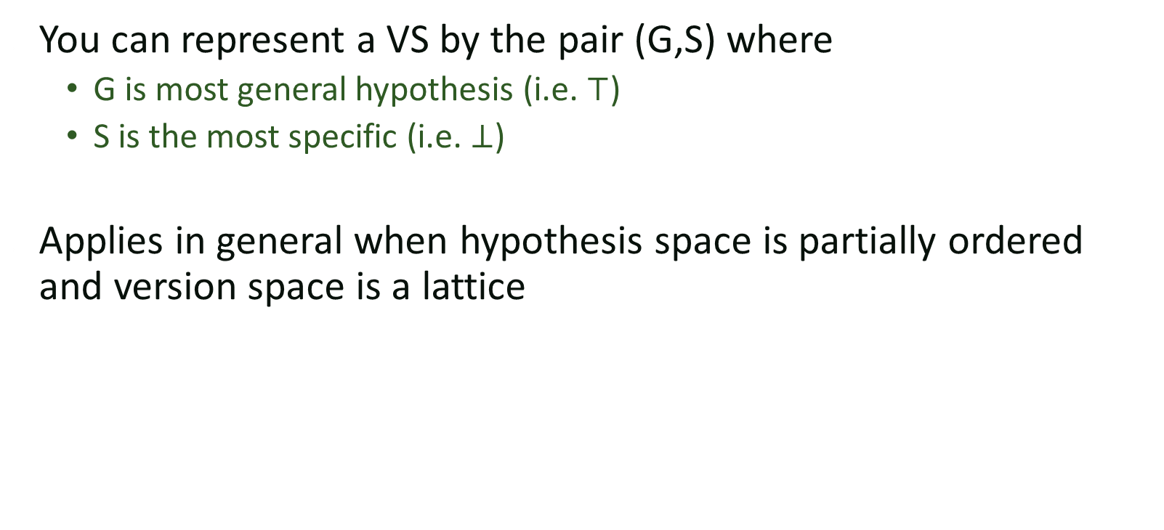
Boundary set representable
You can represent a VS by the pair (G,S) where
  G is most general hypothesis (i.e. $⊤$)
  S is the most specific (i.e. $⊥$)
Applies in general when hypothesis space is partially ordered and version space is a lattice

Slide 28
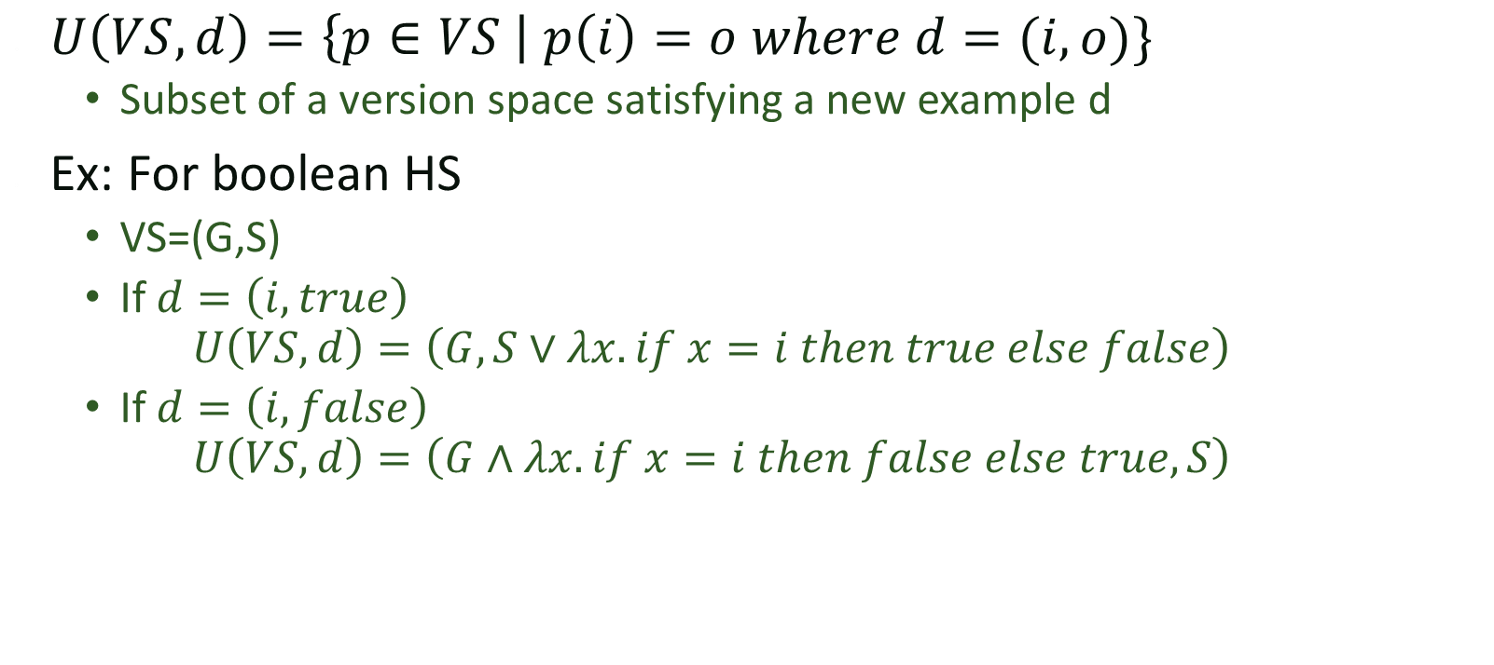
Update
$U\left(VS, d\right)=\left\{p∈VS \right| p\left(i\right)=o where d=(i,o)\}$
  Subset of a version space satisfying a new example d
Ex: For boolean HS
  VS=(G,S)
  If $d=\left(i,true\right)$
  $$U\left(VS,d\right)=\left(G,S∨λx. if x=i then true else false\right)$$
  If $d=\left(i,false\right)$
  $$U\left(VS,d\right)=\left(G∧λx. if x=i then false else true,S\right)$$

Slide 29

Example: FindSuffix
$FS_{T}:$ next occurrence of $T$.

Slide 30
Idea
If your hypothesis space is partially ordered and your VS are boundary set representable, you can represent and search very efficiently
If they are not?
Break them down into simpler hypothesis spaces!

Slide 31

Union
$VS_{H_{1}D}∪VS_{H_{2}D}=VS_{H_{1}∪H_{2} D}$

Slide 32
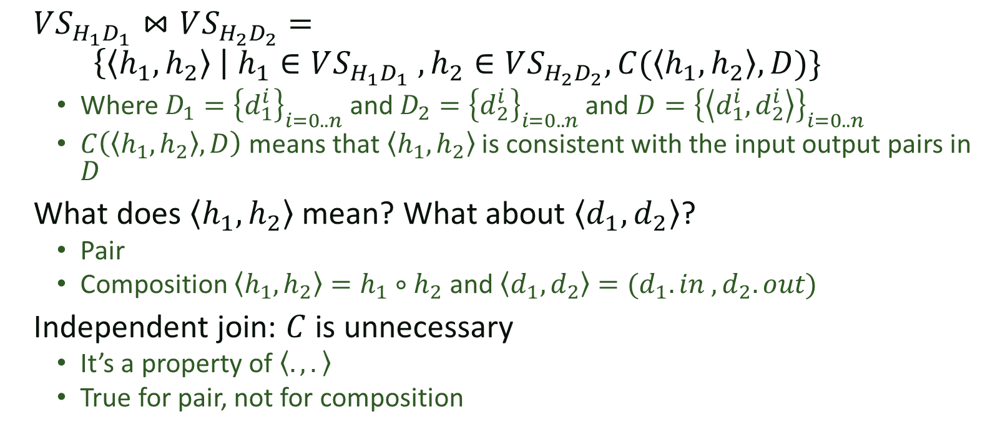
Join
$VS_{H_{1}D_{1}}⋈VS_{H_{2}D_{2}}=$
$\left\{\left\langle h_{1},h_{2}\right\rangle \right| h_{1}∈VS_{H_{1}D_{1}} , h_{2}∈VS_{H_{2}D_{2}}, C(\left\langle h_{1},h_{2}\right\rangle , D)\}$
  Where $D_{1}={\left\{d_{1}^{i}\right\}}_{i=0..n}$ and $D_{2}={\left\{d_{2}^{i}\right\}}_{i=0..n}$ and $D={\left\{\left\langle d_{1}^{i},d_{2}^{i}\right\rangle \right\}}_{i=0..n}$
  $C\left(\left\langle h_{1},h_{2}\right\rangle , D\right)$ means that $\left\langle h_{1},h_{2}\right\rangle$ is consistent with the input output pairs in $D$
What does $\left\langle h_{1},h_{2}\right\rangle$ mean? What about $\left\langle d_{1},d_{2}\right\rangle$?
  Pair
  Composition $\left\langle h_{1},h_{2}\right\rangle =h_{1}∘h_{2}$ and $\left\langle d_{1},d_{2}\right\rangle =(d_{1}.in , d_{2}.out)$
Independent join: $C$ is unnecessary
  It’s a property of $\left\langle ., .\right\rangle$
  True for pair, not for composition
Notes:
What does this mean? I have some pairs of samples $\left\langle d_{1}^{i},d_{2}^{i}\right\rangle$. I want something that works for all of them. Instead of searching the entire $H_{1}⋈H_{2}$ product, I search H_1 for things that work for D_1, I search H_2 for things that work for D_2, and then I join
1->a
2->b
3->c
(char) ‘a’ + i
1->a, 2->b, 3->c, n->c
-1->x
-2->y
-3->z
(char) ‘w’ - i
(1,-1) -> (a,x)
(2,-2) -> (b,y)
(3,-3) -> (c,z)
D-> x
E-> y
F-> z

Slide 33

Transform
$VS_{2}=transform_{τ_{i}, τ_{o}}\left(VS_{1}\right)$ iff
$∀g∈VS_{2 }∃f∈VS_{1} s.t. g=τ_{i}∘f∘τ_{o}$

Slide 34
SMARTedit version space
Notes:
ConstInt:
F(x) = C
LinearInt:
F(x) = x + C

