Slide 1
Lecture 3
Top-Down Explicit Search
Armando Solar-Lezama
with content from Jack Feser

Slide 2
Quick Intro to Functional Idioms
map f lst = case lst of
[] -> []
head:rest -> f(head) : (map f rest)
  Applies f to every element in the list
filter p lst = case lst of
[] -> []
head:rest -> if p(head) then head: (filter p rest)
else (filter p rest)
  Removes any element x for which p(x) is false

Slide 3
Quick Intro to Functional Idioms
foldl binop start lst = case lst of
[] -> start
head:rest -> (foldl binop (binop start head) rest)
  Apply the binary operation binop from left to right to the list

Slide 4
Quick Intro to Functional Idioms
foldl binop start lst = case lst of
[] -> start
head:rest -> (foldl binop (binop start head) rest)
  Apply the binary operation binop from left to right to the list
foldl (+) 1:2:3:4:[]
0

Slide 5
Quick Intro to Functional Idioms
foldl binop start lst = case lst of
[] -> start
head:rest -> (foldl binop (binop start head) rest)
  Apply the binary operation binop from left to right to the list
foldl (+) + 2:3:4:[]
+
0
1

Slide 6
Quick Intro to Functional Idioms
foldl binop start lst = case lst of
[] -> start
head:rest -> (foldl binop (binop start head) rest)
  Apply the binary operation binop from left to right to the list
foldl (+) + 3:4:[]
+
+
2
0
1

Slide 7
Quick Intro to Functional Idioms
foldl binop start lst = case lst of
[] -> start
head:rest -> (foldl binop (binop start head) rest)
  Apply the binary operation binop from left to right to the list
foldl (+) + 4:[]
+
+
3
+
2
0
1

Slide 8
Quick Intro to Functional Idioms
foldl binop start lst = case lst of
[] -> start
head:rest -> (foldl binop (binop start head) rest)
  Apply the binary operation binop from left to right to the list
foldl (+) + []
+
+
4
+
3
+
2
0
1

Slide 9
Quick Intro to Functional Idioms
foldl binop start lst = case lst of
[] -> start
head:rest -> (foldl binop (binop start head) rest)
  Apply the binary operation binop from left to right to the list
+
+
4
+
3
+
2
0
1

Slide 10
Example
 | Midterm 1 | Midterm 2 | Final
Student A | 71 | 75 | 83
Student B | 90 | 87 | 95
Student C | 68 | 77 | 80
Teacher has a gradebook
Wants to drop the lowest score for each student
Needs a program to do this operation

Slide 11


Example
Drop the smallest element from each list
$$\left[\begin{matrix}\left[\begin{matrix}71, & 75, & 83\end{matrix}\right] \\ \left[\begin{matrix}90, & 87, & 95\end{matrix}\right] \\ \left[\begin{matrix}68, & 77, & 80\end{matrix}\right]\end{matrix}\right]$$
$$\left[\begin{matrix}\left[\begin{matrix}75, & 83\end{matrix}\right] \\ \left[\begin{matrix}90 & 95\end{matrix}\right] \\ \left[\begin{matrix}77 & 80\end{matrix}\right]\end{matrix}\right]$$

Slide 12
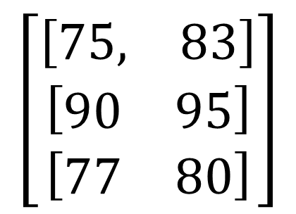
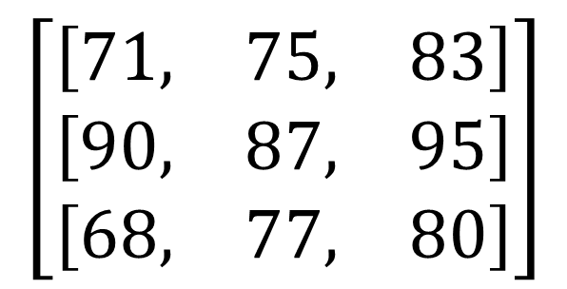
Example
$$\left[\begin{matrix}\left[\begin{matrix}71, & 75, & 83\end{matrix}\right] \\ \left[\begin{matrix}90, & 87, & 95\end{matrix}\right] \\ \left[\begin{matrix}68, & 77, & 80\end{matrix}\right]\end{matrix}\right]$$
$$\left[\begin{matrix}\left[\begin{matrix}75, & 83\end{matrix}\right] \\ \left[\begin{matrix}90 & 95\end{matrix}\right] \\ \left[\begin{matrix}77 & 80\end{matrix}\right]\end{matrix}\right]$$
How can we discover this program?

Slide 13
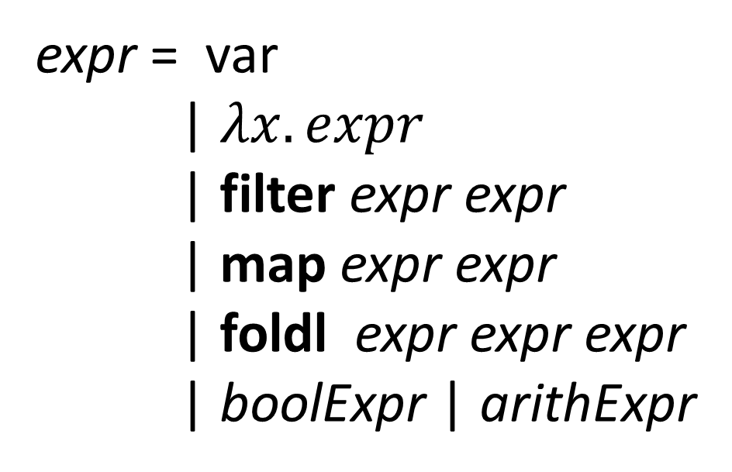
Defining the language
expr = var
| $λx. expr$
| filter expr expr
| map expr expr
| foldl expr expr expr
| boolExpr | arithExpr

Slide 14

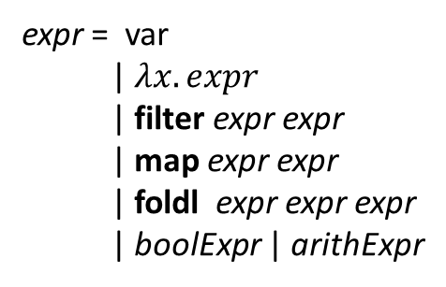
Top-down search
expr = var
| $λx. expr$
| filter expr expr
| map expr expr
| foldl expr expr expr
| boolExpr | arithExpr
dropmins in = expr
in
$λ x.$expr
filter expr expr
map expr expr expr
fold expr expr expr
boolExpr
arithExpr
Many of these programs can be eliminated before
having to complete them!

