Slide 1
Lecture 7
Constraint-based Synthesis with Sketch
Armando Solar-Lezama

Slide 2
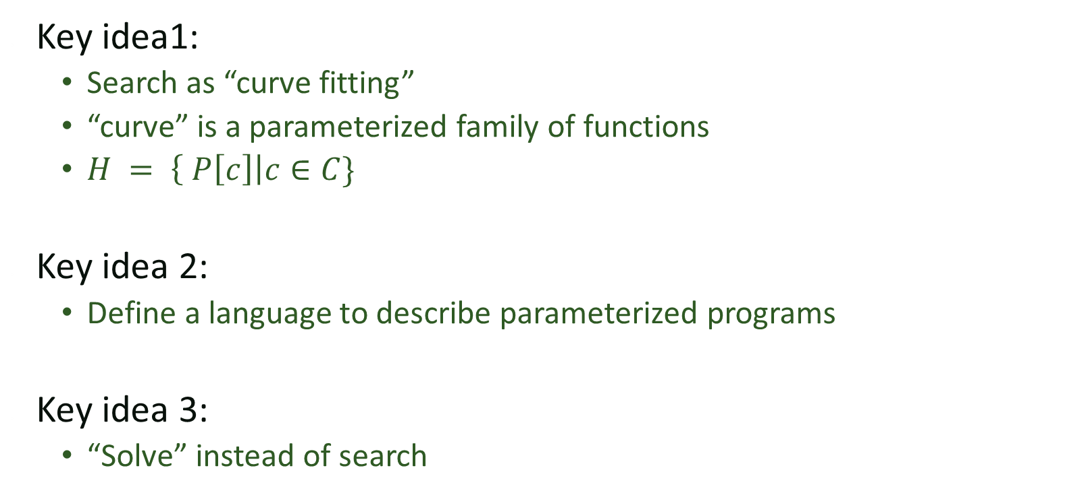
Constraint-based search
Key idea1:
  Search as “curve fitting”
  “curve” is a parameterized family of functions
  $H = \left\{ P\left[c\right]\right|c∈C\}$
Key idea 2:
  Define a language to describe parameterized programs
Key idea 3:
  “Solve” instead of search

Slide 3
Synthesis with constraints
Overview of the Sketch language
Turning synthesis problems into constraints
Efficient constraint solving

Slide 4
Language Design Strategy
Extend base language with one construct
  Constant hole: ??
Synthesizer replaces ?? with a constant
High-level constructs defined in terms of ??
int bar (int x)
{
int t = x * ??;
assert t == x + x;
return t;
}
int bar (int x)
{
int t = x * 2;
assert t == x + x;
return t;
}

Slide 5
Unknown constant→ Sets of Expressions
Expressions with ?? == sets of expressions
  linear expressions x*?? + y*??
  polynomials x*x*?? + x*?? + ??
  sets of variables ?? ? x : y

Slide 6
Example: Registerless Swap
Swap two words without an extra temporary
int W = 32;
void swap(ref bit[W] x, ref bit[W] y){
if(??){ x = x ^ y;}else{ y = x ^ y; }
if(??){ x = x ^ y;}else{ y = x ^ y; }
if(??){ x = x ^ y;}else{ y = x ^ y; }
}
harness void main(bit[W] x, bit[W] y){
bit[W] tx = x; bit[W] ty = y;
swap(x, y);
assert x==ty && y == tx;
}

Slide 7
From simple to complex holes
We need to compose ?? to form complex holes
Borrow ideas from generative programming
  Define generators to produce families of functions
  Use partial evaluation aggressively

Slide 8
Generators
Look like a function
  but are partially evaluated into their calling context
Key feature:
  Different invocations → Different code
  Can recursively define arbitrary families of programs

Slide 9
Sample Generator
/**
* Generate the set of all bit-vector expressions
* involving +, &, xor and bitwise negation (~).
* the bnd param limits the size of the generated expression.
*/
generator bit[W] gen(bit[W] x, int bnd){
assert bnd > 0;
if(??) return x;
if(??) return ??;
if(??) return ~gen(x, bnd-1);
if(??){
return {| gen(x, bnd-1) (+ | & | ^) gen(x, bnd-1) |};
}
}

Slide 10
Example: Least Significant Zero Bit
generator bit[W] gen(bit[W] x, int bnd){
assert bnd > 0;
if(??) return x;
if(??) return ??;
if(??) return ~gen(x, bnd-1);
if(??){
return {| gen(x, bnd-1) (+ | & | ^) gen(x, bnd-1) |};
}
}
bit[W] isolate0sk (bit[W] x){
return gen(x, 3);
}

Slide 11
High order generators
/*
* Generate code from f n times
*/
generator void rep(int n, fun f){
if(n>0){
f();
rep(n-1, f);
}
}

Slide 12
Closures + High Order Generators
generator void rep(int n, fun f){
if(n>0){
f();
rep(n-1, f);
}
}
bit[16] reverseSketch(bit[16] in) {
bit[16] t = in;
int s = 1;
generator void tmp(){
bit[16] m = ??;
t = ((t << s)&m )| ((t >> s)&(~m));
s = s*??;
}
rep(??, tmp);
return t;
}

Slide 13
Syntactic Sugar
{| RegExp |}
RegExp supports choice ‘|’ and optional ‘?’
  can be used arbitrarily within an expression
    to select operands {| (x | y | z) + 1 |}
    to select operators {| x (+ | -) y |}
    to select fields {| n(.prev | .next)? |}
    to select arguments {| foo( x | y, z) |}
Set must respect the type system
  all expressions in the set must type-check
  all must be of the same type

Slide 14
repeat
Avoid copying and pasting
  repeat(n){ s} ➔ s;s;…s;
  each of the n copies may resolve to a distinct stmt
  n can be a hole too.
n

Slide 15
Example: Reversing bits
pragma options "--bnd-cbits 3 ";
int W = 32;
bit[W] reverseSketch(bit[W] in) {
bit[W] t = in;
int s = 1;
int r = ??;
repeat(??){
bit[W] tmp1 = (t << s);
bit[W] tmp2 = (t >> s);
t = tmp1 {|} tmp2;
// Syntactic sugar for m=??, (tmp1&m | tmp2&~m).
s = s*r;
}
return t;
}

Slide 16
Framing the synthesis problem
Goal: Find a function from holes to values
  Easy in the absence of generators
  Finite set of holes so function is just a table
bit[W] isolateSk (bit[W] x) implements isolate0 {
return !(x + ??₁) & (x + ??₂) ;
}

Slide 17
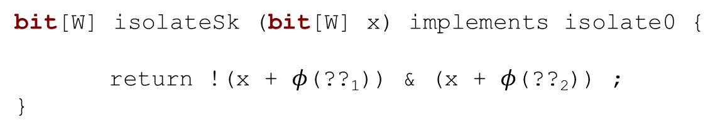
Framing the synthesis problem
Goal: Find a function from holes to values
  Easy in the absence of generators
  Finite set of holes so function is just a table
bit[W] isolateSk (bit[W] x) implements isolate0 {
return !(x + $φ$(??₁)) & (x + $φ$(??₂)) ;
}

Slide 18
Framing the synthesis problem
Generators need something more
generator bit[W] gen(bit[W] x, int bnd){
assert bnd > 0;
if(??₁) return x;
if(??₂) return ??₅;
if(??₃) return ~gen_{g1}(x, bnd-1);
if(??₄){
...
}
}
bit[W] isolate0sk (bit[W] x) implements isolate0 {
return gen_{g0}(x, 3);
}

Slide 19

Framing the synthesis problem
Generators need something more
generator bit[W] gen(bit[W] x, int bnd){
assert bnd > 0;
if($φ$(??₁)) return x;
if($φ$(??₂)) return $φ$(??₅);
if($φ$(??₃)) return ~gen_{g1}(x, bnd-1);
if($φ$(??₄)){
...
}
}
bit[W] isolate0sk (bit[W] x) implements isolate0 {
return gen_{g0}(x, 3);
}

Slide 20

Framing the synthesis problem
Generators need something more
  The value of the holes depends on the context
generator bit[W] gen(context $τ$, bit[W] x, int bnd){
assert bnd > 0;
if($φ$($τ$,??₁)) return x;
if($φ$($τ$,??₂)) return $φ$($τ$,??₅);
if($φ$($τ$,??₃)) return ~gen_{g1}($τ ⋅g_{1}$, x, bnd-1);
if($φ$($τ$,??₄)){
...
}
}
bit[W] isolate0sk (bit[W] x) implements isolate0 {
return gen_{g0}($g_{0}$, x, 3);
}

Slide 21
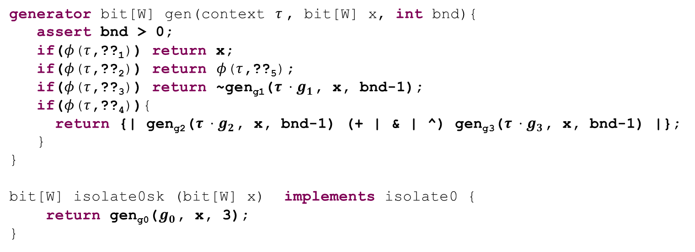


Framing the synthesis problem
generator bit[W] gen(context $τ$, bit[W] x, int bnd){
assert bnd > 0;
if($φ$($τ$,??₁)) return x;
if($φ$($τ$,??₂)) return $φ$($τ$,??₅);
if($φ$($τ$,??₃)) return ~gen_{g1}($τ ⋅g_{1}$, x, bnd-1);
if($φ$($τ$,??₄)){
return {| gen_{g2}($τ ⋅g_{2}$, x, bnd-1) (+ | & | ^) gen_{g3}($τ ⋅g_{3}$, x, bnd-1) |};
}
}
bit[W] isolate0sk (bit[W] x) implements isolate0 {
return gen_{g0}($g_{0}$, x, 3);
}
$φ$($g_{0}$,??_{k})
$φ$($g_{0}g_{1}$,??_{k})
$φ$($g_{0}g_{2}$,??_{k})
$φ$($g_{0}g_{1}g_{2}$,??_{k})
$φ$($g_{0}{g_{1}g}_{3}$,??_{k})
$φ$($g_{0}g_{1}{g_{2}g}_{1}$,??_{k})
...
  Potentially unbounded set of unknowns
  We can bound the depth of recursion
    That means again $φ$ is just a table

Slide 22
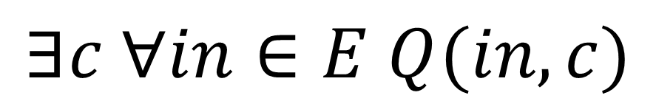
The inductive synthesis problem
$$∃c ∀in∈E Q(in, c)$$
where E = {x₁, x₂, …, x_{k}}

