Slide 1
Lecture 8
Constraint-based search
Continued
Armando Solar-Lezama

Slide 2
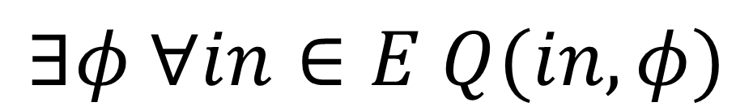
The inductive synthesis problem
$$∃φ ∀in∈E Q(in, φ)$$
where E = {x₁, x₂, …, x_{k}}

Slide 3
Overall Strategy
Sketch with harnesses
Symbolic Execution
Simplification
Encoding
Solver

Slide 4
Building Constraints
Program sketching
Armando Solar-Lezama, International Journal on Software Tools for Technology Transfer
October 2013, Volume 15, Issue 5-6, pp 475-495

Slide 5
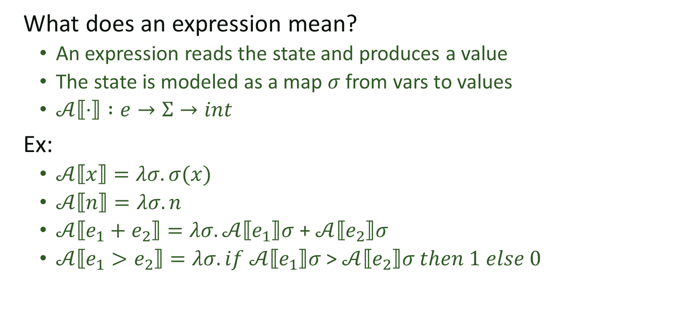
Semantics of a simple language
e:= n | x | e₁ + e₂ | e₁ > e₂
c:= x := e | c₁ ; c₂ | if e then c₁ else c₂ | while e do c
What does an expression mean?
  An expression reads the state and produces a value
  The state is modeled as a map $σ$ from vars to values
  $𝒜⟦⋅⟧ :e→Σ→int$
Ex:
  $𝒜⟦x⟧=λσ. σ(x)$
  $𝒜⟦n⟧=λσ. n$
  $𝒜⟦e_{1}+e_{2}⟧=λσ. 𝒜⟦e_{1}⟧σ$ + $𝒜⟦e_{2}⟧σ$
  $𝒜⟦e_{1}>e_{2}⟧=λσ. if 𝒜⟦e_{1}⟧σ$ > $𝒜⟦e_{2}⟧σ then 1 else 0$

Slide 6
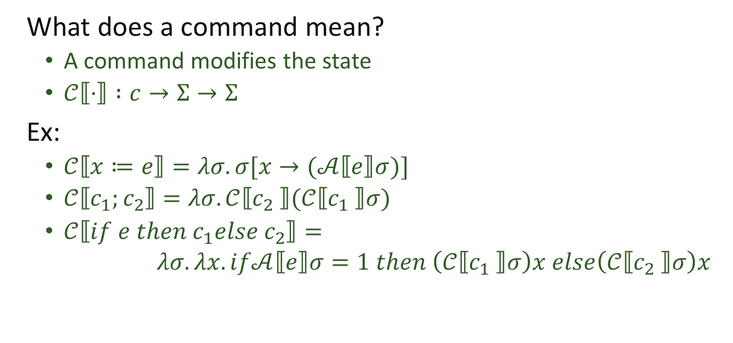
Semantics of a simple language
e:= n | x | e₁ + e₂
c:= x := e | c₁ ; c₂ | if e then c₁ else c₂ | while e do c
What does a command mean?
  A command modifies the state
  $𝒞⟦⋅⟧ :c→Σ→Σ$
Ex:
  $𝒞⟦x≔e⟧=λσ. σ[x→(𝒜⟦e⟧σ)]$
  $𝒞⟦c_{1};c_{2}⟧=λσ.𝒞⟦c_{2} ⟧(𝒞⟦c_{1} ⟧σ)$
  $𝒞⟦if e then c_{1}else c_{2}⟧=$
  $λσ.λx. if𝒜⟦e⟧σ=1 then$ $\left(𝒞⟦c_{1} ⟧σ\right)x else\left(𝒞⟦c_{2} ⟧σ\right)x$

Slide 7
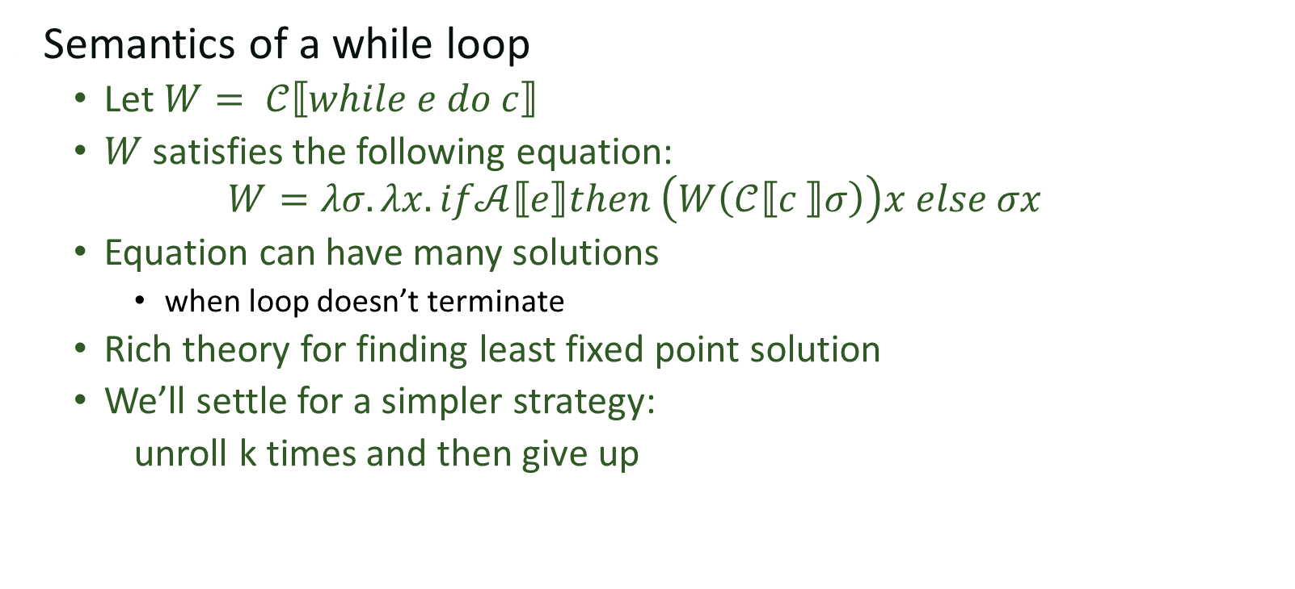
What about loops?
Semantics of a while loop
  Let $W= 𝒞⟦while e do c⟧$
  $W$ satisfies the following equation:
  $$W=λσ.λx. if𝒜⟦e⟧then \left(W\left(𝒞⟦c ⟧σ\right)\right)x else σx$$
  Equation can have many solutions
    when loop doesn’t terminate
  Rich theory for finding least fixed point solution
  We’ll settle for a simpler strategy:
  unroll k times and then give up

Slide 8

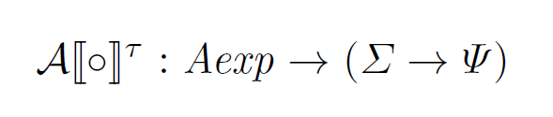



Symbolic execution of sketches
Very similar to what we just saw
  But values are now parameterized by $φ$
  The denotation function will keep track of contexts

Slide 9
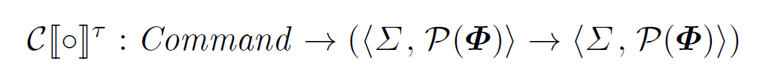
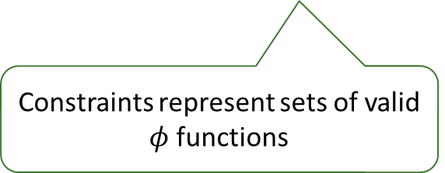
Symbolic Evaluation of Commands
Commands have two roles
  Modify the symbolic state
  Generate constraints
Constraints represent sets of valid $φ$ functions

Slide 10
Symbolic Evaluation of Commands
Assignments and Assertion

Slide 11

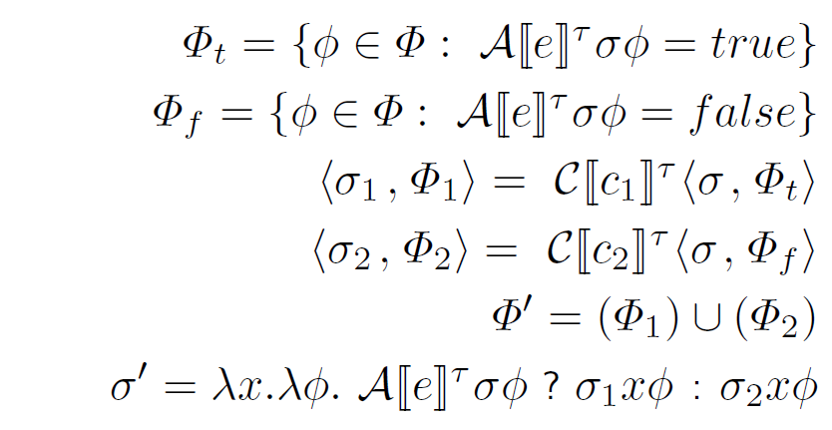
Symbolic Evaluation of Commands
If statement

Slide 12
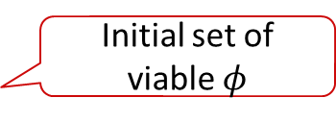
Conditionals
Initial set of viable $φ$
if e
then C1
else C2

Slide 13
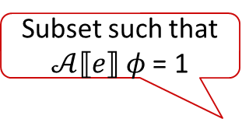
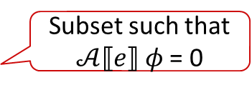
Conditionals
Subset such that $𝒜⟦e⟧$ $φ$ = 1
if e
Subset such that $𝒜⟦e⟧$ $φ$ = 0
then C1
else C2

Slide 14
Conditionals
if e
then C1
else C2
Subset that also passes all the assertions in C2

Slide 15
Conditionals
if e
then C1
else C2
U
Result of conditional

Slide 16
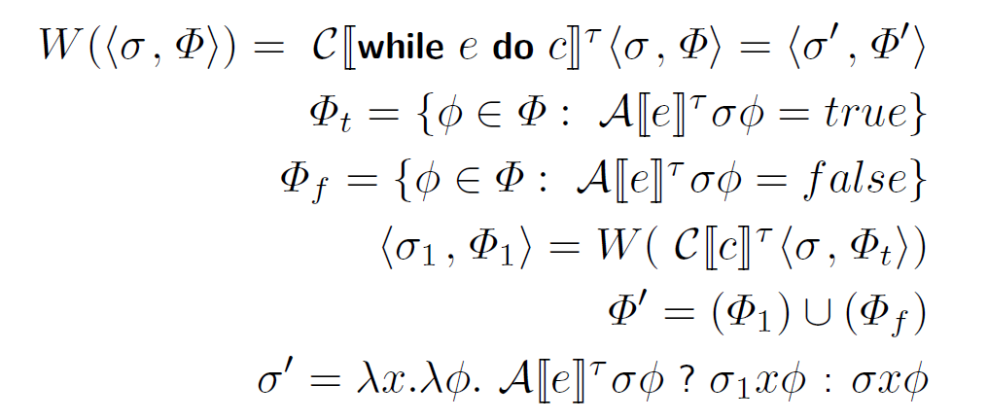
Symbolic Evaluation of Commands
While loops

Slide 17
A sketch as a constraint system
x > φ(??₁)
x+1 > φ(??₁)
int lin(int x){
if(x > φ(??₁))
return φ(??₂)*x + φ(??₃);
else
return φ(??₄)*x;
}
void main(int x){
int t1 = lin(x);
int t2 = lin(x+1);
if(x<4) assert t1 >= x*x;
if(x>=3) assert t2-t1 == 1;
}
φ(??₂)*x + φ(??₃)
φ(??₂)*(x+1) + φ(??₃)
φ(??₄)*x
φ(??₄)*(x+1)
mux
mux
x>=4
1
-
x*x
x<3
=
>=
or
or
and

Slide 18
int popSketched (bit[W] x)
implements pop {
repeat(??) {
x = (x & ??)
+ ((x >> ??) & ??);
}
return x;
}

Slide 19
x
int popSketched (bit[W] x)
implements pop {
repeat(??) {
x = (x & ??)
+ ((x >> ??) & ??);
}
return x;
}

Slide 20
x
>>
&
int popSketched (bit[W] x)
implements pop {
repeat(??) {
x = (x & ??)
+ ((x >> ??) & ??);
}
return x;
}

Slide 21
x
&
>>
&
int popSketched (bit[W] x)
implements pop {
repeat(??) {
x = (x & ??)
+ ((x >> ??) & ??);
}
return x;
}
+

Slide 22
x
&
>>
&
int popSketched (bit[W] x)
implements pop {
repeat(??) {
x = (x & ??)
+ ((x >> ??) & ??);
}
return x;
}
+
mux
x

Slide 23
x
&
>>
&
int popSketched (bit[W] x)
implements pop {
repeat(??) {
x = (x & ??)
+ ((x >> ??) & ??);
}
return x;
}
+
mux
x
>>
&

Slide 24
x
&
>>
&
int popSketched (bit[W] x)
implements pop {
repeat(??) {
x = (x & ??)
+ ((x >> ??) & ??);
}
return x;
}
+
mux
x
&
>>
&
+

Slide 25
x
&
>>
&
int popSketched (bit[W] x)
implements pop {
repeat(??) {
x = (x & ??)
+ ((x >> ??) & ??);
}
return x;
}
+
mux
x
&
>>
&
+
mux
x

Slide 26
x
&
>>
&
int popSketched (bit[W] x)
implements pop {
repeat(??) {
x = (x & ??)
+ ((x >> ??) & ??);
}
return x;
}
+
mux
x
&
>>
&
+
mux
x
>>
&

Slide 27
x
&
>>
&
int popSketched (bit[W] x)
implements pop {
repeat(??) {
x = (x & ??)
+ ((x >> ??) & ??);
}
return x;
}
+
mux
x
&
>>
&
+
mux
x
&
>>
&
+

Slide 28
x
&
>>
&
int popSketched (bit[W] x)
implements pop {
repeat(??) {
x = (x & ??)
+ ((x >> ??) & ??);
}
return x;
}
+
mux
x
&
>>
&
+
mux
x
&
>>
&
+
mux
x

Slide 29
x
&
>>
&
int popSketched (bit[W] x)
implements pop {
repeat(??) {
x = (x & ??)
+ ((x >> ??) & ??);
}
return x;
}
+
mux
x
&
>>
&
+
mux
x
&
>>
&
+
mux
x

Slide 30
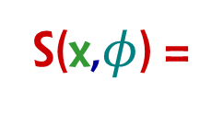
x
&
>>
&
int popSketched (bit[W] x)
implements pop {
repeat(??) {
x = (x & ??)
+ ((x >> ??) & ??);
}
return x;
}
+
mux
x
&
>>
&
+
mux
x
&
>>
&
+
mux
S(x,$φ$) =
x

Slide 31
Ex : Population count. 0010 0110 → 3

Slide 32
Ex : Population count. 0010 0110 → 3
int pop (bit[W] x)
{
int count = 0;
for (int i = 0; i < W; i++) {
if (x[i]) count++;
}
return count;
}

Slide 33
Ex : Population count. 0010 0110 → 3
x
int pop (bit[W] x)
{
int count = 0;
for (int i = 0; i < W; i++) {
if (x[i]) count++;
}
return count;
}

Slide 34
Ex : Population count. 0010 0110 → 3
x
count
0
0
0
0
int pop (bit[W] x)
{
int count = 0;
for (int i = 0; i < W; i++) {
if (x[i]) count++;
}
return count;
}

Slide 35
Ex : Population count. 0010 0110 → 3
x
count
0
0
0
0
int pop (bit[W] x)
{
int count = 0;
for (int i = 0; i < W; i++) {
if (x[i]) count++;
}
return count;
}

Slide 36
Ex : Population count. 0010 0110 → 3
x
count
0
0
0
0
one
0
0
0
1
int pop (bit[W] x)
{
int count = 0;
for (int i = 0; i < W; i++) {
if (x[i]) count++;
}
return count;
}
+
mux
count

Slide 37
Ex : Population count. 0010 0110 → 3
x
count
0
0
0
0
one
0
0
0
1
int pop (bit[W] x)
{
int count = 0;
for (int i = 0; i < W; i++) {
if (x[i]) count++;
}
return count;
}
+
mux
count

Slide 38
Ex : Population count. 0010 0110 → 3
x
count
0
0
0
0
one
0
0
0
1
int pop (bit[W] x)
{
int count = 0;
for (int i = 0; i < W; i++) {
if (x[i]) count++;
}
return count;
}
+
mux
count
+
mux
count

Slide 39
Ex : Population count. 0010 0110 → 3
x
count
0
0
0
0
one
0
0
0
1
int pop (bit[W] x)
{
int count = 0;
for (int i = 0; i < W; i++) {
if (x[i]) count++;
}
return count;
}
+
mux
count
+
mux
count

Slide 40
Ex : Population count. 0010 0110 → 3
x
count
0
0
0
0
one
0
0
0
1
int pop (bit[W] x)
{
int count = 0;
for (int i = 0; i < W; i++) {
if (x[i]) count++;
}
return count;
}
+
mux
count
+
mux
count
+
mux
count

Slide 41
Ex : Population count. 0010 0110 → 3
x
count
0
0
0
0
one
0
0
0
1
int pop (bit[W] x)
{
int count = 0;
for (int i = 0; i < W; i++) {
if (x[i]) count++;
}
return count;
}
+
mux
count
+
mux
count
+
mux
count

Slide 42
Ex : Population count. 0010 0110 → 3
x
count
0
0
0
0
one
0
0
0
1
int pop (bit[W] x)
{
int count = 0;
for (int i = 0; i < W; i++) {
if (x[i]) count++;
}
return count;
}
+
mux
count
+
mux
count
+
mux
count
+
mux
count

Slide 43
Ex : Population count. 0010 0110 → 3
x
count
0
0
0
0
one
0
0
0
1
int pop (bit[W] x)
{
int count = 0;
for (int i = 0; i < W; i++) {
if (x[i]) count++;
}
return count;
}
+
mux
count
+
mux
count
+
mux
count
+
mux
count

Slide 44
Ex : Population count. 0010 0110 → 3
x
count
0
0
0
0
one
0
0
0
1
int pop (bit[W] x)
{
int count = 0;
for (int i = 0; i < W; i++) {
if (x[i]) count++;
}
return count;
}
+
mux
count
+
mux
count
+
mux
count
+
mux
F(x) =
count

Slide 45
Simplification

Slide 46
Structural Hashing
h₀
h₁
h₂
+
+
*
*
a
b

Slide 47
Structural Hashing
h₀
h₁
h₂
h₀
h₁
h₂
+
+
+
*
*
*
*
a
b
a
b

Slide 48
Structural Hashing
h₀
h₁
h₂
h₀
h₁
h₂
h₀
h₁
h₂
+
+
+
+
*
*
*
*
*
a
b
a
b
a
b

Slide 49
Structural hashing + rewriting
h₀
b
a
+
+
0
<
<
<
^
^

Slide 50

Structural hashing + rewriting
$$X+b<b →X<0$$
h₀
b
a
+
+
0
<
<
<
^
^

Slide 51
Structural hashing + rewriting
h₀
a
$$X+b<b →X<0$$
+
0
<
<
<
^
^

Slide 52
Structural hashing + rewriting
h₀
a
$$X+b<b →X<0$$
+
0
<
<
<
^
^

Slide 53
Structural hashing + rewriting
h₀
a
$$X+b<b →X<0$$
+
0
<
<
^
^

Slide 54

Structural hashing + rewriting
h₀
a
$$X+b<b →X<0$$
+
$$X∧X→X$$
0
<
<
^
^

Slide 55
Structural hashing + rewriting
h₀
a
$$X+b<b →X<0$$
+
$$X∧X→X$$
0
<
<
^

Slide 56
Structural hashing + rewriting
h₀
a
$$X+b<b →X<0$$
+
$$X∧X→X$$
0
<
<
^

Slide 57
Structural hashing + rewriting
$$X+b<b →X<0$$
h₀
0
$$X∧X→X$$
<
<
^

Slide 58
Structural hashing + rewriting
$$X+b<b →X<0$$
h₀
0
$$X∧X→X$$
<
<
^

Slide 59
Structural hashing + rewriting
$$X+b<b →X<0$$
h₀
0
$$X∧X→X$$
<
^

Slide 60
Structural hashing + rewriting
$$X+b<b →X<0$$
h₀
0
$$X∧X→X$$
<
^

Slide 61
Structural hashing + rewriting
h₀
0
$$X+b<b →X<0$$
$$X∧X→X$$
<

Slide 62


Constraints to SAT
SAT Solver only understands CNF
  Sum (OR) of variables and their negation
  Equivalent to $\bigwedge_{i∈X}{l_{i}}⇒l_{j}$
h₀
h₁
h₂
$$∧$$
xor
Assert

Slide 63


Constraints to SAT
SAT Solver only understands CNF
  Sum (OR) of variables and their negation
  Equivalent to $\bigwedge_{i∈X}{l_{i}}⇒l_{j}$
h₀
h₁
h₂
$$∧$$
$$t_{1}$$
xor
$$t_{2}$$
Assert

Slide 64
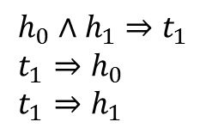
Constraints to SAT
SAT Solver only understands CNF
  Sum (OR) of variables and their negation
  Equivalent to $\bigwedge_{i∈X}{l_{i}}⇒l_{j}$
h₀
h₁
h₂
$$h_{0}∧h_{1}⇒t_{1} \\ t_{1}⇒h_{0} \\ t_{1}⇒h_{1}$$
$$∧$$
$$t_{1}$$
xor
$$t_{2}$$
Assert

Slide 65
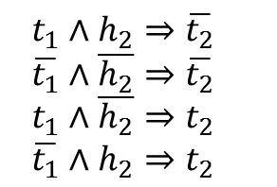
Constraints to SAT
SAT Solver only understands CNF
  Sum (OR) of variables and their negation
  Equivalent to $\bigwedge_{i∈X}{l_{i}}⇒l_{j}$
h₀
h₁
h₂
$$h_{0}∧h_{1}⇒t_{1} \\ t_{1}⇒h_{0} \\ t_{1}⇒h_{1}$$
$$∧$$
$$t_{1}$$
xor
$$t_{2}$$
$$t_{1}∧h_{2}⇒\overline{t_{2}} \\ \overline{t_{1}}∧\overline{h_{2}}⇒\overline{t_{2}} \\ t_{1}∧\overline{h_{2}}⇒t_{2} \\ \overline{t_{1}}∧h_{2}⇒t_{2}$$
Assert

Slide 66
SAT Solver
SAT solving in a nutshell
Constraint database

Slide 67
SAT Solver
SAT solving in a nutshell
Constraint is a CNF Clause
x₁ v x₂ v x₃ v x₄ v x₅ v x₆
Constraint database

Slide 68
SAT Solver
SAT solving in a nutshell
Constraint is a CNF Clause
x₁
x₁ v x₂ v x₃ v x₄ v x₅ v x₆
Constraint database

Slide 69
SAT Solver
SAT solving in a nutshell
Constraint is a CNF Clause
x₁
x₁ v x₂ v x₃ v x₄ v x₅ v x₆
Constraint database
-x₁ v x₇
x₇

Slide 70
SAT Solver
SAT solving in a nutshell
Constraint is a CNF Clause
x₁
x₁ v x₂ v x₃ v x₄ v x₅ v x₆
Constraint database
x₅
-x₁ v x₇
x₇

Slide 71
SAT Solver
SAT solving in a nutshell
Constraint is a CNF Clause
x₁
x₁ v x₂ v x₃ v x₄ v x₅ v x₆
Constraint database
x₅
-x₁ v x₇
x₇
-x₇ v x₆ v -x₅
x₆

Slide 72
SAT Solver
SAT solving in a nutshell
Constraint is a CNF Clause
x₁
x₁ v x₂ v x₃ v x₄ v x₅ v x₆
Constraint database
x₅
-x₁ v x₇
x₇
-x₉
-x₇ v x₆ v -x₅
x₆

Slide 73
SAT Solver
SAT solving in a nutshell
Constraint is a CNF Clause
x₁
x₁ v x₂ v x₃ v x₄ v x₅ v x₆
Constraint database
x₅
-x₁ v x₇
x₇
-x₉
-x₇ v x₆ v -x₅
-x₅ v -x₃ v x₉
x₆
-x₃

Slide 74
SAT Solver
SAT solving in a nutshell
Constraint is a CNF Clause
x₁
x₁ v x₂ v x₃ v x₄ v x₅ v x₆
Constraint database
x₅
-x₁ v x₇
x₇
-x₉
-x₇ v x₆ v -x₅
-x₅ v -x₃ v x₉
x₆
-x₃
-x₆ v x₃ v x₄
x₄

Slide 75
SAT Solver
SAT solving in a nutshell
Constraint is a CNF Clause
x₁
x₁ v x₂ v x₃ v x₄ v x₅ v x₆
Constraint database
x₅
-x₁ v x₇
-x₅ v x₉ v -x₄
x₇
-x₉
-x₇ v x₆ v -x₅
-x₅ v -x₃ v x₉
x₆
-x₃
-x₆ v x₃ v x₄
x₄

Slide 76
SAT Solver
SAT solving in a nutshell
Constraint is a CNF Clause
x₁
x₁ v x₂ v x₃ v x₄ v x₅ v x₆
Constraint database
x₅
-x₁ v x₇
-x₅ v x₉ v -x₄
x₇
-x₉
-x₇ v x₆ v -x₅
-x₅ v -x₃ v x₉
-x₄
x₆
-x₃
-x₆ v x₃ v x₄
x₄

Slide 77
SAT Solver
SAT solving in a nutshell
Constraint is a CNF Clause
x₁
x₁ v x₂ v x₃ v x₄ v x₅ v x₆
Constraint database
x₅
-x₁ v x₇
-x₅ v x₉ v -x₄
x₇
-x₉
-x₇ v x₆ v -x₅
-x₅ v -x₃ v x₉
-x₄
x₆
-x₃
-x₆ v x₃ v x₄
x₄

Slide 78
SAT Solver
SAT solving in a nutshell
Constraint is a CNF Clause
x₁
x₁ v x₂ v x₃ v x₄ v x₅ v x₆
Constraint database
x₅
-x₁ v x₇
-x₅ v x₉ v -x₄
x₇
-x₉
-x₇ v x₆ v -x₅
-x₅ v -x₃ v x₉
-x₄
x₆
-x₃
-x₁ v -x₅ v x₉
-x₆ v x₃ v x₄
x₄

Slide 79
What about Arithmetic?
1) Bit-blast
2) Unary encoding
3) SMT

