Slide 1
Separation Logic Tutorial
Armando Solar-Lezama

Slide 2


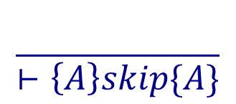



Axiomatic Semantics of IMP
Derivation rules for each language construct
Can be combined together with the rule of consequence

Slide 3
Separation logic
  See: “Local Reasoning about Programs that Alter Data Structures”
    By O’Hearn, Reynolds and Yang
Key idea:
  Break the heap into disjoint pieces
  Focus on a few small pieces at a time
  Statements affect one piece at a time

Slide 4
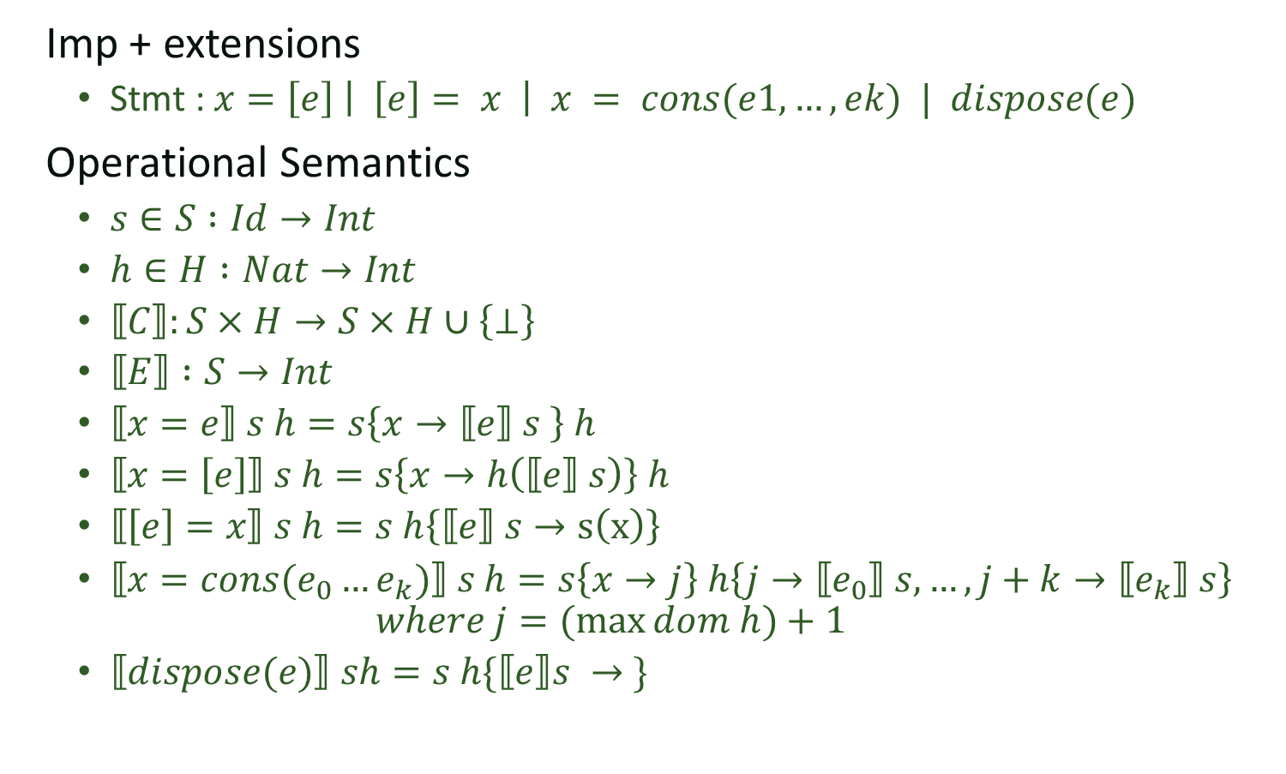
The language
Imp + extensions
  Stmt : $x=\left[e\right] \left| \left[e\right]= x \right| x = cons(e1,…, ek) | dispose(e)$
Operational Semantics
  $s∈S :Id→Int$
  $h∈H :Nat→Int$
  $⟦C⟧:S×H→S×H∪\left\{⊥\right\}$
  $⟦E⟧ :S→Int$
  $⟦x=e⟧ s h=s\left\{x→⟦e⟧ s \right\} h$
  $⟦x=\left[e\right]⟧ s h=s\left\{x→h\left(⟦e⟧ s\right)\right\} h$
  $⟦\left[e\right]=x⟧ s h=s h\left\{⟦e⟧ s→s\left(x\right)\right\}$
  $⟦x=cons(e_{0}…e_{k})⟧ s h=s\left\{x→j\right\} h\left\{j→⟦e_{0}⟧ s, …,j+k→⟦e_{k}⟧ s\right\}$
  $where j=(max{dom h})+1$
  $⟦dispose(e)⟧ sh=s h\{⟦e⟧s → \}$

Slide 5
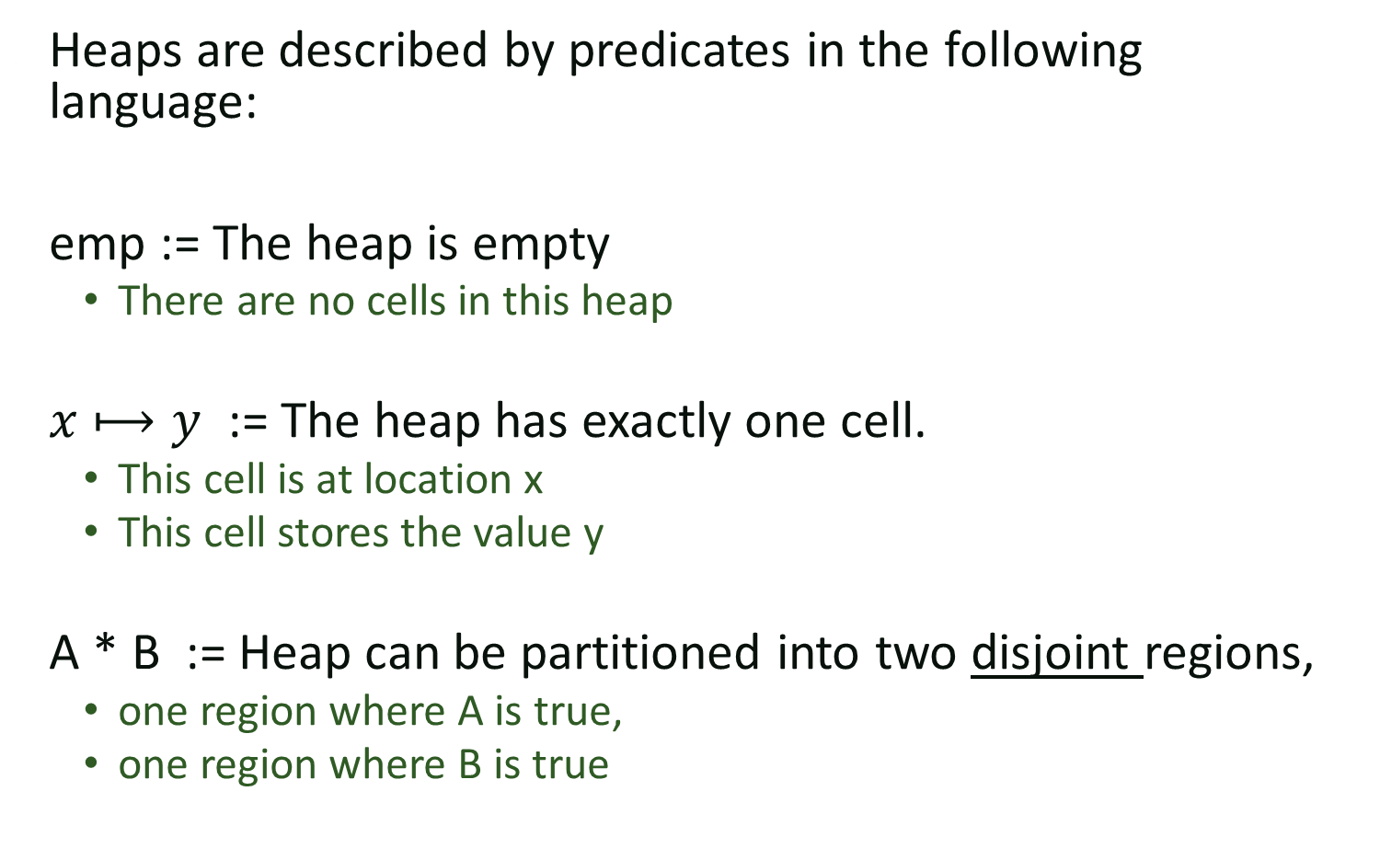
Separation Logic: Notation
Heaps are described by predicates in the following language:
emp := The heap is empty
  There are no cells in this heap
$x⟼y$ := The heap has exactly one cell.
  This cell is at location x
  This cell stores the value y
A * B := Heap can be partitioned into two disjoint regions,
  one region where A is true,
  one region where B is true

Slide 6
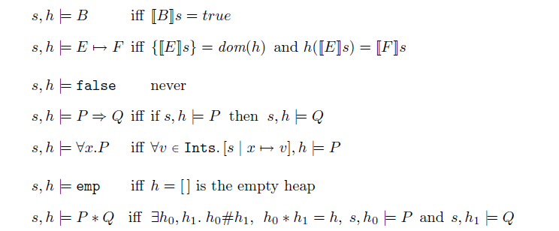
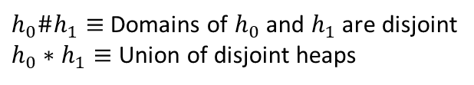
Formalizing the notation
  Copied from the paper by O’Hearn, Reynolds and Yang
$h_{0}\#h_{1}≡$Domains of $h_{0}$ and $h_{1}$ are disjoint
$h_{0}∗h_{1}≡$ Union of disjoint heaps

Slide 7
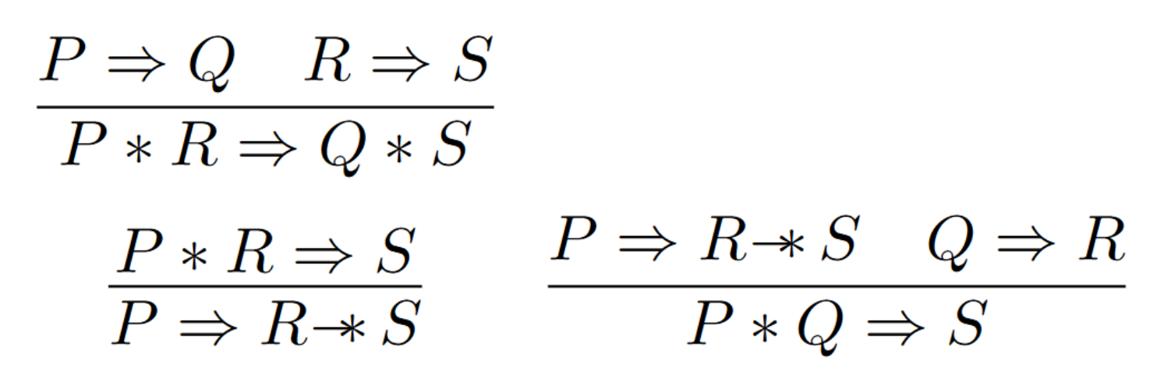

A few more definitions
$\left\{x⟼10\right\}→∗\left\{x⟼10\right\}$*$\left\{y⟼11\right\}$
Some useful rules:

Slide 8
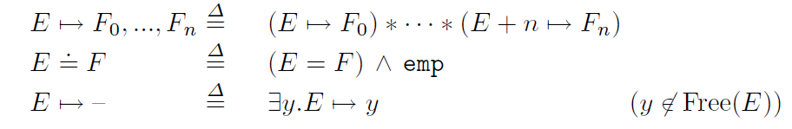
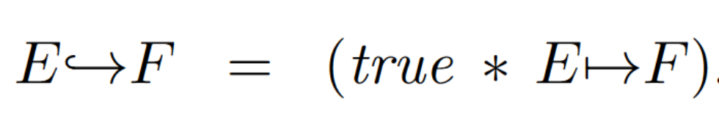

Some additional shorthand
  Copied from the paper by O’Hearn, Reynolds and Yang
An interesting property

Slide 9
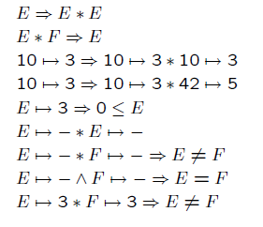
Algebra of heap predicates
Which assertions are valid?
  Copied from the paper by O’Hearn, Reynolds and Yang

Slide 10
Algebra of heap predicates
Which assertions are valid?

Slide 11
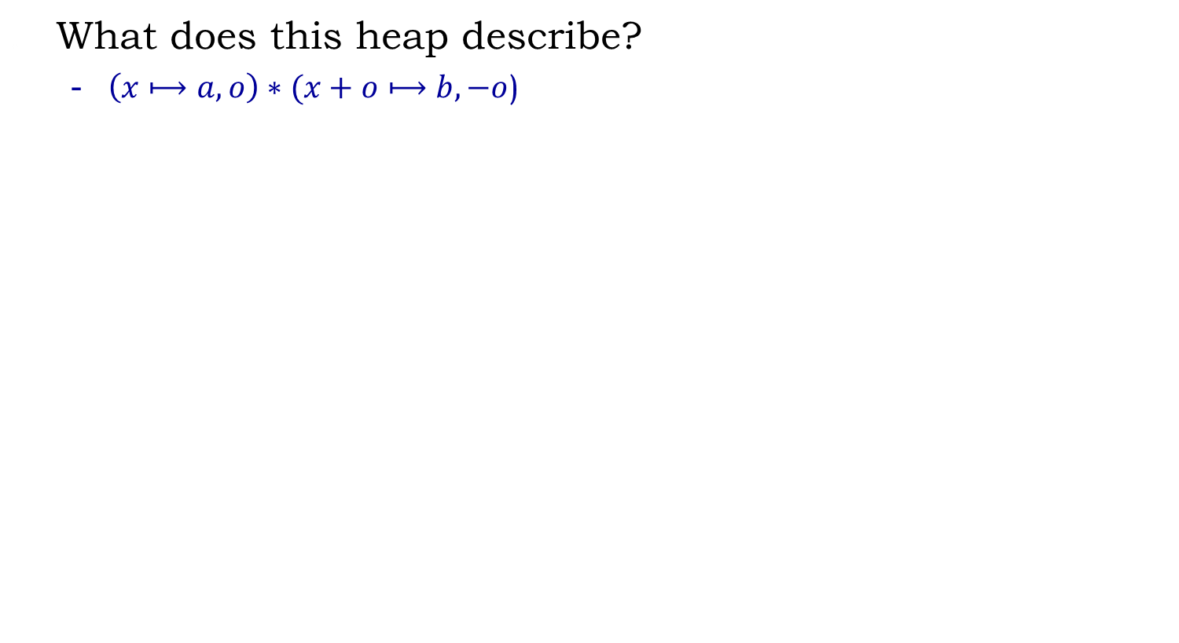
Describing data-structures
What does this heap describe?
  $\left(x⟼a,o\right)∗(x+o⟼b,−o$)
a
o
...
b
-o
x
x+1
x+o
x+o+1

Slide 12
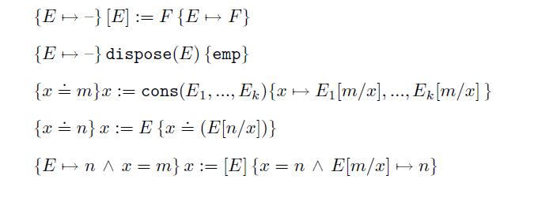
Proofs Rules for Separation Logic
  Copied from the paper by O’Hearn, Reynolds and Yang
Small Axioms

Slide 13
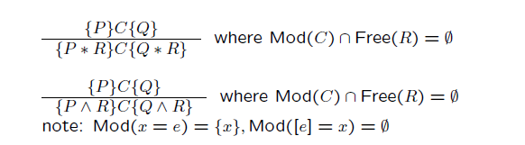
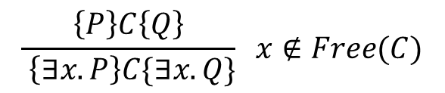
Proof Rules for Separation Logic
  Copied from the paper by O’Hearn, Reynolds and Yang
$$\frac{\left\{P\right\}C\left\{Q\right\}}{ \left\{∃x. P\right\}C\{∃x. Q\}} x∉Free(C)$$

Slide 14
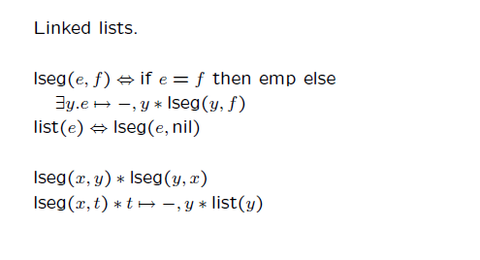
More Cycle Free Data-structures
  Copied from the paper by O’Hearn, Reynolds and Yang

Slide 15
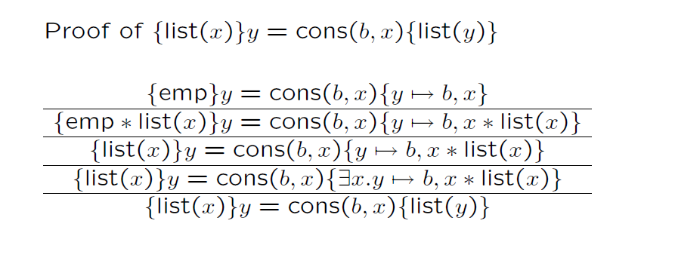
Examples

Slide 16
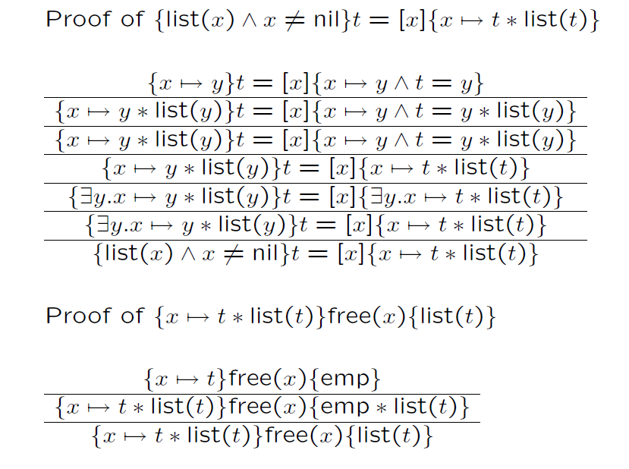
Examples

Slide 17
Concurrency
Resources, Concurrency and Local Reasoning
  By Peter O’Hearn

Slide 18
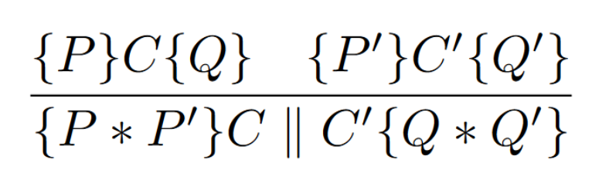
Disjoint Concurrency Rule

Slide 19
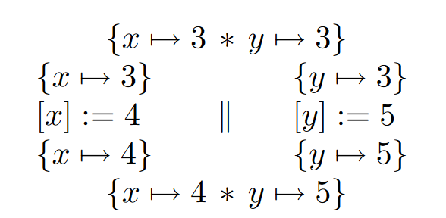
Simple Example

Slide 20
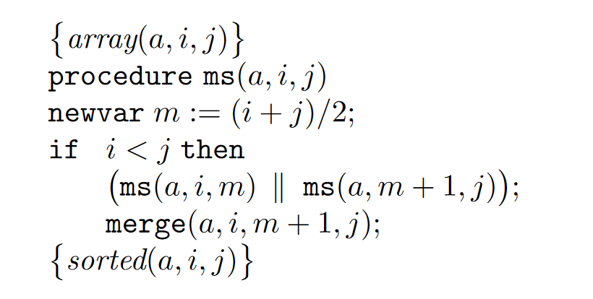
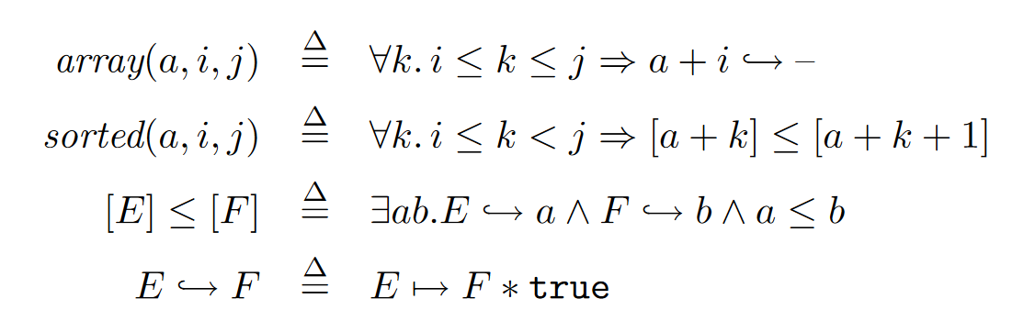
Mergesort

Slide 21
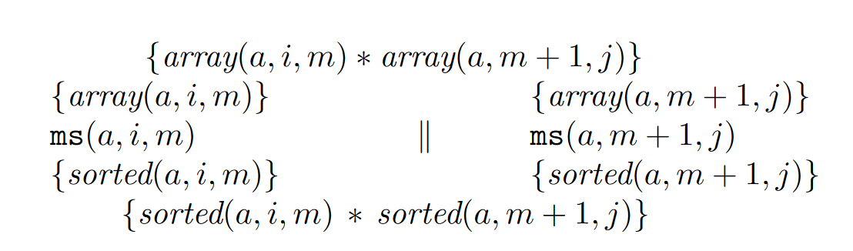
Mergesort

