Slide 1

New applications of program synthesis
Armando Solar-Lezama

Slide 2
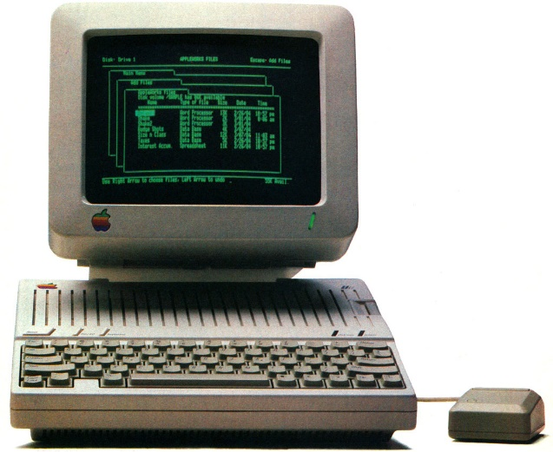
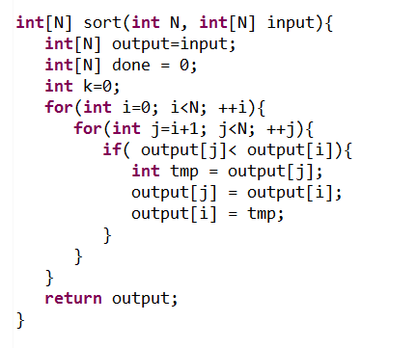
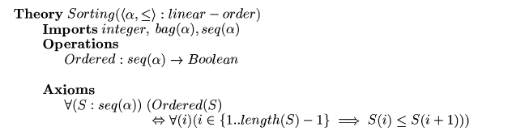
Synthesis: 1980s view
Complete Formal Specification

Slide 3
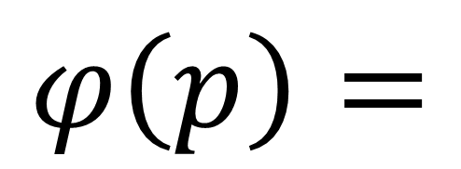
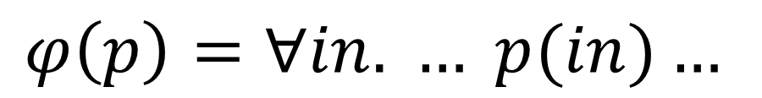
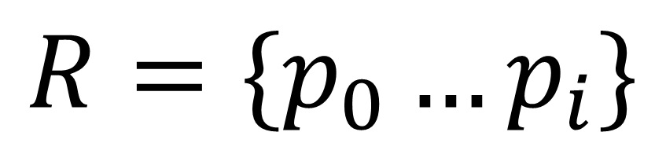

Synthesis: modern view
$$R=\{p_{0}…p_{i}\}$$
Space of programs
$$φ\left(p\right)=$$
$$φ_{1}\left(p\right) \\ {∧φ}_{2}\left(p\right) \\ ∧φ_{3}\left(p\right) \\ ∧φ_{4}\left(p\right)$$
Reference Implementation
Input/Output Examples
Test Harnesses
$$φ\left(p\right)=∀in. … p(in)…$$

Slide 4
Example
Sketch
bit[W] avg(bit[W] x, bit[W] y) implements avgSpec{
return expr@signed({x,y}, 4);
}
Spec
bit[W] avgSpec(bit[W] x, bit[W] y){
bit[2*W] xx = extend@signed(x, 2*W);
bit[2*W] yy = extend@signed(y, 2*W);
bit[2*W] r = rshift@signed(xx+yy, 1);
return (r[0::W]);
}
expr ::= const
| var
| expr>>??
| ~expr
| expr + expr
| expr ^ expr
| expr & expr

Slide 5
Example
Spec
bit[W] avgSpec(bit[W] x, bit[W] y){
bit[2*W] xx = extend@signed(x, 2*W);
bit[2*W] yy = extend@signed(y, 2*W);
bit[2*W] r = rshift@signed(xx+yy, 1);
return (r[0::W]);
}
Sketch
bit[W] avg(bit[W] x, bit[W] y) implements avgSpec{
return expr@signed({x,y}, 4);
}
generator bit[W1] expr([int W1, int k], bit[W1][k] x, int bnd){
assert bnd > 0;
if(??){ return ??; }
if(??){ return x[??]; }
bit[W1] tmp = expr(W1, k, x, bnd-1);
if(??){ return rshift( tmp, ??(3)+1); }
if(??){ return ~tmp; }
if(??){ return {| tmp (+ | ^ | & ) expr(W1, k, x, bnd-1) |}; } }
expr ::= const
| var
| expr>>??
| ~expr
| expr + expr
| expr ^ expr
| expr & expr

Slide 6
And 8 seconds later…
(x & y) + (x ^ y) >> 1
Cool!
Now can you synthesize programs with more than 1 line of code?

Slide 7
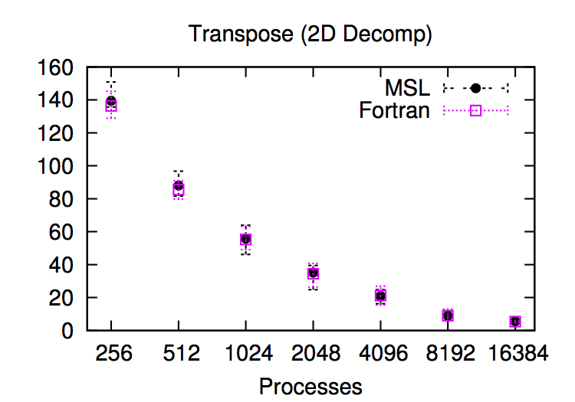
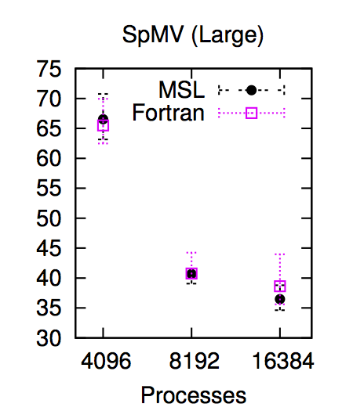
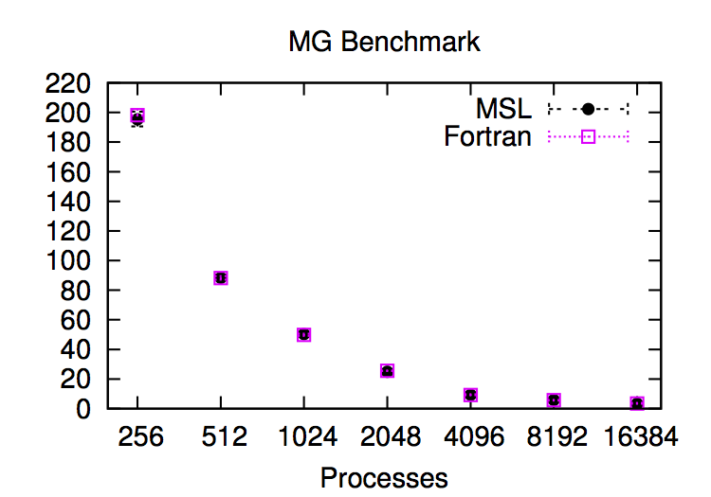
Synthesis of distributed memory algorithms (SC14)
Synthesizer can help with non-trivial distributed memory implementations
Scalability of resulting code is comparable with hand-crafted Fortran

Slide 8
So how much can you synthesize?
A little more if you are synthesizing from scratch
  5 or 6 LOC in one shot
But…
  We can synthesize many more if there is independence
  We can synthesize them within larger pieces of code
    2-4K LOC in many cases
  We can do it very reliably
So what can you do if you can synthesize small expressions in a large program?

Slide 9
Sketch
C-like language with holes and assertions
High-Level Language
Compiler
Synthesis
Solution
Graphical programming
Automated Tutoring

Slide 10
Sketch
C-like language with holes and assertions
Analysis Tool
Synthesis
Sub-problems
Synthesis
Solution
Graphical programming
Automated Tutoring
Program Optimization
Solver
Synthesis

Slide 11
Optimization with synthesis

Slide 12

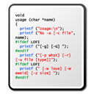
Java to SQL
Methods
SQL Queries
ORM
libraries
Objects
Relations
Application
Database

Slide 13

Java to SQL
Methods
SQL Queries
ORM
libraries
Objects
Relations
Application
Database

Slide 14
Java to SQL
SELECT * FROM user
List getUsersWithRoles () {
List users = User.getAllUsers();
List roles = Role.getAllRoles();
List results = new ArrayList();
for (User u : users) {
for (Role r : roles) {
if (u.roleId == r.id)
results.add(u); }}
return results; }
SELECT * FROM role
List getUsersWithRoles () {
return executeQuery(
“SELECT u FROM user u, role r WHERE u.roleId == r.id
ORDER BY u.roleId, r.id”; }
convert to
Notes:
How bad is the situation? Here is an example from a real-world aplication
What the dev didn’t know is that the first two method calls actually fetch records from the db, as a result when the outer loop is executed a query will be sent to the db, and likewise for the inner one
To speed things up we could have rewritten this code snippet using a simple SQL query as shown here

Slide 15
Join Query
Nested-loop join → Hash join!
O(n²) O(n)
Notes:
Original scales up quadratically as database size increases
There are more experiments in our paper and I invite you to check them out

Slide 16
Real-world Evaluation
Wilos (project management application) – 62k LOC
Operation type | # Fragments found | # Fragments converted
Projection | 1 | 1
Selection | 13 | 10
Join | 7 | 7
Aggregation | 11 | 10
Total | 33 | 28

Slide 17
Real-world Evaluation
iTracker (bug tracking system) – 61k LOC
Operation type | # Fragments found | # Fragments converted
Projection | 3 | 2
Selection | 3 | 2
Join | 1 | 1
Aggregation | 9 | 7
Total | 16 | 12

Slide 18
Beyond SQL
This is a general idea
Synthesis
Proof of
Equivalence
Source Code
DSL Program
Enable optimization by raising the level of abstraction!

Slide 19
Legacy code to Halide
Synthesis
Legacy
Fortran/C++
Code
Proof of
Equivalence
Stencil DLS
(Halide)

Slide 20
Legacy to Halide
for (k=y_min-2;k<=y_max+2;k++) {
for (j=x_min-2;j<=x_max+2;j++) {
post_vol[((x_max+5)*(k-(y_min-2))+(j)-(x_min-2))]
=volume[((x_max+4)*(k-(y_min-2))+(j)-(x_min-2))]
+ vol_flux_y[((x_max+4)*(k+1 -(y_min-2))+(j)-(x_min-2))]
- vol_flux_y[((x_max+4)*(k-(y_min-2))+(j)-(x_min-2))];
}
}
$∀\left(j,k\right)∈Dom$post_vol[j,k] = volume[j,k]
+ vol_flux[j,k+1] + vol_flux[j,k]

Slide 21
Speedups
Speedups on 24 cores

Slide 22
How does it work?

Slide 23
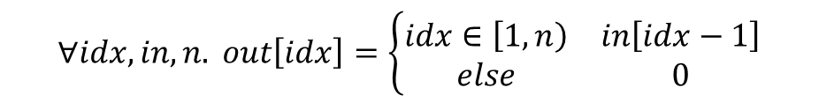
Example
out = 0
for(int i=0; i<n-1; ++i){
out[i+1] = in[i];
}
$$∀idx, in, n. out\left[idx\right]=\left\{\begin{matrix}idx∈\left[1,n\right) & in\left[idx−1\right] \\ else & 0\end{matrix}\right.$$
How do you prove that the code implies the formula?
Induction!

Slide 24
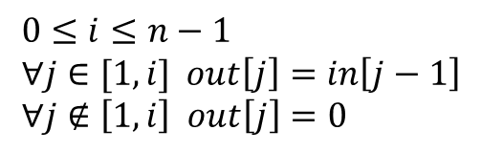
Inductive hypothesis
out = 0
for(int i=0; i<n-1; ++i){
out[i+1] = in[i];
}
$$0≤i≤n−1 \\ ∀j∈[1,i] out\left[j\right]=in\left[j−1\right] \\ ∀j∉\left[1,i\right] out\left[j\right]=0$$
Also called a loop invariant

Slide 25

Proofs about loops
Base case: Invariant holds at step zero
Inductive case: If invariant holds at i, it holds at i+1
Invariant $⇒$ Spec

Slide 26
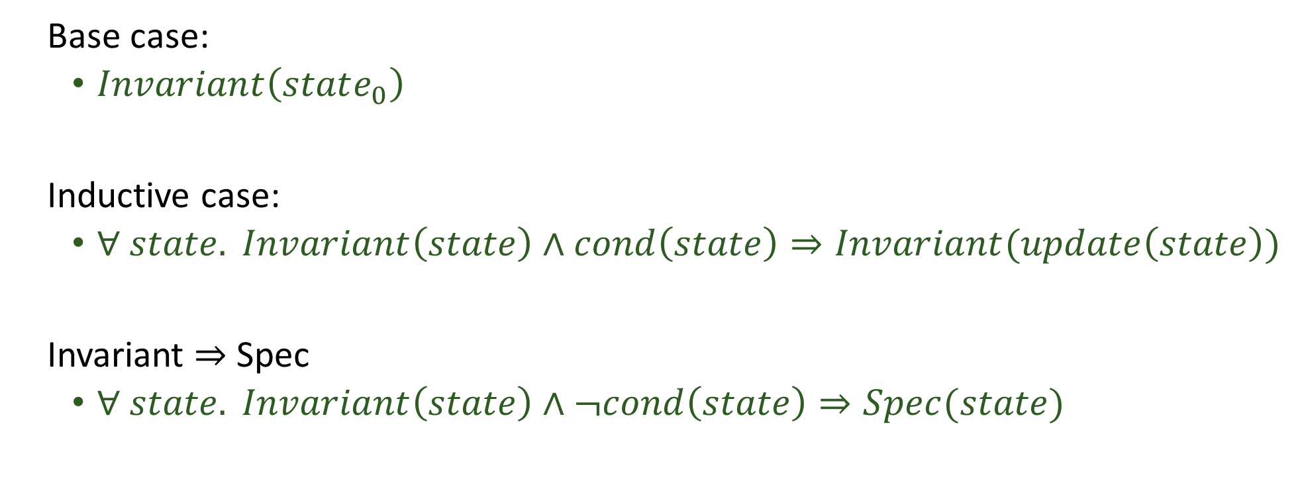
Abstract view
Verification conditions
Base case:
  $Invariant\left(state_{0}\right)$
Inductive case:
  $∀ state. Invariant\left(state\right)∧cond\left(state\right)⇒Invariant(update\left(state\right))$
Invariant $⇒$ Spec
  $∀ state. Invariant\left(state\right)∧¬cond\left(state\right)⇒Spec(state)$

Slide 27


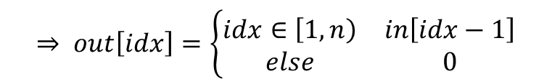



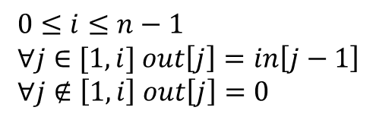
Invariant $⇒$ Spec
out = 0
for(int i=0; i<n-1; ++i){
out[i+1] = in[i];
}
$$0≤i≤n−1 \\ ∀j∈[1,i] out\left[j\right]=in\left[j−1\right] \\ ∀j∉\left[1,i\right] out\left[j\right]=0$$
$$⇒ out\left[idx\right]=\left\{\begin{matrix}idx∈\left[1,n\right) & in\left[idx−1\right] \\ else & 0\end{matrix}\right.$$
$$∀ i, n, out, in, idx$$
$$∧ i≥n−1$$
Loop invariant
$¬$loopCond
$$out=expr$$

Slide 28
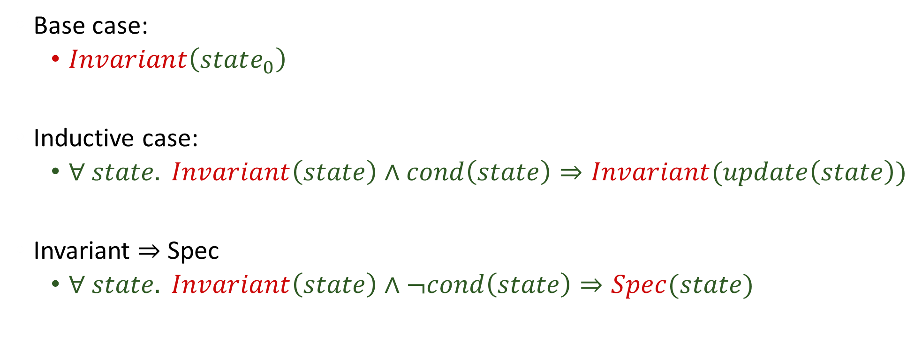
Problem
Invariant and Spec are unknown!
Base case:
  $Invariant\left(state_{0}\right)$
Inductive case:
  $∀ state. Invariant\left(state\right)∧cond\left(state\right)⇒Invariant(update\left(state\right))$
Invariant $⇒$ Spec
  $∀ state. Invariant\left(state\right)∧¬cond\left(state\right)⇒Spec(state)$

Slide 29
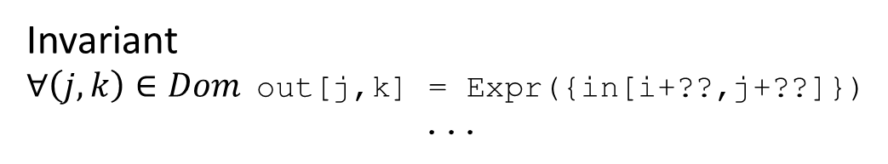
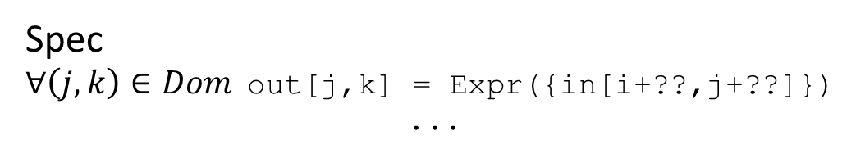
Synthesis problem
Spec
$∀\left(j,k\right)∈Dom$out[j,k] = Expr({in[i+??,j+??]})
...
Invariant
$∀\left(j,k\right)∈Dom$out[j,k] = Expr({in[i+??,j+??]})
...
Find Spec and invariant that satisfy verification conditions

Slide 30
It can be slow
12 hrs
Synthesis time with parallel synthesis on 24 cores

Slide 31
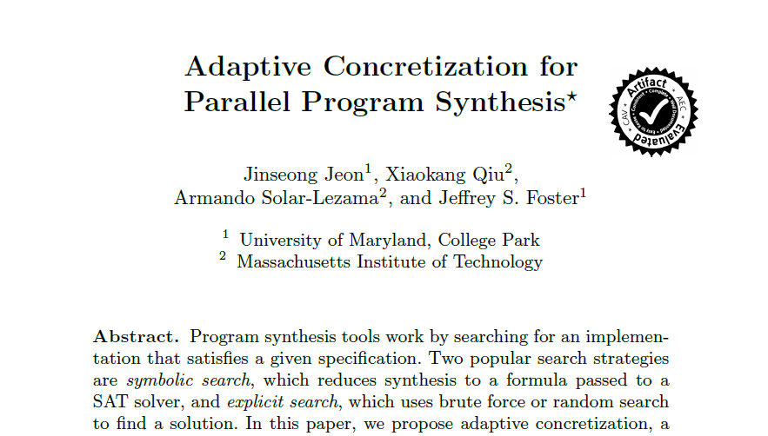
But we know how to parallelize it

Slide 32
Moving forward
Applications
  Synthesis as a core tool for a variety of problems
Techniques
  Data driven synthesis
    Leveraging big code
  Synthesis for synthesizers

Slide 33



Solver Synthesis
With Rohit Singh, Jeevana Inala, Willy Vasquez

Slide 34






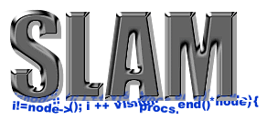

SMT Solvers are great!
UCLID
Boolector
Spec#
How can this possibly work?
Notes:
There’s a lot of them and they are workhorses of a wide variety of fields – from operations research to Molecular biology.
Even then, the way they work is quite surprising. They all try to satisfy the promise of SMT – one specification that should be sufficient to specify just about everything AND also solve it efficiently in every situation! Remember that these are NP complete problems!
This is amazing! There’s only one thing that comes to my mind.
Logos of different solvers at the top + some pictures that different fields (logos of projects) at bottom – a little later SMT-LIB in the middle
“How can this possibly work?” at the bottom: they’re all competing with each other, how is this possible?
Workhorses of a large number of fields
They solve hard problems
NP Complete
Should not scale
Why do they work?
Leverage the inherent structure in problems of practical interest

Slide 35
How is this possible?
Solvers leverage the structure in problems of practical interest
  To a limited extent
  Can find bugs
  Can’t crack RSA
Only so much structure to use!
Can we do better?

Slide 36
Solvers: a high-level view
Formula
Rewriter
SAT
Under-approximation
Refinement
Checking
Solution

Slide 37
Solvers: a high-level view
Formula
Rewriter
SAT
Under-approximation
Refinement
Checking
Solution

Slide 38



Rewriter
a
$$Pred$$
d
a
d
b
Predicate
$$f_{opt}$$
$$f_{orig}$$
b<d
<
<
<
OR
Pattern –Assumptions–> Pattern
Inputs :
a
b
d
Notes:
Traditionally implemented as (full-fledged) code
Exhibits domain specificity
In most cases, can be expressed and understood using simple declarative “rules” : Rewrite rules
Huge impact on performance

Slide 39
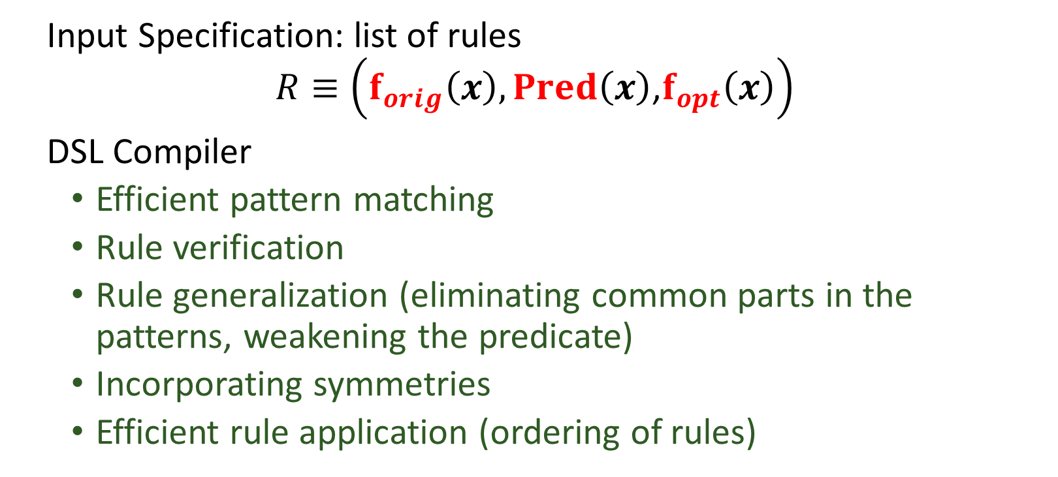
DSL for Rewriters
Input Specification: list of rules
$R≡\left(f_{orig}\left(x\right),Pred\left(x\right)\text{,}f_{opt}\left(x\right)\right)$
DSL Compiler
  Efficient pattern matching
  Rule verification
  Rule generalization (eliminating common parts in the patterns, weakening the predicate)
  Incorporating symmetries
  Efficient rule application (ordering of rules)

Slide 40
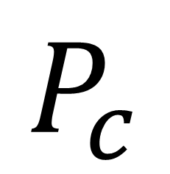
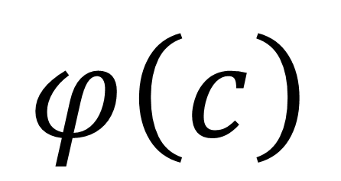
Sketch
C-like language with holes and assertions
$$φ\left(c\right)$$
High-Level Language
Compiler
Unroll
Inline
Enumerate
$$P_{c}$$
We can synthesize all rules from autogenerated sketches!

Slide 41
Synthesizing rules
Corpus of problems
from a domain
Pattern
Extraction
Sketches for
potential rules
Synthesis
Rewrite
Rules

Slide 42
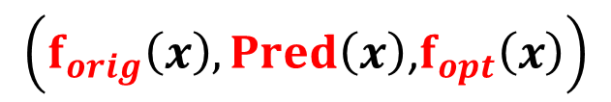
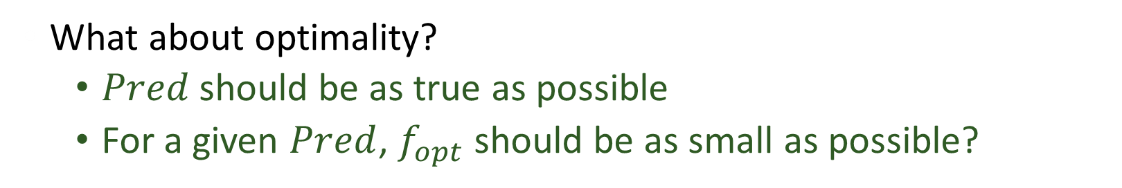
The synthesis problem
$$\left(f_{orig}\left(x\right),Pred\left(x\right)\text{,}f_{opt}\left(x\right)\right)$$
$$∃Pred, f_{opt} ∀x Pred\left(x\right)⇒f_{orig}\left(x\right)=f_{opt}(x)$$
What about optimality?
  $Pred$should be as true as possible
  For a given $Pred$, $f_{opt}$ should be as small as possible?

Slide 43
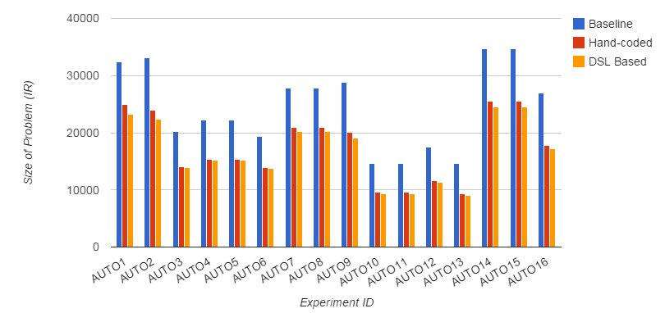
Does it work?
Problem size

Slide 44
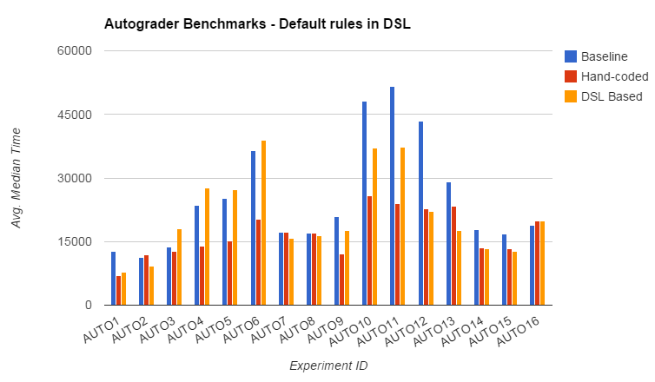
Does it work?
Solution time

Slide 45

Enhancing the IR
$max⁡(a,b)$
  = $ite\left(a<b,b,a\right)$
Replace all $ite\left(a<b,b,a\right)$with $\max\left(a,b\right)$ in the IR?
Notes:
Very common operation in practice
Doesn’t need dedicated representation:

Slide 46
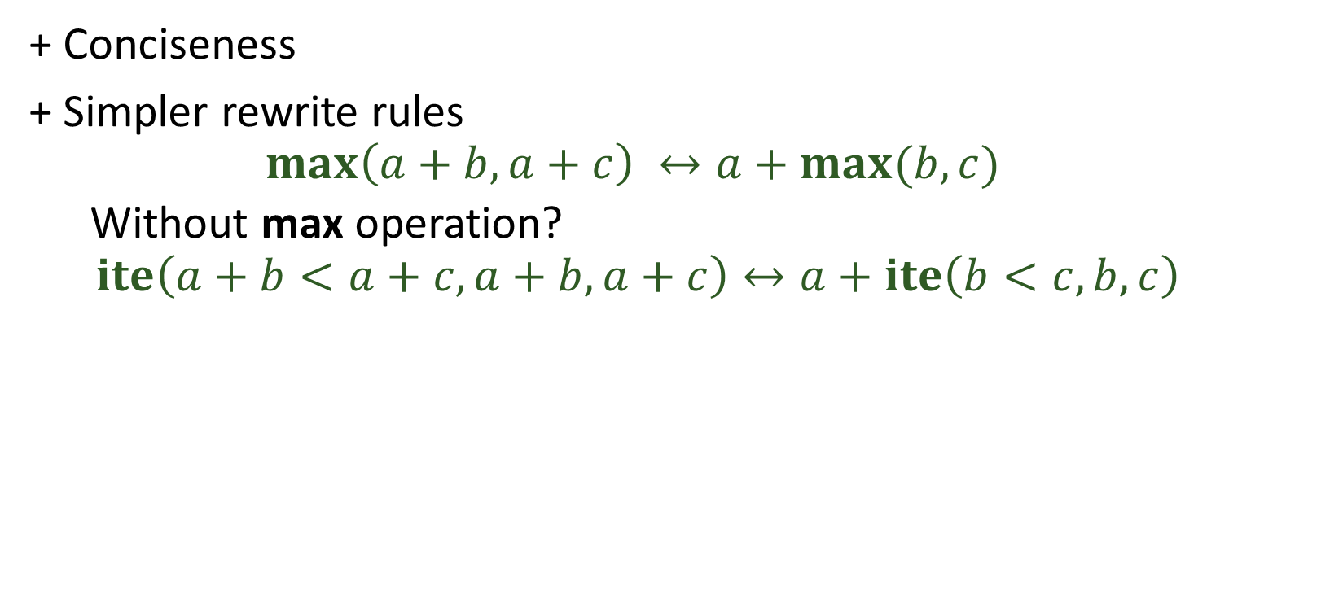
Enhancing the IR
+ Conciseness
+ Simpler rewrite rules
  $$\max\left(a+b,a+c\right) ↔a+max⁡(b,c)$$
  Without max operation?
  $$ite\left(a+b<a+c, a+b,a+c\right)↔a+ite\left(b<c,b,c\right)$$
Notes:
Easier to discover in terms of max, Efficient pattern matching

Slide 47
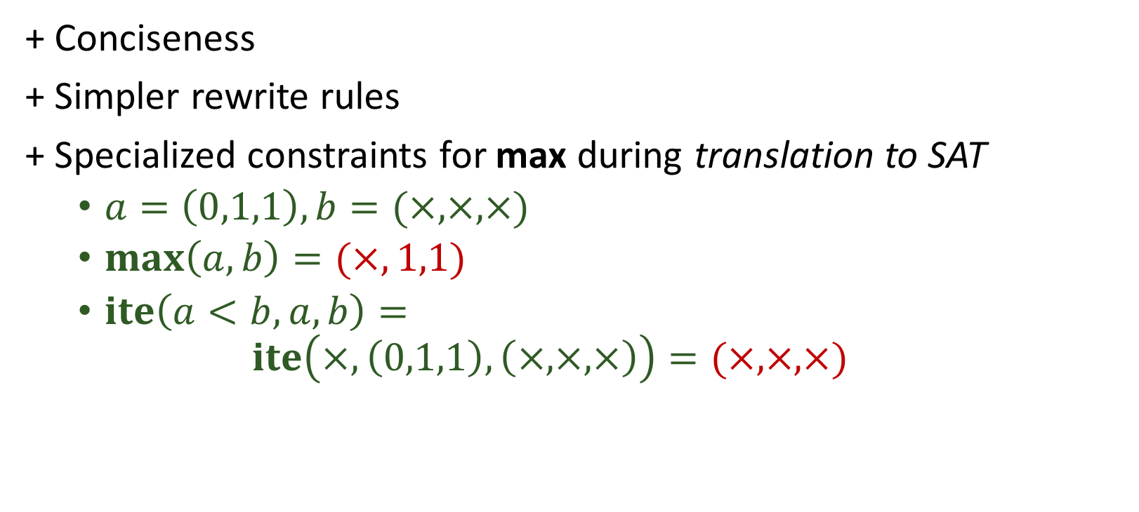
Enhancing the IR
+ Conciseness
+ Simpler rewrite rules
+ Specialized constraints for max during translation to SAT
  $a=\left(0,1,1\right), b=(×,×,×)$
  $\max\left(a,b\right)=(×,1,1)$
  $ite\left(a<b,a,b\right)=$
  $ite\left(×,\left(0,1,1\right), \left(×,×,×\right)\right)=(×,×,×)$
Notes:
How to do specialized translation for max as compared to ite mess? (0,1,1) (x,x,x)
[2:27:02 AM] Armando Solar Lezama: ite(a<b, a,b)
[2:27:47 AM] Armando Solar Lezama: ite(x, (0,1,1), (x,x,x))
[2:28:05 AM] Armando Solar Lezama: max((0,1,1), (x,x,x))
[2:30:13 AM] Rohit: (x,x,x) vs (x,1,1)

Slide 48




Autogenerating Encodings
Must be in CNF form
$$∀x_{0}…x_{n} y$$
$$f\left(x_{0}, …x_{n}\right)=y$$
$$⇔$$
$$P\left(x_{0}, …x_{n},y\right)$$
What about temporaries?
What about optimality?

Slide 49


Autogenerating with temporaries
$$∀x_{0}…x_{n} y$$
$$f\left(x_{0}, …x_{n}\right)=y$$
$$⇔$$
$$∃t P\left(x_{0}, …x_{n},t, y\right)$$

Slide 50

Autogenerating with temporaries
$$∀x_{0}…x_{n} y$$
$$f\left(x_{0}, …x_{n}\right)=y$$
$$⇐$$
$$∃t P\left(x_{0}, …x_{n},t, y\right)$$
This direction is easy

Slide 51


Autogenerating with temporaries
$$∀x_{0}…x_{n} y t$$
$$f\left(x_{0}, …x_{n}\right)=y$$
$$⇐$$
$$P\left(x_{0}, …x_{n},t, y\right)$$
This direction is easy

Slide 52

Autogenerating with temporaries
$$∀x_{0}…x_{n} y$$
$$f\left(x_{0}, …x_{n}\right)=y$$
$$⇒$$
$$∃t P\left(x_{0}, …x_{n},t, y\right)$$
This direction is harder

Slide 53






Solution
$$∀x_{0}…x_{n} y$$
$$f\left(x_{0}, …x_{n}\right)=y$$
$$⇒$$
$$∃t P\left(x_{0}, …x_{n},t, y\right)$$
$$∃t P_{1}\left(x_{0}, …x_{n},t\right)∧P_{2}\left(t,y\right)$$
Enforce that all clauses have only (x,t) or (t,y)
We know how to derive $t$ from $P_{1}$
    Essentially encoding a little solver in a sketch
    Now you can do skolemization!

Slide 54
Does this work?
Encodings for booleans can be generated in seconds
  Already useful in generating constraints for composite nodes

Slide 55
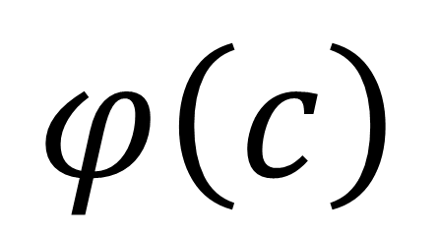
??
Sketch
C-like language with holes and assertions
$$φ\left(c\right)$$
Unroll
Inline
Enumerate
There is more to synthesis than “synthesis”
You can do this too!
  All the sketch infrastructure is available in open source

