Slide 1
Automatically Enforcing Information Flow
Armando Solar-Lezama
From work led by Jean Yang
Notes:
Hi. I’m Jean. Today, I’m going to talk about how to make it easier for programmers to enforce information flow policies.
TRANSITION: Let’s start by thinking about how we can prevent information flow leaks.

Slide 2
Information flow is hard to get right.
Notes:
We keep hearing about them.
Even Facebook, with all of their developer resources and with privacy being so core to their model, has a leak every now and then.
I know that many of you think about information flow from a static program analysis approach, but for this talk we’re going to think about things from a language design approach.
TRANSITION: So what’s hard about getting these programs right?

Slide 3
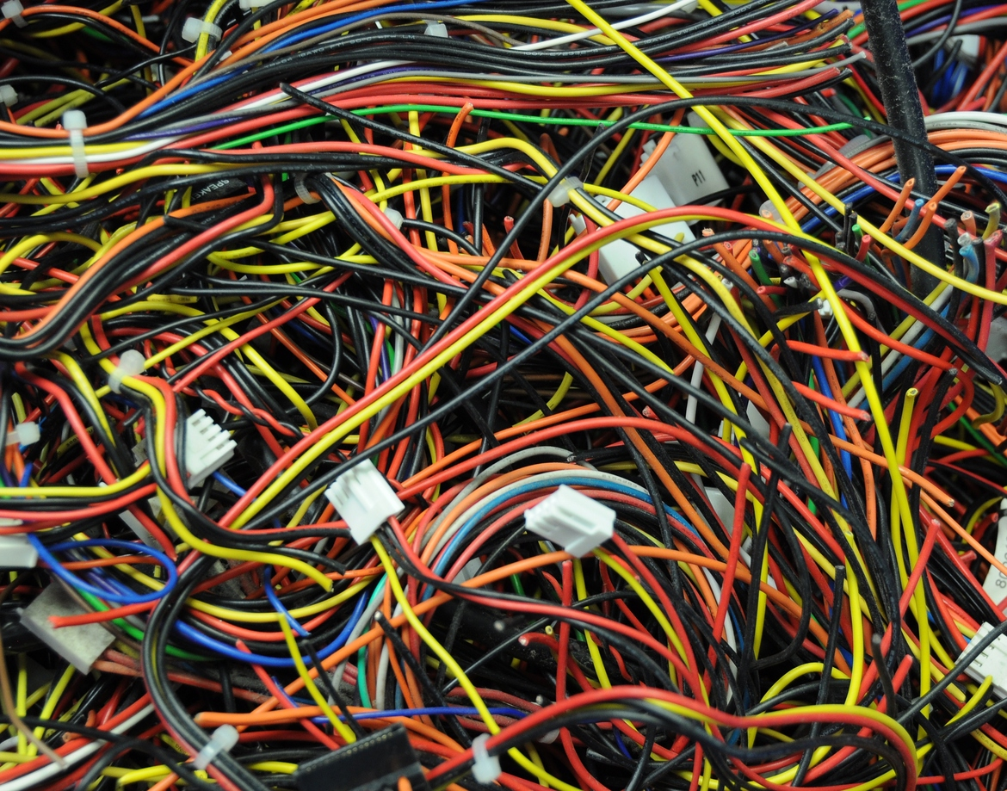
http://500px.com/photo/10237811/tangled-wires-by-doug-mclean
Notes:
Many say the issue is “policy spaghetti.”
Privacy and security policies are distributed in an ad hoc manner across the program, making it difficult to write these programs in the first place. Verification is even more difficult.

Slide 4
Many possible points of failure.
Desired Policy
Implementation
Policy
Only friends can see GPS location.
getLocation(user)
Policy
findAllUsers(location)
Policy
findTopLocations()
Notes:
First of all, there are many points of failure.
Let’s consider what has to happen to enforce a policy that only my friends can see my GPS location.
Well, the programmer has to enforce this policy at all points where the location is used. Not just in the function that gets a user’s location, but in functions that find all users at some given location and the most popular locations among users.
TRANSITION: What’s worse is that the policies are getting more complex.

Slide 5
Increasingly complex policies.
Desired Policy
Only friends can see GPS location.
who are local
within next five hours
Notes:
For instance, we could have a policy that says only friends who are local can see my GPS location within the next five hours.
TRANSITION: Some people might say that developer education solve this problem.

Slide 6
Jeeves Goal: Separate Policy and Functionality
Policy Implementation
Other Implementation
Only friends can see GPS location.
getLocation(user)
findAllUsers(location)
findTopLocations()
Notes:
If we only have to worry about the policy and nothing else, it’s not that complicated.
Similarly, if we only had to worry about the other functionality without the policies, it’s also much simpler.
Now what we need is a way to put the policies back together with the functionality to get the right results.
A tricky part, though, is that handling sensitive values through computations involves integrating with the language semantics.
TRANSITION: Because of this information flow issue, we propose a language-level approach.

Slide 7
Jeeves for Web Applications
Django
+Jeeves = Jelf
Python
Jeeves

Slide 8
The jeeves language

Slide 9
In Jeeves, associate policies with data for automatic enforcement.
Only friends can see GPS location.
policy
data
Notes:
If we only have to worry about the policy and nothing else, it’s not that complicated.
Similarly, if we only had to worry about the other functionality without the policies, it’s also much simpler.
Now what we need is a way to put the policies back together with the functionality to get the right results.
A tricky part, though, is that handling sensitive values through computations involves integrating with the language semantics.
TRANSITION: Because of this information flow issue, we propose a language-level approach.

Slide 10
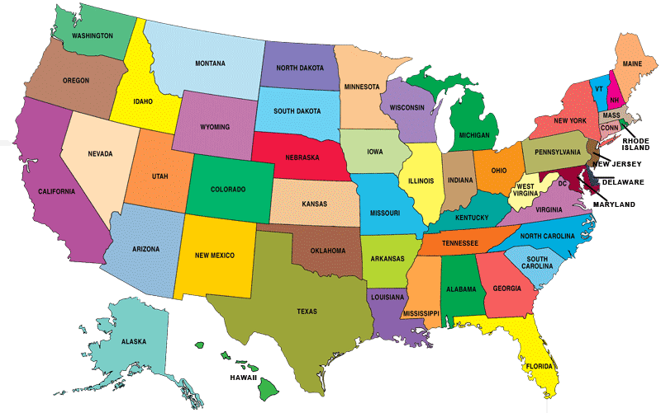
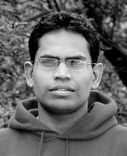
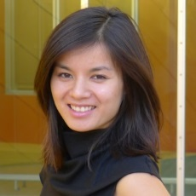
The Jeeves Language
⟨ | ⟩
policies
findAllUsers(Cornell)
You have no friends in this location.
Notes:
This brings us to Jeeves, which has the goal of detangling information flow policies from other functionality.
The key idea in Jeeves is that the programmer can define different views of a piece of data. For instance, we might have a high-confidentiality value corresponding to an actual GPS location and a low-confidentiality value corresponding to the country. The programmer provides policies describing which output channels the high-confidentiality value may flow to.
The programmer can then write policy-agnostic programs which are prepared for these different types of location inputs but don’t know the specific policies. The programmer may implement a function like findAllUsers simply by collecting the users with a given location.
The Jeeves runtime simulates multiple simultaneous executions so that it is prepared to show the appropriate output depending on the output channel. For instance, Cindy, who is here with us, may be able to see that Ras and I are at the Dream Inn, while my groupmate Rishabh, who is back at MIT, sees only that he has no friends at this location.
TRANSITION: In order to adapt this approach for web applications, we have been building a Jeeves web framework.

Slide 11
Sensitive Values
{ low, high }
a = mkLabel()
loc = mkSensitive(a, gpsCoords, country)
High value
Low value
Label
Policies
restrict (a, λoc.(isNear(oc, jean))
Label.
Policy
Output channel
Core Functionality
msg = “Jean’s location is ” + asStr(loc)
Contextual Enforcement
print {owen} msg “Jean’s location is N 42°, W 71°.”
print {rishabh} msg “Jean’s location is in the United States.”
Notes:
First, the programmer can make labels that may be associated with sensitive values.
Sensitive values have a high-confidentiality facet and a low-confidentiality facet, guarded by the label.
If the label’s value is high, then the value acts as the high-confidentiality facet. Otherwise, the value acts as the low-confidentiality facet.
The runtime assigns values to the labels based on policies that the programmer provides.
Policies take a label and a function describing restrictions on the label. The function takes an output channel and returns a predicate determining when the label is allowed to be high.
The Jeeves runtime collects these policies to determine which views of sensitive values should be shown.
The Jeeves programmer can use sensitive interchangeably with other values.
For instance, here we create a string “msg” that is the concatenation of the sensitive location with the string “Alice is at.”
Effectful computations such as print require a context to determine what the output should be.
To evaluate this, the runtime finds an assignment for the labels that satisfies the policies and then uses this assignment to project out the appropriate result.
Printing in the context of user alice should yield the string “Alice is at MIT,” while printing on the context of user bob should yield the string “Alice is at school.”
** QUESTIONS? ***
TRANSITION: Let’s take a closer look at policies.

Slide 12
Faceted Execution
+
“Jean’s location is”
⟨gpsCoords | country⟩ _{a}
⟨ “… N 42°, W 71°.” | “… in the United States.”⟩ _{a}
print {rishabh}
“Jean’s location is in the United States.”
Notes:
To evaluate sensitive values, the runtime performs faceted execution, evaluating the high and low facets and putting the results back together.
The runtime also handles implicit flows by evaluating both sides of a conditional.
After evaluation, we get trees of faceted values, where each facet is guarded by a label.
Policies determine the values of the labels.
The runtime stores mappings of labels to policies in order to eventually assign values to the labels.
Once the runtime gets an output channel, it creates a system of constraints from the labels in order to find a satisfying assignment.
Once it gets a satisfying assignment to the labels, the runtime projects values out of the facets in order to produce the value to output.
*** QUESTIONS? ***
TRANSITION: You may now be wondering…

Slide 13
Jeeves Policies
restrict(a, λoc.isNear(oc, jean))
oc = rishabh
a = high ⇒ isNear(rishabh, jean)
a = high ⇒ false
a = low
Notes
Policies may refer to sensitive values.
There is always a consistent assignment.
Notion of maximal functionality: if a label is allowed to be high, we set it to high.
Notes:
Let’s now take a closer look at the policies.
Restrict creates a function that takes an output channel as an argument and adds a constraint that says if the predicate is _not_ true, the label must be low.
The first thing to note is that policies may refer to sensitive values.
Additionally, the constraints all take the form of requiring a label to be low.
Because of this, the constraint environment is always consistent: assigning everything to low is always consistent.
Especially to handle the circular dependencies that may arise between policies and sensitive values, we have this notion of maximal functionality: labels are set to high unless policies require them to be low.
TRANSITION: The Jeeves runtime uses these policies to project out the appropriate result facet for the viewer.

Slide 14
Evaluating Conditionals
[F-IF-SPLIT]
$$Σ, e_{C}⇓_{pc} Σ_{1}, \left\langle k ? V_{H} : V_{L}\right\rangle$$
Evaluate condition.
$e_{H}=$ ${\text{if} V_{H} \text{then} e}_{T} \text{else} e_{E}$
Create conditionals with each facet.
$e_{L}=$ ${\text{if} V_{L} \text{then} e}_{T} \text{else} e_{E}$
$$Σ_{1},\left\langle k ? e_{H} : e_{L}\right\rangle ⇓_{pc}Σ′, V$$
Evaluate faceted conditional.
$$Σ, {\text{if} e_{C} \text{then} e}_{T} \text{else} e_{E}⇓_{pc}Σ′, V$$
Current assumptions.
[F-SPLIT]
$$k∉pc \text{and} \overline{k}∉pc$$
$$Σ, e_{H}⇓_{pc ∪ \{k\}} Σ_{1}, V_{H}$$
Evaluate each branch under the appropriate assumption.
$$Σ_{1}, e_{L}⇓_{pc ∪ \{\overline{k}\}} Σ_{2}, V_{L}$$
$$V^{′}= \left\langle k ?V_{H} : V_{L}\right\rangle$$
Put results in a facet.
$$Σ,\left\langle k ? e_{H} : e_{L}\right\rangle ⇓_{pc}Σ_{2}, V′$$

Slide 15
Side Effects
[F-PRINT]
$$Σ, e_{oc}⇓_{∅} Σ_{1}, V_{oc}$$
Evaluate output context and expression to print.
$$Σ_{1}, e_{r}⇓_{∅} Σ_{2}, V_{r}$$
$\left\{k_{1}…k_{n}\right\}=closeK(labels\left(e_{oc}\right)∪labels(e_{r}),Σ_{2}$)
Retrieve labels and policies.
$e_{p}= λx.true ∧_{f} …∧_{f}$ $Σ_{2}(k_{n})$
$$Σ_{2}, {(e}_{p} V_{oc})⇓_{∅} Σ_{3}, V_{p}$$
Evaluate policies applied to the output context.
$$\text{pick} pc \text{such} \text{that} pc\left(V_{oc}\right)=oc, pc\left(V_{r}\right)=R, pc\left(V_{p}\right)=true$$
$$Σ\text{, }\text{print} \left\{e_{oc}\right\} e_{r}⇓V_{p}, oc:R$$
Pick a label assignment that satisfies the policies and use this to project out the viewer and result.

Slide 16
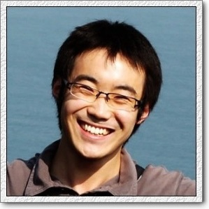
Classical Security
Lattice of access levels.
Level 3:
top secret.
Level 2:
highly classified.
Level 1:
privileged information.
Notes:
In classical security, people typically define a lattice of access levels.
A higher access level corresponds to a higher security level. For instance…
TRANSITION: To view an output, the viewer must have an access level corresponding to the highest level of any value used to compute the output.

Slide 17
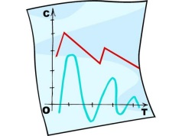
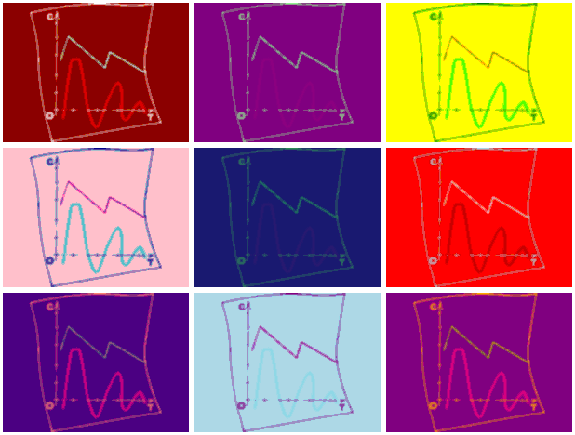
Classical Security
+
Level 3
Level 0
Level 3
Viewers must have access for the highest level.
Notes:
In this model of classical information flow, the access level of a value is the highest level of the values that were used to compute it.
For instance, if we took this classified information and combined it with this Andy Warhol painting to make an Andy Warhol classified information, only the NSA could see it.
The program would not produce any results for anyone else.
TRANSITION: Jeeves is different in that the program always produces results.

Slide 18
Jeeves Security
⟨ | ⟩
+
p
Notes:
In Jeeves, the property is not whether the viewer can see an output, but what output the viewer can see.
Instead of associating a value with an access level, the programmer provides a different value for different access levels.
When anyone except for the NSA tries to view the top secret information, they get to see an Andy Warholed version of “Access Denied.”
TRANSITION: Thus the non-interference guarantee in Jeeves talks about which value is output rather than the access level of the outputs.

Slide 19
Jeeves Non-Interference Theorem
Given a sensitive value
Takes into account when label depends on sensitive values!
⟨ H | L ⟩_{a}
all executions where a must be low produce equivalent outputs no matter the value of H.
Notes:
We have the following non-interference guarantee for Jeeves.
Traditional info flow too strong for the kinds of policies we want to write.
Given a fixed value for the low component, all executions where the level variable must be low produce equivalent outputs no matter what the value of H is.
This guarantee is different than classical non-interference because the dependencies of policies on sensitive values inherently leak some information.
TRANSITION: Let me illustrate how our guarantee captures what can be revealed.

Slide 20
Jeeves Non-Interference Theorem
restrict a: λoc.(distance(oc, location) < 25)
protected location
Viewer within radius:
a is allowed to be high.
viewer
Notes:
Recall the policy that someone can see my actual location if they are near me. This policy depends on the sensitive location.
If the viewer is within the appropriate radius of my location, then the label can be high and they can see the high value.
In this case, the high-confidentiality facet affects the value of the label and flows to the output.

Slide 21
Jeeves Non-Interference Theorem
restrict a: λoc.(distance(oc, location) < 25)
Viewer outside radius:
a must be low.
Viewer should not be able to distinguish actual location from any other of these points.
viewer
protected location
Notes:
If the viewer is outside the radius, then label a must be low. When label a is low, the viewer knows that the high value is outside the radius, but it should not be able to distinguish the actual location from any of the other locations outside the points.
And so we guarantee that high values only flow to viewers to the degree that the policies allow.
TRANSITION: We’ve implemented a real system with these guarantees.

Slide 22
Python Jeeves and Jelf

Slide 23
Python Implementation
For faceted execution, overload operators and perform source transform.
Store policies in runtime environment
+
mkLabel
restrict
⟨3 | 42⟩ _{a}
1
Policy environment
⟨4 | 43⟩ _{a}
Use an SMT solver to check label assignments.
print {rishabh} …
43
Notes:
We have implementations in both Scala and Python.
In the implementations, we overload operators for faceted evaluation. We store policies in the runtime environment.
We use the Z3 SMT solver to find a satisfying assignment to the labels and then we project out the appropriate facet based on the label assignments.
TRANSITION: We have been looking at extending these runtime implementations into web frameworks.

Slide 24
Jelf Web Framework
Jeeves runtime
Application
Project values based on viewer.
⟨ | ⟩
policies
Frontend
Database
Attach policies.
Viewer
@jeeves
Programmer is responsible
Framework is responsible
Notes:
The core component of the Jeeves web framework is the application layer running in Python Jeeves. The application runtime simulates multiple simultaneous executions on sensitive values. We call these sensitive values faceted values and we say the runtime performs faceted execution. Python Jeeves implements a source transformation so the programmer is just writing in Python.
We have extended the faceted execution model across the database interface by creating our own object relational mapping. All data elements are conceptually faceted values indexed by their policies. The programmer specifies information flow policies once, along with the data schemas. The programmer can then write policy-agnostic application code and policy-agnostic database queries. Since policies are executed at runtime, they can contain arbitrary code, including other database queries.
All values input through the frontend go directly to the database, where they are associated with policies. All values pass back through the Jeeves runtime before display so Jeeves can figure out which value to show. The Jeeves web framework is responsible for keeping track of who is looking.
TRANSITION: We reduce the chance of programmer error because the programmer only needs to think about policies in one place.

Slide 25
Sample Schema Code
class UserProfile(Model):
username = CharField()
location = CharField()
# More fields here…
@public_value(“location”)
def jeeves_get_public_location(user):
return getCountry(user.location)
@label_for(“lc”, “location”)
@jeeves
def jeeves_restrict_loc(user, ctxt):
return (user.isFriends(ctxt) and
user.location.isNear(ctxt.location))
Notes:
Here we show an example of what models might look like with policies.
Like Django, our ORM creates a unified object representation. The programmer defines an object that the framework is responsible for mapping onto the database. In Jelf, programmers can define Django schemas as usual. For instance, the UserProfile schema has fields corresponding to user name and location.
Programmers associate with schemas the “public” version of a value. This is the low-confidentiality value that a viewer sees by default if they don’t have access to the high-confidentiality value.
To specify when the high-confidentiality value may flow to the viewer, the programmer may also associate policies with fields. Policies are associated with fields through labels. Policies take as arguments the current data object and a context corresponding to the output channel. Policies may contain arbitrary code, including other queries.
The programmer can then write policy-agnostic queries. We support select, join, and order by. The Jelf framework keeps track of additional columns in the database corresponding to label bookkeeping. The policy enforcement still happens in the application runtime layer.
TRANSITION: To see how this works in practice, we’ve built a simple conference management system.

Slide 26
Jelf DB Interaction
Naive
Jeeves Application
Database
Application logic
Select * from Users with location = “02134”
Jelf
Everything
$$\left\langle \begin{matrix}o & o\end{matrix} \right\rangle$$
This is very slow!

Slide 27
Jelf DB Interaction
Jeeves Application
Database
Application logic
Select * from Users with location = “02134”
Jelf
[Joe, $\left\langle "02134",USA \right\rangle$]
[Joe, 02134]
This is very dangerous!

Slide 28
Jelf DB Interaction
Jeeves Application
Faceted Database
Application logic
Jelf
Select * from
Users with
location = “02134”
,
$$\left\langle \text{[}\text{Joe}\text{,}0\text{2134}\text{]},[] \right\rangle$$

Slide 29
Representing a Faceted DB
…
,
,
,
,

Slide 30
Representing a Faceted DB
User | Location
Joe | 01234
Tim | 02340
Evan | 24456
Jill | 01999

Slide 31
Representing a Faceted DB
Metadata | User | Location
L1,2,high | Joe | 01234
L1,2,low | Joe | USA
L2,3,high | Tim | 02340
L2,3,low | Tim | USA
L3,4,high | Evan | 24456
L3,4,high | Evan | USA
L4,5,high | Jill | 01999
User | Location
Joe | 01234
Tim | 02340
Evan | 24456
Jill | 01999
Select * from Users with location = “02134”
$$\left\langle \text{[}\text{Joe}\text{,}0\text{2134}\text{]},[] \right\rangle$$

Slide 32
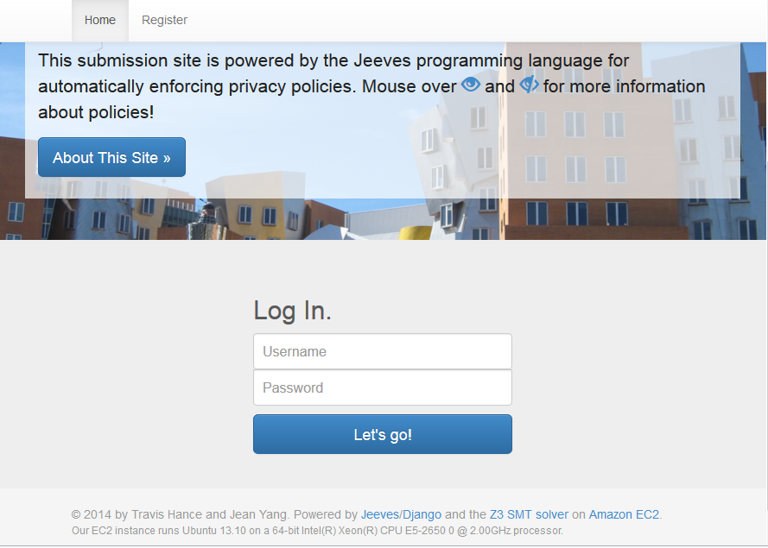
Case study: Conference Management System
DEPLOYED FOR PLOOC 2014!
Notes:
We have built a conference management system and deployed it for use in the Programming Languages for MOOCs conference. It’s still up with no problem. We have 23 users and 7 submissions.
TRANSITION: We use Jeeves policies to restrict access to sensitive fields the conference management system.

Slide 33
Jelf CMS Policy Code
Language | Total LOC | Policy LOC
Javascript | 1826 | 0
Python | 1604 | 131
HTML | 897 | 0
CSS | 212 | 0
Total | 4539 | 131 (2.9%)
Notes:
TRANSITION: How does this compare to HotCRP?

Slide 34
Comparison: HotCRP
Language | Total LOC | Policy LOC
PHP | 34889 | >2326
Javascript | 2566 | 0
CSS | 2503 | 0
Perl | 1422 | 0
SQL | 389 | many
C++ | 237 | 0
Total | 42006 | 2322 (5.5%)
Notes:
We compare our implementation to the implementation
of HotCRP, a state-of-the-art conference management
system used for managing submissions and reviews to
academic conferences. HotCRP is an excellent example
of the “policy spaghetti” that Jelf’s design is intended
to mitigate. Policy code pervades the entire HotCRP
codebase. Because the programmer needs to manage
policies and access checks, almost all of the PHP ﬁles
need to be policy-aware.
The anatomy of the HotCRP policy code is as fol-
lows. The HotCRP policies are implemented in across
at least 24 of the 82 PHP ﬁles. Many policy functions
are contained in a single ﬁle contact.php that is 1779
lines long; this ﬁle corresponds to what a Jeeves policy
ﬁle may look like. These functions can be upwards of
100 lines of nested PHP conditionals. Other ﬁles call
these functions when determining what may be shown;
there are at least hundreds of such checks across the code
base. Besides the functions in contact.php, there are ad-
ditional checks across the program. For instance, there
are 191 occurrences of checks involving the privChair and
conﬂictType variables checking whether the viewer is the
PC chair or has the appropriate conﬂict status. There is
also a fair amount of policy code associated with SQL
queries: many SQL queries construct WHERE clauses
with conditions based on policies.
We show an estimated lower bound on the lines of
“policy code” in Table 4. We deﬁne policy code as code
involved in access checks or deﬁning functions used in
these checks. The numbers are an underestimate: we
counted the functions deﬁned in contact.php, their uses,
and the appearance of a few other variables known to be
used for access checks. We sampled a few hundred lines
of the code base to determine that dynamically-generated
SQL queries involving policy checks were interspersed
throughout the code. The policy code is at least 2,322 out
of 42,006 lines of code in HotCRP. This code includes
the 1,779 lines corresponding to contact.php and the over
500 calls to policy functions across 24 ﬁles.
Though HotCRP has many more features and more
complex policies than our Jelf conference management
system, the main take-away is that there is policy code
scattered across the code base. It is difﬁcult to even char-
acterize what counts as “policy code” because it is so in-
tertwined with functionality. Designing a privacy API on
top of the database could mitigate some of these issues,
and having a domain-speciﬁc privacy language could
reduce the number of lines of policy code. Even with
such an approach, however, privacy remains a global con-
cern and the programmer remains responsible for making
checks across the code base. In such a system, the trusted
base for the policy code must be the entire code base,
as opposed to in a Jelf system, where the trusted policy
code can be concentrated in one location.

Slide 35
Jelf Running Times
Action | Hard-coded | Jelf
Showing all papers | 0.05s | 0.48s
Submitting a paper | 0.07s | 0.19s
Viewing a paper | 0.07s | 0.15s
Submitting a review | 0.05s | 0.15s
Notes:
We compare our implementation to the implementation
of HotCRP, a state-of-the-art conference management
system used for managing submissions and reviews to
academic conferences. HotCRP is an excellent example
of the “policy spaghetti” that Jelf’s design is intended
to mitigate. Policy code pervades the entire HotCRP
codebase. Because the programmer needs to manage
policies and access checks, almost all of the PHP ﬁles
need to be policy-aware.
The anatomy of the HotCRP policy code is as fol-
lows. The HotCRP policies are implemented in across
at least 24 of the 82 PHP ﬁles. Many policy functions
are contained in a single ﬁle contact.php that is 1779
lines long; this ﬁle corresponds to what a Jeeves policy
ﬁle may look like. These functions can be upwards of
100 lines of nested PHP conditionals. Other ﬁles call
these functions when determining what may be shown;
there are at least hundreds of such checks across the code
base. Besides the functions in contact.php, there are ad-
ditional checks across the program. For instance, there
are 191 occurrences of checks involving the privChair and
conﬂictType variables checking whether the viewer is the
PC chair or has the appropriate conﬂict status. There is
also a fair amount of policy code associated with SQL
queries: many SQL queries construct WHERE clauses
with conditions based on policies.
We show an estimated lower bound on the lines of
“policy code” in Table 4. We deﬁne policy code as code
involved in access checks or deﬁning functions used in
these checks. The numbers are an underestimate: we
counted the functions deﬁned in contact.php, their uses,
and the appearance of a few other variables known to be
used for access checks. We sampled a few hundred lines
of the code base to determine that dynamically-generated
SQL queries involving policy checks were interspersed
throughout the code. The policy code is at least 2,322 out
of 42,006 lines of code in HotCRP. This code includes
the 1,779 lines corresponding to contact.php and the over
500 calls to policy functions across 24 ﬁles.
Though HotCRP has many more features and more
complex policies than our Jelf conference management
system, the main take-away is that there is policy code
scattered across the code base. It is difﬁcult to even char-
acterize what counts as “policy code” because it is so in-
tertwined with functionality. Designing a privacy API on
top of the database could mitigate some of these issues,
and having a domain-speciﬁc privacy language could
reduce the number of lines of policy code. Even with
such an approach, however, privacy remains a global con-
cern and the programmer remains responsible for making
checks across the code base. In such a system, the trusted
base for the policy code must be the entire code base,
as opposed to in a Jelf system, where the trusted policy
code can be concentrated in one location.

Slide 36
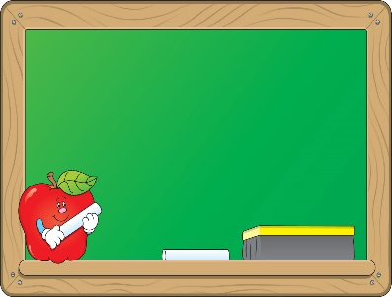
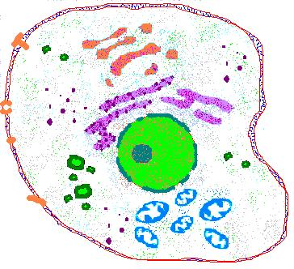
Ongoing Case Studies
Course manager
Medical records (HIPAA)
Protein signaling
Notes:
I’m happy to talk more offline about case studies, including a conference management system that we’ve deployed to run the PLOOC 2014 workshop.
TRANSITION: Now, a quick thank-you to our team.

Slide 37
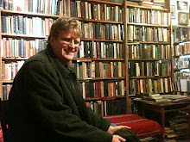
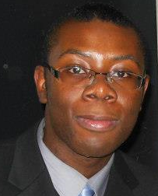
Jeeves Team
Jean Yang
Travis
Hance
Cormac Flanagan
Thomas Austin
Benjamin
Shaibu
Notes:
My advisor Armando, our students, and our collaborators.

