Slide 1
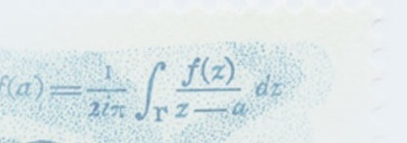




Bridging Boolean and Quantitative
Synthesis Using Smoothed Proof Search
Martin Clochard, Swarat Chaudhuri and
Armando Solar-Lezama

Slide 2


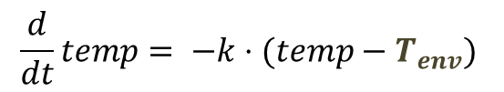
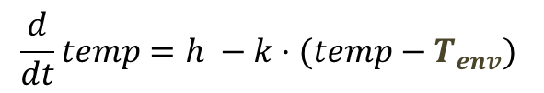

The Parameter Synthesis Problem
tOff := ??; tOn := ??; h := ??
forever {
temp := readTemp();
if (isOn() && temp-$T_{goal}$ > tOff)
switchHeaterOff();
elseif ( !isOn() && temp-$T_{goal}$ < tOn)
switchHeaterOn(h);
}
Heater On:
$$\frac{d}{dt}temp=h −k⋅(temp−T_{env})$$
Heater Off:
$$\frac{d}{dt}temp= −k⋅(temp−T_{env})$$
assert temp > 60;
Notes:
To motivate the problem, consider the following simple exercise. You want to develop a thermostat to control the temperature of a house.
The house is a physical system that behaves according to a set of equations that determine how the temperature evolves when the heater is on or off.
The thermostat, in turn, is a simple piece of code that keeps two thresholds; one to determine when to turn the heater on, and one to determine when to turn it off.
The code is very simple, but determining the correct constants is far from trivial; for example, if tOn is too close to the target temperature, then by the time the next reading comes in, you will have overshot the target by too much.
So the challenge is to find the most effective parameters to keep the house comfortable.

Slide 3
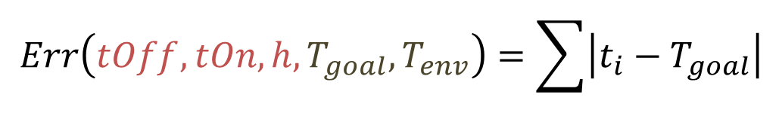

The Parameter Synthesis Problem
$$F(tOff, tOn, h, T_{goal}, T_{env})$$
$F\left(tOff, tOn, h, T_{goal}, T_{env}\right)=[t_{0}, t_{1}, …, t_{k}]$
$$Err\left(tOff, tOn, h, T_{goal}, T_{env}\right)=\sum{\left|t_{i}−T_{goal}\right|}$$
What to do about $T_{goal}$ and $T_{env}?$
Notes:
A simple approach to this problem is to write a program that takes tOn, tOff and h as parameters and simulates the behavior of the house and the thermostat.
The output of this program is a series of temperature readings.
Our goal is to keep the house at a pleasant 75deg, we can write an error function that gives us a measure of how close our temperature readings are to the desired temperature.
This error function is also our program, and our goal, is to find values that minimize its output.
At this point, the problem is no longer a parameter synthesis problem; it’s a problem of how to find values that minimize the output of a complicated program.

Slide 4
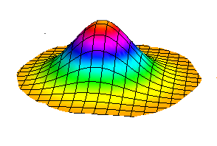


Probabilistic Parameter Synthesis
$goal$ and $T_{env}$ are out of our control
  they behave according to a known distribution
Goal: Find values of $tOff, tOn, h$ to optimize the expected error of the system
$$F(tOff, tOn, h, T_{goal}, T_{env})$$

Slide 5
Adding Probabilistic Assertions
tOff := ??; tOn := ??; h := ??
forever {
temp := readTemp();
if (isOn() && temp-goal > tOff)
switchHeaterOff();
elseif ( !isOn() && temp-goal < tOn)
switchHeaterOn(h);
passert temp > 60 : .95;
}
Assertion only has to be true 95% of the time

Slide 6
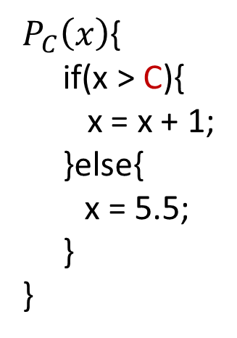
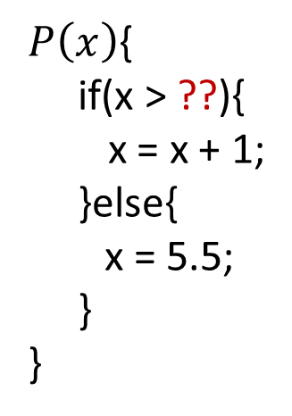

Background: Probabilistic Semantics
$$P_{C}(x):$$
$P_{C}\left(x\right)${
if(x > C){
x = x + 1;
}else{
x = 5.5;
}
}
$P\left(x\right)${
if(x > ??){
x = x + 1;
}else{
x = 5.5;
}
}
2.5
x > C
x = x + 1
x = 5.5
return x

Slide 7

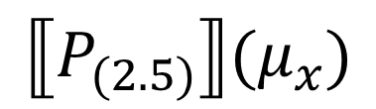
Background: Probabilistic Semantics
$$μ_{x}=$$
$$P_{C}(x):$$
2.5
x > C
x = x + 1
x = 5.5
return x
Probabilistic Semantics
$$⟦P_{(2.5)}⟧(μ_{x})$$

Slide 8
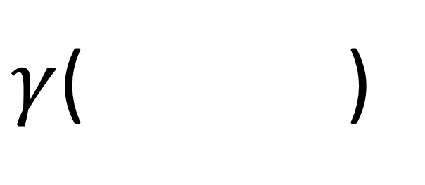
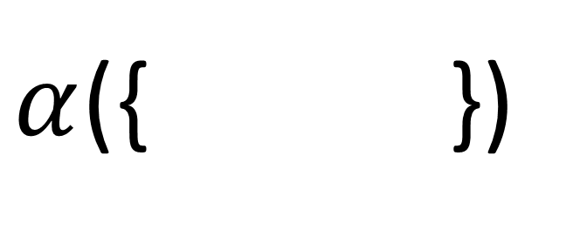
Background [Monniaux 2000]
A histogram is a natural abstraction for a distribution
$α$({ })
$γ$( )
…

Slide 9
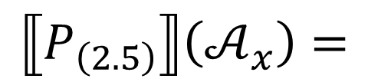

Background:
Verifying Probabilistic Programs [cite]
$$𝒜_{x}=$$
-7.5
-5
-2.5
0
2.5
5
7.5
$$P_{C}(x):$$
2.5
x > C
-7.5
-5
-2.5
0
2.5
5
7.5
x = x + 1
x = 5.5
-7.5
-5
-2.5
0
2.5
5
7.5
-7.5
-5
-2.5
0
2.5
5
7.5
-7.5
-5
-2.5
0
2.5
5
7.5
return x
Abstract Semantics
$$⟦P_{\left(2.5\right)}⟧\left(𝒜_{x}\right)=$$
-7.5
-5
-2.5
0
2.5
5
7.5

Slide 10



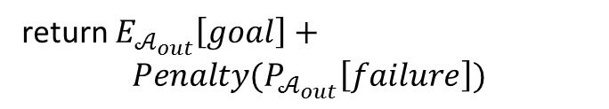
Strawman Synthesis Algorithm
$$Objective(H)$$
$$𝒜_{out}=⟦P_{H}⟧\left(𝒜_{x}\right)$$
return $E_{𝒜_{out}}\left[goal\right]+$
$$Penalty(P_{𝒜_{out}}\left[failure\right])$$
Numerical Optimizer
(Nelder-Mead)
Locally optimal parameter $H$
Problem: Objective(H) is highly discontinuous!

Slide 11
Discontinuity of Abstract Interp.
x=
2.49
x > C
x = x + 1
x = 5.5
return x

Slide 12
Discontinuity of Abstract Interp.
$$𝒜_{x}=$$
-7.5
-5
-2.5
0
2.5
5
7.5
x > C
2.49
-7.5
-5
-2.5
0
2.5
5
7.5
x = x + 1
x= 5.5
-7.5
-5
-2.5
0
2.5
5
7.5
-7.5
-5
-2.5
0
2.5
5
7.5
-7.5
-5
-2.5
0
2.5
5
7.5
return x
-7.5
-5
-2.5
0
2.5
5
7.5

Slide 13






Discontinuity of Abstract Interp.
$$⟦P_{\left(2.5\right)}⟧\left(𝒜_{x}\right)$$
$$⟦P_{\left(2.49\right)}⟧\left(𝒜_{x}\right)$$
$$𝒜_{out}^{2.5}$$
$$𝒜_{out}^{2.49}$$
-7.5
-5
-2.5
0
2.5
5
7.5
-7.5
-5
-2.5
0
2.5
5
7.5
$P_{𝒜_{out}^{2.5}}\left[x<2.5\right]≤0$
$$P_{𝒜_{out}^{2.49}}\left[x<2.5\right]≤0.39$$

Slide 14
Smoothed Proof Search

Slide 15
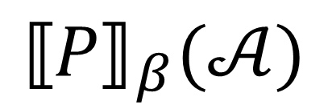
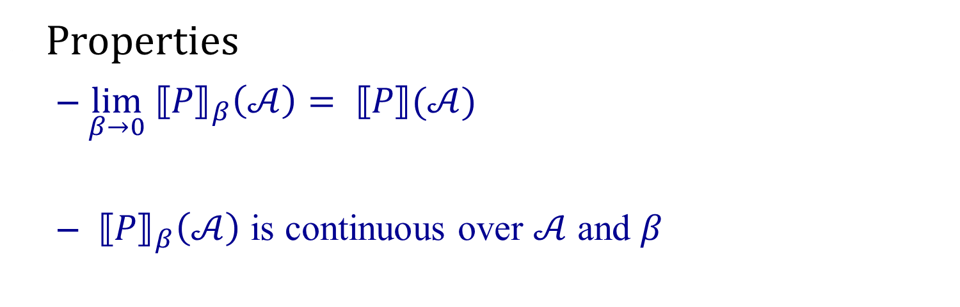
Smooth Abstract Semantics
$${⟦P⟧}_{β}(𝒜)$$
Properties
  $\lim_{β→0}{{⟦P⟧}_{β}\left(𝒜\right)}= ⟦P⟧(𝒜)$
  ${⟦P⟧}_{β}\left(𝒜\right)$ is continuous over $𝒜$ and $β$

Slide 16



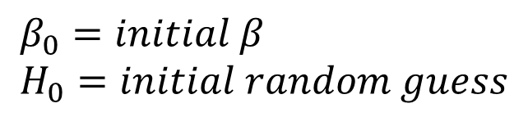

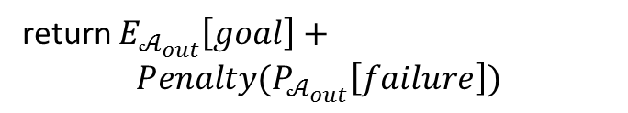



Smoothed Proof Search
$$β_{0}=initial β \\ H_{0}=initial random guess$$
$$Search$$
$$Objective(H)$$
$$𝒜_{out}={⟦P⟧}_{β_{i}}\left(𝒜_{x}×dist(H, β\right))$$
$$β_{i}$$
$$β_{i}∗α→ β_{i+1}$$
return $E_{𝒜_{out}}\left[goal\right]+$
$$Penalty(P_{𝒜_{out}}\left[failure\right])$$
Numerical Optimizer
(Nelder-Mead)
$$H_{i}$$
$$H_{i+1}$$

Slide 17
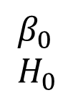
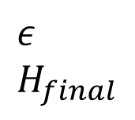
Smoothed Proof Search
$$β_{0}=initial β \\ H_{0}=initial random guess$$
$$β_{0} \\ H_{0}$$
…
$$ε \\ H_{final}$$
Search
Search
Search
Search

Slide 18
Smooth abstract semantics
The details

Slide 19




















Histograms in Higher Dimensions
$$w_{5}$$
$$w_{4}$$
$$w_{2}$$
Weight
$$w_{3}$$
$$w_{1}$$
$$w_{0}$$
-7.5
-5
-2.5
0
2.5
5
7.5
$$E_{0}$$
$$E_{1}$$
$$E_{2}$$
$$E_{3}$$
$$E_{4}$$
$$E_{5}$$
Subsets of $ℝ^{n}$
$$P_{μ}\left[x∈E_{i}\right]≤w_{i}$$
Ellipsoid Domain: Use Ellipsoids to Represent Buckets
$$E_{0}$$
$$w_{0}$$
$$E_{2}$$
$$w_{1}$$
$$w_{2}$$
$$E_{1}$$

Slide 20
Discontinuity
0.5
0.2
0.3
x
y
if( B )
true
false
0.3
0.5
0.2
0.5
y=y-10
y=y+10
x
x
y
y
0.2
0.3
0.5
0.5
x
y

Slide 21
Discontinuity
0.5
0.2
0.3
x
y
if( B )
true
false
0.3
0.5
0.2
y=y-10
y=y+10
x
x
y
y
0.2
0.3
0.5
x
y

Slide 22
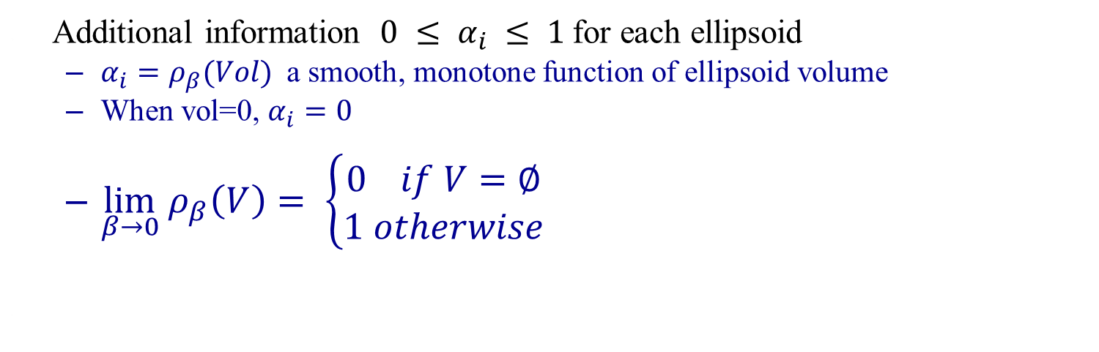
Smooth Abstract Semantics
Track “Distance from disappearance”
High α
Low α
Additional information $0 ≤ α_{i} ≤ 1$for each ellipsoid
  $α_{i}=ρ_{β}(Vol)$ a smooth, monotone function of ellipsoid volume
  When vol=0, $α_{i}=0$
  $\lim_{β→0} ρ_{β}\left(V\right)= \left\{\begin{aligned}0 if V=∅ \\ 1 otherwise\end{aligned}\right.⁡$

Slide 23











Smooth Abstract Semantics
0.5
0.2
0.3
$$α_{0}=1$$
$$α_{1}=1$$
$$α_{2}=1$$
x
y
if( B )
true
false
0.3
0.5
0.2
0.5
y=y-10
y=y+10
x
$$α_{0}=1$$
$$α_{1}=0.2$$
y
x
$$α_{1}=1$$
$$α_{2}=1$$
y
0.2
0.3
$$α_{0}=1$$
0.5
x
$$α_{1}=0.2$$
$$α_{1}=1$$
$$α_{2}=1$$
y

Slide 24














Discontinuity
0.5
0.2
0.3
$$α_{0}=1$$
$$α_{1}=1$$
$$α_{2}=1$$
x
y
if( B )
true
false
0.5
0.5
0.3
y=y-10
y=y+10
0.2
$$α_{0}=1$$
$$α_{1}=1.0$$
$$α_{1}=0.1$$
$$α_{1}=0.5$$
$$α_{1}=1.0$$
$$α_{2}=1$$
$$α_{1}=1.0$$
$$α_{1}=0.8$$
0.5
0.2
0.3
$$α_{0}=1$$
$$α_{2}=1$$
$$α_{1}=1.0$$
$$α_{1}=0.5$$
$$α_{1}=0.1$$
$$α_{1}=0.8$$
$$α_{1}=1.0$$

Slide 25
More Smooth Abstract Semantics
We also need smooth approximations of
  Expected value computation
  Probability bound computation

Slide 26
Some Empirical Results

Slide 27
Experimental Setup
Vary execution setup across two axis:
  What we measure
    Bound we can prove for the synthesized program
    Empirically observed bound on the behavior of the real program
  What we optimize
    Objective function returns the result of standard AI
    Objective function returns the result of running the implementation on a few samples
    Objective function returns the result of smooth AI

Slide 28
Thermostat Expectation
Proved Bounds
    Nelder-Mead on Smooth Interpretation (SNS)
    Nelder-Mead on standard (non-smooth) AI
    Nelder-Mead on samples

Slide 29
Thermostat Expectation
Measured Bounds
    Nelder-Mead on samples
    Nelder-Mead on Smooth Interpretation (SNS)
    Nelder-Mead on standard (non-smooth) AI

Slide 30
Thermostat Probability Bounds
    Nelder-Mead on Smooth Interpretation (SNS)
    Nelder-Mead on standard (non-smooth) AI
    Nelder-Mead on samples

Slide 31
Concluding Remarks
Numerical optimization has a place in synthesis
  even when you care about provable properties
Standard methods do not work with NS
  not out of the box at least
  Start smooth, end sound

