Slide 1
Vulnerability Analysis of False Data Injection

Slide 2
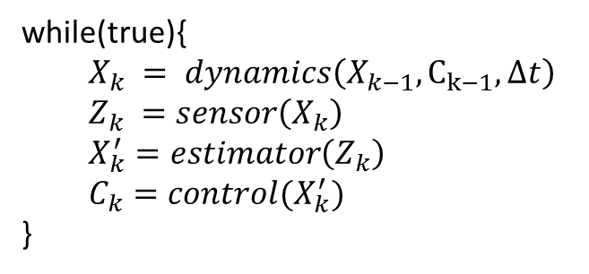
General control loop
while(true){
  $$X_{k} = dynamics\left(X_{k−1}, C_{k−1}, Δt\right) \\ Z_{k} =sensor\left(X_{k}\right) \\ X_{k}^{′}=estimator\left(Z_{k}\right)$$
  $C_{k}=control(X_{k}^{′})$
}

Slide 3
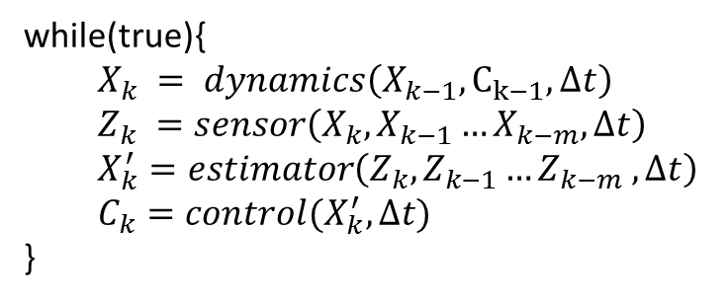
General control loop
while(true){
  $$X_{k} = dynamics\left(X_{k−1}, C_{k−1}, Δt\right) \\ Z_{k} =sensor\left(X_{k}, X_{k−1}…X_{k−m},Δt\right) \\ X_{k}^{′}=estimator\left(Z_{k}, Z_{k−1}…Z_{k−m} ,Δt\right)$$
  $C_{k}=control(X_{k}^{′},Δt)$
}

Slide 4
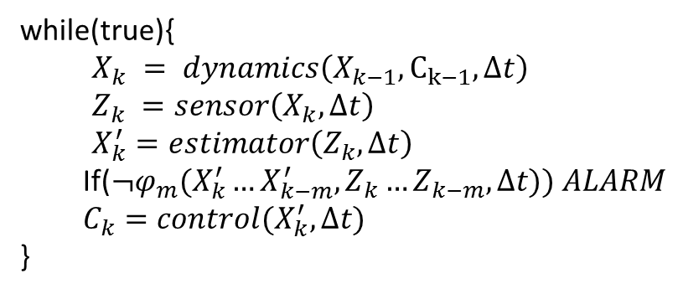
General control loop with monitor
while(true){
  $$X_{k} = dynamics\left(X_{k−1}, C_{k−1}, Δt\right) \\ Z_{k} =sensor\left(X_{k},Δt\right) \\ X_{k}^{′}=estimator\left(Z_{k},Δt\right)$$
  If(${¬φ}_{m}(X_{k}^{′}…X_{k−m}^{′},Z_{k}…Z_{k−m},Δt)) ALARM$
  $C_{k}=control(X_{k}^{′},Δt)$
}

Slide 5
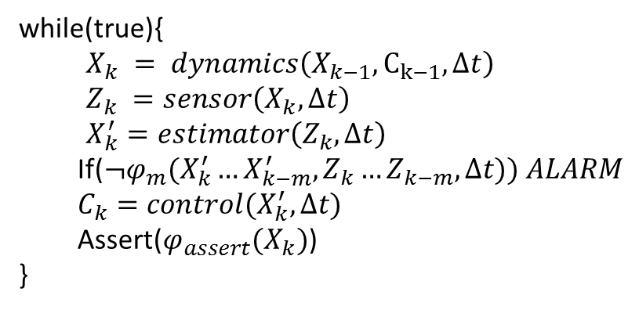
General control loop with safety property
while(true){
  $$X_{k} = dynamics\left(X_{k−1}, C_{k−1}, Δt\right) \\ Z_{k} =sensor\left(X_{k},Δt\right) \\ X_{k}^{′}=estimator\left(Z_{k},Δt\right)$$
  If(${¬φ}_{m}(X_{k}^{′}…X_{k−m}^{′},Z_{k}…Z_{k−m},Δt)) ALARM$
  $C_{k}=control(X_{k}^{′},Δt)$
  Assert($φ_{assert}(X_{k})$)
}

Slide 6
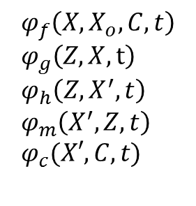
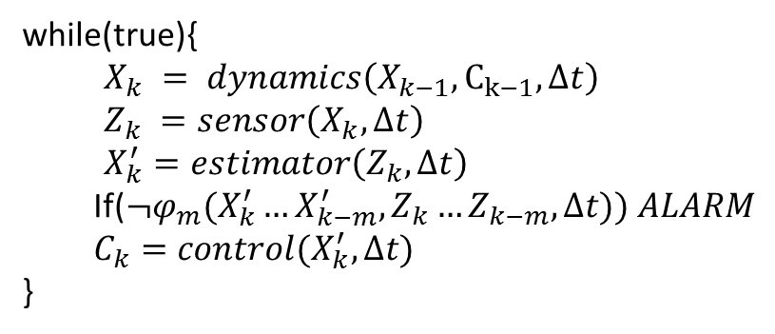
In terms of predicates
while(true){
  $$X_{k} = dynamics\left(X_{k−1}, C_{k−1}, Δt\right) \\ Z_{k} =sensor\left(X_{k},Δt\right) \\ X_{k}^{′}=estimator\left(Z_{k},Δt\right)$$
  If($¬φ_{m}(X_{k}^{′}…X_{k−m}^{′},Z_{k}…Z_{k−m},Δt)) ALARM$
  $C_{k}=control(X_{k}^{′},Δt)$
}
$$φ_{f}\left(X, X_{o}, C, t\right) \\ φ_{g}\left(Z, X,t\right) \\ φ_{h}\left(Z,X^{′},t\right) \\ φ_{m}\left(X^{′},Z,t\right) \\ φ_{c}(X′,C,t)$$

Slide 7
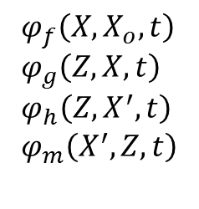
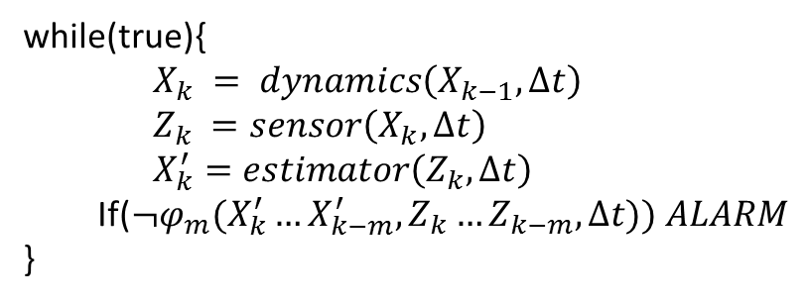
Independently controlled system
while(true){
  $$X_{k} = dynamics\left(X_{k−1}, Δt\right) \\ Z_{k} =sensor\left(X_{k},Δt\right) \\ X_{k}^{′}=estimator\left(Z_{k},Δt\right)$$
  If(${¬φ}_{m}(X_{k}^{′}…X_{k−m}^{′},Z_{k}…Z_{k−m},Δt)) ALARM$
}
$$φ_{f}\left(X, X_{o},t\right) \\ φ_{g}\left(Z, X, t\right) \\ φ_{h}\left(Z,X^{′},t\right) \\ φ_{m}\left(X^{′},Z,t\right)$$

Slide 8
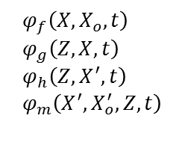
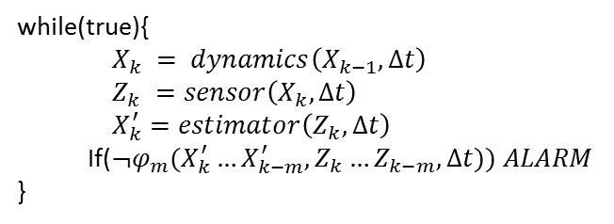
Observability
while(true){
  $$X_{k} = dynamics\left(X_{k−1}, Δt\right) \\ Z_{k} =sensor\left(X_{k},Δt\right) \\ X_{k}^{′}=estimator\left(Z_{k},Δt\right)$$
  If(${¬φ}_{m}(X_{k}^{′}…X_{k−m}^{′},Z_{k}…Z_{k−m},Δt)) ALARM$
}
$$φ_{f}\left(X, X_{o},t\right) \\ φ_{g}\left(Z, X, t\right) \\ φ_{h}\left(Z,X^{′},t\right) \\ φ_{m}\left(X^{′},X_{o}^{′},Z,t\right)$$
$$∀_{X, X_{0},X_{o}^{′},X^{′},Z}∀_{t∈[0,T]} \left|X_{o}−X_{o}^{′}\right|<δ⇒ \\ \left(φ_{f}\left(X,X_{o},t\right)∧φ_{g}\left(Z,X,t\right)∧φ_{h}\left(Z,X^{′},t\right)∧φ_{m}\left(X^{′},X_{o}^{′},Z,t\right)\right)⇒\left|X−X^{′}\right|<ε$$

Slide 9
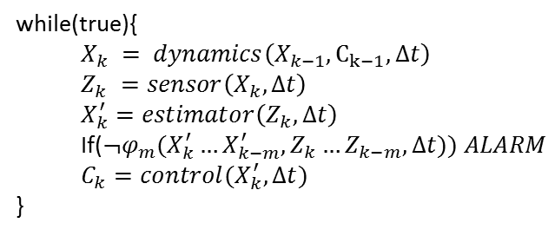
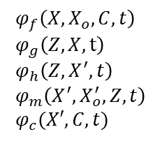
Observability
while(true){
  $$X_{k} = dynamics\left(X_{k−1}, C_{k−1}, Δt\right) \\ Z_{k} =sensor\left(X_{k},Δt\right) \\ X_{k}^{′}=estimator\left(Z_{k},Δt\right)$$
  If($¬φ_{m}(X_{k}^{′}…X_{k−m}^{′},Z_{k}…Z_{k−m},Δt)) ALARM$
  $C_{k}=control(X_{k}^{′},Δt)$
}
$$φ_{f}\left(X, X_{o}, C, t\right) \\ φ_{g}\left(Z, X,t\right) \\ φ_{h}\left(Z,X^{′},t\right) \\ φ_{m}\left(X^{′},X_{o}^{′},Z,t\right) \\ φ_{c}(X′,C,t)$$
$$∀_{X, X_{0},X_{0}^{′},X^{′},C,Z}∀_{t∈[0,T]} \left|X_{o}−X_{o}^{′}\right|<δ∧φ_{c}\left(X_{o}^{′},C,T\right) \\ ⇒\left(φ_{f}\left(X,X_{o},C,t\right)∧φ_{g}\left(Z,X,t\right)∧φ_{h}\left(Z,X^{′},t\right)∧φ_{m}\left(X^{′},X_{o}^{′},Z,t\right)\right)⇒\left|X−X^{′}\right|<ε$$

Slide 10
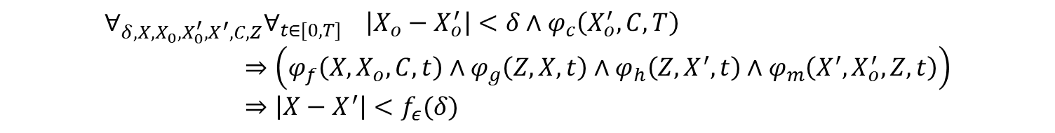
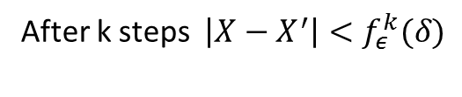
Chaining Time Steps Together
$$∀_{X, X_{0},X_{0}^{′},X^{′},C,Z}∀_{t∈[0,T]} \left|X_{o}−X_{o}^{′}\right|<δ∧φ_{c}\left(X_{o}^{′},C,T\right) \\ ⇒\left(φ_{f}\left(X,X_{o},C,t\right)∧φ_{g}\left(Z,X,t\right)∧φ_{h}\left(Z,X^{′},t\right)∧φ_{m}\left(X^{′},X_{o}^{′},Z,t\right)\right)⇒\left|X−X^{′}\right|<ε$$
$$∀_{δ,X, X_{0},X_{0}^{′},X^{′},C,Z}∀_{t∈[0,T]} \left|X_{o}−X_{o}^{′}\right|<δ∧φ_{c}\left(X_{o}^{′},C,T\right) \\ ⇒\left(φ_{f}\left(X,X_{o},C,t\right)∧φ_{g}\left(Z,X,t\right)∧φ_{h}\left(Z,X^{′},t\right)∧φ_{m}\left(X^{′},X_{o}^{′},Z,t\right)\right) \\ ⇒\left|X−X^{′}\right|<f_{ε}(δ)$$
After k steps $\left|X−X^{′}\right|<f_{ε}^{k}(δ)$

Slide 11

FDI Security
while(true){
  $$X_{k} = dynamics\left(X_{k−1}, C_{k−1}, Δt\right) \\ Z_{k} =sensor\left(X_{k},Δt\right) \\ X_{k}^{′}=estimator\left(Z_{k},Δt\right)$$
  If($¬φ_{m}(X_{k}^{′}…X_{k−m}^{′},Z_{k}…Z_{k−m},Δt)) ALARM$
  $C_{k}=control(X_{k}^{′},Δt)$
}
$$φ_{f}\left(X, X_{o}, C, t\right) \\ φ_{g}\left(Z, X,t\right) \\ φ_{h}\left(Z,X^{′},t\right) \\ φ_{m}\left(X^{′},X_{o}^{′},Z,t\right) \\ φ_{c}(X′,C,t)$$
$$∀_{φ_{g},X, X_{0},X_{0}^{′},X^{′},C,Z}∀_{t∈[0,T]} \left|X_{o}−X_{o}^{′}\right|<δ∧φ_{c}\left(X_{o}^{′},C,T\right) \\ ⇒\left(φ_{f}\left(X,X_{o},C,t\right)∧φ_{g}\left(Z,X,t\right)∧φ_{h}\left(Z,X^{′},t\right)∧φ_{m}\left(X^{′},X_{o}^{′},Z,t\right)\right)⇒\left|X−X^{′}\right|<ε$$
Attacker can replace $g$

Slide 12
FDI Security
while(true){
  $$X_{k} = dynamics\left(X_{k−1}, C_{k−1}, Δt\right) \\ Z_{k} =sensor\left(X_{k},Δt\right) \\ X_{k}^{′}=estimator\left(Z_{k},Δt\right)$$
  If($¬φ_{m}(X_{k}^{′}…X_{k−m}^{′},Z_{k}…Z_{k−m},Δt)) ALARM$
  $C_{k}=control(X_{k}^{′},Δt)$
}
$$φ_{f}\left(X, X_{o}, C, t\right) \\ φ_{g}\left(Z, X,t\right) \\ φ_{h}\left(Z,X^{′},t\right) \\ φ_{m}\left(X^{′},X_{o}^{′},Z,t\right) \\ φ_{c}(X′,C,t)$$
$$∀_{X, X_{0},X_{0}^{′},X^{′},C,Z}∀_{t∈[0,T]} \left|X_{o}−X_{o}^{′}\right|<δ∧φ_{c}\left(X_{o}^{′},C,T\right) \\ ⇒\left(φ_{f}\left(X,X_{o},C,t\right)∧φ_{g}\left(Z,X,t\right)∧φ_{h}\left(Z,X^{′},t\right)∧φ_{m}\left(X^{′},X_{o}^{′},Z,t\right)\right)⇒\left|X−X^{′}\right|<ε$$
Attacker can feed arbitrary Z

Slide 13
Different security questions
Given a monitor, Identify configurations vulnerable to attack
$$∀_{X, X_{0},X_{0}^{′},X^{′},C,Z}∀_{t∈[0,T]} \left|X_{o}−X_{o}^{′}\right|<δ∧φ_{c}\left(X_{o}^{′},C,T\right) \\ ⇒\left(φ_{f}\left(X,X_{o},C,t\right)∧φ_{g}\left(Z,X,t\right)∧φ_{h}\left(Z,X^{′},t\right)∧φ_{m}\left(X^{′},X_{o}^{′},Z,t\right)\right)⇒\left|X−X^{′}\right|<ε$$

Slide 14
Different security questions
Given a monitor, Identify configurations vulnerable to attack
$$∀_{X, X_{0},X_{0}^{′},X^{′},C,Z}∀_{t∈[0,T]} \left|X_{o}−X_{o}^{′}\right|<δ∧Q(X_{0},X,X_{0}^{′},X^{′},C,Z,t) ⇒\left|X−X^{′}\right|<ε$$
$$∀_{X, X_{0},X_{0}^{′},X^{′},X_{1},X_{1}^{′},C,Z}∀_{t∈[0,T]} \left|X_{o}−X_{o}^{′}\right|<δ∧Q\left(X_{0},X_{1},X_{0}^{′},X_{1}^{′},C,Z,T\right) \\ ∧Q(X_{1},X,X_{1}^{′},X^{′},C,Z,t)⇒\left|X−X^{′}\right|<ε$$

Slide 15

Different security questions
Given a monitor, identify attack models for which you are safe
$$∀_{X, X_{0},X_{0}^{′},X^{′},C,Z}∀_{t∈[0,T]} \left|X_{o}−X_{o}^{′}\right|<δ∧φ_{c}\left(X_{o}^{′},C,T\right) \\ ⇒\left(φ_{f}\left(X,X_{o},C,t\right)∧φ_{g′}\left(Z,X,t\right)∧φ_{h}\left(Z,X^{′},t\right)∧φ_{m}\left(X^{′},X_{o}^{′},Z,t\right)\right)⇒\left|X−X^{′}\right|<ε$$
$$φ_{g′}\left(Z,X,t\right)=φ_{g}\left(Z+a,X,t\right)∧\left\|a\right\|<τ$$

Slide 16
Different security questions
Given a monitor, identify attack models for which you are safe
$$∀_{X, X_{0},X_{0}^{′},X^{′},C,Z}∀_{t∈[0,T]} \left|X_{o}−X_{o}^{′}\right|<δ∧φ_{c}\left(X_{o}^{′},C,T\right) \\ ⇒\left(φ_{f}\left(X,X_{o},C,t\right)∧φ_{g′}\left(Z,X,t\right)∧φ_{h}\left(Z,X^{′},t\right)∧φ_{m}\left(X^{′},X_{o}^{′},Z,t\right)\right)⇒\left|X−X^{′}\right|<ε$$
$$φ_{g′}\left(Z,X,t\right)=φ_{g}\left(Z+a,X,t\right)∧\left\|a\right\|<τ$$

Slide 17

Different security questions
Identify a monitor that guarantees safety
$${∃φ_{m} ∀}_{X, X_{0},X_{0}^{′},X^{′},C,Z}∀_{t∈[0,T]} \left|X_{o}−X_{o}^{′}\right|<δ∧φ_{c}\left(X_{o}^{′},C,T\right) \\ ⇒\left(φ_{f}\left(X,X_{o},C,t\right)∧φ_{g′}\left(Z,X,t\right)∧φ_{h}\left(Z,X^{′},t\right)∧φ_{m}\left(X^{′},X_{o}^{′},Z,t\right)\right)⇒\left|X−X^{′}\right|<ε$$
$$φ_{g′}\left(Z,X,t\right)=attacker constraints$$

Slide 18
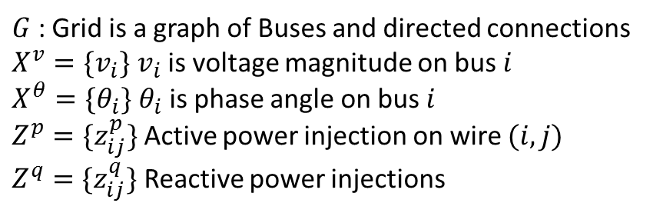

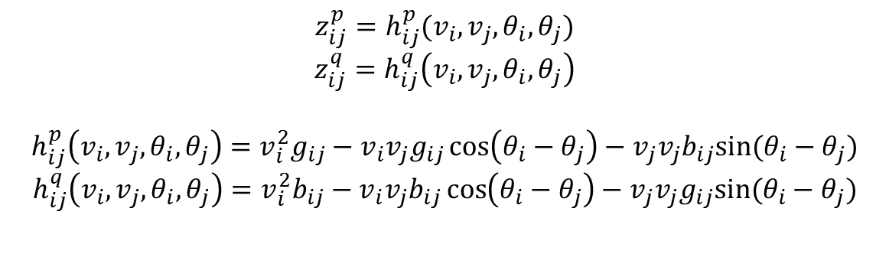
Power grid
$$\left\langle G, X^{v}, X^{θ},Z^{p}, Z^{q}\right\rangle$$
$G$ : Grid is a graph of Buses and directed connections
$X^{v}=\{v_{i}\}$ $v_{i}$ is voltage magnitude on bus $i$
$X^{θ}=\{θ_{i}\}$ $θ_{i}$ is phase angle on bus $i$
$Z^{p}=\{z_{ij}^{p}\}$ Active power injection on wire $(i,j)$
$Z^{q}=\{z_{ij}^{q}\}$ Reactive power injections
$$z_{ij}^{p}=h_{ij}^{p}(v_{i},v_{j},θ_{i},θ_{j})$$
$$z_{ij}^{q}=h_{ij}^{q}\left(v_{i},v_{j},θ_{i},θ_{j}\right)$$
$$h_{ij}^{p}\left(v_{i},v_{j},θ_{i},θ_{j}\right)=v_{i}^{2}g_{ij}−v_{i}v_{j}g_{ij}\cos\left(θ_{i}−θ_{j}\right)−v_{j}v_{j}b_{ij}sin⁡(θ_{i}−θ_{j})$$
$$h_{ij}^{q}\left(v_{i},v_{j},θ_{i},θ_{j}\right)=v_{i}^{2}b_{ij}−v_{i}v_{j}b_{ij}\cos\left(θ_{i}−θ_{j}\right)−v_{j}v_{j}g_{ij}sin⁡(θ_{i}−θ_{j})$$

Slide 19
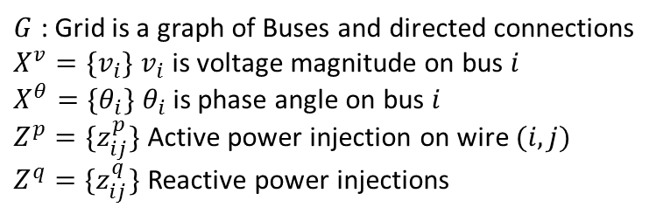


Power grid
$$\left\langle G, X^{v}, X^{θ},Z^{p}, Z^{q}\right\rangle$$
$G$ : Grid is a graph of Buses and directed connections
$X^{v}=\{v_{i}\}$ $v_{i}$ is voltage magnitude on bus $i$
$X^{θ}=\{θ_{i}\}$ $θ_{i}$ is phase angle on bus $i$
$Z^{p}=\{z_{ij}^{p}\}$ Active power injection on wire $(i,j)$
$Z^{q}=\{z_{ij}^{q}\}$ Reactive power injections
z
$$v_{1}θ_{1}$$
$$v_{2}θ_{2}$$
$φ\left(v_{1},θ_{1}\right)=∃z∃v_{2}∃θ_{2} (z=v_{1}^{2}−v_{1}v_{2}\cos\left(θ_{1}−θ_{j}\right)−v_{1}v_{2}\sin\left(θ_{1}−θ_{j}\right))$

Slide 20
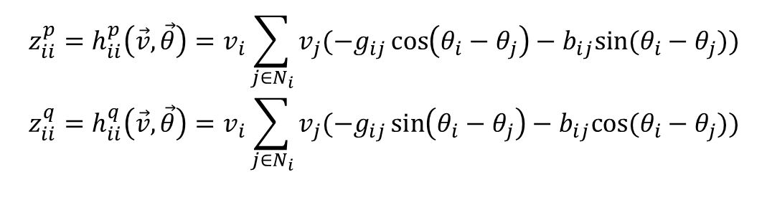
Power Grid
$$\left\langle G, X^{v}, X^{θ},Z^{p}, Z^{q}\right\rangle$$
$G$ : Grid is a graph of Buses and directed connections
$X^{v}=\{v_{i}\}$ $v_{i}$ is voltage magnitude on bus $i$
$X^{θ}=\{θ_{i}\}$ $θ_{i}$ is phase angle on bus $i$
$Z^{p}=\{z_{ij}^{p}\}$ Active power injection on wire $(i,j)$
$Z^{q}=\{z_{ij}^{q}\}$ Reactive power injections
$$z_{ii}^{p}=h_{ii}^{p}\left(\vec{v},\vec{θ}\right)=v_{i}\sum_{j∈N_{i}}{v_{j}(−g_{ij}\cos\left(θ_{i}−θ_{j}\right)−b_{ij}sin⁡(θ_{i}−θ_{j}))} \\ z_{ii}^{q}={h_{ii}^{q}\left(\vec{v},\vec{θ}\right)=v}_{i}\sum_{j∈N_{i}}{v_{j}(−g_{ij}\sin\left(θ_{i}−θ_{j}\right)−b_{ij}cos⁡(θ_{i}−θ_{j}))}$$

Slide 21
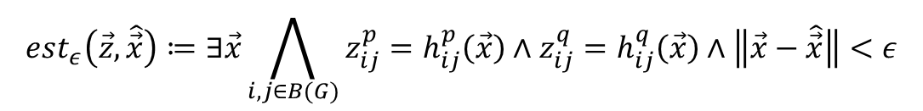

State estimation
An estimate $\vec{z},\hat{\vec{x}}$ is valid if it’s close enough to satisfying the equations
Corresponds to $φ_{h}$ in our general framework
$$est_{ε}\left(\vec{z},\hat{\vec{x}}\right)≔∃\vec{x}\bigwedge_{i,j∈B(G)}{z_{ij}^{p}=h_{ij}^{p}\left(\vec{x}\right)∧z_{ij}^{q}=h_{ij}^{q}\left(\vec{x}\right)∧\left\|\vec{x}−\hat{\vec{x}}\right\|<ε}$$

Slide 22

Monitor
If the state estimation is to far from satisfying the equations, we flag a problem
$$mon_{τ}\left(\hat{\vec{x}},\vec{z}\right)=\left\|\vec{z}−\vec{h}(\hat{\vec{x}})\right\|<τ$$

Slide 23
Attack model
Localized attacks
  Attacker wants to introduce an error at a particular node
  Attacker injects errors to a subset of the grid
  Injected values must be consistent at the interface
Visibility
  Can you directly see the values that you are trying to modify?

Slide 24
Incremental Algorithm
Initial subgrid contains only target node 1
  If an attack is found, you are done
If no attack is found, grow neighborhood
  Leverage results of UNSAT query to grow in a targeted way

Slide 25
Analysis time
Notes:
IEEE standard benchmarks.
S = size of the full grid

