Slide 1
MSL: a Synthesis Enabled Language for Distributed Implementations
Zhilei Xu
Shoaib Kamil
Armando Solar-Lezama
Notes:
Hello every one. Thanks for joining my talk, also the final one of this session.
I’m presenting a joint work with Shoaib and Armando.
We call it MSL. It’s a language designed for helping people write distributed code. In particular, writing SPMD kernels.

Slide 2
Key issues in SPMD programming
partitioned
local states
send/recv
messages
Notes:
I think you are all familiar with the SPMD model.
There are multiple processes running the same program in parallel, but the state is partitioned into individual local states.
Processes cannot access each others’ memory, so they coordinate by sending and receiving messages.
Then you get the evil non-determinism and have to worry about data partitioning, packing and unpacking, so forth.
So, what can we do to help?

Slide 3
MSL: Synthesis + Programming Model
Synthesis: automatically infer low-level details
High Level Programming Model: make the programs easier to analyze and check
Notes:
What we bring to the table are two things: synthesis and a high level programming model for SPMD.
By synthesis, the compiler can automatically infer many low-level details of the code, and alleviate the burden on the programmer.
The high level programming model both enables and compliments synthesis by making the programs easier to analyze and check for correctness.
Combining these two, MSL allows to write SPMD code easier with higher confidence of correctness.

Slide 4
Introducing synthesis
Example: (a+b)/2 without overflowing
UInt avgSpec(UInt a, UInt b) {
return (UInt) ( );
}
(ULong)a + (ULong)b
>> 1
Notes:
Let me first introduce synthesis through a simple example:
Computing the average of two integers. In this function, avgSpec.
Everyone can write this: to avoid overflowing, we first convert the operands to long integers.
Then compute the sum of them and right shift it by one bit.
Then cast the result back to integer and return it.
This is naïve simple and easy to get correct. But what if we want to avoid casting to long int for performance’s sake?

Slide 5
Introducing synthesis
unknown integer
UInt avgImpl(UInt a, UInt b) {
return expr;
}
expr ::= a | b | ??
| expr + expr
| expr & expr | expr | expr
| expr ^ expr | ~ expr
| expr >> ??
Notes:
To get a more efficient implementation, we need some bit twiddling expression. So what will be this expression?
Well, we know that it must involve both a and b, and it may involve some unknown integer constant.
It can also be the sum of two sub-expressions of this kind.
Likewise, it may involve bitwise logical operators.
And bit shifting.
This is a standard BNF grammar describing our high level insight about the expression we want.

Slide 6
Introducing synthesis
UInt avgImpl(UInt a, UInt b) {
generator UInt expr () {
return {| a | b | ??
| expr() + expr()
| expr() & expr | expr() | expr()
| expr() ^ expr() | ~ expr()
| expr() >> ?? |} ;
}
}
return expr();
}
expr ::= a | b | ??
| expr + expr
| expr & expr | expr | expr
| expr ^ expr | ~ expr
| expr >> ??
Notes:
In our language, we can directly represent the grammar in a special form of function, we call it a generator.
Look it’s almost the same as the grammar.
The generator describes a space of expressions that we care to return.

Slide 7
Introducing synthesis
UInt avgImpl(UInt a, UInt b) implements avgSpec {
generator UInt expr () {
return {| a | b | ??
| expr() + expr()
| expr() & expr | expr() | expr()
| expr() ^ expr() | ~ expr()
| expr() >> ?? |} ;
}
}
return expr();
}
UInt avgSpec(UInt a, UInt b) {
return (UInt) ( (ULong)a + (ULong)b >> 1 );
}
Notes:
Next we tell the compiler that the actual expression should implement the same functionality as avgSpec

Slide 8
Introducing synthesis
UInt avgImpl(UInt a, UInt b) implements avgSpec {
generator UInt expr () {
return {| a | b | ??
| expr() + expr()
| expr() & expr | expr() | expr()
| expr() ^ expr() | ~ expr()
| expr() >> ?? |} ;
}
}
return (a & b) + (a ^ b) >> 1;
}
<Hacker’s Delight, Section 2-5>
Notes:
Next we tell the compiler that the actual expression should implement the same functionality as avgSpec

Slide 9
Sketch-based synthesis
Specification: just a simple program
Sketch: an incomplete program, high-level
Solver: completes the sketch, based on equivalence
Correctness
Flexibility
Notes:
Then a solver will resolve all the unknown values and choices, instantiate generators to concrete valid code, and get a completed program. The solver does this by knowing that the sketch must behave equivalently to the specification.

Slide 10
Can we do synthesis for MPI?
No! That’s too hard.
MPI with Fortran/C is too low-level to analyze
The program is non-deterministic
Hard to match send() & recv()
Low-level array/pointer manipulation for message buffers
Solution:
Only deal with a high level abstraction of the bulk-synchronous subset of SPMD
Notes:
Only deal with the bulk-synchronous subset of SPMD
High level abstraction for bulk-synchronous model

Slide 11
Bulk-synchronous parallelism
Computation Phase
Communication Phase
Computation Phase
Communication Phase
Notes:
You know about the benefits of bulk-synchrony. In this model, programs are split into computation and communication phases. During computation phases, processes do purely local things independently. They only interact during communication phase. All processes must enter the communication phase synchronously, then they do data exchange together, and then release control and go back to computation.
Many MPI program are already written in this way because the programmers know this is easier for human to reason about.
But the compiler cannot exploit this because it’s hard to tell whether an MPI program has been organized in this disciplined manner.

Slide 12
Related languages
Languages with bulk-synchronous support:
X10, Titanium, …
MSL is inspired by them
Notes:
That’s why languages like X10 and titanium all provide mechanisms to model bulk-synchronous parallelism.
X10 for example, allows the programmer to stick to the bulk-synchronous subset, for the compiler to exploit the advantage.
MSL is inspired by the success of those languages, and we add synthesis and other ingredients to the MSL programming model.

Slide 13
Outline
What do MSL programs look like?
How does synthesis work in MSL?
Does MSL generate efficient code?

Slide 14
MSL programming example
Y
Y
X
Z
Transpose
X
Z
A[z, y, x]
Assign
B[x, y, z]

Slide 15
MSL programming example
Y
Y
X
Z
X
Z
void trans(int nx, int ny, int nz,
double[nz,ny,nx] A, ref double[nx,ny,nz] B) {
for (int x = 0; x < nx; x++)
for (int y = 0; y < ny; y++)
for (int z = 0; z < nz; z++)
B[x,y,z] = A[z,y,x];
}
Notes:
Fix indent

Slide 16
MSL programming example
Y
X
Process 0
Process 1
Z

Slide 17
MSL programming example
Y
Y
X
Z
Process 0
Process 0
Process 1
Process 1
X
Z

Slide 18
MSL programming example
Y
Y
X
Z
Process 0
Process 0
Process 1
Process 1
X
Z

Slide 19
MSL programming example
Y
Y
X
Z
Process 0
Process 0
Process 1
Process 1
X
Z

Slide 20
MSL programming example
Y
Y
X
Z
Process 0
Process 0
Process 1
Process 1
X
Z
The problem suddenly becomes non-trivial
We also want transpose for many other transformation: (x,y,z)->(z,y,x), (x,y,z)->(z,x,y), …
Notes:
Furthermore , codes like FFT requires many different transposition and each of them requires a slightly different implementation.

Slide 21
MSL programming example
Insight: use All_to_all()
Notes:
Let’s see how MSL can help us.
In order for
Does something very similar to transpose

Slide 22
MSL programming example
All_to_all ( Abuf, Bbuf )
All processes call All_to_all together
Abuf
Proc 0
Proc 1

Slide 23
MSL programming example
All_to_all ( Abuf, Bbuf )
Buffers have the same dimensions: N x L
Abuf
Proc 0
N
L
N
Proc 1
L

Slide 24
MSL programming example
All_to_all ( Abuf, Bbuf )
Redistribute Abuf to get Bbuf
Abuf
Bbuf
Proc 0
Proc 0
N
L
N
Proc 1
Proc 1
L
Notes:
Takes these buffers which can be seemed as N arrays each of length L
The I th array of every process ends up in process i

Slide 25
MSL programming example
All_to_all ( Abuf, Bbuf )
Redistribute Abuf to get Bbuf
Abuf
Bbuf
Proc 0
Proc 0
N
L
N
Proc 1
Proc 1
L

Slide 26
MSL programming example
void dtrans( int nx, int ny, int nz, int N, double[nz/N, ny, nx] LA, ref double[nx/N, ny, nz] LB) {
pack(LA, Abuf);
All_to_all( Abuf , Bbuf ); // programmer’s insight
unpack(Bbuf, LB);
}

Slide 27
MSL programming example
void dtrans( int nx, int ny, int nz, int N, double[nz/N, ny, nx] LA, ref double[nx/N, ny, nz] LB) {
pack(LA, Abuf);
All_to_all( Abuf , Bbuf ); // programmer’s insight
unpack(Bbuf, LB);
}

Slide 28
MSL programming example
void dtrans( int nx, int ny, int nz, int N, double[nz/N, ny, nx] LA, ref double[nx/N, ny, nz] LB) {
int L = (nx/N)∗ny∗(nz/N);
double[ N, L ] Abuf;
double[ N, L ] Bbuf;
pack(LA, Abuf);
All_to_all( Abuf , Bbuf ); // programmer’s insight
unpack(Bbuf, LB);
}

Slide 29
MSL programming example
void dtrans( int nx, int ny, int nz, int N, double[nz/N, ny, nx] LA, ref double[nx/N, ny, nz] LB) {
int L = (nx/N)∗ny∗(nz/N);
view LB as double[ N, L ] Abuf; // insight
double[ N, L ] Bbuf;
pack(LA, Abuf);
All_to_all( Abuf , Bbuf ); // programmer’s insight
unpack(Bbuf, LB);
}

Slide 30
MSL programming example
void dtrans( int nx, int ny, int nz, int N, double[nz/N, ny, nx] LA, ref double[nx/N, ny, nz] LB) {
int L = (nx/N)∗ny∗(nz/N);
view LB as double[ N, L ] Abuf; // insight
view LA as double[ N, L ] Bbuf;
pack(LA, Abuf);
All_to_all( Abuf , Bbuf ); // programmer’s insight
unpack(Bbuf, LB);
}

Slide 31
MSL programming example
void dtrans( int nx, int ny, int nz, int N, double[nz/N, ny, nx] LA, ref double[nx/N, ny, nz] LB) {
int L = (nx/N)∗ny∗(nz/N);
view LB as double[ N, L ] Abuf;
view LA as double[ N, L ] Bbuf;
pack(LA, Abuf); // pack 3D array to 2D buffer
All_to_all( Abuf , Bbuf );
unpack(Bbuf, LB);
}

Slide 32
MSL programming example
void pack( int n1, int n2, int n3, double[n1, n2, n3] in ) {
}

Slide 33
MSL programming example
void pack( int n1, int n2, int n3, int N, int L double[n1, n2, n3] in, ref double[N, L] out ) {
for (int i = 0; i < n1; i++)
for (int j = 0; j < n2; j++)
for (int k = 0; k < n3; k++)
out[ ???, ??? ] = in[i][j][k];
}

Slide 34
MSL programming example
void pack( int n1, int n2, int n3, int N, int L double[n1, n2, n3] in, ref double[N, L] out ) {
view out as double[N * size] outBuf;
for (int i = 0; i < n1; i++)
for (int j = 0; j < n2; j++)
for (int k = 0; k < n3; k++)
outBuf[ ??? ] = in[i][j][k];
}

Slide 35
MSL programming example
void pack( int n1, int n2, int n3, int N, int L double[n1, n2, n3] in, ref double[N, L] out ) {
view out as double[N * size] outBuf;
generator int expr() {
return {| ?? | n1 | n2 | n3 | N | L
| expr() / N | expr() * expr() |};
}
for (int i = 0; i < n1; i++)
for (int j = 0; j < n2; j++)
for (int k = 0; k < n3; k++)
outBuf[ i*expr() + j*expr() + k*expr() ] = in[i][j][k];
}

Slide 36
MSL programming example
void pack( int n1, int n2, int n3, int N, int L double[n1, n2, n3] in, ref double[N, L] out ) {
view out as double[N * size] outBuf;
generator int expr() {
return {| ?? | n1 | n2 | n3 | N | L
| expr() / N | expr() * expr() |};
}
for (int i = 0; i < n1; i++)
for (int j = 0; j < n2; j++)
for (int k = 0; k < n3; k++)
outBuf[ i*1 + j*n1 + k*(n1*n2) ] = in[i][j][k];
}

Slide 37
MSL programming example
void unpack(int n1, int n2, int n3, int N, int L, double[N, L] in, ref double[n1, n2, n3] out) {
view in as double[n1*n2*n3] inBuf;
view out as double[N * L] outBuf;
generator int expr() {
return {| ?? | n1 | n2 | n3 | N | L
| expr() / N | expr() * expr() |};
}
for (int p = 0; p < N; p++)
for (int i = 0; i < expr() ; i++)
for (int j = 0; j < expr() ; j++)
for (int k = 0; k < expr() ; k++)
outBuf[p*expr()+i*expr()+j*expr()+k*expr()]
= inBuf[p*expr()+i*expr()+j*expr()+k*expr()];
}

Slide 38
MSL programming example
void unpack(int n1, int n2, int n3, int N, int L, double[N, L] in, ref double[n1, n2, n3] out) {
view in as double[n1*n2*n3] inBuf;
view out as double[N * L] outBuf;
generator int expr() {
return {| ?? | n1 | n2 | n3 | N | L
| expr() / N | expr() * expr() |};
}
for (int p = 0; p < N; p++)
for (int i = 0; i < n1 ; i++)
for (int j = 0; j < n2 ; j++)
for (int k = 0; k < n3 ; k++)
outBuf[ p*(n3/N) + i*(n2*n3) + j*n3 + k*1 ]
= inBuf[p*n1 + i*(n2*n3/N) + j*(n3/N) + k*1 ];
}

Slide 39
MSL programming example
The exact pack / unpack functions work for all transformations:
(x, y, z) -> (z, y, x); (x, y, z) -> (z, x, y), …
Just need to change the specification trans()
Need to tell SPMD dtrans() and sequential trans() are equivalent

Slide 40
MSL programming example
Y
Y
X
Mapping?
Process 0
Process 1
Z
Fundamental Problem
Even for just testing
trans()
global state
dtrans()
partitioned local states

Slide 41
MSL programming example
Y
Y
X
X
Process 0
distribute
Process 1
Z
Z

Slide 42
MSL programming example
Y
Y
X
X
Process 0
collect
Process 1
Z
Z

Slide 43
MSL programming example
void tester( int nx, int ny, int nz, double[nz,ny,nx] A, ref double[nx,ny,nz] B)
implements trans
{
spmdfork {
double[ nz/N, ny, nx ] LA = distribute(A);
double[ nx/N, ny, nz ] LB = distribute(B);
dtrans(nx, ny, nz, N, LA, LB);
collect(A, LA);
collect(B, LB);
}
}
Notes:
Pictures of spawned processes

Slide 44
MSL programming model
global
state
partitioned
states
distribute / collect
equivalance
sequential
specification
SPMD
sketch
SPMD
implementation

Slide 45
MSL programming model
Sequential specification: operates on global state
SPMD sketch: operates on partitioned local states
Related via distribute/collect functions
Solver completes the sketch based on equivalence
global
state
partitioned
states
distribute / collect
equivalance
sequential
specification
SPMD
sketch

Slide 46
Outline
What do MSL programs look like?
How does synthesis work in MSL?
Does MSL generates efficient programs?

Slide 47
MSL synthesis process
SPMD sketch
w/ unknowns ( ?? )
o
program transformation
sequential sketch
w/ unknowns ( ?? )
Synthesis
Equivalence Checking
Sequential
Specification
o

Slide 48
MSL synthesis process
SPMD sketch
w/ unknowns ( ?? )
o
program
transformation
sequential sketch
w/ unknowns ( ?? )
Synthesis
Equivalence Checking
Sequential
Specification
o
Notes:
I’ll describe the program transformation that turns a SPMD distributed program to a sequential deterministic program.

Slide 49
SPMD program transformation
Key to determinism: stick to the bulk-synchronous model
Computation Phase
Communication Phase
Computation Phase
Communication Phase
Notes:
All processes must enter the communication phase synchronously, they do data exchange together and then release control

Slide 50
SPMD program transformation
Key to determinism: stick to the bulk-synchronous model
Computation Phase
All_to_All / Allreduce / Reduce
Computation Phase
Communication Phase

Slide 51
SPMD program transformation
Key to determinism: stick to the bulk-synchronous model
Computation Phase
All_to_All / Allreduce / Reduce
Computation Phase
Point to point Communication ???
Notes:
But what about point to point communications?
On the one hand, We still want the nice structured synchronous communication model.
On the other hand , the nature about point to point communications is: well, they are point to point. Every process can freely choose whom to send the message, and some process may not even participate in the data exchange.
How to reconcile these two requirements?

Slide 52
Restricted communication
transfer( int n, double[n] sendBuf,
int receiverId, ref double[n] recvBuf )
Notes:
A single call to transfer does sending and receiving at once. It specifies the receiver’s ID and the buffer to send and buffer where it receives.
All processes must call transfer synchronously

Slide 53
Restricted communication
transfer( int n, double[n] sendBuf, int receiverId, ref double[n], recvBuf)
transfer
transfer
transfer
Notes:
No longer needs to match send()s and recv()s because they are the same

Slide 54
Restricted communication
transfer( int n, double[n] sendBuf, bool doSend
int receiverId, ref double[n] recvBuf, bool doRecv )
Notes:
A single call to transfer does sending and receiving at once. It specifies the receiver’s ID and the buffer to send and buffer where it receives.
All processes must call transfer synchronously

Slide 55
SPMD program transformation
Computation phases are not synchronized, but processes all operate on purely local data
Local Computation
Local Computation
Local Computation

Slide 56
SPMD program transformation
So different orders of interleaving make no difference during computation phases
Local Computation
Local Computation
Local Computation

Slide 57
SPMD program transformation
Processes affect each other during communication phases: well synchronized, fully deterministic
Local Computation
Local Computation
Local Computation
transfer
transfer
transfer

Slide 58
SPMD program transformation
fully synchronous and deterministc
Computation Phase
All_to_All / Allreduce / Reduce
Computation Phase
transfer
Notes:
Simulated by sequential programs

Slide 59
SPMD program transformation
double[N, 1] AA, BB;
spmdfork {
double[1] a, b;
a[0] = pid*1.0;
AllReduce(a, b, PLUS);
}
for (int pid=0; pid<N; pid++) {
AA[pid, 0] = pid*1.0;
}
double temp = 0.0;
for (int pid=0; pid<N; pid++) {
temp += AA[pid, 0];
}
for (int pid=0; pid<N; pid++) {
BB[pid, 0] = temp;
}
Notes:
Annimate right
Highlight left

Slide 60
Recall: MSL synthesis process
SPMD sketch
w/ unknowns ( ?? )
sequential sketch
w/ unknowns ( ?? )
Synthesis
Equivalence Checking
Sequential
Specification

Slide 61
Synthesis step
Two sequential programs:
spec(in) v.s. sketch(unknowns, in)
Find assignments to unknowns s.t.
For all in, spec(in) == sketch(unknowns, in)

Slide 62
Synthesis step
Idea:
Turn programs into constraints (equations) by symbolic execution
then solve the constraints

Slide 63
Synthesis step
spec(int in, ref int out1) {
out1 = in + in;
}
sketch(int in, ref int out2)
implements spec
{
out2 = in * ??;
}
Variables: in, out1, out2, unknown (??)
Constraints:
out1 == in + in
out2 == in * unknown
out1 == out2
Solver problem: Find unknown, s.t.
Forall in, all 3 constraints can be satisfied
Notes:
If you find solutions to this , guaranteed to be correct no bugs

Slide 64
Limitations
With loops, equations for full correctness are very hard.
Shortcut: bounded unrolling.
Floating points
Finite fields: algebraically behave like the real number
Fix point arithmetic
Notes:
For programs with loops, getting those equations for full correctness is very hard.
What we do is to unroll the loops up to some bounded amount, and only focus on small inputs that iterates over the loops less than the bounded times.
That means we no longer have full correctness guarantee. But thanks to the fact that we can search exhaustively among the space of small tests, in practice we can still get correct solutions and prevent many bugs.
In addition to this limitation, we also cannot

Slide 65
Recall: MSL synthesis process
SPMD sketch
w/ unknowns ( ?? )
Efficient
MPI / C++
code
code gen
o
program transformation
sequential sketch
w/ unknowns ( ?? )
Synthesis
Equivalence Checking
Sequential
Specification
o

Slide 66
Code generation
MSL program translates into MPI/C++ straight-forwardly
MSL communication mechanisms have their counter-part in MPI

Slide 67
Code generation
transfer() is simulated by Isend() & Irecv()
transfer
transfer
transfer
transfer
transfer
transfer

Slide 68
Code generation
transfer() is simulated by Isend() & Irecv()
Isend
Isend
Isend
Irecv
Irecv
Irecv
Barrier
Isend
Isend
Isend
Irecv
Irecv
Irecv
Barrier

Slide 69
Code generation
Process 0
Process 1
Process 2
transfer1
Isend
Isend
Isend
Irecv
Irecv
Irecv
Isend
Isend
Isend
transfer2
Irecv
Irecv
Irecv

Slide 70
Code generation
Process 0
Process 1
Process 2
transfer1
Isend
Isend
Isend
Irecv
Irecv
Irecv
Isend
Isend
Isend
transfer2
Irecv
Irecv
Irecv
Notes:
Without barrier, transfer() will be out of sync and we lose determinism

Slide 71
Code generation
Message tag to the rescue!
tag = 1
tag
mismatch
Isend
Isend
Isend
Irecv
Irecv
Irecv
tag = 2
Isend
Isend
Isend
Irecv
Irecv
Irecv
Notes:
Tags protects transfers from cross phase message passing, and gives us barrier like safety without barrier like performance.
So what is our performance like?

Slide 72
Outline
What do MSL programs look like?
How does synthesis work in MSL?
Does MSL generates efficient programs?

Slide 73
Evaluation
Three kernels from NAS parallel benchmarks
Transpose (from FT)
Sparse Matrix-Vector multiplication (from CG)
MultiGrid (MG)
Different communication patterns: short/long, regular/irregular, all-to-all, reduce
In spite of the restricted programming model, MSL allows writing interesting kernels
Notes:
Bulk-synchronous SPMD kernels, quite different from each other

Slide 74
Performance Evaluation
Compare MSL generated code with hand-written official MPI/Fortran code
Running on NERSC Hopper cluster (Cray XE6, 2 AMD 12-core MagnyCours 2.1GHz per node)
Different scales of parallelism: 256 to 16384
Problem size: Class E (SpMV has to use larger customized config for higher parallelism)
Run 7 times and plot min, median, and max

Slide 75
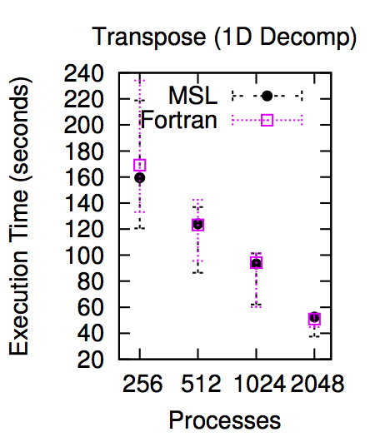
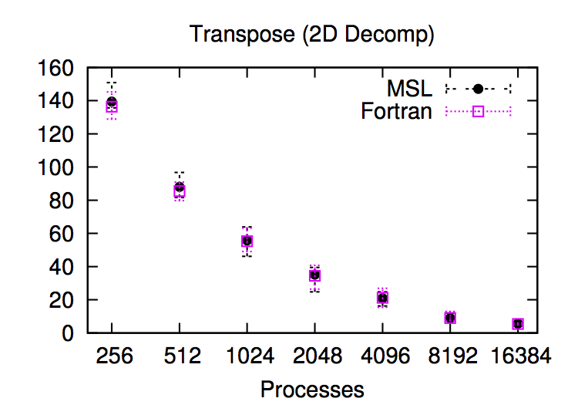
Performance Evaluation: Transpose

Slide 76
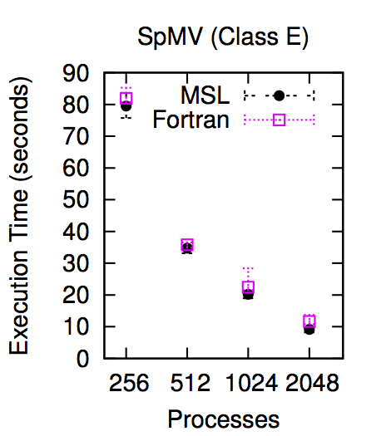
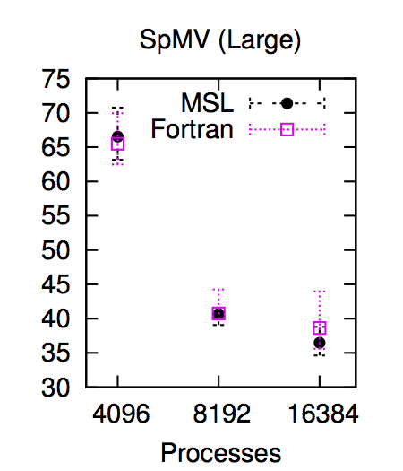
Performance Evaluation: SpMV

Slide 77
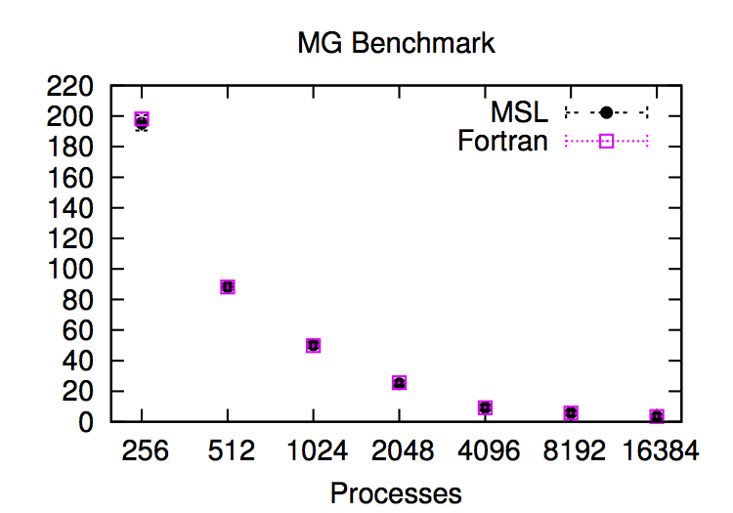
Performance Evaluation: MG

Slide 78
Outline
What do MSL programs look like?
How does synthesis work in MSL?
Does MSL generate efficient programs? YES.

Slide 79
Related Work
Generative Programming
Domain-Specific Languages for HPC
Halide, TCE, Tera, …
General Languages for HPC
Chapel, Fortress, Titanium, UPC, X10, ZPL, …
Synthesis

Slide 80
Conclusion
With high level abstraction of the SPMDmodel, we can analyze and synthesize bulk-synchronous programs
The synthesis feature in MSL infer low-level details and helps to write correct distributed implementations more easily
The restrictions in the programming model still allow for writing interesting kernels and generating efficient MPI/C++ code.

Slide 81
Thank you!
Thanks for your attention!
Questions?

