Slide 1

Making synthesis practical Are we there yet?
Armando Solar-Lezama

Slide 2
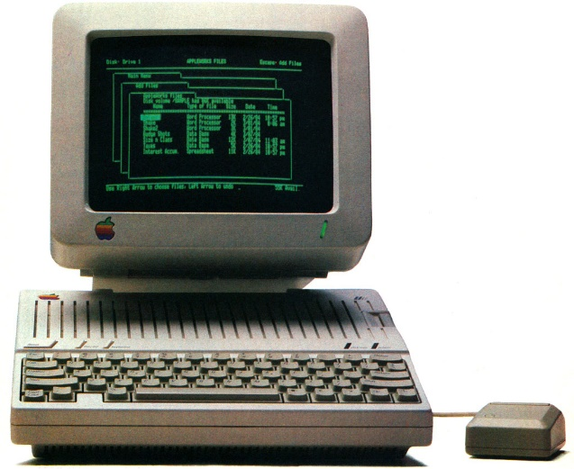
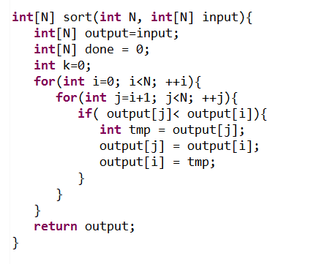
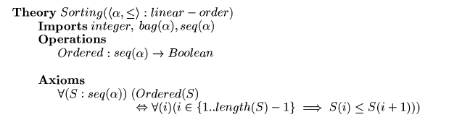
Synthesis: 1980s view
Complete Formal Specification

Slide 3
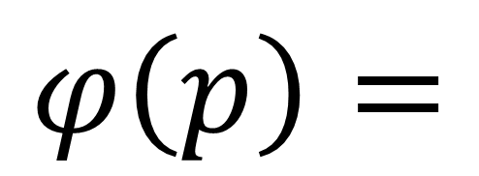
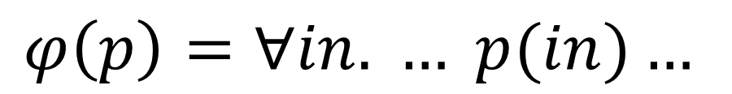
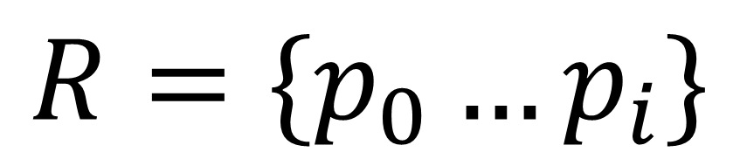

Synthesis: modern view
$$R=\{p_{0}…p_{i}\}$$
Space of programs
$$φ\left(p\right)=$$
$$φ_{1}\left(p\right) \\ {∧φ}_{2}\left(p\right) \\ ∧φ_{3}\left(p\right) \\ ∧φ_{4}\left(p\right)$$
Safety Properties
Input/Output Examples
Test Harnesses
$$φ\left(p\right)=∀in. … p(in)…$$

Slide 4
Example
You want to partition N elements over P procs
  How many elements should a processor get?
Obvious answer is N/P
Obvious answer is wrong!
N = 18
P = 5

Slide 5
Synthesizing a partition function
What do we know?
  The interface to the function we want
  Not all processors will get the same # of elements
  The kind of expressions we expect
void partition(int p, int P, int N, ref int ibeg, ref int iend){
if(p< {$ p, P, N, N/P, N%P : *, + $} ){
iend = {$ p, P, N, N/P, N%P : *, + $};
ibeg = {$ p, P, N, N/P, N%P : *, + $};
}else{
iend = {$ p, P, N, N/P, N%P : *, + $};
ibeg = {$ p, P, N, N/P, N%P : *, + $};
}
}
N
P
N%P
*
+
p
N/P

Slide 6
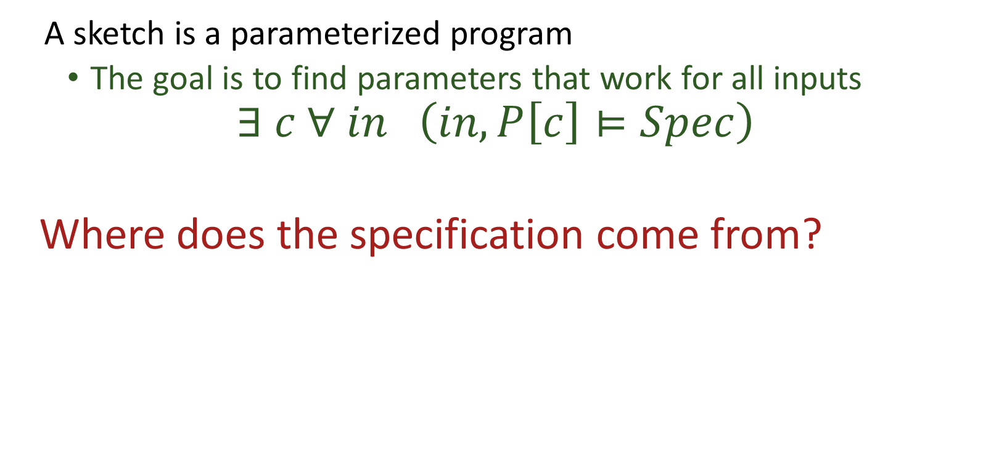
Key Idea
A sketch is a parameterized program
  The goal is to find parameters that work for all inputs
  $$∃ c ∀ in \left(in, P\left[c\right]⊨Spec\right)$$
  Where does the specification come from?

Slide 7
Tests as specifications
How does the system know what a partition is?
harness void testPartition(int p, int N, int P){
if(p>=P || P < 1){ return; }
int ibeg, iend;
partition(p, P, N, ibeg, iend);
assert iend - ibeg < (N/P) + 2;
if(p+1 < P){
int ibeg2, iend2;
partition(p+1, P, N, ibeg2, iend2);
assert iend == ibeg2;
}
if(p==0){ assert ibeg == 0; }
if(p==P-1){ assert iend == N; }
}
Partitions should be balanced
Adjacent partitions should match
First and last partition should go all the way to the ends

Slide 8
And 5 seconds later…
void partition(int p, int P, int N, ref int ibeg, ref int iend){
if(p < (N % P)){
iend = ((N / P) + 1) * (1 + p);
ibeg = p + ((N / P) * p);
}else{
iend = ((N / P) * p) + ((N / P) + (N % P));
ibeg = (N % P) + ((N / P) * p);
}
}
Cool!
Now can you synthesize programs with more than 5 lines of code?

Slide 9
Can you synthesize more than 5 LOC?
Not that much more
  In the example we synthesized 25 AST nodes
  We can do twice as much, but not much more
But…
  We can synthesize them within larger pieces of code
    1-2K LOC in some of our tests
  We can do it very reliably
So what can you do if you can synthesize 5-10 expressions in a program?

Slide 10
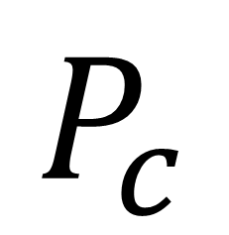
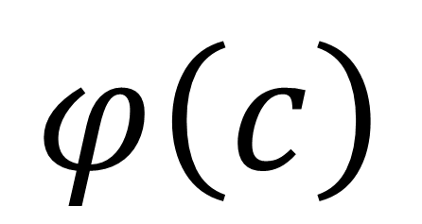
Program
+
Pre/Post cond
+
Invariants
Sketch
C-like language with holes and assertions
$$φ\left(c\right)$$
VC
Generator
Unroll
Inline
Enumerate
$$P_{c}$$
Provably Correct Synthesis
Program Optimization

Slide 11
Sketch
C-like language with holes and assertions
$$φ\left(c\right)$$
High-Level Language
Compiler
Unroll
Inline
Enumerate
$$P_{c}$$
Provably Correct Synthesis
Program Optimization
Automated Tutoring
Solver
Synthesis

Slide 12
Program
+
Pre/Post cond
+
Invariants
Sketch
C-like language with holes and assertions
$$φ\left(c\right)$$
VC
Generator
Unroll
Inline
Enumerate
$$P_{c}$$
Provably Correct Synthesis
Program Optimization
Automated Tutoring
Solver
Synthesis

Slide 13


Invariant Synthesis for Optimization
Work with Alvin Cheung and Shoaib Kamil

Slide 14




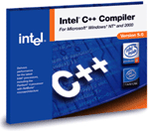
Optimization then and now
Naïve source code
Domain specific problem description
Pochoir
ATLAS
Halide
Close to optimal implementation
Optimal executable
Kind-of-OK executable

Slide 15
What about existing source code?
Synthesis
Proof of
Equivalence
Source Code
DSL Program

Slide 16

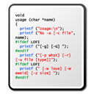
Java to SQL
Methods
SQL Queries
ORM
libraries
Objects
Relations
Application
Database

Slide 17

Java to SQL
Methods
SQL Queries
ORM
libraries
Objects
Relations
Application
Database

Slide 18
Java to SQL
SELECT * FROM user
List getUsersWithRoles () {
List users = User.getAllUsers();
List roles = Role.getAllRoles();
List results = new ArrayList();
for (User u : users) {
for (Role r : roles) {
if (u.roleId == r.id)
results.add(u); }}
return results; }
SELECT * FROM role
List getUsersWithRoles () {
return executeQuery(
“SELECT u FROM user u, role r WHERE u.roleId == r.id
ORDER BY u.roleId, r.id”; }
convert to
Notes:
How bad is the situation? Here is an example from a real-world aplication
What the dev didn’t know is that the first two method calls actually fetch records from the db, as a result when the outer loop is executed a query will be sent to the db, and likewise for the inner one
To speed things up we could have rewritten this code snippet using a simple SQL query as shown here

Slide 19
Java to SQL
List getUsersWithRoles () {
List users = User.getAllUsers();
List roles = Role.getAllRoles();
List results = new ArrayList();
for (User u : users) {
for (Role r : roles) {
if (u.roleId == r.id)
results.add(u); }}
return results; }
outerInvariant(users, roles, u, results, …)
innerInvariant(users, roles, u, r, results, …)
results = outputExpr(users, roles)
preCondition →
outerInvariant(users/query(…), results/[], …)
outerInvariant(…) ∧ outer loop terminates →
results = outputExpr(users, roles) …
Verification conditions
Notes:
How bad is the situation? Here is an example from a real-world aplication
What the dev didn’t know is that the first two method calls actually fetch records from the db, as a result when the outer loop is executed a query will be sent to the db, and likewise for the inner one
To speed things up we could have rewritten this code snippet using a simple SQL query as shown here

Slide 20
Program
+
Unkown Post cond
+
Unknown Invariants
Sketch
C-like language with holes and assertions
$$φ\left(c\right)$$
VC
Generator
Unroll
Inline
Enumerate

Slide 21
Join Query
Nested-loop join → Hash join!
O(n²) O(n)
Notes:
Original scales up quadratically as database size increases
There are more experiments in our paper and I invite you to check them out

Slide 22
What about HPC?
Synthesis
Legacy
Fortran/C++
Code
Proof of
Equivalence
Stencil DLS
(Halide)

Slide 23
Legacy to Halide
for (k=y_min-2;k<=y_max+2;k++) {
for (j=x_min-2;j<=x_max+2;j++) {
post_vol[((x_max+5)*(k-(y_min-2))+(j)-(x_min-2))]
=volume[((x_max+4)*(k-(y_min-2))+(j)-(x_min-2))]
+ vol_flux_y[((x_max+4)*(k+1 -(y_min-2))+(j)-(x_min-2))]
- vol_flux_y[((x_max+4)*(k-(y_min-2))+(j)-(x_min-2))];
}
}
$∀\left(j,k\right)∈Dom$post_vol[j,k] = volume[j,k]
+ vol_flux[j,k+1] + vol_flux[j,k]

Slide 24
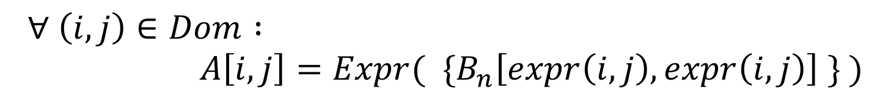
Invariants
$$∀ \left(i,j\right)∈Dom : \\ A\left[i,j\right]=Expr( \{B_{n}\left[expr\left(i,j\right), expr\left(i,j\right)\right] \} )$$

Slide 25
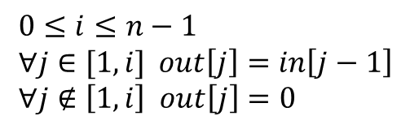
Example
out = 0
for(int i=0; i<n-1; ++i){
out[i+1] = in[i];
}
$$0≤i≤n−1 \\ ∀j∈[1,i] out\left[j\right]=in\left[j−1\right] \\ ∀j∉\left[1,i\right] out\left[j\right]=0$$
Loop invariant

Slide 26
Challenges
Big invariants
Complex floating point arithmetic
Universal Quantifiers

Slide 27

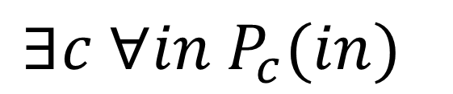
Quantifiers
$$∃c ∀in P_{c}(in)$$
if(outerInvariant(…) && !outerCond()){
assert out == outputExpr(in) ;
}
$∃c ∀in outerInvariant_{c}∧¬outerCond⇒out=outExpr_{c}$
$∃c ∀in ∃\left(i,j\right)\text{(}\text{(}\left(i,j\right)∈D_{c,in}⇒Q\left(i,j,c,in\right)\text{)} ∧ ¬\text{outerCond}\text{)}⇒out=outExpr_{c}$
$∃c ∀in \text{(}∀\left(i,j\right)∈D_{c,in} Q\left(i,j,c,in\right)∧ ¬\text{outerCond}\text{)}⇒out=outExpr_{c}$
The $∀$ leads to a $∃∀∃$ constraint!

Slide 28

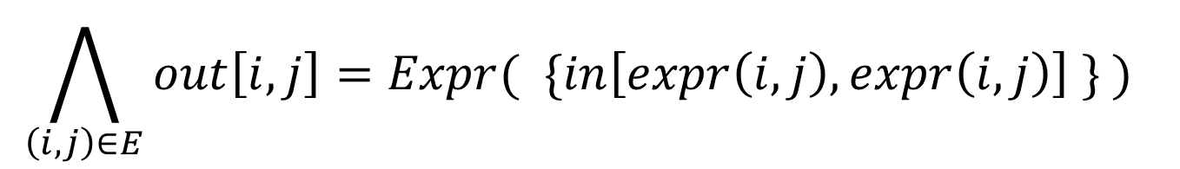
Quantifiers
$$∃c ∀in P_{c}(in)$$
Always safe to weaken this condition (more true)
if(outerInvariant(…) && cond()){
assert out == outputExpr(in) ;
}
$$\bigwedge_{\left(i,j\right)∈E}{out\left[i,j\right]=Expr( \{in\left[expr\left(i,j\right), expr\left(i,j\right)\right] \} ) }$$
$∀ \left(i,j\right)∈Dom :out\left[i,j\right]=Expr( \{in\left[expr\left(i,j\right), expr\left(i,j\right)\right] \} )$
Let the synthesizer discover $E$!

Slide 29
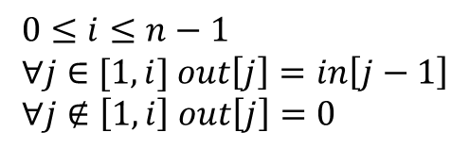


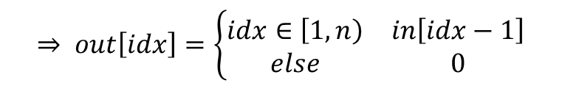


Example
out = 0
for(int i=0; i<n-1; ++i){
out[i+1] = in[i];
}
$$0≤i≤n−1 \\ ∀j∈[1,i] out\left[j\right]=in\left[j−1\right] \\ ∀j∉\left[1,i\right] out\left[j\right]=0$$
$$⇒ out\left[idx\right]=\left\{\begin{matrix}idx∈\left[1,n\right) & in\left[idx−1\right] \\ else & 0\end{matrix}\right.$$
$$∀ i, n, out, in, idx$$
$$∧ i≥n−1$$
Loop invariant
$¬$loopCond
$$out=expr$$

Slide 30
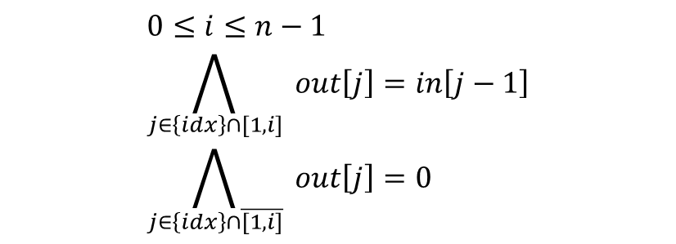


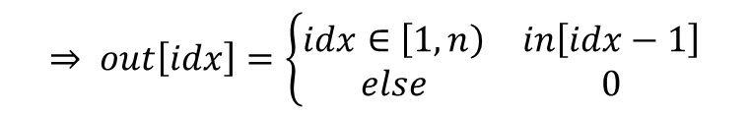


Example
out = 0
for(int i=0; i<n-1; ++i){
out[i+1] = in[i];
}
$$0≤i≤n−1 \\ \bigwedge_{j∈\left\{idx\right\}∩[1,i]}{ out\left[j\right]=in\left[j−1\right]} \\ \bigwedge_{j∈\left\{idx\right\}∩\overline{[1,i]}}{ out\left[j\right]=0}$$
$∀$ $i, n, out, in, idx$
$$⇒ out\left[idx\right]=\left\{\begin{matrix}idx∈\left[1,n\right) & in\left[idx−1\right] \\ else & 0\end{matrix}\right.$$
$$∧ i≥n−1$$
$¬$loopCond
$$out=expr$$
Loop invariant

Slide 31
Benchmarks
29 Kernels from 3 DOE MiniApps
  16 distinct kernels

Slide 32
Synthesis time
12 hrs
Synthesis time with parallel synthesis on 24 cores

Slide 33
Speedups
Speedups on 24 cores

Slide 34



Solver Synthesis
With Rohit Singh, Jeevana Inala, Willy Vasquez

Slide 35






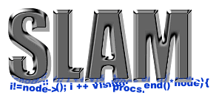

SMT Solvers are great!
UCLID
Boolector
Spec#
How can this possibly work?
Notes:
There’s a lot of them and they are workhorses of a wide variety of fields – from operations research to Molecular biology.
Even then, the way they work is quite surprising. They all try to satisfy the promise of SMT – one specification that should be sufficient to specify just about everything AND also solve it efficiently in every situation! Remember that these are NP complete problems!
This is amazing! There’s only one thing that comes to my mind.
Logos of different solvers at the top + some pictures that different fields (logos of projects) at bottom – a little later SMT-LIB in the middle
“How can this possibly work?” at the bottom: they’re all competing with each other, how is this possible?
Workhorses of a large number of fields
They solve hard problems
NP Complete
Should not scale
Why do they work?
Leverage the inherent structure in problems of practical interest

Slide 36
How is this possible?
Solvers leverage the structure in problems of practical interest
  To a limited extent
  Can find bugs
  Can’t crack RSA
Only so much structure to use!
Can we do better?

Slide 37
Solvers: a high-level view
Formula
Rewriter
SAT
Under-approximation
Refinement
Checking
Solution

Slide 38
Solvers: a high-level view
Formula
Rewriter
SAT
Under-approximation
Refinement
Checking
Solution

Slide 39



Rewriter
a
$$Pred$$
d
a
d
b
Predicate
$$f_{opt}$$
$$f_{orig}$$
b<d
<
<
<
OR
Pattern –Assumptions–> Pattern
Inputs :
a
b
d
Notes:
Traditionally implemented as (full-fledged) code
Exhibits domain specificity
In most cases, can be expressed and understood using simple declarative “rules” : Rewrite rules
Huge impact on performance

Slide 40
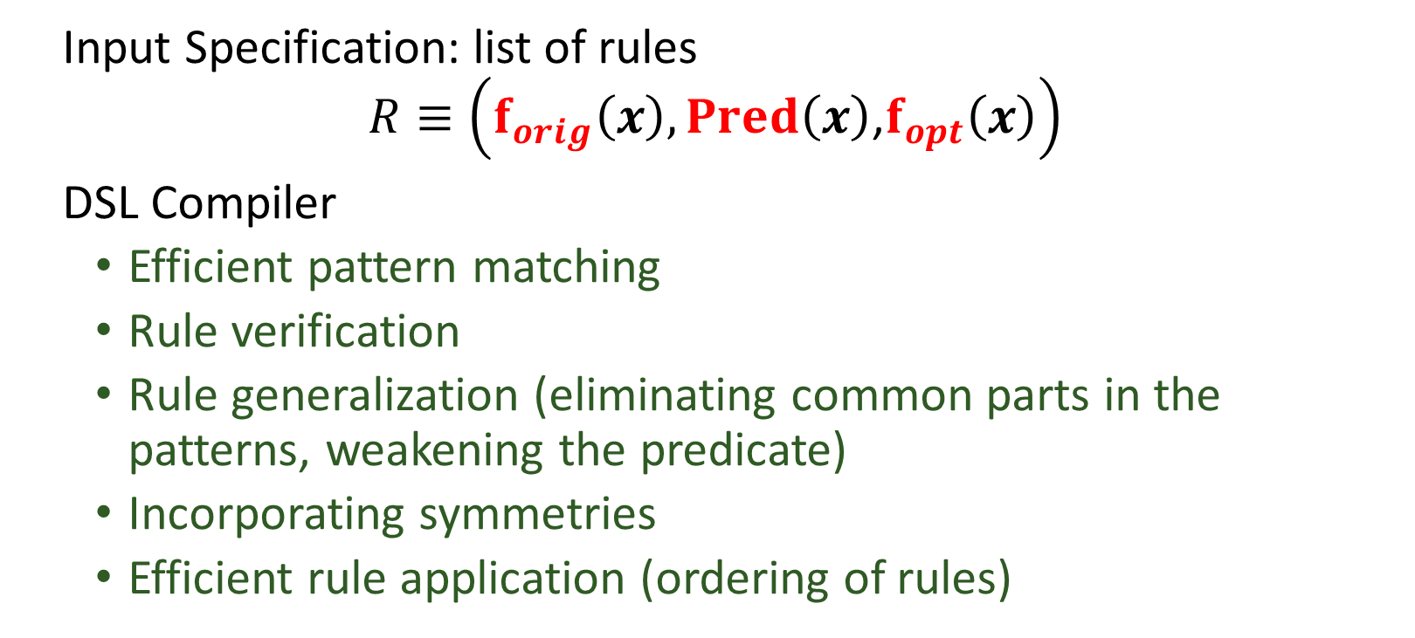
DSL for Rewriters
Input Specification: list of rules
$R≡\left(f_{orig}\left(x\right),Pred\left(x\right)\text{,}f_{opt}\left(x\right)\right)$
DSL Compiler
  Efficient pattern matching
  Rule verification
  Rule generalization (eliminating common parts in the patterns, weakening the predicate)
  Incorporating symmetries
  Efficient rule application (ordering of rules)

Slide 41
Sketch
C-like language with holes and assertions
$$φ\left(c\right)$$
High-Level Language
Compiler
Unroll
Inline
Enumerate
$$P_{c}$$
We can synthesize all rules from autogenerated sketches!

Slide 42
Synthesizing rules
Corpus of problems
from a domain
Pattern
Extraction
Sketches for
potential rules
Synthesis
Rewrite
Rules

Slide 43
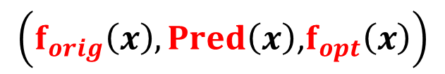

The synthesis problem
$$\left(f_{orig}\left(x\right),Pred\left(x\right)\text{,}f_{opt}\left(x\right)\right)$$
$$∃Pred, f_{opt} ∀x Pred\left(x\right)⇒f_{orig}\left(x\right)=f_{opt}(x)$$
What about optimality?
  $Pred$should be as true as possible
  For a given $Pred$, $f_{opt}$ should be as small as possible?

Slide 44
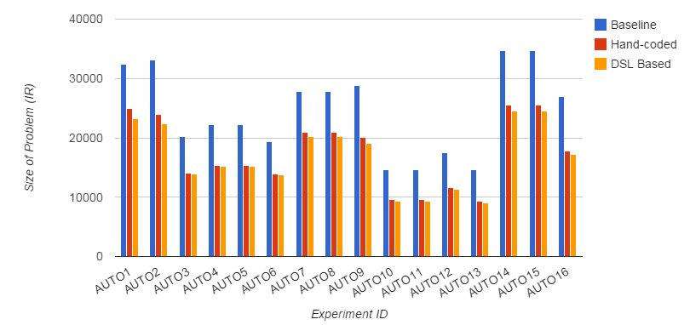
Does it work?
Problem size

Slide 45
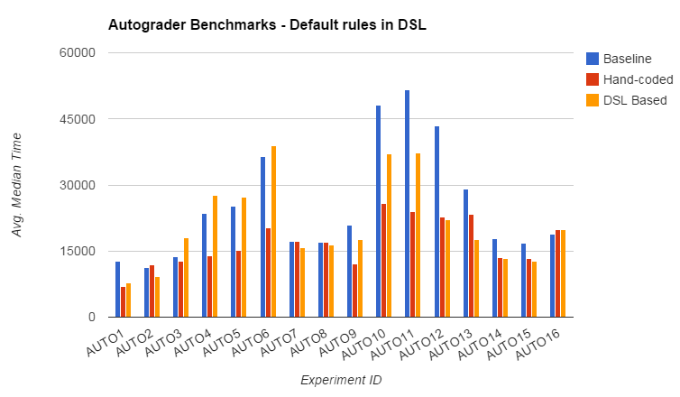
Does it work?
Solution time

Slide 46

Enhancing the IR
$max⁡(a,b)$
  = $ite\left(a<b,b,a\right)$
Replace all $ite\left(a<b,b,a\right)$with $\max\left(a,b\right)$ in the IR?
Notes:
Very common operation in practice
Doesn’t need dedicated representation:

Slide 47
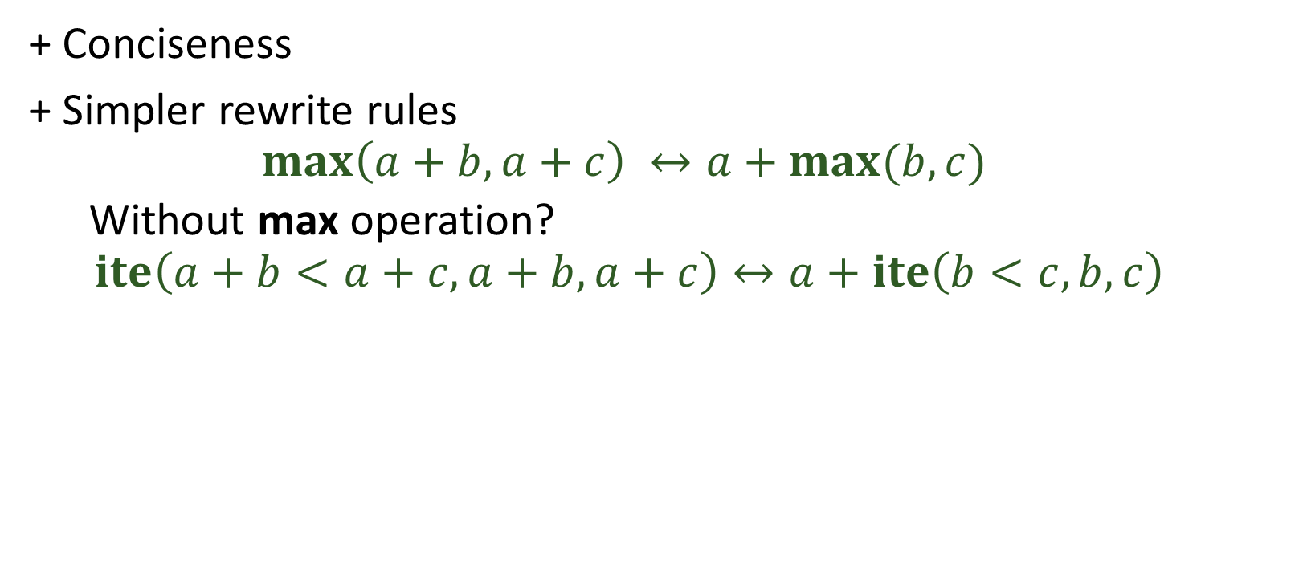
Enhancing the IR
+ Conciseness
+ Simpler rewrite rules
  $$\max\left(a+b,a+c\right) ↔a+max⁡(b,c)$$
  Without max operation?
  $$ite\left(a+b<a+c, a+b,a+c\right)↔a+ite\left(b<c,b,c\right)$$
Notes:
Easier to discover in terms of max, Efficient pattern matching

Slide 48
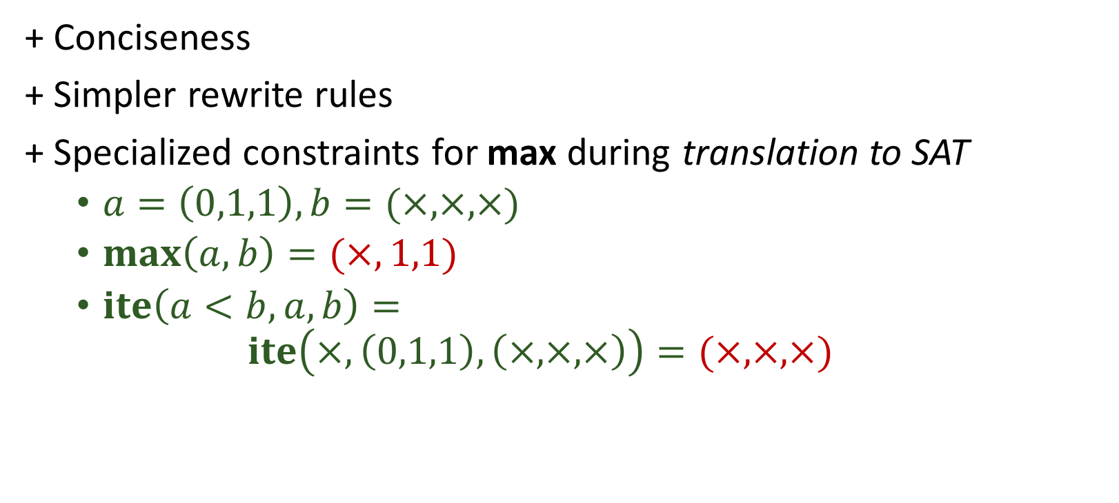
Enhancing the IR
+ Conciseness
+ Simpler rewrite rules
+ Specialized constraints for max during translation to SAT
  $a=\left(0,1,1\right), b=(×,×,×)$
  $\max\left(a,b\right)=(×,1,1)$
  $ite\left(a<b,a,b\right)=$
  $ite\left(×,\left(0,1,1\right), \left(×,×,×\right)\right)=(×,×,×)$
Notes:
How to do specialized translation for max as compared to ite mess? (0,1,1) (x,x,x)
[2:27:02 AM] Armando Solar Lezama: ite(a<b, a,b)
[2:27:47 AM] Armando Solar Lezama: ite(x, (0,1,1), (x,x,x))
[2:28:05 AM] Armando Solar Lezama: max((0,1,1), (x,x,x))
[2:30:13 AM] Rohit: (x,x,x) vs (x,1,1)

Slide 49




Autogenerating Encodings
Must be in CNF form
$$∀x_{0}…x_{n} y$$
$$f\left(x_{0}, …x_{n}\right)=y$$
$$⇔$$
$$P\left(x_{0}, …x_{n},y\right)$$
What about temporaries?
What about optimality?

Slide 50


Autogenerating with temporaries
$$∀x_{0}…x_{n} y$$
$$f\left(x_{0}, …x_{n}\right)=y$$
$$⇔$$
$$∃t P\left(x_{0}, …x_{n},t, y\right)$$

Slide 51

Autogenerating with temporaries
$$∀x_{0}…x_{n} y$$
$$f\left(x_{0}, …x_{n}\right)=y$$
$$⇐$$
$$∃t P\left(x_{0}, …x_{n},t, y\right)$$
This direction is easy

Slide 52


Autogenerating with temporaries
$$∀x_{0}…x_{n} y t$$
$$f\left(x_{0}, …x_{n}\right)=y$$
$$⇐$$
$$P\left(x_{0}, …x_{n},t, y\right)$$
This direction is easy

Slide 53

Autogenerating with temporaries
$$∀x_{0}…x_{n} y$$
$$f\left(x_{0}, …x_{n}\right)=y$$
$$⇒$$
$$∃t P\left(x_{0}, …x_{n},t, y\right)$$
This direction is harder

Slide 54






Solution
$$∀x_{0}…x_{n} y$$
$$f\left(x_{0}, …x_{n}\right)=y$$
$$⇒$$
$$∃t P\left(x_{0}, …x_{n},t, y\right)$$
$$∃t P_{1}\left(x_{0}, …x_{n},t\right)∧P_{2}\left(t,y\right)$$
Enforce that all clauses have only (x,t) or (t,y)
We know how to derive $t$ from $P_{1}$
    Essentially encoding a little solver in a sketch
    Now you can do skolemization!

Slide 55
Does this work?
Encodings for booleans can be generated in seconds
  Already useful in generating constraints for composite nodes

Slide 56
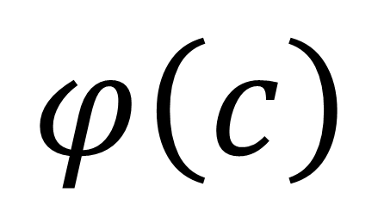
??
Sketch
C-like language with holes and assertions
$$φ\left(c\right)$$
Unroll
Inline
Enumerate
There is more to synthesis than “synthesis”
You can do this too!
  All the sketch infrastructure is available in open source

