Slide 1
Constraint Based Synthesis
From Sketches to Storyboards
Rishabh Singh and Armando Solar-Lezama
Notes:
Over the last few days, we have seen several different applications of synthesis for what could collectively be called Quality Control

Slide 2
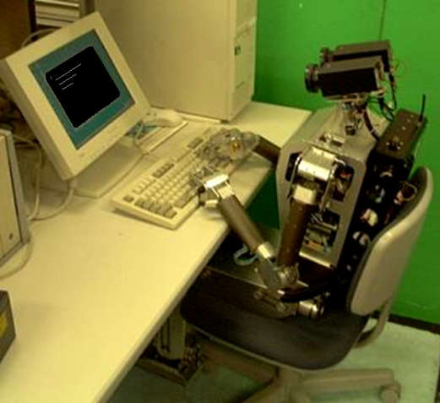
Framing the synthesis problem
Mundane
Science Fiction
VisualBasic
( )
Python
Fortran?
Automate challenging programming steps
Leverage programmer knowledge

Slide 3
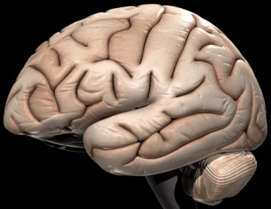
Fundamental question
How to combine human insight and machine power
Synergy between human and machine is key

Slide 4
Lessons from verification
Embrace partial specifications
Because there will never be a spec for PowerPoint
Speak to programmers in their own language
Test harnesses good, high order logic bad
Don’t be afraid of exhaustive exploration
But do it intelligently
You don’t have to do everything statically
For many problems it is too hard

Slide 5
Multimodal Synthesis

Slide 6
Programming with Code
{
n = v.next;
p = v.prev;
p.next = n;
n.prev = p;
}

Slide 7
Programming with Pictures
v
next
next
next
next
a
x
b
prev
prev
prev
prev
next
next
next
a
b
n
prev
prev
prev
x

Slide 8
Bridging the semantic gap
n
next
next
{
s = n.succ;
p = n.pred;
p.succ = s;
s.pred = p;
}
a
x
b
prev
prev
next
a
b
prev
Problem: the picture is not a program
you can not “compile” the picture into a program
More like programming by example
except the picture is not an example either

Slide 9
Scenarios vs. Examples
n
n
next
next
next
next
next
next
next
next
a
x
b
a
x
b
prev
prev
prev
prev
prev
prev
prev
prev
next
a
b
prev
A scenario is more powerful than an example
each scenario represents an infinite set of examples
It is also less powerful
The picture is ambiguous regarding the fate of …

Slide 10
Multimodal Synthesis
Each scenario is a partial specification
that’s why they can be simple
Completeness vs. complexity tradeoff
irrespective of format complete specs are more complex
Trick:
combine many simple specs in different formalisms to fully constrain the behavior

Slide 11
Multimodal Synthesis
Trick:
combine many simple specs in different formalisms to fully constrain the behavior
Concrete Scenarios
Abstract Scenarios
Correct Code
Synthesizer
Inductive Insights
Synthesizer
Invariants
Structural Info
Storyboard

Slide 12
Anatomy of a storyboard

Slide 13
Linked List Reversal
head
mid
a
next
f
e
next
b
head
mid’
a
next
e’
f’
next
b

Slide 14
Scenarios for LL-reversal
head
next
mid
next
a
f
e
b
head
next
mid’
next
a
e’
f’
b
head
head
head
a
next
b
a
head
head
head
a
next
b
a

Slide 15
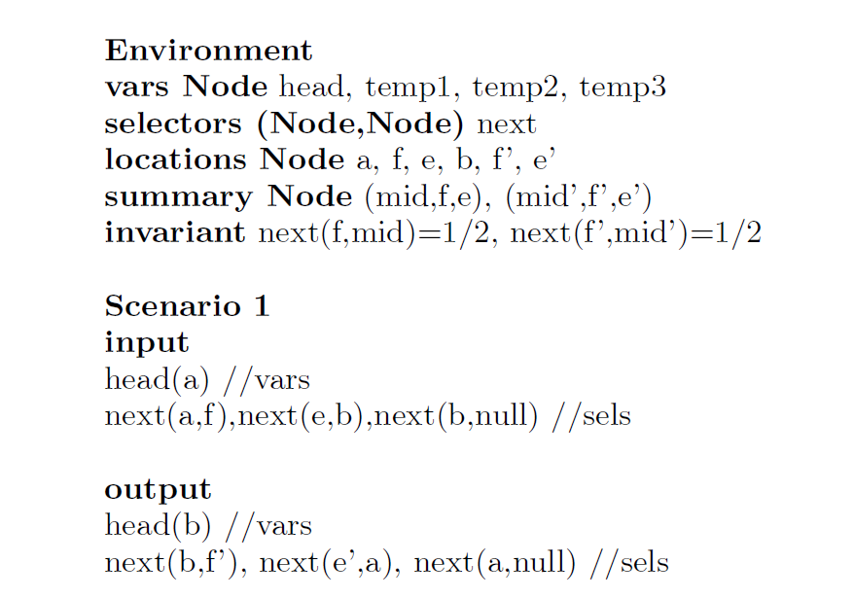
Text representation of Scenario
head
next
mid
next
a
f
e
b
head
next
mid’
next
a
e’
f’
b

Slide 16
Inductive insights with fold/unfold
Unfold:
x’ = f
x’= e
x’
mid
f
e
x’ = f
e = e’
mid
x’
next
f’
e’

Slide 17
Inductive insights with fold/unfold
Unfold:
x’ = f
x’= e
x’
mid
f
e
x’ = f
e = e’
mid
x’
next
f’
e’
Fold:
x’ = f
x’= e
x’
mid
f
e
x’ = f
e = e’
mid
x’
next
f’
e’

Slide 18
Text Representation of Unfold
Unfold:
x’ = f
x’= e
x’
mid
f
e
x’ = f
e = e’
mid
x’
next
f’
e’

Slide 19
Fold/Unfold
These rules are part of the specification
without them the scenarios are too imprecise
They can also serve to communicate insights
y
val > y.val
f=y
b=b’
f’
val ==y.val
f=b=y
stuff
stree’
f
y
b’
stree
b
stuff
stuff’
val < y.val
f=y
b=b’
y
Underspecified summary node
f’
stuff’
stree’
b’

Slide 20
Fold/Unfold
These rules are part of the specification
without them the scenarios are too imprecise
They can also serve to communicate insights
v
lleft
next
next
next
a
x
b
prev
prev
prev
lright
lleft
next
next
a
b
prev
prev
lright

Slide 21
Look Sketch
void llReverse(Node head)
{
?? /*1*/
while (?? /*p*/)
{
?? /*2*/
}
?? /*3*/
}
Notes:
In addition to the storyboard, the framework also requires the user to provide a loop skeleton of the implementation the programmer is looking for. In this example, the skeleton says that the implementation should have a single while loop. There should be a set of statements before the loop, a set of statements inside the loop body and a set of statements following the loop. The goal of the synthesizer is now to fill up these blanks appropriately to obtain the desired implementation.

Slide 22
Look Sketch
void llReverse(Node head)
{
cstmt* /*1*/
while (cond /*p*/)
{
cstmt* /*2*/
}
cstmt* /*3*/
}
Notes:
In addition to the storyboard, the framework also requires the user to provide a loop skeleton of the implementation the programmer is looking for. In this example, the skeleton says that the implementation should have a single while loop. There should be a set of statements before the loop, a set of statements inside the loop body and a set of statements following the loop. The goal of the synthesizer is now to fill up these blanks appropriately to obtain the desired implementation.

Slide 23
Conditional Statements
var(.ptr?) op var(.ptr?) | null
cstmt : if(COND) then STMT
var(.ptr?) = var(.ptr?)
unfold/fold var

Slide 24
Constraint Based synthesis primer

Slide 25
Synthesis as curve fitting
Define a parameterized family of Programs$\{P_{c}\}$
Turn search for functions ➔ a search for parameters
Derive constraints on parameter $c$
Solve constraints to find $c_{sol}$ s.t.

Slide 26
Ex: Sketch
Language support for defining ${\{P}_{c}\}$
Simple integer hole (??) + generators
Constraints generated incrementally by CEGIS
Synthesize
Check
$$c$$
Insert your favorite
checker here
$$∃c s.t. Correct(P_{c}, in_{i})$$
$$∃in s.t. ¬Correct(P_{c}, in_{i})$$
$$in$$
$$\{in_{i}\}$$

Slide 27
Plan of attack
Define constraints from Storyboards
Use CEGIS to generate incrementally

Slide 28
Constraints from storyboards

Slide 29
Control flow sketch defines a CFG
s_{in}
void llReverse(Node head)
{
cstmt* /*1*/
while (cond /*p*/)
{
cstmt* /*2*/
}
cstmt* /*3*/
}
f₁
s₁
f₂
false
f_{p}
true
s₃
s₂
f₃
s_{out}
Almost, we have no conditional branches
Notes:
First we obtain the control flow graph from the implementation.

Slide 30
Equations
s_{in}
$$s_{1}=f_{1}\left(s_{in}\right)∪f_{2}\left(s_{2}\right)$$
f₁
$$s_{2}=f_{p}\left(s_{1}\right)$$
s₁
f₂
$$s_{3}= \overline{f_{p}}\left(s_{1}\right)$$
false
f_{p}
true
s₃
$$s_{out}=f_{3}\left(s_{3}\right)$$
s₂
f₃
s_{out}

Slide 31
Synthesis vs. Verification
$$s_{1}=f_{1}\left(s_{in}\right)∪f_{2}\left(s_{2}\right)$$
Verification
known : f, s_{in}
unknown : s_{out ,} s_{i}
Synthesis
known : s_{in,} s_{out}
unknown : f_{i}
$$s_{2}=f_{p}\left(s_{1}\right)$$
$$s_{3}= \overline{f_{p}}\left(s_{1}\right)$$
$$s_{out}=f_{3}\left(s_{3}\right)$$

Slide 32
Synthesis challenges
Find values for c_{i}
they don’t form a lattice
Can’t give to solver
We are interested in LFP
si are sets of shapes
Key:
avoid set reasoning
s$1=f1\left(sin ,c1\right)⋃f2(s2,c2)$
s$2=fp\left(s2,cp\right)$
s$3=\overline{fp}\left(s1,cp\right)$
s$out=f3\left(s3,c3\right)$

Slide 33
Eliminating sets
Use non-determinism to model sets
works because of associativity of transfer functions
Avoid sets that arise from loops points
f_{unfold}
f_{unfold}
j

Slide 34
Loop unrolling
f₁
f₁
f_{p}
f₁
true
f_{p}
f₃
true
f_{p}
f₃
.
.
.
$$sout=⋃i pi(In,c)$$
false
f_{p}
f₃
f_{p}
false
false
f₃
f₃
p₀
p₁
p_{k}

Slide 35
Not your grandmother’s unrolling
We are evaluating in the abstract domain
You expect to reach fixed point in k steps.
You prefer solutions that reach fixed point faster

Slide 36
2: Unfold functions
f_{unfold}
j
Parameterize the unfold choice j
$$sout=⋃j⋃i pij(In,c)$$

Slide 37
Solving the constraint
$$sout=⋃j⋃i pij(In,c)$$
Rewrite the formula as:
$$sout⊆⋃j⋃i pij(In,c)$$
$$sout⊇⋃j⋃i pij(In,c)$$

Slide 38
Quantifier alternation constraint
$$sout⊆⋃j⋃i pij(In,c)$$
$$∃c ∀j ∀i pij\left(In,c\right)∈sout$$
$$sout⊇⋃j⋃i pij(In,c)$$
$$∃c ∃j ∃i pij\left(In,c\right)= sout$$
$∃∀ constraint :$ CEGIS solver

Slide 39
Experiments

Slide 40
Case studies - I
Manipulation | #Clauses | Memory | #Scen | Time
ll-insertion | 1.99M | 0.75G | 4 | 2m9s
ll-deletion | 1.88M | 0.54G | 4 | 1m48s
ll-reverse | 1.30M | 0.35G | 4 | 1m49s
ll-find-last | 1.02M | 0.29G | 4 | 0m56s
ll-swap-first-last | 1.08M | 0.31G | 4 | 4m18s
dll-traversal | 1.72M | 0.88G | 4 | 1m58s
dll-reversal | 2.04M | 0.49G | 4 | 3m47s

Slide 41
Case studies - II
Manipulation | #Clauses | Memory | #Scen | Time
bst-search(contains) | 0.62M | 0.37G | 1 | 1m02s
bst-search | 0.77M | 0.45G | 1 | 6m07s
bst-find-min | 0.63M | 0.45G | 1 | 0m58s
bst-find-max | 0.57M | 0.18G | 1 | 0m23s
bst-left-rotate | 1.41M | 0.50G | 3 | 3m18s
bst-right-rotate | 1.47M | 0.43G | 3 | 3m15s
bst-insertion | 1.04M | 0.46G | 3 | 1m52s
bst-deletion | 0.63M | 0.62G | 6 | 3m13s
Manipulation | #Clauses | Memory | #Scen | Time
aig-insertion | 0.17M | 0.31G | 4 | 1m04s

Slide 42
BST Deletion
Simple storyboard was under-constrained
Two additional concrete instances were required
Still better than using only concrete examples
constraints grow too big before there are enough examples to constrain the algorithm

Slide 43
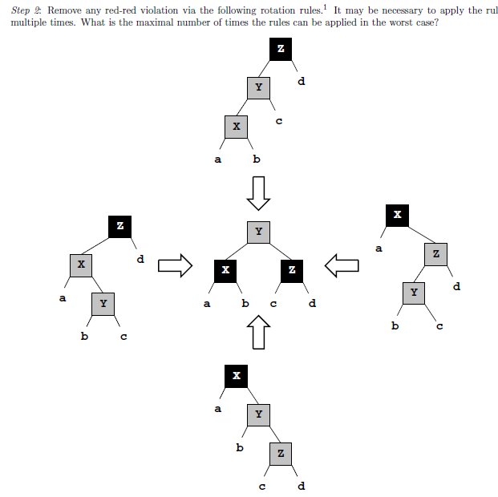
Red Black Tree Insertion
4 cases to fix red black tree invariant after insertion

Slide 44
Red Black Tree Insertion
fixRBTree(Node root, Node x){
while(x.p != null && x.p.p != null){
y = x.p;
z = x.p.p;
if(cond1) //case1
elsif(cond2) //case2
elsif(cond3) //case3
elsif(cond4) //case4
else break;
x = z;
}
color[root] = black;
}

Slide 45
Research Questions
Interactivity
Debugging storyboards
Corner cases
Automated fuzzing of scenarios
Symmetry reduction
Concurrent data structures

Slide 46
Conclusion
Constraints are a powerful basis for synthesis
Multimodal interaction makes specs simpler
Interactivity is key

