Slide 1
Automatic Generation of Formula Simplifiers based on Conditional Rewrite Rules
Research Qualifying Examination
Rohit Singh Adviser: Armando Solar-Lezama
Massachusetts Institute of Technology, Cambridge, USA
October 9, 2015
Notes:
Hi everyone, I am Rohit Singh, a graduate student at MIT and I will be talking about a new off beat approach to building solvers. Let’s begin by looking at these SMT solvers

Slide 2

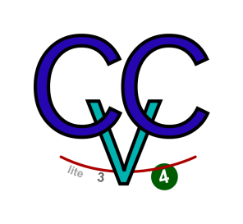




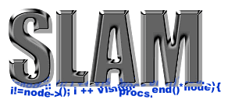

SMT Solvers are great!
UCLID
Boolector
Spec#
Can we do better?
Notes:
There’s a lot of them and they are workhorses of a wide variety of fields – from operations research to Molecular biology.
No matter where your problems come from you can compile them to the same format and use any SMT solver to solve them.
Even then, the way they work is quite surprising. They all try to satisfy the promise of SMT – one specification that should be sufficient to specify just about everything AND also solve it efficiently in every situation! Remember that these are NP complete problems!
This is amazing! There’s only one thing that comes to my mind.
Logos of different solvers at the top + some pictures that different fields (logos of projects) at bottom – a little later SMT-LIB in the middle
“How can this possibly work?” at the bottom: they’re all competing with each other, how is this possible?
Workhorses of a large number of fields
They solve hard problems
NP Complete
Should not scale
Why do they work?
Leverage the inherent structure in problems of practical interest

Slide 3
Domain specificity
UCLID
Boolector
Spec#
solver generator, far from there
Notes:
Animation – for each domain different solver
problem is that someone has to write these (corpus
far from there
we

Slide 4
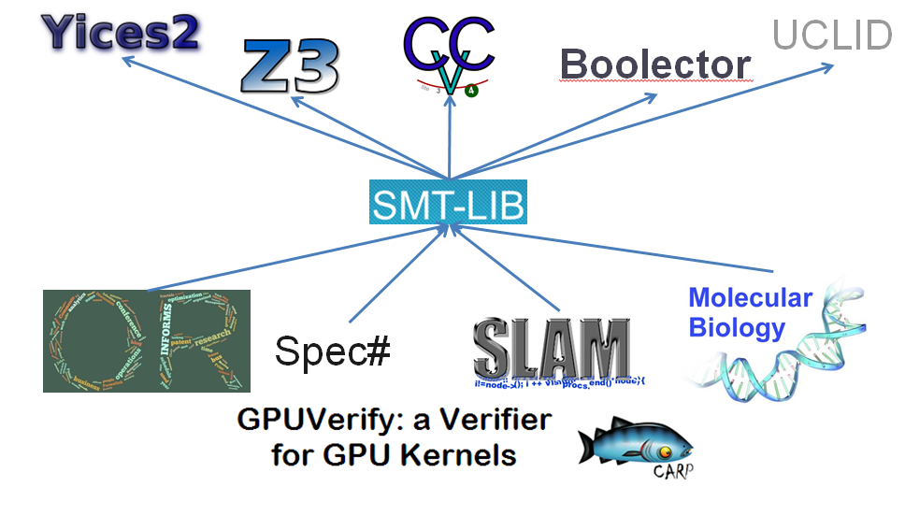
Because…
SMT Solvers leverage the inherent structure in problems of practical interest
To a limited extent
  Can find bugs
  Can’t crack RSA
Only so much structure to use!
Can we do better?
Notes:
Are we doing as much as we can?

Slide 5
Simplifier
Uses local term-rewriting to make formulas easier to solve
Every solver has one of these
Notes:
We are far from there
one step in that direction

Slide 6
Simplifier in Boolector [TACAS 09]
SMT-LIB
Parser
Other Params
Simplifier
Under-approximation
Array Consistency Checker
Formula Refinement
SAT Solver
Model Generator
Model
SAT/UNSAT
Notes:
what is that little step, most solvers have rewrite

Slide 7
A part of a solver that can benefit
SMT-LIB
Parser
Other Params
Simplifier
Under-approximation
Array Consistency Checker
Formula Refinement
SAT Solver
Model Generator
Fairly common to have this phase: z3, Sketch Solver, Boolector etc
Notes:
Sketch is not an SMT solver but still has similar formula manipulation phases as other solvers and uses

Slide 8
In the context of Sketch
Sketch
Parser
Other Params
Simplifier
SAT Solver
CEGIS Loop
Optimizations
Notes:
Why Sketch? (1) We know it better (2) Similar IR and Rewriting as other Solvers (3) It IS a solver built on top of a SAT solver

Slide 9
Sketch Simplifier
Messy low-level C++ code
  Employs simple declarative Rewrite rules
  Huge impact on performance
Notes:
Sketch has many passes – timeout if no rewriting
Traditionally implemented as (full-fledged) code
Exhibits domain specificity
In most cases, can be expressed and understood using simple declarative “rules” : Rewrite rules
Huge impact on performance

Slide 10




Domain specificity
Simplifying constraints before sending them to the solver
Adding an optimization to Sketch tool:
  For certain problems: +2x performance
  For others: way slower than before
$$φ_{1}$$
$5$ minutes
Simplifier-1
Solver
Formula
$$φ_{2}$$
Simplifier-2
Solver
$10$ hours
Notes:
There’s evidence that existing tools already do things to make their tools work on specific problems.
Yes, we can do better with domain specificity (e.g. DS specialization of our tools)
Writing constraints to the solver
Need to be really careful
Ensuring the “right” format
Tools spend a lot of effort
Brings a huge improvement in performance
Adding an optimization to Sketch tool:
For certain problems – makes the tool go much faster
For others – makes the tool go way slower

Slide 11
In the context of Sketch
Sketch
Parser
Other Params
Internal Representation(IR)
Rewriter
Internal Representation(IR)
SAT Solver
CEGIS Loop
Optimizations
Rewriting is at the core
Notes:
Why Sketch? (1) We know it better (2) Similar IR and Rewriting as other Solvers (3) It IS a solver built on top of a SAT solver

Slide 12
Internal Representation
Internal language for constraints
Directed Acyclic Graphs
a
d
b
or(lt(a, b), lt(a, d))
<
<
OR
Notes:
What you’re representing and low level structs and pointers – what is the internal language – primitives make a big difference – limit the number of constructs
Not low level structs – what is internal language for constraints
Primitives make a big difference
Want to limit no. of constructs when building by hand – name of the game
But in some cases this can be counter-productive – example = max

Slide 13
Internal Representation

Slide 14



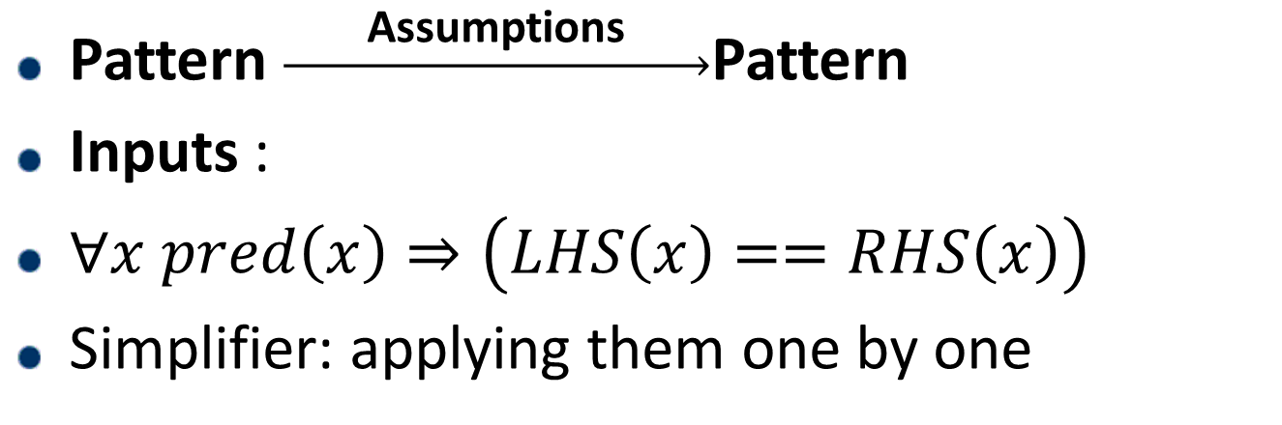
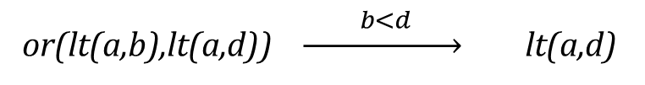
Conditional Rewrite Rules
  Simple and declarative
  or(lt(a,b),lt(a,d)) $\underset{→}{ b<d }$ lt(a,d)
a
d
a
d
b
$$pred$$
b<d
<
<
<
$$LHS$$
$$RHS$$
OR
Pattern $\underset{→}{ \text{Assumptions} }$Pattern
Inputs :
$∀x pred\left(x\right)⇒\left(LHS\left(x\right)==RHS\left(x\right)\right)$
Simplifier: applying them one by one
a
b
d
Notes:
Traditionally implemented as (full-fledged) code
Exhibits domain specificity
In most cases, can be expressed and understood using simple declarative “rules” : Rewrite rules
Huge impact on performance

Slide 15
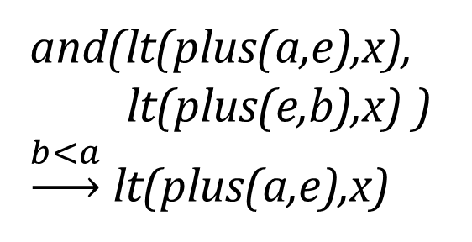
Sketch Simplifier
Full-fledged code for implementing Rewrite Rules
if(nfather->type == LT && nmother->type == LT){
// (a+e<x) & (b+e<x) ---> a+e<x when b<a
if(nfather->mother->type == PLUS && nmother->mother->type == PLUS){
bool_node* nfm = nfather->mother;
bool_node* nmm = nmother->mother;
bool_node* nmmConst = nmm->mother;
bool_node* nmmExp = nmm->father;
if(isConst(nmmExp)){
bool_node* tmp = nmmExp;
nmmExp = nmmConst;
nmmConst = tmp;
}
bool_node* nfmConst = nfm->mother;
bool_node* nfmExp = nfm->father;
if(isConst(nfmExp)){
bool_node* tmp = nfmExp;
nfmExp = nfmConst;
nfmConst = tmp;
}
if(isConst(nfmConst) && isConst(nmmConst) && nfmExp== nmmExp){
if(val(nfmConst) < val(nmmConst)){
return nmother;
}else{
return nfather;
}
}
}
}
and(lt(plus(a,e),x),
lt(plus(e,b),x) )
$\underset{→}{b<a}$ lt(plus(a,e),x)
Notes:
Traditionally implemented as (full-fledged) code
In most cases, can be expressed and understood using simple declarative “rules” : Rewrite rules
Huge impact on performance

Slide 16
Sketch Simplifier
Messy low-level C++ code
  Employs simple declarative Rewrite rules
  Huge impact on performance
Notes:
Traditionally implemented as (full-fledged) code
Exhibits domain specificity
In most cases, can be expressed and understood using simple declarative “rules” : Rewrite rules
Huge impact on performance

Slide 17
Problem Statement
Given a corpus of benchmark problems (formulas) from a domain:
  Learn recurrent sub-terms (patterns)
  Learn impactful conditional Rewrite Rules
  Generate a simplifier based on these rules
Notes:
Fully automatically

Slide 18
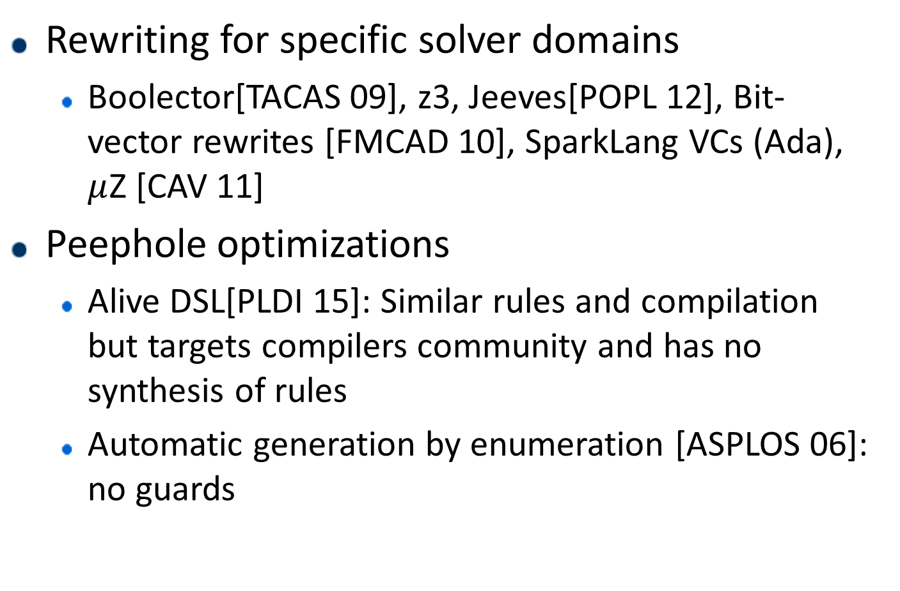
Related Work
Rewriting for specific solver domains
  Boolector[TACAS 09], z3, Jeeves[POPL 12], Bit-vector rewrites [FMCAD 10], SparkLang VCs (Ada), $μ$Z [CAV 11]
Peephole optimizations
  Alive DSL[PLDI 15]: Similar rules and compilation but targets compilers community and has no synthesis of rules
  Automatic generation by enumeration [ASPLOS 06]: no guards
Notes:
We focused on the Rewriter part

Slide 19
Related Work
Motif discovery [ICMLA 07, IPDPS 04, ICIC 09]: complete algorithms are too slow, no labels on nodes
Term/Graph Rewriting:
  Stratego/XT [ASF+SDF 97], GrGen: pattern matching and code generation is similar, absence of guards on rules
LALR parser generation [Journal of Computer Languages 89]
Notes:
We focused on the Rewriter part

Slide 20
Problem Statement
Given a corpus of benchmark problems (formulas) from a domain:
  Learn recurrent sub-terms (patterns)
  Learn impactful conditional Rewrite Rules
  Generate a simplifier based on these rules
Solution: Swapper framework
Notes:
Fully automatically

Slide 21
Contribution
Automating generation of conditional Rewrite Rules
Generating optimal simplifier using Auto-tuning
Showing performance improvement on Sketch benchmarks
Showing generality of the framework with SMT-LIB based rewriting
Notes:
for common recurring patterns in a domain
Demonstrating the use of Auto-tuning to select an optimal subset of rules,
Evaluation of the approach on Sketch benchmarks

Slide 22
Swapper framework
Corpus of Benchmarks
Pattern Finding (Clustering)
Patterns
Rule Generation (Synthesis)
Rules
Optimal Simplifier
Simplifier
Auto-tuning (Machine Learning)
Simplifier Generation (Compilation)
Subset of Rules
Notes:
We focused on the Rewriter part

Slide 23
Swapper framework
Corpus of Benchmarks
Pattern Finding (Clustering)
Patterns
Rule Generation (Synthesis)
Rules
Optimal Simplifier
Simplifier
Auto-tuning (Machine Learning)
Simplifier Generation (Compilation)
Subset of Rules
Notes:
We focused on the Rewriter part

Slide 24
Pattern Finding
Given a corpus of benchmark problems as DAGs, find common repeating patterns
Different from motif discovery:
  Structure and semantics of DAGs: Labels on nodes (operation types), Static Analysis information
  Strict probabilistic significance not needed, approximations will work
Tried multiple methods:
  Clustering based approach using parse feature vectors approximating similarity of two patterns
  Random sampling: Fast and approximate
Notes:
Finding recurrent patterns – what we tried and what worked

Slide 25
Pattern Finding: Random sampling
Pick a node at random
Randomly choose to pick a non-terminal parent or not
Repeat until reached cutoff size
  Restart if can’t proceed
Aggregate patterns with counts
AND
SRC
OR
NOT
OR
Notes:
Animate
Details of Random Sampling, Some depth, maybe example

Slide 26


Pattern Finding: Random sampling
AND
AND
[False]
AND
[False,True]
[False]
$$≡$$
OR
$$≢$$
OR
OR
OR
OR
OR
Similarity criterion for aggregation:
DAG signature: incorporates symmetries
Static Analysis information from benchmark DAGs
Notes:
Animate
Details of Random Sampling, Some depth, maybe example
why – for rule generation

Slide 27
Pattern Finding: Random sampling
Fast and approximate
Gives a sense of where to look for Rewrite Rules first
Ergodic in nature: can cover all patterns eventually
Notes:
Animate
Details of Random Sampling, Some depth, maybe example

Slide 28
Swapper framework
Corpus of Benchmarks
Pattern Finding (Clustering)
Patterns
Rule Generation (Synthesis)
Rules
Optimal Simplifier
Simplifier
Auto-tuning (Machine Learning)
Simplifier Generation (Compilation)
Subset of Rules
Notes:
We focused on the Rewriter part

Slide 29
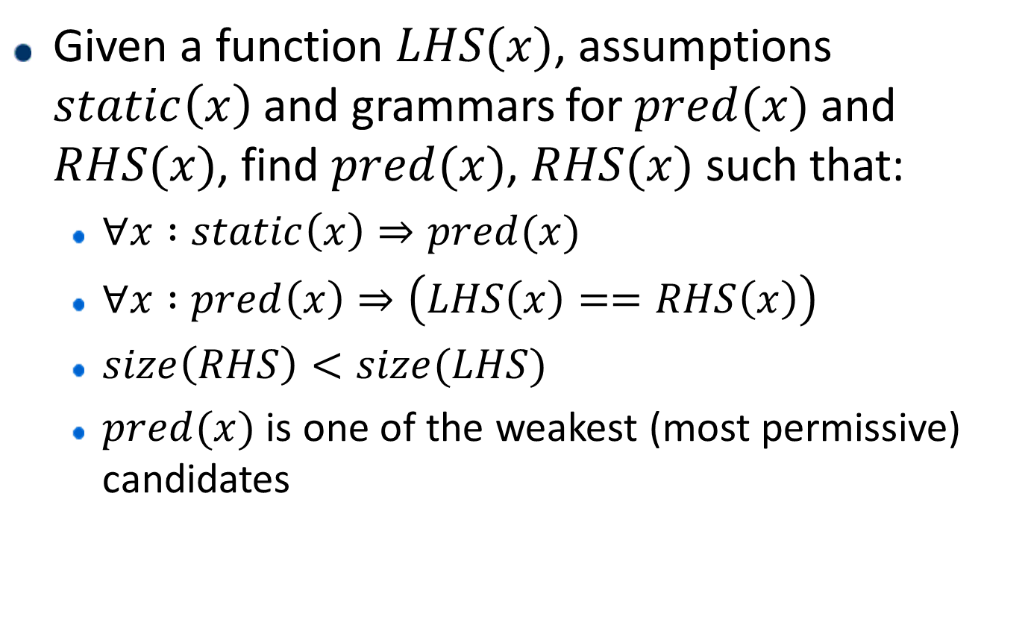
Rule Generation: SyGuS problem
Given a function $LHS(x)$, assumptions $static\left(x\right)$ and grammars for $pred(x)$ and $RHS(x)$, find $pred(x)$, $RHS(x)$ such that:
  $∀x :static\left(x\right)⇒pred(x)$
  $∀x :pred\left(x\right)⇒\left(LHS\left(x\right)==RHS\left(x\right)\right)$
  $size\left(RHS\right)<size(LHS)$
  $pred(x)$ is one of the weakest (most permissive) candidates
Notes:
Synthesis
Template based (using Sketch itself)
Enumeration based search
Example: a rule generated by us

Slide 30
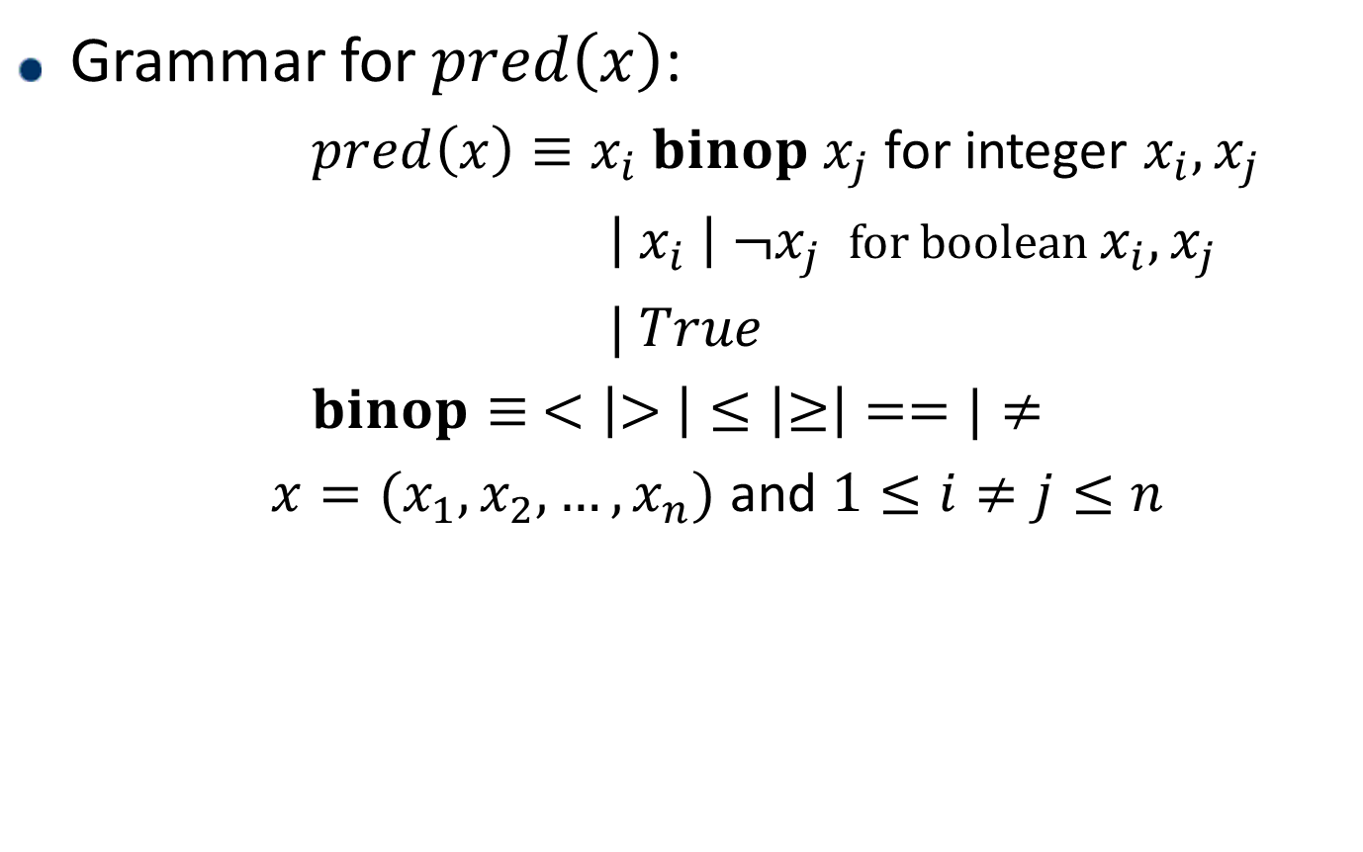
Rule Generation: SyGuS problem
Grammar for $pred\left(x\right)$:
  $pred\left(x\right)≡x_{i} binop x_{j}$ for integer $x_{i},x_{j}$
  $\left| x_{i} \right| ¬x_{j}$ for boolean $x_{i},x_{j}$
  $| True$
  $binop≡ <\left|> \right|≤\left|≥\right|==|≠$
  $x=(x_{1},x_{2},…,x_{n})$ and $1≤i≠j≤n$
Notes:
Inspired by existing rewrite rules in Sketch

Slide 31
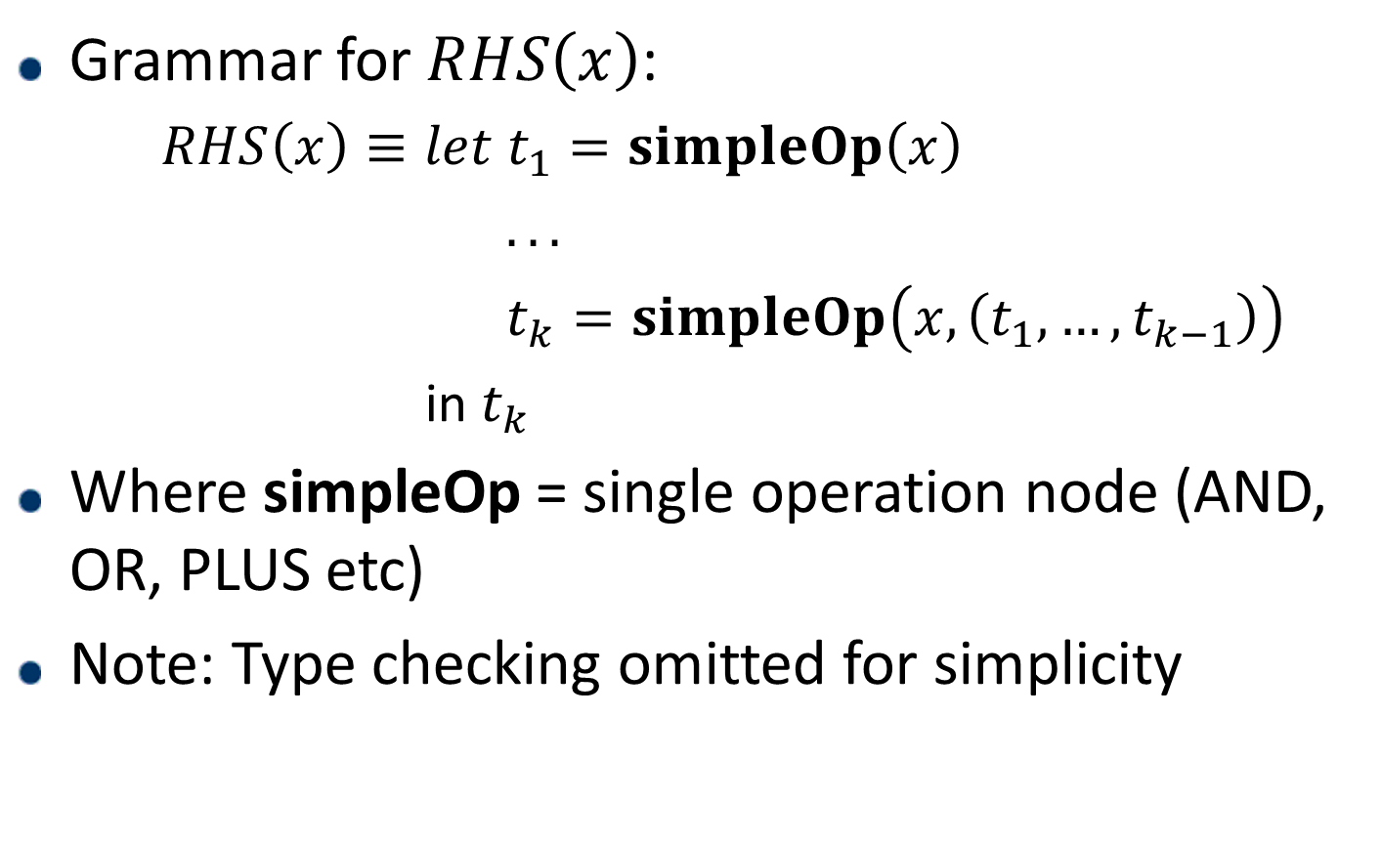
Rule Generation: SyGuS problem
Grammar for $RHS\left(x\right)$:
  $RHS\left(x\right)≡let t_{1}=simpleOp\left(x\right)$
  $. . .$
  $t_{k}=simpleOp\left(x,\left(t_{1},…,t_{k−1}\right)\right)$
  in $t_{k}$
Where simpleOp = single operation node (AND, OR, PLUS etc)
Note: Type checking omitted for simplicity
Notes:
Synthesis
Template based (using Sketch itself)
Enumeration based search
Example: a rule generated by us

Slide 32
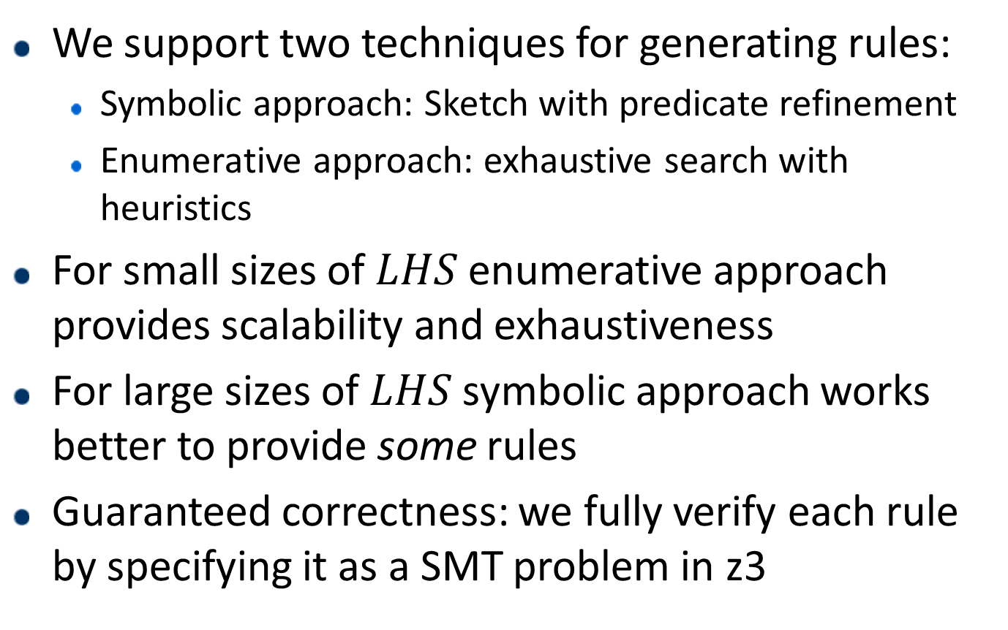
Rule Generation: Techniques
We support two techniques for generating rules:
  Symbolic approach: Sketch with predicate refinement
  Enumerative approach: exhaustive search with heuristics
For small sizes of $LHS$ enumerative approach provides scalability and exhaustiveness
For large sizes of $LHS$ symbolic approach works better to provide some rules
Guaranteed correctness: we fully verify each rule by specifying it as a SMT problem in z3
Notes:
Synthesis
Template based (using Sketch itself)
Enumeration based search
Example: a rule generated by us

Slide 33
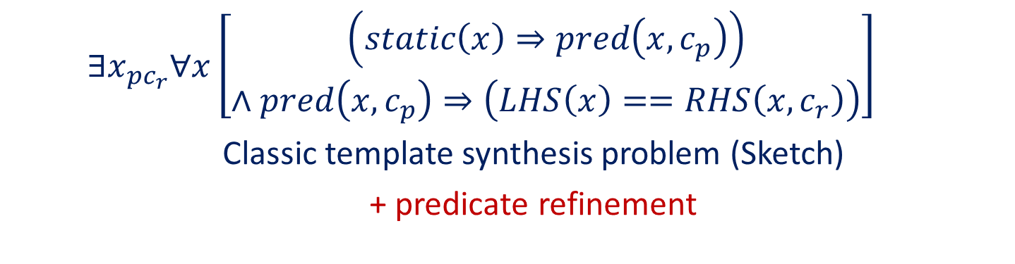
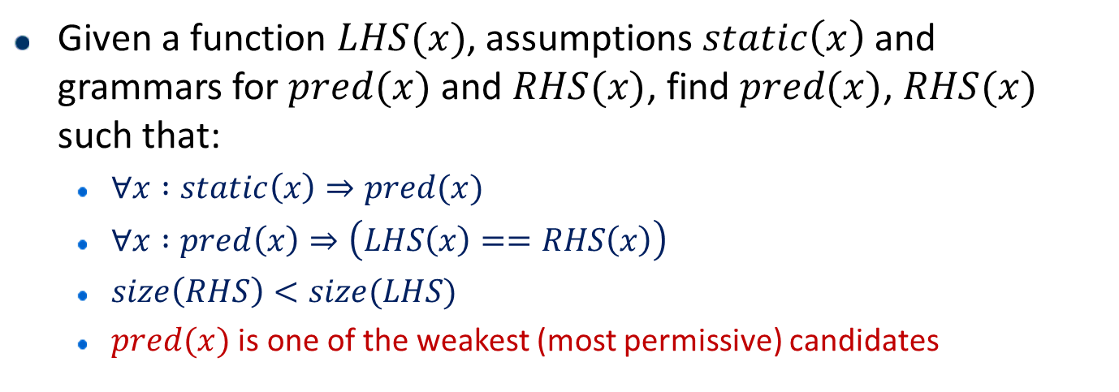
Rule Generation: Symbolic approach
Given a function $LHS(x)$, assumptions $static\left(x\right)$ and grammars for $pred(x)$ and $RHS(x)$, find $pred(x)$, $RHS(x)$ such that:
  $∀x :static\left(x\right)⇒pred(x)$
  $∀x :pred\left(x\right)⇒\left(LHS\left(x\right)==RHS\left(x\right)\right)$
  $size\left(RHS\right)<size(LHS)$
  $pred(x)$ is one of the weakest (most permissive) candidates
  $$∃x_{pc_{r}}∀x\left[\begin{aligned}\left(static\left(x\right)⇒pred\left(x,c_{p}\right)\right) \\ ∧pred\left(x,c_{p}\right)⇒\left(LHS\left(x\right)==RHS\left(x,c_{r}\right)\right)\end{aligned}\right]$$
  Classic template synthesis problem (Sketch)
  + predicate refinement
Notes:
Details, verification of rules with z3, some part of Generalizations?

Slide 34

Rule Generation: Predicate Refinement
Ensuring $pred(x)$ is one of the weakest candidates
  Iterative process to find $(RHS,pred)$ pairs
  Tradeoff between $size(RHS)$ and applicability of $pred$
Notes:
Details, verification of rules with z3, some part of Generalizations?

Slide 35
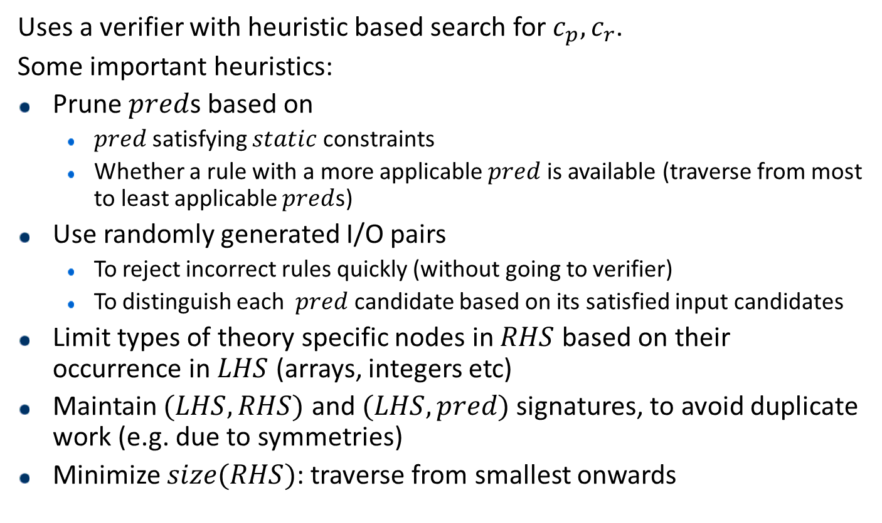
Rule Generation: Enumerative approach
Uses a verifier with heuristic based search for $c_{p},c_{r}$.
Some important heuristics:
Prune $pred$s based on
  $pred$satisfying $static$ constraints
  Whether a rule with a more applicable $pred$ is available (traverse from most to least applicable $pred$s)
Use randomly generated I/O pairs
  To reject incorrect rules quickly (without going to verifier)
  To distinguish each $pred$ candidate based on its satisfied input candidates
Limit types of theory specific nodes in $RHS$ based on their occurrence in $LHS$ (arrays, integers etc)
Maintain $(LHS,RHS)$ and $(LHS,pred)$ signatures, to avoid duplicate work (e.g. due to symmetries)
Minimize $size(RHS)$: traverse from smallest onwards
Notes:
Details, verification of rules with z3, some part of Generalizations?

Slide 36
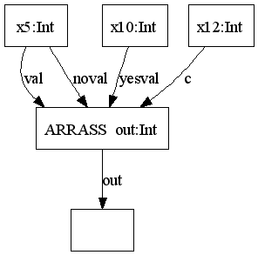
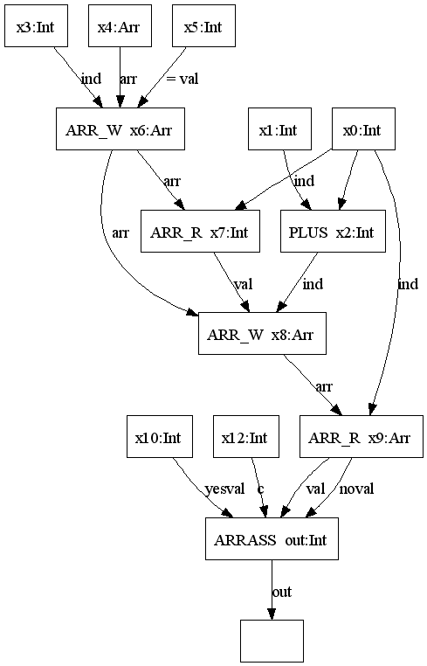
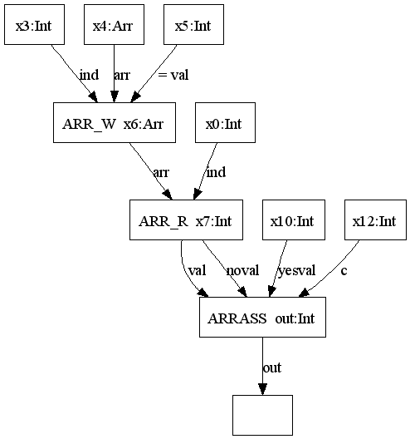





Rule Generation: Example
$$x0==x3$$
$if\left(x_{5}==x_{12}\right)$
$$return x_{10}$$
$else return x_{5}$
$a\left[x_{3}\right]=x_{5}$
$a\left[x_{0}+x_{1}\right]=a\left[x_{0}\right]$
$if\left(a\left[x_{0}\right]==x_{12}\right)$
$return x_{10}$
$else return a\left[x_{0}\right]$
$$True$$
$a\left[x_{3}\right]=x_{5}$
$$if\left(a\left[x_{0}\right]==x_{12}\right)$$
$return x_{10}$
$else return a\left[x_{0}\right]$
Notes:
Synthesis
Template based (using Sketch itself)
Enumeration based search
Example: a rule generated by us

Slide 37
Swapper framework
Corpus of Benchmarks
Pattern Finding (Clustering)
Patterns
Rule Generation (Synthesis)
Rules
Optimal Simplifier
Simplifier
Auto-tuning (Machine Learning)
Simplifier Generation (Compilation)
Subset of Rules
Notes:
We focused on the Rewriter part

Slide 38
Simplifier Generation
Given a set of conditional Rewrite Rules, we generate efficient C++ code for the simplifier
  Performs rule generalization to find the crux of each rule and avoid overheads
  Incorporates symmetries of the rules automatically
  Shares burden of pattern matching across rules
Notes:
Focus on generalizations and explain the benefits (not need to worry about extraneous nodes that might have crept into the pattern)

Slide 39
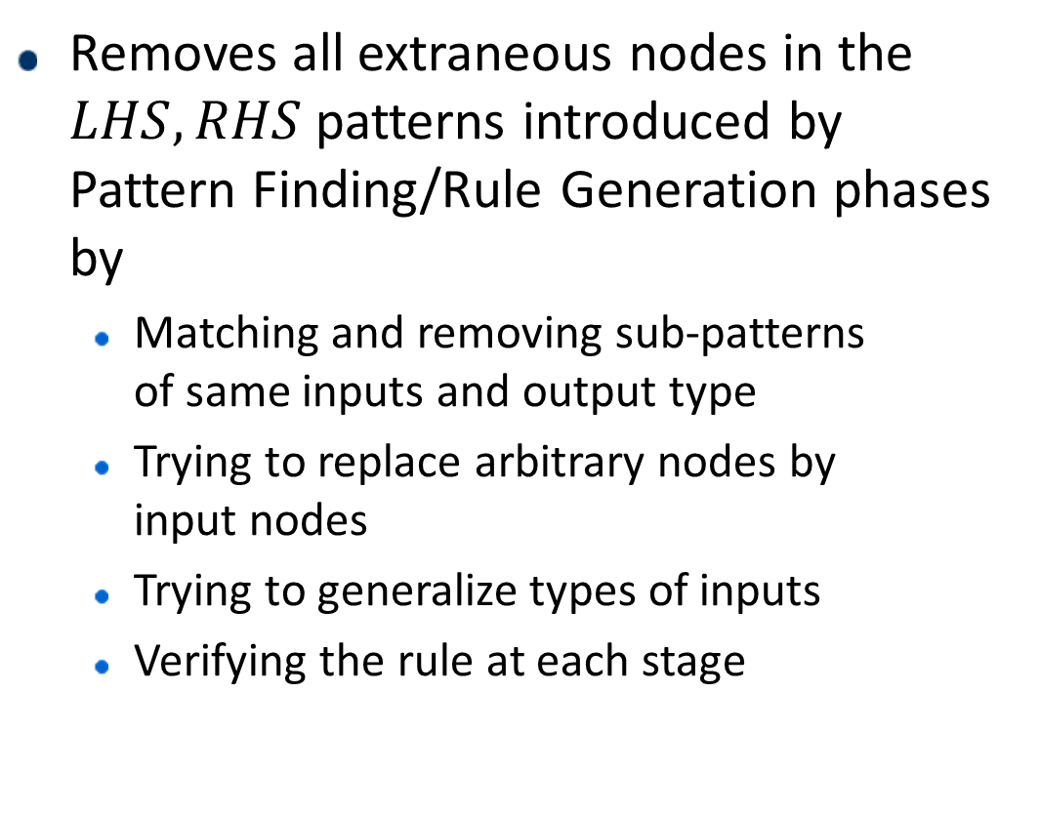
Simplifier Generation: Rule Generalization
Removes all extraneous nodes in the $LHS,RHS$patterns introduced by Pattern Finding/Rule Generation phases by
  Matching and removing sub-patterns
  of same inputs and output type
  Trying to replace arbitrary nodes by
  input nodes
  Trying to generalize types of inputs
  Verifying the rule at each stage
Notes:
Focus on generalizations and explain the benefits (not need to worry about extraneous nodes that might have crept into the pattern)

Slide 40
Simplifier Generation: Pattern Matching
Notes:
Details of matching

Slide 41
Swapper framework
Corpus of Benchmarks
Pattern Finding (Clustering)
Patterns
Rule Generation (Synthesis)
Rules
Optimal Simplifier
Simplifier
Auto-tuning (Machine Learning)
Simplifier Generation (Compilation)
Subset of Rules
Notes:
We focused on the Rewriter part

Slide 42

Auto tuning
Identifies the best subset
of rules
Problem Setup:
  Search space parameters:
    Permutation of rules
    Number of rules to be used
    Space reduction: consider permutation as different for only those rules which have conflicting patterns
  Optimization function
    Runs the solver and compares original performance to the new performance after applying the simplifier
Ansel et al, PACT 2014
http://opentuner.org
Notes:
618.1766778
405.0763
533.6466361

Slide 43
Auto tuning
  Optimization function
    Runs the solver multiple times and compares original performance to the new performance after applying the simplifier
  Tradeoffs
    Capturing randomness inside
    the solver may lead to long
    runtimes
    More rules can increase the
    search space and search time
    by a lot
Notes:
618.1766778
405.0763
533.6466361

Slide 44
Experiments: Questions
Can Swapper generate good simplifiers in reasonable time and low cost?
How do Swapper generated simplifiers perform relative to hand written simplifier in Sketch?
How domain specific are the simplifiers generated by Swapper?
How general is Swapper framework?
Notes:
We focus on these four questions

Slide 45
Experiments: Setup & Terminology
We compare the following simplifiers:
  Hand-coded: default in Sketch. Comprises of:
    Rules that can be expressed in our framework
    Constant propagation
    Structural hashing
    Other complex rules
  Baseline: disables rules in a) from Hand-coded
  Auto-generated: incorporates generated rules over the Baseline
Each simplifier is applied before the problem is handed to the solver
Openstack: Two VMs (24 cores, 32GB RAM, 40 threads)
Notes:
Openstack, toolchain diagram

Slide 46
Experiments: Domains & Benchmarks
Storyboard and QBS used for validation in initial stages
Full evaluation was done on AutoGrader and Sygus
Generated rewriter for SMTLIB benchmarks

Slide 47
Experiments: Realistic Costs
Time and Cost Estimation (on AWS, parallelism of 40 threads)
Costs less than an hour’s work of a good developer
Can reduce time by increasing parallelism or smarter evaluations with timeouts

Slide 48
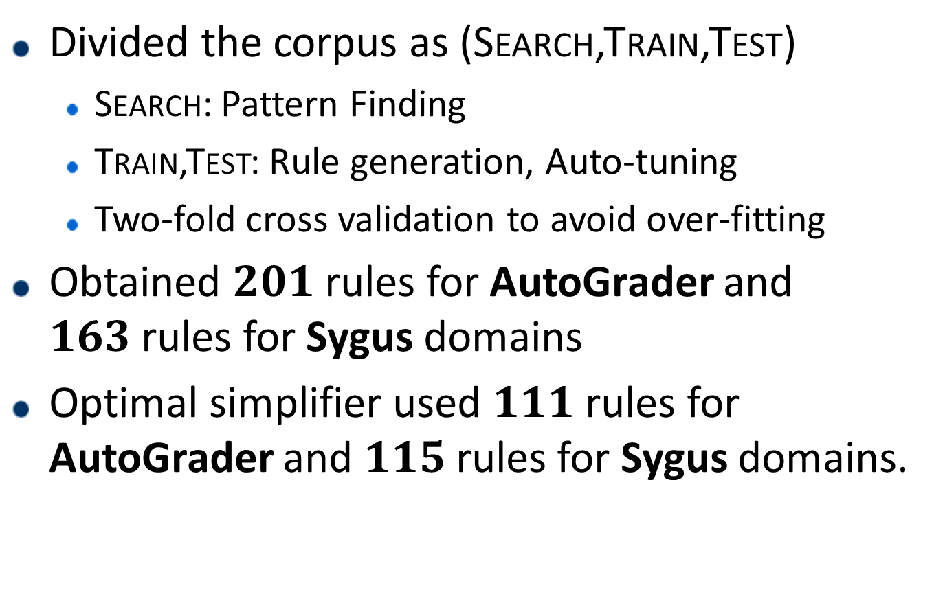
Experiments: Swapper performance
Divided the corpus as (Search,Train,Test)
  Search: Pattern Finding
  Train,Test: Rule generation, Auto-tuning
  Two-fold cross validation to avoid over-fitting
Obtained $201$rules for AutoGrader and $163$rules for Sygus domains
Optimal simplifier used $111$ rules for AutoGrader and $115$rules for Sygus domains.
Notes:
Optimal simplifiers used 111 and 115 rules

Slide 49
Experiments: Swapper performance
Impact on sizes
AutoGrader: 33.2%, 6.8% reductions
Sygus: 1.6%, 1.6% reductions
Notes:
Optimal simplifiers used 111 and 115 rules

Slide 50
Experiments: Swapper performance
Impact on times
AutoGrader: 27.5s,20s,18s average times
Sygus: 22s,21s,10s average times
Notes:
Optimal simplifiers used 111 and 115 rules

Slide 51
Experiments: Domain Specificity
Impact on times across domains
Notes:
Optimal simplifiers used 111 and 115 rules

Slide 52
Experiments: SMTLIB Translation
Size reduction by 19% on average, not much impact on time

Slide 53
Conclusion
We demonstrated that Swapper can generate good simplifiers in reasonable time and low cost.
We showed that Swapper generated simplifiers perform better than hand written simplifier in Sketch.
We showed the domain specificity of simplifiers generated by Swapper
We also showed generality of Swapper framework by extending it for SMTLIB benchmarks

Slide 54
Questions?

Slide 55
Thank You!

