Slide 1
Demo
Armando Solar-Lezama

Slide 2
Example
fun CG(A, M, b, x, $ε$)
$r := b – A∗x$
$z := M^{−1}∗r$
$p := z$ ; $γ := r⋅ z$
for $k:=1:size(A)$
$s := A∗p$
$α :=γ /(p⋅ s)$
$x := x +α ∗p$
$r := r −α ∗ s$
if ( $r⋅ r <ε^{2}$) return $x$
$z := M^{−1}∗r$
$γ_{new} := r⋅ z$
$β :=γ_{new} / γ$
$γ =γ_{new}$
$p := z +β∗p$
end
return $x$
Very high-level transformation
Performance bottleneck
Operation is expensive
The result is used right away

Slide 3
Example
fun CG(A, M, b, x, $ε$)
$r := b – A∗x$
$z := M^{−1}∗r$
$p := z$; $γ := r⋅ z$
for $k:=1:size(A)$
$s := A∗p$
$t:=\{A, M^{−1}, r, z, p, s, γ\}$
$α :=γ /(p⋅ s)$
$x := x +α ∗p$
$r := r −α ∗ s$
if( $r⋅ r <ε^{2}$) return $x$
$z≔\{r, z, t, s, α,γ\}$
$γ_{new} := r⋅ z$
$β :=γ_{new} / γ$
$γ =γ_{new}$
$p := z +β∗p$
end
return $x$
Idea:
Move the expensive computation out of the critical path
Computation of z no longer involves matrix multiplication
The idea is simple, but we need to figure out the details

Slide 4
Example
fun CG(A, M, b, x, \epsilon)
$r := b – A∗x$
$z := M^{−1}∗r$
$p := z$; $γ := r⋅ z$
for $k:=1:size(A)$
$s := A∗p$
$t:=M^{−1}∗s$
$α :=γ /(p⋅ s)$
$x := x +α ∗p$
$r := r −α ∗ s$
if( $r⋅ r <ε^{2}$) return $x$
$z≔z −α∗t$
$γ_{new} := r⋅ z$
$β :=γ_{new} / γ$
$γ =γ_{new}$
$p := z +β∗p$
end
return $x$
Synthesizer can figure this out in < 3 min.

Slide 5
Transpose
void dtrans(int nx, int ny, int nz, int N,
double[nz/N, ny, nx] LA,
ref double[nx/N, ny, nz] LB) {
int bufsz = (nx/N)*ny*(nz/N);
view LA as double[N, bufsz] abuf;
view LB as double[N, bufsz] bbuf;
pack(LA, bbuf);
All_to_all(bbuf, abuf); // re-distribute
unpack(nx, ny, nz, abuf, LB);
}

Slide 6
pack
void pack([int an1, int an2, int an3, int bn1],
double[an1, an2, an3] in,
ref double[nprocs, bn1] out) {
view out as double[nprocs*bn1] fout;
for (int i = 0; i < an1; i++)
for (int j = 0; j < an2; j++)
for (int k = 0; k < an3; k++)
fout[i*dim()+j*dim()+k*dim()] // i+j*an1+k*an1*an2
= in[i][j][k];
}
gen int num() {
return {| an1 | an2 | an3 | bn1 | nprocs |};
}
gen int dim() {
return {| ?? | num() | num()/nprocs | dim()*dim() |};
}

Slide 7
pack
void pack([int an1, int an2, int an3, int bn1],
double[an1, an2, an3] in,
ref double[nprocs, bn1] out) {
view out as double[nprocs*bn1] fout;
gen int num() {
return {| an1 | an2 | an3 | bn1 | nprocs |};
}
gen int dim() {
return {| ?? | num() | num()/nprocs | dim()*dim() |};
}
for (int i = 0; i < an1; i++)
for (int j = 0; j < an2; j++)
for (int k = 0; k < an3; k++)
fout[i*dim()+j*dim()+k*dim()] // i+j*an1+k*an1*an2
= in[i][j][k];
}

Slide 8
unpack
void unpack([int an1, int bn1, int bn2, int bn3],
double[nprocs, an1] in, ref double[bn1, bn2, bn3] out) {
view in as double[nprocs*an1] fin;
view out as double[bn1*bn2*bn3] fout;
for (int p = 0; p < nprocs; p++)
for (int i = 0; i < dim(); i++) // bn1
for (int j = 0; j < dim(); j++) // bn2
for (int k = 0; k < dim(); k++) // bn3/nprocs
fout[p*dim() + i*dim() + j*dim() + k*dim()]
// bn3/nprocs, bn2*bn3, bn3, 1
= fin[p*dim() + i*dim() + j*dim() + k*dim()];
// an1, bn2*bn3/nprocs, bn3/nprocs, 1
}
gen int num() {
return {| an1 | an2 | an3 | bn1 | nprocs |};
}
gen int dim() {
return {| ?? | num() | num()/nprocs | dim()*dim() |};
}

Slide 9
unpack
void unpack([int an1, int bn1, int bn2, int bn3],
double[nprocs, an1] in, ref double[bn1, bn2, bn3] out) {
view in as double[nprocs*an1] fin;
view out as double[bn1*bn2*bn3] fout;
gen int num() {
return {| an1 | bn1 | bn2 | bn3 | nprocs |};
}
gen int dim() {
return {| ?? | num() | num()/nprocs | dim()*dim() |};
}
for (int p = 0; p < nprocs; p++)
for (int i = 0; i < dim(); i++) // bn1
for (int j = 0; j < dim(); j++) // bn2
for (int k = 0; k < dim(); k++) // bn3/nprocs
fout[p*dim() + i*dim() + j*dim() + k*dim()]
// bn3/nprocs, bn2*bn3, bn3, 1
= fin[p*dim() + i*dim() + j*dim() + k*dim()];
// an1, bn2*bn3/nprocs, bn3/nprocs, 1
}

Slide 10
test
void tester(int nx, int ny, int nz,
double[nz,ny,nx] A, ref double[nx,ny,nz] B) implements trans {
assume nz % nprocs == 0 && nx % nprocs == 0;
spmdfork {
double[nz/nprocs,ny,nx] LA = distribute(A);
double[nx/nprocs,ny,nz] LB = distribute(B);
dtrans(nx, ny, nz, nprocs, LA, LB);
collect(A, LA);
collect(B, LB);
}
}

Slide 11
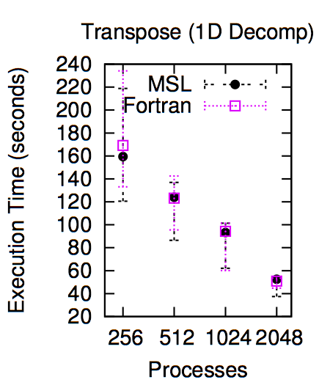
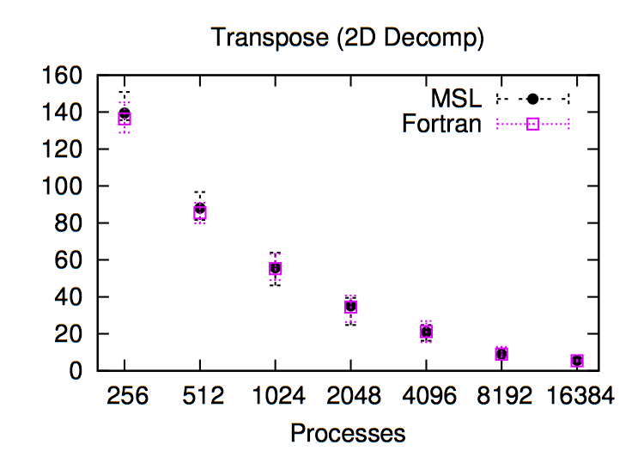
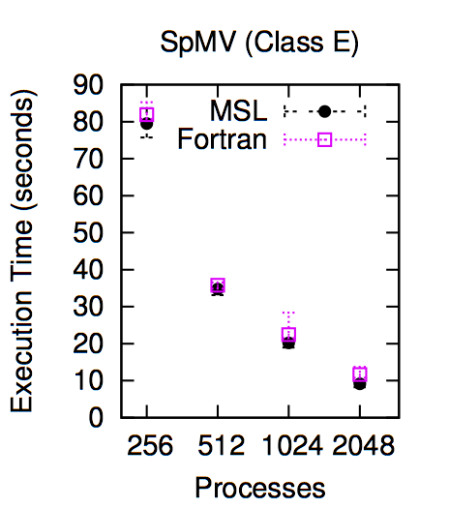
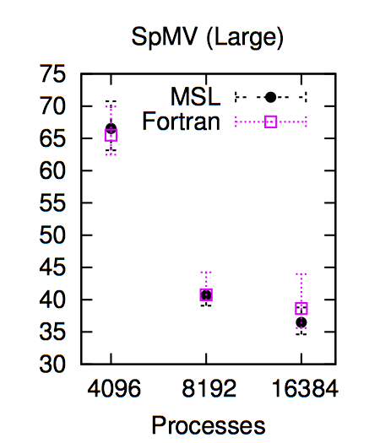
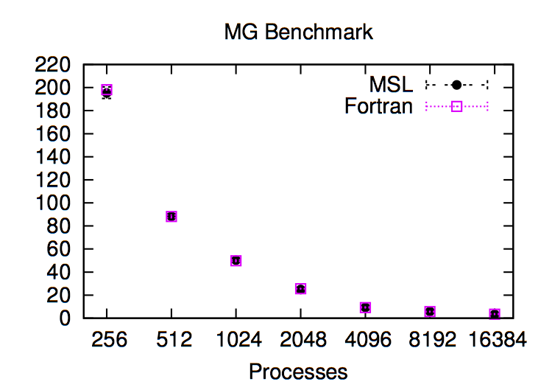
Experiments

