Slide 1
Storyboard Programming
Rishabh Singh and Armando Solar-Lezama

Slide 2
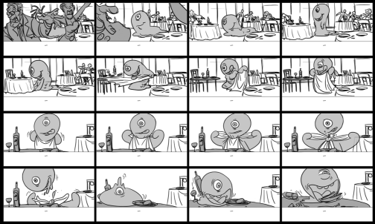
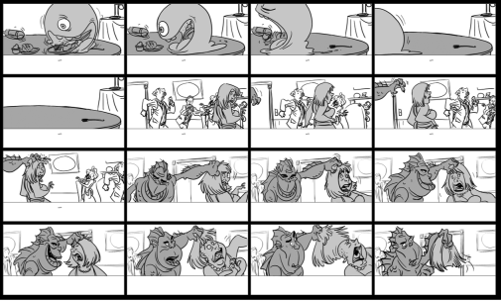
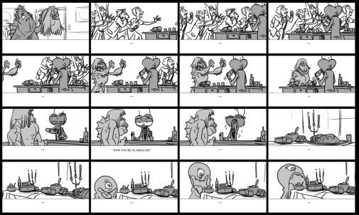
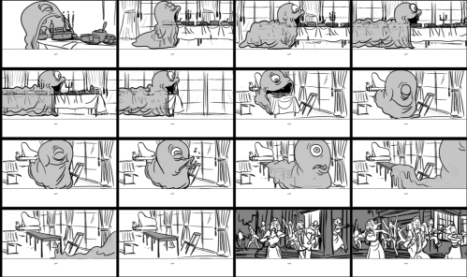
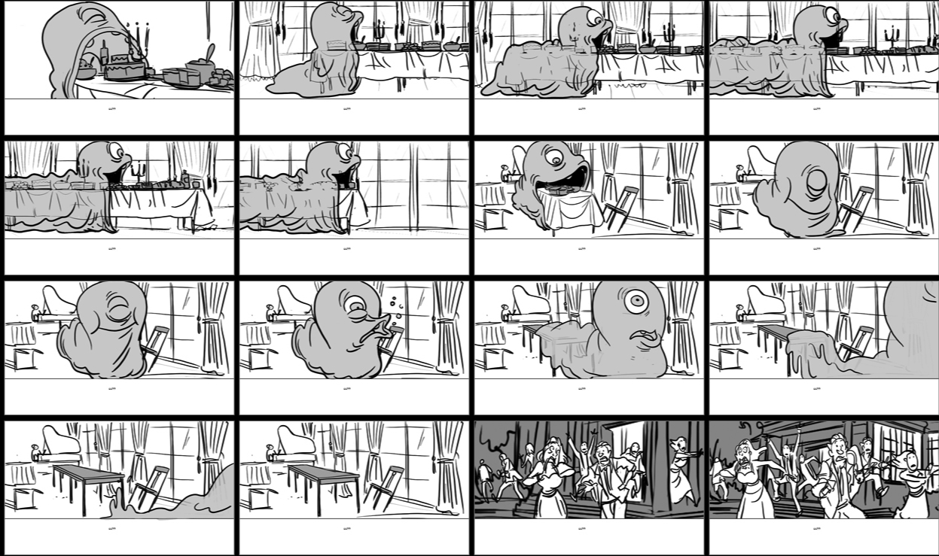
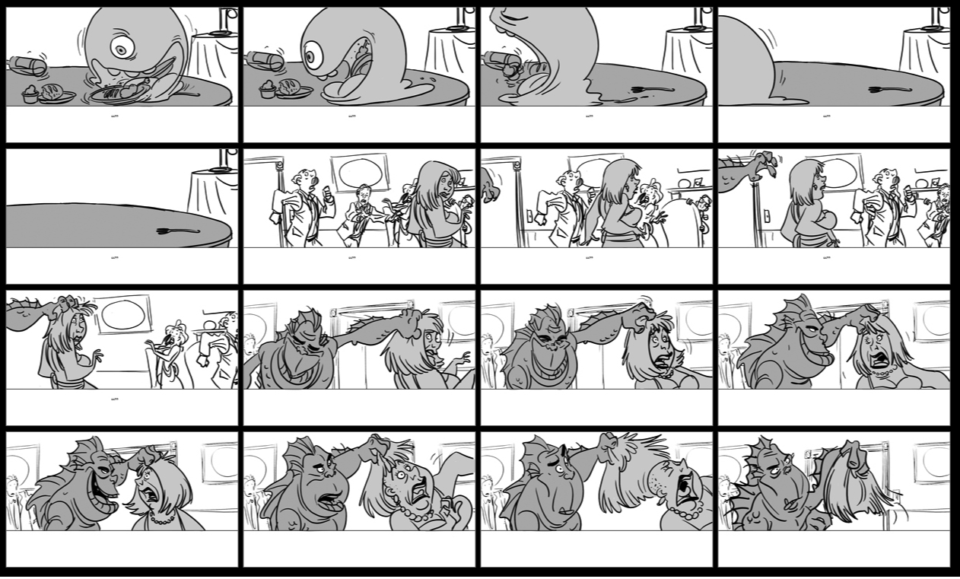
Storyboard Programming
© Nassos Vakalis

Slide 3
Storyboard Programming
head
x
head
x
head
x
head
x
front
a
b
back
front
a
b
back
head
head
head
head
front
a
x
b
back
front
a
x
x
b
back
x
void insert(List l, Node x){
Node head = l.head;
Node cur = head, prev = null;
while(cur != null && cur.val < x){
prev = cur;
cur = cur.next;
}
if(head == null) head = x;
if(prev != null) prev.next = x;
x.next = cur;
}
x
void insert(List l, Node x){
Node head = l.head;
Node cur, prev;
...
while(...){
...
}
...
}
head
head
head
head
x
x
x
front
front
b
a
a
back
b
back
head
head
head
head
front
front
a
a
x
x
x
b
x
b
back
back

Slide 4
How do we make this real
Give semantic meaning to the storyboard
storyboard is the link between synthesizer and user
storyboard is a specification
storyboard focuses on what is important
Algorithm must exploit storyboard insight
turn the insights of the storyboard into an abstract domain
synthesis algorithm must be able to exploit abstraction
Expand expressiveness and scalability
some problems are too hard to solve in one shot
even with abstraction
how do we express inductive insight?

Slide 5
Anatomy of a Storyboard
Environment
Env{
Node head, prev, curr;
[Node] a, b, x;
[[Node]] front, back ;
front.next = { front, a};
back.next = {back, null};
}
head
x
head
front
a
b
back
head
head
front
a
x
b
back

Slide 6
Anatomy of a Storyboard
Scenario
Start {
head = front;
a.next = b;
b.next = back;
}
End{
head = front;
a.next = x;
x.next = b;
b.next = back;
}
head
x
front
a
b
back
head
front
a
x
b
back

Slide 7
Storyboard ➔ Abstract Domain
head
prev
cur
x
front
a
b
back
Environment
Env{
Node head, prev, curr;
[Node] a, b, x;
[[Node]] front, back ;
front.next = { front, a};
back.next = {back, null};
}
struct Node{
Node next;
int value;
assert next != null =>
value < next.value;
}

Slide 8
Storyboard ➔ Abstract Domain
head
prev
cur
x
front
a
b
back
null
head = { , }
a.next = { , , }
b.next = { , }
x.next = { , }
cur = { }
prev = { }
front
b
x
back
b
front
a
x
b
back
front
a
x
b
back

Slide 9
Verifying with Abstract Interpretation
Standard program analysis technique
Our synthesis algorithm will be based on it

Slide 10
Transition Function
Given a state
cur, head
x
prev
front
a
b
back
prev = cur;
cur = cur.next;
f₂
prev
head
x
cur
prev
head
x
front
a
b
back
cur
front
a
b
back
Produces a set of states

Slide 11
Transition Function
Given a set of states
cur
prev
head
cur, head
x
prev
prev
head
x
x
front
a
b
back
front
a
b
back
front
a
b
back
cur
prev = cur;
cur = cur.next;
f₂
cur, head
prev
prev
head
x
cur
prev
head
head
x
x
x
front
a
b
back
front
a
b
back
front
a
b
back
front
a
b
back
cur
prev
cur
Produces a new set of states

Slide 12
Verification by Abstract Interpretation
head
x
t_{in}
front
a
b
back
cur = head; prev = null
cur, head
prev
cur
prev
head
x
x
f₁
front
a
b
back
front
a
b
back
prev
head
head
prev = cur;
cur = cur.next;
x
x
t₁
f₂
front
a
b
back
front
a
b
back
cur
prev
cur
cur != null & cur.val < x
cur, head
x
prev
false
true
front
a
b
back
f_{p}
t₂
prev
head
x
t₃
front
a
b
back
if(head == null)
head = x;
if(prev != null)
prev.next = x;
x.next = cur;
head
x
cur
cur
prev
head
front
a
b
back
x
f₃
prev
cur
front
a
b
back
head
t_{out}
front
a
x
b
back

Slide 13
Verification by Abstract Interpretation
Sets of states
t_{in}
f₁
t₁
f₂
false
f_{p}
true
t₃
t₂
f₃
t_{out}
If the formula is satisfiable, it means the program is correct.

Slide 14
From Verification to Synthesis
What if the code itself is unknown?

Slide 15
From Verification to Synthesis
head
x
t_{in}
front
a
b
back
??
cur, head
prev
cur
prev
head
x
x
f₁
front
a
b
back
front
a
b
back
prev
head
head
??
x
x
t₁
f₂
front
a
b
back
front
a
b
back
cur
prev
cur
??
cur, head
x
prev
false
true
front
a
b
back
f_{p}
t₂
prev
head
x
t₃
front
a
b
back
??
head
x
cur
cur
prev
head
front
a
b
back
x
f₃
prev
cur
front
a
b
back
head
t_{out}
front
a
x
b
back

Slide 16
From Verification to Synthesis
t_{in}
??
f₁
cur
cur
prev.next
prev.next
??
prev
prev
t₁
f₂
head.next
=
head.next
head
head
cur.next
cur.next
??
false
f_{p}
true
t₂
t₃
??
Assignments in each block are of this form
f₃
t_{out}

Slide 17
From Verification to Synthesis
t_{in}
switch(c1){
case 0: t = cur;
case 1: t = prev;
case 2: t = head;
}
t = if(c2) t; else t.next;
switch(c3){
case 0: cur = t;
case 1: prev = t;
case 2: head = t;
case 3: cur.next = t;
case 4: prev.next = t;
case 5: head.next = t;
}
??
f₁
??
t₁
f₂
??
false
f_{p}
true
t₂
t₃
??
f₃
Set of possible assignments can be represented with a parameterized block of code
t_{out}

Slide 18
Synthesis with Abstract Interpretation
t_{in}
f₁
t₁
f₂
false
f_{p}
true
t₃
t₂
f₃
Basic Satisfiability Query
just find a C that satisfies the equation and you are done
in principle should be easy to do with a SAT solver
scalability is an issue
t_{out}

Slide 19
Challenge
Set of abstract states can get really big
synthesis in “one shot” no longer an option
Counterexample Guided Inductive Synthesis
candidate implementation
succeed
Inductive Synthesizer
Automated Validation
Derive candidate implementation from concrete inputs.
fail
ok
buggy
Your verifier/checker goes here
fail
counterexample input
observation set E
Validation is now abstract interpretation

Slide 20
CEGIS with Abstract Interpretation
Start with a random (and probably wrong) solution
Do Abstract Interpretation to discover problem.
Extract a trace that illustrates the problem.
Derive constraints from the trace
Solve constraints to get a new solution
Verify the new solution and repeat the process if it turns out to be incorrect.

Slide 21
Incorporating Inductive Insight
Example: Reversing a Linked List
list reverseSK(list lst){
node cur=null, prev=null;
while(null!=lst.head){
cur = lst.head;
lst.head = cur.next;
cur.next = prev;
prev = cur;
}
lst.head = cur;
return lst;
}
…
c
c
h
h
c
c
c
h
h
c
h
c
c
c
c
h
h
c
h
h
h
h
h
h
z
z
z
z
z
z
z
z
a
z
a
a
a
a
a
a
a
a
a
b
b
b
b
b
b
b
c
c
c
z
a
y
z
c
c
c
c
c
c
d
d
d
d
d
d
e
e
a
b
c
z
e
a
b
z
p
p
p
p
p
p
p
p
p
In order to reason about this program,
we need to know that can be expanded into
j
j
k
Once we make this knowledge part of the storyboard,
the rest of the process works just like before

