Slide 1
Semantic communication with simple goals is equivalent to on-line learning
Brendan Juba (MIT CSAIL & Harvard)
with Santosh Vempala (Georgia Tech)
Full version in Chs. 4 & 8 of my Ph.D. thesis:
http://hdl.handle.net/1721.1/62423

Slide 2
Interesting because…
On-line learning algorithms provide the first examples of feasible (“universal”) semantic communication.
Or…
Semantic communication problems provide a natural generalization of on-line learning

Slide 3
So?
New models of on-line learning will be needed for most problems of interest.
These semantic communication problems may provide a crucible for testing the utility of new learning models.

Slide 4
What is semantic communication?
Equivalence with on-line learning
An application: feasible examples
Limits of “basic sensing”

Slide 5
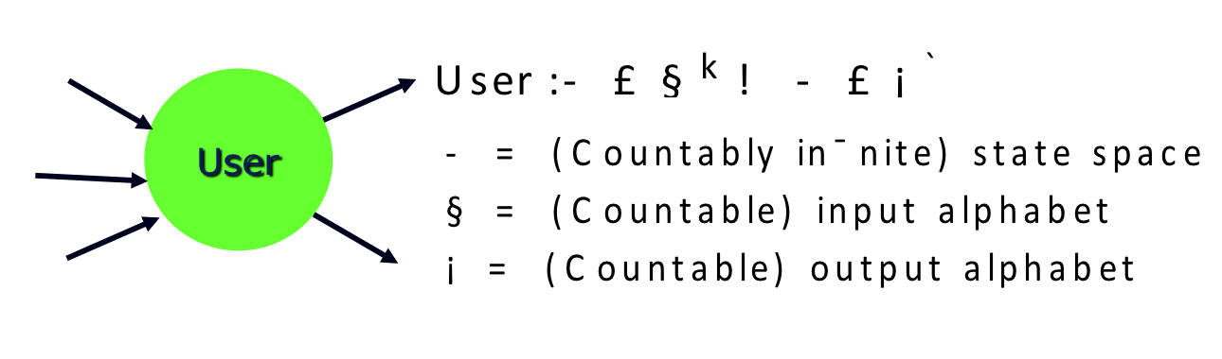
Miscommunication happens…
Q: CAN COMPUTERS COPE
WITH MISCOMMUNICATION AUTOMATICALLY??
Notes:
The semantic communication model was introduced to capture and address
problems of miscommunication in computer systems
ex: slides created by my advisor Madhu render as gibberish on my laptop…
more generally, often standards aren’t followed or change over time
Motivating question: can computers cope with this automatically?

Slide 6



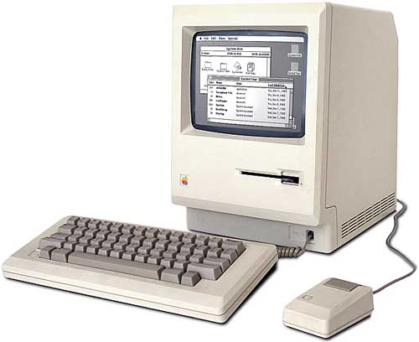
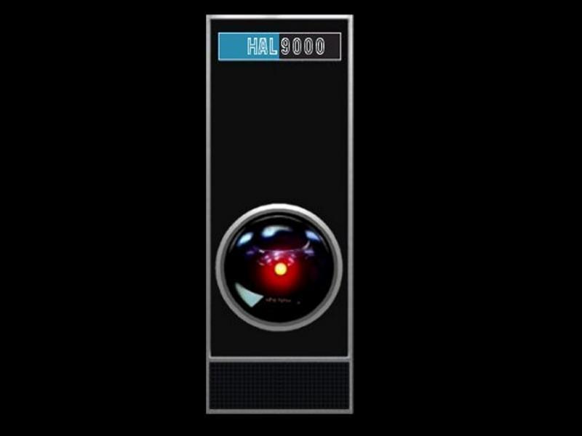
What is semantic communication?
A study of compatibility problems by focusing on the desired functionality (“goal”)
x
ENVIRONMENT
“user message = f(x)?”
S
f(x)
“S-UNIVERSAL USER FOR COMPUTING f”
“USER”
“SERVER”
Notes:
…model compatibility of two parties by studying the *three*-way interaction of those parties w/ an environment
we refer to the party who acts on our behalf in pursuit of the goal as the “user,”
and the other party whose help we need as the “server”
For example, if our goal is to outsource the computation of a (hard) function f…
…the “semantics” of the communication is given by the interactions with the environment (ref. defines “success”)
Could also define, e.g., “printing” by checking that the *server* sends the appropriate encoding of x to Env.
Server comes from collection S; we say user is “S-universal” if it is compatible with every server in S

Slide 7

Multi-session goals [GJS’09]
INFINITE SESSION STRATEGY: ZERO ERRORS AFTER FINITE NUMBER OF ROUNDS
ENV
THIS WORK - “ONE-ROUND” GOAL:
ONE SESSION = ONE ROUND
…
SESSION 1
SESSION 2
SESSION 3
Notes:
on-line setting: adversary chooses state of env. for each session, user must achieve goal repeatedly
User doesn’t control session end! (but, gets many sessions to work with)
In this work, we consider “one-round” goals in which each session lasts exactly one round.
We expect that the “right” strategy shouldn’t incur *any* errors,
correspondingly wish that we eventually “learn” this strategy from our mistakes---
that “miscommunication” is restricted to a bounded “initial period”
i.e., incur no errors after finite # of sessions … # can vary depending on server

Slide 8
Summary: 1-round goals
Goal is given by Environment (entity) and
Referee (predicate)
Adversary chooses infinite sequence of states of Environment: σ₁, σ₂,…
On round i, Referee produces a Boolean verdict based on σ_{i} and messages received from User and Server
Achieving goal = Referee rejects finitely often

Slide 9
S-Universal user for 1-round goal
So: user strategy is S-Universal if for every S in S,
the goal is achieved in the system with S.
(thus: for every sequence of Environment states, Referee only rejects messages sent by user and S finitely many times—“finitely many errors”)

Slide 10
Anatomy of a user
MOTIVATION FOR THIS WORK: CAN WE FIND AN EFFICIENT STRATEGY SEARCH ALGORITHM IN ANY NONTRIVIAL SETTING??
ENVIRONMENT
GOAL-SPECIFIC FEEDBACK—E.G., INTERACTIVE PROOF VERIFIER FOR f
Strangely, learning theory played no role so far…
Sensing
feedback
GENERIC STRATEGY SEARCH ALGORITHM—E.G., ENUMERATION
Controller
Notes:
The algorithms we have for universal users look like this…
…for computing functions, the sensing module is given by an interactive proof sys.
And the controller simply enumerates algorithms. (“generic”—works with any success/fail feedback)
Not terribly efficient, but “optimal” at a certain level of generality (passwords take exp. time to find)
We weren’t really happy with this… so we wanted to know…
(…perhaps by restricting the kind of strategies we aimed to be able to emulate)
Now, notice, contrary to what we’d expected, learning theory didn’t play any role so far.

Slide 11

Sensing for multi-session goals
SAFETY: ERRORS DETECTED WITHIN FINITE # OF ROUNDS
1-SAFETY: ERRORS DETECTED WITHIN FINITE # ONE ROUND
I’D BETTER TRY SOMETHING ELSE!!
THIS WORK: ALL DELAYS BOUNDED TO ONE ROUND.
VIABILITY: SEE NO FAILURES WITHIN FINITE # OF ROUNDS FOR AN APPROPRIATE COMMUNICATION STRATEGY
1-VIABILITY: SEE NO FAILURES WITHIN FINITE # ONE ROUND FOR AN APPROPRIATE COMMUNICATION STRATEGY
ENV
…
SESSION 1
SESSION 2
SESSION 3
Notes:
In multi-session goals, we only need to detect failures a finite number of rounds later
(some delay = some add’l failed sessions is OK)
Thus, safety: sensing fn. detects failures w/in some bounded # of rounds
(unless we’re actually succeeding at the goal, i.e., we know errors are fixed)
and viability: after some bounded # of rounds, we don’t see any more failures
But, in this work, we again make things easier by restricting the delays to one round
(so that on the next round, we get feedback on our performance on the previous round,
and an appropriate strategy gets positive feedback from the next round onwards)

Slide 12
Key def’n: Generic universal user
For a given class of user strategies U, we say that a (controller) strategy is a m-error generic universal user for U if, for any 1-round goal, class of servers S and sensing function V such that
V is 1-safe for the goal with every S in S and
V is 1-viable for the goal with every S in S via some user strategy U in U,
the controller strategy using V makes at most
m(U) errors with a S that is 1-viable with U in U.
Notes:
Most important def. in the talk—captures a generic controller strategy for a limited class of users U…
…when the controller is plugged in to an appropriate sensing module,
the referee is only dissatisfied with its messages m times (parameterized by size of user strategy)
an “appropriate sensing module” is not only safe for S, but also viable with one of the simple strategies
Note: if this algorithm is efficient (and sensing is efficient) then we have efficient S-universal users!
**captures the existing approach to designing universal users based on sensing in simple settings

Slide 13
What is semantic communication?
Equivalence with on-line learning
An application: feasible examples
Limits of “basic sensing”
Notes:
So that’s what we’ll see to be equivalent to on-line learning.

Slide 14
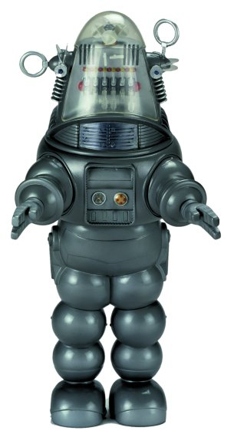
Recall: on-line learning [BF’72,L’88]
f ∈C
m-MISTAKE BOUNDED LEARNING ALGORITHM FOR C: FOR ANY f ∈C AND SEQUENCE x₁, x₂, x₃,… THE ALGORITHM MAKES AT MOST m(f) WRONG GUESSES
x₁
x₂
x₃
f(x₁)= y₁?
f(x₂)= y₂?
f(x₃)= y₃?
ENV
Algorithm is said to be conservative if its state only changes following a mistake
…
TRIAL 1
TRIAL 2
TRIAL 3
Notes:
Just to remind you… the mistake-bounded on-line learning model
for a class of Boolean functions C, some target concept f is chosen
proceeds in an infinite sequence of “trials” …
on each trial, an adversary selects an x, the algorithm guesses the value of f,
and the algorithm is told whether or not its guess is correct.
The algorithm is m-mistake bounded if… and it’s conservative if…

Slide 15
Main result
A conservative m-mistake bounded learning algorithm for C is an m+1-error generic universal user for C;
an m-error generic universal user for C is an
m-mistake bounded learning algorithm for C.
⇒ON AN ERROR, USER MUST NOT HAVE BEEN CONSISTENT WITH VIABLE f∈C.
⇐ ON-LINE LEARNING IS CAPTURED BY A 1-ROUND GOAL; EACH f∈C IS REPRESENTED BY A SERVER S_{f}.
Notes:
So, as alluded to earlier, the mistake-bounded learning model is
essentially equivalent to the generic controller strategies for universal users
(+1 error because we allow our sensing function one error’s worth of “slack”)
As you might expect, the sensing module’s feedback corresponds to the feedback
provided on each trial in on-line learning.

Slide 16
What is semantic communication?
Equivalence with on-line learning
An application: feasible examples
Limits of “basic sensing”

Slide 17
Key point: the number of mistakes depends only on the representation size of the halfspace, not the examples
Theorem. There is a O(n²(b+log n))-mistake bounded learning algorithm for halfspaces with b-bit integer weights over Q^{n}, running in time polynomial in n, b, and the length of the longest instance on each trial.
Based on reduction of halfspace learning to convex feasibility with a separation oracle [MT’94] combined with technique for convex feasibility for sets of lower dimension [GLS’88].
Notes:
… we care about the overhead only depending on the representation size because
enumeration strategies only incurred a # of errors depending on the representation size
and we wish to preserve this, just reducing the overhead to a polynomial
(such strategies were conjectured to exist…)

Slide 18
Interesting because…
On-line learning algorithms provide the first examples of feasible (“universal”) semantic communication.
(Confirms a main conjecture from [GJS‘09])

Slide 19
Extension beyond one round
Work by Auer and Long (‘99) yields efficient universal user strategies for k-round goals (when U is a class of stateless strategies, k ≤ log log n) or for classes of log log n-bit valued functions, given an efficient mistake bounded algorithm for one round (resp. bitwise).

Slide 20
But of course, halfspaces << general protocols.
We believe that only relatively weak functions are learnable.
☞ There are limits to what can be obtained by this equivalence…

Slide 21
What is semantic communication?
Equivalence with on-line learning
An application: feasible examples
Limits of “basic sensing”

Slide 22
Theorem. If C = {f:X→Y} is such that for every (x,y) ∈ X×Y some f satisfies f(x)=y, then any mistake-bounded learning algorithm for C (from 0-1 feedback) must make Ω(|Y|) mistakes on some f w.h.p.
E.g., linear transformations…
Notes:
For starters, we have this (generic) lower bound for strategies with large messages…
(in the case of large messages, it’s important that we’re using this yes/no feedback,
not being told the correct value of the function)
… applies broadly to many natural classes of possible strategies, e.g., linear trans.

Slide 23
Sketch
Idea: negative feedback is not very informative—many f∈C indistinguishable.
For every dist. over user strategies, every x, some y is guessed w.p. ≤ ¹/_{|Y|}.
  Min-max: there is a dist. over f s.t. negative feedback is received w.p. 1-¹/_{|Y|}.
After k guesses, total prob. of positive feedback only increased by k/(1-^{k}/_{|Y|})-factor.
Notes:
…thus, to get a constant prob. of *not* making a mistake, we need a number of trials
on the same order as the number of messages.

Slide 24
So, generic universal users for such a class must be exponentially inefficient in the message length.
Likewise, traditional hardness for Boolean concepts shows eg., DFAs [KV’94] and AC₀ circuits [K’93] don’t have efficient generic universal users.
Notes:
So this kind of success/fail feedback can only allow us to efficiently emulate
extremely simple classes of users…

Slide 25
Recall…
ENVIRONMENT
Sensing
feedback
Only introduced to make the problem easier to solve!
Controller

Slide 26
We don’t have to use “basic sensing!”
Any feedback we can provide is fair game.
Interesting because…
Semantic communication problems provide a natural generalization of on-line learning
Negative results ⇒ New models of learning needed to tackle these problems; semantic communication problems provide natural motivation.

Slide 27
References
[GJS’09] Goldreich, Juba, Sudan. A theory of goal-oriented communication. ECCC TR09-075, 2009.
[BF’72] Bā̄rzdiņš, Freivalds. On the prediction of general recursive functions. Soviet Math. Dokl. 13:1224–1228, 1972.
[L’88] Littlestone. Learning quickly when irrelevant attributes abound: A new linear-threshold algorithm. Mach. Learn. 2(4):285–318, 1988.
[AL’99] Auer, Long. Structural results about on-line learning models with and without queries. Mach. Learn. 36(3):147–181, 1999.
[MT’94] Maass, Turán. How fast can a threshold gate learn? In Computational learning theory and natural learning systems: Constraints and prospects, vol. 1, pp.381-414, MIT Press, 1994.
[GLS’88] Grötschel, Lovász, Schrijver. Geometric algorithms and combinatorial optimization. Springer, 1988.
[KV’94] Kearns, Valiant. Cryptographic limitations on learning Boolean formulae and finite automata. J. ACM 41:67–95, 1994.
[K’93] Kharitonov. Cryptographic hardness of distribution-specific learning. In: 25th STOC. pp. 372–381, 1993.
[J’10] Juba. Universal Semantic Communication. Ph.D. thesis, MIT, 2010. Available online at: http://hdl.handle.net/1721.1/62423 (Springer edition coming soon)

