Slide 1
Compression Without a
Common Prior
An information-theoretic justification for ambiguity in language
Brendan Juba (MIT CSAIL & Harvard)
with Adam Kalai (MSR)
Sanjeev Khanna (Penn)
Madhu Sudan (MSR & MIT)
Notes:
Will describe an information-theoretic problem for which
solutions resemble natural language in interesting ways
(may therefore be helpful to the study of natural languages,
much like how thinking about building cameras helps the study of the eye)

Slide 2
Encodings and ambiguity
Communication across different priors
“Implicature” arises naturally
Notes:
We’ll start by describing a basic model that generalizes some classic problems in
Information theory

Slide 3
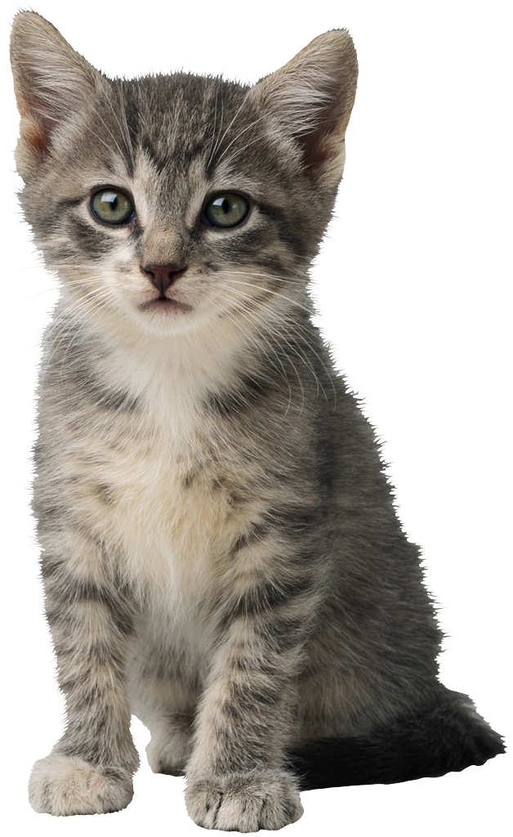
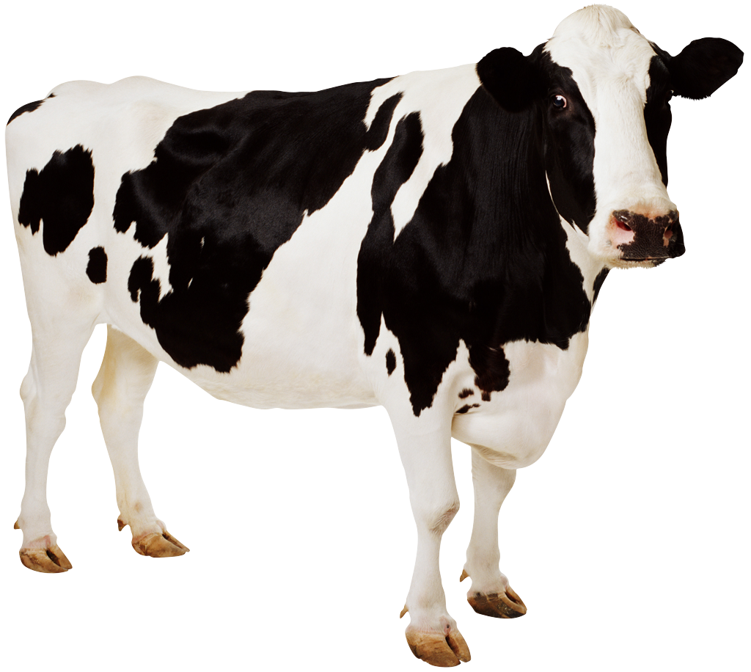
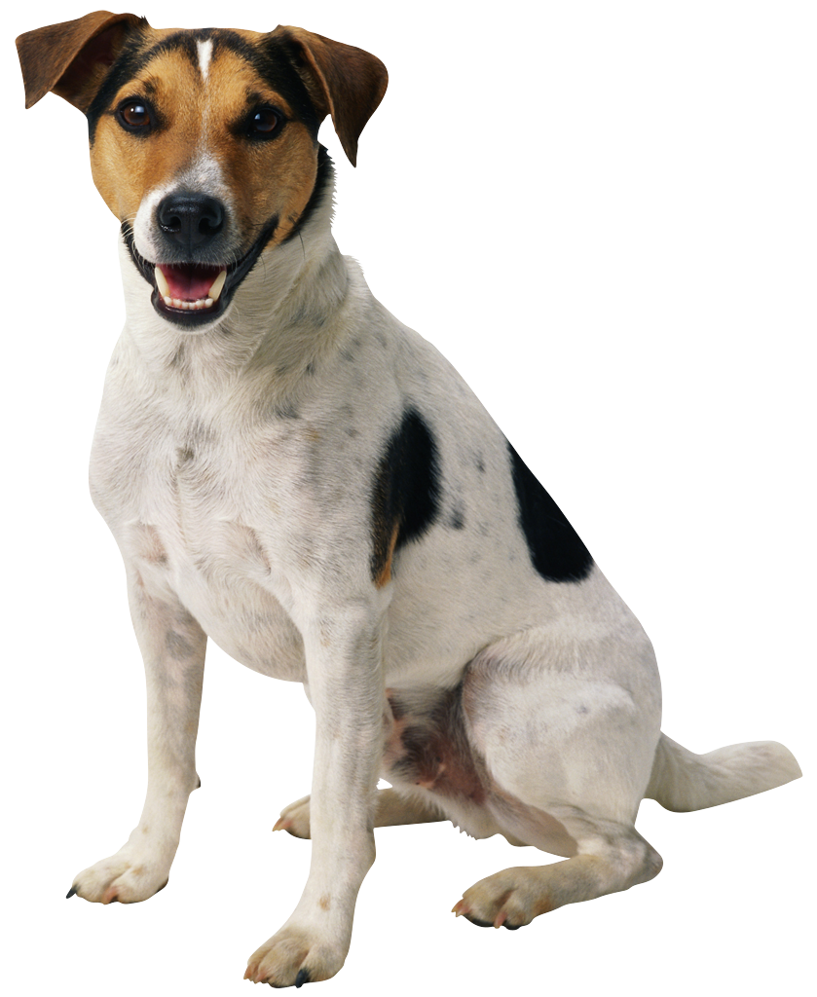
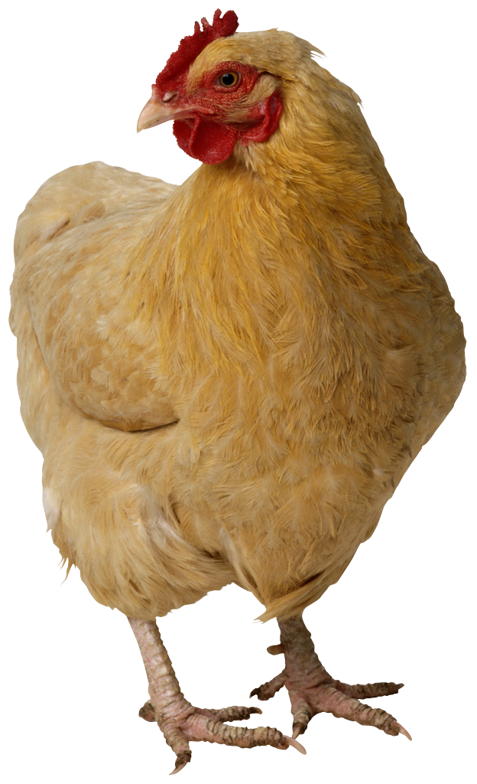
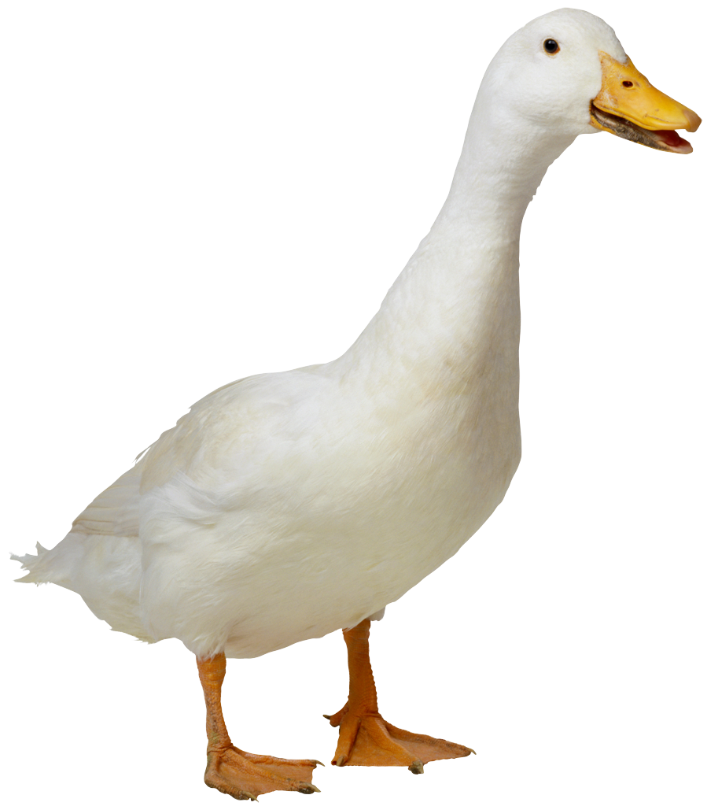
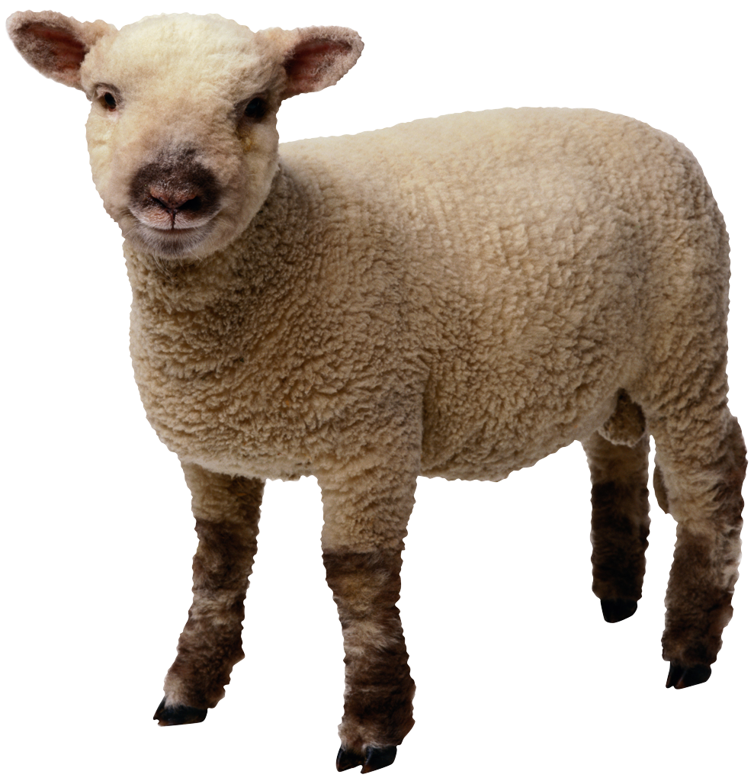
Encoding schemes
“MESSAGES”
Chicken
Bird
Cat
Duck
Dinner
Pet
Lamb
Cow
Dog
“ENCODINGS”
Notes:
Encoding schemes are a simple model of one-way communication
there is a set of possible “messages” and a set of “encodings,”
and the encoding scheme is given by a matching between them

Slide 4
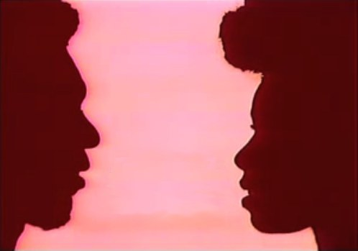
Communication model
CAT
RECALL: ( , CAT) ∈ E
Notes:
Model communication in the obvious way:
the sender transmits an encoding that is paired with the intended message

Slide 5
Ambiguity
Chicken
Bird
Cat
Duck
Dinner
Pet
Lamb
Cow
Dog
Notes:
Notice, we are explicitly allowing encoding schemes to be ambiguous
Formally, this means that the encoding side may have degree > 1

Slide 6

WHAT GOOD IS AN AMBIGUOUS ENCODING??
Notes:
You may be wondering at this point what good the ambiguous encodings are
turns out that they already arise very naturally in information theory…

Slide 7
Prior distributions
Chicken
Bird
Cat
Duck
Dinner
Pet
Lamb
Cow
Dog
Decode to a maximum likelihood message
Notes:
We introduce a probability distribution over the messages:
We could think of the messages as drawn from a random source, as is typical
in information theory
Then we decode an ambiguous encoding to its most likely message
(eliminates competing alternatives)

Slide 8
Source coding (compression)
Assume encodings are binary strings
Given a prior distribution P, message m,
choose minimum length encoding that decodes to m.
FOR EXAMPLE, HUFFMAN CODES AND SHANNON-FANO (ARITHMETIC) CODES
NOTE: THE ABOVE SCHEMES DEPEND ON THE PRIOR.
Notes:
Supposing further that the encodings are given by binary strings,
a natural thing to do is to attempt to minimize the coding length.
Familiar standard codes – Huffman and Shannon-Fano (i.e., arithmetic) codes – are designed for this purpose.
Note that the kinds of codes we use for this compression should be ambiguous:
short encodings are not “dedicated” to any particular string (though the encoding
graph does depend on the shared distribution in these cases…)

Slide 9
More generally…
Unambiguous encoding schemes cannot be too efficient. In a set of M distinct messages, some message must have an encoding of length lg M.
+If a prior places high weight on that message, we aren’t compressing well.

Slide 10
I THOUGHT YOU SAID THIS HAD SOMETHING TO DO WITH LANGUAGE??
INDEED, ARITHMETIC CODES LOOK NOTHING LIKE NATURAL LANGUAGE
Notes:
You may feel a little lost at this point.
…I promised a problem for which solutions resembled language. Although these
efficient coding schemes must be “ambiguous” in our sense, they still don’t much
resemble languages.

Slide 11

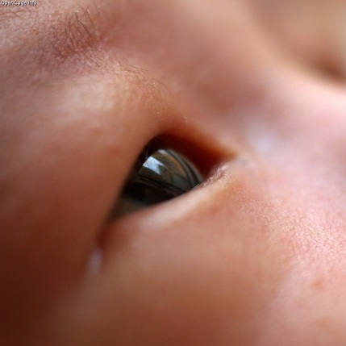
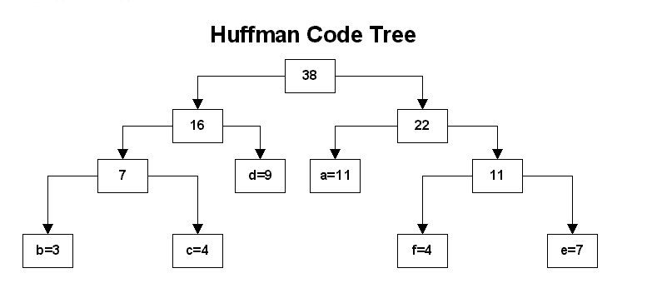
≈
Since we all agree on a prob. distribution over what I might say, I can compress it to: “The 9,232,142,124,214,214,123,845th most likely message. Thank you!”
≈
Notes:
You may feel a little lost at this point.
I lured you in with this talk about how the design of cameras helped us understand the eye;
And specifically, I promised a problem for which solutions resembled language.
Although these efficient coding schemes must be “ambiguous” in our sense,
they still don’t much resemble languages.

Slide 12
Encodings and ambiguity
Communication across different priors
“Implicature” arises naturally
Notes:
We’ll introduce a new version of the problem that will fulfill our original promise

Slide 13


SUPPOSE ALICE AND BOB SHARE THE SAME ENCODING SCHEME, BUT DON’T SHARE THE SAME PRIOR…
P
Q
CAN THEY COMMUNICATE??
HOW EFFICIENTLY??
Notes:
Our set-up:
Alice and Bob share encoding scheme, i.e., the bip. graph defining encodings
They DON’T have identical priors now. We want to see when they can communicate,
and how efficiently. Note, arithmetic coding and Huffman coding **no longer work.**

Slide 14
Disambiguation property
An encoding scheme has the
disambiguation property (for prior P) if
for every message m and integer Θ,
there exists some encoding e=e(m,Θ) such that
for every other message m’
P[m|e] > Θ P[m’|e]
WE’LL WANT A SCHEME THAT SATISFIES DISAMBIGUATION FOR ALL PRIORS.
Notes:
Our approach to constructing good encodings will go via
constructing schemes that satisfy this “disambiguation property”

Slide 15
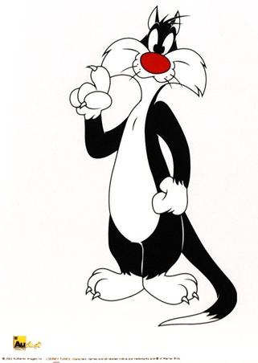

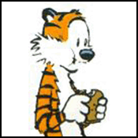
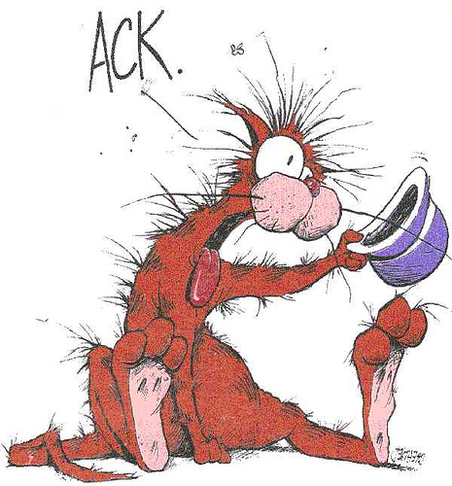

THE ORANGE CAT WITHOUT A HAT.
THE ORANGE CAT.
THE CAT.
Notes:
Disambiguation w.r.t. a given prior allows us to find an encoding
for which our intended message strongly dominates under our prior
Note that natural languages seem like they should satisfy disambiguation.

Slide 16
Closeness and communication
Priors P and Q are α-close (α ≥ 1) if
for every message m,
αP(m) ≥ Q(m) and αQ(m) ≥ P(m)
The disambiguation property and closeness together suffice for communication
Pick Θ=α²—then, for every m’≠m,
Q[m|e] ≥ ¹/_{α}P[m|e] > αP[m’|e] ≥ Q[m’|e]
SO, IF ALICE SENDS e THEN MAXIMUM LIKELIHOOD DECODING GIVES BOB m AND NOT m’…
Notes:
Alpha-close if P & Q (alpha-)dominate each other (in the usual sense)
Suppose Alice has prior P and Bob had prior Q.
…middle inequality obtained by disambiguation w.r.t. P,
the others by closeness of P & Q

Slide 17
Constructing an encoding scheme.
CAN BE PARTIALLY DERANDOMIZED BY UNIVERSAL HASH FAMILY. SEE PAPER!
(Inspired by Braverman-Rao)
Pick an infinite random string R_{m} for each m,
Put (m,e) ∈ E ⇔ e is a prefix of R_{m}.
Alice encodes m by sending prefix of R_{m} s.t.
m is α²-disambiguated under P.
COLLISIONS IN A COUNTABLE SET OF MESSAGES HAVE MEASURE ZERO, SO CORRECTNESS IS IMMEDIATE.
Notes:
…We know that when the disambiguation property is satisfied (for alpha^2),
Bob can use maximum likelihood decoding and recover m.
Since such a disambiguating index only fails to exist w.p. 0, this scheme works w.p. 1.
(Aside: we don’t strictly need *infinite* randomness. A message set of size M
can be derandomized with log M random bits… but see the paper for details.)
How efficient is it?

Slide 18
Analysis
Claim. Expected encoding length is at most
H(P) + 2log α + 2
Proof. There are at most α²/P[m] messages with P-probability at least P[m]/α². By a union bound, the probability that any of these agree with R_{m} in the first log α²/P[m]+k bits is at most 2^{-k}.
So: Σ_{k}Pr[|e(m)| ≥ log α²/_{P[m]}+k] ≤ 2
➔ E[|e(m)|] ≤ log α²/_{P[m]} +2
Notes:
The encoding length is pretty close to optimal and the proof is pretty short.
…
This sum – which is equal to the expected amount by which the encoding length exceeds log alpha^2/P[m] – is bounded by two
by the above bound on the terms of the sum.
That gives us the desired upper bound on the expected encoding length.

Slide 19
Remark
Mimicking the disambiguation property of natural language provided an efficient strategy for communication.
Notes:
Even though our construction is still not so similar to natural language,
it is still closer than Huffman codes and arithmetic coding. Of course, this was because
we attempted to mimic a property of natural languages in our construction.
The neat thing was that this gave us a strategy that not only worked for this new problem,
but was also efficient.

Slide 20
Encodings and ambiguity
Communication across different priors
“Implicature” arises naturally
Notes:
In this last part of the talk, I’ll show how a natural attempt to improve the efficiency
of our scheme further leads to an effect that appears in natural languages,
“conversational implicature.”

Slide 21

Motivation
If one message dominates in the prior, we know it receives a short encoding. Do we really need to consider it for disambiguation at greater encoding lengths?
PIKACHU, PIKACHU, PIKACHU, PIKACHU, PIKACHU, PIKACHU, PIKACHU, PIKACHU, PIKACHU, PIKACHU, PIKACHU, PIKACHU, PIKACHU, PIKACHU…
Notes:
The improvement in our scheme is motivated by the following observation…

Slide 22
Higher-order decoding
Suppose Bob knows Alice has an α-close prior, and that she only sends α²-disambiguated encodings of her messages.
If a message m is α⁴-disambiguated under Q,
P[m|e] ≥ ¹/_{α}Q[m|e] > α³Q[m’|e] ≥ α²P[m’|e]
So Alice won’t use an encoding longer than e!
Bob “filters” m from consideration elsewhere: constructs E_{B} by deleting these edges.

Slide 23
Higher-order encoding
Suppose Alice knows Bob filters out the
α⁴-disambiguated messages
If a message m is α⁶-disambiguated under P, Alice knows Bob won’t consider it.
So, Alice can filter out all α⁶-disambiguated messages: construct E_{A} by deleting these edges
Notes:
Same argument as before

Slide 24
Higher-order communication
Sending. Alice sends an encoding e s.t. m is α²-disambiguated w.r.t. P and E_{A}
Receiving. Bob recovers m’ with maximum Q-probability s.t. (m’,e) ∈ E_{B}

Slide 25
Correctness
Alice only filters edges she knows Bob has filtered, so E_{A}⊇E_{B}.
  So m, if available, is maximum likelihood message
Likewise, if m was not α²-disambiguated before e, at all shorter e’
  m is not filtered by Bob before e.
∃m’≠m
α³Q[m’|e’] ≥
α²P[m’|e’] ≥ P[m|e’]
≥ ¹/_{α}Q[m|e’]
Notes:
Note furthermore that it never does worse than the original scheme, and clearly
sometimes it may do better. (Not going to analyze performance in any detail
beyond this; not the point.)

Slide 26
Conversational Implicature
When speakers’ “meaning” is more than literally suggested by utterance
Numerous (somewhat unsatisfactory) accounts given over the years
  [Grice] Based on “cooperative principle” axioms
  [Sperber-Wilson] Based on “relevance”
Our Higher-order scheme shows this effect!
Notes:
The point: conversational implicature occurred *naturally* as a strategy to improve the
efficiency in our abstract problem!
We don’t claim that *everything* arises in an attempt to gain efficiency in our kinds of
problems… gives a simple account of many basic examples, though

Slide 27
Recap. We saw an information-theoretic problem for which our best solutions resembled natural languages in interesting ways.

Slide 28
The problem. Design an encoding scheme E so that for any sender and receiver with α-close prior distributions, the communication length is minimized.
(In expectation w.r.t. sender’s distribution)
Questions?

