Slide 1
Efficient Semantic Communication via Compatible Beliefs
Brendan Juba (MIT CSAIL & Harvard)
with Madhu Sudan (MSR & MIT)
Notes:
We introduce a refinement of the semantic communication model that captures settings
in which a protocol can be flexible without suffering impractical overhead

Slide 2
Motivation
Beliefs model
Sketch of result

Slide 3
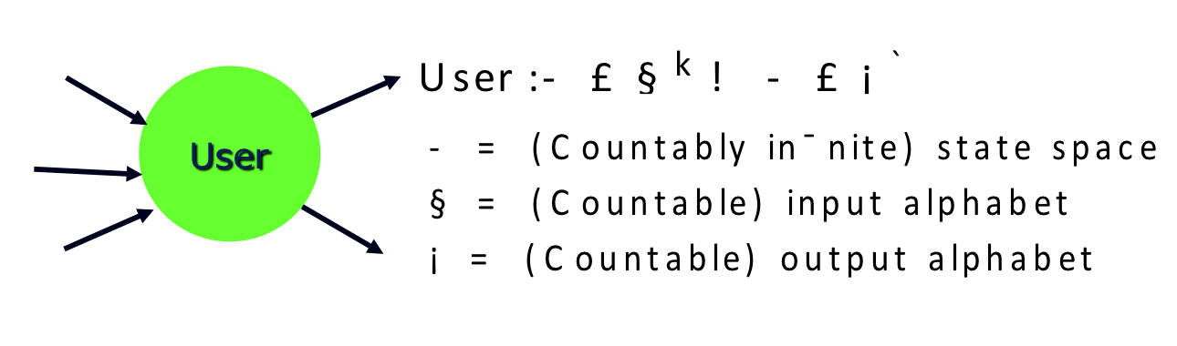
Miscommunication happens…
Q: CAN COMPUTERS COPE
WITH MISCOMMUNICATION AUTOMATICALLY??
Got that?
Notes:
Basic problem we wish to address: miscommunication in computer systems
ex: slides created by Madhu render as gibberish on my laptop…
more generally, often standards aren’t followed or protocols need to be updated
(e.g., IPv4->IPv6, need new driver for new printer)
Original motivating question: can computers cope with this automatically?

Slide 4

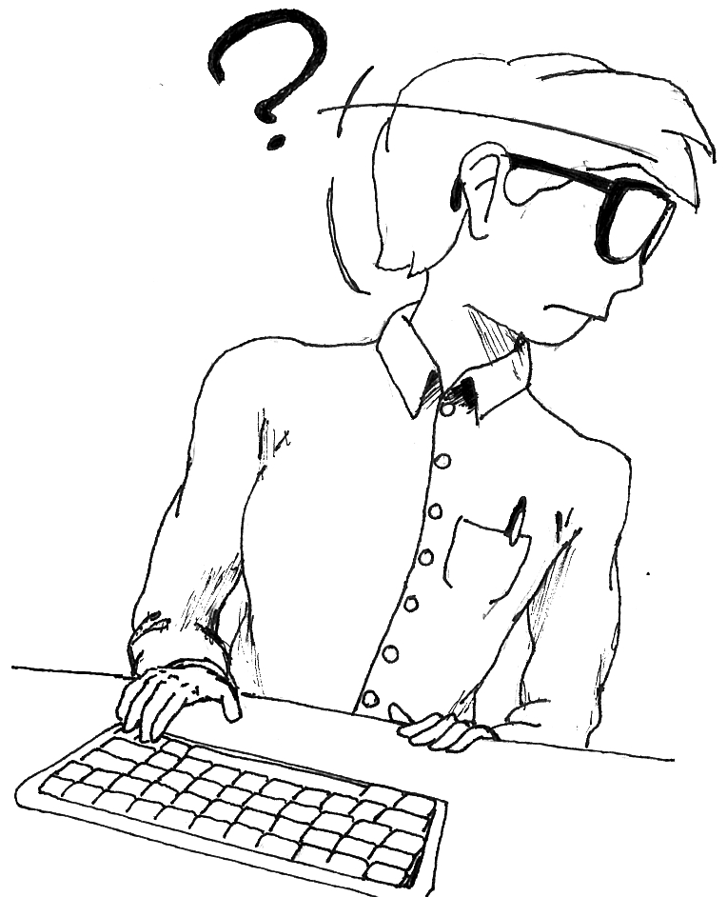
Defining (mis)communication
ENVIRONMENT
Printer
INTERFACE FIXED IN ADVANCE
Printer driver
Printer firmware
Notes:
Introduce “goals” so that we can define “correct functioning.” Ex, printing… want to write driver
The comm. entities are the printer driver and printer’s firmware – comm. across binary channel
But, *meaning* of their comm. Is actually given by their (inter)actions w.r.t. the env.-modeled by more channels
*These* channels correspond to the interfaces of the driver (w.r.t. computer system) and the firmware w.r.t. the printer’s hardware.
They are FIXED IN ADVANCE, as part of model goal (meaning of comm. across interface w/ Env. not in question)
THIS GOAL: end-user chooses a document, compares the output of the printer with chosen string.
Introduction of goal was ESSENTIAL: allows me to determine what is “good enough” communication
I really don’t care what happens in the bottom half, except as it affects the top

Slide 5

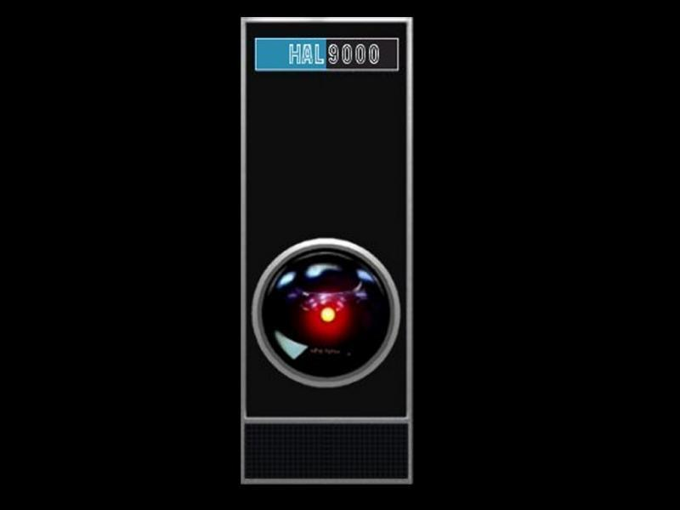
Goal of computation (function f)
This talk: f will be PSPACE-complete
x
ENVIRONMENT
“user returns f(x)?”
f(x)
“user”
“server”
Notes:
This talk: focus on goal of computation (though results generalize)
Environment sends user ‘x’ and user should return ‘f(x)’
we think of the user as randomized poly-time,
so only interesting when f is hard and
the user relies on the server to communicate the answer
IN PARTICULAR: this talk, we’ll focus on PSPACE-complete f

Slide 6
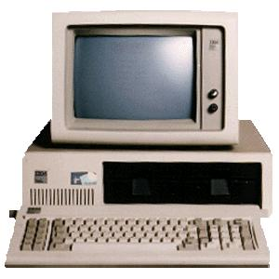
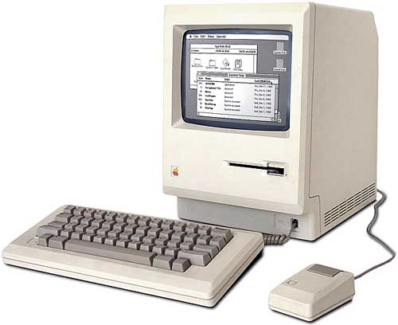
S-universal user (for computing f)
x
ENVIRONMENT
“user returns f(x)?”
S
f(x)
Notes:
A strategy that overcomes potential miscommunication is referred to as a
“universal user” (w.r.t. a fixed background goal for communication)
always modeled as universal w.r.t. a collection of possible servers S:
formally, no matter which server in S is encountered, the user succeeds (computes f)
Thus overcoming the potential miscommunication

Slide 7
S-universal user (for computing f)
Formally,
U is a S-universal user for computing f if
∀servers S∈S ∃ poly. running time for U
∀inputs x, initial states of U & S
Pr[ ] ≥ ⅔
On input x with S, U runs poly(|x|)
steps and U’s final output is f(x)
[JS’08]: can construct universal users for computing PSPACE-complete f for maximally large class S

Slide 8
Problem: Password-protected servers
x
ENVIRONMENT
11110
11110
110
0110
f(x)
Notes:
The trouble is that most classes of servers S we naturally define
contain “password-protected” servers:
the server has a “password” in mind, and doesn’t say or do anything
unless it receives the password.

Slide 9
Theorem [JS08,GJS09]. S-Universal users for classes S containing password-protected servers and goals that require the server to act must run for Ω(2^{l}) rounds with servers with passwords of length l.
PROMISES MORE THAN WE WANTED!
CAN WE REFINE AWAY PASSWORDS??
Notes:
We’re unhappy that password-protected servers are included in these classes because
password-protected servers thwart our attempts to give reasonable running-time bounds.
We never expected nor wanted to have a “universal break-in” though;
can we *refine* our defs. so that success won’t promise to find passwords efficiently?

Slide 10
Motivation
Beliefs model
Sketch of result
Notes:
Will show one approach to eliminating passwords & giving reasonable bounds
by introducing “beliefs” of the user and server into the model
In particular, will allow us to capture a notion of the server being “easy to use”

Slide 11
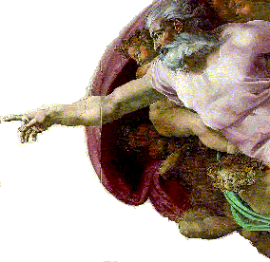

Server’s Beliefs
I’VE CHOSEN AN S WITH POLYNOMIAL Q-BENCHMARK RUNNING TIME
Q
x
SO, NO PASSWORD!!
f(x)
t_{U,S}(|x|)
Def’n: Q-Benchmark running time
T_{Q,S}(n) = E_{U⬅Q}[t_{U,S}(n)]
Notes:
Roughly, we assume the server has a prior distribution Q over user strategies;
For a random user strategy drawn from Q,
can evaluate quality of server w.r.t. these “beliefs” in terms of users’ running times
ASSUME: users from Q achieve goal with server.
thus: define Q-Benchmark running time of a server
“server designer” optimizes running time of users from Q,
that is: chooses S with low Q-benchmark running time

Slide 12
PREFIXING A MESSAGE WITH %!PS-Adobe IS THE MOST NATURAL THING IN THE WORLD.
WHY DOESN’T IT WORK??
Q
THAT ISN’T A “PASSWORD.”
x
MORAL: NEED “SIMILAR” BELIEFS…
Notes:
Haven’t solved anything yet: DOES NOT guarantee server is ACTUALLY easy to use
imposition of Q corresponds to an assumption, so for example… (specter of passwords…)
more formally: if Q is program length-weighted uniform dist,
benchmark running time depends on choice of programming language

Slide 13
Compatibility
α(P, Q ) = Σ_{ω} min{P(ω),Q(ω)} = 1-|P-Q|_{TV}
P
Q
Notes:
Suppose that the *user* has a prior belief distribution P
over what *user* protocols are natural
and that the server has a prior belief distribution Q (as before)
Now, we define the agreement of P and Q as… (box) i.e., 1-(stat. dist/total var. dist.)
this will be our formal measure of the compatibility of beliefs.

Slide 14
Compatibility controls overhead of universal communication
DEPENDENCE ON SERVER?
Theorem. Let P be a sampleable distribution, suppose every server S∈S has a belief distribution Q_{S}.
For PSPACE-complete Π, there exist polys r & w such that if strategies from Q_{S} decide Π with S,
there is a user strategy U_{P} that computes Π with any S∈S on x of length n in time
w(¹/_{α(P, Q )},n) × (T_{Q,S} o r)(n)
Can recover [JS’08] by taking
P = length-weighted uniform
Q_{S} = δ_{U(S)} (for U(S) helped by S)
DEPENDENCE ON BENCHMARK TIME W.R.T SERVER BELIEFS
DEPENDENCE ON COMPATIBILE BELIEFS
RECALL: “benchmark time” T_{Q,S}(n) = E_{U⬅Q}[t_{U,S}(n)],
“compatibility” α(P, Q ) = Σ_{ω} min{P(ω),Q(ω)}
Notes:
All we need to state our main theorem: the (in)compatibility controls the
overhead beyond the benchmark time taken by a universal user strategy,
eg., for deciding PSPACE-complete problems
(there may also be some polynomial blow up, from n to r(n), in the “input size”)
Captures original result, but reduces the overhead if the server, e.g., helps many users
Or if the user’s distribution may be restricted somehow

Slide 15
Key points
Server designers can evaluate benchmark time w.r.t. their beliefs
Compatible beliefs lead to low overhead (beyond benchmark time)
Beliefs capture natural approaches
Notes:
(1) Is clear from def’n of benchmark running time; (2) follows from our main theorem.
(3) is fuzzier, but the point is that whether one has a list of protocols one wants to serve (USB),
one wishes to help all “simple” programs in some programming language,
or one wishes to exploit “analogies” to natural languages/human behavior,
we can define belief distributions to capture these kinds of assumptions.
Thus our framework captures the natural approaches to enabling efficient compatibility

Slide 16
Motivation
Beliefs model
Sketch of result
Notes:
The proof of the main theorem is pretty easy and not the point,
but I’ll give you a quick idea of how it goes

Slide 17
Starting point: [JS’08]
High weight in P corresponds to short programs in enumeration
SAMPLE
Enumerate algorithms U’:
give each constant share of running time, repeatedly double running time (cf. Levin’73)
Use U’ with S to simulate interactive proof system for Π, return answer if successful
(exploits efficient prover strategy using Π)
FROM P
REPEATEDLY DOUBLE # OF SAMPLES PER TIME BOUND,
INTRODUCE DOUBLED MAXIMUM TIME BOUND
Notes:
As a starting point, we recall the simple algorithm from earlier work, that is in turn
an interactive analogue of Levin’s universal search algorithms…
The key point is that PSPACE-complete problems Pi have proof systems in which
the prover can be simulated by queries to Pi; verifier then checks answer.
Our new strategy samples instead, and uses a related sampling schedule
(…so in phase i there are i bounds, exponentially growing, total time spent on each is 2^i…)

Slide 18
Analysis in three easy steps
Markov’s inequality: For poly. r from proof system, U’⬅Q_{S}, see success w.p. 1-γ
if we use U’ run for (¹/_{γ})(T_{Q,S} o r)(n) steps
See success w.p. 1-γ-|P-Q|_{TV} = α(P, Q_{S} )-γ for U’⬅P instead
So, if we run 2/α(P, Q_{S} ) samples from P for
(²/_{α(P, Q )} )(T_{Q,S} o r)(n) steps each, see success with constant probability
So, try using γ = α(P, Q_{S} )/2
w also contains: overhead from simulating proof system, logarithmic overhead in 1/α(P, Q_{S} )
(i distinct bounds in phase i)

Slide 19
Compatibility controls overhead of universal communication
Theorem. Let P be a sampleable distribution, suppose every server S∈S has a belief distribution Q_{S}.
For PSPACE-complete Π, there exist polys r & w such that if strategies from Q_{S} decide Π with S,
there is a user strategy U_{P} that computes Π with any S∈S on x of length n in time
w(¹/_{α(P, Q )},n) × (T_{Q,S} o r)(n)
Actual dependence:
Õ(¹/_{α(P, Q )}²)
RECALL: “benchmark time” T_{Q,S}(n) = E_{U⬅Q}[t_{U,S}(n)],
“compatibility” α(P, Q ) = Σ_{ω} min{P(ω),Q(ω)}

Slide 20
RECAP: We refined the semantic communication model to capture natural settings in which flexible communication is possible with low overhead.

Slide 21
Open problem
Construct a server with low benchmark running time for a natural goal and belief distribution!
Notes:
I’ve told you how these servers can be used, not how to build them.
We have one simple example in the paper, where the users are expected to “identify their language”
I don’t count this as a “natural” belief distribution (although it does capture practice, cf. USB)

Slide 22
Key points
Server designers can evaluate benchmark time w.r.t. their beliefs
Compatible beliefs lead to low overhead (beyond benchmark time)
Beliefs capture natural approaches
RECALL: “benchmark time” T_{Q,S}(n) = E_{U⬅Q}[t_{U,S}(n)]
RECALL: “compatibility” α(P, Q ) = Σ_{ω} min{P(ω),Q(ω)},
overhead is Õ(¹/_{α(P, Q )}²)
FIN.

