Slide 1
Universal Semantic Communication
Brendan Juba (Harvard and MIT)
with Madhu Sudan (MSR and MIT)
& Oded Goldreich (Weizmann)
Notes:
I’m going to present a new model
for communication in the absence of a fixed common language
thus allowing us to design algorithms that overcome the problems
of miscommunication that may arise in such instances

Slide 2
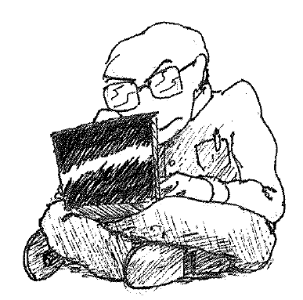
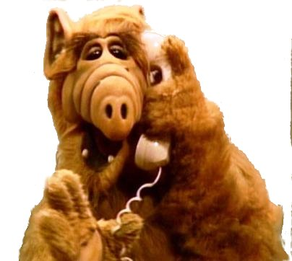

Notes:
Our model will capture different degrees of knowledge of a common language
At the one extreme, when both ends understand each other perfectly,
we recover, e.g., the settings of information theory or communication complexity
And at the other, where there is no a priori understanding…
we can think of communicating with an “alien”
How can we model this? The idea is to consider, rather than a single “alien,” …

Slide 3








Notes:
(rather than a single “alien”) we consider a large CLASS of ALL potential “aliens”
that we might encounter.
The objective will be to design a communications protocol
that “works” with ALL of these “aliens.”
“works?”

Slide 4
HOW DO WE DEFINE THE “MEANING OF THE COMMUNICTATION???”
110100
110100
TO BE CONTINUED…
Notes:
Shannon’s model: “working” meant receiver got same bits produced by source. since Shannon controlled both ends of channel, end of story.
We no longer know what’s at the other end, and learning the entire “translation” map
not generally possible… fortunately, also turns out to be unnecessary.
… intuitively, we only want the “meaning of communication” to be the same, i.e., learn “enough”
(meaning?? e.g., comm. complexity: compute joint function… getting right answer is “enough”)
But note, the meaning can’t be defined by what we say! (Strings exchanged are arbitrary!)
How do we resolve this issue???
For exposition (and motivation), we’ll fix a very concrete, natural instance

Slide 5
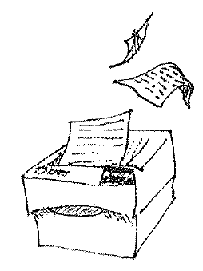
A FAILURE TO COMMUNICATE!
MAN, WHAT THE EFF??
Notes:
Suppose Bob just got a new printer; he hits “print,” and then this happens…
…What we have here is a failure to communicate.
In a sense, the printer is speaking a different “language”
than Bob’s computer expects. (Wrong driver---happens!)
We would like a model to capture and address
such misunderstandings in communications systems

Slide 6
Outline
Model of communication
Theory of finite communication
Example: computation
Model for infinite communication
Notes:
Inf. theory/comm. complexity assume that “communicators” at ends of channel
designed together, precisely what fails to hold in such settings.
(e.g., printer didn’t exist when computer was built)
So, we’ll describe a model of communication better suited to
capturing and addressing problems of “miscommunication,”
by introducing the “meaning” of the communication to the model

Slide 7
“Meaning” = Usage
=
ENVIRONMENT
Notes:
Relax problem by introducing “Meaning,” means exactly what we need it to here:
the communication serves our purposes. So for example, here…
… the “meaning” of the communication is that the printer will print the user’s doc.
(mention, this view of meaning has long pedigree in philosophy…)
“I don’t know what goes across that cable, and I don’t want to know!” – seems true in general
In particular: the “meaning” of the communication is something external to the comm. channel
…in our model, take everything beyond the communications channel
as the “environment” … specifically including the doc. to be printed and printed pages

Slide 8
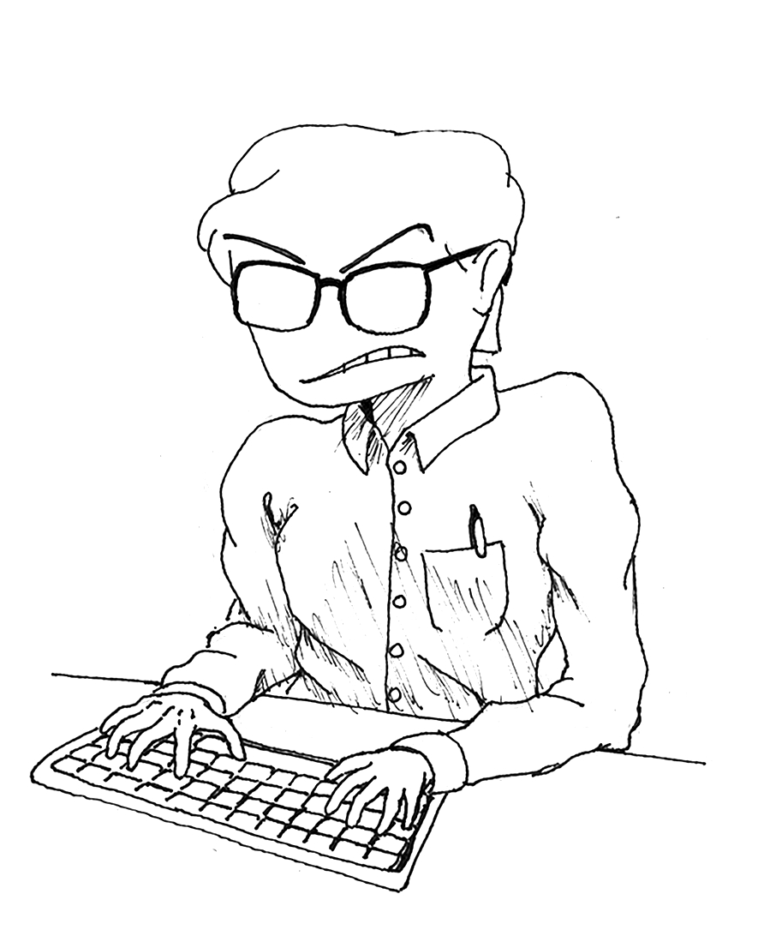
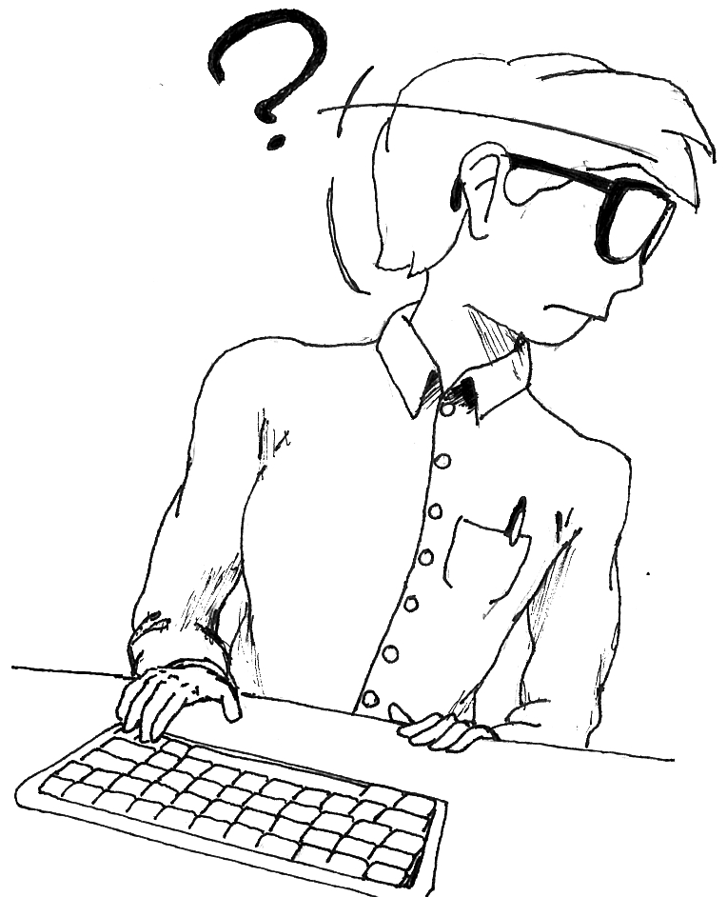
Printing, formally
GOAL OF COMMUNICATION
ENVIRONMENT
Printer
INTERFACE FIXED IN ADVANCE!
Printer driver
Printer firmware
Notes:
Precisely, the comm. entities are the printer driver and printer’s firmware – share binary channel
Meaning of their comm. is given by their (inter)actions w.r.t. the env.-modeled by more channels
*These* channels correspond to the interfaces of the driver (w.r.t. computer system) and the firmware w.r.t. the printer’s hardware. They are FIXED IN ADVANCE (part of the model Env.)
(so meaning of comm. across interface w/ Env. not in question)
THE GOAL. Formally: end-user (in Env) nondet. chooses a document (string),
intuitively, referee compares the output of the printer with chosen string.
Formally, compare representations sent across the two interfaces.

Slide 9

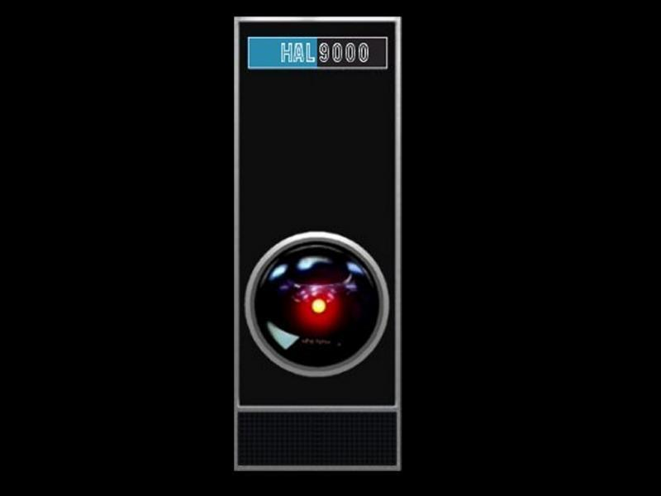
Abstract goals of communication
“G = (ENV,R)”
ENVIRONMENT
BEHAVIOR DEFINED WITH GOAL
environment internal state
R: g {0,1}
dist.
over
dist.
over
U: Ω^{u} × {0,1}* g Ω^{u} × {0,1}*
S: Ω^{s} × {0,1}* g Ω^{s} × {0,1}*
σ^{u}₁
σ^{s}₁
σ^{u}₂
σ^{s}₂
FINITE GOAL OF COMMUNICATION: “USER ACHIEVES GOAL” IF
USER “HALTS” WHEN R = 1
“USER”
“SERVER”
Notes:
model communication between “user” and “server” – binary channel
communication is a Markov process over internal states and msgs. (actually, msg. *profile*)
Meaning of their interaction defined by third entity in interaction: “the environment”
Captures *everything* external to user-server communication,
Env’s behavior w.r.t. state (*interface*) crucial elt. in def’n of goal;
“success of communication” is a function of its state (e.g, R : “doc. = printout?”).
(Its state can be def’d to store entire history, so not really a limitation)
*THIS* is what we want to remain constant across all different “languages.”
Finite comm: User “achieves goal” if it returns/halts when comm. is successful

Slide 10
Goal of computation (function f)
x
ENVIRONMENT
R = “user message = f(x)?”
f(x)
Notes:
(Remember: goal given by pair, ENV. and R.)
Environment sends user ‘x’ and user should return ‘f(x)’
the server is not necessarily involved at all
we think of the user as randomized poly-time,
so if f can be computed in randomized poly-time,
the user can send f(x) on its own… but if f is hard,
the user relies on the server to communicate the answer

Slide 11
Key Concepts
Goal of Communication
Universal user
Sensing function
Helpful server
Notes:
Four key definitions will appear in this talk.
We just saw goals, a generalization of a “computational problem”
Next, we’ll see a solution concept,
Universal users---the algorithms we seek for goals
The other two… will appear in the next part of the talk.

Slide 12
Bob’s problem
I DON’T KNOW WHICH ONE!
P
?
?
BOB WANTS TO PRINT SUCCESSFULLY, REGARDLESS OF WHICH PRINTER HE IS USING
Notes:
That was the model of communication. Let’s see how it captures Bob’s problem,
modeling “misunderstandings” in communication…
One printer interprets ‘0’ as white and ‘1’ as black, and the other is vice-versa.
Bob just wants to print out *his* document, regardless of the printer he gets
Presumably, if Bob knew how the printer was going to treat its messages,
he could send the document or its “inverse” and get his desired printout
(We could also imagine a much larger class of printers…)

Slide 13
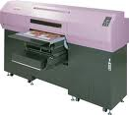



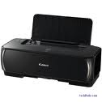



Notes:
(we could imagine a much larger class of printers)
each with a different driver and hence a different “language”
and we will define some large classes later, when we model
“communication without common knowledge”
but for now, we’ll stick to the current, concrete set of printers

Slide 14

Universal user
P-Universal user for printing
ENVIRONMENT
P
NOTE: WE SHOULD SUCCEED FROM ANY STATE
Notes:
(abstract) solution concept: A universal user succeeds at communication
no matter which member he/she communicates with---
so here, no matter which printer we are connected to… we should print correctly.
(Properly, for the class of printers P, P-universal user for printing)
Also require that universal user succeeds from *any* state of the server+env…
correspondingly, only consider “forgiving” goals where this is possible (next)

Slide 15
FROM ANY STATE??
I SURE BLEW THAT…
ENVIRONMENT
ENVIRONMENT
1101
1101
THAT’S ALL I NEEDED TO HEAR!
I’M THROUGH WITH YOU
Notes:
We introduced the caveat about “any state” because otherwise
our problem is impossible for an uninteresting reason
Exactly the right thing to do in one situation…
…may make the goal impossible to achieve in another.
(Similarly, with the environment, we might “fall off a cliff”)
Ideally, we’d like a relaxation of this condition, but stipulating that
*any* state should be OK is the simplest way around this problem

Slide 16
Summary: universal user
Definition. A universal user for a goal G = (ENV,R) and a class of servers S is a user strategy s.t. for every server S in S and every initial state of S and ENV, the user achieves G.
(w.h.p.)
WE WILL SAY THAT THE UNIVERSAL USER IS “EFFICIENT” IF, WITH EACH SERVER S IN S,
THE USER RUNS IN SOME POLYNOMIAL TIME
DEPENDING ON S, WITH THE GOAL-SPECIFIC SIZE PARAMETER DEPENDING ON ENV.
That is, halts when R = 1
Notes:
So, to recap, here is our second key definition.
Properly, we usually consider achieving G “whp” (we won’t dwell on this today)
We measure time complexity in a goal-specific way. Usually there is a “natural” way
(e.g., “instance length”) but don’t want to worry too much about how this is done (in the bg)…
Note that our notion of “efficient” here allows arbitrary dependence on S.

Slide 17
Outline
Model of communication
Theory of finite communication
Example: computation
Model for infinite communication
Notes:
Questions about the model?
(We’ll get a sense of when these problems can be solved next…)
Now, we’ll see some theorems that inform us about the requirements
of universal users that only run for a finite amount of time and halt.

Slide 18
IT’S ALL ABOUT THE FEEDBACK!!
Notes:
intuitively, feedback is essential, and we can formalize this intuition.
But more significantly, we can specify an appropriate kind of feedback
that is *sufficient* for the construction of universal users!

Slide 19
Key Concepts
Goal of Communication
Universal user
Sensing function
Helpful server
Notes:
brings us to our third key definition, sensing
the formal notion of feedback
which turns out to be crucial

Slide 20


Sensing functions: “safety”
ENVIRONMENT
I CAN STOP!
RECALL, REFEREE:
R : environment’s view g {0,1}
SENSING FUNCTION:
V : user’s view g {0,1}
“V IS SAFE”:
V = 1 e R = 1 (w.h.p.)
Notes:
sensing function: allows the user to “sense” the environment’s satisfaction
a boolean function that the user can compute from its various interactions;
Ideally, the sensing fn.’s indication should match referee’s verdict, but eff. it’s “just a window”
the sensing function is “safe” for the goal and class of servers if,
when it gives a positive indication, the user can halt and the goal is achieved.
(note, it need not *always* give a positive indication
whenever the user is succeeding... one that is never positive is always “safe,”
so need more than just “safety” to be of any use)

Slide 21

Sensing functions: “viability”
ENVIRONMENT
I CAN STOP!
M
“V IS VIABLE” IF THERE EXISTS SOME USER STRATEGY THAT RELIABLY OBTAINS V = 1
Notes:
complementary notion called “viability”
says: regardless of printer and environment’s states,
(regardless of what user has done, even adversarially)
some efficiently computable actions *can*
obtain a positive indication from the sensing function
(for every server in the class, some such program exists)
… like “forgivingness” for sensing functions… important because…

Slide 22
Theorem 1. If there is an efficiently computable S-safe and S-viable sensing function for a goal, then there is an efficient
S-Universal user for that goal.
Achieving Universal Communication
Each algorithm of length l gets ≈ 1/l²2^{l}-share of the total running time
ENUMERATE ALL USER ALGORITHMS, RUN EACH WITH CONSTANT FACTOR OVERHEAD: SAFE & VIABLE SENSING FUNCTION INDICATES WHEN TO HALT
Notes:
Sensing functions are the crucial bit of feedback to enable constructions of universal users:
Given safe & viable sensing function, we can enumerate
all programs, incurring only a “constant factor overhead” in the running time
safety => only stop when successful, viability => efficiently observe success.
… but the constant factor is *terrible*, exponential in program length.
Can we hope to do better?

Slide 23
Theorem 2. There is a natural class of 2^{l} servers S s.t. a S-Universal user for any goal that requires the server to act experiences an overhead of
Ω(2^{l}) rounds.
Theorem 2. There is a natural class of 2^{l} servers S s.t. a S-Universal user for any goal that requires the server to act experiences an overhead of
Ω(2^{l}) rounds.
Might still consider restricted classes where we can be efficient…
IT TAKES ≈2^{l} ROUNDS TO SEND
ALL 2^{l} PASSWORDS OF LENGTH l!
NOTE: QUALITATIVELY OPTIMAL IN TERMS OF PROGRAM LENGTHS!
Notes:
No! We have this theorem…
The class S is a class of “password protected” servers
that don’t act until they get their own L bit “password” from the user
Note that since L-bit passwords can be hard-coded into programs at the cost of L bits, the enumeration is qualitatively optimal for the password classes.
A simple class, so concerning; nevertheless, can consider restrictions that reduce overhead

Slide 24
So what is Theorem 1 good for??
CHARACTERIZATION IN TERMS OF SENSING FUNCTIONS CAN BE USEFUL
Notes:
... we’ll show how it captures the capabilities of the strongest possible universal users.

Slide 25
Helpful servers
KEY DEF. #4…
ENVIRONMENT
“S IS HELPFUL” IF THERE EXISTS SOME USER STRATEGY THAT RELIABLY SUCCEEDS AT G
Notes:
(Key def. #4) Fix a goal “(ENV.,R)”, and consider servers that are “helpful” for it
i.e., for which there exists some fixed efficient program,
that, regardless of the state of the server/environment,
will succeed at the goal. (Makes R happy *AND HALTS*)
(in contrast to viability, makes no reference to a “sensing function”
but rather, refers directly to achieving the goal)

Slide 26
S_{G}
Notes:
For a goal G, we’ll denote this class
of servers that are helpful for G
by “S_G”
It contains *all* servers for which *some* efficient user can reliably succeed at G
this is the largest class for which a user could hope to succeed at G.
--a user succeeding with a server witnesses its membership in this class

Slide 27
S_{G}-Universal user for G
No Common Knowledge Necessary!
ENVIRONMENT
S_{G}
Notes:
Thus…whenever it is possible for a program to reliably succeed at a goal G,
a universal user for the class of all helpful servers also succeeds!
Such a user is “maximally universal” (achieves G for the largest possible set)
Such a user would solve Bob’s original printing problem in a very strong sense
it succeeds no matter which printer is provided, as long as it prints.
This is our formalization of “communicating with aliens”
(Since S_G contains password-protected servers, Theorem 2 tells us that
this user can’t be too efficient, and pf. of Thm. 1 gives an optimal construction…)

Slide 28
Theorem 3. If there is an efficient
S-Universal user for a goal, then there is an efficiently computable S-safe and S-viable sensing function for that goal.
THE FUNCTION THAT TELLS A UNIVERSAL USER WHEN TO HALT IS A SAFE & VIABLE SENSING FUNCTION
Notes:
So we see (by Thm. 1) that it is possible to construct a universal user (for the class of all helpful servers) if we have a safe & viable sensing function.
Now… moreover, we see that sensing is the *only* way we can construct a universal user
(in the finite communication setting..) (Proof)

Slide 29
Main Theorem. There is an efficient
S-Universal user for a goal if and only if there is an efficiently computable S-safe and S-viable sensing function for the goal.
MORAL: SAFE & VIABLE SENSING FUNCTIONS ARE PRECISELY THE FUNCTIONS THAT TELL UNIVERSAL USERS WHEN TO HALT!
Notes:
In summary, the finite communication setting is captured by this main theorem
(… & the proof is summarized by the following observation…)
so it is an exact characterization …again, *in the finite communication setting.*
We see that the requirement that the user halts makes things clear & simple, but there are other settings (“on-line” or “infinite” communication) where things aren’t so clear.

Slide 30
Theorem 4. If a sensing function is S_{G}-safe for a goal G, then it is safe for G with all servers, even malicious and unhelpful ones.
CAN CONSTRUCT A HELPFUL SERVER
THAT BREAKS SAFETY WHENEVER SOME ADVERSARY CAN
Notes:
Another limitation of these very strong users:
Thm. 3 says that the halting fn. for universal users for class of all helpful servers
is a safe sensing fn. for the class of all helpful servers…
These sensing functions must be very safe---they must not provide
false positive indications, no matter what.

Slide 31
Proof sketch: Theorem 4
ENVIRONMENT
I CAN STOP!
NOT
S_{G}-SAFE
FOR G
S_{G}
Notes:
Not safe: there’s an adversary who can make the fn. output 1 w/out succeeding.
Notice that there are servers in S_G that have arbitrary behavior on any finite set of histories.
(E.g., servers that become helpful when they receive a password outside this finite set of msgs.)
So, the adversary can find a server in S_G that approximates his interaction with the user---this helpful server fools the sensing fn, therefore can’t be S_G safe

Slide 32
RECAP: 1. Sensing is necessary and sufficient
2. Sensing with helpful servers must also be safe with all servers
We’ll see a more concrete interpretation of these theorems next…

Slide 33
Outline
Model of communication
Theory of finite communication
Example: computation
Model for infinite communication
Notes:
We’ll illustrate these theorems with the goal of computation.
We stress that this is just a nice (concrete) illustration of these theorems!
(one which a complexity theorist might particularly appreciate…)
Our definitions of goals captured *much* more than simply computational problems!!

Slide 34
Goal of computation (function f)
x
ENVIRONMENT
R = “user message = f(x)?”
f(x)
Notes:
(Remember: goal given by pair, ENV. and R.)
Environment sends user ‘x’ and user should return ‘f(x)’
we think of the user as randomized poly-time,
so only interesting when f is hard and
the user relies on the server to communicate the answer

Slide 35
For which problems can solutions be communicated without common knowledge?
Notes:
(i.e., with the class of all helpful servers for solving the problem)
We’ll see a characterization of these problems shortly… but first…

Slide 36

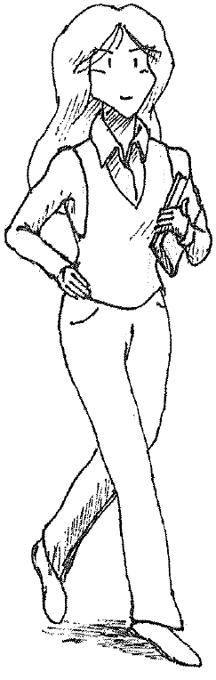
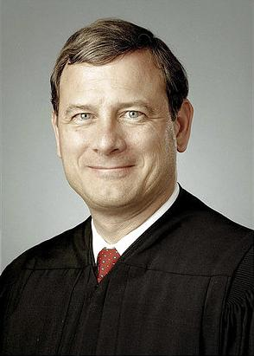
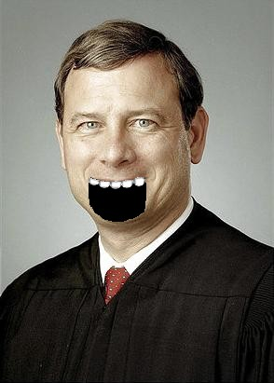

Competitive Proof Systems
(Bellare-Goldwasser ‘94)
S
“x ∈ S”
PROVE IT!
WELL, I’M CONVINCED!
YOU AREN’T FOOLING ANYONE!
EFFICIENT, GIVEN ORACLE FOR S
COMPLETENESS
(“COMPETITIVE PROVER”)
SOUNDNESS
(STANDARD)
Notes:
Restricted proof sys. introduced by Bellare & Goldwasser to study complexity of provers
soundness property is standard: proving claim, “x in S;” if x not in S,
cheating prover can’t fool verifier w.p. > 1/3.
completeness property is important part: exists “competitive prover” …
an efficient (poly-time) prover strategy using oracle for S, convinces verifer x in S w.p. > 2/3.
A natural choice: convincing a sound efficient verifier implies that we can decide S,
so assuming the prover can decide S (i.e., with help of oracle) is a minimal requirement
(So why am I heading off on this digression..?)

Slide 37
Theorem 5. Let G be the goal of deciding membership in a set S.
Then there is a S_{G}-universal user for G iff there are competitive proof systems for both S and S^{c}.
Corollary. If there is a S_{G}-universal user for G then S is in PSPACE.
Notes:
These competitive proof systems turn out to be exactly what we need…
(really, more generally, a competitive proof system that “works” for every instance)
This solves our problem, in a sense. (characterization in terms of prior concepts)
we also have this corollary… (compet. proof system => IP=PSPACE)
and finally, I’ll give some examples of problems that have universal users later.

Slide 38
Theorem 5: obtaining a competitive proof system from a universal user
TIME’S UP…
x
ENVIRONMENT
“x ∈ S”
S(x)
S_{G}
NOT FOOLED: THEOREMS 3&4
S
Notes:
We have a universal user who works with every helpful server
an oracle for S is, in particular, helpful.
So, there must be a fixed poly. running time for the user w.r.t. an oracle for S.
The pf sys verifier runs the universal user for this bounded amount of time (interact. w/ prover),
and checks that the answer the user produces matches the claim
note: simulating the S-oracle is trivially a competitive prover strategy, and it’s complete here;
by Thm 4 (& 3) the user doesn’t produce wrong answers with adversarial servers
and hence, either gives the right answer or no answer w/ a cheating prover

Slide 39
Theorem 5: obtaining a universal user from a competitive proof system
x
HELPFUL SERVER
“x ∈ S”
I WON’T BE FOOLED!
S
Notes:
We have a proof system w/ a prover that is efficient given an oracle for S
no such thing exists… but if the server is helpful for deciding S,
there is a user strategy that, interacting with the server, simulates the S oracle
Suppose we had guessed this user strategy somehow…
we use this to obtain the claim (for the value of x) and simulate the prover
We actually enumerate user strategies (with const. factor overhead)
Prior to getting it right, the verifier’s soundness guarantees we don’t return wrong answers (effectively, same construction as in proof of Thm. 1)

Slide 40
Computational problems with universal users
Any PSPACE-complete problem [Shamir’92]
Any #P-complete problem [LFKN’92]
Graph Isomorphism [GMW’91]
Total functions in NP (solvable by
Levin’s universal search algorithm [Levin’73])
  Integer Factoring
  Discrete Logarithm
  many more…
Notes:
This is a list of problems with the necessary competitive proof systems;
(w. references)
Thus, by theorem 5, we find that each of these problems has a universal user

Slide 41
Outline
Model of communication
Theory of finite communication
Example: computation
Model for infinite communication
Notes:
want to say a few words about infinite executions
this model is generally much more complicated,
so can’t get into much detail here
will be suitable for servers, operating systems, etc… that don’t “return” or “halt”

Slide 42
Multi-session goals
REPEATING FINITE COMMUNICATION STRATEGY:
PROBABILITY p OF FAILURE EACH SESSION…
REPEATING FINITE COMMUNICATION STRATEGY:
PROBABILITY p OF FAILURE EACH SESSION…
INFINITE SESSION STRATEGY: ZERO ERRORS AFTER FINITE NUMBER OF ROUNDS
ENV
…
SESSION 1
SESSION 2
SESSION 3
Notes:
on-line setting: adversary chooses state of environment for each session,
must achieve (finite execution) goal repeatedly
User doesn’t (necessarily) control session end! (but, gets many sessions to work with)
A finite execution strategy would incur an error on each session with prob. P
but we could expect that the “right” strategy shouldn’t incur *any* errors,
so correspondingly we might wish that we eventually “learn” this strategy from our mistakes---
that “miscommunication” is restricted to a bounded “initial period”
i.e., incur no errors after finite # of sessions … # can vary depending on server
(important if user doesn’t control session end so that the goal is forgiving for infinite class)

Slide 43
Sensing for infinite goals
SAFETY: ERRORS DETECTED WITHIN FINITE # OF ROUNDS
I’D BETTER TRY SOMETHING ELSE!!
VIABILITY: FAILURES CEASE WITHIN FINITE # OF ROUNDS FOR AN APPROPRIATE COMMUNICATION STRATEGY
ENV
…
SESSION 1
SESSION 2
SESSION 3
Notes:
Since we aren’t bound by needing to decide when to terminate the session,
we can actually achieve this stronger long-term goal with weaker sensing:
rather than needing to detect whether or not the referee is satisfied,
we only need to detect failures a finite number of rounds later
(some delay = some add’l failed sessions is OK)
Thus, safety: sensing fn. detects failures w/in some bounded # of rounds
(unless we’re actually succeeding at the goal, i.e., we know errors are fixed)
and viability: after some bounded # of rounds, we don’t see any more failures

Slide 44
This weaker version of sensing suffices to construct universal users for infinite goals.
But is it necessary??

Slide 45
An impossible finite goal
I WONDER IF IT PRINTED…
ENVIRONMENT
11110
110
0110
RECALL: WE SHOULD STOP IN FINITE TIME
Notes:
Something impossible in the finite communication setting due to lack of feedback:
suppose the environment provides no feedback on the printer’s output
and suppose the printer is password protected…
all the printers look exactly the same to us---even the ones where he didn’t guess the pw
…can’t try all infinitely many passwords in finite time,
so a universal user can’t *stop* in finite (bounded) time! (else he fails w/ those printers)
Thus, the user can’t achieve this goal in the finite comm. setting

Slide 46
A possible infinite goal
ENVIRONMENT
11110
110
0110
PASSWORD FOUND IN FINITE # OF ROUNDS
MORAL: FEEDBACK IS UNNECESSARY!
Notes:
Now consider the same goal, but suppose we have infinitely many rounds to work in
enumerate the passwords, trying successively more each round
for each password, there is some finite round after which we find the password.
Thus, the goal is achieved without feedback in any meaningful sense—we don’t need feedback!
Again, the crucial difference here was that the user didn’t need to decide when to halt.
Extends to (weak) universal strategy for “very forgiving” goals:
run more and more protocols each session! (run the right one after finite #...)

Slide 47
We saw a model for capturing problems of misunderstanding in communications systems.
We also saw some limits of “strong” solutions to this problem.

Slide 48
Key Concepts
Goal of Communication
Helpful server
Universal user
Sensing function
G = (ENV,R: g {0,1})
environment internal state
V : user’s view g {0,1}
SAFETY: ERRORS DETECTED WITHIN FINITE # OF ROUNDS
SAFETY: V = 1 e R = 1
THERE EXISTS SOME USER STRATEGY THAT RELIABLY SUCCEEDS AT G
VIABILITY: FAILURES CEASE WITHIN FINITE # OF ROUNDS FOR AN APPROPRIATE COMMUNICATION STRATEGY
VIABILITY: THERE EXISTS SOME USER STRATEGY THAT RELIABLY OBTAINS V = 1
for every server S in S and every initial state of S and ENV, the user achIeveS G
Notes:
A talk about four key definitions
GOAL G is given by a pair, the environment and a referee
HELPFUL SERVER for G allows robust achievement of G
we hope to do so with all such servers using a single UNIVERSAL USER
constructing which is equivalent to constructing a SENSING FUNCTION
that detects achievement of G (safely and viably) from user’s view

Slide 49
“Meaning” is relevant
I DON’T THINK SO.
RIDICULOUS! I ONLY NEED MY PRINTER TO RECEIVE THE SAME BITS I SENT, RIGHT??
110100
110100
IF ONLY, BOB…
Notes:
Claim: a general solution to Bob’s problem should consider how
the printer interprets Bob’s message.
But Shannon claimed: meaning irrelevant, we only need to encode/decode right
So, Bob, comfortable with Shannon’s theory of communication,
is skeptical of the need for this complication.
…why do you introduce this metaphysical nonsense into my mathematics!

Slide 50
Choose your own counterexample
Map is infinite
Printer is black-box
Different messages
may have same effect
Verifiable?
NOTE: NOT
A “REAL” PROBLEM!
. . .
Notes:
Many reasons why learning “identity map” wouldn’t be possible. e.g.,…
Boils down to:
If you can’t even tell the difference between the “right” map and “wrong” maps, how can you expect to succeed at learning the right one?
But why would you need to tell? “Doing the right thing” is enough.
The problem of learning the identity map was an artifact of Shannon’s model
(where Shannon assumed that the two ends were designed together)...

Slide 51
Password-protected servers
ENVIRONMENT
11110
11110
110
0110
Notes:
to see why,
a model of “passwords” will be useful to us in the following…
the server has a “password” in mind, and doesn’t say or do anything
unless it receives the password.
Note: passwords may be of any length.

Slide 52
001
0001000
PW ( )
100111
11
0
11110
1100001
00110
111111
0001
Notes:
Properly, we model this as a whole class of printers,
representing every different possible password…
This is the “password closure” of a printer, or more generally, of a server.

Slide 53
Theorem 2. A PW(S)-Universal user for a goal that requires the server to act must run for Ω(2^{l}) rounds with servers with passwords of length l.
IT TAKES ≈2^{l} ROUNDS TO SEND
ALL 2^{l} PASSWORDS OF LENGTH l!
NOTE: QUALITATIVELY OPTIMAL IN TERMS OF PROGRAM LENGTHS!
Notes:
No! We have this theorem: “a universal user for the password closure of a server S and a goal that…”
It’s pretty obvious… (& extending it to randomized users is an easy exercise)
Note that since L-bit passwords can be hard-coded into programs at the cost of L bits, the enumeration is qualitatively optimal for the password closure classes.

Slide 54
FINITE vs. INFINITE
Strong short-term guarantee
Strong sensing necessary
NO short term guarantee
Strong long-term guarantee
Sensing seems unnecessary
Notes:
(fair to say that we don’t understand what’s possible in infinite executions all that well.)

Slide 55
Open problem
Find an “interesting” class of servers
for which a universal user can be more efficient than a trial-and-error search.
IDEALLY, “BOUNDED-OPTIMAL” SEARCH…
Notes:
I have one major open problem in mind
it is pretty general, but also seems pretty hard…
Note that what I have in mind is like “bounded optimal” search;
I don’t want to assume a bound on the # of states of the server or environment

Slide 56
Goal of Communication
Helpful server
Universal user
Sensing function
Notes:
That’s it! Any questions?

Slide 57
Notes:
That’s it! Any questions?

