Slide 1
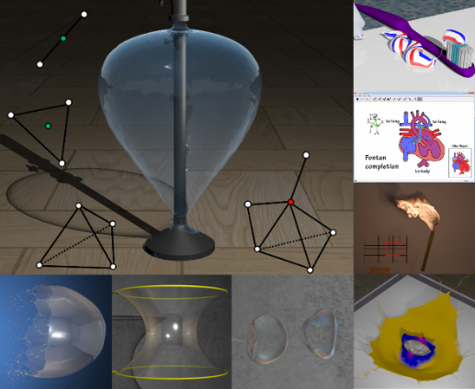
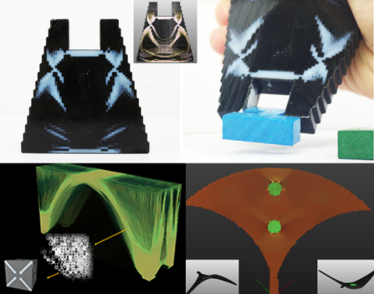
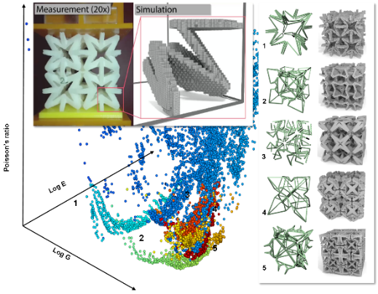

Computational Understanding of Complex Physical Systems
Bo Zhu
MIT CSAIL

Slide 2
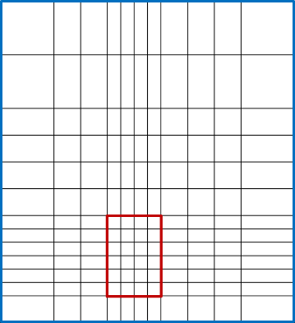
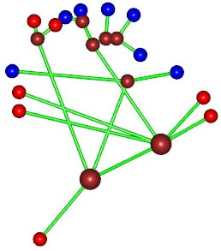
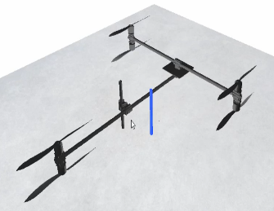
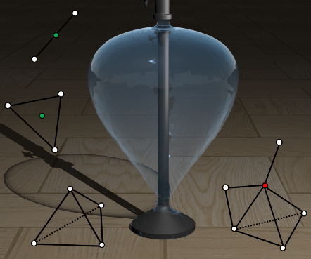
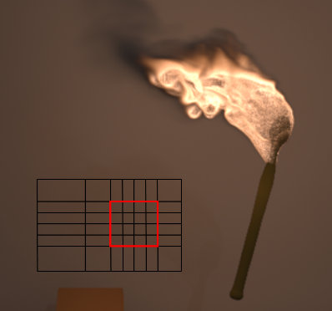
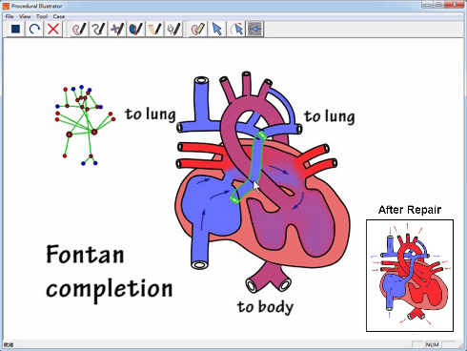
Q1: How to create simulations for complex systems?
Geometric structures, PDE solvers, and meshing algorithms for complex fluid simulation
Simplicial Complexes
Far-Field Grid
Hydraulic Graph
Parametrized Sticks
Codimensional Fluids
Large-Domain Fluids
Sketching Hearts
Customized Drones
[Zhu et.al. SIGGRAPH 2013, 2014, 2015, SIGGRAPH Asia 2011] [Du et.al. SIGGRAPH Asia 2017]

Slide 3
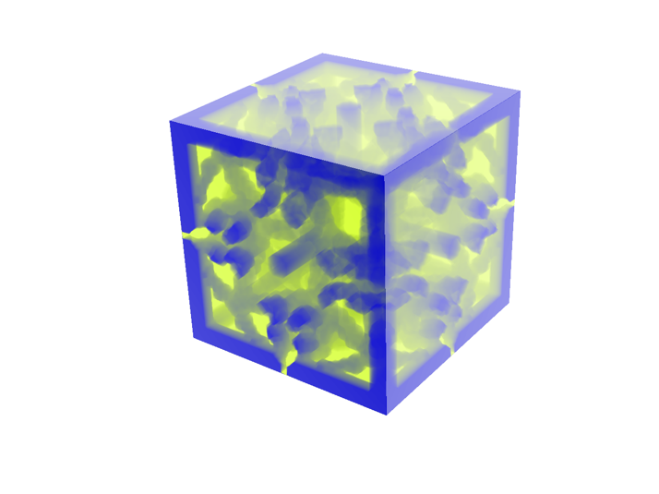
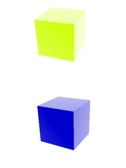
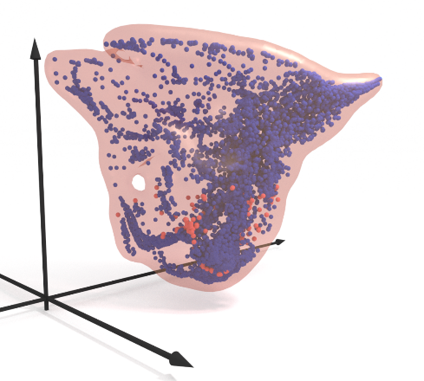
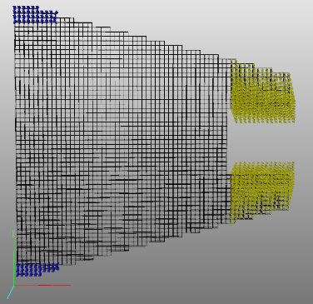
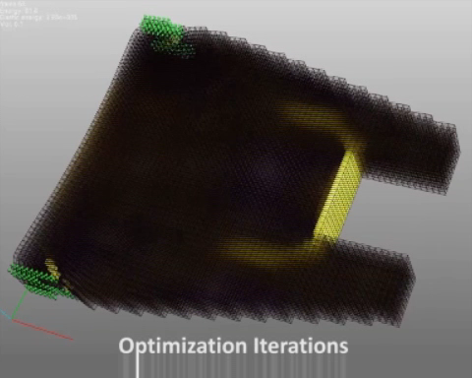
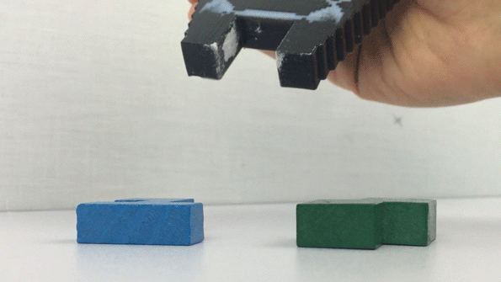
Q2: How to build mappings between simulation and function?
Multi-scale topology optimization on 3D printing voxel level
Poisson’s Ratio
Young’s Modulus
Shear Modulus
Base Materials
Microstructure
Material Property Gamut
Continuous Constraints
Discrete Mapping
Grip
Force
Design Goal
Topology Optimization
3D Printed Functional Gripper
[Zhu et.al. ACM Trans. Graph. 36:5 (2017)]

Slide 4
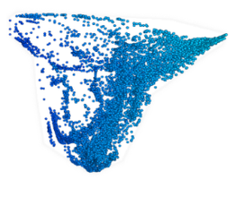
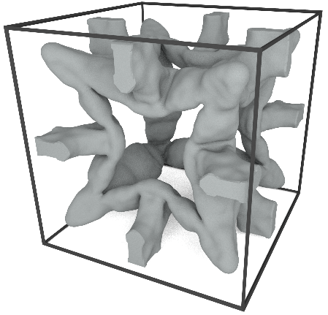
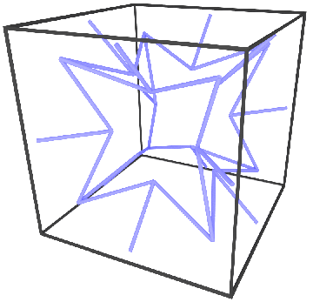
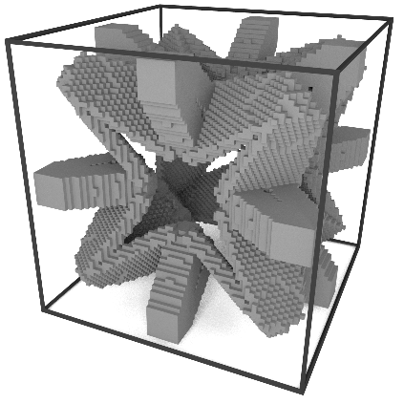
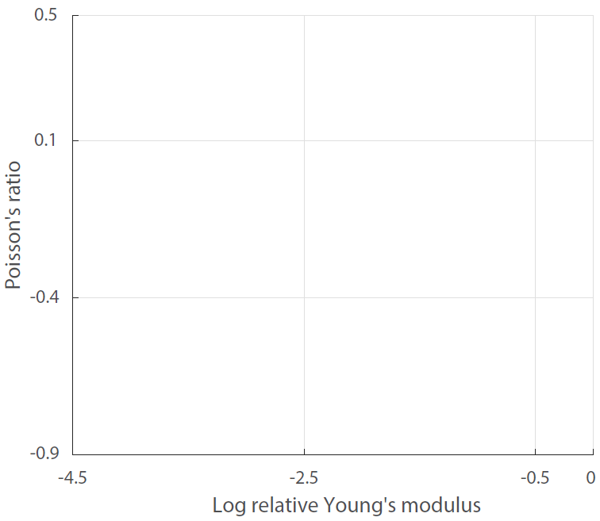
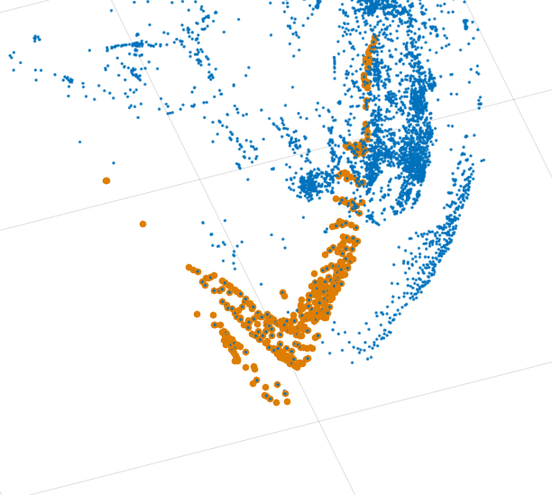
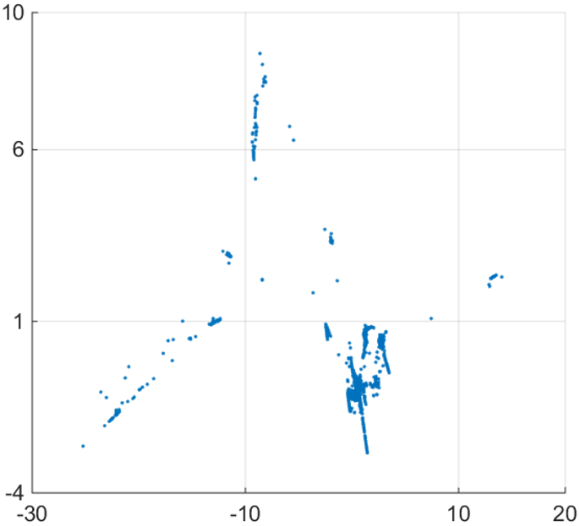
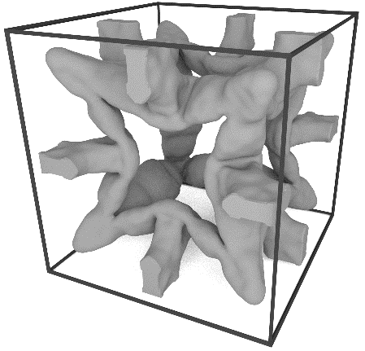
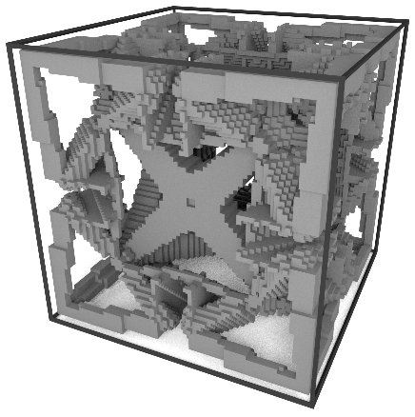
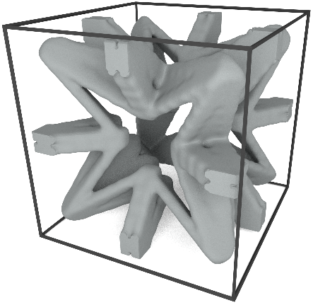
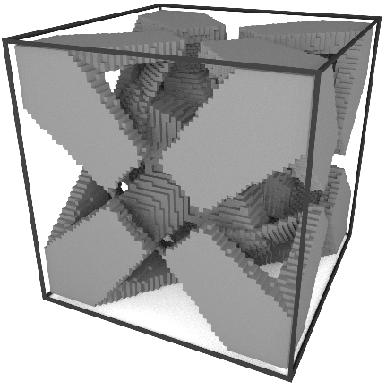
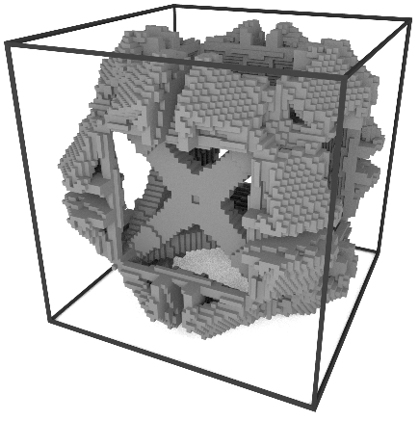
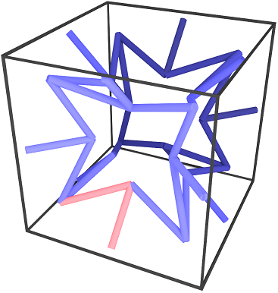
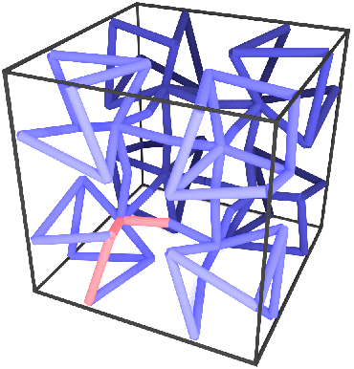
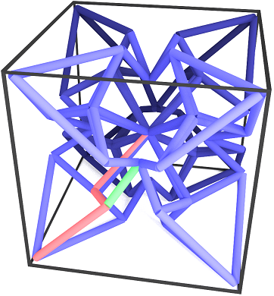
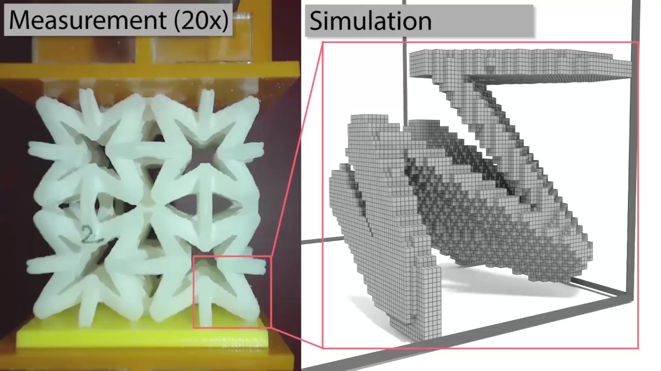
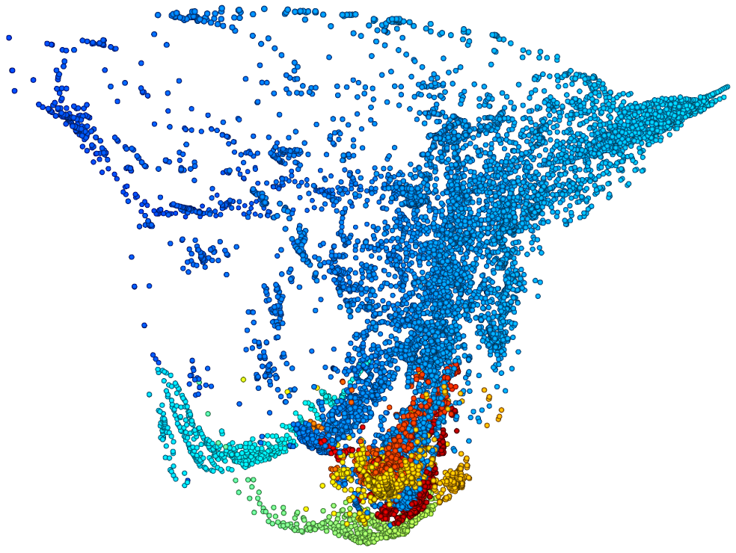
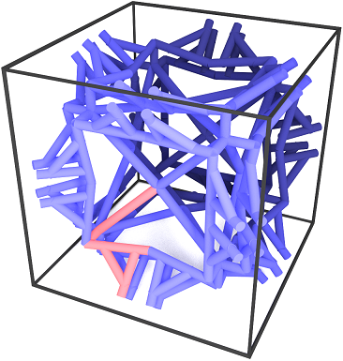
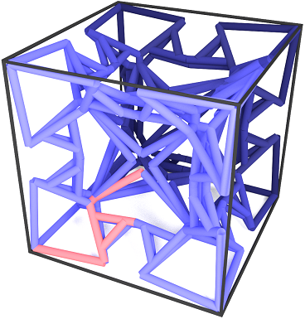
Q3: How to discover mechanisms with extremal properties?
Automate the discovery of new microstructural materials
Nonlinear dimensionality
reduction
Family representative
Skeleton
Fitted structure
Distribution of a family
Input: Gamut
Identify Families
Fit Templates
Reduce Parameters
1
2
3
Poisson’s ratio
Log E
4
Log G
5
Five families of new materials with extremal
auxetic properties have been discovered
Experimental Validation
[Chen et.al. Science Advances (to appear), 2018]

Slide 5


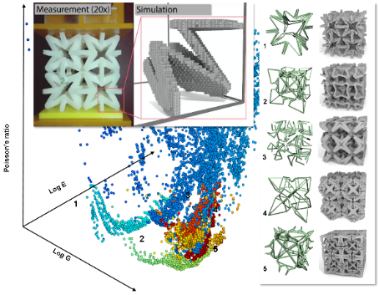
Future Plans at Purdue University
Research Vision
  Simulation tools to investigate complex physical systems
    Natural phenomena, biological systems, soft robots, etc.
  Computational approaches to automate scientific discovery
    Physical simulation, data generation, and machine learning
  Automated cyber-physical system design and understanding
    Agile drones, fast walkers, efficient swimmers
Potential Collaborations
  Department of Computer Science
    Computational Science and Engineering, Graphics and Visualization, Machine Learning and Information Retrieval, etc.
  College of Engineering
    Biomed Engineering, Manufacturing, Materials, Mechanical Systems, etc.
?

