Slide 1

Motion Magnification
Ce Liu Antonio Torralba William T. Freeman
Frédo Durand Edward H. Adelson
Computer Science and Artificial Intelligence Laboratory
Massachusetts Institute of Technology

Slide 2
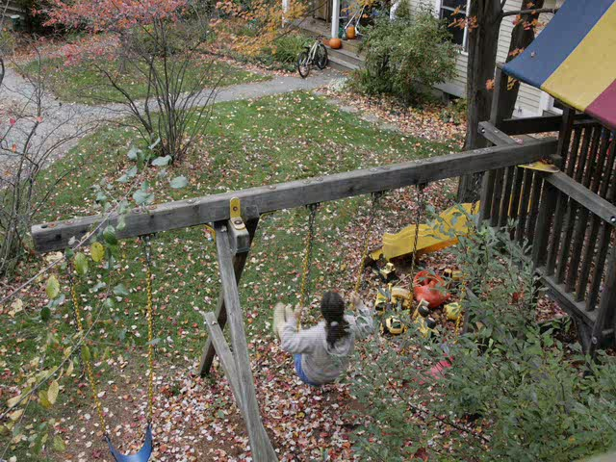
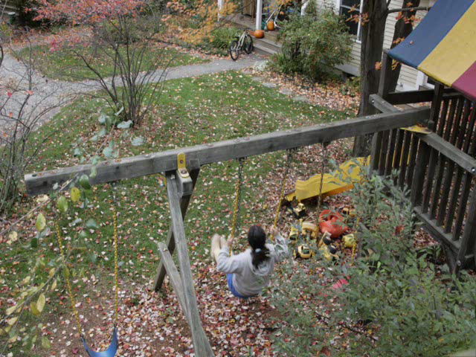
Motion Microscopy
How can we see all the subtle motions in a video sequence?
Original sequence
Magnified sequence

Slide 3
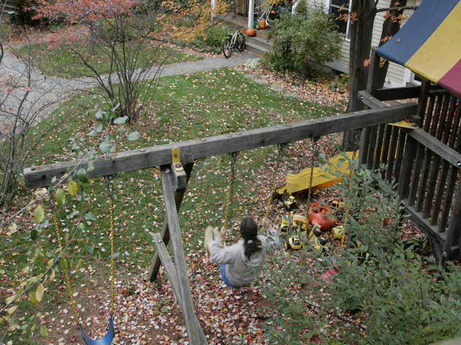
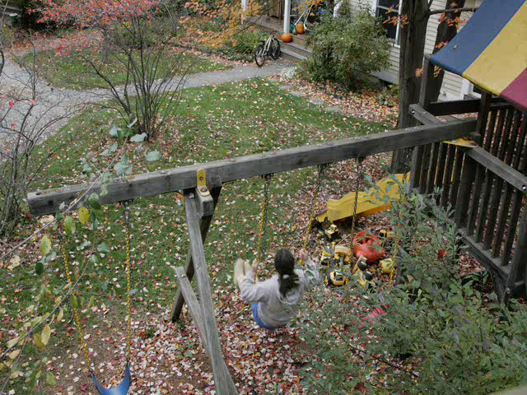
Naïve Approach
Magnify the estimated optical flow field
Rendering by warping
Original sequence
Magnified by naïve approach

Slide 4
Layer-based Motion Magnification Processing Pipeline
Input raw video
sequence
Video
Registration
Feature point
tracking
Trajectory
clustering
Output magnified
video sequence
Magnification,
texture fill-in,
rendering
Layer
segmentation
Dense optical
flow interpolation
User
interaction
Layer-based motion analysis
Stationary camera, stationary background

Slide 5
Layer-based Motion Magnification Video Registration
Input raw video
sequence
Video
Registration
Feature point
tracking
Trajectory
clustering
Output magnified
video sequence
Magnification,
texture fill-in,
rendering
Layer
segmentation
Dense optical
flow interpolation
User
interaction
Layer-based motion analysis
Stationary camera, stationary background

Slide 6
Robust Video Registration
Find feature points with Harris corner detector on the reference frame
Brute force tracking feature points
Select a set of robust feature points with inlier and outlier estimation (most from the rigid background)
Warp each frame to the reference frame with a global affine transform

Slide 7
Motion Magnification Pipeline Feature Point Tracking
Input raw video
sequence
Video
Registration
Feature point
tracking
Trajectory
clustering
Output magnified
video sequence
Magnification,
texture fill-in,
rendering
Layer
segmentation
Dense optical
flow interpolation
User
interaction
Layer-based motion analysis

Slide 8


Challenges (1)

Slide 9





Adaptive Region of Support
Confused by occlusion !
Brute force search
Learn adaptive region of support using expectation-maximization (EM) algorithm
time
region of support
time

Slide 10
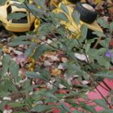
Challenges (2)

Slide 11
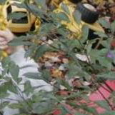
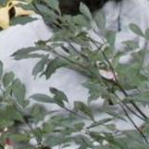
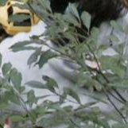
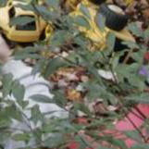
Trajectory Pruning
Tracking with adaptive region of support
Outlier detection and removal by interpolation
Nonsense at full occlusion!
inlier probability
Outliers
time

Slide 12
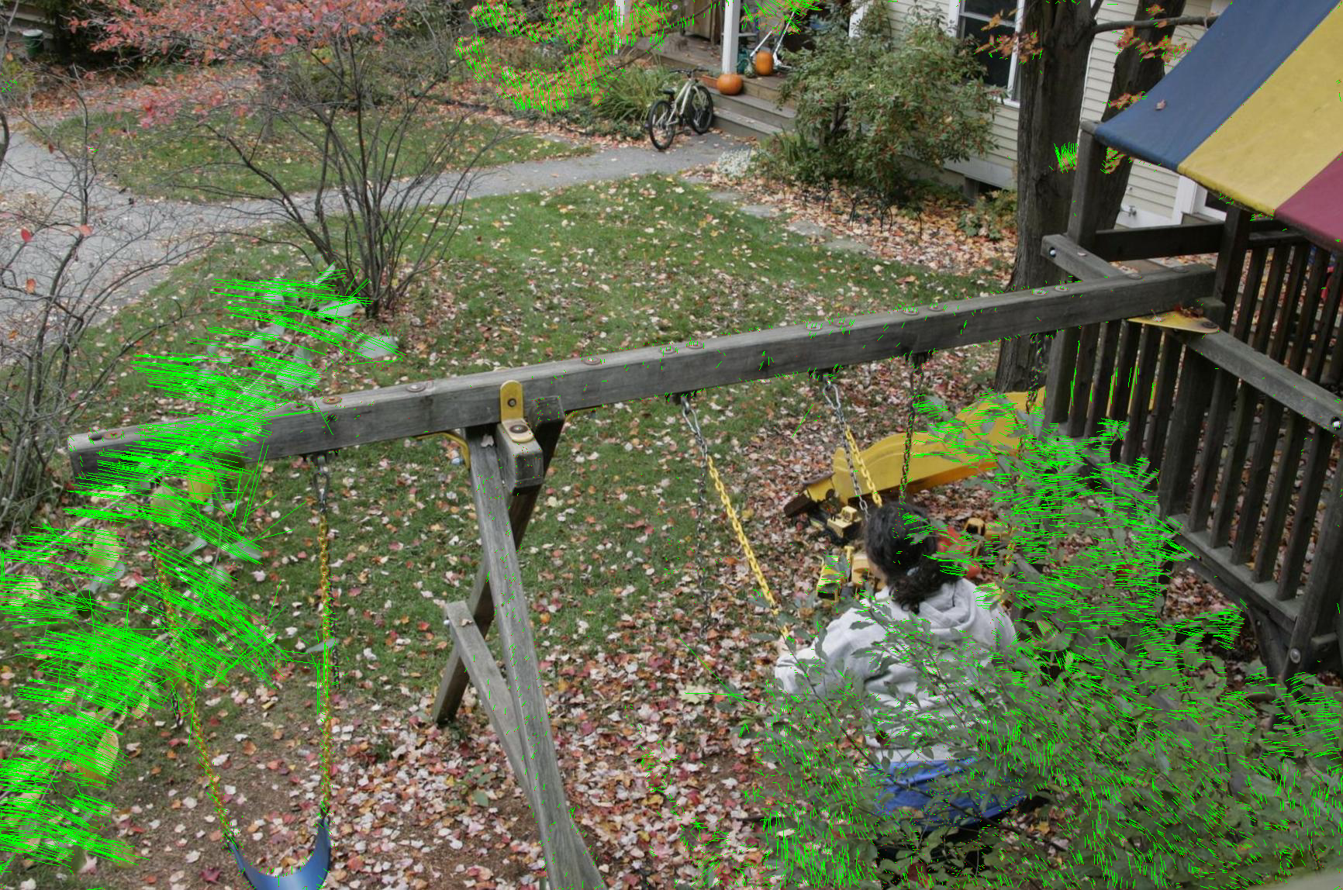
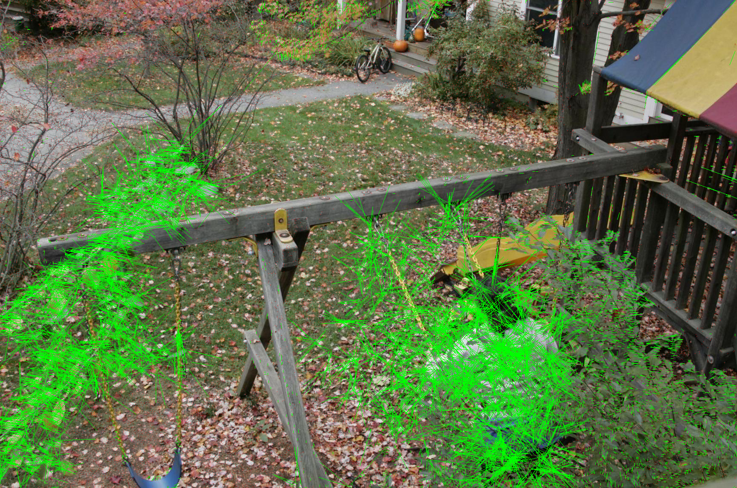
Comparison
Without adaptive region of support and trajectory pruning
With adaptive region of support and trajectory pruning

Slide 13
Motion Magnification Pipeline Trajectory Clustering
Input raw video
sequence
Video
Registration
Feature point
tracking
Trajectory
clustering
Output magnified
video sequence
Magnification,
texture fill-in,
rendering
Layer
segmentation
Dense optical
flow interpolation
User
interaction
Layer-based motion analysis

Slide 14

Normalized Complex Correlation
The similarity metric should be independent of phase and magnitude
Normalized complex correlation

Slide 15
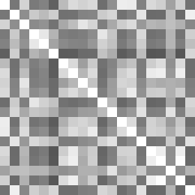
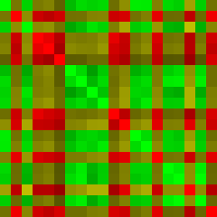
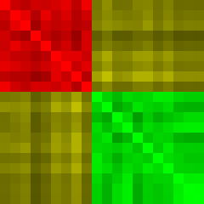
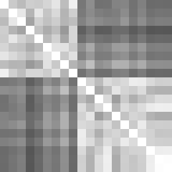
Spectral Clustering
Trajectory
Two clusters
Trajectory
Affinity matrix
Clustering
Reordering of affinity matrix

Slide 16
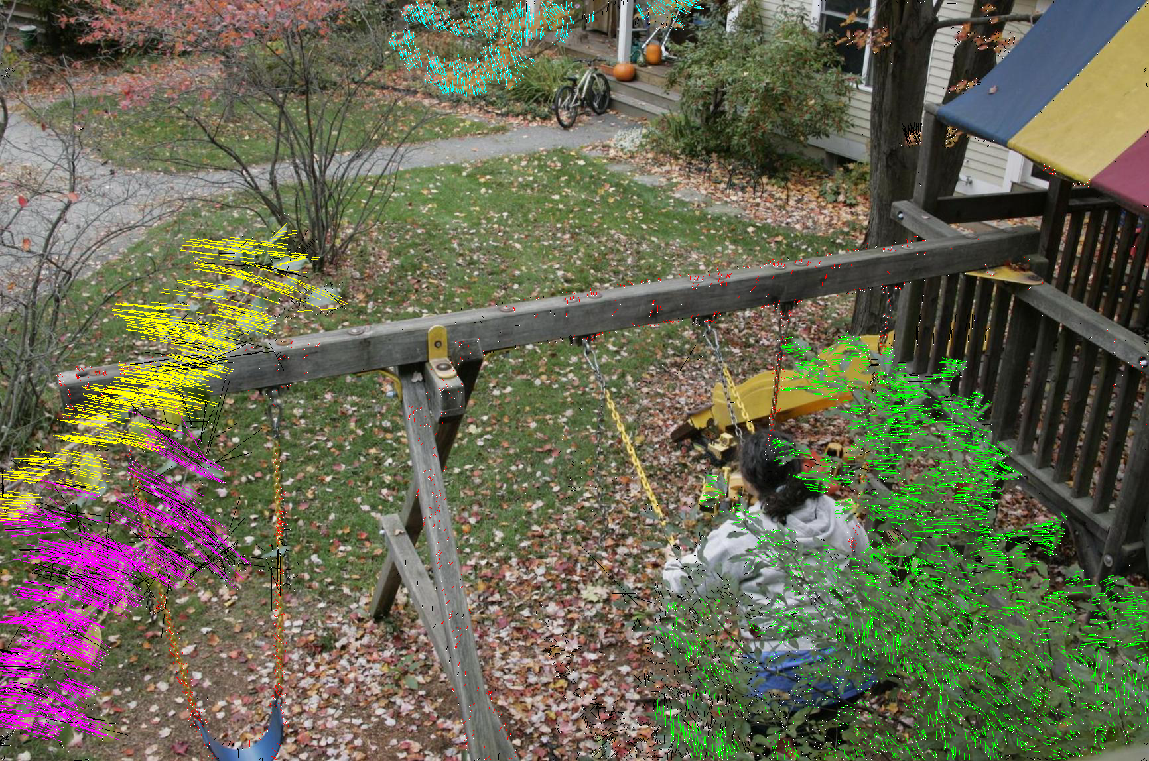
Clustering Results

Slide 17
Motion Magnification Pipeline Dense Optical Flow Field
Input raw video
sequence
Video
Registration
Feature point
tracking
Trajectory
clustering
Output magnified
video sequence
Magnification,
texture fill-in,
rendering
Layer
segmentation
Dense optical
flow interpolation
User
interaction
Layer-based motion analysis

Slide 18
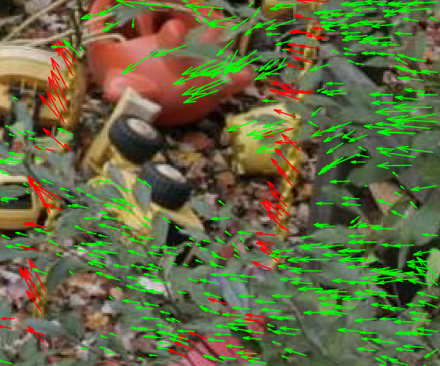
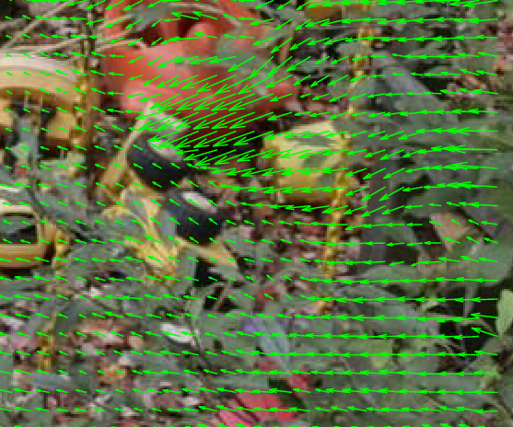
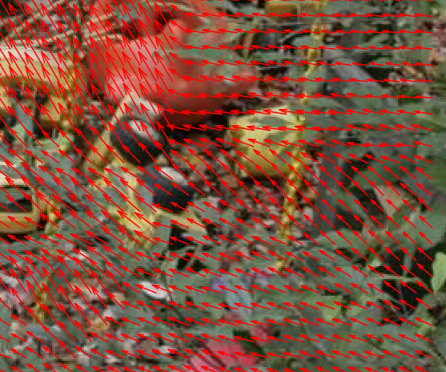
From Sparse Feature Points to Dense Optical Flow Field
Interpolate dense optical flow field using locally weighted linear regression
Flow vectors of clustered sparse feature points
Dense optical flow field of cluster 1 (leaves)
Dense optical flow field of cluster 2 (swing)
Cluster 1: leaves
Cluster 2: swing

Slide 19
Motion Magnification Pipeline Layer Segmentation
Input raw video
sequence
Video
Registration
Feature point
tracking
Trajectory
clustering
Output magnified
video sequence
Magnification,
texture fill-in,
rendering
Layer
segmentation
Dense optical
flow interpolation
User
interaction
Layer-based motion analysis

Slide 20
Motion Layer Assignment
Assign each pixel to a motion cluster layer, using four cues:
  Motion likelihood—consistency of pixel’s intensity if it moves with the motion of a given layer (dense optical flow field)
  Color likelihood—consistency of the color in a layer
  Spatial connectivity—adjacent pixels favored to belong the same group
  Temporal coherence—label assignment stays constant over time
Energy minimization using graph cuts

Slide 21
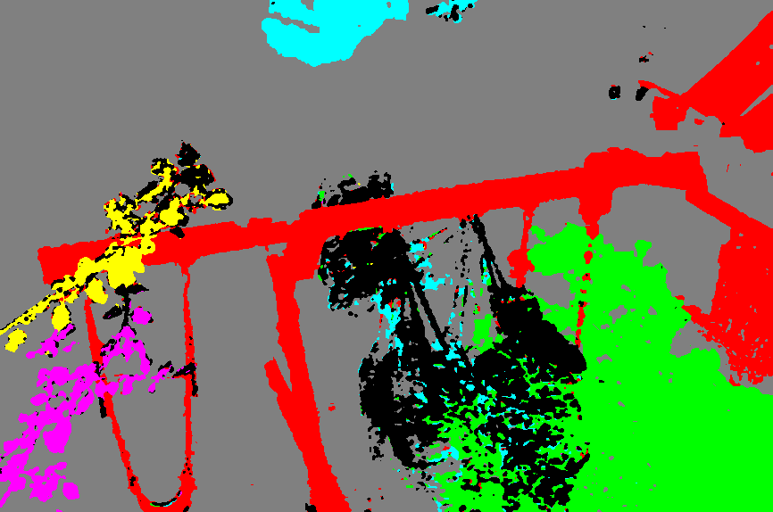
Segmentation Results
Two additional layers: static background and outlier

Slide 22
Motion Magnification Pipeline Editing and Rendering
Input raw video
sequence
Video
Registration
Feature point
tracking
Trajectory
clustering
Output magnified
video sequence
Magnification,
texture fill-in,
rendering
Layer
segmentation
Dense optical
flow interpolation
User
interaction
Layer-based motion analysis

Slide 23

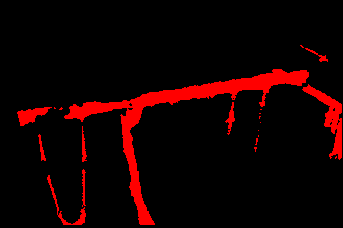
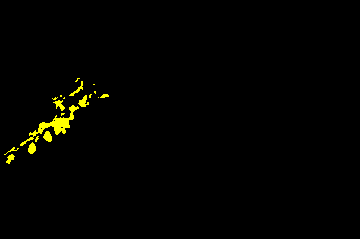
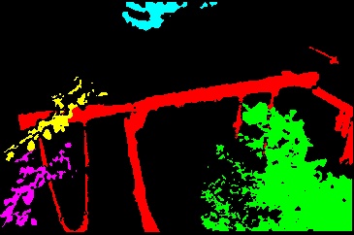
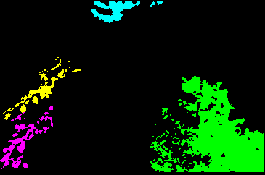
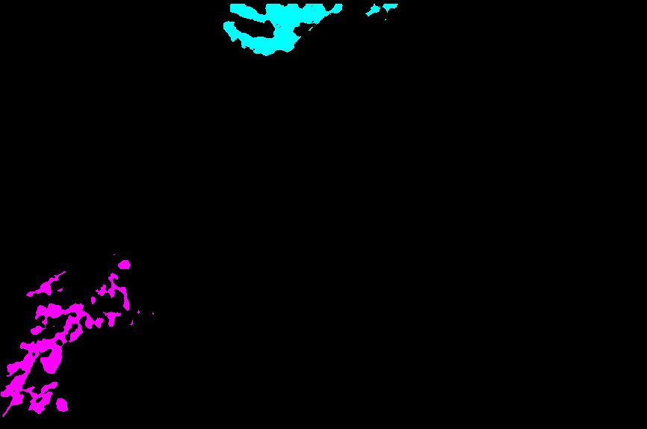
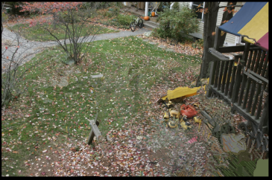
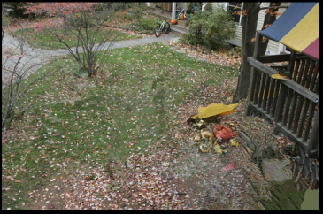
Layered Motion Representation for Motion Processing
Background
Layer 1
Layer 2
Layer mask
Occluding layers
Appearance for each layer before texture filling-in
Appearance for each layer after texture filling-in
Appearance for each layer after user editing

Slide 24
Video
Motion Magnification

Slide 25
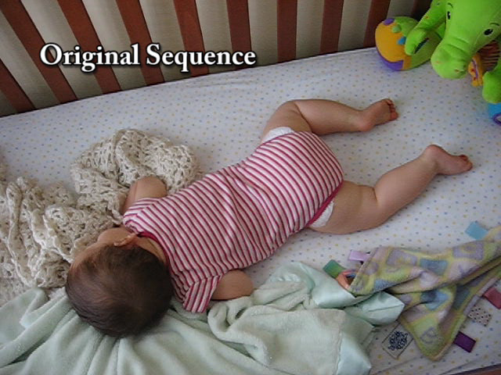
Is the Baby Breathing?

Slide 26
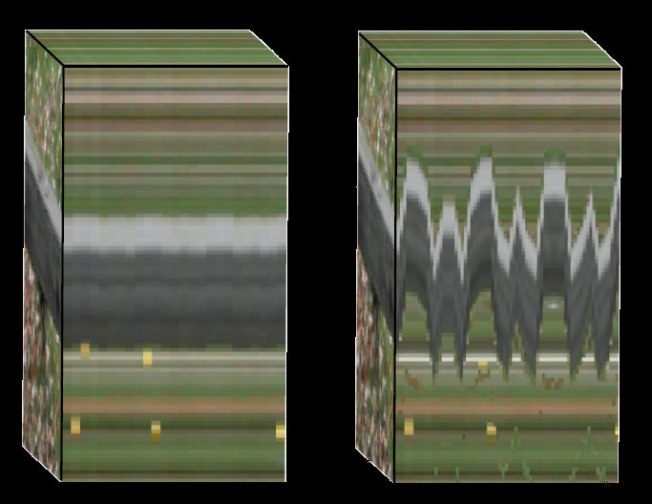
Are the Motions Real?
Original
Magnified
y
y
x
x
t
t

Slide 27
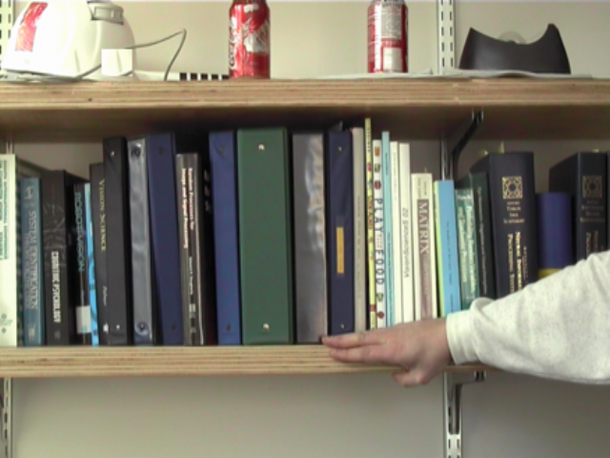
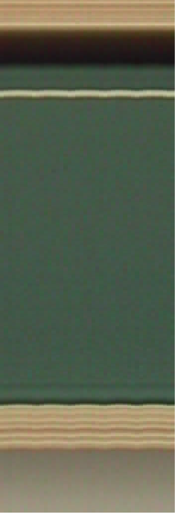
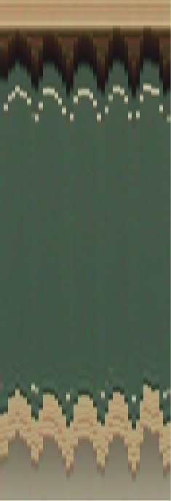

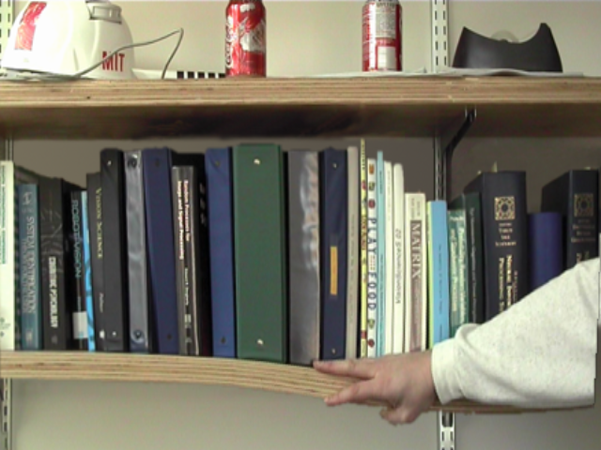
Are the Motions Real?
Original
Magnified
Original
Magnified
time
time

Slide 28
Applications
Education
Entertainment
Mechanical engineering
Medical diagnosis

Slide 29
Conclusion
Motion magnification
  A motion microscopy technique
Layer-based motion processing system
  Robust feature point tracking
  Reliable trajectory clustering
  Dense optical flow field interpolation
  Layer segmentation combining multiple cues

Slide 30
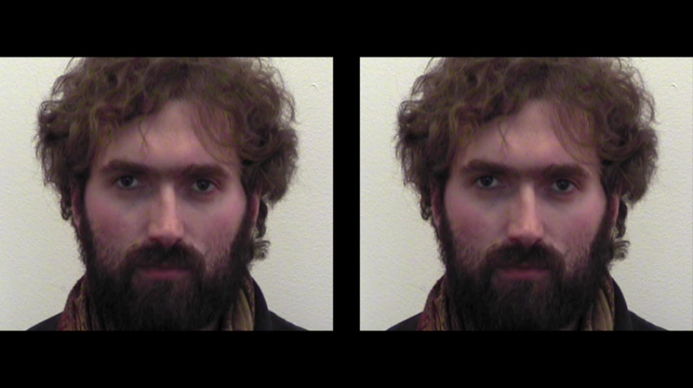
Thank you!
Motion Magnification
Ce Liu Antonio Torralba William T. Freeman Frédo Durand Edward H. Adelson
Computer Science and Artificial Intelligence Laboratory
Massachusetts Institute of Technology

