Slide 1

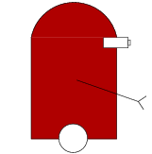

Models for Multi-View Object Class Detection
Han-Pang Chiu

Slide 2

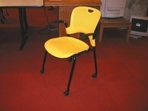
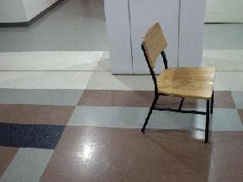
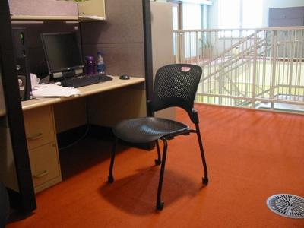
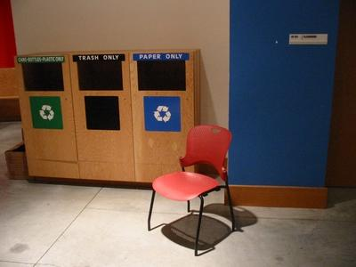
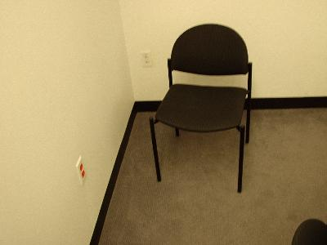
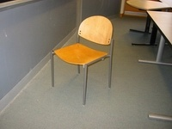
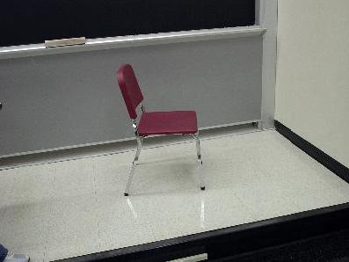
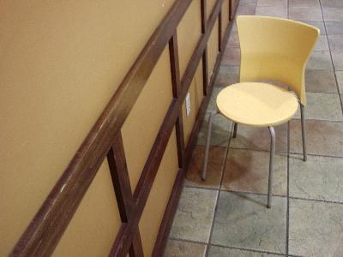
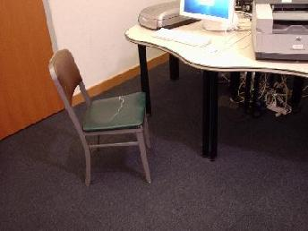
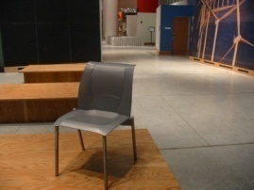

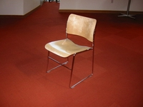
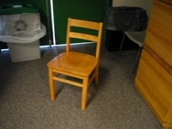
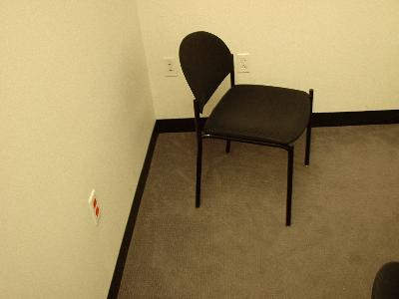
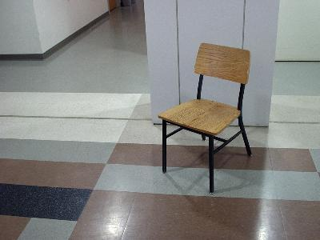
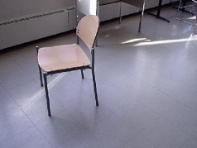
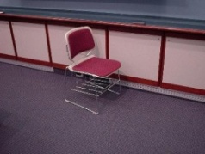
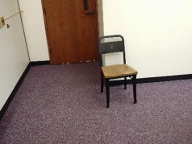
Multi-View Object Class Detection
Multi-View
Same Object
Single-View
Object Class
Multi-View Object Class
Training Set
Test Set
Notes:
Animation, different tasks, 3D reconstruction

Slide 3
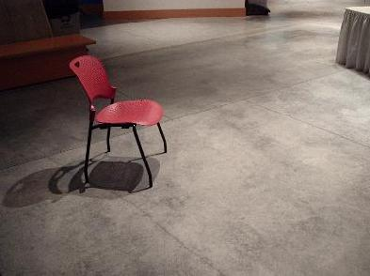
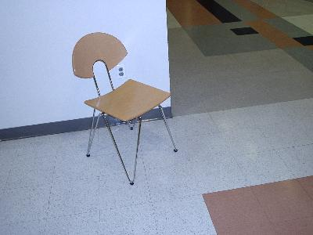
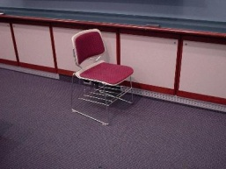

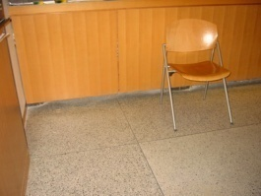
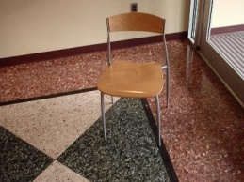
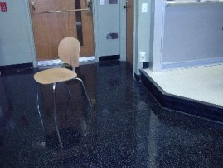
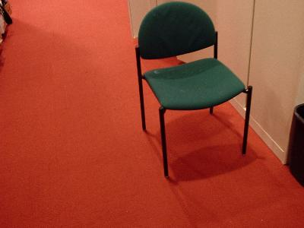
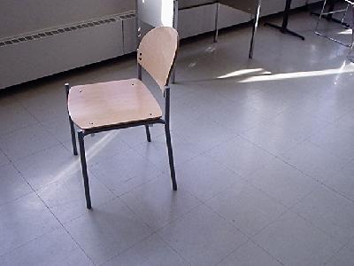
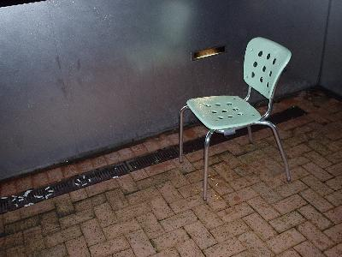
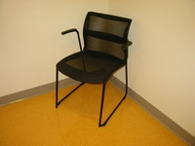
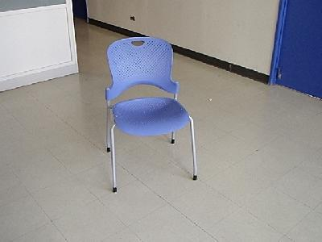
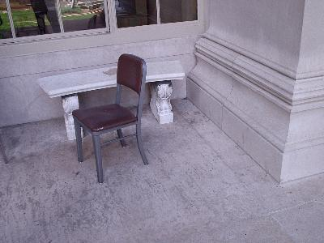
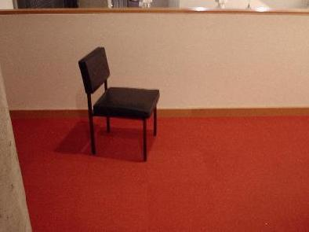
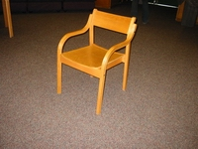
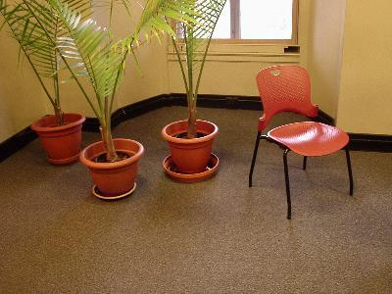
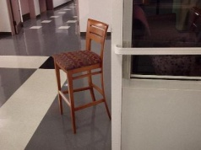
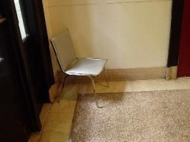
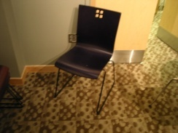
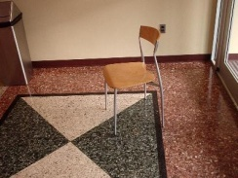
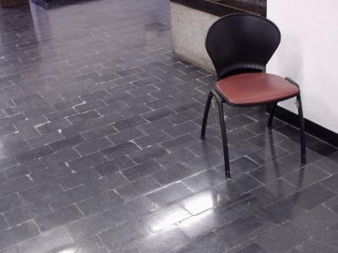
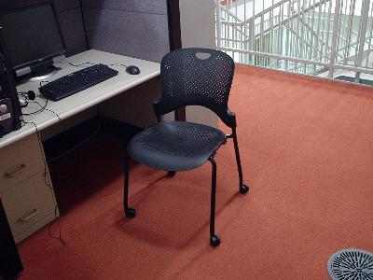
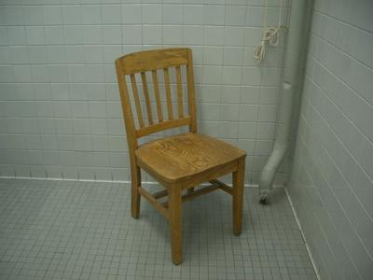
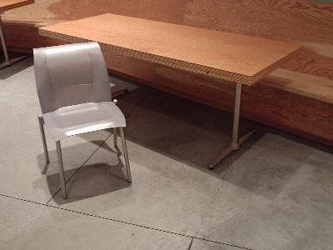
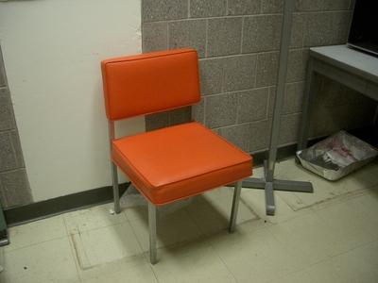
The Roadblock
All existing methods for multi-view object class detection require many real training images of objects for many viewpoints.
The learning processes for each viewpoint of the same object class should be related.

Slide 4
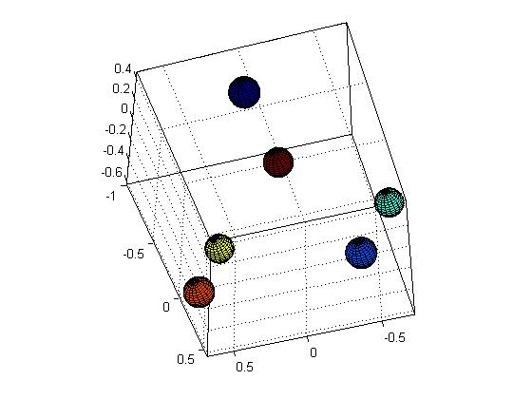
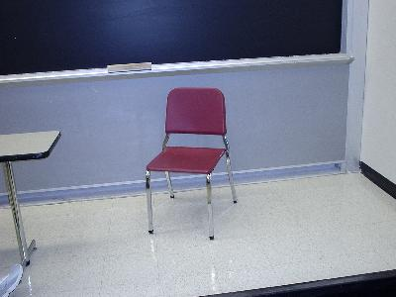
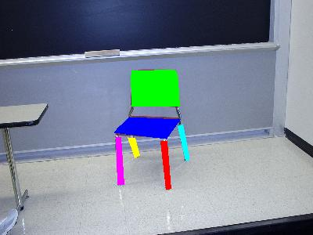
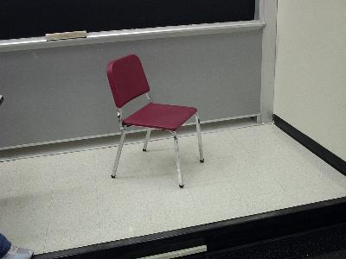
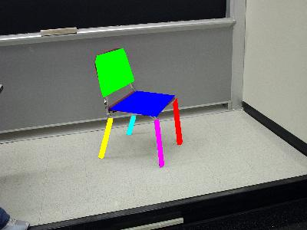
The Potemkin Model
The Potemkin¹ model can be viewed as a collection of parts, which are oriented 3D primitives.
- a 3D class skeleton: The arrangement of part centroids in 3D.
- 2D projective transforms: The shape change of each part from one view to another.
¹So-called “Potemkin villages” were artificial villages, constructed only of facades. Our models, too are constructed of facades.
Notes:
Same type, components, put 3D skeleton

Slide 5


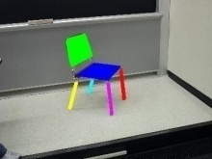


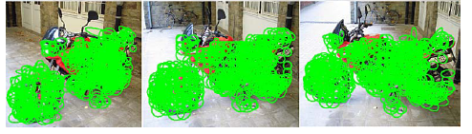
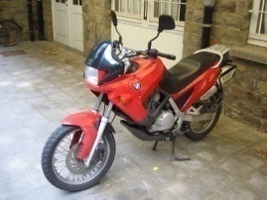





Related Approaches
Data-Efficiency , Compatibility
cross-view constraints
[Thomas06, Savarese07, Kushal07]
The Potemkin Model
3D
2D
explicit 3D model
[Hoiem07, Yan07]
multiple 2D models
[Crandall07, Torralba04, Leibe07]
Notes:
Less real training images to construct the model, put icon for each approach, next slide, 3D understanding

Slide 6






Two Uses of the Potemkin Model
Generate virtual training data
2. Reconstruct 3D shapes of detected objects
3D Understanding
2D Test Image
Multi-View Object Class Detection System
Detection Result

Slide 7
Outline
Potemkin Model | Basic | Generalized | 3D
Estimation | Class Skeleton
Real Training Data | Supervised Part Labeling
Use | Virtual Training Data Generation

Slide 8

Definition of the Basic Potemkin Model
A basic Potemkin model for an object class with N parts.
- K view bins
- K projection matrices
- NK² transformation matrices
- a class skeleton (S₁,S₂,…,S_{N}): class-dependent
3D Space
2D
Transforms
K view bins

Slide 9


Estimating the Basic Potemkin Model
Phase 1
- Learn 2D projective transforms from a 3D oriented primitive
8 Degrees Of Freedom
view α
T_{α,β}
view β
view α
T¹_{α,β}
T²_{α,β}
T³_{α,β}
………………
view β
Notes:
delete reference, title: learning the Potemkin model phase 1, add the slide of the definition of the Potemkin model before this slide, define the 2D transform, matrix, different colors for fixed, learn from data

Slide 10















Estimating the Basic Potemkin Model
Phase 2
We compute 3D class skeleton for the target object class.
Each part needs to be visible in at least two views from the view bins we are interested in.
We need to label the view bins and the parts of objects in real training images.
Notes:
Each slide has its own title, effect of orientation

Slide 11




















Using the Basic Potemkin Model

Slide 12























The Basic Potemkin Model
Estimating
Using
Synthetic
Class-Independent
Real
Class-Specific
Virtual
View-Specific
3D Model
Few Labeled Images
All Labeled Images
2D Synthetic Views
Part Transforms
Part Transforms
Generic Transforms
Skeleton
Combine Parts
Shape Primitives
Target Object Class
Virtual Images
Notes:
Animation for all small pieces

Slide 13
Problem of the Basic Potemkin Model
Notes:
Add the figure of up-right blocks

Slide 14
Outline
Potemkin Model | Basic | Generalized | 3D
Estimation | Class Skeleton | Multiple Primitives
Real Training Data | Supervised Part Labeling
Use | Virtual Training Data Generation

Slide 15










Multiple Oriented Primitives
An oriented primitive is decided by the 3D shape and the starting view bin.
View1 View2 ……………………….. View K
K views
azimuth
Multiple
Primitives
elevation
azimuth
2D Transforms
2D views
Notes:
Add other slide of possible 3d shapes

Slide 16
3D Shapes
view α
2D Transform
T_{α,β}
view β
K view bins
Notes:
Add other slide of possible 3d shapes

Slide 17













The Potemkin Model
Estimating
Using
Synthetic
Class-Independent
Real
Class-Specific
Virtual
View-Specific
3D Model
Few Labeled Images
All Labeled Images
2D Synthetic Views
Primitive Selection
Part Transforms
Part Transforms
Generic Transforms
Skeleton
Infer Part Indicator
Combine Parts
Shape Primitives
Target Object Class
Virtual Images
Notes:
Animation for all small pieces

Slide 18







Greedy Primitive Selection
Find a best set of primitives to model all parts
M
- Four primitives are enough for modeling four object classes (21 object parts).
Greedy Selection
view α
view β
?
A
B
Notes:
New outline slide, delete the graph model, explain the figure(QofT), replot the figure, animation for quality of transformation

Slide 19


Primitive-Based Representation

Slide 20








The Influence of Multiple Primitives
Better predict what objects look like in novel views
Single Primitive
Multiple Primitives
Notes:
Take more time. An example

Slide 21





















Virtual Training Images
Notes:
reverse

Slide 22
The Potemkin Model
Estimating
Using
Synthetic
Class-Independent
Real
Class-Specific
Virtual
View-Specific
3D Model
Few Labeled Images
All Labeled Images
2D Synthetic Views
Primitive Selection
Part Transforms
Part Transforms
Generic Transforms
Skeleton
Infer Part Indicator
Combine Parts
Shape Primitives
Target Object Class
Virtual Images
Notes:
Animation for all small pieces

Slide 23
Outline
Potemkin Model | Basic | Generalized
Estimation | Class Skeleton | Multiple Primitives
Real Training Data | Supervised Part Labeling | Self-Supervised Part Labeling
Use | Virtual Training Data Generation

Slide 24
Self-Supervised Part Labeling
For the target view, choose one model object and label its parts.
The model object is then deformed to other objects in the target view for part labeling.
Notes:
Back to the new outline slide

Slide 25
Multi-View Class Detection Experiment
Detector: Crandall’s system (CVPR05, CVPR07)
Dataset: cars (partial PASCAL), chairs (collected by LIS)
Each view (Real/Virtual Training): 20/100 (chairs), 15/50 (cars)
Task: Object/No Object, No viewpoint identification
Object Class: Chair
Object Class: Car
True Positive Rate
Real + Virtual (self-supervised)
Real + Virtual (multiple primitives)
Real + Virtual (multiple primitives)
Real images
Real + Virtual (single primitive)
Real + Virtual (single primitive)
Real + Virtual (single primitive)
Real images from all views
Real images from all views
Real images from all views
Real images from all views
Real images
Real images
Real images
Real images
False Positive Rate
False Positive Rate
Notes:
Class/non-class, no viewpoint, show this, animation for each line

Slide 26
Outline
Potemkin Model | Basic | Generalized | 3D
Estimation | Class Skeleton | Multiple Primitives | Class Planes
Real Training Data | Supervised Part Labeling | Self-Supervised Part Labeling
Use | Virtual Training Data Generation

Slide 27
Definition of the 3D Potemkin Model
A 3D Potemkin model for an object class with N parts.
K view bins
K projection matrices, K rotation matrices, T_{α}∈R^{3×3}
a class skeleton (S₁,S₂,…,S_{N})
K part-labeled images
-N 3D planes, Q_{i} ,(i∈ 1,…N): a_{i} X+b_{i} Y+c_{i} Z+d_{i} =0
3D Space
K view bins

Slide 28


3D Representation
Efficiently capture prior knowledge of 3D shapes of the target object class.
The object class is represented as a collection of parts, which are oriented 3D primitive shapes.
This representation is only approximately correct.

Slide 29

Estimating 3D Planes
Notes:
Learning of 3DP model before this slide. Orientation of the chair, occlusion handling, one more slide of deformation

Slide 30






Self-Occlusion Handling
No Occlusion Handling
Occlusion Handling
Notes:
Learning of 3DP model before this slide. Orientation of the chair, occlusion handling, one more slide of deformation

Slide 31








3D Potemkin Model: Car
Minimum requirement: four views of one instance
Number of Parts: 8
(right-side, grille, hood, windshield, roof,
back-windshield, back-grille, left-side)

Slide 32
Outline
Potemkin Model | Basic | Generalized | 3D
Estimation | Class Skeleton | Multiple Primitives | Class Planes
Real Training Data | Supervised Part Labeling | Self-Supervised Part Labeling
Use | Virtual Training Data Generation |  | Single-View 3D Reconstruction

Slide 33
Single-View Reconstruction
3D Reconstruction (X, Y, Z) from a Single 2D Image (x_{im}, y_{im})
- a camera matrix (M), a 3D plane
Notes:
3D Potemkin model, add Hoiem, at least 2 real images of the same instance for each visible part from the view bins we are interested in. animation of each part, math and figure (two slides)

Slide 34



Automatic 3D Reconstruction
3D Class-Specific Reconstruction from a Single 2D Image
- a camera matrix (M), a 3D ground plane (a_{g}X+b_{g}Y+c_{g}Z+d_{g}=0)
Geometric
Context
(Hoiem et al.05)
3D Potemkin
Model
offset
Occluded
Part
Prediction
P₂
P₁
2D Input
Detection
(Leibe et al. 07)
Segmentation
(Li et al. 05)
Self-Supervised
Part Registration
3D Output
Notes:
3D Potemkin model, add Hoiem, at least 2 real images of the same instance for each visible part from the view bins we are interested in. animation of each part, math and figure (two slides)

Slide 35

Application: Photo Pop-up
Hoiem et al. classified image regions into three geometric classes (ground, vertical surfaces, and sky).
They treat detected objects as vertical planar surfaces in 3D.
They set a default camera matrix and a default 3D ground plane.

Slide 36
Object Pop-up
The link of the demo videos:
http://people.csail.mit.edu/chiu/demos.htm

Slide 37





Depth Map Prediction
Match a predicted depth map against available 2.5D data
Improve performance of existing 2D detection systems

Slide 38


Application: Object Detection
109 test images and stereo depth maps, 127 annotated cars
15 candidates/image (each candidate c_{i}: bounding box b_{i}, likelihood l_{i} from 2D detector, predicted depth map z_{i})
z_{s}
Videre Designs
z_{i}
scale
offset
Likelihood from detector
Depth consistency
Notes:
Separate the method (data) and the results (two figures), reweighting, weight is different , change the size of min

Slide 39
Experimental Results
Number of car training/test images: 155/109
Murphy-Torralba-Freeman detector (w = 0.5)
Dalal-Triggs detector (w=0.6)
Murphy-Torralba-Freeman Detector
Dalal-Triggs Detector
Notes:
Separate the method (data) and the results (two figures), reweighting, weight is different , change the size of min

Slide 40



Quality of Reconstruction
Calibration: Camera, 3D ground plane (1m by 1.2m table)
20 diecast model cars
Average | overlap | centroid error | orientation error
Potemkin | 77.5 % | 8.75 mm | 2.34º
Single Plane |  | 73.95 mm | 16.26º
Ferrari F1: 26.56%, 24.89 mm, 3.37º
Notes:
Move popup before this slide, Popup, 2.5D, Quality, Robot

Slide 41
Application: Robot Manipulation
20 diecast model cars, 60 trials
Successful grasp: 57/60 (Potemkin), 6/60 (Single Plane)
The link of the demo videos:
http://people.csail.mit.edu/chiu/demos.htm

Slide 42

Application: Robot Manipulation
20 diecast model cars, 60 trials
Successful grasp: 57/60 (Potemkin), 6/60 (Single Plane)

Slide 43





Occluded Part Prediction
A Basket instance
The link of the demo videos:
http://people.csail.mit.edu/chiu/demos.htm
Notes:
Put a photo of this basket, hand-labeled , the same instance, test the quality of reconstruction

Slide 44
Contributions
The Potemkin Model:
- Provide a middle ground between 2D and 3D
- Construct a relatively weak 3D model
- Generate virtual training data
- Reconstruct 3D objects from a single image
Applications
- Multi-view object class detection
- Object pop-up
- Object detection using 2.5D data
- Robot Manipulation
Notes:
Top 2 slide, the Potemkin model, application, a weak 3D model improves many computer vision tasks. It provides middle ground between 2D and 3D

Slide 45
Acknowledgements
Thesis committee members
- Tómas Lozano-Pérez, Leslie Kaelbling, Bill Freeman
Experimental Help
- LableMe and detection system: Sam Davies
- Robot system: Kaijen Hsiao and Huan Liu
- Data collection: Meg A. Lippow and Sarah Finney
- Stereo vision: Tom Yeh and Sybor Wang
- Others: David Huynh, Yushi Xu, and Hung-An Chang
All LIS people
My parents and my wife, Ju-Hui

Slide 46

Thank you!

