Slide 1
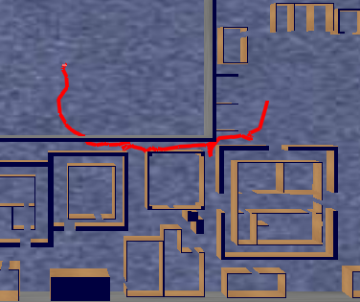
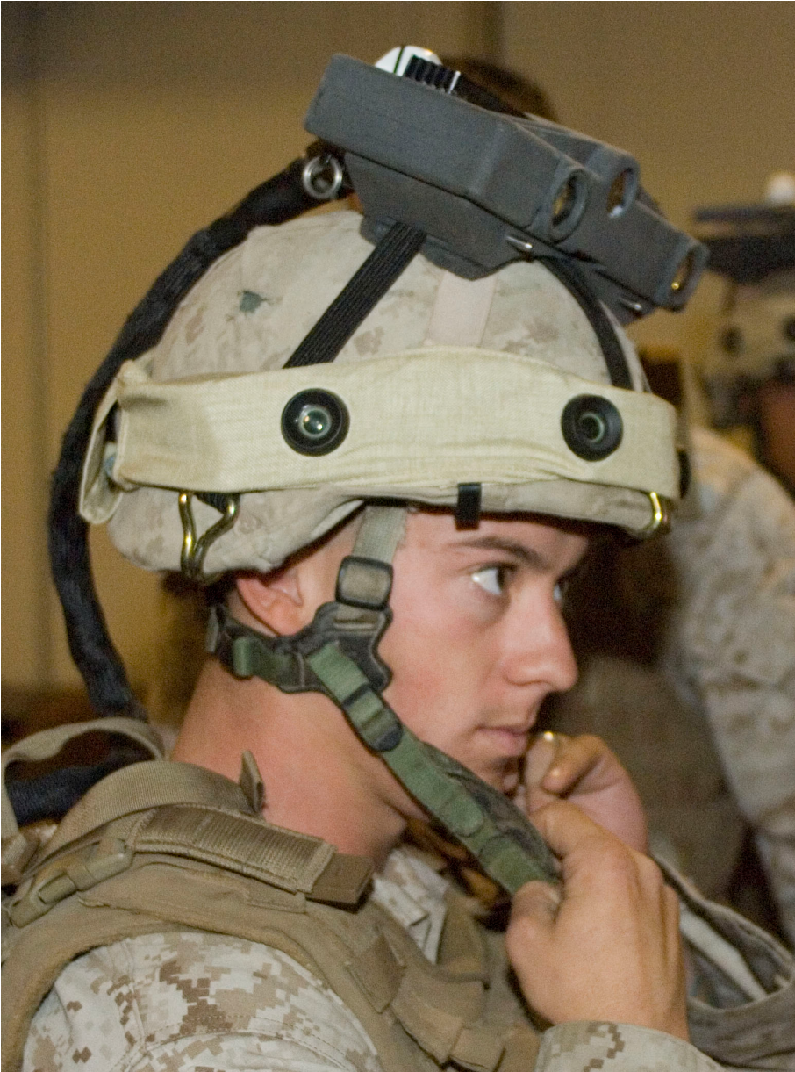
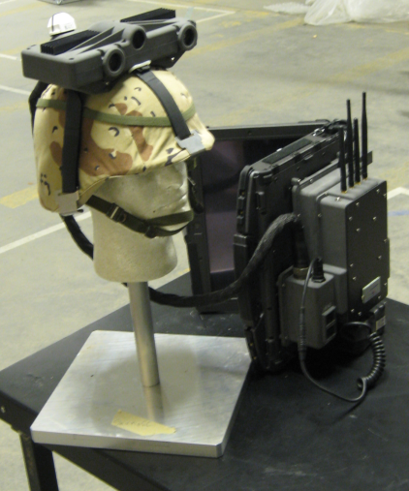
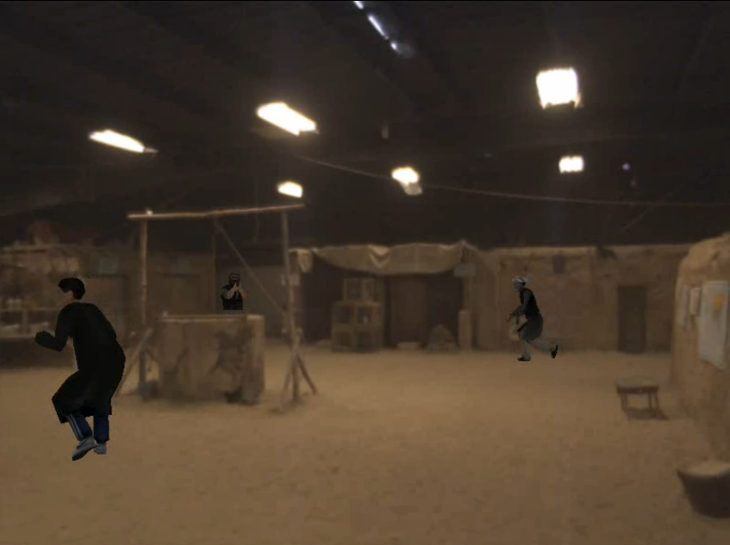
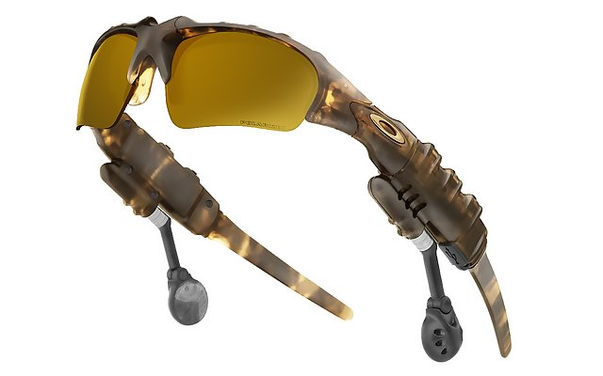
Hardware System
Navigation Algorithm Framework
Trajectory of Tracked User
Sensor Integrated
Helmet
Front-Stereo
IMU
Back-Stereo
Distributed
Aperture
Visual
Odometry
Augmented Scene Viewed by User in HMD
Kalman
Filter
3D Head Pose
(3d location &
3d orientation)
Head
Mounted
Displays
Visual
Landmark
Matcher
Landmark
Database
Battery/Comms.
Pack

