Slide 1


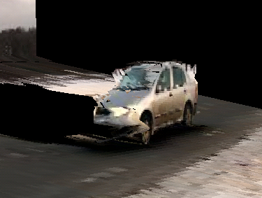


2D Part Template
3D Potemkin Model
2D Input
Detection
Segmentation
Part Registration
3D Pop-up Model

