Slide 1


Identification and Behavioral Sensing using Radio Signals
Chen-Yu Hsu
Rumen Hristov, Guang-He Lee, Mingmin Zhao, Dina Katabi
Notes:
Hi everyone, this is Chen-Yu from MIT.
Today, I am gonna talk about our work on identification and behavioral Sensing using radio signals.
This is a join work with my collogues Rumen, Guang-He, Mingmin, and Dina.

Slide 2
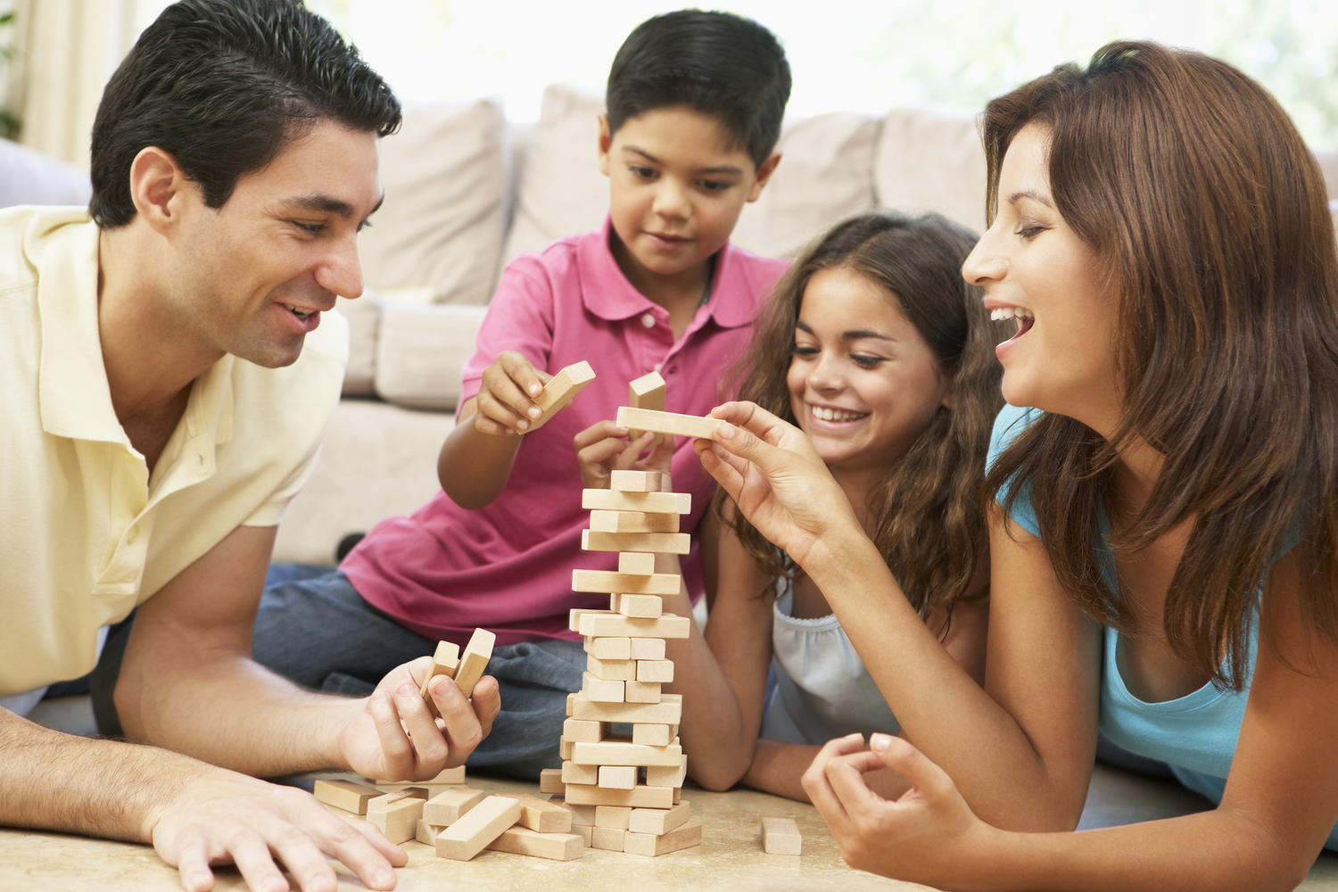
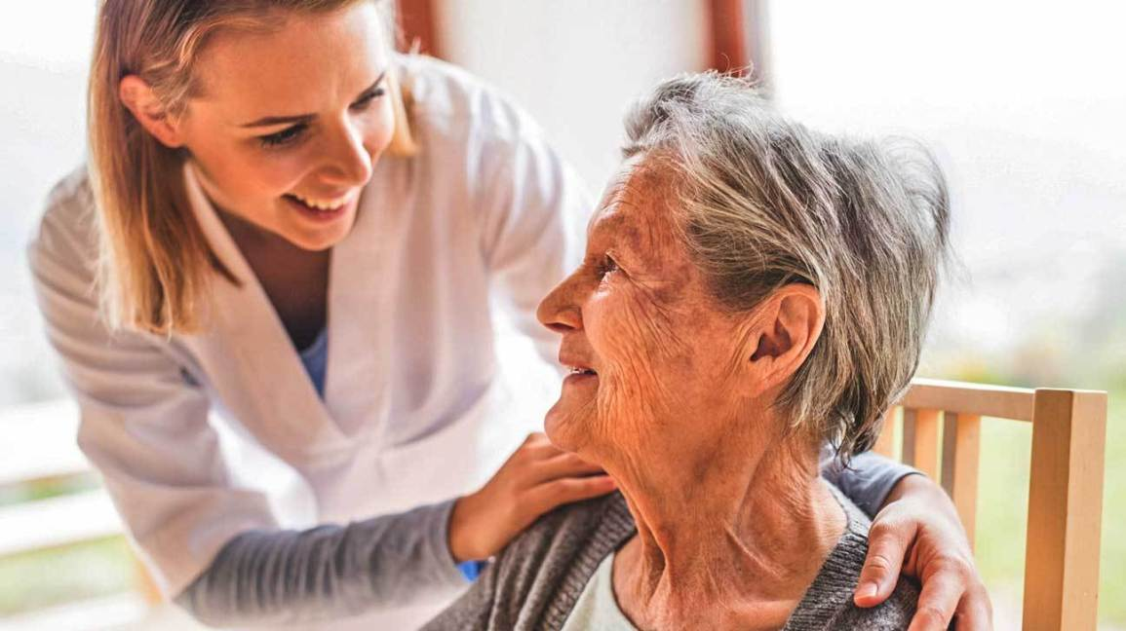
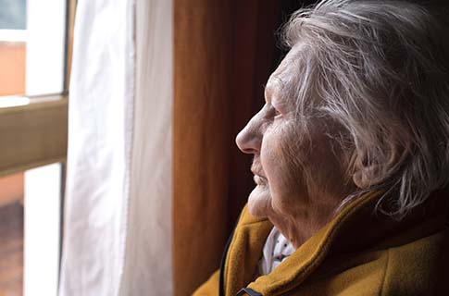
Social and mental-health studies require learning behavior and interactions
Family interaction
Caregiver-patient
Depression & dementia
Notes:
In social and mental health studies, we want to understand user behavior and interactions.
For example, social researchers are interested in how much time parents spend with their kids at homes, and how that affects children’s development.
Similarly, medical professionals would like to know how caregivers interact with the patients.
For mental health studies, doctors would want to know if a patient has signs of depression or anxiety by understanding how they spend time at home.

Slide 3
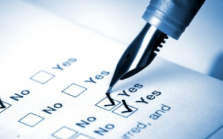
An Example study: caregiver-patient
Goal: understand the level of independence of a patient
Start
3 months
Patient info (age, habits)
Medication history
Caregiver info
…
How much time the caregiver spent with the patient each day?
Patient takes medication on prescribed times? Need help from caregiver for toileting?
Is the patient sedentary most of the time? Capable of preparing meals in the kitchen?
Notes:
Let’s look at an example study: we want to understand the level of independence of a patient in a 3-month study
At the start of the study, we collected some basic information from the patient and the caregiver
Throughout the 3 months, we want to answer questions, such as:
- How much time the caregiver spent with the patient each day?
- Does the patient take medication on prescribed times? Need help from caregiver for toileting?
- Is the person sedentary most of the time? Capable of preparing meals in the kitchen?
Currently, to answer these questions, we rely on questionnaires.
Writing the questionnaires once or twice may be fine
However, the overhead of remembering and writing down all the details every day for the entire 3 month creates a huge overhead. [click]

Slide 4
An Example study: caregiver-patient at home
Goal: understand the level of independence of the patient
Start
3 months
Basic info (age, habits)
Medication history
Stop reporting in long-term studies
Inaccurate & subjective bias
[Möller CHI’13, Wang Ubicomp ‘14, Wash CHI’17]
Notes:
Writing the questionnaires once or twice may be fine
However, the overhead of remembering and writing down all the details every day for the entire 3 month creates a huge overhead. [click]
In fact, studies have shown that the overhead causes people to stop reporting.
[click] Moreover, self-reporting are often inaccurate and subjective, because people simply forget what they did, or want to make a good impressions.

Slide 5
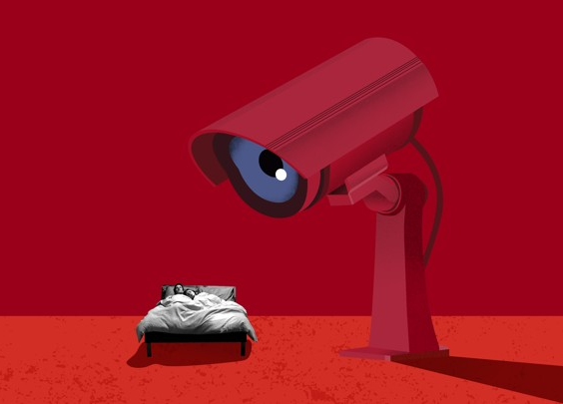
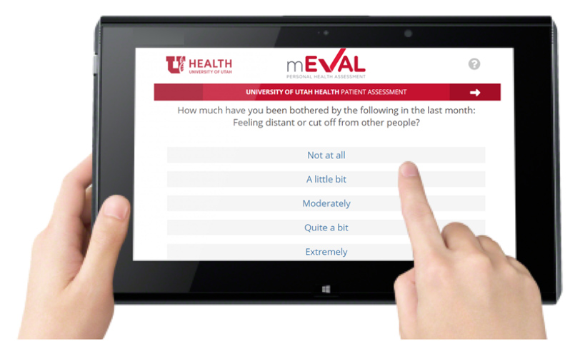
Current Solutions
Self-reporting
Cameras
Inaccurate and subjective
Not sustainable for long-term studies
Accurate
Non-invasive
Privacy-invasive
Notes:
So what are the alternatives?
One might think why not use cameras?
It can be accurate, but putting cameras in homes to record everything all the time is just too privacy-invasive.
[click] Compared with cameras, self-reporting is at least non-invasive, but it’s inaccurate and non-sustainable.
So what can we do?

Slide 6
Marko
A tool for enabling behavioral sensing using radio signals
Where
When & how long
Who
Accurate
How much time the caregiver spent with the patient each day?
Low overhead
Patient take medication on prescribed times? Need help from caregiver for toileting?
Non-invasive
Is the patient sedentary most of the time? Capable of preparing meals in the kitchen?
Notes:
In this talk, I’ll introduce our system, Marko, a tool for enabling behavioral sensing using radio signals.
[click] We want a solution that is accurate, low user overhead, and non-invasive.
[click] Our idea is to create an abstraction for behavioral sensing.
This abstraction has 3 elements where, when & how long, and who. [pause]
[click] If we look at the earlier questions again, they all involve these elements.
Interestingly, we found that location embeds a lot of information about user behavior.
If a nurse goes to the medication cabinet and then approaches the patient, she’s likely helping the patient with medication.

Slide 7
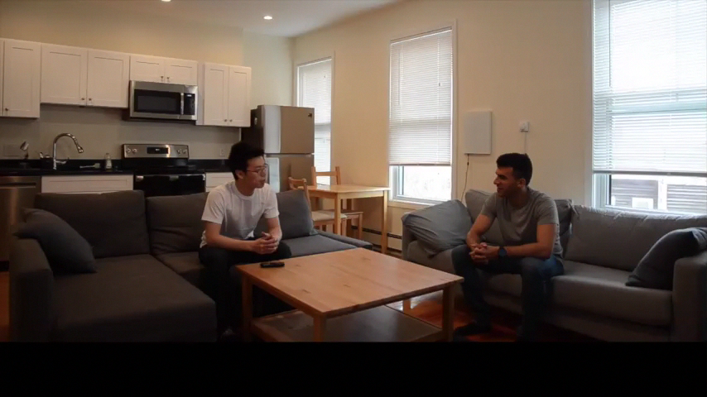
Notes:
The sensor is like a small WiFi box on the wall [click].
It transmits radio signals and analyzes the reflections.
Here, we show the output of our system. It shows the location of the sensor and the two users in a top-down view.
The camera view on the left is just for illustration.
Our system identifies the two users, let’s say Bob and Chris.
It also extract trajectories marked the user ID.
With the floor map, we can know that Chris went to the fridge to get something, and they spent some time together on the TV couches.

Slide 8
How does Marko work?
Extract short user trajectories from radio reflections
(where & when)
Tag trajectories with user identities (who)
Bootstrap in new homes with new users automatically
(for real-world deployments)
Notes:
So, how does it work?
I am going to describe three components of our system:
[click] First, we extract user trajectories from radio signals. This answers where and when.
[click] Then, we tag each trajectory with the user ID. This answers who.
[click] Finally, we scale the system to new homes and new users automatically.

Slide 9
How does Marko work?
Extract short user trajectories from radio reflections
(where & when)
Tag trajectories with user identities (who)
Bootstrap in new homes with new users automatically
(for real-world deployments)
Notes:
Let’s start with the first one.

Slide 10
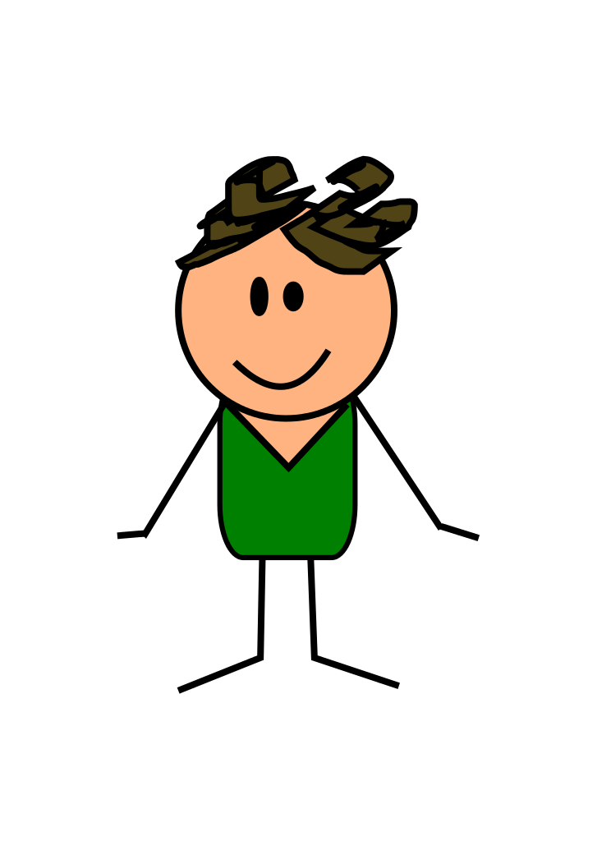
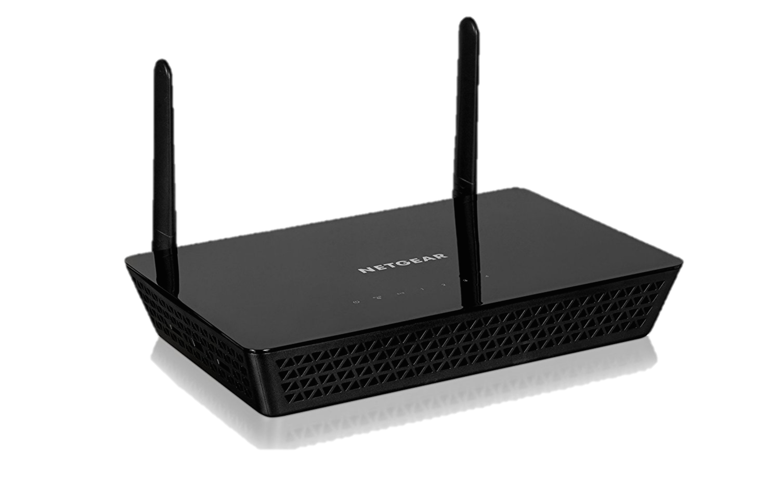
Sensing with Radio Signals
RF signals
Reflections
(information of the user)
Notes:
At the very high-level, the sensor transmit a radio frequency signal.
As the signal reflect off the user, it carries information about the user.
Marko works by analyzing these reflections to extract user information.

Slide 11
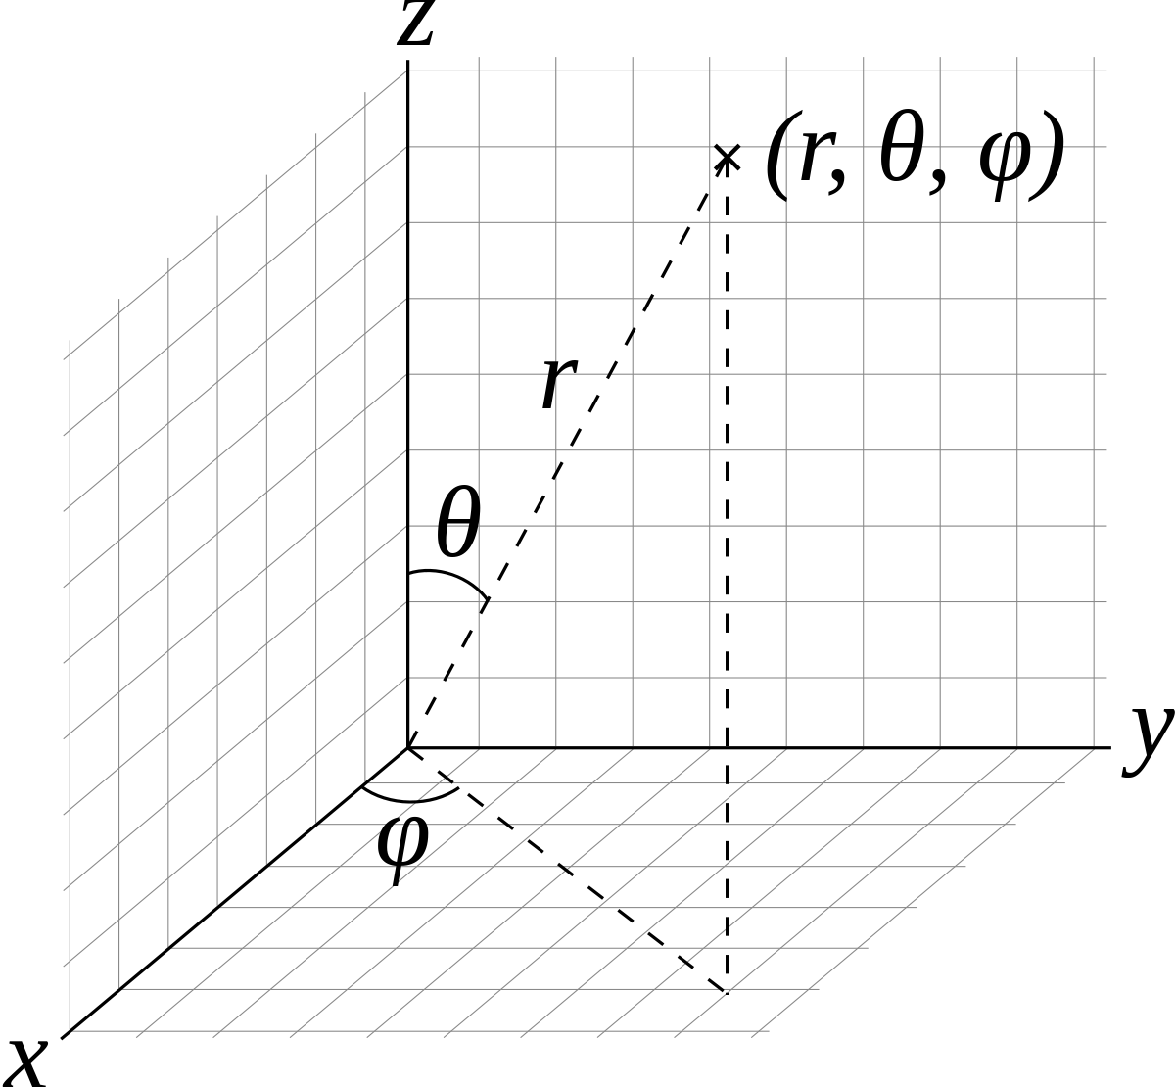


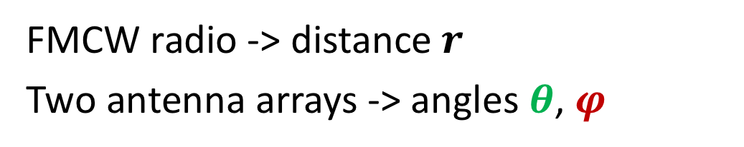
Antenna arrays with FMCW radio
FMCW radio -> distance $r$
Two antenna arrays -> angles $θ$, $φ$
Vertical RF frame $P(r, θ)$
Horizontal RF frame $P(r, φ)$
Notes:
Specifically, we use antenna arrays with FMCW radio as our sensor.
[click] FMCW radio gives us the distance of the reflector, while an antenna array gives us the incoming angle.
With this setup, we can actually map out different reflections in the 3D space.
[click] In the actual processing, we project the reflections on two planes to create two images.
[click] The horizontal RF frame shows the reflection intensity as a function of distance and horizontal angle.
[click] The vertical RF frame shows the reflection as a function of distance and vertical angle.

Slide 12
Antenna arrays with FMCW radio
RF frames disentangle people and track their motion
Person 2
Person 1
Notes:
In this case, [click] the first person is shown as the blobs circled in red, and [click] the 2nd person is shown as the blobs circled in green.
[click] We use these RF frames to disentangle people’s reflections and track their motion.

Slide 13
Create short trajectories of each user
Problem: no user identities!
RF frames over time
A short trajectory
…
B
E
A
Localization
Tracking Algorithm
Notes:
With multiple RF frames over time, we can connect the blobs into short trajectories using localization and tracking algorithms.
Due to the time limit, I am not going into the details.
[click] Here’s an example trajectory of a user in his home, shown in a top-down view with a floor map
The person walks into the coverage area of Marko at point A, makes a turn to go into the living room, stays in the kitchen room for a while, and finally leaves the coverage area at point E.
With the trajectories, we can know where people are and when.
[click] However, one problem is that because we are working with reflections, we don’t know user identities.
We can see blobs moving in the RF frames, but we don’t know who is who.

Slide 14
How does Marko work?
Extract short user trajectories from radio reflections
(where & when)
Tag trajectories with user identities (who)
Bootstrap in new homes with new users automatically
(for real-world deployments)
Notes:
This takes us to the 2nd part: how can we extract user identities from radio signals? [pause]

Slide 15
Idea: analyze reflections in both space and time
RF frames over time
?
User Identity
…
How to extract complex patterns to predict user id?
How to deal with multiple people in the environment?
Notes:
Our idea is to analyze reflections in both space and time.
[click] If we look at the RF frames, they capture spatial features about a person’s body shapes, height and build.
For example, a person with wider chest would take up more space in the RF frames.
[click] Moreover, as we look across frames over time, they capture temporal features such as the dynamics of how a person walks, which is known to be a useful feature for identification.
[click] But the question remains: how do we extract these complex patterns to predict user id?
[click] Also, how to deal with multiple people in the environment?
Each big blob here contains multiple small reflectors, representing different body parts and their movements.
It’s very hard to hand engineer features from these RF signals.

Slide 16
Extracting patterns with spatio-temporal CNNs
How to deal with Multiple people?
Notes:
Instead of engineering the features, we use convolutional neural networks or CNNs to learn relevant features for identification.
Specifically, we feed a sequence of RF frames to the network, and use spatio-temporal convolutions to extract both spatial and temporal features.
We process the horizontal and vertical RF frames with a two branch network, and fuse the feature vectors at the end for the final predictions.
However, [click] if there are multiple people in the RF frames, how would the network know who to look at and predict the ID?
Let say if there are two people in the RF frames, the best the network can do would be a random guess.

Slide 17
Use trajectories to guide attention
Once trained, Marko can track and identify people
Notes:
Our solution is to guide the neural network’s attention with the short trajectories we have.
[click] Let say we have two people, shown as the red and blue trajectories here.
[click] To identify the red user, we take the red trajectory, and create tubes around where the person is moving in space.
We project the spatial tubes on the RF frames.
Now the RF frames contain signals only from the red user, and we can ask the question who this red user is.
Once the models are trained, Marko can take the radio signals, process them into RF frames and trajectories, and use them to tag each trajectory with the user id.
However, how do we train the models?

Slide 18
How does Marko work?
Extract short user trajectories from radio reflections
(where & when)
Tag trajectories with user identities (who)
Bootstrap in new homes with new users automatically
(for real-world deployments)
Notes:
This takes us third part.

Slide 19
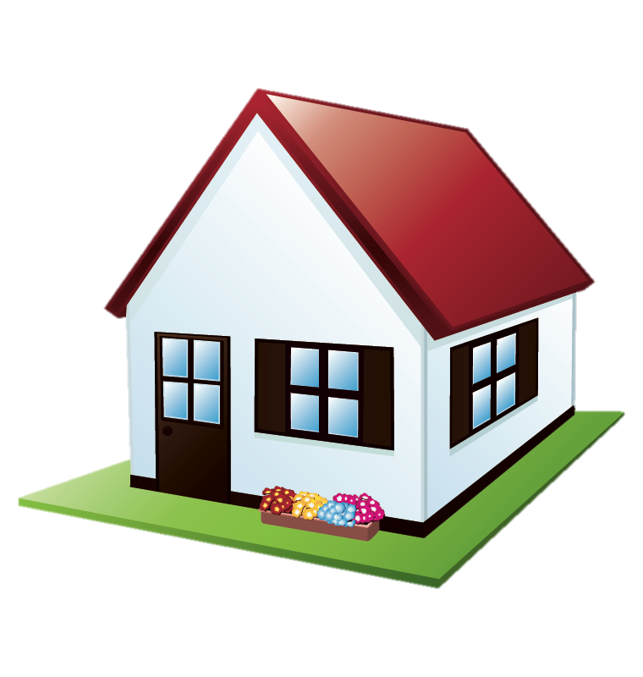
How to get labels to train the neural network?
Each new home has different users
Need new classifiers
Classifier 2 (Chris & Danny)
(new labels)
…
Classifier 1 (Alice & Bob)
Asking users or researchers to label data is impractical!
Notes:
A fundamental problem is: how do we get labels to train the neural networks? [pause]
[click] Each new home has different users, so we need to create new classifiers, and need new labels.
Let’s say home 1 has Alice and Bob, and home 2 has Chris and Danny.
We cannot just take the classifier from home 1 and use it for home 2.
[click] Moreover, each study typically involves many homes.
[click] Asking the users or researchers to manually label data is impractical.
It’s also hard for people to look at the RF signals or trajectories, and label who is who.
Ideally, we want a system that we can take to a new home, and runs it automatically. What can we do? [pause]

Slide 20
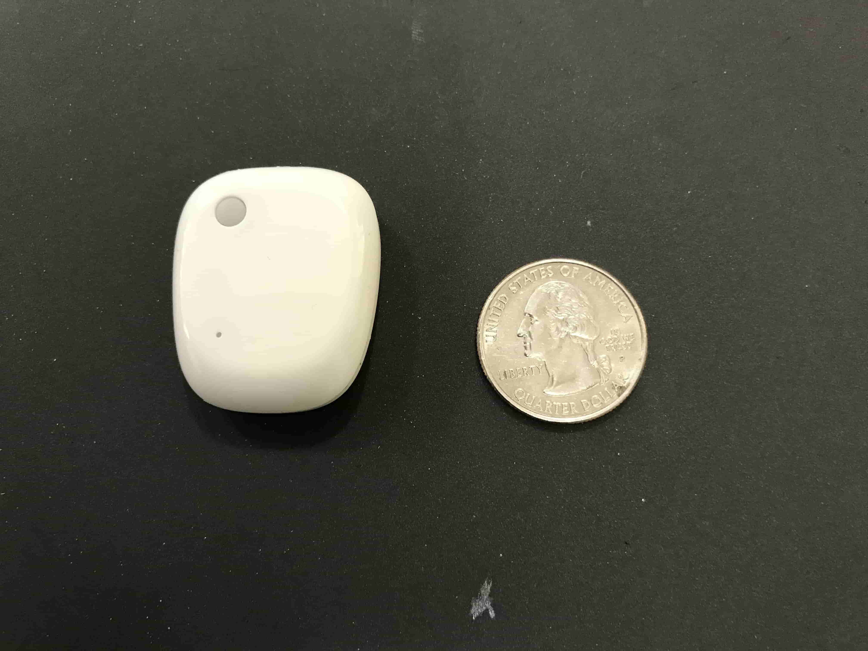
Idea: Auto-labeling with Multimodal Learning
Training phase: users can carry a small accelerometer
Radio Reflection
RF frames
Identity
predictions
ID-Nets
Trajectories
Acc. Sensor
Acceleration
User motion
Notes:
Our idea is to automatically label the data with multimodal learning. Let me explain what I mean by that.
[click] So here’s our current system: we have the user, collect radio reflections,
and we have the identification neural network to predict user ids.
[click] During the training phase, the first week of the study, user can carry a small accelerometer.
[click] We use a sensor with a size of a quarter that can be easily carried around.

Slide 21
Idea: Auto-labeling with Multimodal Learning
Training phase: users can carry a small accelerometer
Bob
Radio Reflection
?
RF frames
Identity
predictions
ID-Nets
Trajectories
Loss
Alice’s Sensor
Acceleration 1
Auto Labeler
Bob’s Sensor
Acceleration 2
ID labels
(e.g., Bob)
Chris’ Sensor
Acceleration 3
Match motion from the two modalities to create ID labels
Which one is matched?
Notes:
In reality, we don’t know who is reflecting the radio signal, and we see multiple streams of acceleration data.
Let’s say we have Alice, Bob, and Chris carrying the sensor, we’ll have 3 acceleration streams.
[click] We use an auto labeler to take a trajectory and acceleration data, and decide which acceleration stream is matched with this trajectory.
[click] Let’s say if bob’s acceleration data is matched, we know the signals are reflected from Bob.
[click] We use these ID labels to train the identification network.
[click] By matching motion from the two modalities, we can create ID labels to train the system.

Slide 22
Matching acceleration with RF-trajectory
Similarity Score
Learning to measure the similarity
Auto Labeler
Auto-Labeler
Generalize to new users!
(Auto-labeling for all new homes)
Acceleration
RF trajectory
Notes:
To match acceleration data with RF trajectory, we formulate the problem as [click] learning the similarity between the two modalities.
[click] We design a two branch neural network, where the model learns to correlate the two streams in the feature space, and produces a similarity score at the end.
One nice thing is that, learning to match the two modalities is something that can be generalized to new users. [pause]
This means that once this auto-labeler is trained, we can auto-label for all new homes

Slide 23
Once trained, no need for accelerometer
Radio Reflection
RF frames
Identity
predictions
ID-Nets
Trajectories
User motion
Run Marko in new homes automatically
Notes:
Once the system is trained, it works using only the radio signals alone. The users does not need to carry the accelerometer anymore.
With this auto-labeling design, we can create new classifiers without any manual labor.
We can take the system, and runs it in new homes automatically.

Slide 24
Evaluation

Slide 25
Evaluation
Real-world deployment for one month in 6 homes
Town house with 4 residents
One-bedroom apartment with young couples (x3)
Homes in an assisted living facility (x2)
Evaluate the accuracy and perform case studies
Notes:
We evaluated Marko through real-world deployment in 6 homes over one month.
This includes a town house with 4 residents.
Three one-bedroom apartments with young couples and no kids.
Two homes in an assisted living facility.
We’re going to look at the accuracies of the system and also a few case studies.

Slide 26
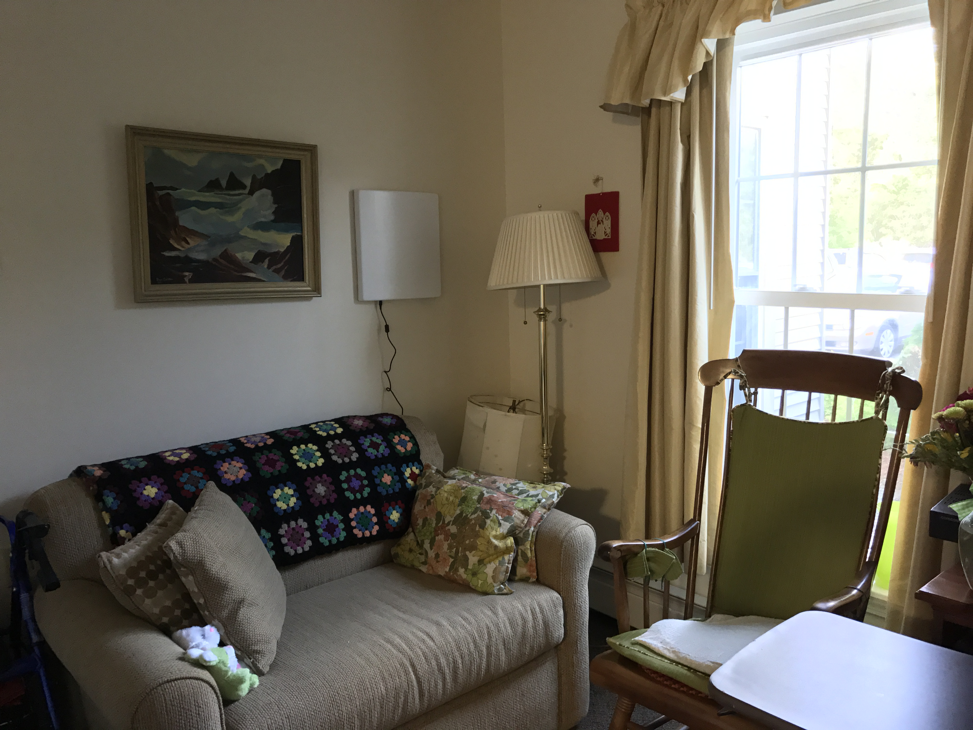
Marko

Slide 27
Accuracy of Identification
Accuracy (%)
Marko’s Avg. Accuracy: 90 %
Baseline: PCA + Random forest
Baseline Avg. Accuracy 62 %
Marko Identifies users accurately in different homes
Notes:
First let’s look at the accuracy of identification.
[click] Across the 6 homes, Marko achieves an average accuracy of 90%.
[click] We also compared Marko with baseline that uses PCA with Random Forest, and the average accuracy is 62%
[click] This shows that Marko can identify users accurately in their own homes, as they live their normal lives.

Slide 28
Accuracy of Auto-Labeling
Accuracy (%)
Agreement between human labelers: 96%
Test on unseen homes
(leave-one-out)
Avg. Accuracy: 95 %
Generalize to unseen homes accurately
Notes:
Next, let’s look at how accurate the auto-labeler is.
[click] Since the goals is to auto-label users in a new home, for each test home, we train the model on data from other homes.
[click] The average accuracy across different homes is 95%.
This is very accurate. In fact, when we ask 3 human labelers to manually label the data by looking at the acceleration and RF trajectoreis, [click] the inter-labeler agreement is around 96%.
This shows that the errors made by the auto-labeler is similar to the inconsistency between how humans interpret the data.
[click] This also shows the the auto-labeler generalizes to unseen homes accurately.

Slide 29
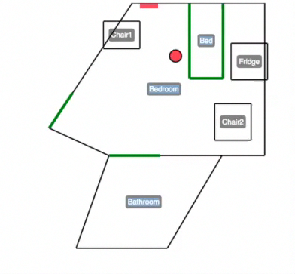
Case study 1: Caregiver-Patient Interaction
Nurse Schedule
Red: patient
Green: caregiver
Bed
4x speed
The patient
Medication
Cabinet
Notes:
I want to show you some case studies to share what we learn from this experience, and how people can use Marko in a study.
In one of the homes, we have an elderly patient and a nurse who takes care of the patient.
Interestingly, once we separate the patient’s trajectories from those of the nurse, we found that the patient never take medication on her own.
[click] I am gonna show you a video of marko’s output. The red dot here is the patient.
[click] The nurse comes in, say hi to the patient and went to the medication cabinet.
She probably prepares the meds on the chair, and help the patient with the medication.
[click] We can also plot all the times when the nurse visits throughout a week.
We can see that the nurse regularly visits the patient at 6am, 1pm and 7pm.
These are actually the time when the nurse helped with the medication.
[click] On some days, the nurse visits in the middle of the night.
What happened was that the patient was wandering at night, and the nurse helped the patient to get back to bed.

Slide 30
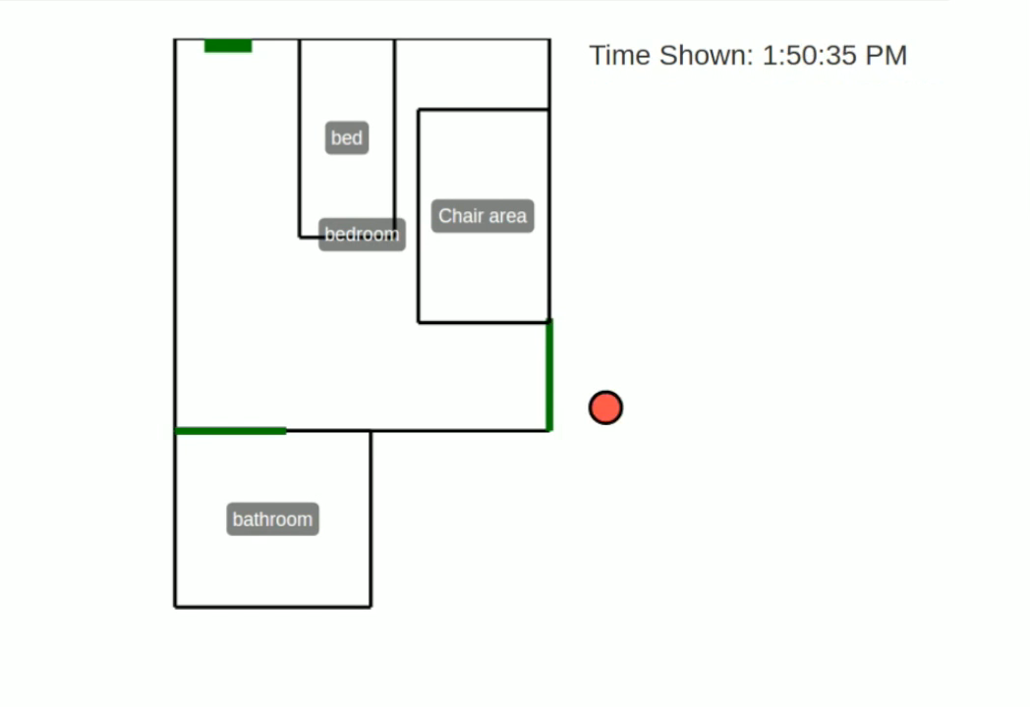
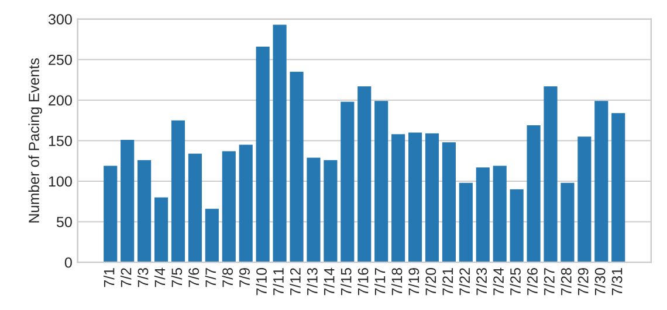
Case study 2: Health Profiling
Alzheimer’s disease behavioral symptoms such as agitation or pacing develop in over 90% of the patients
The patient
Notes:
The 2nd study I want to show you is related to mental health.
In another home that we deploy with, the patient has Alzheimer’s with dementia.
One of the common symptoms of Alzheimer is agitation, e.g. showing repetitive movement such as pacing.
[click] I am going to play a video of Marko’s output here. Again, the red dot is the patient.
We can see that the patient just repeatedly pacing in and outside of the room. [pause]
The nursing staff knows that the patient has agitation, but it’s really hard to *quantify* the level of agitation.
[click] With Marko, we can extract these pacing events and plot it as a function of different days.
Here, we see that normally the patients paces around 100 times, but in some days, the patient paces close to 300 times.
With this information, doctors can start quantifying this very important metric in agitation,
and understand if the medication is improving things or if one should lower the dose.

Slide 31
Case Study 3: Couple’s Routines & Interaction
x
x
x
x
Entry/Exit
Living
Room
Kitchen
Bedroom
Notes:
Finally, I want to show you a case more related to social studies.
We use Marko to analyze the daily behavior of a couple.
On the y-axis we show if a person is in a particular area, and the x-axis is time. The blue mark is for the man and red for the woman.
[click] In the morning, the man woke up around 7 and left the home around 8.
[click] The woman left around 7.
[click] In the evening, the woman
got back home around 6, spent some time in the living room, probably got food in the kitchen.
[click] On this particular day, the man returned from work late around 9. That’s pretty long work hours.
But the couple still spent time together for 2 hours in the living room before going to bed.
[click] Interestingly, the woman woke up again in the middle of the night, went to the kitchen and stayed in the living room till 4.
If this shows up in many days, either she has sleeping issue or something is wrong.
With this information across multiple days, we can discover if the couple has healthy routines and how they spent time together.

Slide 32
Related Work
Behavioral Sensing
  Self-reporting through questionnaires or diaries [Möller’13, Wang‘14, Wash’17]
  Wearables [Consolvo’08, Lane’10, Rachuri’10, Aharony’11, Wang’14]
Measures only limited actions, cannot measure interaction, and
Adherence problems [Ledger’14, Clawson’15, Shih’15, Lazar’15, Fox’17]
RF-based identification [Adib’15, Hong’16, Wang’16, Zeng’16, Chen’17, Shi’17, Zhao’18]
  Restrict the user to walk on a few pre-determined paths
  Cannot deal with multiple people
  Does not scale to new homes automatically
Notes:
Of course, we build on a large body of related work.
For behavioral sensing, I told you about self-reporting, and how it can be inaccurate and not sustainable.
People also tried to use wearables. But they only measure limited set of actions, and cannot measure interaction between people.
They also suffer from adherence problems, as people tend to forget to wear or charge the devices.
We also build on past work in using Radio signals for identification.
However, that work is very limited.
It often requires the users to walk on a pre-determine path to identify them.
Of course, for a system to work in-the-wild, we cannot ask users to always walk on a pre-determined line in their homes.
Also, past work cannot deal with multiple people in the scene, and does not scale to new homes automatically.

Slide 33
Conclusion
First RF-based system for in-home user identification and behavioral sensing
Accurate, low-overhead, non-invasive and scales to new homes and new users automatically
Opens up new opportunities for longitudinal studies of behavior, mental health, and social interaction
Website: marko.csail.mit.edu

