Slide 1
Top-k String Similarity Search with Edit-Distance Constraints
Dong Deng (Tsinghua, Beijing, China)
Guoliang Li (Tsinghua, Beijing, China)
Jianhua Feng (Tsinghua, Beijing, China)
Wen-Syan Li(SAP Labs, Shanghai, China)
Notes:
Good morning everyone. Thank you for this opportunity to talk to you today. My name is Dong Deng and I am from Tsinghua university, Beijing. China. Today I am going to present an efficient trie-based method to solve the top-k string similarity search problem. This is a joint work with guoliang, jianhua, and wen shan.

Slide 2
Outline
Motivation
Problem Formulation
Progressive Framework
Pivotal Entry-based Method
Range-based Method
Experiment
Conclusion
Notes:
So this is the outline of my presentation. I will first give the motivation.

Slide 3
Real-world Data is Rather Dirty！☹
DBLP Complete Search
Typo in “author”
Typo in “title”
Argyrios Zymnis
Argyris Zymnis
relaxed
related
Notes:
As we all know. Data in real world is really dirty. Here is an example. We have typos in dblp data. In the upper side we have typos in author name, and on the lower side we have typos in title field.

Slide 4
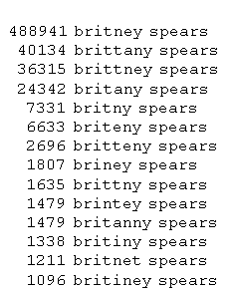
Web Search
Errors in queries
Errors in data
Bring query and meaningful results closer together
Actual queries gathered by Google
Notes:
When we search the google engine, we may not type in the exactly query, that is we may contains error in queries. Also There may be errors in the dataset. So, the similarity search bring query and meaningful results closer together.

Slide 5
Example: a movie database
Iron man
The man
Find movies starred Samuel Jackson
Star | Title | Year | Genre
Keanu Reeves | The Matrix | 1999 | Sci-Fi
Samuel Jackson | Iron man | 2008 | Sci-Fi
Schwarzenegger | The Terminator | 1984 | Sci-Fi
Samuel Jackson | The man | 2006 | Crime
Notes:
Here is an example. We have a tranditional movie dataset here. If we want to find movie starred by Samuel Jackson. It is very easy to achieve and we get the two blue records as results.

Slide 6
Query: Schwarzenegger?
The user doesn’t know the exact spelling!
Star | Title | Year | Genre
Keanu Reeves | The Matrix | 1999 | Sci-Fi
Samuel Jackson | Iron man | 2008 | Sci-Fi
Schwarzenegger | The Terminator | 1984 | Sci-Fi
Samuel Jackson | The man | 2006 | Crime
Notes:
But what if we want to query schwarzenegger? Which some user doesn’t know the exact spelling ?

Slide 7
Relaxing Conditions
Find movies with a star “similar to” Schwarrzenger.
Star | Title | Year | Genre
Keanu Reeves | The Matrix | 1999 | Sci-Fi
Samuel Jackson | Iron man | 2008 | Sci-Fi
Schwarzenegger | The Terminator | 1984 | Sci-Fi
Samuel Jackson | The man | 2006 | Crime
Notes:
Here we need to relax the conditions and use a similarity search which find a star similar to the query string.

Slide 8
String Similarity Search
String Similarity Search finds all entries from the dictionary that approximately match the query.
Applications:
Biology, Bioinformatics
Information Retrieve
Data Quality, Data Cleaning
….
Notes:
Thus we propose the problem of string similarity search which finds all entries from a dictionary that approximately match the query. This problem has plenty of applications such as bioinformatics, information retrieve and data cleaning and data quality.

Slide 9
Outline
Motivation
Problem Formulation
Progressive Framework
Pivotal Entry-based Method
Range-based Method
Experiment
Conclusion
Notes:
Next, I will give the formular problem definition.

Slide 10
Problem Formulation
Top-k String Similarity Search: Given a string set S and a query string q, top-k string similarity search returns a string set R ⊆ S such that |R|=k and for any string r∈ R and s∈ S − R, ED(r, q) ≤ ED(s, q).
the top-3 similar strings of srajit
Notes:
So here we have the problem of top-k string similarity search. To given a similarity bound is difficult to end users as they have no knowledge about the underlining dataset. Thus we want to solve the topk string similar search problem which outputs k most similar strings to the query. Here we have an example. Consider the strings in the table. Given a top-3 query srajit, we find sarit, seraji and surajit as they are the most similar string to srajit.

Slide 11
Edit Distance
ED(r, s): The minimum number of single-character edit operations(insertion/deletion/substitution) to transform r to s.
ED(srajit, seraji) = 2
Notes:
to quantify the similarity Here we use a famous similarity function edit distance, The edit distance is the minimum number of edit operation needed to transform one string to another. For example the edit distance between srajit and seraji is 2 as we can transform srajit to seraji by inserting ‘e’ and deleting ‘t’.

Slide 12
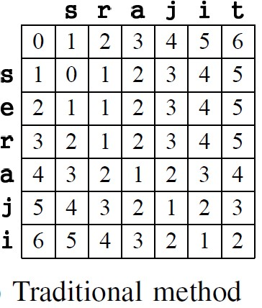
Dynamic Programming
Insertion
Deletion
Match/Subsitition
D_{i,j} = min{D_{i-1, j} + 1, D_{i, j-1} + 1, D_{i-1, j-1} + 0/1}
Notes:
To calculate the edit distance between two strings there is an dynamic programming method as show in the slide. We have a matrix whose cell denote the edit distance between the two prefixes of strings. And the cell in lower right corner is the edit distance between the two strings. The transformation function is shown here, by using the function we can get the edit distance between the two strings. The dynamic programming way always select the minimum value from the other three direction as shown in the slides

Slide 13
Dynamic Programming
ED(srajit, seraji) = 2
D_{i,0} = i, D_{0,j} = j,
D_{i,j} = min{D_{i-1, j} + 1, D_{i, j-1} + 1,
D_{i-1, j-1} + t_{i, j}},
0 if a_{i} = b_{j}
1 if a_{i} ≠ b_{j}.
Insert e
where t_{i, j} =
Delete t
Notes:
Here we have an example, to calculate the edit distance between the two strings, we first initial the first row and first column of the matrix and then use the dynamic programming method to calculate the cell values row by row. The red line is an alignment to transform srajit to seraji which first match the two ‘s’s insert an ‘e’ and match the raji, and finally a deletion of t.

Slide 14
Outline
Motivation
Problem Formulation
Progressive Framework
Pivotal Entry-based Method
Range-based Method
Experiment
Conclusion
Notes:
So next we propose a progressive framework for the top-k string similarity search problem.

Slide 15
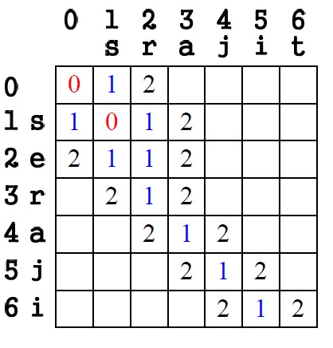
Progressive Method
Smallest Cell First.
E₀ : (0, 0) (1,1)
Notes:
We first show how the progressive method works in two strings. The basic idea is that we always select the smallest cell to extend to other uncalculated cells which fill the uncalculated cells directly. That is because the smallest cell always generate the next smallest cells. Here we have an example, we first identify the two smallest cells entry [0,0] and [1,1] whose value are both 0.

Slide 16
Progressive Method
Extending Cells
E₀ : (0, 0) (1,1)
Notes:
Next we extend the two smallest cells from three directions to the other uncalculated cells.

Slide 17
Progressive Method
Extending Cells
E₀ : (0, 0) (1,1)
E₁ : (1,0) (0,1)(2,1)
(1,2) (2,2)
Notes:
And we get five cells and fill them with value 1 as show in the slides. This is because no other way can fill an even smaller value to these five cells.

Slide 18
Progressive Method
Find Match Cells.
E₀ : (0, 0) (1,1)
E₁ : (1,0) (0,1)(2,1)
(1,2) (2,2)
Notes:
After extending the smallest value, we need to find the matching uncalculated cells from the extended cells. This is because a match operation will not increase the edit distance between two prefixes. And This will generate the next smallest value, too.

Slide 19
Progressive Method
Find Match Cells.
E₀ : (0, 0) (1,1)
E₁ : (1,0) (0,1)(2,1)
(1,2) (2,2) (3,2) (4,3)
(5,4) (6,5)
Notes:
As show in the slides, after finding match cells we get next another four cells and fill them with value 1.

Slide 20
Progressive Method
Extend Smallest Cells
E₀ : (0, 0) (1,1)
E₁ : (1,0) (0,1)(2,1)
(1,2) (2,2) (3,2) (4,3)
(5,4) (6,5)
E₂: (2,0) (3,1) (4,2)
(5,3) (6,4) (1,3)(2,3)
(3,3) (4,4) (5,5) (6,6)
Notes:
Similarity next we extend the set of smallest cells with value 1 to get next smallest cels with value 2 and finally get the results that the edit distance between srajit and seraji is 2.

Slide 21
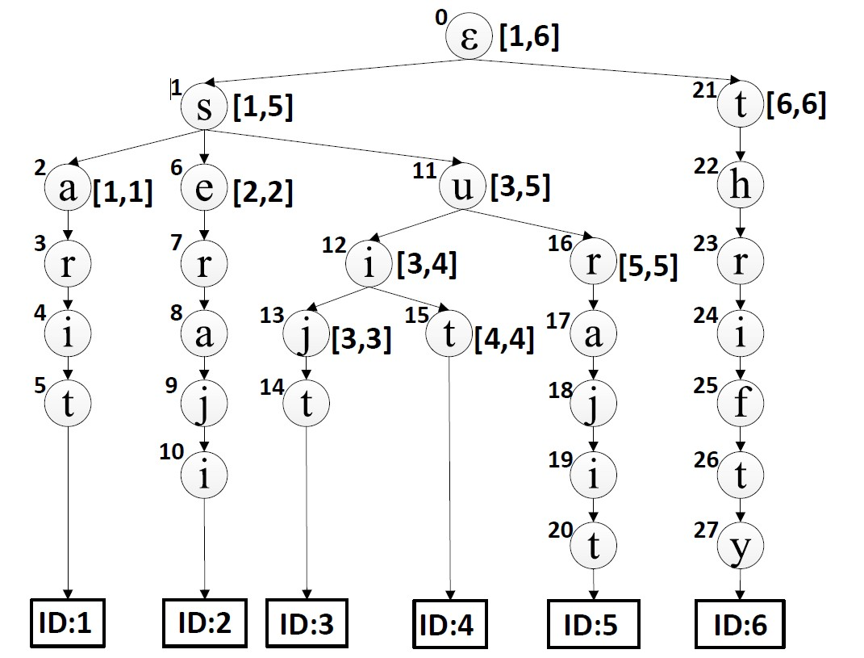
Progressive Framework
Index all strings using a trie structure
Top3-Query:
Q=srajit
Entry
i-th node of trie;
j-th character of Q
(n_{i} j)
Tx: node and char with ED=x
Notes:
Next we show how to use this progressive framework to addresse our top-k string similarity search problem. To achieve this, we need to first build a trie structure over the dataset. The trie structure on the right side is based on the strings in previous table. Also we introduce a concept of entry which consists of a node and a prefix of the query string. An entry can be basically understand as a cell in previous matrix. Suppose a top-3 query srajit is issued. Next we illustrates how to compute the top-3 results of query “srajit”.

Slide 22
Progressive Framework
index: 0 1 2 3 4 5 6
Find Match Nodes from (n₀ 0) Top3-Query: ε s r a j i t
T₀: (n₀ 0) (n₁ 1)
i-th node of trie;
j-th character of Q
(n_{i} j)
Tx: node and char with ED=x
Notes:
We adapt the progressive framework on the trie structure. We first add the entry consists of node zero and theprefix with length zero into the smallest node sets with edit distance zero. Next we need to find those matching entries whose edit distance is also zero. As n1 which is the node in red cycle, matches the ‘s’ of the query string , we add the entry of ⟨n1, 1⟩ into the set of smallest nodes with edit distance 0.

Slide 23
Progressive Framework
index: 0 1 2 3 4 5 6
Extends Nodes (n₀, 0) Top3-Query: ε s r a j i t
T₀: (n₀ 0) (n₁ 1)
i-th node of trie;
j-th character of Q
(n_{i} j)
Tx: node and char with ED=x
Notes:
Next we need to calculate the entries with edit distance 1 by extending from the two smallest entries. We use the first entry node zero and zero as an example.

Slide 24
Progressive Framework
index: 0 1 2 3 4 5 6
Extends Nodes (n₀, 0) Top3-Query: ε s r a j i t
T₀: (n₀ 0) (n₁ 1)
T₁: (n₀ 1) (n₁ 0) (n₂₁ 0)
(n₂₁ 1) (n₁ 1)
i-th node of trie;
j-th character of Q
(n_{i} j)
Tx: node and char with ED=x
Notes:
For ⟨n0, 0⟩, we can extend it by three edit operation. By a deletion, we want to add ⟨n0, 1⟩ in to the set of next smallest entries, similary by a insertion we wan to add ⟨n21, 0⟩ , and by a substitution we want to add ⟨n1, 1⟩, and ⟨n21, 1⟩. As ⟨n1, 1⟩ is already calculated in the set of edit distance one, we do not add it.

Slide 25
Progressive Framework
index: 0 1 2 3 4 5 6
Return Results:n₂₀ n₅ n₁₀ Top3-Query: ε s r a j i t
T₀: (n₀ 0) (n₁ 1)
T₁: (n₀ 1) (n₁ 0) (n₂₁ 0)
(n₂₁ 1) (n₁ 1)
……(n₂₀ 6)……
T₂: …(n₅ 6)… (n₁₀ 6)…
Notes:
Similarly we compute T1 and T2. As there are 3 answers in T2, we terminate and return n20 (“surajit”) with edit distance 1, and n5 (“sarit”) and n10 (“seraji”) with edit distance 2.

Slide 26
Outline
Motivation
Problem Formulation
Progressive Framework
Pivotal Entry-based Method
Range-based Method
Experiment
Conclusion
Notes:
In this section, we propose a method to reduce the size of entry set Ex in order to improve the performance of computing the edit distance between two strings (Section IV-A) and then extend
this technique to support similarity search (Section IV-B).

Slide 27
Pivotal Entry-based Method
Definition 2 (Pivotal Entry): An entry ⟨i, j⟩ in Ex is called a pivotal entry, if D[i + 1][j + 1] > D[i][j].
We only need to keep the
pivotal entry
0
Notes:
Consider an entry ⟨i, j⟩ in Ex. The goal of keeping ⟨i, j⟩ in Ex is to extending to next smallest entry and find those matching entry. If an entry have a matching entry next we can discard this entry and as the next matching entry will dominate this entry. That is the set of extended entry by the matching entry is covered by the current entry. We propose the concept of pivotal entry which have no matching entry behind it and we only need to keep those pivotal entries. For example as show in the silde, for the two entry with cell value 0, as the one in black cycle has a matching next to it we drop it. For the entry in red cycle, it is a pivotal entry and we keep it.

Slide 28
Pivotal Entry-based Method
Smallest Pivotal Entry First.
P₀ : (1,1)
Notes:
Next we show how the pivotal entry based method works. We still calculate from the smallest pivotal entry. First, the smallest pivotal entry is [1,1] as show in the slide with cell value 0.

Slide 29
Pivotal Entry-based Method
Extending Cells
P₀ : (1,1)
Notes:
then we compute the set of pivotal entry with cell value 1 based on it. By substitution, deletion and insertion we extended to three other entries with cell value 1.

Slide 30
Pivotal Entry-based Method
Extending Cells
P₀ : (1,1)
P₁ : (2,1) (1,2) (2,2)
Notes:
But the extended entries are not all pivotal entries. We need to find matching based on them and on the last entry with no matching next to it is pivotal entry.

Slide 31
Pivotal Entry-based Method
Find Match Entries.
P₀ : (1,1)
P₁ : (2,1) (1,2) (2,2)
Notes:
next we find the match entry based on the extended three entries.

Slide 32
Pivotal Entry-based Method
Find Match Cells.
P₀ : (1,1)
P₁ : (1,2) (2,2) (6,5)
Notes:
And We find that the entry [1,2], [2,2] and [6,5] is pivotal entry as they have no matching next.

Slide 33
Pivotal Entry-based Method
Extend Smallest Cells.
P₀ : (1,1)
P₁ : (1,2) (2,2) (6,5)
P₂: (1,3) (2,3) (6,6)
Notes:
Next, similarly, we continue to calculate the set of pivotal entry with edit distance 2 based on the smallest pivotal entry set with edit distance one and get the final result.

Slide 34
Pivotal Entry-based Method
Definition 3 (Pivotal Triple): Given an entry ⟨n, j⟩, one of
n’s children n_{c}, and a query q, triple ⟨n, j, n_{c}⟩ is called a
pivotal triple, if ED(n_{c}, q[1, j + 1]) > ED(n, q[1, j]).
n_{i}: i-th node of trie
(n_{i} j n_{c})
j : j-th character of Query
n_{c}: a child of n_{i}
Px: pivotal triples with ED(n_{i}, Q[1 … j])=x
Notes:
Next we show how to use the pivotal entry-based method to solve the top-k string similarity search problem. To achieve this we first propose a concept of pivotal triple. The pivotal triple consists of a node, a position, also a prefix in query string and a child of the first node. Which means that for all the string under the first node, The child and the prefix is a pivotal entry. A triple is a pivotal triple if and only if it’s child node do not match the next character of the prefix.

Slide 35
Pivotal Entry-based Method
Index all strings using a trie structure
Top3-Query:
Q=srajit
(n_{i} j n_{c})
n_{i}: i-th node of trie
j : j-th character of Query
n_{c}: a child of n_{i}
Notes:
We still consider the last example and we have a trie on the right side and a top3 query srajit on the left side.
We first find the set of pivotal triple with edit distance 0.

Slide 36
Pivotal Entry-based Method
index: 0 1 2 3 4 5 6
Find Match Nodes Top3-Query: ε s r a j i t
P₀: … (n₁ 1 n₂) …
(n_{i} j n_{c})
n_{i}: i-th node of trie
j : j-th character of Query
n_{c}: a child of n_{i}
Notes:
Here we find a pivotal triple as show in the slides. For node 1, as its child node 2 do not match the second character of the query string, thus they consists a pivotal triple.

Slide 37
Pivotal Entry-based Method
index: 0 1 2 3 4 5 6
Extend Node (n₁ 1 n₂) Top3-Query: ε s r a j i t
P₀: … (n₁ 1 n₂) …
P₁: ...
Substitution: (n₂ 2 n₃)
Insertion: (n₂ 1 n₃) (n₃ 2 n₄)
Deletion: (n₁ 2 n₂) (n₂ 3 n₃)
…
Notes:
We extend this pivotal triple by three operations. we do a substitution and add ⟨n2, 2, n3⟩. For insertion, ⟨n2, 1, n3⟩ is not a pivotal entry as n3 matches the second character of query string. Thus we use the match operation and add ⟨n3, 2, n4⟩. For deletion, we also extend ⟨n1, 2, n2⟩ to ⟨n2, 3, n3)

Slide 38
Pivotal Entry-based Method
index: 0 1 2 3 4 5 6
Return Results Top3-Query: ε s r a j i t
P₀: … (n₁ 1 n₂) …
P₁: … (n₂₀ 6 φ) …
P₂: ..(n₅ 6 φ) (n₁₀ 6 φ) …
…
Notes:
Similarly we computed all pivotal triples and get three results.

Slide 39
Pivotal Entry-based Method
Too many tuples
Want to group the children together
Notes:
As there may be multiple pivotal entry triples with the same node and prefixes, we want to group them to improve the performance. That is for a node and prefixes, the node may have multiple children such that them form a pivotal triple. It is expensive both for store them and extending them. Thus we want to group these children of the node together. To achieve this we encode the trie structure by assign an ID in a pre-order for each leaf node and each internal node we maintain an ID range [ln, un], which is the minimum and (maximum) leaf node ID under the internal node. Thus we can aggregate the children by record the node range.

Slide 40
Outline
Motivation
Problem Formulation
Progressive Framework
Pivotal Entry-based Method
Range-based Method
Experiment
Conclusion
Notes:
Next we propose a range-based method here.

Slide 41
Range based Method
Definition 4 (Pivotal Quadruple): A quadruple
⟨[l, u], d, j⟩ is a pivotal quadruple, if it satisfies
(1) ⟨l, u⟩ is a sub-range of a d-th level node’s range;
(2) for any string s with ID in [l, u],
ED(s[1, d + 1], q[1, j + 1]) > ED(s[1, d], q[1, j]);
(3) strings with ID l − 1 or u + 1 do not satisfy
conditions (1) or (2).
Notes:
To achieve this we first propose a concept of pivotal quadruple. The pivotal quadruple consists of a node range, a trie-depth and a position also a prefix in query string. Which means that for each string s in the range, the node in d-th level and the prefix is a pivotal entry. A quradruple is a pivotal quradruple if and only if the strings in the range have no d+1-th level node match the next character of the prefix.

Slide 42
Range based Method
Index all strings using a trie structure
Top3-Query:
Q=srajit
[l, u] a range
([l,u] d j)
j : j-th character
d: the d-th level
Px: pivotal quadruples
with ED=x
Notes:
We consider the last example and we have a trie on the right side and a top3 query srajit on the left side.

Slide 43
Range based Method
index: 0 1 2 3 4 5 6
Find Match Nodes Top3-Query: ε s r a j i t
P₀: ([6,6] 0 0) ([1,5] 1 1)
[l, u] a range
([l,u] d j)
j : j-th character
d: the d-th level
Px: pivotal quadruples
with ED=x
Notes:
For any string s in the trie from 1 to 5, none of them have a node in second level matching the second character of the query string thus the quadruple with range from 1 to 5 and with depth 1 and prefix length 1 is a pivotal quraple. Similarly, as none of node in first level and in the string within range 6 to 6 matching the prefix with length 1, the

Slide 44
Range based Method
index: 0 1 2 3 4 5 6
Extend Node ([6,6] 1 1) Top3-Query: ε s r a j i t
P₀: ([6,6] 0 0) ([1,5] 1 1)
P₁: ……([6,6] 1 1)……
P₂: …
Substitution: ([6,6] 2 2)
Insertion: ([6,6] 2 1) ([6,6] 3 2)
Deletion: ([6,6] 1 2)
…
Notes:
We extend the red one pivotal quadruple. There are also three edit operation here. For substitution, we add ⟨[6, 6], 2, 2⟩. For insertion, ⟨[6, 6], 2, 1⟩ is not a pivotal entry as the third character of string s6 matches the second character of query. Thus we find the next matching character and add ⟨[6, 6], 3, 2⟩. For deletion, we add ⟨[6, 6], 1, 2⟩. The details of the three edit operation is rather complicate and we will not go into the details.

Slide 45
Range based Method
index: 0 1 2 3 4 5 6
Return Results Top3-Query: ε s r a j i t
P₀: ([6,6] 0 0) ([1,5] 1 1)
P₁: ……([6,6] 1 1)……
……([5,5] 7 6) ……
P₂: ……([1,1] 5 6)……
…….([2,2] 6 6)……
Notes:
Similarly, we find three results as show in the slides.

Slide 46
Outline
Motivation
Problem Formulation
Progressive Framework
Pivotal Entry-based Method
Range-based Method
Experiment
Conclusion
Notes:
Next we show some experimental results

Slide 47
Experiment Setup
Three real Data sets
Existing algorithms
B^{ed}-Tree (downloaded from its hompage)
Adaptive Q-gram (we implemented)
Flamingo(downloaded and we extended it to suppert topk query)
Notes:
We conducted an extensive set of experimental studies on three real datasets. The first one is the Author dataset which is a set of author names and extracted from the publications in PubMed ∥. The second one is the Word dataset, which is a set of common English words. The third one is a set of Email addresses. We randomly selected 100 queries from the datasets and compared the average elapsed time. Table VII shows the detailed information of the three datasets. We compared our algorithms with state-of-the-art methods, AQ [20], Bed-Tree [21], and Flamingo [10].

Slide 48
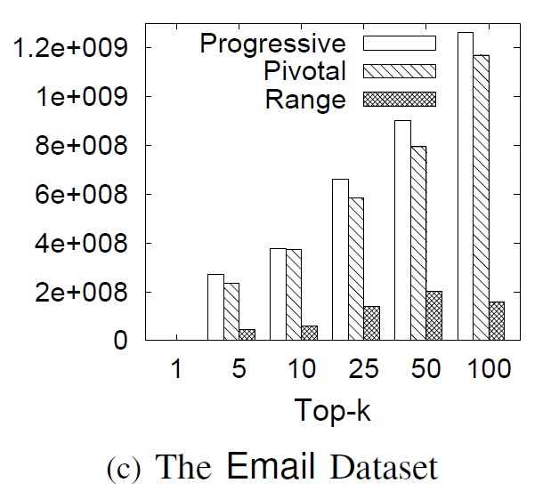
Number of entries calculated
RANGE was about 6 times lesser than PROGRESSIVE and PIVOTAL. This is because RANGE use pivotal quadruple group pivotal triples together and skip the unnecessary entries.

Slide 49
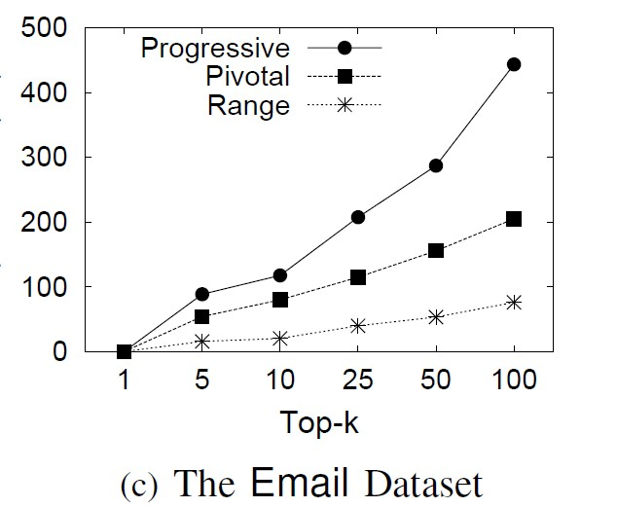
Running time of the three methods
The range-based method pruned many non-pivotal entries against the progressive-based method and grouped the pivotal entries to avoid unnecessary computations.

Slide 50
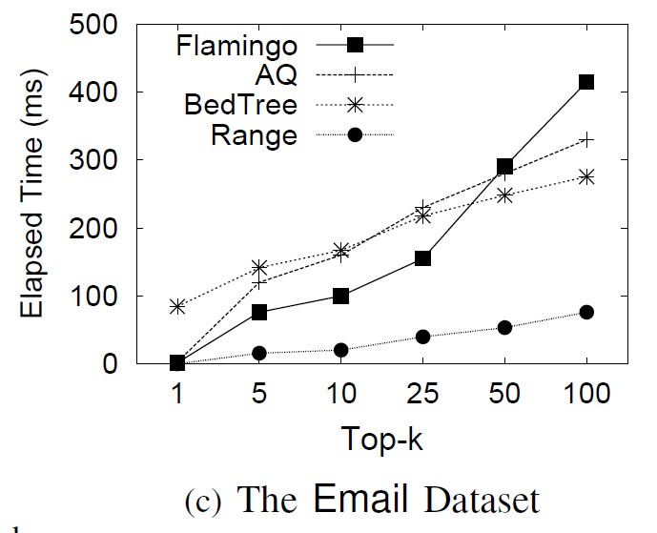
Comparison with State-of-the-art Methods
Notes:
we compare our range-based method with state-of-the-art methods, AQ, Bed-Tree, and Flamingo by varying different k. As they needed tune some parameters (e.g., gram length), we reported their best results. Our method achieved the highest performance and outperformed existing methods. This is because Bed-Tree only used
the string level pruning, while our method can utilize the character-level pruning. That is for a string, Bed-Tree can
only take its edit distance to the query as a threshold. Our method can progressively compute edit distance and can use the edit distance of prefixes of a string and the query as a threshold. Thus our method outperformed Bed-Tree.

Slide 51
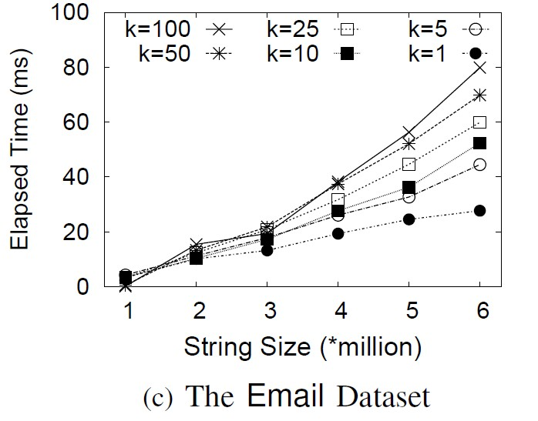
Scalability with Dataset Sizes
for k=100, our method took
27 milliseconds for 1 million strings,
52 milliseconds for 3 million strings
79 milliseconds for 6 million strings.

Slide 52
Outline
Motivation
Problem Formulation
Progressive Framework
Pivotal Entry-based Method
Range-based Method
Experiment
Conclusion

Slide 53
Conclusion
Top-k String Similarity Search
A progressive framework to support top-k similarity search.
A pivotal entries method to avoid unnecessary computations.
A range-based method groups the pivotal entries.
Experimental results show that our method significantly outperforms existing methods

Slide 54
Thanks!
Q&A
http://dbgroup.cs.tsinghua.edu.cn/dd/projects/topksearch

