Slide 1

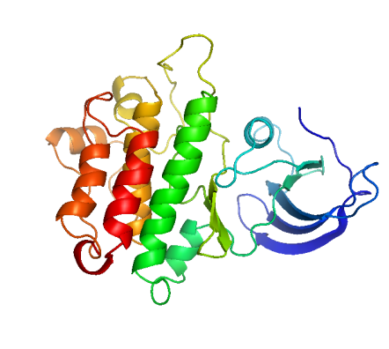
Unraveling the mechanism of chaperone-mediated protein folding
Jian Peng
Department of Mathematics
Computer Science and Artificial Intelligence Lab
Massachusetts Institute of Technology

Slide 2
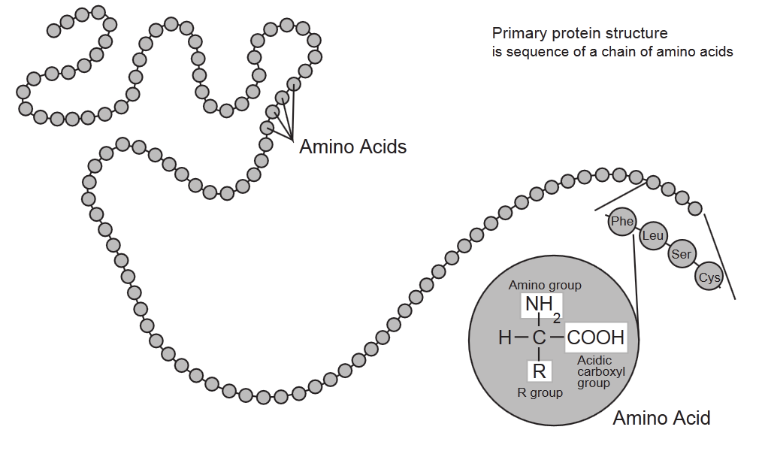
Protein
(residue)
R: side-chain group

Slide 3

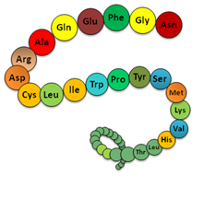

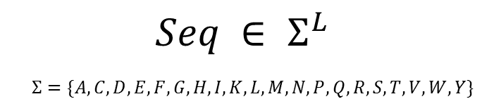
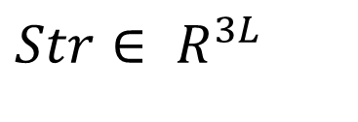
Protein folding/structure prediction
F( ) =
$Seq ∈ Σ^{L}$
$$Σ=\{A,C,D,E,F,G,H,I,K,L,M,N,P,Q,R, S, T, V, W, Y\}$$
$Str∈ R^{3L}$
raptorx.uchicago.edu
RaptorX: RECOMB 2009, ISMB 2010, Proteins 2011, ISMB 2012, Nature Protocols 2012

Slide 4
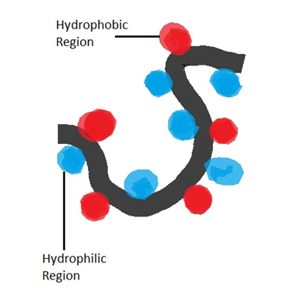
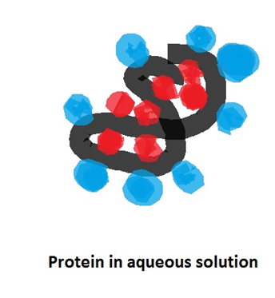
Protein folding in cells : hydrophobic effect

Slide 5
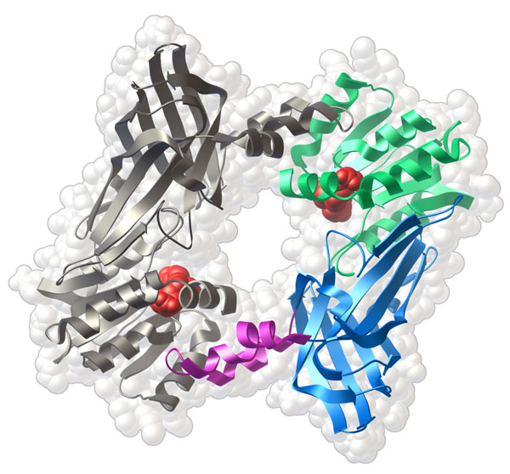
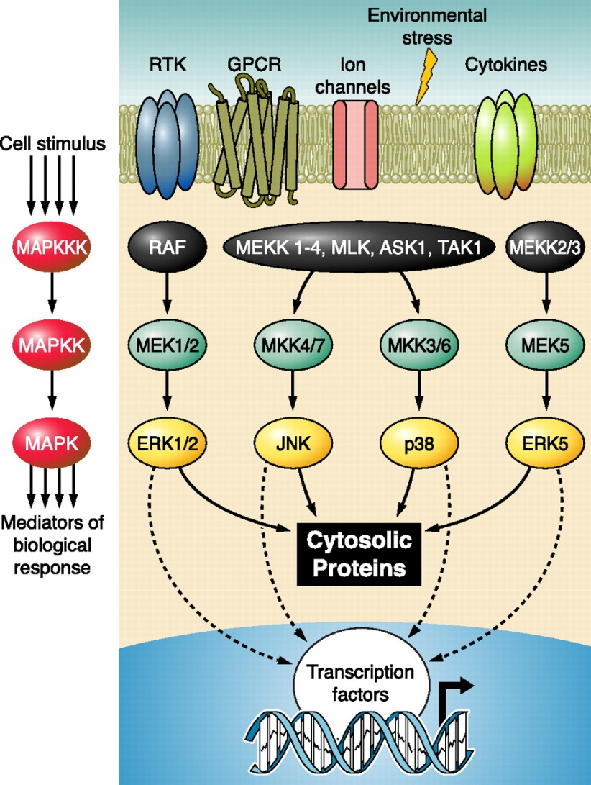
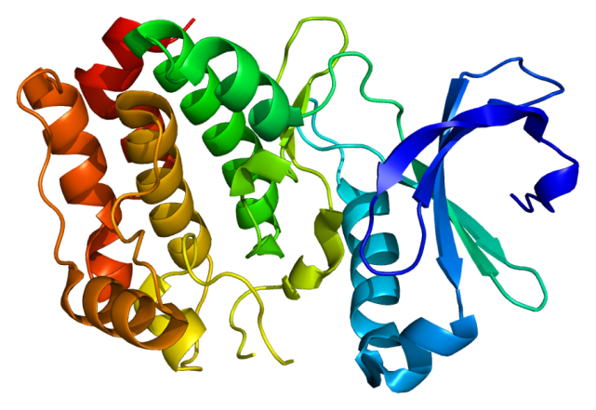
Protein structure and function
Molecular switch
Signaling transduction
Enzyme

Slide 6
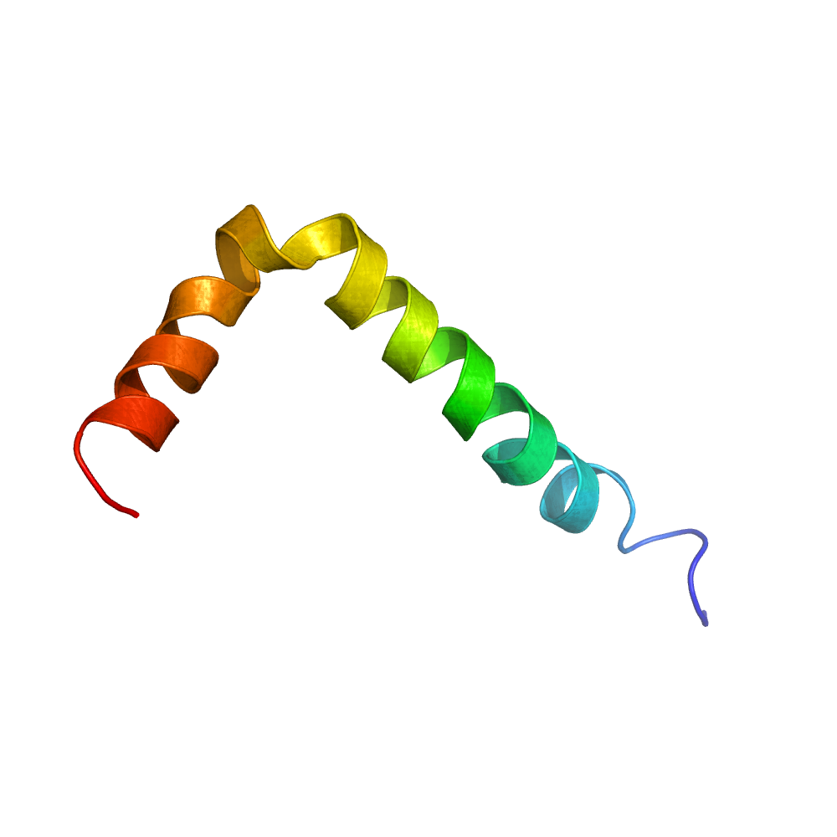
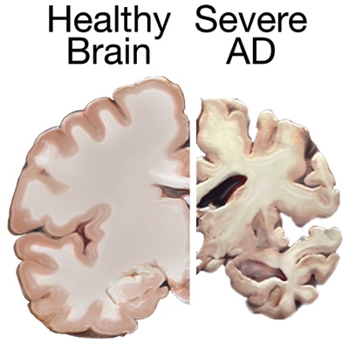
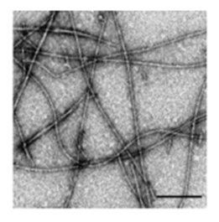
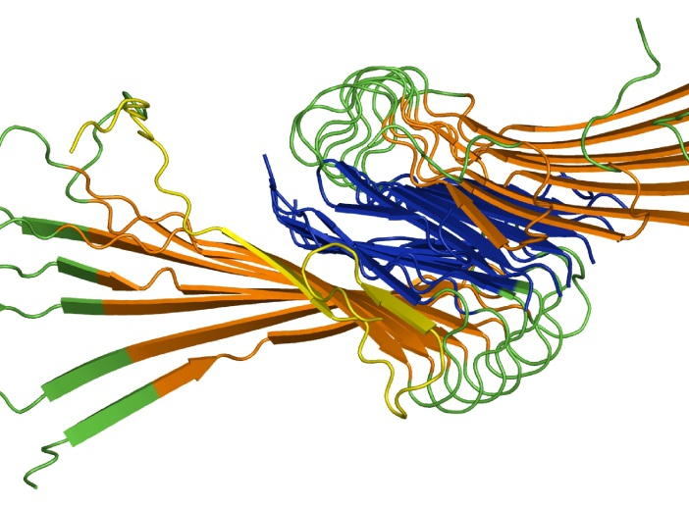
Protein misfolding and neurodegenerative diseases
Healthy Brain
Alzheimer's
Aggregation
Misfolding
Fibrillization

Slide 7
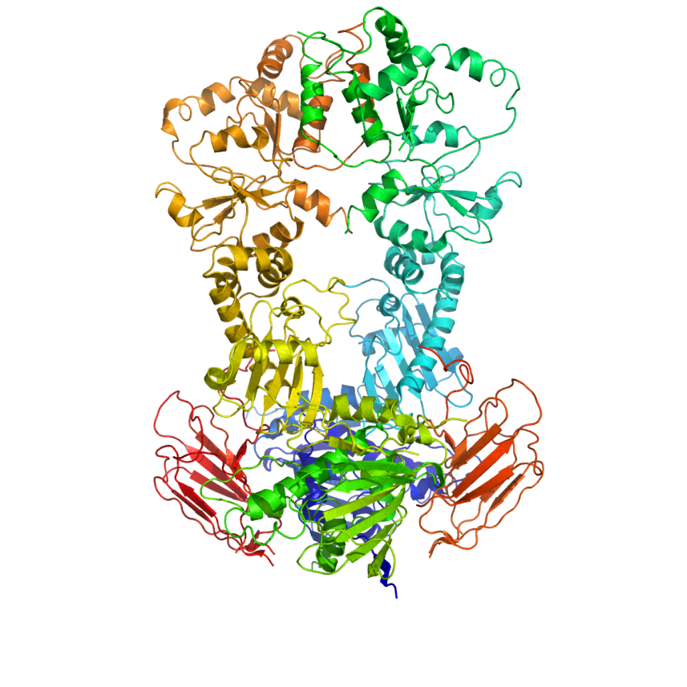
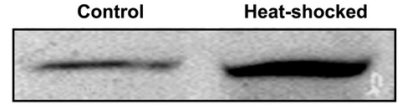
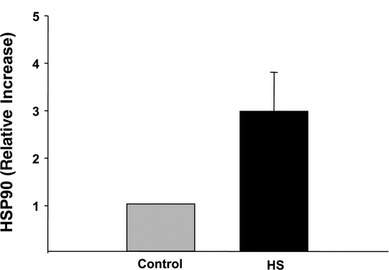
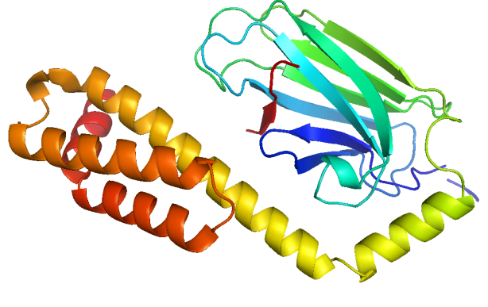


Heat shock proteins as chaperones
Hsp90
$$37℃$$
$$42℃$$
Hsp70

Slide 8

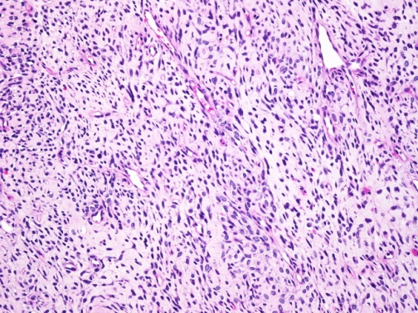
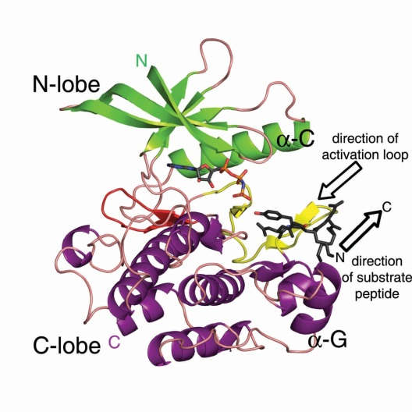
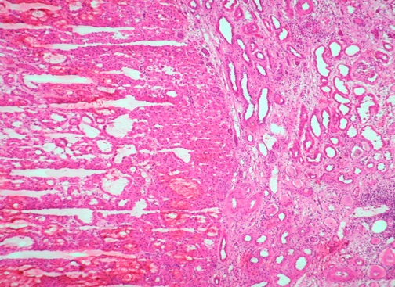
(Oncogenic) protein kinases and cancer

Slide 9


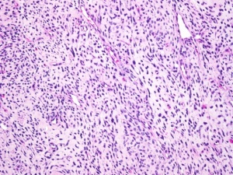
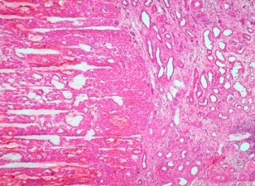
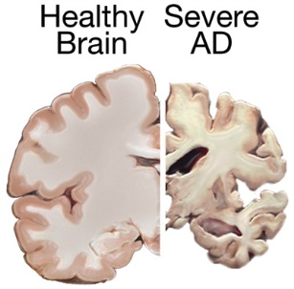

Role of molecular chaperones in human diseases
Cancer
Neurodegeneration
Health
HSP90

Slide 10
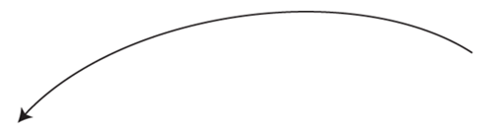
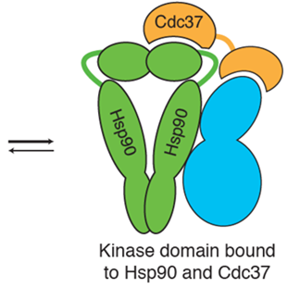
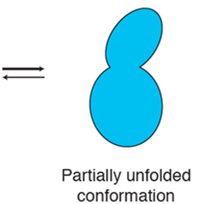

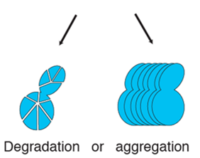
Quality control: chaperone cycle

Slide 11
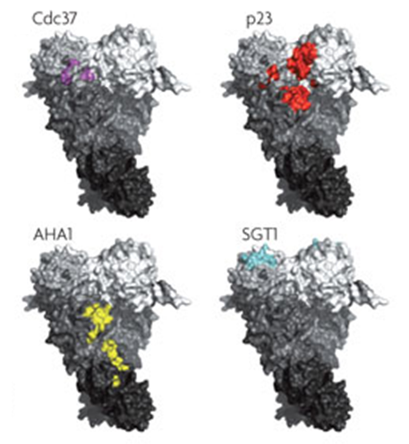
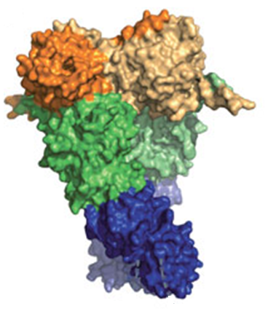
Hsp90 co-chaperones

Slide 12
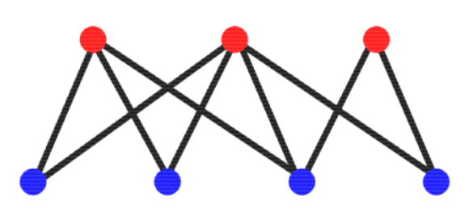
Q1: What is the functional specificity of co-chaperones?
Co-chaperones
Human (client) proteins

Slide 13
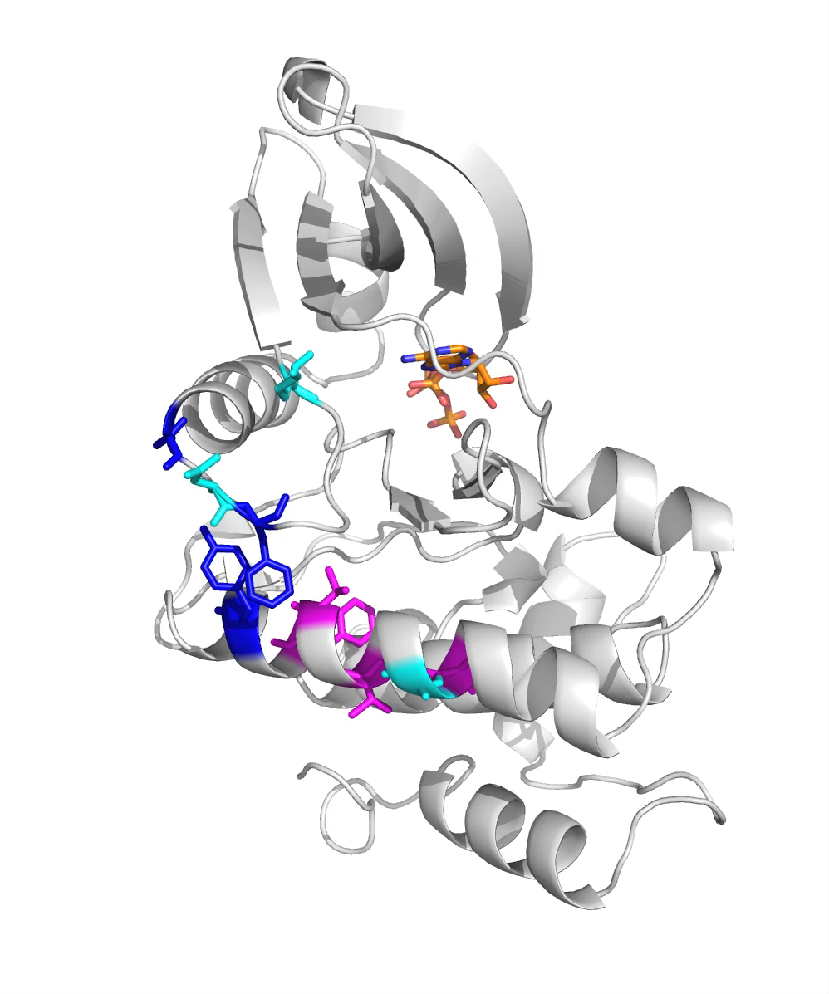
Q2: What is the determinant of chaperone::client specificity?
f( ) = binding

Slide 14
Outline
Background
Chaperone-mediated protein homeostasis network
How Hsp90 regulates the folding of protein kinases
Other current work and future directions

Slide 15
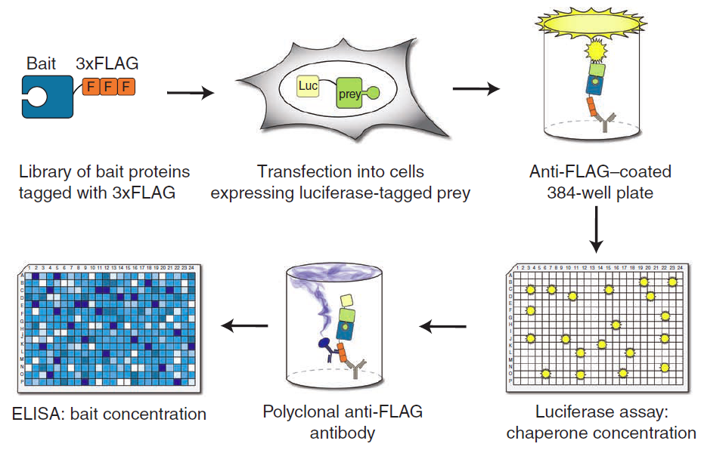
LUminescence-based Mammalian IntERactome mapping (LUMIER)
putative client protein
chaperone/co-chaperone
High-throughput, sensitive, in-vivo & quantitative
Courtesy of Dr. Mikko Taipale at Whitehead institute

Slide 16
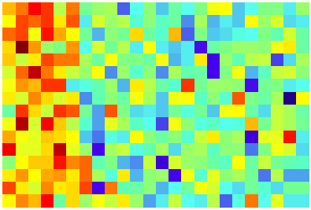
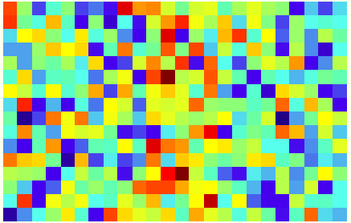

LUMIER data: 300 plates of luminescence
60 Preys: chaperones (hsp70,hsp90), co-chaperones and other cofactors
800 Baits: putative client proteins, including kinases, transcription factors
5 Plates
5 Plates
Prey 1
Prey 2
5 Plates
5 Plates
Prey 59
Prey 60

Slide 17
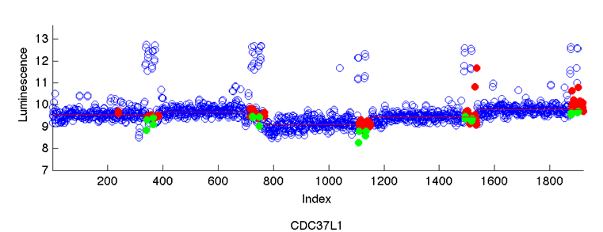
LUMIER data: Batch effect
Plate 1
Plate 2
Plate 3
Plate 4
Plate 5
Prey:
Blue: prey-bait pairs
Red: control wells (background)
Green: empty wells (GFP)

Slide 18
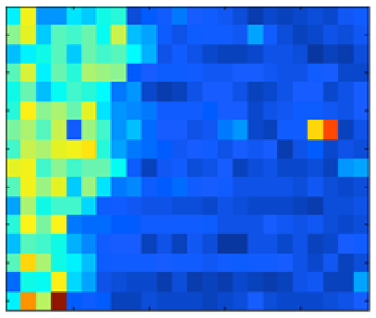
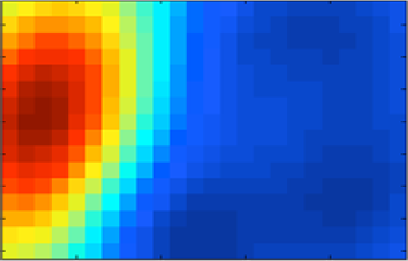
LUMIER data: Spatial bias
Observed data
Spatial bias

Slide 19
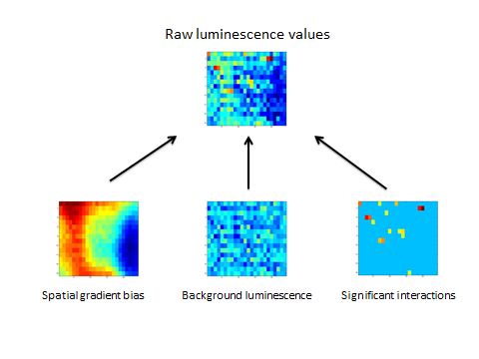
Data normalization

Slide 20






Model setting
$$For each well w, prey g and plate p$$
$$N\left(u_{gp},σ_{g}^{2}\right)$$
$$b_{gp.}\sim N(β,K)$$
$u_{gp}\sim N(m_{g},ρ^{2})$
$${\tilde{x}}_{gpw}{\sim N(u_{e}}_{,}σ_{e}^{2})$$
$b_{gp.}$: spatial bias
$u_{gp}$: batch bias

Slide 21







LUMIER score: mixture modeling
$$For each well w, prey g and plate p, the observed luminescence:$$
$$x_{gpw} \sim \left(1−z_{gpw}\right)N\left(b_{gpw}+u_{gp},σ_{g}^{2}\right)+z_{gpw}N(b_{gpw}+u_{gp}+u_{e},σ_{g}^{2}+σ_{e}^{2} )$$
Binary variable${ z}_{gpw}$ = 1 if a real interaction in w
$$N\left(u_{gp},σ_{g}^{2}\right)$$
$$b_{gp.}\sim N(β,K)$$
$u_{gp}\sim N(m_{g},ρ^{2})$
$${\tilde{x}}_{gpw}\sim N(u_{e},σ_{e}^{2})$$
$b_{gp.}$: spatial bias
$u_{gp}$: batch bias

Slide 22
LUMIER score: mixture modeling
$$For each well w, prey g and plate p, the observed luminescence:$$
$$x_{gpw} \sim \left(1−z_{gpw}\right)N\left(b_{gpw}+u_{gp},σ_{g}^{2}\right)+z_{gpw}N(b_{gpw}+u_{gp}+u_{e},σ_{g}^{2}+σ_{e}^{2} )$$
Binary variable${ z}_{gpw}$ = 1 if a real interaction in w
EM algorithm
Parameter estimation
$$N\left(u_{gp},σ_{g}^{2}\right)$$
$$b_{gp.}\sim N(β,K)$$
$u_{gp}\sim N(m_{g},ρ^{2})$
$${\tilde{x}}_{gpw}\sim N(u_{e},σ_{e}^{2})$$
$b_{gp.}$: spatial bias
$u_{gp}$: batch bias

Slide 23
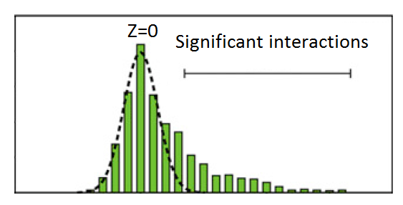

LUMIER score: mixture modeling
$$For each well w, prey g and plate p, the observed luminescence:$$
$$x_{gpw} \sim \left(1−z_{gpw}\right)N\left(b_{gpw}+u_{gp},σ_{g}^{2}\right)+z_{gpw}N(b_{gpw}+u_{gp}+u_{e},σ_{g}^{2}+σ_{e}^{2} )$$
Binary variable${ z}_{gpw}$ = 1 if a real interaction in w
EM algorithm
(all plates)
$$N\left(u_{gp},σ_{g}^{2}\right)$$
$$x_{gpw}−u_{gp}−b_{gpw}$$
$$b_{gp.}\sim N(β,K)$$
$u_{gp}\sim N(m_{g},ρ^{2})$
$${\tilde{x}}_{gpw}\sim N(u_{e},σ_{e}^{2})$$
$b_{gp.}$: spatial bias
$u_{gp}$: batch bias

Slide 24
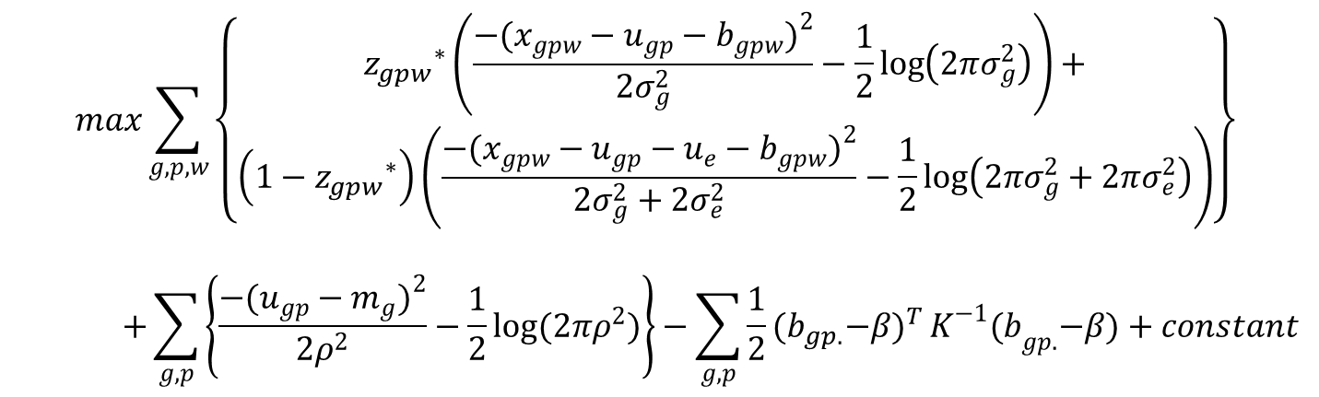
Expectation-Maximization (EM)
Maximum-likelihood by EM algorithm
E-step
$${z_{gpw}}_{}^{∗}←\frac{N(b_{gpw}+u_{gp}+u_{e},σ_{g}^{2}+σ_{e}^{2};x_{gpw}) }{N\left(b_{gpw}+u_{gp},σ_{g}^{2};x_{gpw}\right)+N(b_{gpw}+u_{gp}+u_{e},σ_{g}^{2}+σ_{e}^{2};x_{gpw}) }$$
M-step
  Solve the following optimization by gradient descent
$$max\sum_{g,p,w}{\left\{\begin{aligned}{z_{gpw}}_{}^{∗}\left(\frac{−(x_{gpw}−u_{gp}−b_{gpw})^{2}}{2σ_{g}^{2}}−\frac{1}{2}\log\left(2πσ_{g}^{2}\right)\right)+ \\ \left(1−{z_{gpw}}_{}^{∗}\right)\left(\frac{−(x_{gpw}−u_{gp}−u_{e}−b_{gpw})^{2}}{2σ_{g}^{2}+2σ_{e}^{2}}−\frac{1}{2}\log\left(2πσ_{g}^{2}+2πσ_{e}^{2}\right)\right)\end{aligned}\right\}}$$
$$+\sum_{g,p}{\left\{\frac{−(u_{gp}−m_{g})^{2}}{2ρ^{2}}−\frac{1}{2}log(2πρ^{2})\right\}}−\sum_{g,p}{\frac{1}{2}{{(b}_{gp.}−β)}^{T}}K^{−1}{(b}_{gp.}−β)+constant$$

Slide 25
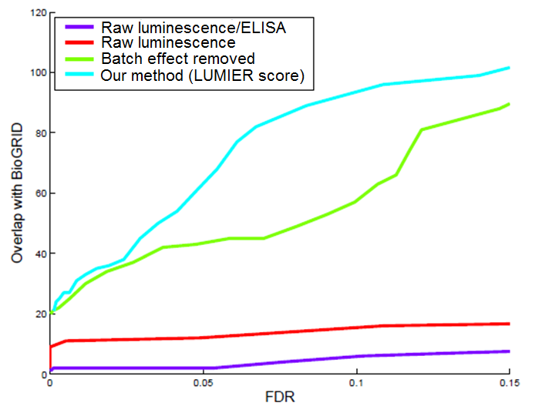
Validation with existing interactions

Slide 26
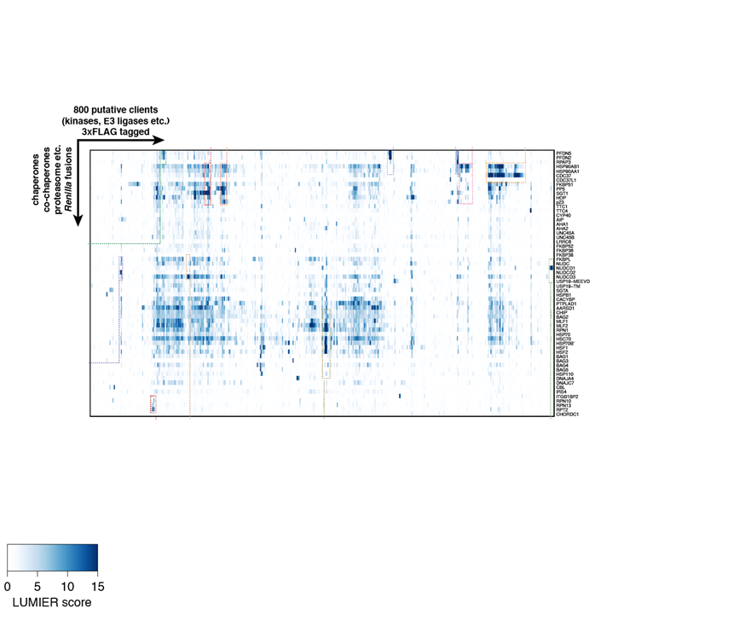
Network Matrix (bi-clustering)

Slide 27
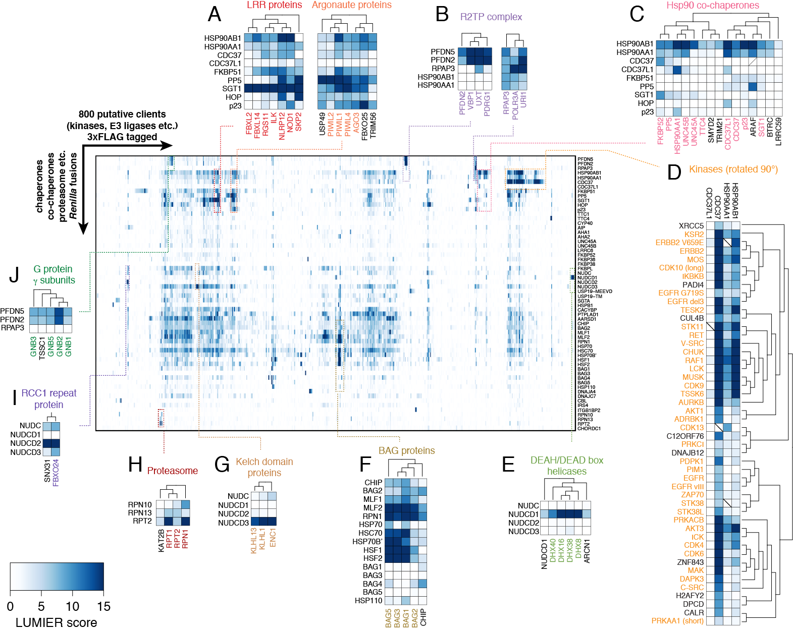
Network Matrix

Slide 28
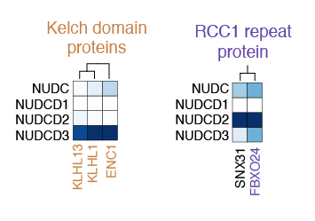
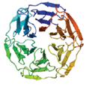
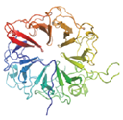
Our analysis found novel Hsp90 co-chaperones & specificity: NUDC proteins
NUDC: nuclear distribution proteins

Slide 29
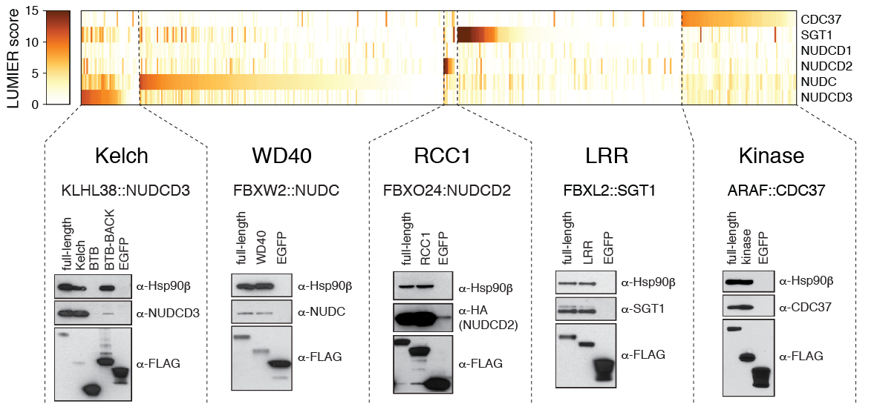





New Hsp90 co-chaperones: NUDC family
NUDCD3
NUDC
NUDCD2
SGT1
CDC37

Slide 30
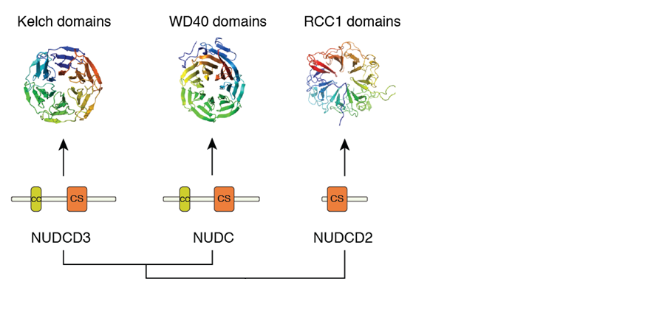
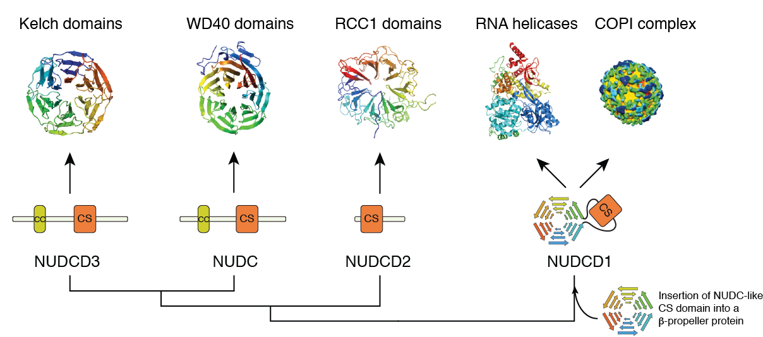
NUDC family: domains and clients

Slide 31
NUDC family: domains and clients
RaptorX: RECOMB 2009, ISMB 2010, Proteins 2011, ISMB 2012, Nature Protocols 2012
LUMIER analysis & NUDC results: Cell (accepted, Peng as the major computational author)

Slide 32

Client beta-propeller specificity of Hsp90 is not conserved in sequence

Slide 33
Client kinase specificity of Hsp90 is not conserved in sequence

Slide 34


Client kinase specificity of Hsp90 is not correlated with global structural stability (r=0.14)

Slide 35
Q2: What is the determinant of chaperone::client specificity?
f( ) = binding

Slide 36
Outline
Background
Chaperone-mediated protein homeostasis network
How Hsp90 regulates the folding of protein kinases
Other current work and future directions

Slide 37



Motif for Hsp90::kinase specificity
We want to find a set of important residues ($Key$) that can explain the specificity of client kinase specificity
Highly diverse sequences
  Sequence alignments
  are difficult to compute
High-dimensional estimation
  280 data points (only 220
  canonical kinases)
  More than 6000 features if
  each amino acid identity is
  treated as a feature variable.
$$Key$$
${Binding}^{k}=\sum_{i∈Key}{w_{i}}{Seq}_{i}^{k},{ Seq}_{i}^{k}$ is the i-th residue of kinase k

Slide 38


Predictive model
$(Seq ∈ Σ^{∗})$
Kinase sequences
Binding values
$${Binding}^{k}=\sum_{i∈Key}{w_{i}}{Seq}_{i}^{k}$$

Slide 39


Sequence/structure alignment
  Kinase sequence alignments are difficult to compute
  1. Less than 30% of human kinases have solved crystal structures
  2. Kinase sequences are highly divergent (sequence identity can be <15%)

Slide 40
Sequence/structure alignment
  Kinase sequence alignments are difficult to compute
  1. Less than 30% of human kinases have solved crystal structures
  2. Kinase sequences are highly divergent (sequence identity can be <15%)
  SOLUTION: We can generate a very large set of structure alignments from existing kinase structures and train an accurate model to align the rest of kinase sequences.
Statistical alignment model
Estimation and Prediction
Training data
Sequence Alignment

Slide 41









Sequence alignment
$$Alignment= {argmax}_{a}\sum_{i=1}^{L}{F(a_{i−1}→a_{i},π^{s}\left(a,i\right),π^{t}\left(a,i\right))}$$
$π^{s}\left(a,i\right)$ records the residue index of sequence $s$ involved in the $i$-th state of alignment $a.$
L
P
S
R
E
Insertion at sequence s
M
S
Alignment $a$
L | P | - | S | R | E
S | A | L | L | - | Q
M
A
$$π^{t}\left(a,3\right)=2$$
L
$$π^{s}\left(a,3\right)=3$$
Match states (M)
Insertion at sequence t
M
L
$a$={
$$\}$$
M, | M, | I_{s}, | M, | I_{t} | M
Q
$$Score(a)= F\left(D→M,1,1\right)+F\left(M→M,2,2\right)+F\left(M→I_{s},3,2\right)$$
$$+F\left(I_{s}→M,4,3\right)+F\left(M→I_{t},4,4\right)+F\left(I_{t}→M,5,5\right)$$

Slide 42

A conditional random fields model for sequence alignment
$$P\left(a | {seq}_{s},{seq}_{t}\right)=\frac{1}{Z}exp\left[\sum_{i=1}^{L}{F(a_{i−1}→a_{i},π^{s}\left(a,i\right),π^{t}\left(a,i\right))}\right]$$
L
P
S
R
E
Insertion at sequence s
M
S
Alignment $a$
L | P | - | S | R | E
S | A | L | L | - | Q
M
A
$$π^{t}\left(a,3\right)=2$$
L
$$π^{s}\left(a,3\right)=3$$
Match states (M)
Insertion at sequence t
M
L
$a$={
$$\}$$
M, | M, | I_{s}, | M, | I_{t} | M
Q
$$Score(a)= F\left(D→M,1,1\right)+F\left(M→M,2,2\right)+F\left(M→I_{s},3,2\right)$$
$$+F\left(I_{s}→M,4,3\right)+F\left(M→I_{t},4,4\right)+F\left(I_{t}→M,5,5\right)$$

Slide 43









Features for the alignment model
$$F\left(a_{i−1}→a_{i},x,y\right)=$$
$$w_{}^{CONS} × CONS(s,x,t,y)$$
evolutionary conservation
$${+ w}_{}^{ss} × SS(s,x,t,y)$$
secondary structure
$${+ w}_{}^{sa} × SA(s,x,t,y)$$
solvent accessibility

Slide 44



Model Training
The model was trained by maximizing likelihood using the gradient descent method.
$$\frac{∂\log{P\left(a | {seq}_{s},{seq}_{t}\right)}}{∂F(M→I_{s},x,y)}=δ\left[∃i: a_{i−1}=M∧ a_{i}=I_{s}∧ π^{s}\left(a,i\right)=x ∧π^{t}\left(a,i\right)=y\right]$$
{Whether there is a such step in alignment $a$}
$$−\sum_{\tilde{a}}{P\left(\tilde{a} | {seq}_{s},{seq}_{t}\right)δ\left[∃i: {\tilde{a}}_{i−1}=M ∧ {\tilde{a}}_{i}=I_{s}∧ π^{s}\left(\tilde{a},i\right)=x ∧π^{t}\left(\tilde{a},i\right)=y\right] }$$
{Marginal probability of this step with model P}
Partial sum (forward)
Dynamic programming
complexity:$O(L_{s}L_{t})$
Partial sum (backward)

Slide 45
Kinase sequence alignment
Alignment accuracy
BLAST
HMM
Ours
Finally, we aligned all kinases with the EGFR kinase domain.

Slide 46






Predicting Hsp90::kinase specificity
We want to find a set of important residues ($Key$) that can explain the specificity of client kinase specificity
High-dimensional regression
  280 data points (only 220 canonical kinases)
  More than 6000 features if amino acid identity is
  used for features
${Binding}^{k}=\sum_{i∈Key}{w_{i}}{Seq}_{i}^{k}, { Seq}_{i}^{k}$ is the i-th residue of kinase k
$$Data matrix$$
$$Binding$$
$$×w →$$
$$(w:a sparse weight vector)$$

Slide 47
Dimensionality reduction
Amino Acid | Steric | Polarizability | Hydrophobicity | Isoelectric
A | 1.28 | 0.05 | 1.8 | 6.11
G | 0 | 0 | -0.4 | 6.07
V | 3.67 | 0.14 | 4.2 | 6.02
L | 2.59 | 0.19 | 3.8 | 6.04
I | 4.19 | 0.19 | 4.5 | 6.04
F | 2.94 | 0.29 | 2.8 | 5.67
Y | 2.94 | 0.3 | -1.3 | 5.66
W | 3.21 | 0.41 | 9 | 5.94
T | 3.03 | 0.11 | -0.7 | 5.6
S | 1.31 | 0.06 | -0.8 | 5.7
R | 2.34 | 0.29 | -4.5 | 10.74
K | 1.89 | 0.22 | -3.9 | 9.99
H | 2.99 | 0.23 | -3.2 | 7.69
D | 1.6 | 0.11 | -3.5 | 2.95
E | 1.56 | 0.15 | -3.5 | 3.09
N | 1.6 | 0.13 | -3.5 | 6.52
Q | 1.56 | 0.18 | -3.5 | 5.65
M | 2.35 | 0.22 | 1.9 | 5.71
P | 2.67 | 0 | -1.6 | 6.8
C | 1.77 | 0.13 | 2.5 | 6.35
Four major physico-chemical propensities
Clustering of 527
amino acid features
from AAIndex database

Slide 48




Find the key residues: robust sparse regression
$$f^{k}=feature matrix \left(m × L, m features of L residues\right)$$
$$y^{k}=LUMIER score of kinase k$$
$$q=a m × L zero matrix, t=1$$
Randomly subsample$two sets S^{t}$ and $T^{t}$
Solve the following L1-regularized regression
$$L\left(w^{t},S^{t},λ^{t}\right)=\sum_{k∈S^{t}}{{\left(\sum_{i=1}^{L}{\sum_{j=1}^{m}{w_{ij}^{t}f_{ij}^{k}−y^{k}}}\right)}^{2}}+λ^{t}\sum_{i=1}^{L}{\sum_{j=1}^{m}{|w_{ij}^{t}|}}$$
$${w^{t∗}≔argmin}_{w^{t}}L\left(w^{t},S^{t},λ^{t}\right)$$
$λ^{t}$ is chosen on validation set $T^{t}$
$$q=q+1\left[w^{t∗}≠0\right], t=t+1$$
Repeat 10000 times
Rank all features by $q$, and choose the top k features by cross validation

Slide 49

Structural motif
hydrophobicity
steric parameter
charge

Slide 50


Predicting Hsp90 clients
1
TPR
0
0
1
FPR
AUC = 0.81
Sensitivity = 0.80
Specificity = 0.77

Slide 51
Validation on new kinases
Predicted clients
Predicted non-clients
Kinase | Predicted | Experimental
ABL2 | + | +
DDR2 | + | +
INSR | + | +
CDK12 | + | +
EPHA3 | + | +
CHUK | + | +
RPS6KB2 | + | +
IKBKB | + | +
GSK3B | + | +
PDPK1 | + | +
BRAF | + | +
NPR1 | + | +
EPHB2 | + | -
EPHB3 | + | -
EPHA8 | + | -
Total | 15 | 12
Kinase | Predicted | Experimental
MAP2K1 | - | -
BRSK1 | - | -
SCYL1 | - | -
ROR1 | - | -
MASTL | - | -
LATS1 | - | -
MGC42105 | - | +
CDKL1 | - | +
MAP2K4 | - | +
Total | 9 | 6
Accuracy 0.75
Precision (PPV) 0.8

Slide 52

Structural motif
-
+
1. 97 on αC-β4
2. 99 on αC-β4
3. 100 on αC-β4
4. 105 on αC-β4
5. 148 on αE
6. 156 on αE
7. 147 151 153 154 on αE
Normalized
coefficients
Stability of αE
charge
hydrophobicity
steric parameter

Slide 53


αE local stability correlates with specificity
αE
(r=0.7)
αF
αH
αΙ

Slide 54

Computational designs
Consensus approach: Introducing point mutations in the critical residues of nonclient proteins, using the consensus client sequence as a template
1. Choose a mutant AA according to the and
2. Introduce the mutation on the kinase 3D structure
3. Optimize the side-chain and calculate the stability change by the mutation
4. If the stability change is tolerable, then accept the mutation and go to Step 1for the
next position.

Slide 55


PDK1
Can we modify PDK1 to a client?
PDK1 kinase
Prediction: client
Experiment: non-client

Slide 56

Computational designs: PDK1

Slide 57

Model 2.0
Peng et al, (to be submitted to Nature Structural and Molecular Biology)

Slide 58
Outline
Background
Chaperone-mediated protein homeostasis network
How Hsp90 regulates the folding of protein kinases
Other current work and future directions

Slide 59

Computational Biology
Structural and molecular biology
  Protein structure modeling by machine learning and graphical models (RECOMB09, ISMB10&12, Proteins, Nature Protocols, Protein Science)
  Stability analysis for HIV Gag protein mutations (CROI 2011, Journal of Virology, Science in submission)
  Protein-protein interactions (Genome Biology 2012, NIH R01)
raptorx.uchicago.edu
>85,000 predictions from >9000 users since 2012

Slide 60
Machine learning
Probabilistic graphical models
  Nonlinear conditional random fields (CNF: NIPS09)
  Fast estimation of the normalization factor by sampling (AISTATS13)
  Latent variable models
Approximate inference
  Variational inference and message passing algorithm (ICML11, UAI12, NIPS12, AISTATS12)
Learning dependencies from data
  Casual inference from biological data
  Structure learning for Bayesian networks

Slide 61

Algorithms for Big-data genomics
Traditional:
New:
Compressive genomics (ISMB13, RECOMB14, Nature Review Genetics, two submitted to Nature Biotech, NIH/NSF BigData Grant)

Slide 62







Functional homologs: probabilistic data integration
Disease-related genes
Functional homologs
Experiments

Slide 63



Protein-RNA interactions
Predicting protein-RNA interaction by coarse-grained model
Finding novel long noncoding RNA
  RNA-seq
  Sequence/structural conservation
Analyzing CLIP-seq (HITS-CLIP/PAR-CLIP) datasets
+
Binding?

Slide 64
Thank you!
Acknowledgements:
All members in Berger Lab @ MIT
Mikko Taipale & Susan Lindquist @ Whitehead Institute, MIT
Norbert Perrimon @ Harvard Medical School
Mona Singh @ Princeton
Jinbo Xu @ TTI-Chicago
Microsoft Research Fellowship

