Slide 1
What’s wrong with csail-related and how can we fix it?
David Karger

Slide 2
Better online tools for communal discussion
David Karger

Slide 3
What’s a Theoretician Like you Doing in a Place Like This?
David Karger

Slide 4
Why
Communities benefit from
Sharing information
Discussing ideas
Learning about each other
Building ties
Online tools can help
But they still have many flaws

Slide 5
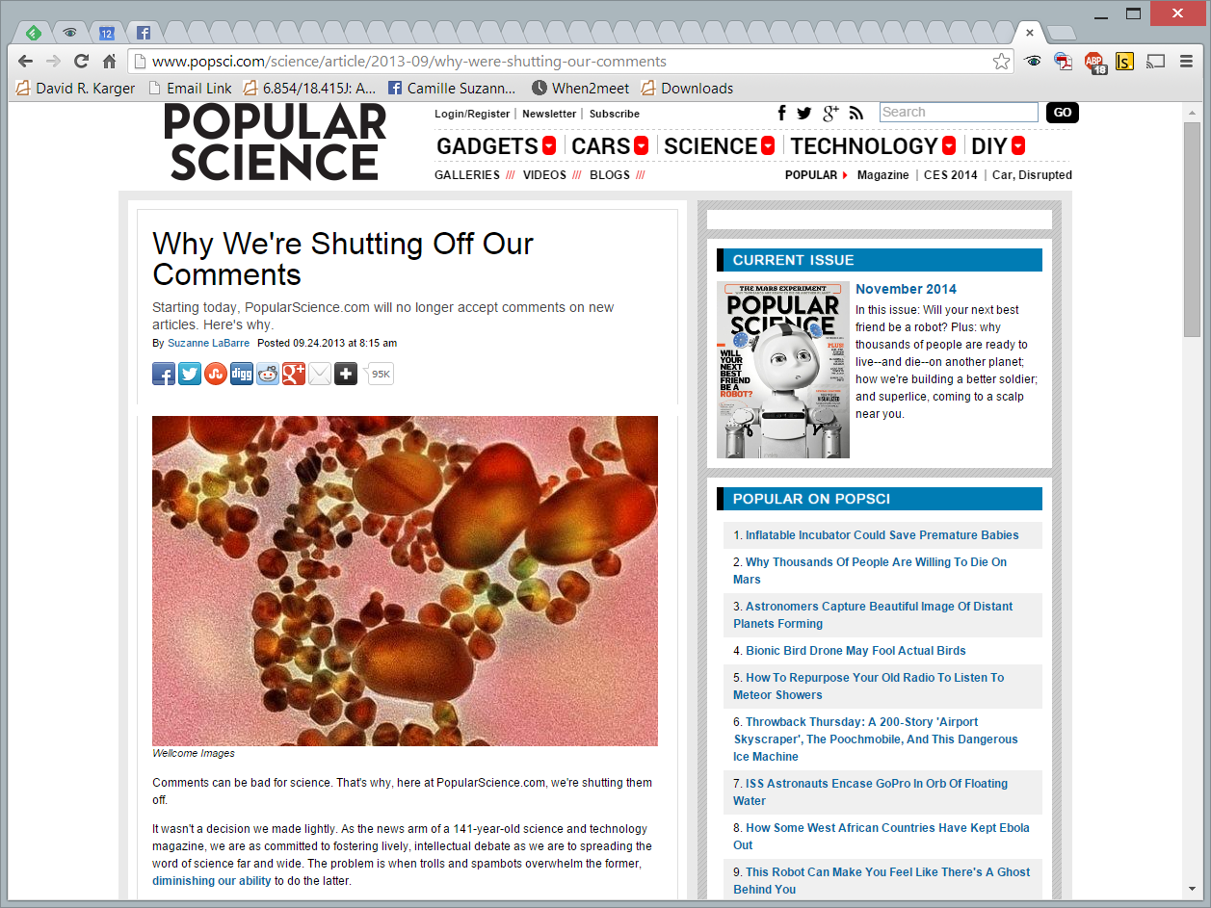

Slide 6
Popular Science
“Comments can be bad for science. That’s why here, at PopularScience.com, we’re shutting them off.”
“We are committed to fostering lively, intellectual debate.”
[Brossard-Sheufele]: randomized nanotech article with nice or nasty comments
“Simply including an ad hominem attack in a reader comment was enough to make study participants think the downside of the reported technology was greater than they'd previously thought.”

Slide 7
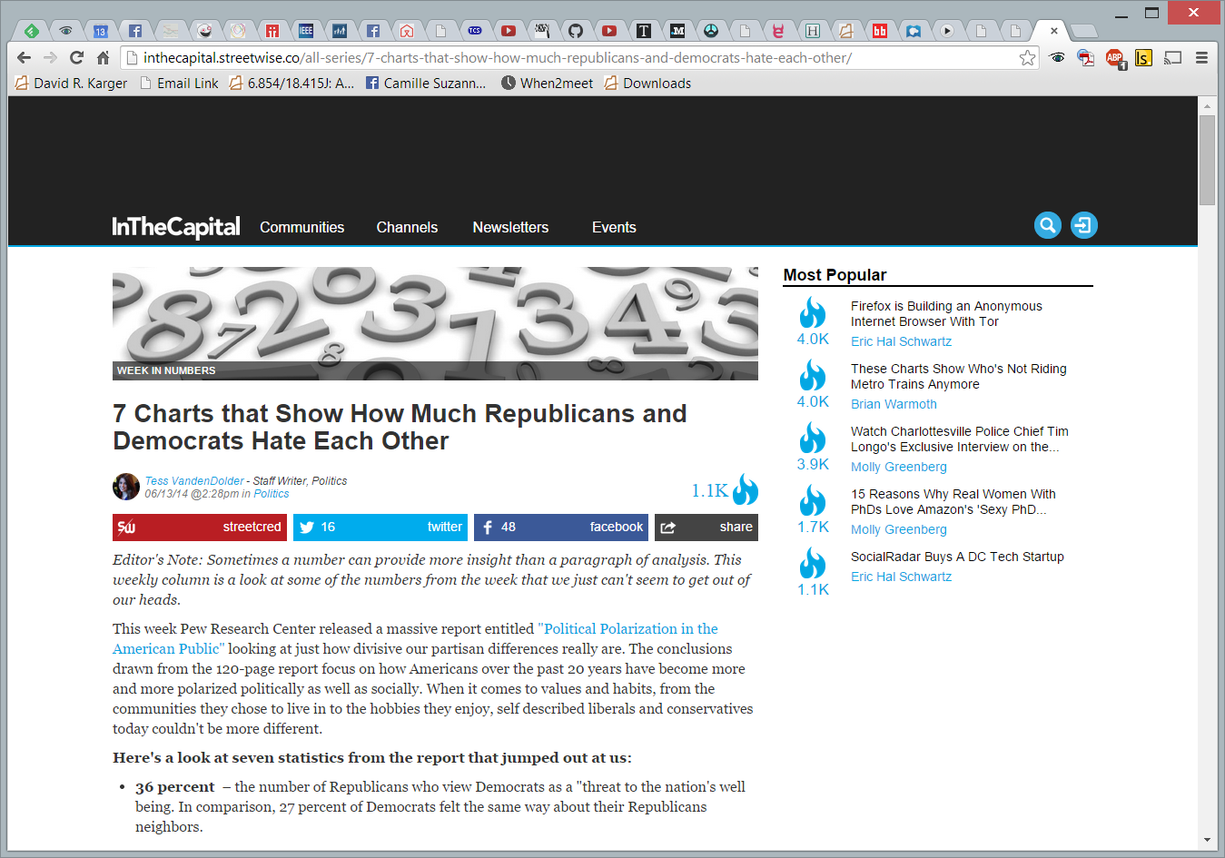

Slide 8
Mailing Lists
Email invented 1967
First mailing list, MsgGroup, in 1971
To discuss idea of using email for group discussion
Tools essentially unchanged in 40 years
Must be doing something right!
What is it?
But lots of dissatisfaction
What’s wrong?
How to fix it?

Slide 9
The Research
What are the problems mailing lists currently have and what are the limitations of the mailing list systems used?
Why, despite these problems and limitations, do we still use a mailing list for community discussion?
How might we build tools to address these problems and limitations without ruining what makes mailing lists attractive?

Slide 10
The Study
Looked at 20 mailing lists, 2 in depth
Interviews and surveys
Qualitative study
Understand problem space and design space
No statistical power
Csail-related was one of the lists
I’ll focus on it today
Results surprisingly typical

Slide 11
Interviewed 10 people: 1 professor, 2 administrators, 1 research scientist, 1 postdoc, 4 graduate students, 1 former graduate student
Followed up with a survey and surveyed 108 people (67% male, 23% female, median age 27)

Slide 12
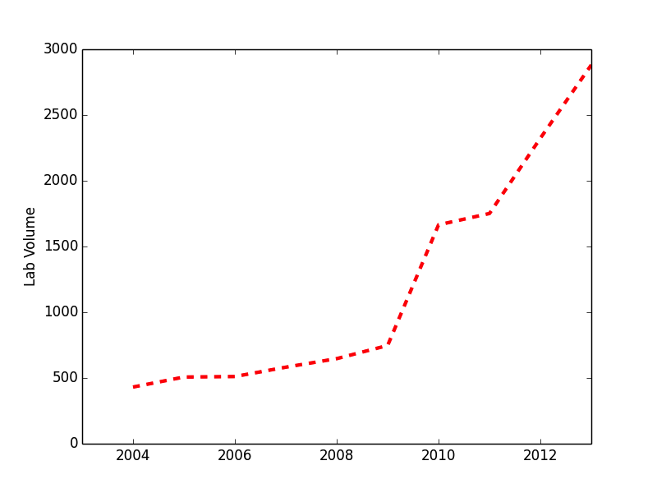
csail-related
Membership?
Median estimate 500-800
Actually 4100
(lab size: 1000)
World-readable archives
Last year:
~ 7 posts/day
708 unique posters
Top poster 3 times as active as any other

Slide 13
People want interaction….

Slide 14
…but are Afraid to Post
69% of respondents that wanted to see more discussion have never participated in a discussion

Slide 15
Why?
Afraid of spamming large audiences
I’m not sure what it is that I would be losing if I hit that send button but...I felt...I’m just spamming people...and I’m only perpetuating inbox overload to people.
Don’t want to get into a heated argument
...A couple times...I would feel like I had something to say and I would write this reply...I would spend a lot of time on it and then think this isn’t worth it...it’s just going to devolve into an age old argument of the same type that has happened over and over again.
Afraid of appearing stupid
One thing that csail-related is relatively devoid of is technical questions. You’re keenly aware that the way...you’ll ask a question signals an ignorance that you’re afraid to show in csail-related with such smart people.

Slide 16
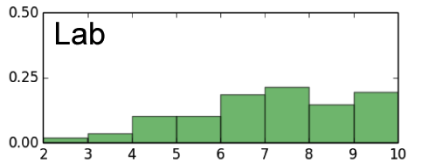
What are the problems?
2: Differences in type of content desired
Not everyone wants more discussion
I sometimes wish there were more meaningful conversations about technology and less about logistics and so on. ...Those things show up a lot in talks but I don’t think people discuss them enough.
...if I had to pinpoint an ideal level for me, personally, I don’t know, maybe 10 to 15 percent less of what [the discussion level] currently is right now, would be great.
Reply-to vs Reply-all
...You might as well just post it [to the list]. If they’re not interested they can either skip over it, or quickly skim over it, or whatever.
I despise it when people hit the reply to all button instead of the reply to button.
Discussion-desired (2=least, 10=most)

Slide 17
What are the problems?
2: Push vs. Pull Access
People access their emails in many different ways
Automatic filing to a separate folder or tab (pull):
More likely to miss a lot of emails, read at their leisure, don’t mind irrelevancy
...I think I skim csail-related less not because of a disengagement from the list but just because the email client has suddenly hidden them…
I treat it the same way that I would treat a...water cooler where you walk by and there’s some colleagues talking...but you can’t spend all day at the water cooler.
No filing, all emails go to main inbox (push):
More likely to read all emails, read them when they arrive, sensitive to irrelevancy
...[there’s] the risk of missing important mails when I allow many to go unread because the state of being read or unread is less signaling...
[Email] is something that I make an effort to stay on top of. I will unsubscribe from mailing lists if I think it’s sending me too much email that’s not relevant.

Slide 18
What are the problems?
2: Push vs. Pull Access
Problems arise when you expect or imagine that others have the same access strategy as you
Automatic filer:
When...you get emails from someone, it doesn’t take you that much time to just get rid of it. I think the people who really don’t like spam already filter their email... In which case my additional email really takes like three seconds of your time.
Main inbox reader:
When I’m thinking about sending an email to csail-related, I’m like, “Wow, does every single person related to csail-related really need to get this email?” If that’s not the case, I probably wouldn’t send it.

Slide 19
Why are we still using a mailing list?
What about social media – Facebook Groups, Google+ Communities, subreddits, discussion forums?
Almost everyone prefers email (86%)

Slide 20
Why?
Email = work, Social Media = play
I wouldn’t be surprised if people start posting cat videos to this. [Facebook] has been a distraction for most people...When I look at csail-related...I don’t see it as a place to post cat videos.
Email is more used and more controllable
You only have the choice [on Facebook Groups]...I want to watch every message...or I don’t. If you say yes, then...your cellphone [is] beeping every 5 minutes. If you say no, you’re going to miss everything. There’s no in between where once a day I can...see what’s new.
Facebook plays games with what they show people and so there’s no even clear notion of who it is that’s seen what you’re sending...[Email’s] really the only mechanism where it comes with this feeling of it’ll get seen.
Other reasons: Social Media feels more public somehow, current Social Media systems don’t prioritize group communications

Slide 21
Individual vs Group Rights
The best part about this list is X's replies.
X is a active detriment to the mailing list.
X is the best and worst thing about csail-related
X is very annoying. Everyone on the list already knows his opinions, yet he feels constantly compelled to share them anyway. A large number of people clearly disagree with him (on topics such as offering Amazon gift cards as a survey reward...), yet we know that responding on-list will get us nowhere and merely create more pointless traffic.
Please stop X from being able to post to this list; his responses are rarely relevant and show a blatant disregard for respect to the original poster. More often, his responses come off as obnoxious and annoying than helpful or being able to make any point.
At first, X's kneejerk responses to certain topics annoyed me, but I have come to find them amusing.
Someone is really annoying that they direct every thread to the subject only he cares. You know whom I am talking about
Removing X would make for a lot less traffic. He's so repetitive that his responses aren't really necessary.
Xsays the darndest things.
There were discussions that were very insensitive that happened last year after the Collier shooting that really were inappropriate. I filter the message to go to my trash now due to some discussions.

Slide 22
How might we address these problems and limitations without ruining what makes mailing lists attractive?
How can we make csail-related better?

Slide 23
New Mailing List Tool
Slow mail
Send to a few; replies make it spread
Reduce fear of spamming
Muting recipients
The don’t see your email or replies
Reduce fear of trolls
Friend moderation
A few friends “approve” your post before sending
Reduce fear of looking stupid

Slide 24
New Mailing List Tool
Rate limited delivery
Let people control how much they receive
Reduce fear of spamming
No replies
Members see only initial message
Explicitly “subscribe” to any followup discussion

Slide 25
Plans
Papers list
Anyone who publishes a paper announces here
With a paragraph explaining why it’s interesting
Replace csail-related?
Will you sign up?

Slide 26
Can we build tools
to fix democracy

