Slide 1
User Interfaces that Entice People to Manage Better Information
David Karger
MIT

Slide 2
Small Data
Why do we think our tools will handle exabytes when we can’t even manage our personal information?

Slide 3
Conclusion
We work hard to create tools that effectively manage information for us
People are better than computers at IM
  they just don’t have the right tools
  or the time/desire
Don’t assume passive information consumers
  encourage active user information management
  by identifying user needs and capabilities
  and minimizing effort to use
  and maximizing/exposing benefit

Slide 4
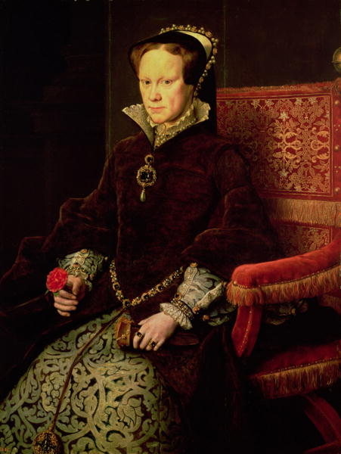


Current Tools

Slide 5
The Questions
How can we give people the ability to manage more or better information?
How do we make them want to?

Slide 6
Examples
Capture small random “information scraps”
Discuss lecture notes while reading
Encourage collaborative news sharing
Author structured data and visualizations
Each encourages users to author information that was not previously recorded
You can try each one for yourself

Slide 7
Information Scraps
You can’t find it if it isn’t there
Bernstein, van Kleek, Karger, schraefel
37

Slide 8
The State of PIM
We have developed a vast array of powerful tools to help people manage their personal information
The result: everyone has a computer on their desk for PIM

Slide 9

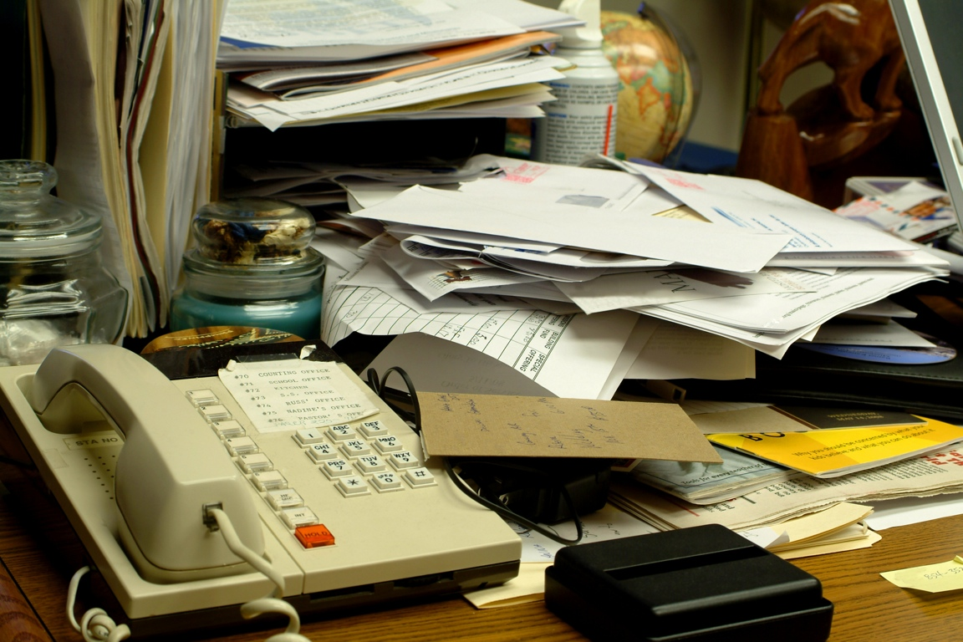
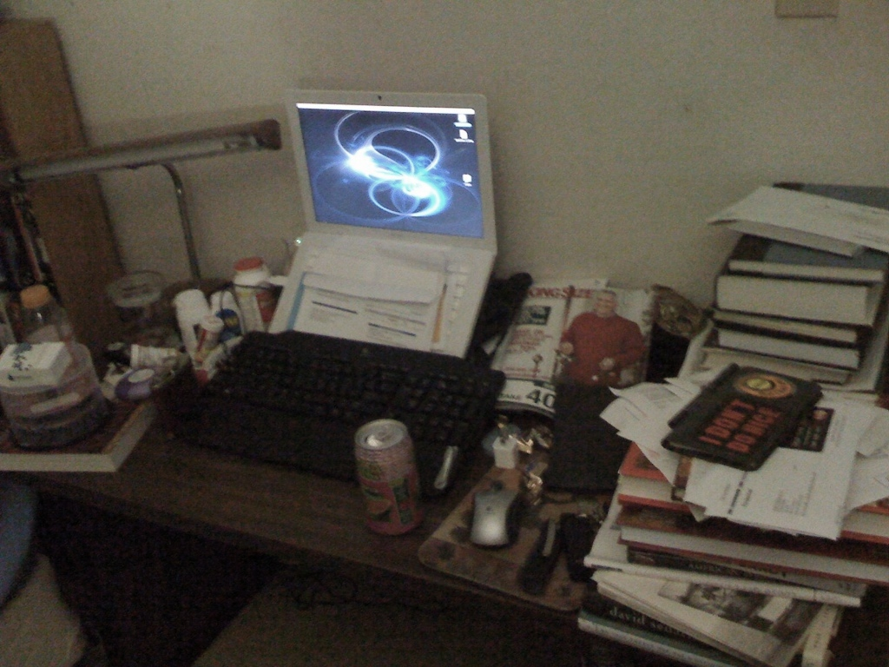
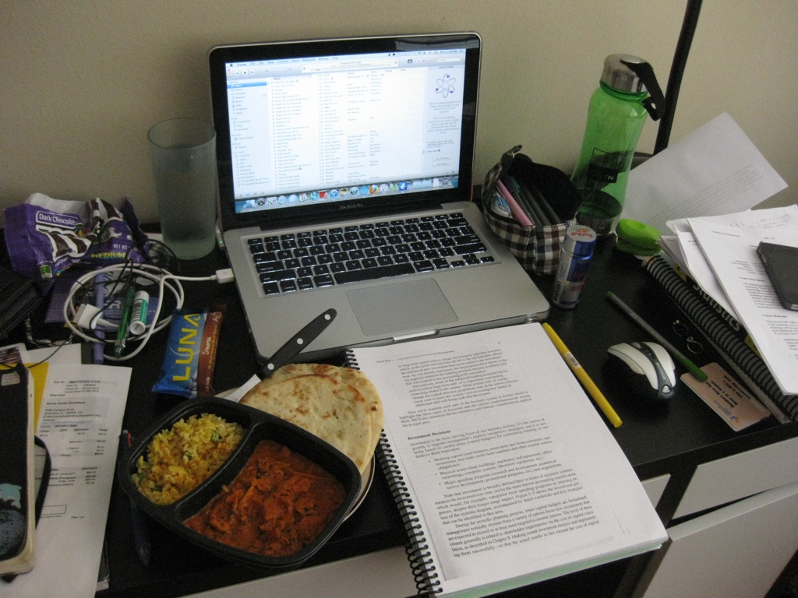
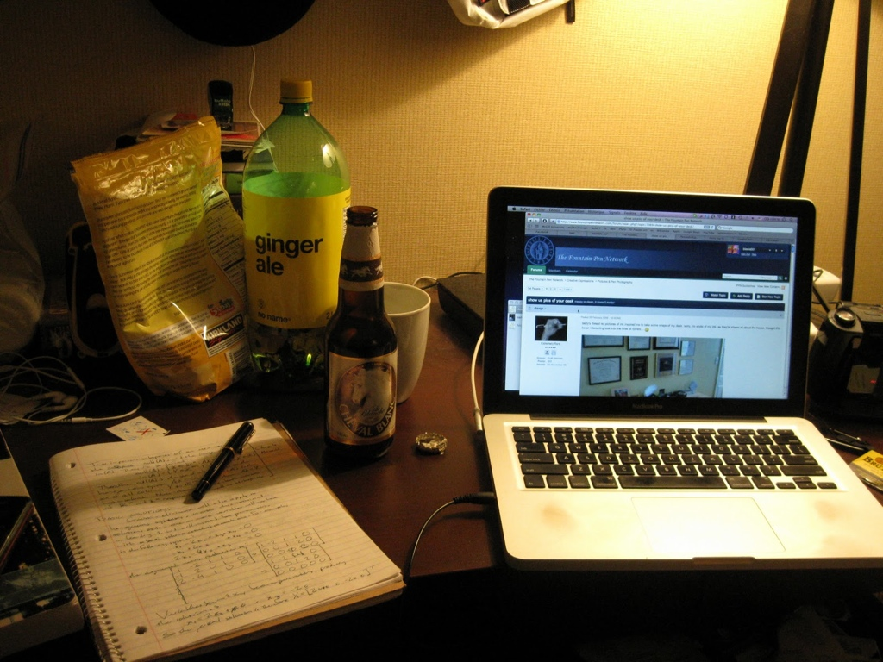
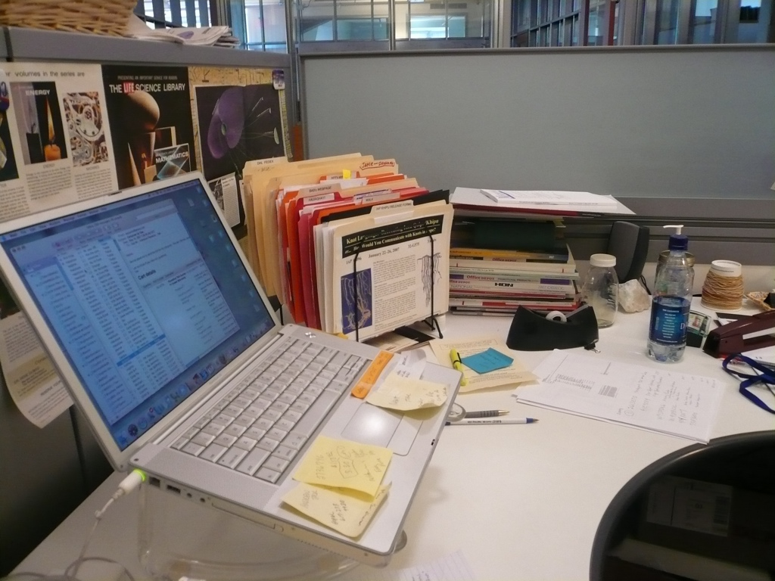
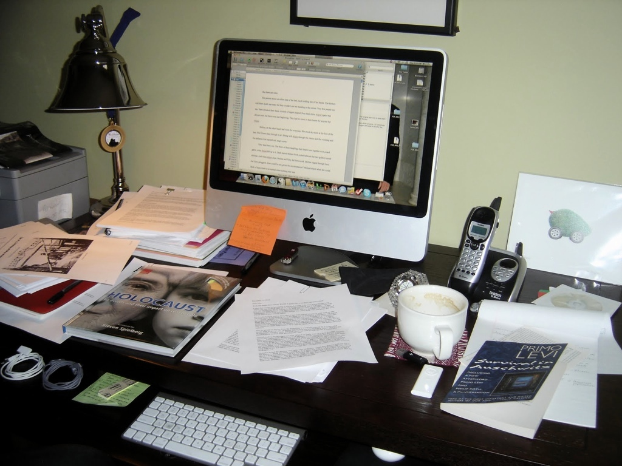
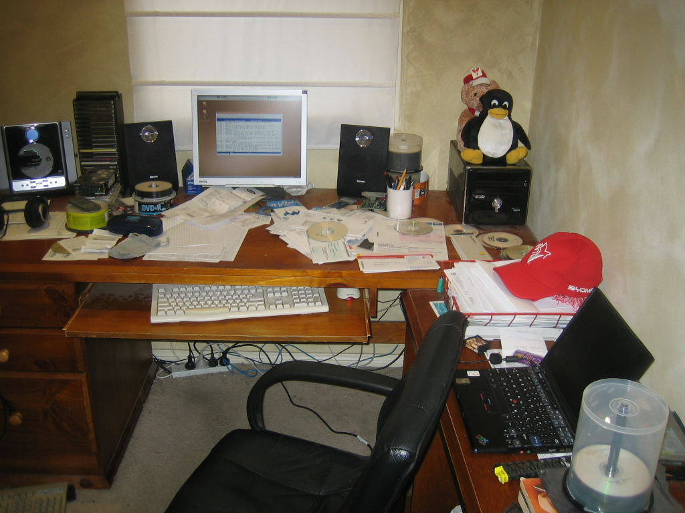
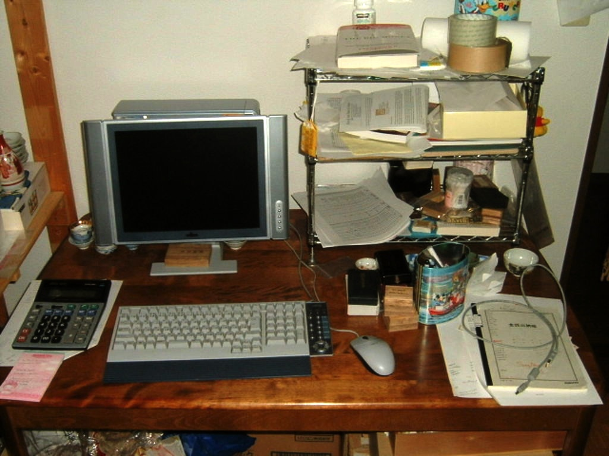
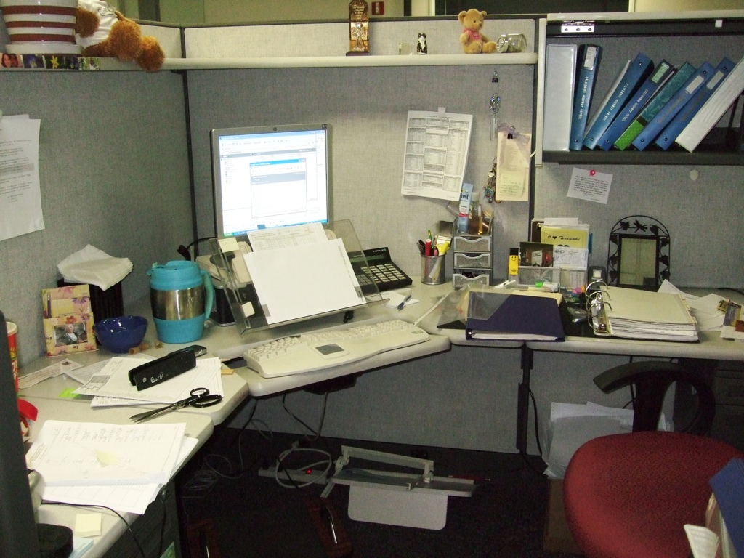
9

Slide 10
Information Scraps
Many tools for managing many info types
But lots of it never placed in computer
So cannot be managed by tools
  No matter how good they are
Why? (ran a study)
What can we do about it? (built a tool)

Slide 11
Info Scraps Study
Long Interview Study
  27 participants
  5 organizations
  1-hour semi-structured interviews
  and artifact examinations
Triangulation
  try to get at all info
  by inquiring about tools, locations, and types
Self validating
  Our personal weird information management practices are actually quite common

Slide 12
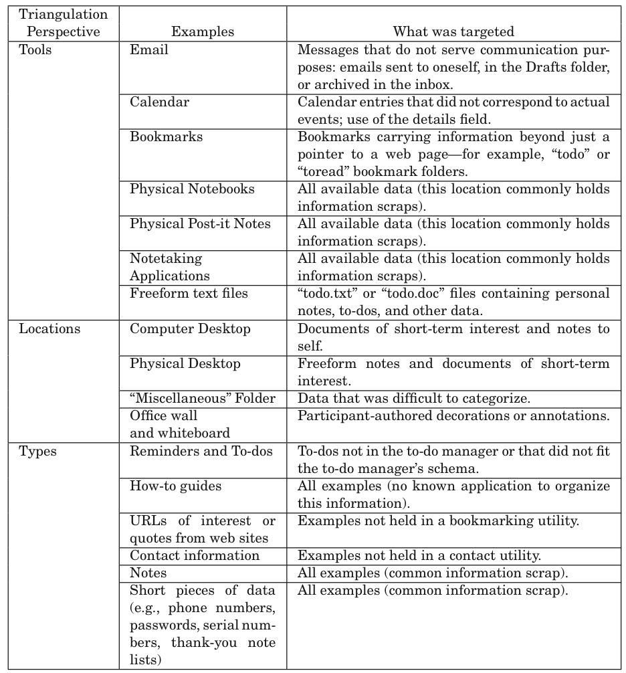

Slide 13
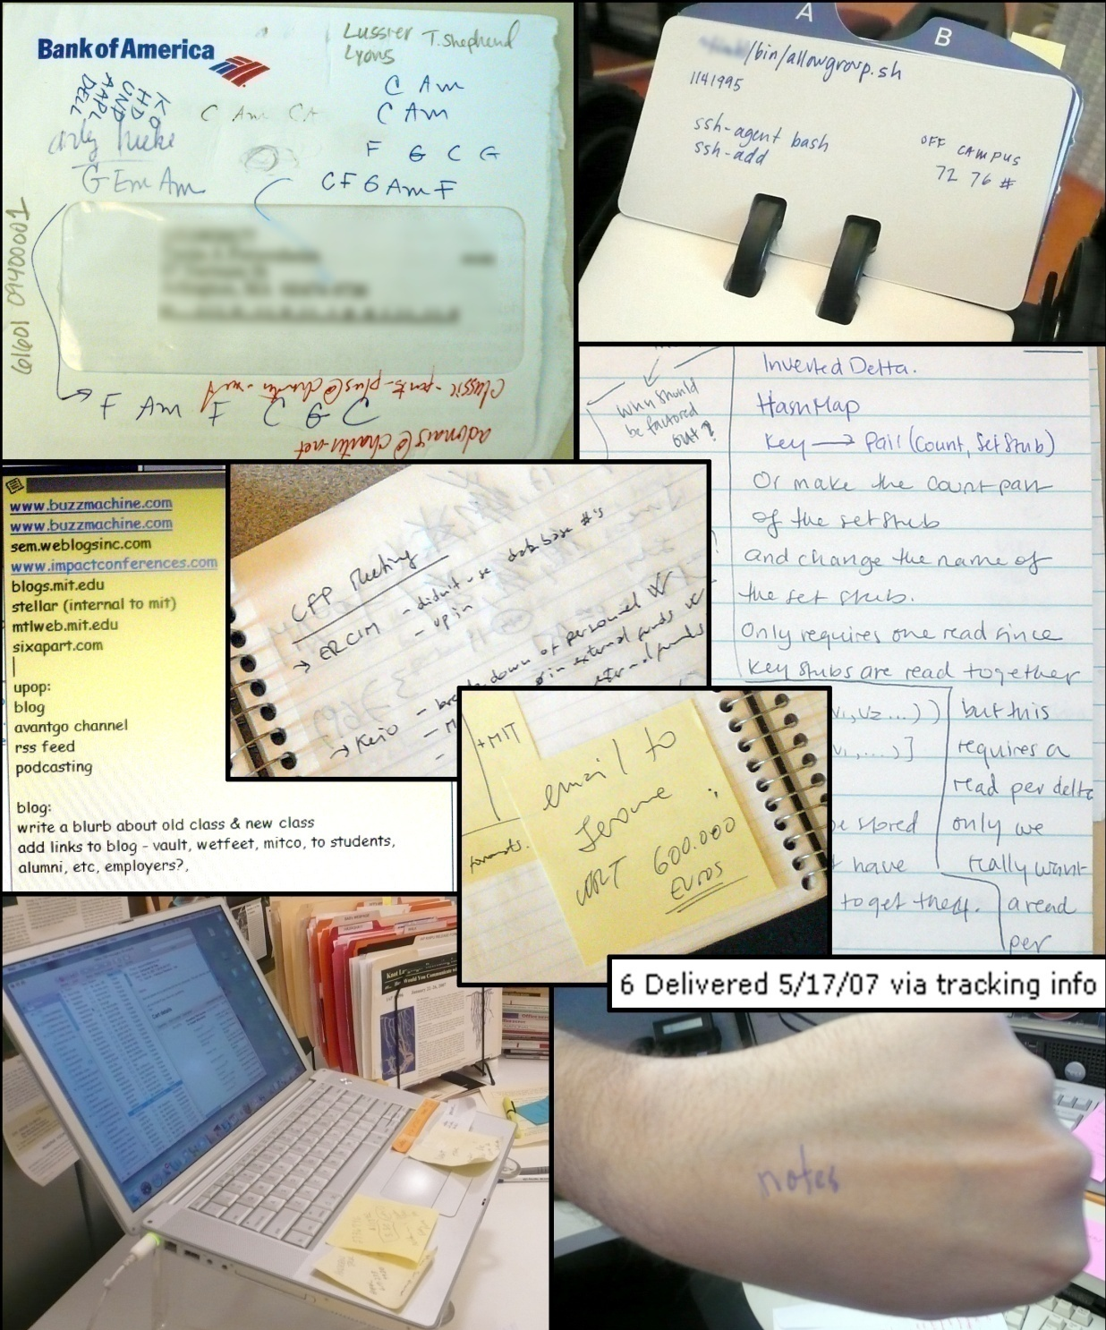
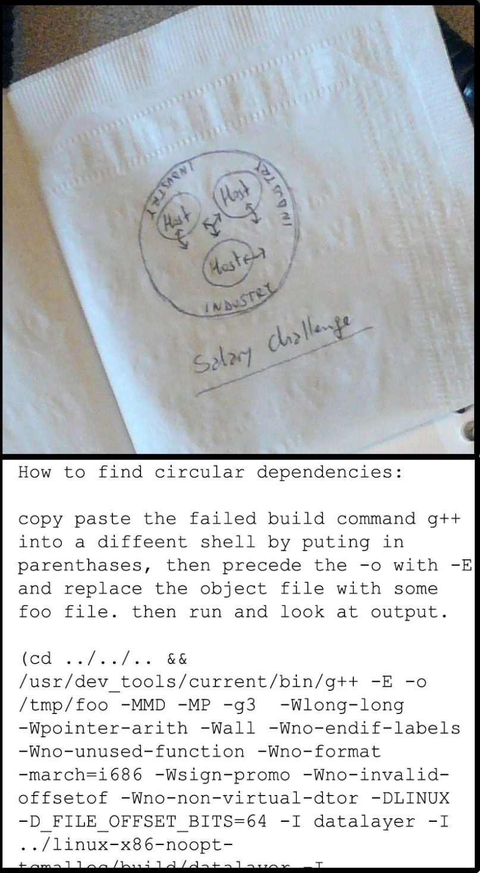
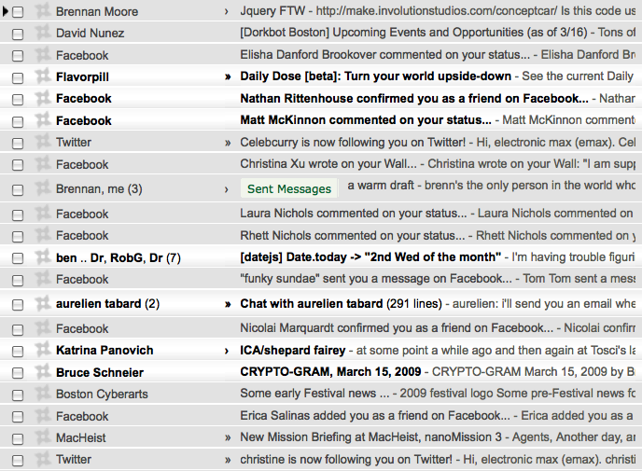
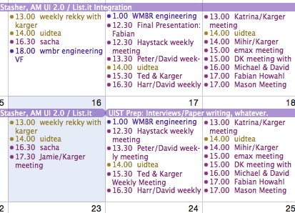
#1 – using computer is distracting/impossible

Slide 14
Flow
Ben Bederson, “Interfaces for Staying in the Flow”, Ubiquity 2004
A sense of focused task concentration
“First, by whatever name you call it - “the runner's high,” “being in the moment,” “in the zone”, “when time slows down,” “the opposite of writer's block,” flow has been studied and celebrated by mystics, athletes, artists and their coaches and guides for centuries.”
---Obama presidential campaign solicitation

Slide 15
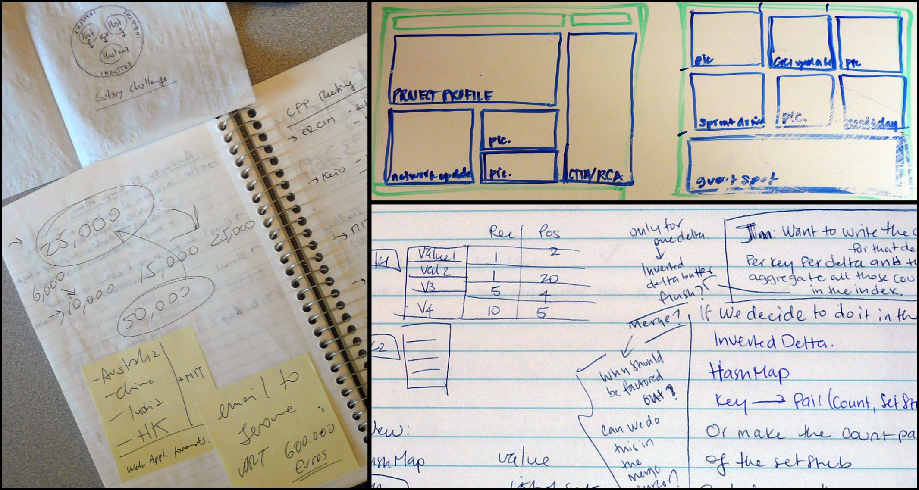
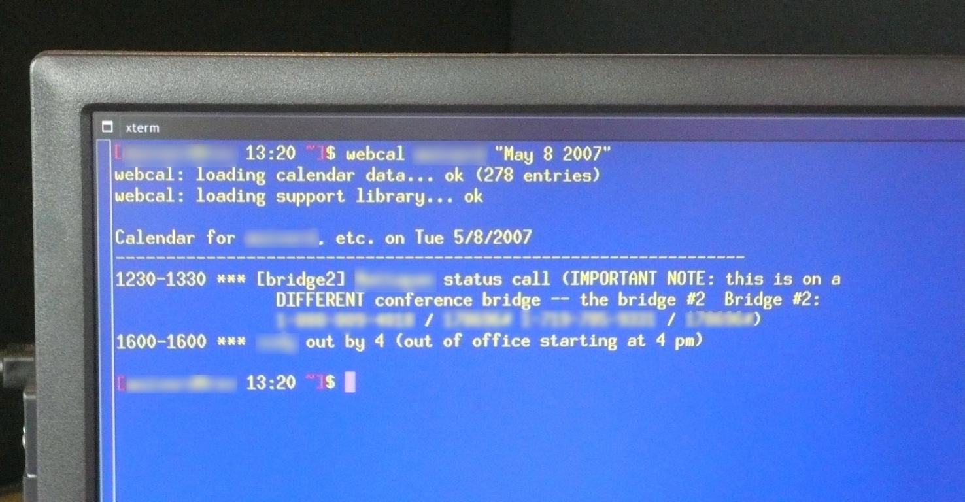
#2 – chimeric information fights app boundaries
meeting notes contain to-dos, contacts, ref. bits, calculations;
calendar events share parts with contacts, bookmarks, maps
contacts double as reminders (to-contacts)

Slide 16
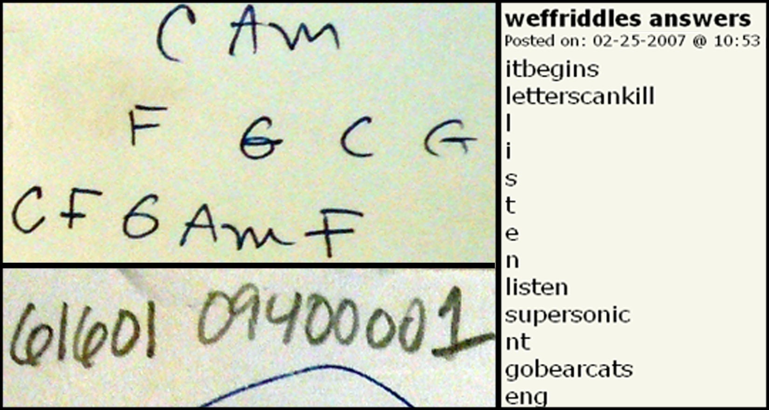
#3 – “rare” information forms don’t fit any app

Slide 17
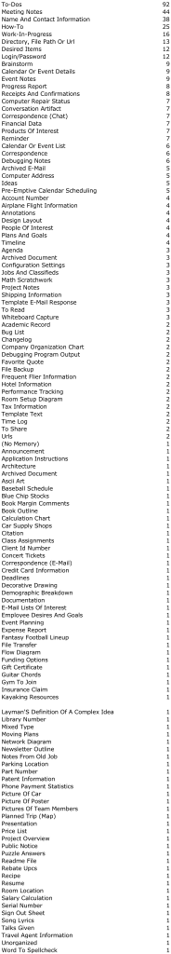

Slide 18
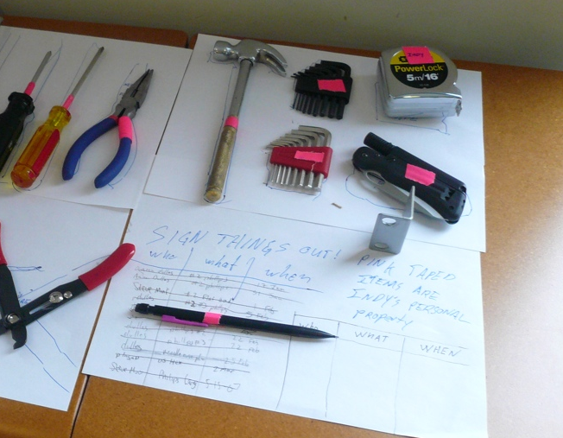
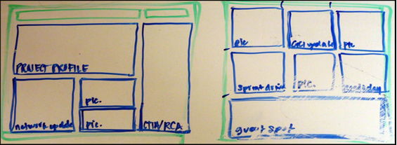
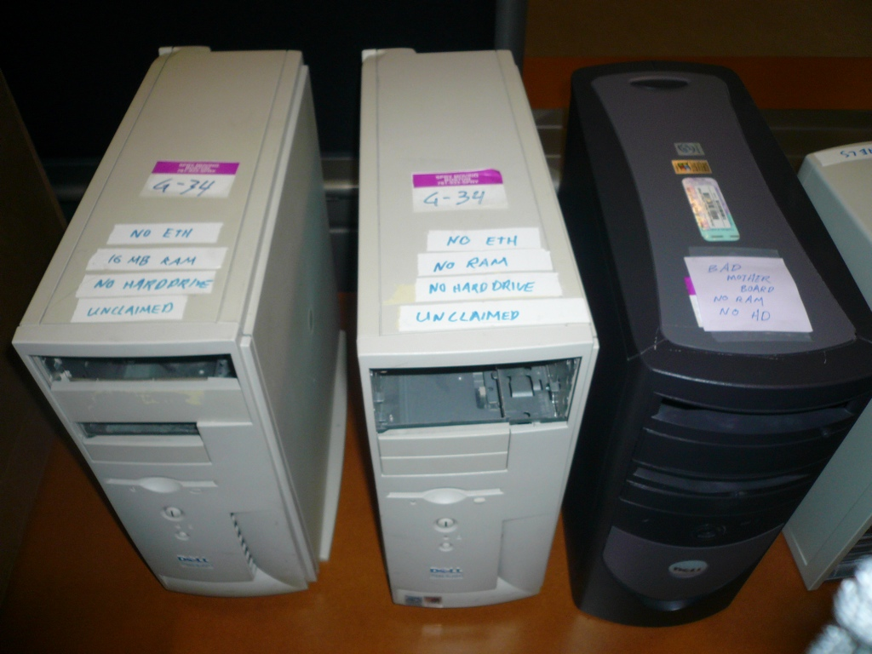
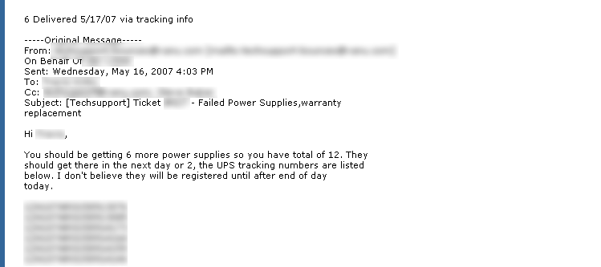
#4 – Want in view at right time---workflow integration

Slide 19
Interviews: Why do you create information scraps?
Using computer distracting or impossible:
  speed/effort
  availability
Schema mismatch
No suitable place
In view at right time
“If it takes 3 clicks to get down, it’s easier to e-mail.”- FIN1
“When I’m in meetings or run into someone in the hall” - ADMIN6
“I wanted to assign dates to notes, but Outlook would only allow dates on tasks.”- MAN3
“I don’t have a place to put MAC addresses” - ENG6
“If it’s not in my face, I’ll forget about it” - ADMN3

Slide 20
Inhibitions to Digital Capture
Costs
  Effort to record
  Fight imposed schema
  Entry time/distraction
  Tool unavailable

Slide 21
List.it:
Lightweight note Capture
Van Kleek, Bernstein, Vargas, Panovich, Karger, schraefel
40

Slide 22
Inhibitions to Digital Capture
Costs
  Effort to record
  Fight imposed schema
  Entry time/distraction
  Tool unavailable
Fixes
  No organization
  Plain text
  Browser + Hotkeys
  Cross-computer sync
  offline + online modes

Slide 23
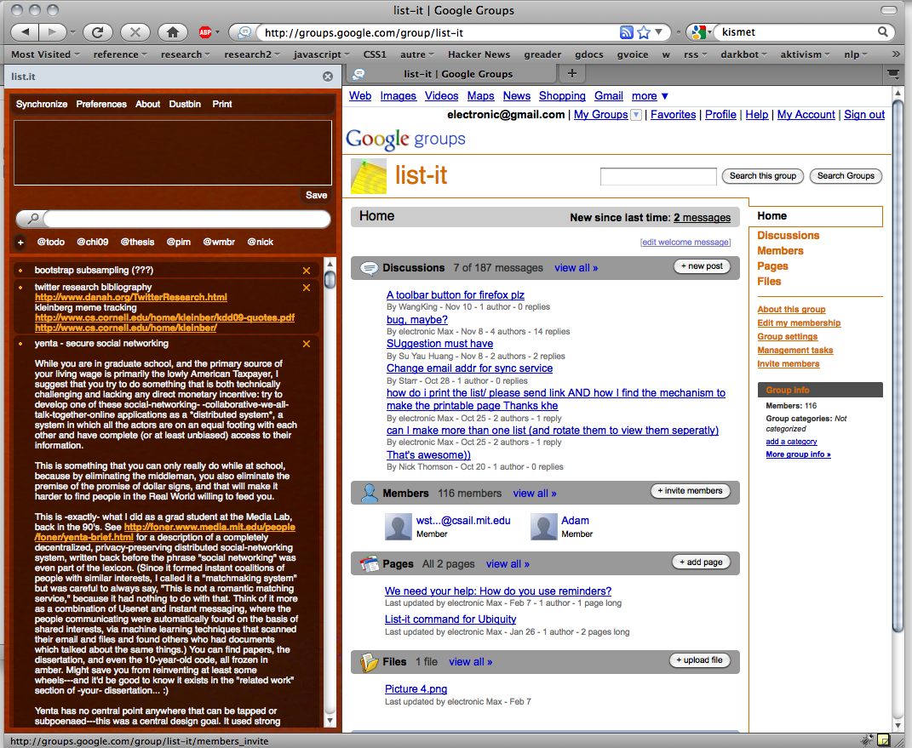
list.it
An open source
micro-note tool for Firefox
(Aug 2008-now)
http://code.google.com/p/list-it
http://listit.csail.mit.edu
http://addons.mozilla.org/en-US/firefox/addon/12737/
Rapid capture
Generic (text) content
No organization overhead

Slide 24
Note Entry
list.it
An open source
micro-note tool for Firefox
(Aug 2008 release)
http://code.google.com/p/list-it
http://listit.csail.mit.edu
http://addons.mozilla.org/en-US/firefox/addon/12737/
50,000+ downloads
20,000 registered users
594,000 notes
920 study participants
Text Search
Filtered Note List

Slide 25
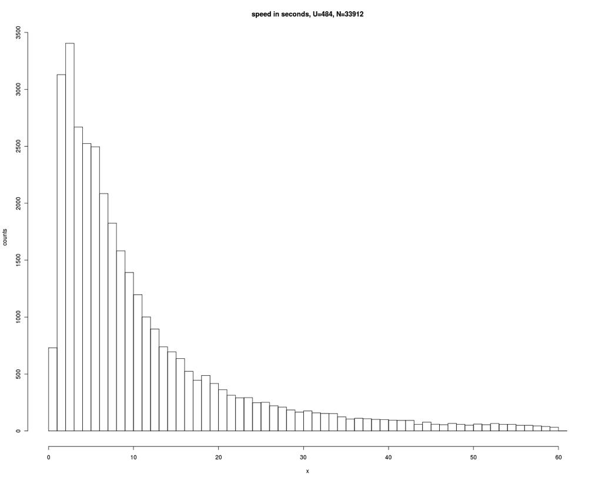
Speed In Seconds
U=484, N=33912
median: 7.4s
95% < 60s
25

Slide 26
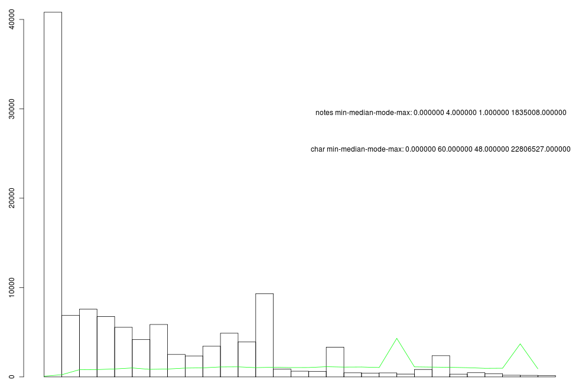
Note Length
N: 33,912
Median lines: 4
Median characters: 48
26

Slide 27
teapot, power strip
email HW re vacation
talk to Brin re:ictd
make inspiration wall.
corkboard tiles.
ask dslr
deposit checks
sb at 8:15, 1111 Bent St
costco optometrist?
BGM wiki http://bg.xxxxx.xxx/wiki
renter's insurance
jshieh
4212B9
Thurs 11.30am - Fred fMRI
http://ec2.images-amazon.com/images/I/xxxx.jpg
Lynn, Tony, Dave(?); larry straw: 777-222-1111
Wasserbett nachfllen
Merlot proposal
Jack's retiremnt lunch Wed Feb 15 @2:30 in WXXX 811!
The United States has not caused this global meltdown. China and other export oriented countries did. It is their refusal to develop a domestic market willing and able to digest a large portion of the....
soy latte java
laptop at HMS (next week)
waiting on mechanic for AAA
Harp photos
meltmuck http://web.mit.edu/…
malt, malted vanilla
jimmy: (323) 668-xyzz
pacific auto service
talk at noon, 7 Div Av
bring tonight: laundry, dishes,
gas\N 8/12: $138.16\N 8/18:$89\N 8/23:$132.59
hotel for Reunions
mw 965 $100 shoemall.com
Play some more Rich King beta.
Egg Stain Removal from Clothing\N To remove an egg stain, cover the area with salt and let sit an hour before washing.\N (Homemaking, laundry, cleaning)
NABPB : \N\N Order Number 9999999
$Xx,XXX.XX with interest, and continuing at a Contract rate of yy% from 3/27/08; (through 4/25/08 in the amount of $zz,zzz.zz a per diem rate of $n.nnnnnn)
Mango Rhubarb Salsa: mince c rhubarb/2c mango/scallion/seeded jalapeno/T cilantro&mint&olvoil&lime/salt. Chill. Srv w tacos or grilled fish.
TODO
BOOKMARK
CALENDAR
ACCOUNTS
REF
RECIPE
CONTACT

Slide 28
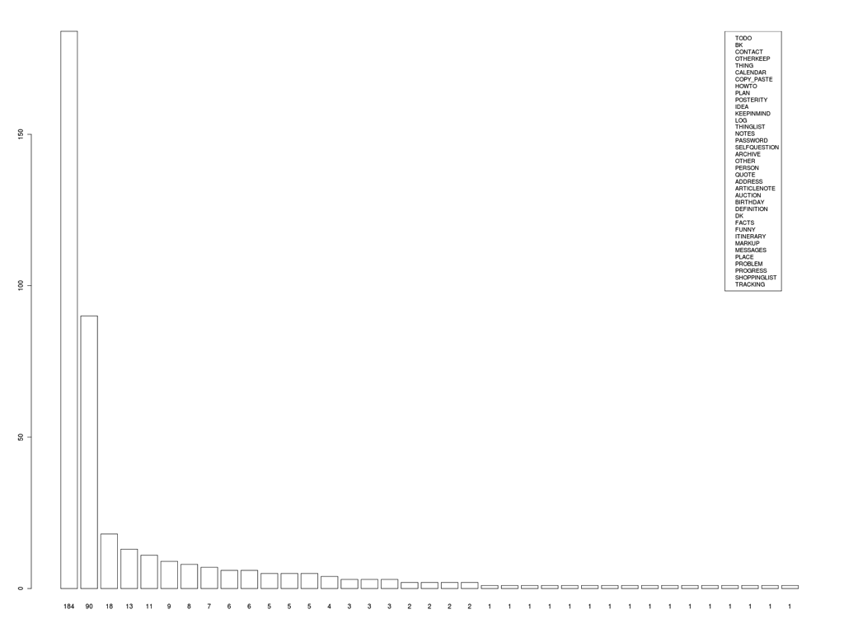
Frequency of note types
N=540
3 coders
48 categories:
Top Categories:
TODO: explicitly marked “to do”, or starting with a verb;
WEB BOOKMARK: URL alone or w/ label;
CONTACT: info about someone
OTHER- KEEP: codes, dates, non-word character sequences
THING: a single non-person entity (proper or common noun);
CALENDAR: calendar entry
COPY_PASTE: clipboard stuff
HOWTO: instructions how to do something
THINGLIST: multiple named or common nouns (e.g. “car, turnips, cat”);
;
28

Slide 29
List.it Contains Apps’ Data
structured PIM type | application
to-do list | tasks; remember the milk; todo managers
web bookmark | browsers; delicious
calendar event | gCal, iCal, Outlook
contact info | Outlook, Address Book, mobile phones
meeting notes | OneNote, EverNote, Word
cooking recipes | RecipeBank, RecipeManager
Because faster?
Because more flexible?

Slide 30
List.it Interviews
online survey
  225 respondents
e-mail interviews
  18 participants
Why do you use list.it?
  (35%) ease/speed
  (20%) simplicity
  (20%) “direct replacement for paper post-it”
  (15%) visibility and accessibility
  (5%) sync across machines
  (5%) nowhere else to put it

Slide 31
At first I tried using Evernote and found it too "veiled." Too laborious to load and to work with. [...] I was looking for a note-taking program that would really seem as if I were just doing that: typing onto a blank space of some sort and then going on to the next blank space.
I liked List-It for several reasons: the ease of use, the fact that the text typed (or pasted) in was so clearly visible and uppermost in function. I had hoped that List-It would replace [...] WordPad and/or NotePad. List-It proved ideal: I didn't have to open a new file; I didn't have to name this file; and I didn't have to wonder in which directory this file would end up once I had closed it.
It would be a great boon for me to have such a one click icon on my desk top to get me immediately into Link-It [sic] to make a note. At the moment I must open Firefox first - two or so steps which can distract my stream of thought. The joy of yellow stickies is that it takes no time to grab the little stack and write.
I like that list-it is flexible. I often prefer to write notes that don't seem to pertain to anything important on paper because I'd feel silly seeing something unimportant in an organization program, amongst my *real* tasks.
I often use list-it to file stuff I want to look at later to see if I want to keep it or not.
Notes:
few features to learn
features are obvious, easy to understand
reduce upfront navigation, actions, decisions and categorization:
goes in the same place, in any way you like

Slide 32
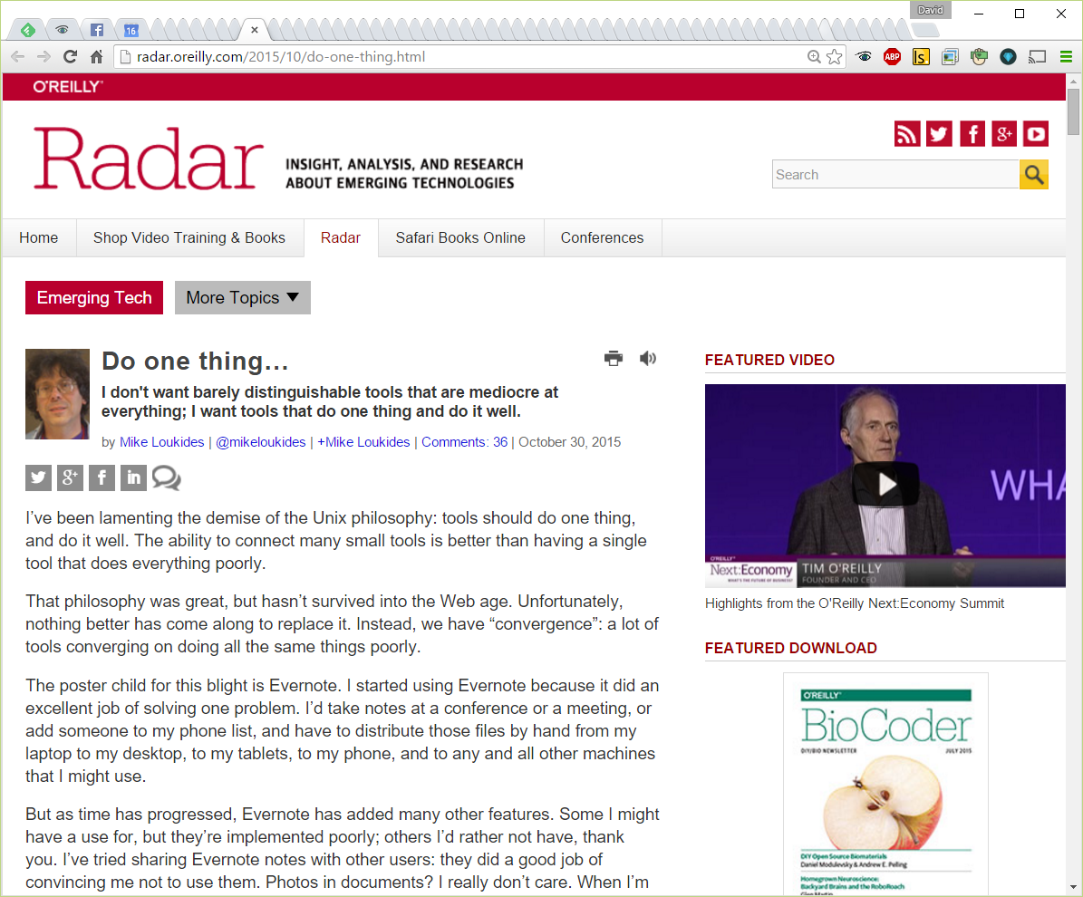

Slide 33
User Types
43

Slide 34
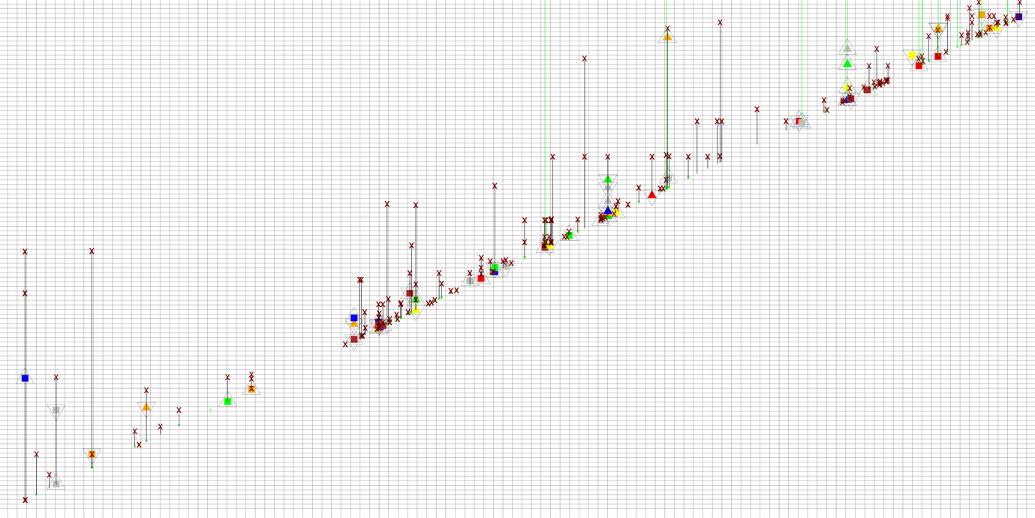
How do people keep and access information in list-it?
note lifelines: a two year retrospective of list-it use

Slide 35
august 2010
august 2008
2 years

Slide 36
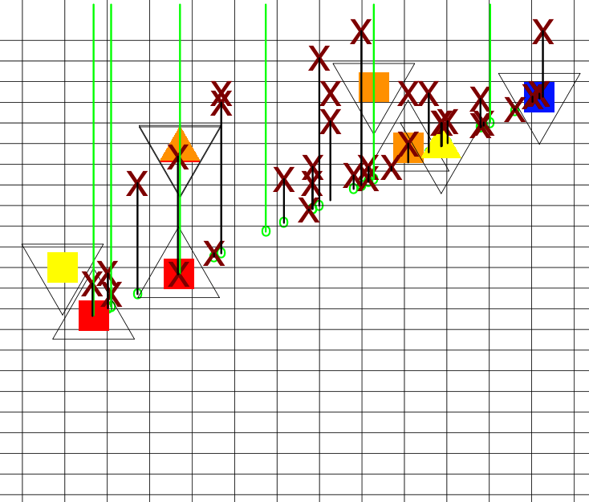
how do people keep notes?
deletion
edit shrink
note still alive
(remaining undeleted)
lifetime
creation line
edit growth
1 week
1 week
(inner colors - day of week of edit)

Slide 37
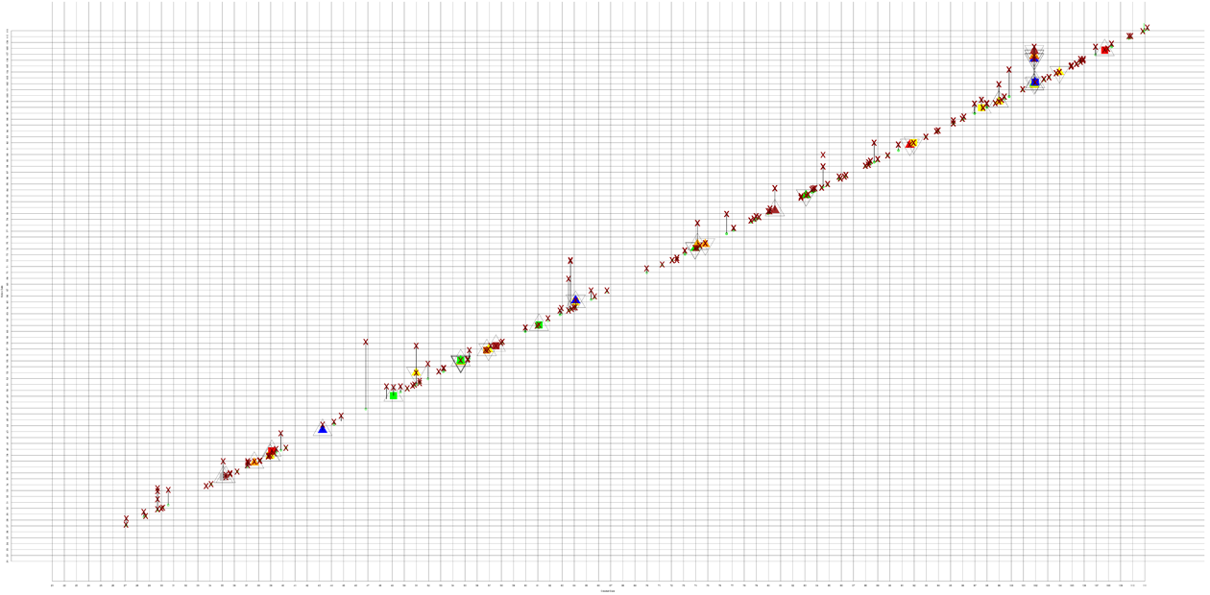
Minimalist
Who is this?

Slide 38
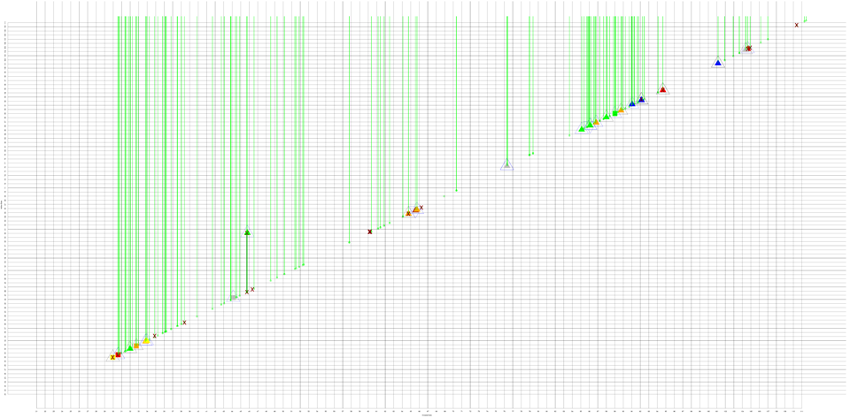
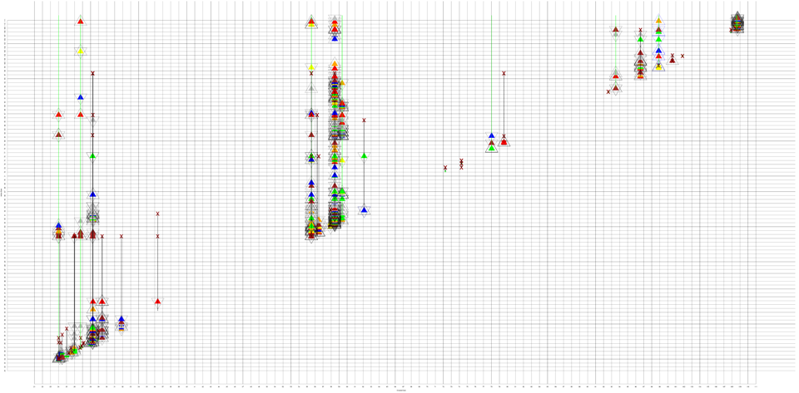
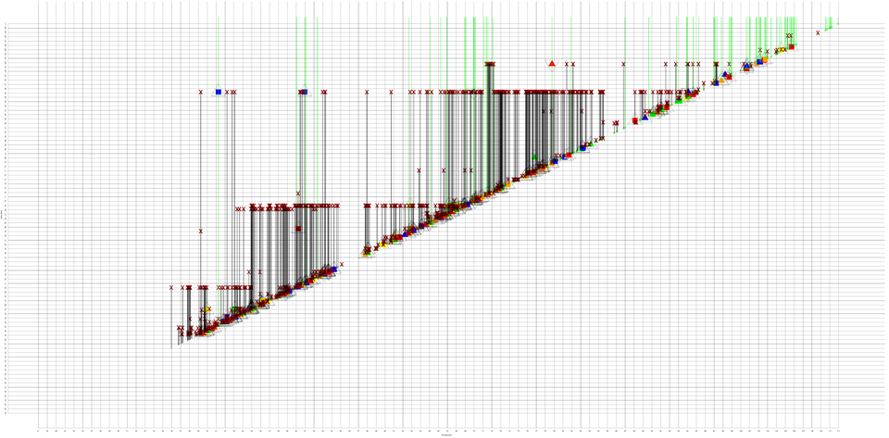
Packrat

Slide 39
Revisionist

Slide 40
Spring Cleaner

Slide 41
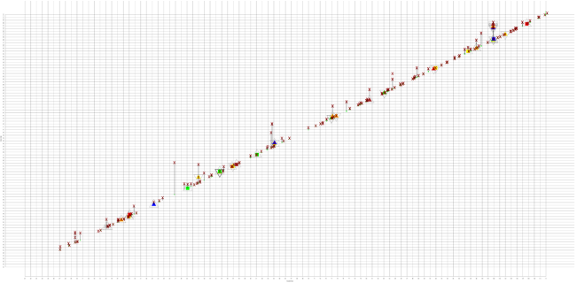

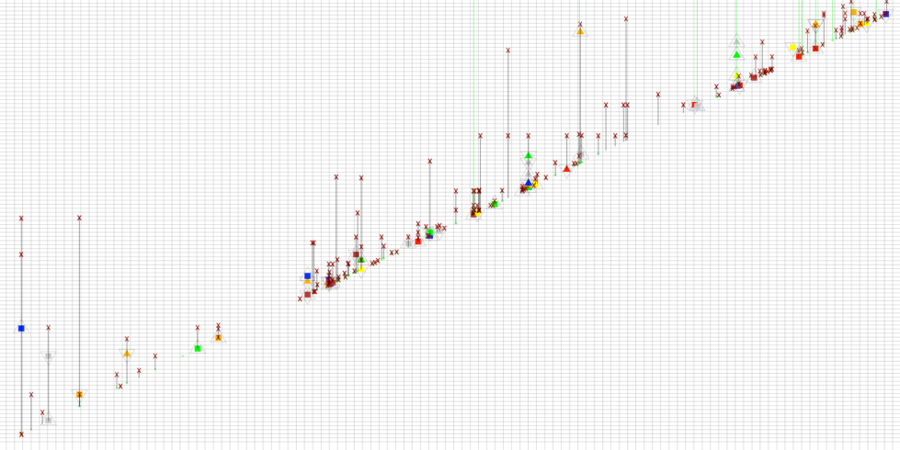
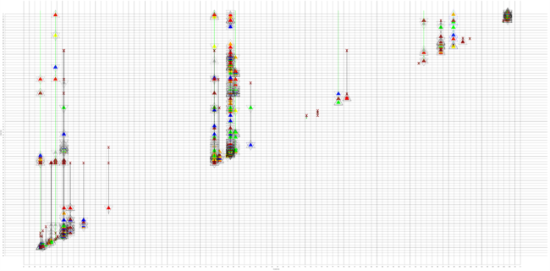

3 coders
first clustered, identified 4 archetypes
coded 420 users each
on <none, some, much> for each personality
much
minimalist
none
packrat
none
revisionist
K = 0.561 (moderate)
some
sweeper

Slide 42
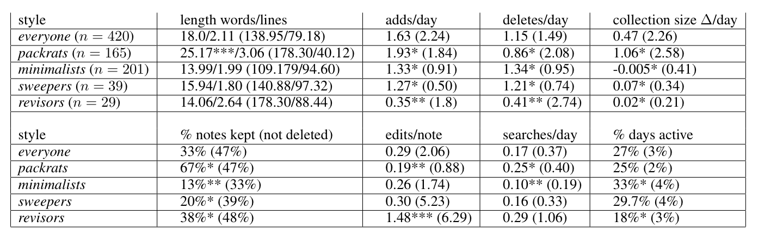
All tests rejected the null hypothesis indicating significant differences among keeping styles as follows: chars/note: F(4, 66146)=49.69 (p ≪ 0.001), words/note: F(4, 66146)=32.21 (p ≪ 0.001); edits/note: F(4,66146)=297.99 (p ≪ 0.001); added notes/day F(4,415)=6.16 (p < 0.01); deleted notes/day F(4,415)=2.95 (p < 0.05); note collection size change/day F(4,415)=10.41 (p ≪ 0.001); % notes kept F(4, 415)=10847.48 (p ≪ 0.001); searches/day F(4,415)=8.35 (p < 0.01); days active F(4,415)=5.87 (p < 0.01).
Results of pairwise Tukey-HSD post-hoc analysis indicated above with (***p ≪ 0.001, ** p < 0.01, *p < 0.05) for all features that exceeded pairwise significance.

Slide 43
Encouraging Classroom Forum Contribution
43

Slide 44
The Problem
“Take a log cabin in the West, put a wooden bench in it, with Mark Hopkins on one end and a student on the other, and you have a college.” --- James Garfield
Faculty-student teaching doesn’t scale
  Even on campus
  Can’t continuously assess individual students
  We don’t know what they don’t know
  Can’t teach to their individual questions
Student-student teaching does scale

Slide 45
Discussion Forums: Benefits
Students can ask questions
  whenever they have them, not just in class
And get answers
  from other students (scale) and staff
Archival Q&A record
  knowledge accumulates over time
Faculty feedback
  what’s confusing and needs teaching or editing?

Slide 46
Discussion Forums: Out of Context
Interrupt reading to visit forum
  Check Facebook while you’re at it….
  Cost of multitasking/loss of flow
Hunt for answer to your question
  When it might not even exist
Describe question context (“on page 23…”)
  If question longer than answer, skip
Find questions you can answer
  Big effort with no benefit to you

Slide 47
Automation?
Retrieve content based on question
Automatically filter for relevance & quality
Automatically classify to ease navigation/exploration
All
  In use
  Powerful
  Hard to do well

Slide 48
Idea
Course content provides a context
Keep that context during discussion
By having discussions in the margins

Slide 49
NB
Threaded discussions like a forum
  But in document margin
Standard web site
Faculty initiates
  signs up
  invites students
  uploads PDF (and now HTML/Video)
Students discuss
  Highlight text, enter comment
  Reply to existing comment

Slide 50
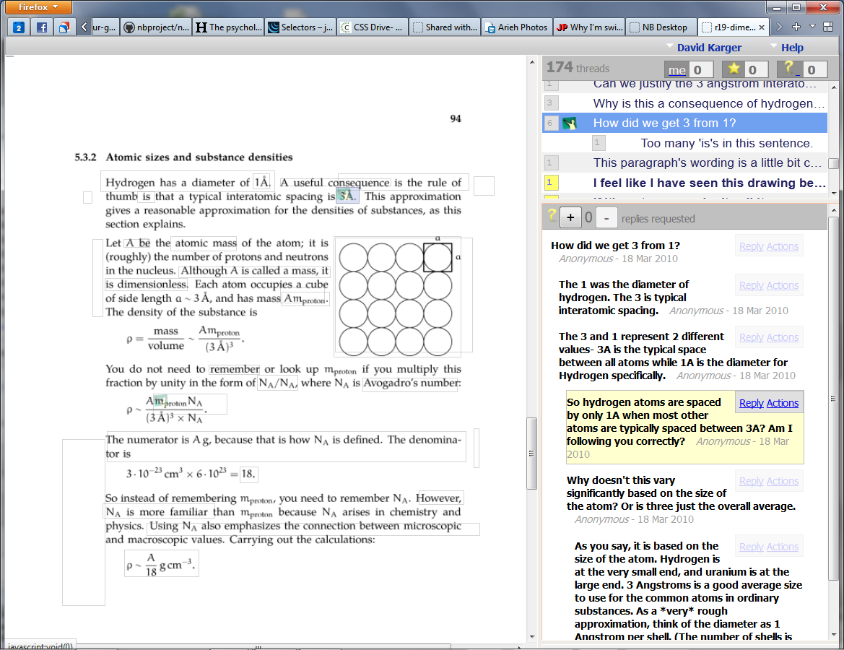

Slide 51
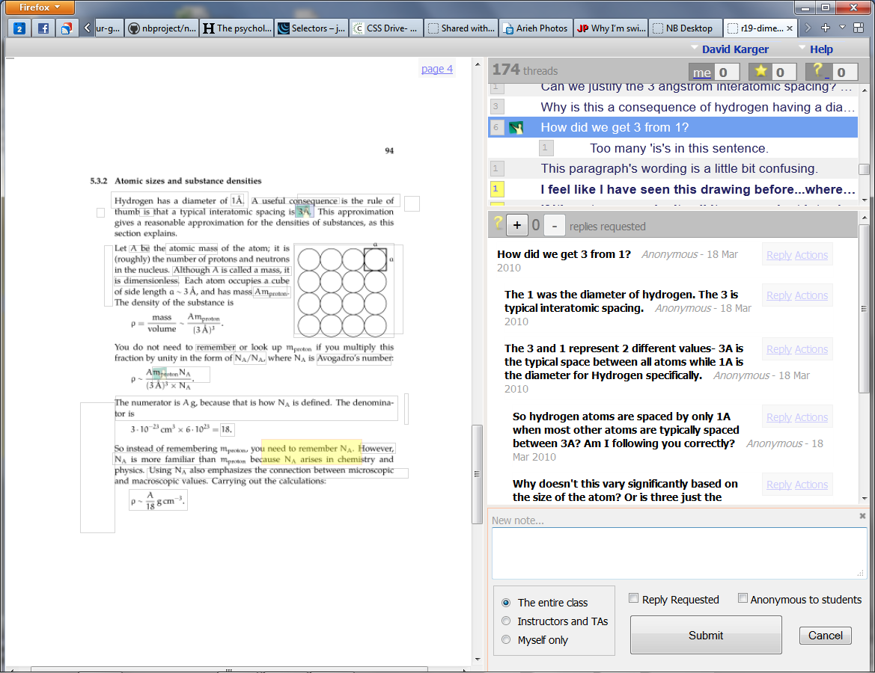

Slide 52
Benefits
Discuss as you read, without exiting note view
  Stay in the flow
See discussion of what you are reading now
  Answers that can help you
  Questions others want answered
Context is clear
  No need to explain in question
  No need to understand from question
Annotations form “heat map” of trouble spots

Slide 53
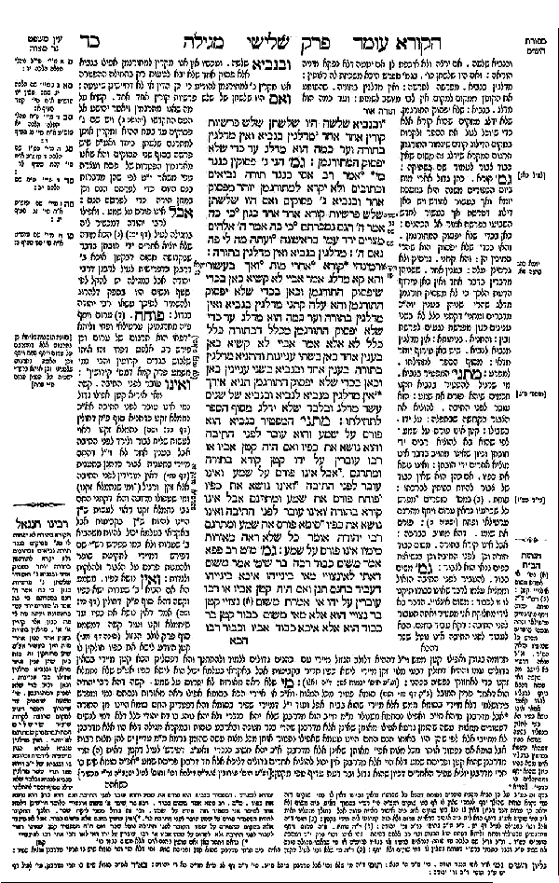
Babylonian Talmud
Primary source
Commentary on primary
Commentary on secondary
Commentary on tertiary

Slide 54
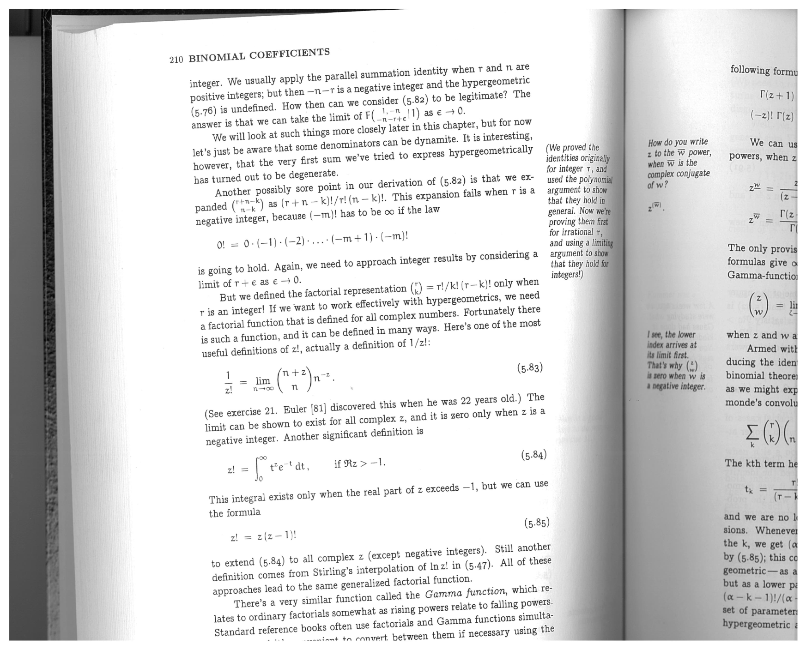
Concrete Mathematics

Slide 55
Assessment
50

Slide 56
Nb Usage
Class | School | Comments | Per Student
Approximation Methods | MIT | 14258 | 151
Shakespeare | URI | 10641 | 130
Human-Comp. Interaction | MIT | 10420 | 83
Applied Physics 50 | Harvard | 5120 | 97
Applied Math 103 | Cal State | 4436 | 61
CopyrightX | Harvard | 2688 | 17
Engineering 2410 | Olin | 1993 | 39
Government 2001 | Harvard | 1324 | 19
Cell Biology | Rochester | 1074 | 32
CS225 | Harvard | 880 | 40
Health Economics | Pacific | 807 | 50
Fysik B | KTH | 369 | 9

Slide 57
Nb Usage
294 classes with > 100 comments
  No MOOCs
  11218 students
  310,010 comments in 199,549 threads
U. Colorado, Cal State, Dartmouth, Edinborough, Harvard, Middlebury, MIT, NC State, Olin, Pacific, Pitt, Princeton, Puget Sounds, Rochester Institute of Technology, SKKU, Toronto, UC Davis, U. Rhode Island, U. Texas, Vermont, Wesleyan, Yale
Math, Chemistry, Biology, Stats, Physics, Mech E, CS, Law, Government, Shakespeare, Philosophy
Frequent re-use

Slide 58
Nb Usage
Class | School | Comments | Per Student
Approximation Methods | MIT | 14258 | 151
Shakespeare | URI | 10641 | 130
Human-Comp. Interaction | MIT | 10420 | 83
Applied Physics 50 | Harvard | 5120 | 97
Applied Math 103 | Cal State | 4436 | 61
CopyrightX | Harvard | 2688 | 17
Engineering 2410 | Olin | 1993 | 39
Government 2001 | Harvard | 1324 | 19
Cell Biology | Rochester | 1074 | 32
CS225 | Harvard | 880 | 40
Health Economics | Pacific | 807 | 50
Fysik B | KTH | 369 | 9

Slide 59
Best Use Class
Sanjoy Mahajan, “The Art of Approximation”, MIT
  Prior to nb, had required paper annotations
Annotation required
  But grew to double required amount over term
  Voluntary usage after benefits demonstrated by force
Extensive in-depth discussions
73% questions resolved by other students
  Most students considered answers “timely”
  Meaning less than one hour
  Far faster than staff responses

Slide 60
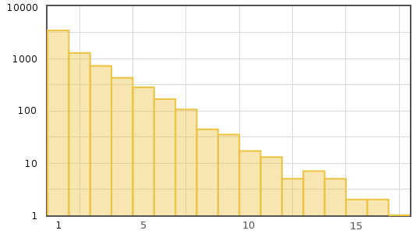
Content
Discussion Length
14,258 Annotations
  153/student
  310 by faculty
77% in discussions
13.9 discussions/page
3.5 posts/discussion
1.4 “long” discussions/page (length > 5)

Slide 61
Content
Percentage | Type
26% | Substantive Commentary (typos, wording suggestions)
32.1% …20.3% …11.5% | Substantive Questions ...about concepts ...about meaning of text
18.5% …15.7% … 2.8% | Substantive Answers …by students …by faculty
23% | Other (humor, anecdotes, “me too”)
Question Resolutions | Percentage
By students in same thread | 50.8%
By students in other thread | 12%
By faculty | 8.6%
Not resolved | 28%

Slide 62
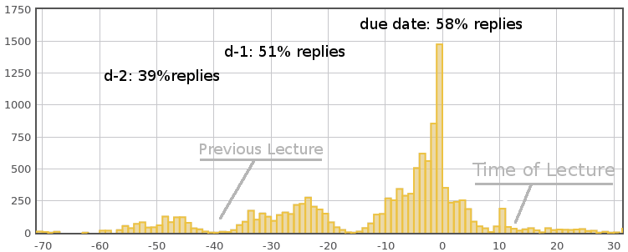
Timing
Time for discussion to happen
Future opportunities to study/improve student study habits

Slide 63
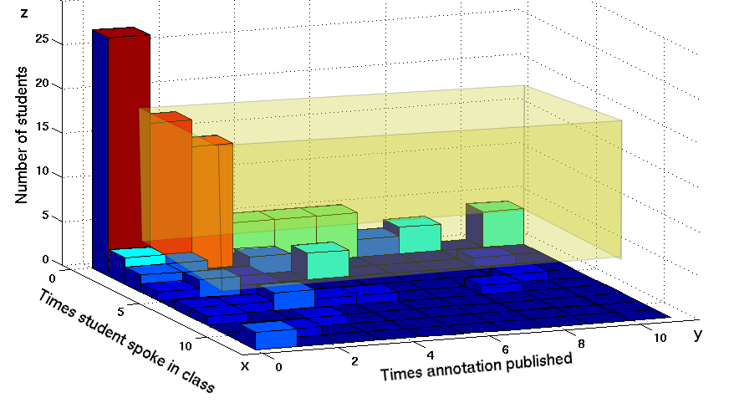
Participation
Dead weight
Writers
No correlation between in-class participation and nb commenting
Nb opens a new channel for quiet participants
Benefits to them and to the class
Talkers

Slide 64
User Feedback

Slide 65
Student Feedback
Substantial discussion
  “Never had this level of in-depth discussion before”
  “Cool to see other people's comments on the material.”
  “The volume of discussion and feedback was much greater than in any other class.”
Collective intelligence
  “I was able to share ideas and have my questions answered by classmates”
  “I really enjoyed the collaborative learning. The comments that were made really helped my understanding of some of the material.”
  “Open questions to a whole class are incredibly useful. Everyone has their area of expertise and this is access to everyone's combined intelligence”

Slide 66
Student Feedback
Measuring stick
  “It's encouraging to see if I'm not the only one confused and nice when people answer my questions. I also like answering other people's questions.”
  “[NB] helps me see whether the questions I have are reasonable/shared by others, or in some cases, whether I have misunderstood or glossed over an important concept.”

Slide 67
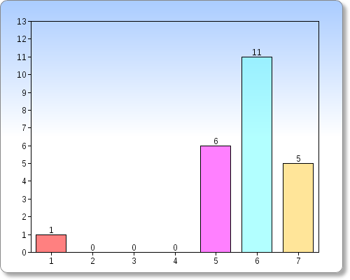
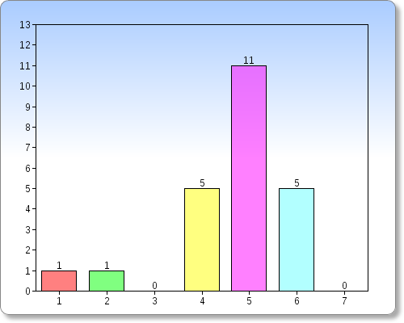
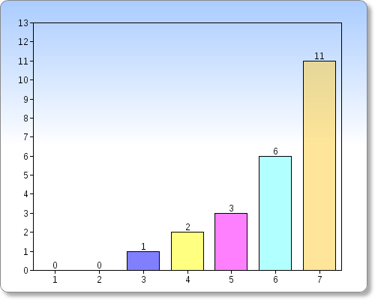
Faculty Feedback
Satisfaction
Comment Quality
Intent to reuse

Slide 68
Improved Online Discussion
“Students were much more comfortable than they ever are in class with asking one another questions and providing answers. There were more real debates on NB than I've ever been able to conjure in a classroom.
“The quiet students had really good things to say that they never would have said in class. The loud students in class that aren't always right, were told when they weren't necessarily correct.
“Students did establish dialogue among themselves via comments, which delighted me because even in class this not always happen.
“It's a definite improvement over traditional discussion boards, which I have tried previously without success.

Slide 69
Improved In-Class Discussion
“The quality of the in-class discussions was much higher than when I had taught the course previously.
“Class sessions changed from regular teaching to discuss NB posts. Of course it had become possible much better to focus on important and difficult points.
“They don't just come to class and listen and go home. They know something when they come to class and can participate and ask GOOD questions in class. We were able to have deeper and more thought provoking discussions where in the past we couldn't even have a discussion.
“It was obvious that the vast majority of the class was reading prior to class. This was very different than prior years.

Slide 70
Know your Students
“Students came much more alive than in usual class teaching (even with discussion time). I suddenly noticed their way of thinking, personality, struggles with the material, determinedness to solve big and small problems.
“Being able to respond directly to a student meant that even the shy ones got a personalized learning experience, which never would have happened ordinarily. I think this is extremely beneficial.
“I felt more connected to the students and what they were thinking.
“NB has certainly helped me make my classroom more student-centered.

Slide 71
Better Teaching
“It helped uncover misconceptions and areas of confusion that I did not expect. I never would have known about many of these things otherwise,
“The students' comments allowed me to notice when they were misinterpreting something from the reading, which I could follow up in class.
“It really did enable me to tune a lecture to the students' needs.
“I was surprised by how difficult some ideas were for students. For example, one reading had an estimate of the number of bits stored on a CDROM. That whole section was dripping with questions and anxiety in the comments. Thus, I spent the following class helping students get a feel for the physical parameters (e.g. highest frequency of human hearing), which was very helpful, and I wouldn't have known to do that if it weren't for NB.

Slide 72
Just a Forum?
Most results/quotes could be about any forum
Though it does indicate that no forum has succeeded this much in students’ other classes
Any evidence annotation approach was better?

Slide 73
NB-specific Benefits
Context sensitive comments
  “How does he get from 1 to 3 here?”
  “Why?”
  Easier to ask a question than standard forum
Responses synthesizing proximate threads
  “The two threads to the left say….”
74% of students did not print notes
  Could have printed, read, checked forum later
  In-place benefits outweighed those of paper

Slide 74
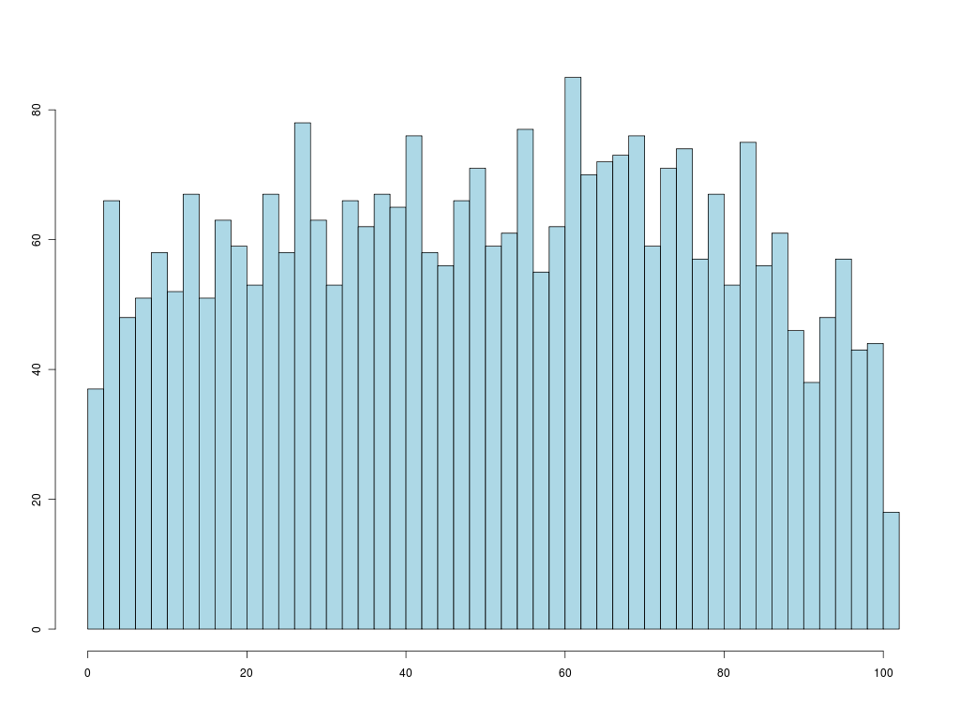
Discussion While Reading
Logged all usage
Identified reading sessions (10 min-1 hour)
When in interval were replies to comments?
Evenly distributed throughout reading
Staying in the flow….
Hypothesis: this gave
critical mass for forum
to succeed

Slide 75
Contrast: WebAnn [Brush, 2001]
Similar system, but very different usage
  Students printed notes, annotated paper
  Returned later to type in annotations
Result: far less/slower conversations
  Had to enforce separate “reply” requirement
Reason? “Minor” deterrents
  Required browser plugin, wireless connectivity
    Neither ubiquitous in 2001
  Clunkier web UIs
  Students less comfortable online

Slide 76
Summary
Annotation can work
  Substantial student-student teaching
  Participation by quiet students
  Online reading
  Timely guidance to faculty on trouble spots
NB is just a medium; computes nothing
  People do the information management
Key: providing information in the flow
  See questions/comments at the right time
  Ask questions without leaving context

Slide 77
Return to Hypertext?
Hypertext is now synonymous with the web
It shouldn’t be
Many ways to present linkage between text
  Web: navigate to a different page
  NB: present linked text in margins
  Another: embed in documents
NB law-school students wanted to annotate the annotations
  How display/navigate this linkage?
  Without losing “center”?

Slide 78
Where Next?
Broader investigation of online discussion tools
Mailing lists
Why are they still here?
How can we fix them
CHI 2015

Slide 79
Structured Data
[Huynh, Benson, Karger, Miller]
58

Slide 80
Structured Data
We all know structured data is good data
It supports
  Rich visualizations
  Sorting, filtering, and other queries
  Merger with other structured data
Clearly useful
  Companies pay money to get these features

Slide 81
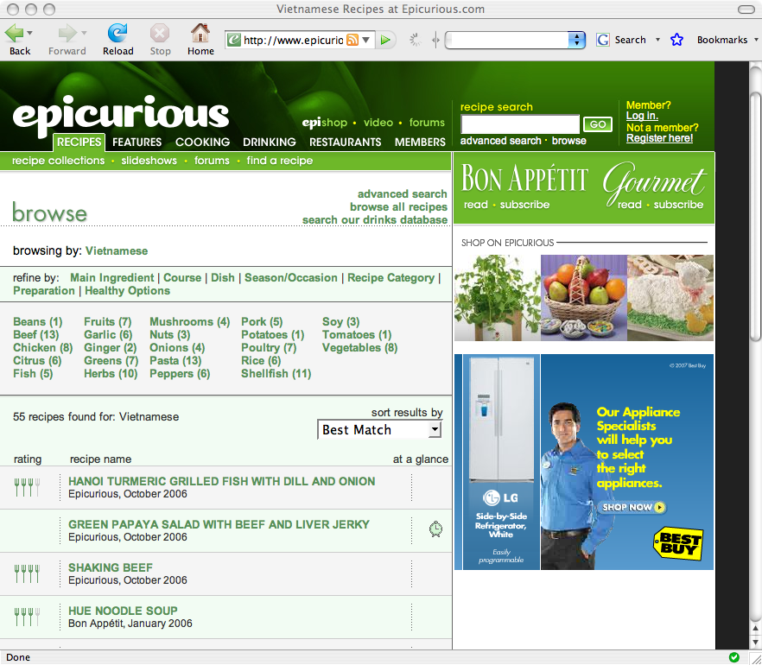
search
filter
sort
template

Slide 82

today

Slide 83

Mere mortals just write text or html

Slide 84



Wiki
Blog
Forum

Slide 85
Why?
Professional sites implement a rich data model
  Information stored in databases
  Extracted using complex queries
  Fed into templating web servers to create human readable content
Plain authors left behind
  Can’t install/operate/define a database
  Can’t write the queries to extract the data
  Limited to unstructured text pages
  Less power to communicate effectively
  Less interest in publishing data

Slide 86
Coping: Information Extraction
Lots of useful data locked in the text
So lots of NLP/ML for information extraction
  Entity recognition
  Coreference
  Relationship extraction
Imperfect, so errors creep in
And end user still misses out on benefits
  Can’t manage their data as data
  Can’t present rich visualizations and interactions

Slide 87
Alternative: Enforcement
Require users to record structured data
For the benefit of their corporate masters
E.g., Electronic Medical Records ….

Slide 88
Alternative: Incentives
Give regular people tools that let them author structured data and visualizations themselves
So they can communicate as well as professional web sites
  their incentive
And their data is available in high fidelity for combination and reuse with other data
  social benefit

Slide 89
Approach
HTML is the language of the web
Extend it to talk about data
Anyone authoring HTML should be able to author data and interactive visualization
Edit data-HTML in web pages, blogs and wikis to let authors create and visualize data
02

Slide 90
Approach
Publishing data is easy
  Just put a spreadsheet online
  Rows are items, columns are properties
Identify key elements of interactive visualizations
  Like spreadsheet charts
Add them to the HTML document vocabulary
  Insert them like images or videos today
Configure by binding them to underlying data
  Pick chart columns in spreadsheet

Slide 91

Like Spreadsheets
Put data in Spreadsheet
  Items are rows, properties are columns
Pick a chart type (visualization)
Specify which columns used in chart

Slide 92
search
filter
sort
template

Slide 93
Image
HTML:
<img
src=…

Slide 95
Data
Items (Recipes)
Each has properties
  Title
  Source magazine
  Publication date
  Rating
  Ingredients
Publish as spreadsheet
  One item per row
  Columns for properties

Slide 96
Views
Show a collection
  Bar chart
  Sortable list (here)
  Map
  Thumbnail set
Bound to properties
  Sort by property?
  Plot which property?
HTML:
<div ex:role=“view”
ex:viewClass=“list”
ex:sort=“price”/>

Slide 97
Facets
Way to filter a collection
  Specify a property
  E.g. ingredient
  User clicks to pick
  Restrict collection to matching items
HTML:
<div ex:role=“facet”
ex:expression=“ingredient”/>

Slide 98
Templates
Format per item
HTML with “fill in the blanks”
HTML:
<div ex:role=“template”
<b>
<div ex:content=“title”/>
</b>
<div ex:content=“date”/>
</div>

Slide 99
Key Primitives of a Data Page
Data
  A spreadsheet
Templates
  Explain how to display a single item
  Describe what properties should be shown where
Views
  Ways of looking at collections of items
  Lists, Thumbnails, Maps, Scatter plots
  Specify which properties determine layout
Facets
  For filtering information based on its structure

Slide 100

General Enough?
Text search
Sorting by Properties
Templated Items
Faceted Browsing

Slide 101

Text search
Sorting by Properties
Templated Items
Faceted Browsing

Slide 102

Text search
Sorting by Properties
Templated Items
Faceted Browsing

Slide 103

Text search
Sorting by Properties
Templated Items
Faceted Browsing

Slide 104

Sorting by Properties
Text search
Templated Items
Faceted Browsing

Slide 105

Sorting by Properties
Text search
Templated Items
Faceted Browsing

Slide 106

Sorting by Properties
Text search
Templated Items
Faceted Browsing

Slide 107
Impoverished Information Visualization?
Is the sameness of all these pages a good thing?
Most information presenters are not ambitious
Carefully designed, domain- and task-specific information interactions will always be superior
But powerful lowest common denominator
People’s experience of it makes it more powerful
  Leverage expectations
  No need to learn new site

Slide 108
Exhibit
Proof-of-concept implementation
05

Slide 109
Exhibit
Use vocabulary just outlined
Link to a javascript library that
  Loads the data
  Interprets the new data-HTML tags
  Implements the widgets they describe on the data
An interactive web site from 2 static files
  HTML + data-HTML describes presentation
  And links to data file: spreadsheet, CSV, XML, JSON…
Nothing to install or configure
  All runs in visitor’s browser

Slide 110
Demo

Slide 111
Outcomes
Open source project as of 2008
1800 exhibits on 800 domains
Reasonably large user community

Slide 112

Hobby Stores

Slide 113

Science

Slide 114

PhD Theses

Slide 115

Rental Apartments

Slide 116

Data.gov

Slide 117

NGOs

Slide 118

Newspapers

Slide 119

Libraries

Slide 120

Sports

Slide 121

Strange Hobbyists

Slide 122

Strange Hobbyists

Slide 123


Slide 124

Urdu Dictionary

Slide 125
Network Television Schedule

Slide 126
Map Store

Slide 127
Scalability
Javascript is slow, not designed for databases
  Exhibit is fast for < 25000 items
  Works for bigger sets, just slows down
Plenty of small data sets
  (most end users’)

Slide 128
Usage Study

Slide 129
Usage Study
Deployed 2007
  ~1900 exhibits on 800 domains
  Millions of views
Many data sets with no natural site on the web
By fetching and analyzing these, we can ask
  What kind of data do people want to publish?
  And how do they want to publish it?
  (subject to limitations imposed by Exhibit)

Slide 130
Exhibit from a scientist’s perspective
Open
  (Everything can be downloaded and inspected)
Declarative
  (easy to analyze)
Standard widget set
  (analysis domain independent)
Notes:
Why is this interesting seven years later, from a scientist’s perspective?

Slide 131
Data Set
1,897 Exhibits scraped from web
  data, viz config, surrounding design
100 Hand-coded
266k Usage Events from 56 Exhibits
  how people browse and interact
12 Author interviews
Notes:
So going back to the pipeline, this dataset lets us take a mixed-method look at the whole pipeline.

Slide 132
12 Interview Subjects
None trained in web development.
Occupations:
  administrators (e.g.: study abroad office)
  teachers
  business managers
  students
Some learned HTML in order to use Exhibit.

Slide 133

Schema Size (Number of Properties)

Slide 134
Data Format
Some exhibits use multiple formats, so sum > 100%
JSON | 69%
Google Spreadsheet | 32%
Bibtex | 2%
RDF | 1%
Excel | 0.1%
CSV | 0.06%
Freebase | 0.06%

Slide 135
Users author data in Spreadsheets
2,000 Exhibits: 32% use Google Spreadsheets
Only a handful of Excel users; reason to believe they’re writing in Excel and converting to JSON
  12 Interviews: many used Excel to author, converted JSON to publish
All who interacted with JSON hated it
  “With JSON, it was too tedious and too difficult to chase after every missed comma and every unequal bracket.”
  “That was the part that was less intuitive to me, setting up the JSON file.”
  “With JSON one of my concerns is not the coding but the missing brackets…that gets to be an issue.”
Because of bad documentation, didn’t know exhibit reads Excel/csv

Slide 136
Data Model
Table
Multi-Valued Table
Name | Country
Ted | USA
Bob | Canada
Name | Country | Hobbies
Ted | USA | hiking, running
Bob | Canada | hiking, fishing
Acyclic Graph
Cyclic Graph
athlete
sport
running
follows
USA
Ted
sport
hiking
Ted
Bob
Canada
Bob
fishing
follows
Claire
sport
athlete

Slide 137
Data Model
Table
Multi-Valued Table
41%
38%
Acyclic Graph
Cyclic Graph
21%
6%
59% using non-tabular data
Notes:
59% of Exhibit users are using a data format that isn’t supported by mainstream data editors like Excel. They are either stuck “abusing” Excel to encode the data or editing JSON, which our interview subjects didn’t like.

Slide 138

Better data tools
All of these can be written in a spreadsheet
But that’s like saying Notepad.exe can be used to author a computer program.
Need end-user tools for editing rich data models
  (not MS Access)
Notes:
From an HCI perspective, you’re essentially throwing away a tremendous amount of information that you could have otherwise used to help the user

Slide 139

Authoring by Copying
HTML describes visualization
Copy it, change the data
(Maybe change the presentation too)
oops!

Slide 140
Copy-Paste-Tweak Development

Slide 141
Copy-Paste-Tweak Development
“
The reason that the exhibits ended up being something I was able to use was that there were some examples, and God I just wished there were more.
It was one of the things I remember very clearly, going through [the wiki] and seeing how everybody did things.
Examples were invaluable.
”

Slide 142
Summary
Structured data is good data
Massive current efforts in information extraction
Instead, give people the ability (simple language) and incentive (visualization) to author structured data

Slide 143
Summary
Anyone who can write HTML can write a data-interactive web page
  Sorting, filtering, searching
  Lists, Maps, Timelines, Plots
  Item templates
Post it on the web and it works
Data is explicit, can be extracted for reuse
The visualization is the incentive

Slide 144
HTMLifying Design

Slide 145
Bricolage
Ranjitha Kumar with Scott Klemmer
“Design Mining the Web”
Identified common patterns on the web
  Commonly used elements
  (“Hero Image”, “Top menu bar”)
  Color pallettes
Used machine learning to extract, classify, learn patterns
Bricolage could remap your web site
  Determine what design you’re using
  Extract the content
  Embed in a different found design for that content

Slide 146
But
Bricolage “knew” what the designs were
But it couldn’t “explain” or “provide a recipe” for them
So nobody could repurpose or tweak them
A descriptive language for “what Bricolage did” could change that….

Slide 147
Wasn’t CSS supposed to solve this?
“Separate content from presentation”
  Content in HTML
  CSS describes presentation
  Selectors attach CSS to relevant bits of HTML
Semantic labels let you change the style without touching the content
  Write CSS once, use often
  Change in one place, applies everywhere
Users who see something they like can easily reuse
  Annotate own html with classes
  Copy or link to css
  Without knowing CSS!
No server or application beyond browser

Slide 148
How would you make David’s site look like James’?
Just copy some CSS?
Notes:
I’m going to show you the simple task of making David’s website look like someone else’s

Slide 150
Huge amount of “design HTML” commingled with content and hard to edit

Slide 151
CSS Struggles
High-level layout rules are complex or impossible in CSS
  Visual nesting described in tags, not css rules
  CSS styles individual DOM nodes, not relationships between nodes
CSS often requires HTML “scaffolding” to hang its rules on
  A div inside a div so the two can get different pieces of the CSS
Changes to design often require changes to “design HTML” in the content document
“Design HTML” has to be repeated everywhere it’s used
  So design changes have to be redone everywhere
Reusing design requires figuring out which parts are design
Editable content obscured by mass of design HTML

Slide 152
Common solution: Templating
Notes:
I’m going to show you the simple task of making David’s website look like someone else’s

Slide 154
Template languages
today are not
HTML

Slide 155
Templating Challenges
Template is often a program
  With control flow and side effects and other confusing behavior
In a language quite different from HTML
  You can’t look at it and see what it will make
  Hard to edit
  (Impossible for end users)
Often executed server-side
  Never appears in client
  End users can’t copy/tweak it
  Needs right server-side infrastructure to use it
People happy to use CSS fail to adopt these tools

Slide 156
Cascading Tree Sheets
Modeled on CSS
  Wraps content html in presentational html
  Declarative
  No control flow, state, order
Any web page is a CTS “sheet”---a design mockup
  “I want my page to look like that one”
CSS selectors specify content to by “styled”
  Used to connect content HTML to presentational HTML
Only skill/tools required are HTML/CSS editing
  To create content HTML
  To connect content to presentation
  To create a new presentation mockup/CTS sheet
Client-side js implementation
  Simulation of future browsers with native capability

Slide 157
CTS Syntax

Slide 158

CTS Language
CSS Relates Parts of Two (HTML) Trees
Notes:
OK, So let’s look at the surface form of the language.
How should we describe these relations?
Well, CSS provides a pretty good way to say what THIS and THAT are.

Slide 159
CTS Language
How should we describe these relations?
Notes:
OK, So let’s look at the surface form of the language.
How should we describe these relations?
Well, CSS provides a pretty good way to say what THIS and THAT are.

Slide 160
CTS Language
CSS Selectors to describe binding points.
h1 > img
goesThere
img.me
Notes:
So here’s what we’ll do. We’ll let you just reuse CSS selectors to talk about the nodes.

Slide 161
CTS Language
CSS-style attachment as well:
  On the node
  In a <style> block
  In a stylesheet (“Tree sheet”)
h1 > img
goesThere
img.me
Notes:
And while we’re at it, we might as well let you attach these relations the same way you attach CSS. So you could put it right on a node, or in a style block or style sheet. And we’ll call that a tree sheet.

Slide 162



HTML
CSS
Data
CTS
Karger | h1>img :goesThere Landay | img.me;
Notes:
OK, so we have this little language for expressing relations between HTML nodes. And we don’t even know what does yet, but we do know that it aligns with a lot of what we know about programming.

Slide 163
Mockup Driven Design
Content Document
  Data object expressed as HTML
Design Mockup
  Design object expressed as HTML
Renders in browser
Direct manipulation
O(1) design updates
  Using any HTML edit tool you like
For either task, high signal-to-noise ratio

Slide 164

User Study: Course Pages
17 participants
Modify, Copy, Insert the nth announcement
Two variants ordinary HTML versus content-only HTML.
Notes:
Prevalent enough that everyone is making them.
Transient enough that nobody bothers to attempt to use CMS.
So they’re often hand-build.

Slide 165


Slide 166

Copy, Paste, and Edit operations significantly faster with CTS-separated HTML

Slide 167

Microformat Themes
CTS not just for whole-page design
Concept from the SW community
Overload CSS classes to annotate data amidst HTML
Used for “small” objects
  hCard
  hCal
  hReview
Microformatted data can be styled
by CTS
Notes:
At the minimum -> template
It’s also going to have these other interesting properties.

Slide 168
Widget Encapsulation

Slide 169
var margin = 20,
diameter = 960;
var color = d3.scale.linear()
.domain([-1, 5])
.range(["hsl(152,80%,80%)", "hsl(228,30%,40%)"])
.interpolate(d3.interpolateHcl);
var pack = d3.layout.pack()
.padding(2)
.size([diameter - margin, diameter - margin])
.value(function(d) { return d.size; })
var svg = d3.select("body").append("svg")
.attr("width", diameter)
.attr("height", diameter)
.append("g")
.attr("transform", "translate(" + diameter / 2 + "," + diameter / 2 + ")");
d3.json("flare.json", function(error, root) {
if (error) return console.error(error);
var focus = root,
nodes = pack.nodes(root),
view;
var circle = svg.selectAll("circle")
.data(nodes)
.enter().append("circle")
.attr("class", function(d) { return d.parent ? d.children ? "node" : "node node--leaf" : "node node--root"; })
.style("fill", function(d) { return d.children ? color(d.depth) : null; })
.on("click", function(d) { if (focus !== d) zoom(d), d3.event.stopPropagation(); });
var text = svg.selectAll("text")
.data(nodes)
.enter().append("text")
.attr("class", "label")
.style("fill-opacity", function(d) { return d.parent === root ? 1 : 0; })
.style("display", function(d) { return d.parent === root ? null : "none"; })
.text(function(d) { return d.name; });
var node = svg.selectAll("circle,text");
d3.select("body")
.style("background", color(-1))
.on("click", function() { zoom(root); });
zoomTo([root.x, root.y, root.r * 2 + margin]);
<!DOCTYPE html>
<meta charset="utf-8">
<style>
.node {
cursor: pointer;
}
.node:hover {
stroke: #000;
stroke-width: 1.5px;
}
.node--leaf {
fill: white;
}
.label {
font: 11px "Helvetica Neue", Helvetica, Arial, sans-serif;
text-anchor: middle;
text-shadow: 0 1px 0 #fff, 1px 0 0 #fff, -1px 0 0 #fff, 0 -1px 0 #fff;
}
.label,
.node--root,
.node--leaf {
pointer-events: none;
}
</style>
<body>
<script src="http://d3js.org/d3.v3.min.js"></script>
<script>
function zoom(d) {
var focus0 = focus; focus = d;
var transition = d3.transition()
.duration(d3.event.altKey ? 7500 : 750)
.tween("zoom", function(d) {
var i = d3.interpolateZoom(view, [focus.x, focus.y, focus.r * 2 + margin]);
return function(t) { zoomTo(i(t)); };
});
transition.selectAll("text")
.filter(function(d) { return d.parent === focus || this.style.display === "inline"; })
.style("fill-opacity", function(d) { return d.parent === focus ? 1 : 0; })
.each("start", function(d) { if (d.parent === focus) this.style.display = "inline"; })
.each("end", function(d) { if (d.parent !== focus) this.style.display = "none"; });
}
function zoomTo(v) {
var k = diameter / v[2]; view = v;
node.attr("transform", function(d) { return "translate(" + (d.x - v[0]) * k + "," + (d.y - v[1]) * k + ")"; });
circle.attr("r", function(d) { return d.r * k; });
}
});
d3.select(self.frameElement).style("height", diameter + "px");
</script>

Slide 170
Adding Data Interaction

Slide 171
How would you edit a publication from your web browser?
Notes:
Let’s go back to this problem of editing content in the browser.

Slide 172
Standard Templates/Exhibit
Data
Rendering
Web Page
Template
…but you can’t go backwards.
Notes:
And remember that a problem with the way we build web applications today is that the rendering process doesn’t go both ways. We need an entirely DIFFERENT apparatus to bring us backward than we have to go forward.

Slide 173
Bidirectional Data Flow
The relational approach we’ve defined enables bidirectional data flow without any modification.
Data tree nodes related to web page tree nodes
  Change to web page node changes mapped data node
  Independent of particular page editing method
  Just listen for page changes
Just need a server that can store a (data) tree and receive/send update messages
  Firebase or Meteor
  Favorite CMS
Data
Bidirectional
Web Page
Template
Rendering

Slide 174
Spreadsheet Backed Apps

Slide 175
Idea
Google spreadsheets are a fine back-end store for bidirectional content editing
Bonus: they can compute
  In a model that end users understand well

Slide 176
Quilt: Spreadsheet Backed Apps
Spreadsheets remain one of the most popular data management tools today.
[Voida, Harmon, and Al-Ani. CHI 2011]
HTML
data modeling
computation
UI flexibility
distribution
Notes:
Editing documents is nice, but wanted to see what else we could do with better environments for application creation. So we built a system called Quilt to explore spreadsheet backed apps.

Slide 177


Quiltfor Spreadsheets
Wrap the Google Data API in a Tree
Handles events, throws events
Create a selector language for the spreadsheet “tree”
Google Sheet
Tree Proxy
CTS Engine
Notes:
Integrating spreadsheets into CTS is a few implementation steps, so I’m just going to cover one or two interesting bits.
Google Spreadsheets has an API, and we wrapped it in a tree-shaped proxy. And it handles events and throws events and translates tree manipulations into API calls against the spreadsheet.

Slide 178
Quilt for Spreadsheets
Wrap the Google Data API in a Tree
  Handles events, throws events
Create a selector language for the spreadsheet “tree”
Google Sheet
Tree Proxy
CTS Engine
Notes:
Integrating spreadsheets into CTS is a few implementation steps, so I’m just going to cover one or two interesting bits.
Google Spreadsheets has an API, and we wrapped it in a tree-shaped proxy. And it handles events and throws events and translates tree manipulations into API calls against the spreadsheet.

Slide 179
Quilt for Spreadsheets
Wrap the Google Data API with a Tree
  Handles events, throws events
Create a selector language for the spreadsheet “tree”
As Cells
A1, B3
As Items Collections
rows, cols
As Item Properties
(column headings)
Task, Done
Worksheet Prefix
worksheet !
Notes:
And so the interesting part became this choice of how to allow users to address the spreadsheet. For the web, they use CSS selectors, but what about a sheet.
Well…
.. (And there are others you might do, and users we’ve been talking to have suggested to us based on their own spreadsheet habits)

Slide 180
Quilt for Spreadsheets
Wrap the Google Data API with a Tree
  Handles events, throws events
Create a selector language
mypage | h1 :is someSheet | A1 ;
mypage | ul :are someSheet | rows ;
Notes:
So here is one thing you might say.
You might say the H1 is….

Slide 181
Quilt for Spreadsheets
Wrap the Google Data API with a Tree
  Handles events, throws events
Create a selector language for spreadsheet “tree”
mypage | h1 :connect someSheet | A1 ;
mypage | ul :connect someSheet | rows ;
connect is is, are, and graft
Notes:
And there is another interesting bit.
Because, given a spreadsheet selection, you know what the type is.
Remember back to that LI and DIV example when we created the ARE command?
Well with a spreadsheet there is no ambiguity. We know if you’re addressing a set or a scalar. And since we now know these relations are symmetric.

Slide 183

Todo List Demo

Slide 184

Mortgage Calculator Demo

Slide 185
User Study
15 HTML Beginners
40% hadn’t used <table>
66% hadn’t used <form>
15 Minutes learning session
connect, show-if, hide-if
4 App building tasks

Slide 186
Given Ordinary HTML Mockups without CTS Present

Slide 187
Todo List Task
Add
<h1>TODO</h1>
<ul>
<li>
<input type="checkbox" />
<span>Example Task</span>
</li>
</ul>
<form>
<input />
<button>Add</button>
</form>

Slide 188
Todo List “Answer Key”
Add
<h1>TODO</h1>
<ul connect=rows>
<li>
<input connect=Done type="checkbox" />
<span connect=Task>Example Task</span>
</li>
</ul>
<form connect=rows>
<input connect=Task />
<button>Add</button>
</form>

Slide 189








2 Tasks
Todo List
Then 2 more
Chat Room
Calculator

Slide 190
Results
Task 1
Task 2
Task 3
Task 4
14/15
13/15
5/5
5/5
Notes:
Offered 3&4 to 7

Slide 191

Completion Times---Predicted

Slide 192
Completion Times---Actual

Slide 193
“
It feels amazing. I thought it would take me three 8 hour days to do something like this. And then to be able to just do it with Google Docs which is something that I use so frequently, and for it to be so easy and to make so much sense, yeah, it’s really cool.
”

Slide 194
var TodoList = React.createClass({displayName: 'TodoList',
render: function() {
var createItem = function(itemText) {
return React.DOM.li(null, itemText);
};
return React.DOM.ul(null, this.props.items.map(createItem));
}
});
var TodoApp = React.createClass({displayName: 'TodoApp',
getInitialState: function() {
return {items: [], text: ''};
},
onChange: function(e) {
this.setState({text: e.target.value});
},
handleSubmit: function(e) {
e.preventDefault();
var nextItems = this.state.items.concat([this.state.text]);
var nextText = '';
this.setState({items: nextItems, text: nextText});
},
render: function() {
return (
React.DOM.div(null,
React.DOM.h3(null, "TODO"),
TodoList( {items:this.state.items} ),
React.DOM.form( {onSubmit:this.handleSubmit},
React.DOM.input( {onChange:this.onChange, value:this.state.text} ),
React.DOM.button(null, 'Add #' + (this.state.items.length + 1))
)
)
);
}
});
React.renderComponent(TodoApp(null ), mountNode);
This is how industry today welcomes newcomers for something as basic as a todo list
Notes:
And I want to go back to this Facebook example.

Slide 195
Add
<h1>TODO</h1>
<ul>
<li>
<input type="checkbox" />
<span>Example Task</span>
</li>
</ul>
<form>
<input />
<button>Add</button>
</form>

Slide 196
Add
<h1>TODO</h1>
<ul>
<li>
<input type="checkbox" />
<span>Example Task</span>
</li>
</ul>
<form>
<input />
<button>Add</button>
</form>

Slide 197
Add
<h1>TODO</h1>
<ul connect=rows>
<li>
<input connect=Done type="checkbox" />
<span connect=Task>Example Task</span>
</li>
</ul>
<form connect=rows>
<input connect=Task />
<button>Add</button>
</form>

Slide 198
Self Tracker for High School Students
<form connect=“Weight ! rows”>
<input connect=“weight” />
<input type=“hidden” connect=“date” />
<button>Record</button>
</form>

Slide 199
Meal Board for MIT Frat Catering

Slide 200
Graduated!
http://cloudstitch.io/

Slide 201
Conclusion
Ask not what your computer can do for you…

Slide 202
Conclusion
People can be powerful information managers
  Capturing information scraps
  Discussing lecture notes
  Recommendation/sharing content
  Authoring structured data and visualization
In each case, consider
  what people are able to do
  how to reduce deterrents and show benefits
  so they want to

Slide 203
List.it
People can capture more information
Major deterrents:
  Interruption of work to capture data
  Struggle to decide where to put it
  Rigid structure of apps
Resolve by:
  Minimizing capture effort
  Flat organization
  No required structure

Slide 204
NB
Students can collaborate to understand content
Deterrents from traditional forums:
  Interruption to use them
  Don’t know where/when to seek relevant Q&A
Resolve by:
  Placing discussion in margin
  Adjacent to relevant content
  See what’s relevant while you are reading
  Ask/answer without leaving

Slide 205
Exhibit
People can author structured data and create rich interactive visualizations
Deterrent:
  Complexity of structured data management tools
Overcome by:
  Data as authoring (not programming or db)
  Incentive of rich visualizations
  Embed in well-known tools
  Write HTML, or edit a wiki or blog

Slide 206
Quilt
HTML + Spreadsheet = complete web app
Thinking about the task isn’t the problem---it’s the programming language/interface
People can do computation (in a spreadsheet)
People can do web design (in HTML)
People can put them together

Slide 207
Conclusion
We work hard to create tools that effectively manage information for us
People are better than computers at IM
  they just don’t have the right tools
  or the time/desire
Don’t assume passive information consumers
  encourage active user information management
  by identifying user needs and capabilities
  and minimizing effort to use
  and maximizing/exposing benefit

Slide 208
Students and *Colleagues
*Mark Ackerman (NB)
Ted Benson (Exhibit, Datapress)
Michael Bernstein (List.it, Feedme)
Fabian Howahls (Wibit)
David Huynh (Exhibit)
Adam Marcus (Datapress, Feedme)
*Rob Miller (Exhibit)
Katrina Panovich (List.it, Feedme)
*mc schraefel (List.it)
Wolfe Styke (List.it)
Greg Vargas (List.it)
Max van Kleek (List.it)
Sacha Zyto (NB)

Slide 209
Try Them All (Almost)
All at http://haystack.csail.mit.edu/
http://listit.csail.mit.edu/
http://nb.mit.edu/
http://simile-widgets.org/exhibit
http://projects.csail.mit.edu/datapress
http://cloudstitch.io/
All open source (cloudstitch caveats)
All welcome contribution/collaboration

Slide 210
Recruitment
Deploying 2 new tools---please try
Mailing list
  http://murmur.csail.mit.edu/
Social browsing
  http://eyebrowse.csail.mit.edu/

Slide 211
EXTENSIONS
What if you can’t write HTML?

Slide 212

Wibit
Collaborative Authoring in a Wiki
Exhibit is text file
Put it in a wiki
Combine data interaction and collaboration

Slide 213

Wibit
Collaborative Authoring in a Wiki
Wikitext to describe Exhibit

Slide 214
Contrast: DBpedia
Wikipedia “infoboxes” are “structured data”
  But are authored as text
DBpedia project
  Spiders Wikipedia
  Applies information extraction to infoboxes
  Stores results in queryable database
Challenges
  Sloppy infoboxes yield errors in database
  Parsed data not in wiki for users to view
  No rich visualization in Wikipedia
Better to author as structured data!

Slide 215

Exhibit in a Blog: Datapress
Wordpress plugin
Link to data source
Then WYSYWIG your visualization

Slide 216

WordPress + datapress
Notes:
Loop through a bunch of pictures of bloggers using plain exhibits.

Slide 217

Or Just a Document
DIDO --- Data Integrated Active Document
Javascript WYSIWYG Editor included with document
Edit in place and save

Slide 218
DATA EXPORT
08

Slide 219


Slide 220


Slide 221


