Slide 1
Why everyone should be their own database administrator, UI designer, and Web 2.0 site developer, and how they can
David Karger

Slide 2
Free your Data: Instant Gratification with the Semantic Web
David Karger

Slide 3
Conclusion
Structure makes information more useful
Allows multiple rich visualizations
Eases repurposing, combination, mashups with other info
Structure can be done by end users
Authoring structured information
Authoring interesting interactions with that information
Combining and repurposing
Web 2.0 is about data
Comes from everywhere
Goes where it needs to
Combines with other data
Looks the way you want

Slide 4
Some Web History
Motivation

Slide 5
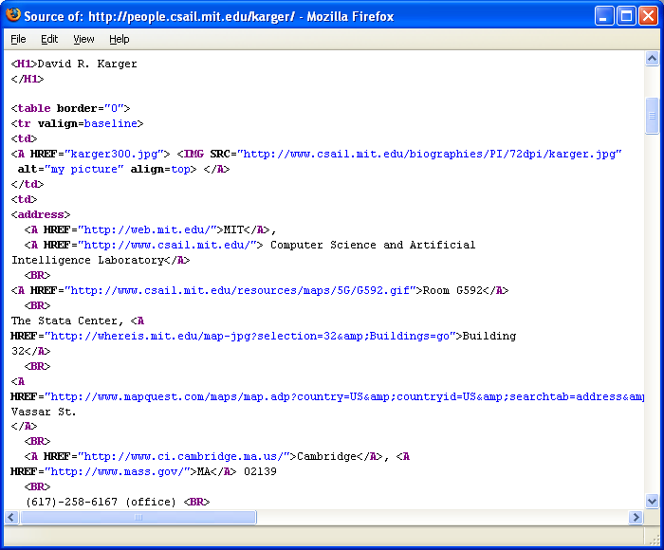
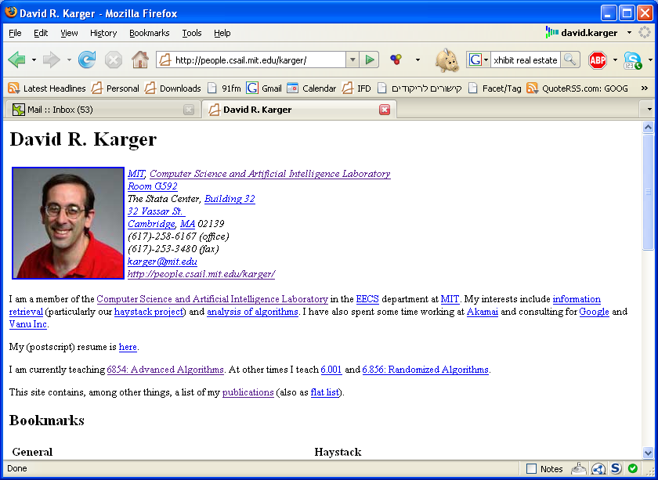
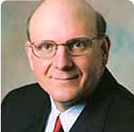
Steve Ballmer
good old days ... early 1990s

Slide 6
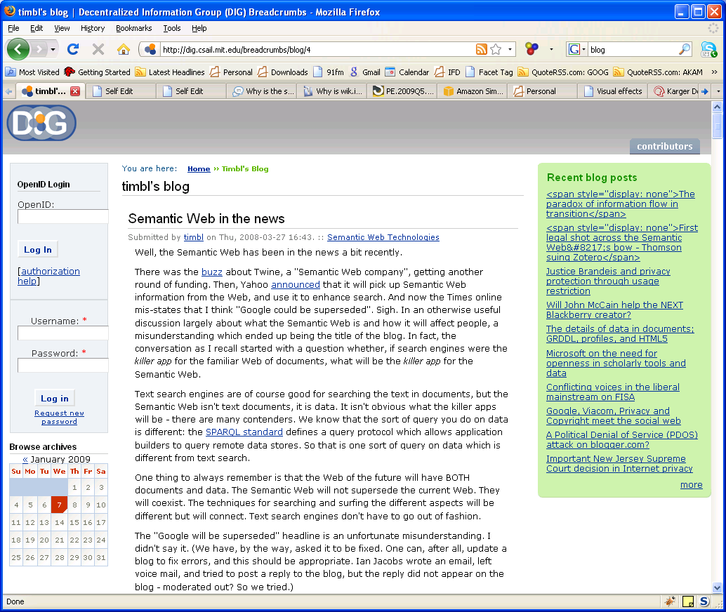
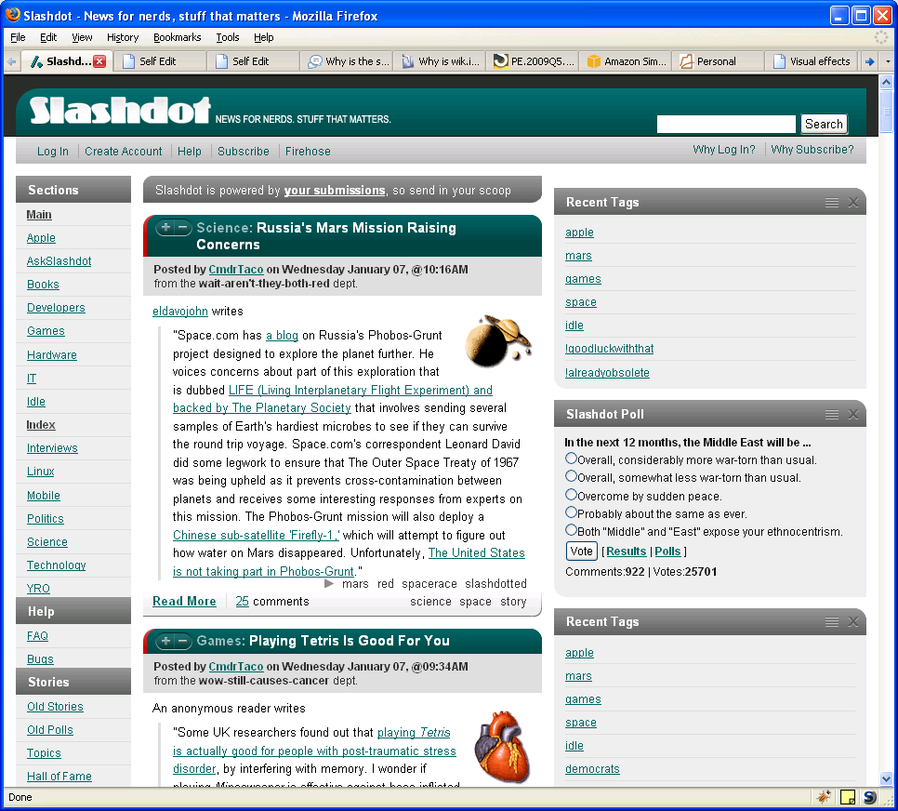
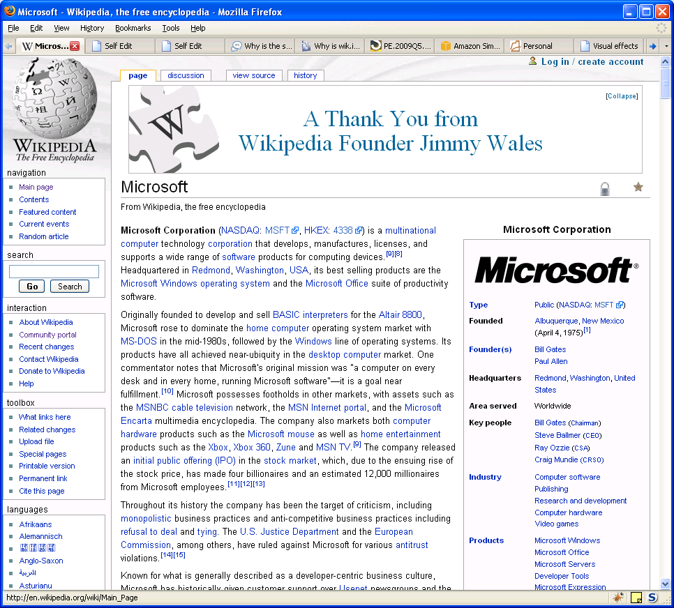
Wiki
Blog
Forum

Slide 7
A Society of Authors
Suddenly, masses were motivated to contribute content
What was so novel?
We could author documents with Word
We could get them with ftp
“Minor” workflow changes
The URL: canonical address for every page
The click: instant access to what’s at the link
The browser: staying inside one application
The copy/paste/tweak ecology that arose
No need to understand to create content
The key: instant gratification
More kindly, good cost-benefit

Slide 8
The Virtuous Cycle of Information
 | High Benefit | Low Cost
Reader | Find the info I need Discover new things | One click fetch Instant availability No application to master
Author | Be seen Share what I know Impress people Gratitude of users | No new skills needed Easy to author
Not just casual users
These are the forces that enourage content creation in intranets

Slide 9
Steve Ballmer
good old days ... early 1990s

Slide 10
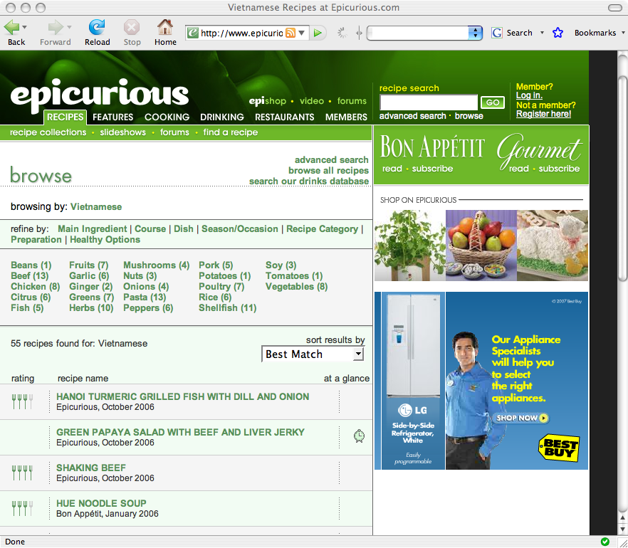
search
Filter
sort
Today

Slide 11
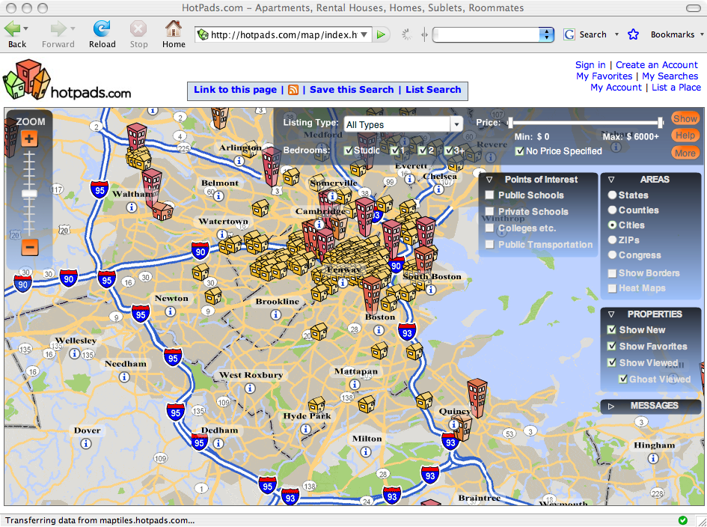
today

Slide 12
A Bifurcation
“Professional” sites implement a rich data model
Information stored in databases
Extracted using complex queries
Fed into templating web servers to create human readable content
Rich structure supports rich interaction
Rich, informative visualizations
Filtering and Sorting
Data entry and validation forms
Result: fancy, lively “web 2.0” sites
“Plain” authors left behind
Can’t install/operate a database
Don’t know how to define a database schema
Can’t write the queries to extract the data
Limited to flat, dull text pages (even in blogs and wikis)

Slide 13
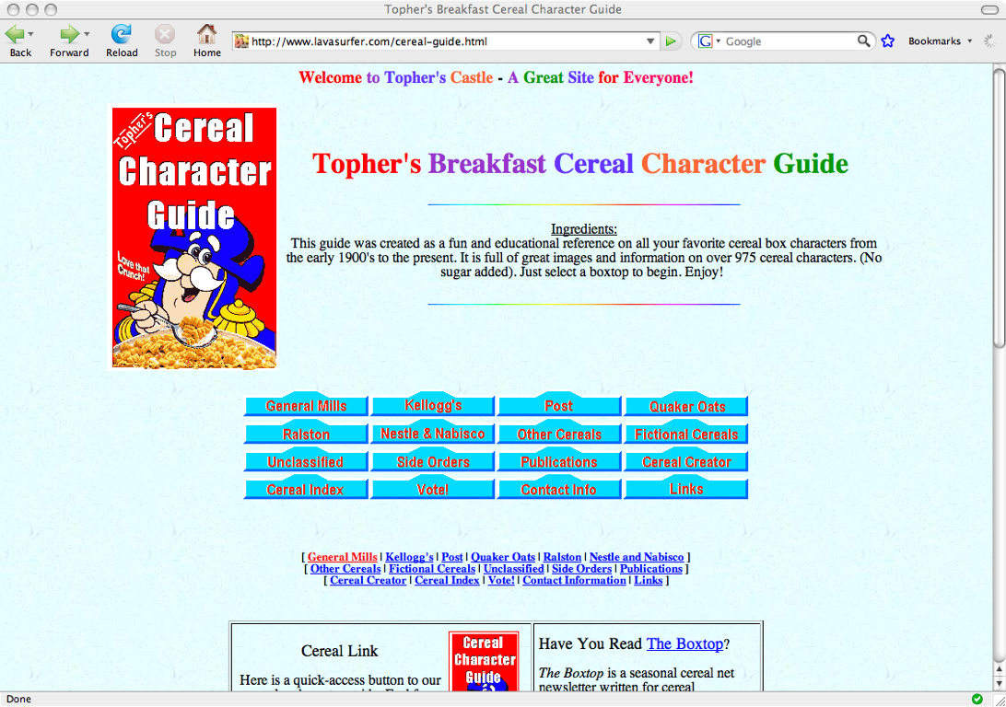
search
Filter
sort
“Plain” authors left behind

Slide 14
Content Carriers
Sites designed to hold content of a specific type
Photos on Flickr
Videos on Youtube
Recipes on Epicurious
Book reviews on Amazon
Friend lists and interests on Facebook
Data models and interfaces specialized to that type of data
Developers define schemas, templates, workflows, etc.
Plain users can
Contribute data into these content carrier repositories
Benefit from structure when exploring/consuming that data

Slide 15
Content Carries Constrain Creativity
I have to publish “their way”
What if I don’t like their theme/layout/organization?
How can my wife show her books sorted chronologically by birthdate of the author?
How can I let people filter my folk dance video collection by choreographer, tempo, and year choreographed?
How does a biologist display his paradigm-changing gene taxonomy?
And there’s no carrier for the really unusual stuff
Where to put UFO sightings, sock collections, sea glass, roman coin mints, pubs of ontario...?

Slide 16
Even Worse Between Sites
Content carriers are “vertical data silos”
I get rich interaction with data on one site
But what if I am interested in its connections to data on another site?
Neither web site understands the other’s data
Neither can offer good interaction with the combined data
Response: Mashups
Someone finds multiple web sites with info they want
writes programs to “scrape” (extract) data from each site
writes programs to merge data from multiple sites
programs new (database backed) web site to display merged data
Great if you can program and manage a web site!
Result: another web site partitioning data the wrong way

Slide 17
The Ideal
Anyone should be able to
Create interesting data
Or, find data on multiple web sites and combine it
Create compelling, useful presentations of that data
With rich visualization and interaction
Share it easily with everyone else on the web
All without knowing
How to program
How to install a database
What a schema is

Slide 18
Most of the Web is CRUD
Impossible to enable everyone to author arbitrary information processing tools
Most of what happens is direct manipulation of information
Create information according to some model
Read/explore/visualize/navigate using rich interfaces
Update using rich editing interfaces
Delete
True even on fancy professional web sites
Flickr, Youtube, Epicurious, Amazon, Facebook
Sites are dumb storage
Computation is left to the human users

Slide 19
A Data Model FOR EVERYTHING
RDF

Slide 20
Requirements
Hold anything
Connect anything
Be copy/pastable
Change at need

Slide 21
Semantic Networks
Movie
type
Minimum data model
Names for arbitrary objects
Arbitrary named links between two objects
No required schemas
Much like the web, except
Items need not be web pages
Machine readable “anchor text” in links
Yet Powerful
Relations are natural/universal
title
Superman
venue
8PM
time
location
Kendall Sq.
Loew’s
type
Theater

Slide 22
RDF
Movie
type
W3C standard
URL for every object
URL for every property
Additional layers to represent schemas, functional constraints, inference rules, policy
title
Superman
venue
8PM
time
location
Kendall Sq.
Loew’s
type
Theater

Slide 23
A “Semantic Web” Vision
Autonomous computational agents perform sophisticated information tasks on behalf of their human users
Use data that is annotated with rich semantics
Ontologies that explain precisely what the data means
Schema annotations that explain how to align multiple ontologies
Rules that explain how new data can be formally derived from existing
Inference systems that put it all together
Lots of logicians and AI researchers developing tools
This vision is frightening
Involves solving problems that have bedeviled AI for decades
Often used to attack the semantic web
Or to argue to slow down deployment
“we can’t put up that data until we have an ontology!”

Slide 24
Aim Lower: the Data Web
Not “make computers help” but “make them not hinder”
“First, do no harm”
Don’t worry about sophisticated new capabilities
Just let people do the obvious things
Create a tiny bit of structure:
Name objects (with URLs)
Record named relations between them
No semantics on relations
No schemas
No inference
This is both
Technically simple (as opposed to inference)
Immediately useful (as we will see)

Slide 25
Alternatives?
SQL:
Has to have schemas
Field built around complex query optimization or transaction processing
Doesn’t like “sloppy”
XML:
Focus on tree-shaped data
Messy to manage complex interlinking of many different data objects
RDF
Easy to create sloppily, incrementally
Everything gets named---eases reuse, linking
Fewest requirements means easiest adoption
But it doesn’t really matter
Same representational power, so any would do
And user shouldn’t know which we’ve chosen

Slide 26
A User Interface
Exhibit

Slide 27
Key Pieces
What are the “primitves” of a fancy web site?
Lenses
Template explaining how to display an object
By describing what properties should be shown, and how
Views
Ways of looking at collections of objects
Lists, Thumbnails, Maps, Scatterplots
Often exploit structure in layout
Facets
Widgets for filtering or sorting information based on its structure
How can we let plain users author them?
Create a domain specific vocabulary
Descriptive rather than imperative

Slide 28
Exhibit
An interactive web site from static files
One file for data --- RDF
One for presentation --- HTML
Extend HTML vocabulary
Lens tags for showing data items
View tags for laying them out
Facets for searching, filtering, sorting
Drive it all with javascript
Nothing to install or configure

Slide 29
Exhibit Demo

Slide 30
Data Formats
JSON as default format
Can also put data in HTML table
Babel converter: http:// simile . mit . edu / babel /
Bibtex
Excel spreadsheets
Tab separated values
RDF/XML, N3
Dynamic importers
Google spreadsheets (live data)
JSON files

Slide 31
Scalability
Javascript is slow, not designed for implementing DBs
Recommended for < 500 items
Some people have been brave: 2733 items or more
Not a limitation per se
Plenty of small data sets

Slide 32
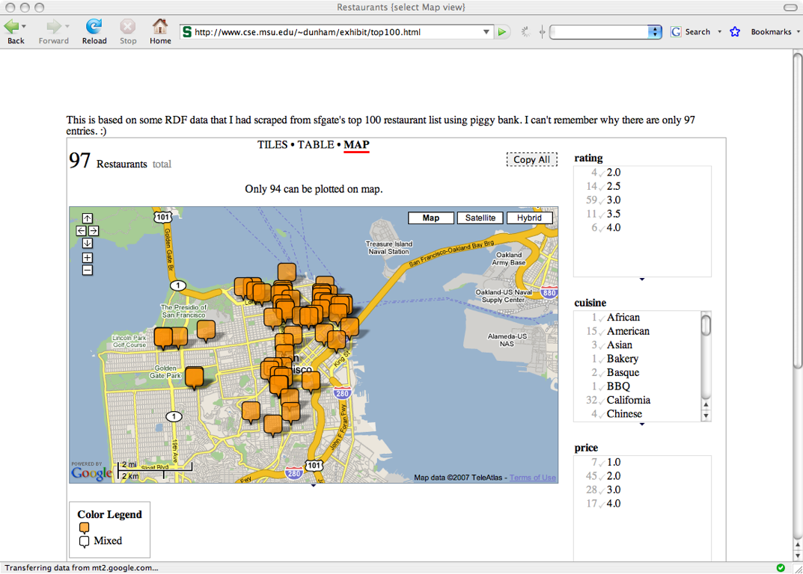

Slide 33
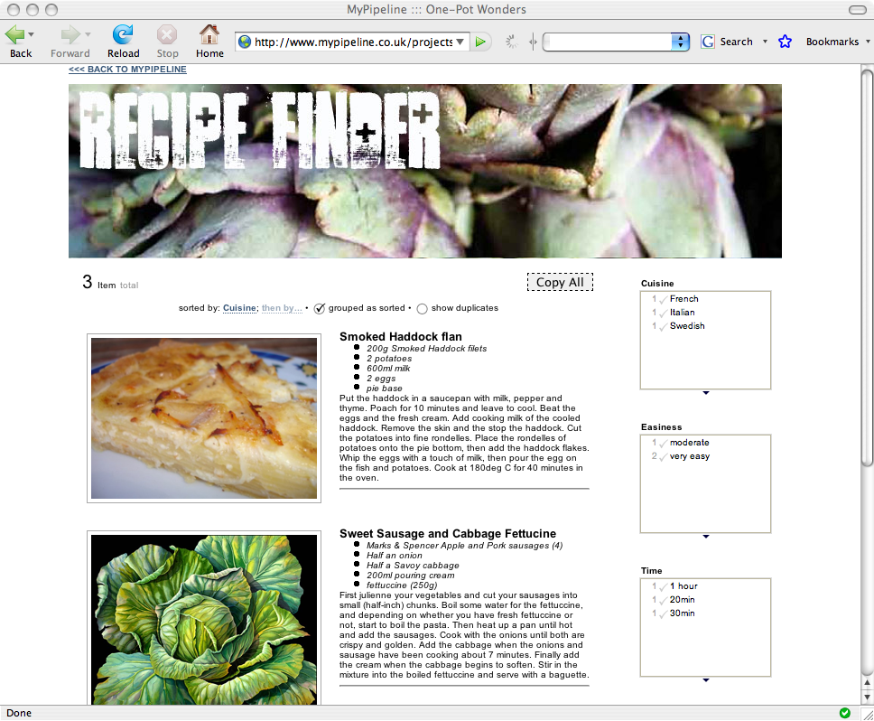

Slide 34
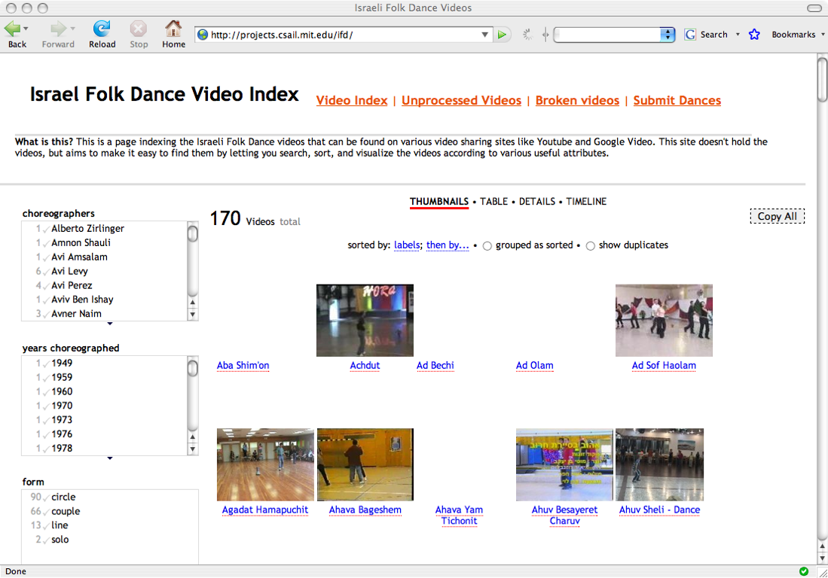

Slide 36
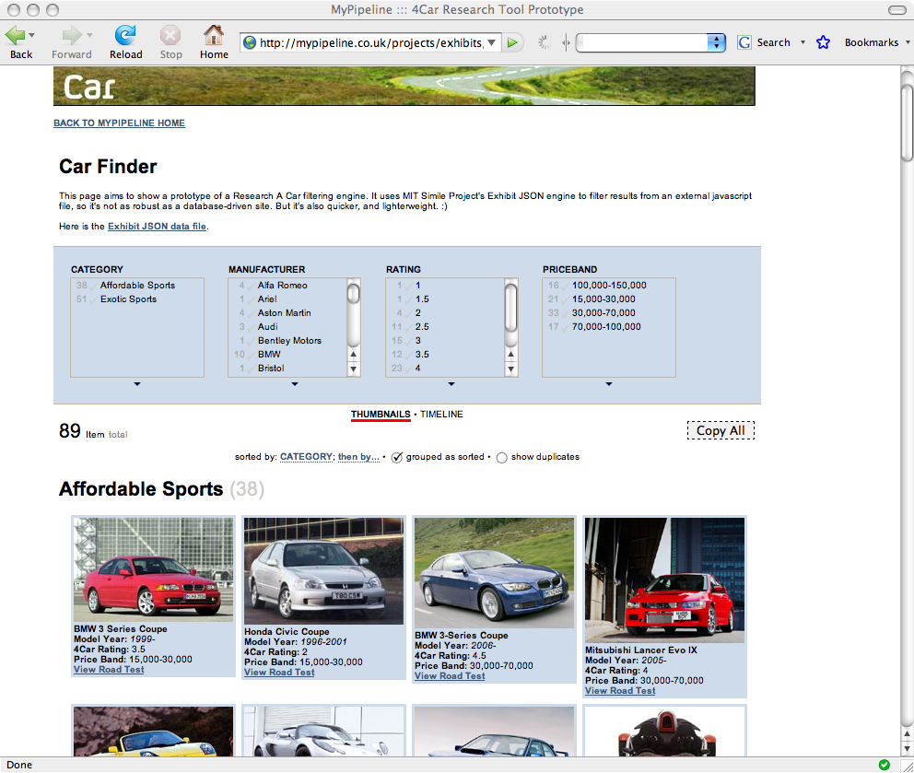

Slide 37
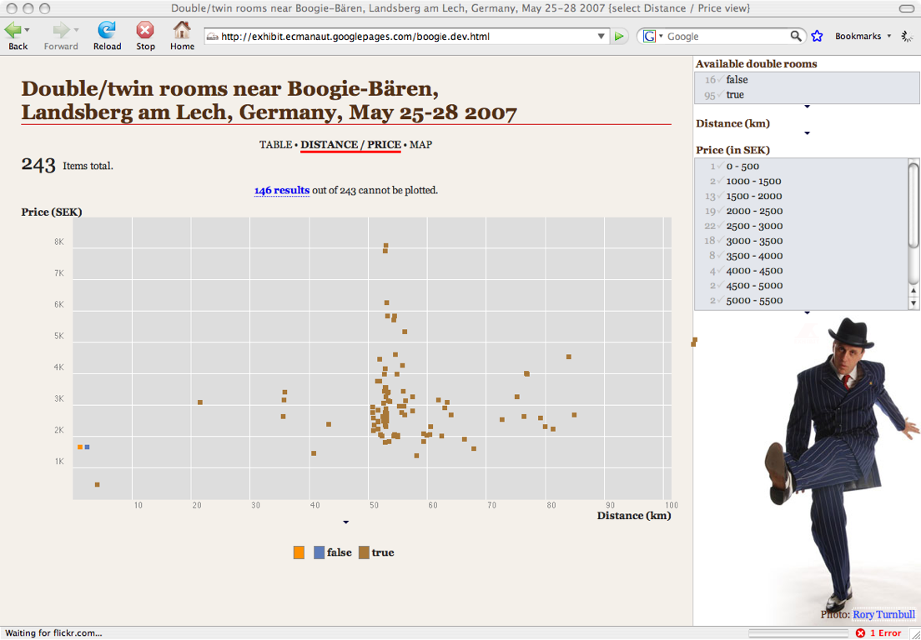

Slide 39
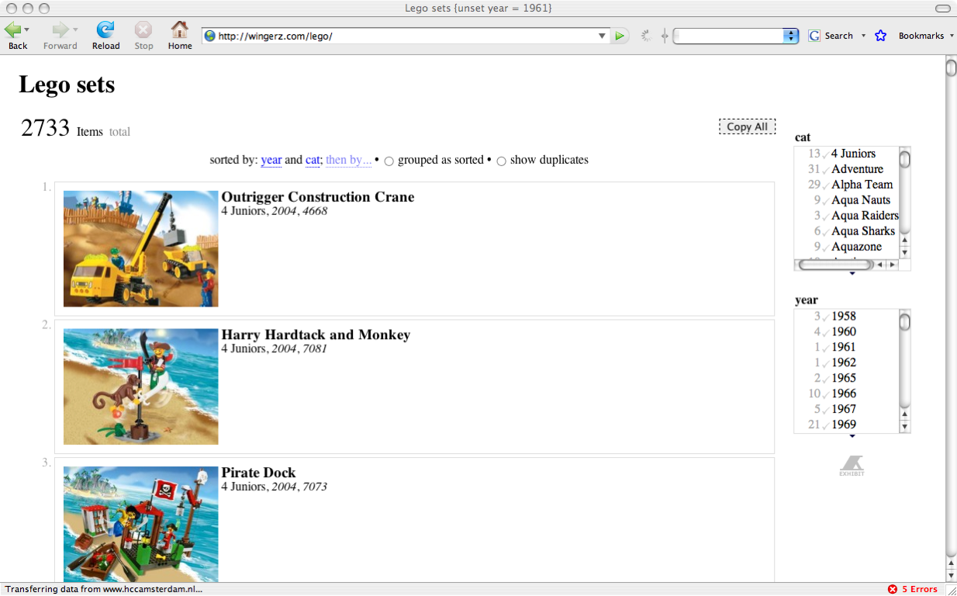

Slide 40
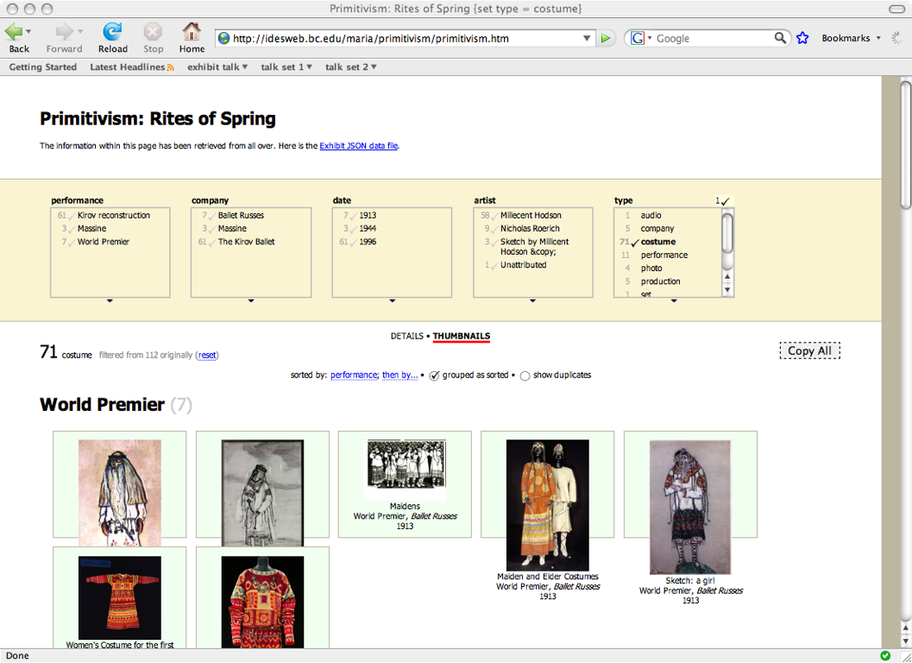

Slide 41
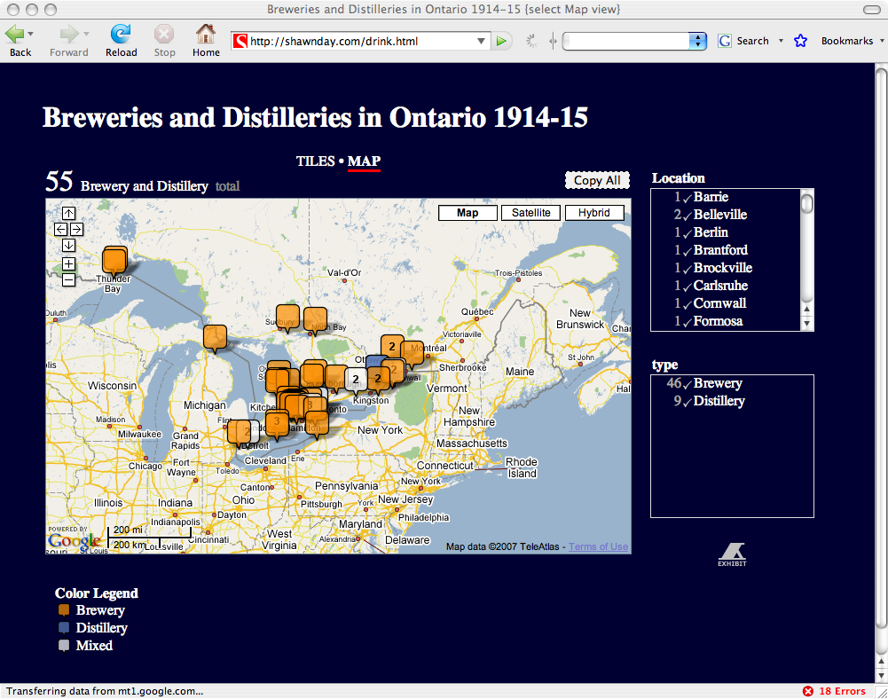

Slide 42
presentations
company members
software tools
restaurants
recipes
radio albums
installed fonts
hotels near a dance event
dogs for adoption
lego sets
dances, costumes, performances
breweries and distilleries
kansai dialect field study data
world conflicts
wedding attendees

Slide 43
The Long Tail
Professional data integrators
Fancy APIs
quantity
or
popularity
dormant data publishers
merchandise
events
free labor
news
in addition to grad students
photos
movies
software
breweries and distilleries
in Ontario 1914 - 1915
israel folk dance videos
lego sets
information topics

Slide 44
Use Case: MIT “Course Picker” catalog
Implemented a new interactive course catalog for MIT
4 undergraduates, 1 week
2 days to write the UI
2 days to reformat the data into RDF
(after 6 months needed to get the data from the registrar)
Used by 1700 students a week after release
Adopted as official MIT online course catalog

Slide 45
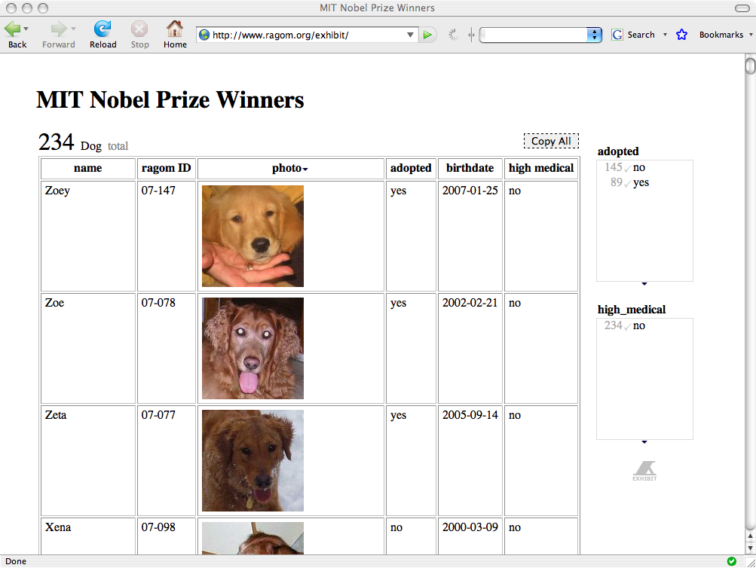
Authoring by Copying
Views, lenses in HTML file
Copy it, change the data
(Maybe change the presentation too)
oops!

Slide 46
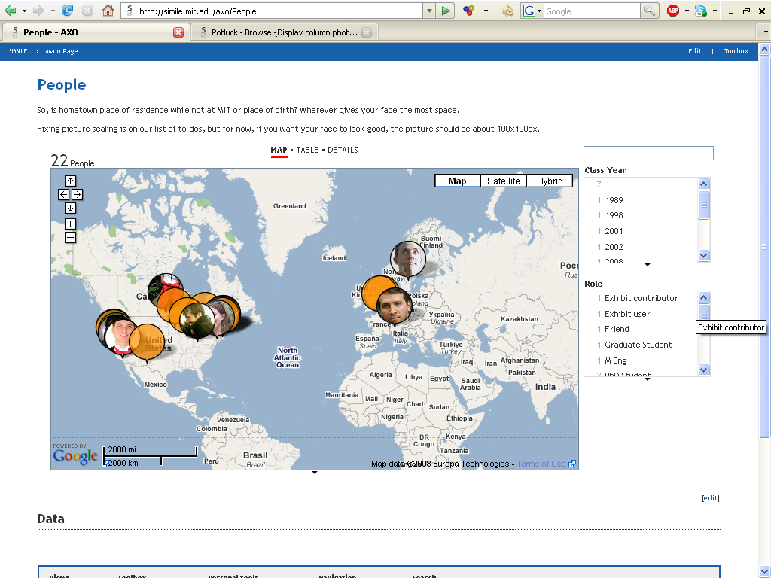
Collaborative Authoring in a Wiki
Exhibit is a text file
So stick it in a wiki

Slide 47
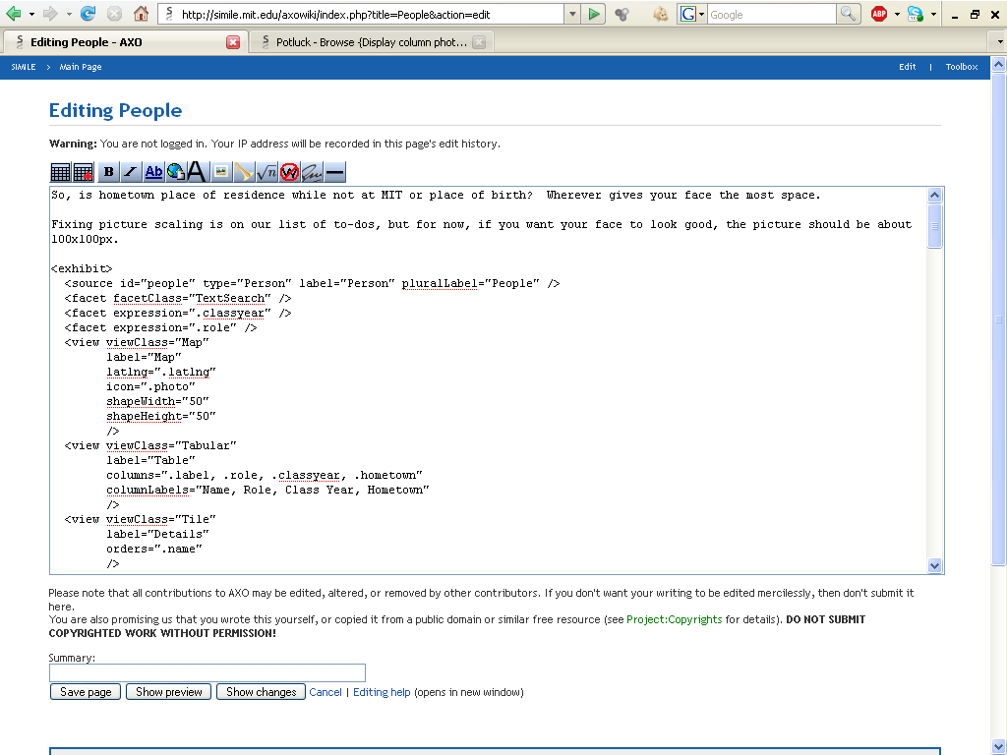
Collaborative Authoring in a Wiki
Exhibit is text file
Put it in a wiki

Slide 48
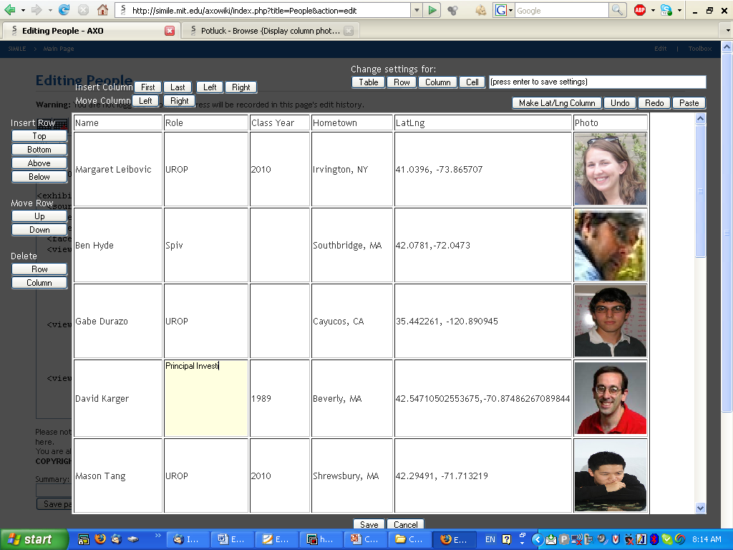
Collaborative Authoring in a Wiki
Exhibit is text file
Put it in a wiki
Data in a table
Add a nicer UI for data editing
Combine:
easy wiki collaboration
rich data interaction

Slide 49
Data in Motion

Slide 50
Exhibit Side Effects
Have we just created more vertically partitioned web sites?
What if we need to combine data from several?

Slide 51
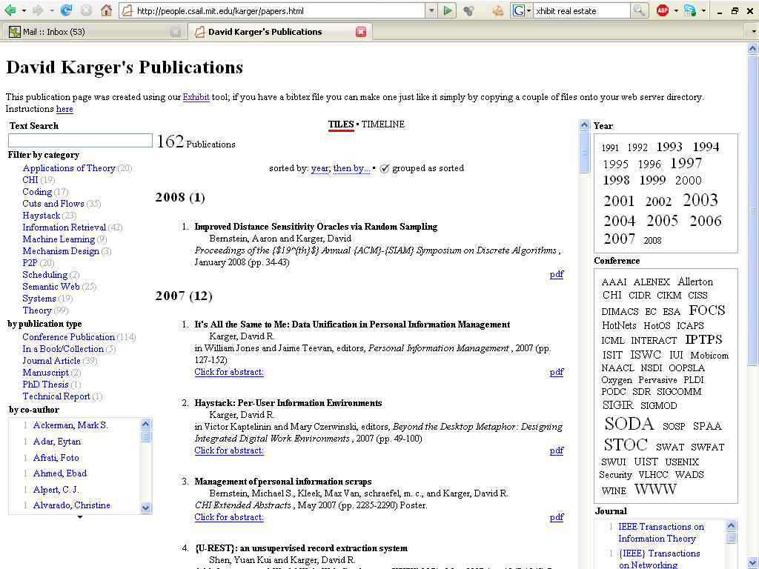

Slide 52
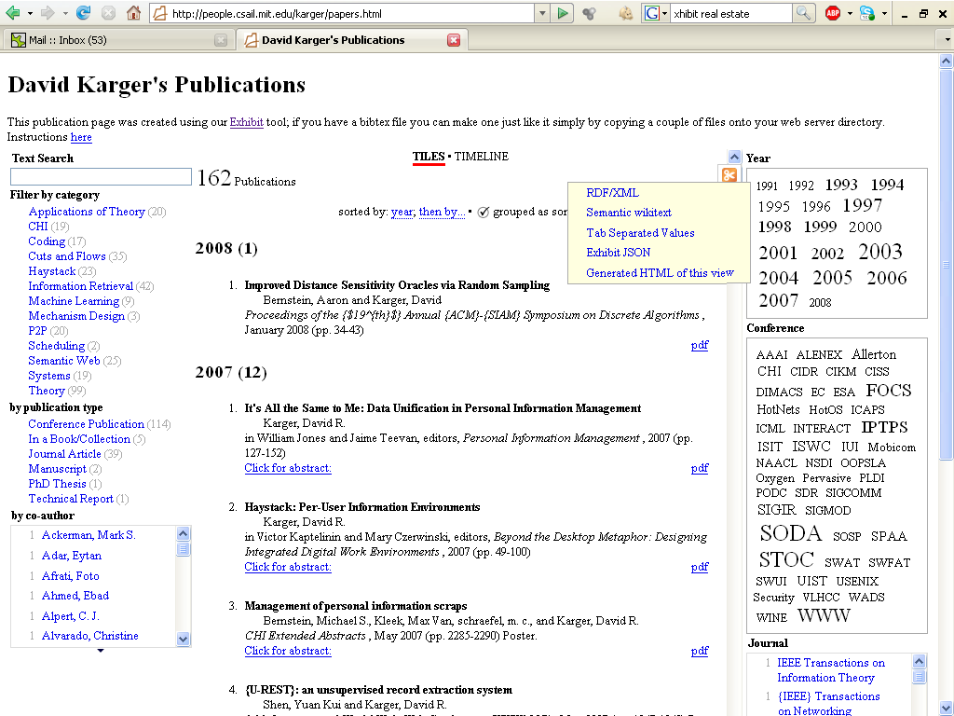

Slide 53
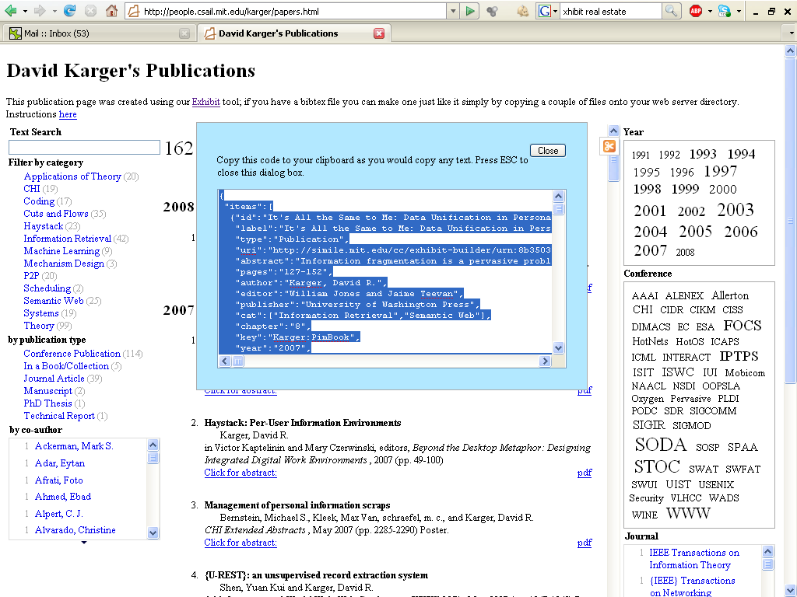

Slide 54
Incentives
Sell authors (or employees) on fancy interactive web site
Data merging, linking, reuse as side effect

Slide 55
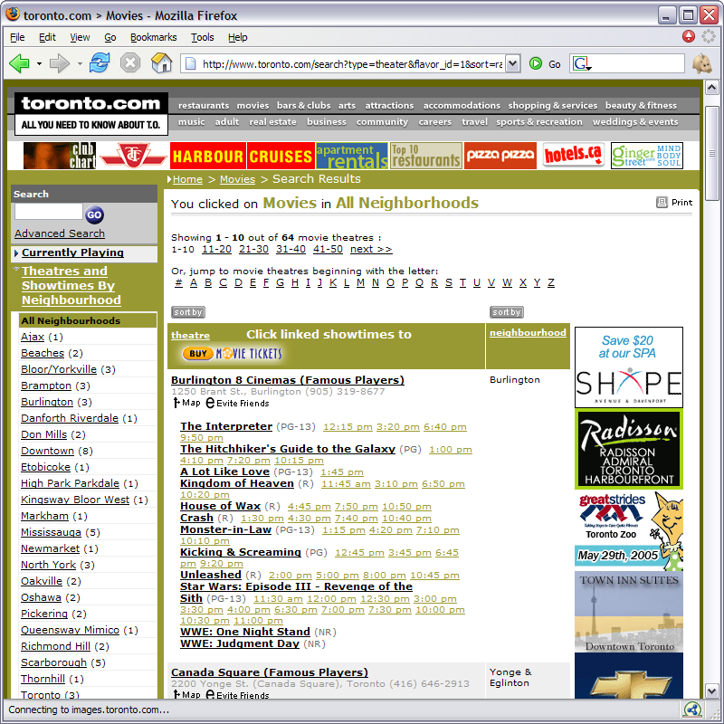
Find some movies

Slide 56
Free that data

Slide 57
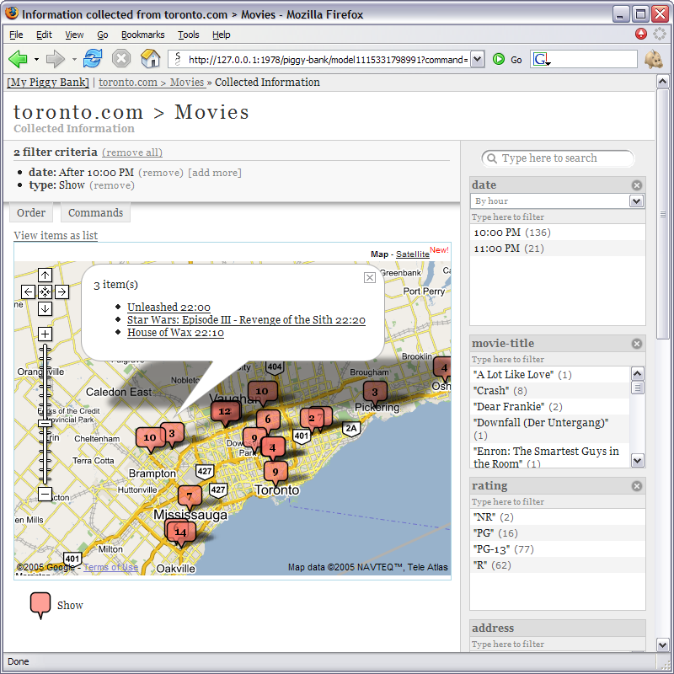
Show it a different way

Slide 58
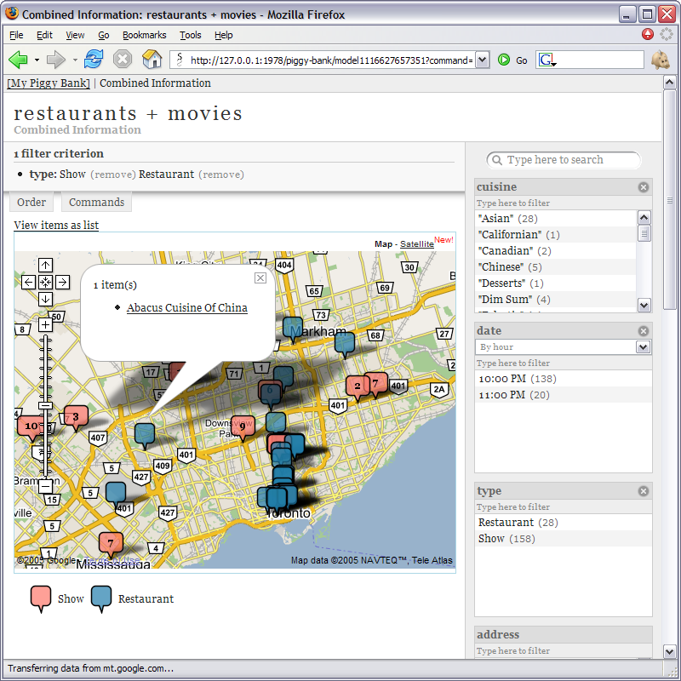
Combine it with other sources

Slide 59
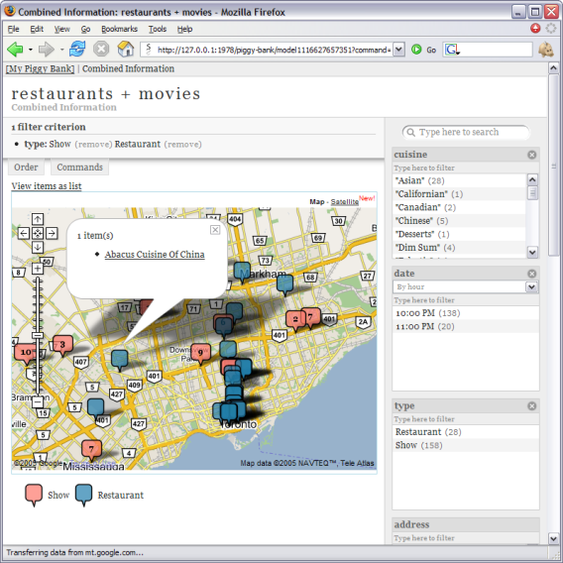
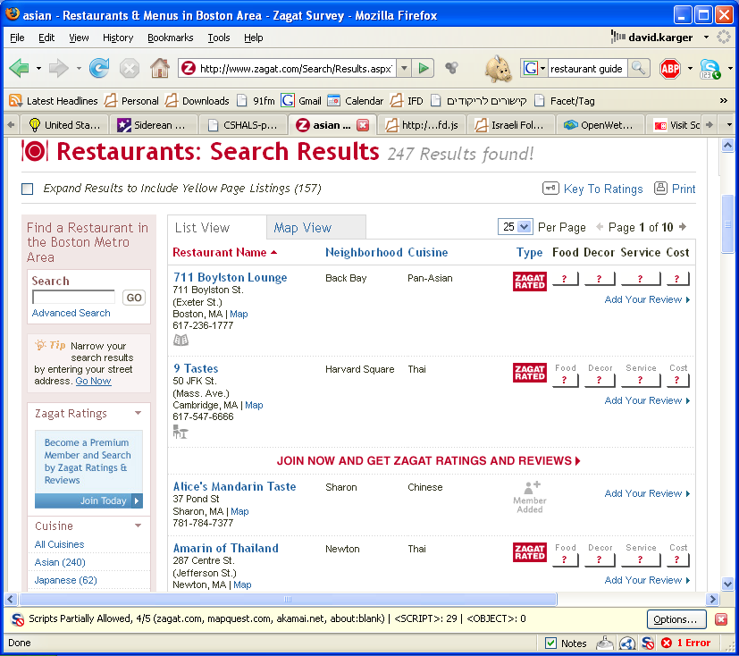
Make your own mashups
Download Data
Movie Title
Address
Scrape Data
Place
Restaurant Name

Slide 60
Alignment

Slide 61
The Problem
If individuals create data independently, it is unlikely to “link up” nicely
May use different names for properties of data
Or format information values differently
At large scale, this is “enterprise data integration”
A big problem, solved with big hammers
Individuals’ data sets outnumber the integrators
Have to let individuals do own integration
Which means it has to be easy---done by eye

Slide 62
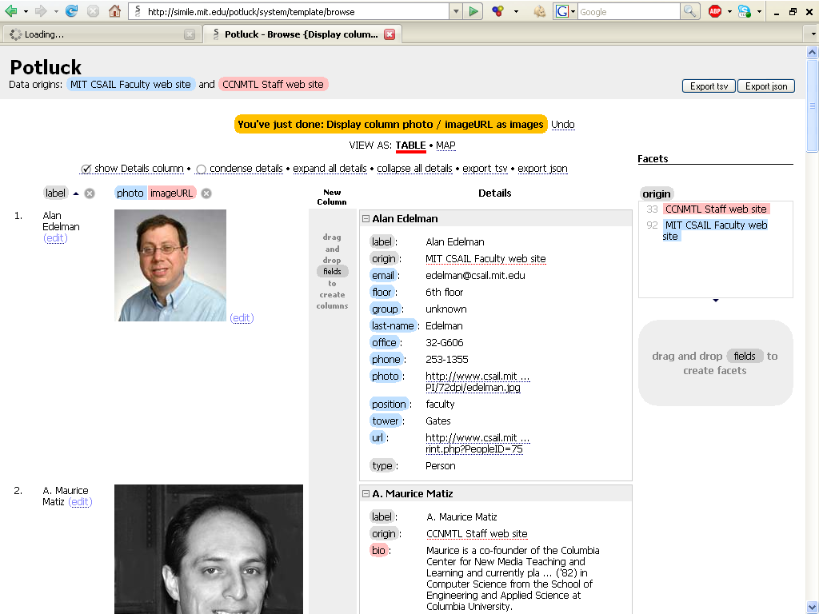

Slide 63
Conclusion
We have the tools to separate data from presentation
RDF repositories
Lenses/views to display arbitrary data in arbitrary combination
Vocabulary of operations to act on the data
Doing so would offer substantial benefits
Data unified --- Application barriers go away
Anyone can create interesting data and visualizations
People can repurpose info to their own specific needs
Put people in the drivers seat
Not about sophisticated information tools
About simple flexible tools to let people do the sophisticated work

Slide 64
Thanks
Dennis Quan
Vineet Sinha
Karun Bakshi
David Huynh
Margaret Leibovic
Gabriel Durazo
Nina Guo

Slide 65
More Info
Haystack.csail.mit.edu
Simile.mit.edu

